Slide 1

2016 Minimum Design Standards
Structures- Bridges, Non-Buried Structures, Culverts
Part 2 of 2
Nebraska Administrative Code
Title 428
Rules and Regulations of the
Board of Public Roads Classifications and Standards
(Administrative Host: Nebraska Department of Transportation)
County Roads and Municipal Streets
Neb. Rev. Stat. 39-2113
https://dot.nebraska.gov/media/5593/nac-428-rules-regs-nbcs.pdf
Boards - Liaison Services Section
8/8/2019
Notes:
8/8/2019 Updated first slide – Administrative Host: Nebraska Department of Transportation, not Nebraska Department of Roads.
8/7/2019 Updated. Previous version dated 1/2/2017. First and last slides updated Dept Logo, and the web link on the first slide.
On behalf of the Nebraska Board of Public Roads Classifications and Standards, welcome to this presentation.
This is one in a series of videos the purpose of which is to provide information on the Board’s county roads and municipal streets standards.
Reference Nebraska Administrative Code Title 428, Chapter 2.
The topic for this segment is minimum design standards for bridges, non-buried structures and culverts.
It is addressed in two videos. This is the second of the two.
NOT FOR AUDIO
Target Audience: Highway and Street Superintendents, and Consultants
Acknowledgements
Typical Roadway Cross Section: Phil TenHulzen, NDOT Roadway Design Division (Slides 93, 95, 98)
Asphalt Concrete Equivalent Thickness (ACET): Bruce Barrett, NDOT Materials & Research Division (Slides 153-154)
Several Photos of 3R Projects: Roger Figard and City of Lincoln Public Works Staff
Benefit/Cost Analysis: Nicole Frankl, NE-LTAP (Slides 196-200)
Several Bridge Photos: Bridge Division (Mark Traynowicz, Babrak Niazi, Marvin Taylor)
Horizontal Clear Zone: Bill Gulick, KY DOT (Slides 279, 281-284)
ADA: FHWA August 20-21, 2013 Webinar (Slides 304, 308, 311-319, 325-326) http://connectdot.connectsolutions.com/p7r08bvr75l/
ADA: NE-LTAP (Dan Cady) PROWAG presentation (Slides 306, 322-324)
ADA: Chris Hassler, NDOT (Slides 307, 309-310, 320-321)
ADA: Chris Malmberg, HDR Engineering (Slides 305, 328-330)

Slide 2

Overall Learning Objectives
2016 Standards Video Series
Know Functional Classification
Find and use the correct minimum design standards table
Be familiar with Definitions
Know and Understand the Notes
Understand 3R requirements
Know which work to apply to One- and Six-Year Plans
Know fundamentals of horizontal clear zone
Review current ADA requirements
Part 2 of 2
Slide 2
Notes:
As mentioned in the Bridges and Structures video, Part I, other videos in this series cover the learning objectives shown on this slide.
Some of the other videos should be viewed and understood before watching this video on bridges and structures.
That includes the Bridges and Structures video, Part I.
NOT FOR AUDIO
The assumption is that you are already familiar with, or at least know where to find information on
Functional classification systems (Title 428 NAC Chapter 1)
How to Get to, and Use, the tables on pages 55-86 of the Minimum Design Standards
Terminology is important – Definitions are on pages 37-46 of the MDS
Notes, essentially an extension of the tables, are found on pages 47-54 of the MDS
Understanding 3R requirements is a point of emphasis because 3R standards for county roads and municipal streets were added to the Minimum Design Standards in 2016.
Learning Objectives 6, 7 and 8 will not be covered directly in [this video] the Bridges and Structures videos.
Minimum Maintenance Standards (pages 88-91 of the MDS)
Relaxation of Standards (pages 92-94)

Slide 3
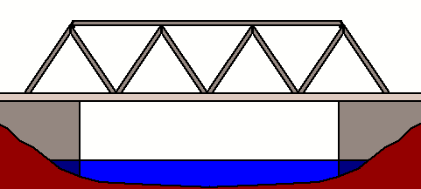
Learning Objectives
Structures
Know Functional Classification
Find and use the correct minimum design standards table
Be familiar with Definitions
Know and Understand the Notes
Understand 3R requirements
Know which work to apply to One- and Six-Year Plans
Know fundamentals of horizontal clear zone
Review current ADA requirements
Part 2 of 2
Slide 3
Notes:
In this 2-part series of videos on bridges and structures, definitions, notes and 3R requirements specific to bridges and structures will be covered.
Of those three, Part I covers definitions, and introduces the two notes (18 and 19) that address the two design criteria for bridges and structures – clear bridge width and design structural loading capacity.
This video, Part II, will
go into more depth on Clear Bridge Width and its associated Note 18,
address other notes, and also
provide a summary of 3R requirements for bridges and structures.
[In this video, definitions, notes and 3R requirements specific to bridges and structures will be covered.]

Slide 4
Learning Objectives
Structures
Tables – the part for Structures and how it works – in the Minimum Design Standards
The Two Design Criteria for Structures
Basis of Values for Design Criteria
Design Structural Loading Capacity – HL93, HS15
Clear Bridge Width – simple formulas
Scope of Work – how work on the roadway and the structure can affect one another
Low Water Stream Crossings and Stream Fords
Part 2 of 2
Slide 4
Notes:
This 2-part series of videos also covers other learning objectives specific to bridges and structures:
Of the learning objectives shown, Part I discusses and demonstrates how Tables in the Minimum Design Standards work for bridges and structures, and introduces the two design criteria for structures and the basis of their values.
This video, Part II, gets into more depth on Note 18 and clear bridge width, addresses how work on a roadway and work on a structure can affect one another, and also addresses low-water stream crossings and fords.
NOT FOR AUDIO
In addition, [this video will cover] this 2-part series of videos covers other learning objectives specific to bridges and structures:
Tables and how those work for Structures
The Two design criteria directly related to structures, and the basis of values for those two criteria
The Two Design Criteria are:
Design Structural Loading Capacity; in particular Live Loads HL93 and HS15 will be explained, and
Clear Bridge Width is calculated from simple formulas
The type of work on a structure and the type of work on the road either side of the structure can affect the scope of work on each other; those requirements will be discussed
Low Water Stream Crossings and Stream Fords and their unique requirements will also be covered.

Slide 5
Learning Objectives
Know Functional Classification
Find and use the correct minimum design standards table
Be familiar with Definitions
Know and Understand the Notes
Understand 3R requirements
Know which work to apply to One- and Six-Year Plans
Know fundamentals of horizontal clear zone
Review current ADA requirements
vs. N&R and Maint.
Part 2 of 2
Slide 5
Notes:
The next segment is about 3R requirements.
The scope of 3R work will be contrasted and compared to New & Reconstructed work and to Maintenance work.

Slide 6
3R Boundaries - Bridges
Quick, Short-term, low cost
Longer lasting, higher cost
Maintenance 3R Reconstructed
Maintenance
Clean, replace, repairing
Replacing parts (essentially same design) rails, floors, stringers, piling and beams
In-kind replacement of walls
Nothing extensive or costly
3R
More than Maintenance, up to and including Rehabilitation (Replace entire superstructure)
Widen
Redeck
Bridge rail (updated design)
Culvert Extensions
Reconstructed
Bridge lengthened (jump span)
Replacement of entire bridge, non-buried structure, or culvert
Including in-kind Culvert Replacements
·
Note 20 (Page 54)
Part 2 of 2
428 NAC 2-001.03A1d3, Page 40
428 NAC 2-003, Pages 88-91
428 NAC 2-003.01C4 and .01C5, Page 89
Neb. Rev. Stat. §39-2101
Slide 6
Notes:
In the Standards tables, starting on page 55, the two columns on the right are New & Reconstructed and 3R.
This slide shows the boundaries between New & Reconstructed, 3R and Maintenance for bridges, structures and culverts.
Starting in the left column with Maintenance, you see various activities as defined in 428 NAC 2-003 the Minimum Maintenance standards; an example is replacement of rotted timber piling with steel piling. Note the phrase “nothing extensive or costly” (per 428 NAC 2-003.01C5 Page 89) which is subjective but essentially prevents a structure from being re-built without being brought up to standards.
Going over the right column, New & Reconstructed typically means that the structure is replaced in its entirety, including an in-kind culvert replacement, or it could be adding a jump span.
The middle column is 3R, which is any scope between the right and left columns. This may include widening, redecking, updating bridge rail, and culvert extensions.
Although 3R work extends the life of a structure and possibly makes it safer, it is considered an interim measure. State Statute 39-2101 requires roadways and bridges eventually to be brought up to reconstructed standards. [Quite often, however, “reasonable financing” is difficult to come by!]
Finally, the 2016 standards do allow an additional activity that needs to be added to the maintenance column. See Note 20 on page 54 which allows an in-kind replacement of a superstructure for a timber bridge with a national functional classification of Local and ADT fewer than 400 VPD. This will be discussed later in the video.
NOT FOR AUDIO
Bridge 3R structural capacity (June 8, 2015 meeting minutes – comments by Mark Traynowicz, NDOT Bridge Engineer):
Design Loading and Load Rating (and load posting if necessary) are two different attributes of a bridge or structure. Design loading is how bridge members are sized in its original design. After the bridge is built, at various points throughout its life it is inspected and load rated based on various factors including its condition; if necessary, it is load posted.
Bridges and structures are typically designed to support more than legal weight trucks. Repeated loading, fatigue, can weaken a structure over time; many times overweight trucks, permit loads, are required to cross bridges.
An existing bridge can be designed to original design loading and still be load posted. It can happen for various reasons. Loads have increased (bigger trucks/loads) over the years since initial construction, for example. Or, some structural members deteriorate which effectively reduces the cross sectional area its load supporting capability. It may be more cost effective (or the funds simply aren't available) to load post a bridge than to replace it or do extensive and costly work.
Any new element or component added to a bridge or structure under 3R work must meet 3R standards for structural capacity. For example, a widened portion must be sized and built to the original design loading.

Slide 7
Clear Bridge Width (CBW)
Formulas, Minimums
Basis of Values in Tables
Note 18
Structures
Minimum Lane Width (from Tables)
  N&R lane width for replacements
  3R lane width for 3R work
Two-lane road or street
Calculated by Formula
Part 2 of 2
428 NAC 2-001.03A6i, Page 46
428 NAC 2-001.03B, Note 18, Page 53
Slide 7
Notes:
This slide shows the basis for minimum clear bridge width values shown in the tables. The clear bridge width is based on the appropriate minimum lane width in the same table assuming a two-lane road, and is calculated based on the formula indicated in the table for each value.

Slide 8
Clear Bridge Width (CBW)
Formulas, Minimums
Note 18
Structures
Approach traveled way width plus shoulder widths
Approach traveled way width plus 4 ft. (each side)
Approach traveled way width plus 3 ft. (each side)
Approach traveled way width plus 2 ft. (each side)
Approach traveled way width plus 1.5 ft. (each side)
Approach traveled way width plus 1 ft. (each side)
Approach traveled way width plus 0.5 ft. (each side)
Approach traveled way width
Use the planned traveled way width and planned shoulder width
Part 2 of 2
428 NAC 2-001.03A6i, Page 46
428 NAC 2-001.03B, Note 18, Page 53
Slide 8
Notes:
These are the formulas from Note 18 on page 53.
Note that the clear bridge width is based on the approach traveled way width.
It is important to understand the basis for clear bridge width values, in order to identify the correct minimum standard clear bridge width,
just in case you have a different situation than assumed in the tables (which is a two-lane road with standard lane width).
It is also important to use the planned traveled way width (and the planned shoulder width in the case of Formula A) when calculating the clear bridge width especially if the planned width is greater than the minimum width in the standards.
1/2/2017: PLANNED MEANS THE MINIMUM LANE WIDTH AND SHOULDER WIDTH REQUIRED BY THE MDS, 428 NAC 2-001.03, CONSISTENT WITH THE TYPE OF WORK DONE ON THE BRIDGE OR STRUCTURE. IF DESIGN PLANS CALL FOR WIDER LANES AND/OR SHOULDERS THAN WHAT IS SHOWN IN MDS TABLES, THEN THE TRAVELED WAY WIDTH USED IN THE FORMULA MUST BE BASED ON THE THOSE. MAYBE INCLUDE AN EXAMPLE
Finally, just a note that Formulas E and G apply mainly to bridges using urban area standards
NOT FOR AUDIO
CBW is based on formulas in the AASHTO Green Book and in TRB SR-214 for rural, and from FHWA’s Mitigation Strategies (LOTO) for Urban New and Reconstruction.
1/16/2016 e-mail Jim Wilkinson and LeMoyne Schulz
The phrase "approach roadway" or "approach" is used several times in the AASHTO Green Book but is not defined. Maybe because it is difficult to define (it would be subjective)! What do you think it means? If the shoulders are being widened only to accommodate an upgrade to guardrail which is attached to the bridge, would that be considered widening the approach roadway? I don't think I would. To me, the key is driver expectation. Widening the approach roadway, in my opinion, means widening the roadway beyond just the vicinity of the bridge, creating the expectation of a wider roadway all along that segment of roadway and not just at the bridge location. Widening the shoulders just to accommodate new guardrail at a bridge location, to me, is not the same as widening the approach roadway, as the term is used in the AASHTO Green Book. In other words, an approach roadway is the roadway leading up to a feature such as a bridge, it's the overall roadway driving experience as you near a feature and not just a very short length adjacent to the feature that holds guardrail in place. Would you agree? YES

Slide 9
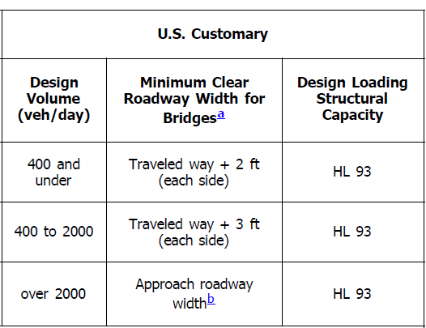
Clear Bridge Width (CBW)
Formulas – Basis – Rural N&R Work
Minimum Design Standards
Structures
1 of 2
MDS
Note 18
Formulas (page 53)
(D)
(C)
(A)
Part 2 of 2
AASHTO Green Book, 11th Edition, Table 5-6, Rural Local
Slide 9
Notes:
For New and Reconstructed work, the CBW is Based on formulas in the AASHTO Green Book
This slide shows one of the tables from the AASHTO Green Book, as an example.
In this slide, the appropriate formulas from Note 18 are indicated on the right side.
You will notice that, for Rural bridges, AASHTO GB does not go less than 2 ft each side plus the traveled way width.

Slide 10
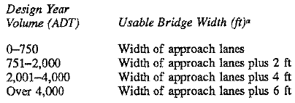
Clear Bridge Width (CBW)
Formulas – Basis
Rural 3R Work
Minimum Design Standards
Structures
2 of 2
MDS
Note 18 Formulas
(Page 53)
(H)
(F)
(D)
(C)
TRB SR-214
Recommendation 9
Page 199
Part 2 of 2
Slide 10
Notes:
For 3R work, the CBW is Based on formulas in the Transportation Research Board’s Special Report-214
In this slide, the appropriate formulas from Note 18 are indicated on the right side.
Note how SR-214 expresses widths differently than AASHTO GB.
“Plus 2 ft” means 2 ft total, not 2 ft each side.

Slide 11
Clear Bridge Width (CBW)
Formulas – Basis
Urban N&R Work (Replacement)
(Approach) Curbed Section
Minimum Design Standards
Structures
Formula E: 1.5 ft each side
Basis: Lateral Offset to Obstruction (LOTO)
Mitigation Strategies
Page 40 (CBW)
Page 64 (LOTO)
FHWA Mitigation Strategies for Design Exceptions, July, 2007, Pages 40 and 64
428 NAC 2-001.03A6i, Page 46
428 NAC 2-001.03B, Note 18, Page 53
Part 2 of 2
Slide 11
Notes:
As mentioned previously in this presentation, for Urban Area New & Reconstructed curbed sections the minimum clearance from the edge of the traveled way to the farthest nearest vertical roadside element is 1.5 ft. This is based upon FHWA’s Mitigation Strategies for Design Exceptions, July, 2007, Page 64, Lateral offset to obstruction. Basically, it is a shy distance. Shy distance is an estimated distance average drivers tend to move away from – or shy away – from an object or obstacle. In this case, drivers would tend to shy away from the bridge rail toward the centerline or the adjacent lane. The State also uses 1.5 ft as the basis for their State Highway Standards minimum.
NOT FOR AUDIO
Note that Urban Area standards are lower speed (45 MPH and less)
From Page 40 of FHWA Mitigation Strategies for Design Exceptions, July, 2007:
Potential problems associated with narrow bridges are twofold.
#1: Relatively short bridges represent a discontinuity that may affect driver behavior. The narrowed cross section can make some drivers uncomfortable and cause them to dramatically reduce speed, increasing the risk of rear-end crashes and degrading operations on high-speed, high-volume facilities.
The bridge rail may be close enough to the travel lanes to cause drivers to shy towards the centerline or into adjacent lanes (Figure 13). The bridge infrastructure itself is closer to the edge of pavement and thus represents a roadside hazard. Even when properly designed and delineated, there is an increased risk of a roadside collision with a bridge end closer to the edge of traveled way.
#2: A second set of concerns is evident for longer bridges (say, greater than 500 feet in length). The safety and operational concerns at narrow bridges are similar to those on roads with narrow shoulders. There may be inadequate space for storage of disabled vehicles, enforcement activities, emergency response, and maintenance work. The lack of shoulder width on the bridge may make it impossible to avoid a crash or object on the roadway ahead. In addition, options are limited for non-motorized users such as bicyclists, forcing them onto the traveled lanes or close to the bridge rail.
Another concern: Narrow bridges on horizontal curves can have limited horizontal stopping sight distance past the bridge rail (Figure 10). Operations can be degraded, particularly on long bridges on high-speed roadways, because of speed reductions as drivers enter the narrowed cross section as well as a decrease in driver comfort on the bridge.

Slide 12
Clear Bridge Width (CBW)
Formulas – Basis
Urban 3R Work
(Approach) Curbed Section
Minimum Design Standards
Structures
Formula G: 0.5 ft each side
Consistent with State Highway Standards (Note G)
Part 2 of 2
428 NAC 2-001.03A6i, Page 46
428 NAC 2-001.03B, Note 18, Page 53
428 NAC 2-001.02A, Note G, Page 10
Slide 12
Notes:
For 3R work done under Urban Area standards, the Board of Public Roads decided to use 0.5 ft as a minimum clearance from the edge of traveled way to the farthest nearest vertical roadside element on a structure. This is consistent with State highway standards Note G on page 10.
NOT FOR AUDIO
1 ft total (0.5 ft each side) is not the value recommended by FHWA’s Mitigation Strategies for Design Exceptions, July, 2007 but it is what the State went with and the Standards Committee decided to be consistent with that.
In other words, using the definition of gutter line (1 ft from back-of-curb), the CBW needs to be at least one ft wider than gutter line to gutter line
But the note indicates 0.5 ft each side in order prevent the possibility of ending up with one foot on one side and zero on one side.
So it’s a 2 ft difference between N&R and 3R CBW’s in urban areas

Slide 13
Clear Bridge Width (CBW)
Note 18
Structures
1 of 5
Cannot be less than the width shown in tables
Rural Area N&R Standards – 24 ft minimum CBW
Part 2 of 2
428 NAC 2-001.03A6i, Page 46
428 NAC 2-001.03B, Note 18, Page 53
Slide 13
Notes:
The CBW cannot be less than the values shown in the MDS tables. They may need to be more , but cannot be less!
There is only one exception to this, and will be addressed later in the presentation.
As a reminder, the minimum CBW for any new or reconstructed structure using rural area standards is 24 ft.

Slide 14
Clear Bridge Width (CBW)
Formulas, Minimums
Note 18
Structures
2 of 5
Example of Minimum CBW wider than the CBW Value in a Table – Table 03I, pgs 67-68
  Rural Area, Minor Collector, ADT < 400 VPD
    10 ft Lanes @ 50 MPH, 11 ft @ 55 MPH
    Formula (D) = plus 2 ft each side
    24 ft minimum in Table, based on 50 MPH
      10 + 10 + 2 + 2 = 24 ft
    26 ft minimum CBW for 55 MPH design
      11 + 11 + 2 + 2 = 26 ft
Part 2 of 2
428 NAC 2-001.03I, Pages 67-68
428 NAC 2-001.03A6i, Page 46
428 NAC 2-001.03B, Note 18, Page 53
Slide 14
Notes:
This slide shows an example where the minimum CBW is greater than the value indicated in the table. For this Rural Area table, Table I on pages 67-68, the CBW values on page 68 are based on lane widths for the 50 MPH design speed. For this case, the lane width in Table I for fewer than 400 VPD, is 10 ft. The table is based on a two-lane road, therefore the minimum traveled way for the 50 MPH design speed is 20 ft.
The CBW according to Note 18 Formula (D) on Page 53 which adds 2 ft to each side, is 24 ft, and this is exactly the minimum value shown in the table.
If the design speed is 55 MPH, the minimum lane width is 11 ft. The minimum traveled way for the 55 MPH design speed is wider – 22 ft vs. 20 ft. The CBW likewise is wider – 26 ft vs. 24 ft.
If there is a relaxation of standards for CBW in this case, for the 55 MPH design speed, it must therefore be based on the larger CBW value (26 ft)

Slide 15
Clear Bridge Width (CBW)
Formulas, Minimums
Note 18
Structures
3 of 5
Example of Minimum CBW wider than the CBW value in a table – Table 03C, pgs 55-56
  Urban Area, Minor Arterial, New and Reconstructed work
    Curbed section, undivided
    Table value: 25 ft. minimum CBW
    Formula (E) applies (Note 18, page 53)
    Four 11 ft. lanes (approach traveled way)
    CBW Minimum = 1.5 + 4(11) + 1.5 = 47 ft.
May also need to add width for shoulders, auxiliary lanes, sidewalks
Part 2 of 2
428 NAC 2-001.03A6i, Page 46
428 NAC 2-001.03B, Note 18, Page 53
Slide 15
Notes:
This is another example of how a minimum CBW can be greater than the value in the table. In this case, it is caused by two additional lanes for a total of four lanes. The values in the tables are based on a two-lane roadway.
If there is a relaxation of standards for CBW in this case it must therefore be based on the larger value of 47 ft. Note that additional clear bridge width may be necessary if a median, shoulders, auxiliary lanes and sidewalks are being carried across the structure.

Slide 16

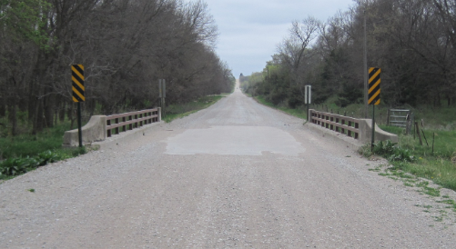
Finding the Standards Table
Example – County Bridge, 2-lane
Location: Lancaster County, S. 119th St, South and West of Denton
ADT: 250 VPD Posted: 50 MPH
2’ 11’ 11’ 2’
Part 1 of 2
NBIS #C005500305P
Slide 16
Notes:
The first video, Part I, presented an example of how to find the table that applies to a hypothetical bridge replacement project.
The example assumes 11 ft driving lanes and 2 ft shoulders.
Thus, the traveled way is 2 x 11, or 22 ft.

Slide 17
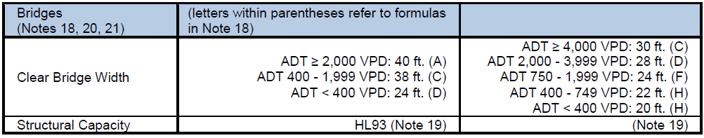
Finding the Standards Table
Example – County Bridge, 2-lane
Rural, Local table, 001.03J
Bridges and Structures Criteria on Page 70
Design Criteria New & Reconstructed 3R
    26 ft minimum CBW
      22 + 2 + 2 = 26 ft
Part 1 of 2
Slide 17
Notes:
As a reminder, Table J on pages 69-70 applies Rural Area Standards to roads with a national and state functional classification of Local. The minimum clear bridge width shown on page 70 for the under 400 VPD group is 24 ft. But we did not check the formula in Part I.
Knowing more about Note 18, and how the tables work for structures, let’s determine the minimum clear bridge width based on the formula.
Formula D is required for the under 400 VPD group.
Formula D, from Note 18 on page 53, requires a minimum of 2 ft each side to be added to the planned traveled way.
The planned traveled way width is assumed to be 22 ft in this case. Adding 2 ft to each side results in 26 ft. minimum CBW.
Thus, the minimum CBW is 26 ft, not the 24 ft shown in the table.

Slide 18
Clear Bridge Width (CBW)
Formulas, Minimums
Note 18
Structures
4 of 5
No less than width shown in tables
3R CBW EXCEPTION (Note 18)
Some 3R clear bridge widths are allowed to be less if
CBW is calculated by formula
Based on minimum 3R lane width
CBW ≥ planned traveled way width
Part 2 of 2
428 NAC 2-001.03A6i, Page 46
428 NAC 2-001.03B, Note 18, Page 53
Slide 18
Notes:
As mentioned previously, there is one exception to the rule that no CBW can be less than the value in the table.
It pertains only to 3R work on structures.
The standards allow the minimum CBW value to be less than the value in the table under the following conditions:
The CBW is calculated using the formula indicated in the table,
is based on the minimum 3R lane width in the table, and
results in a CBW at least as wide as the planned traveled way.
The reason for this exception is that
There are more variables that determine 3R lane widths – those variables being %HT and paved/unpaved.
The 3R CBW values in the tables are generally based on the more conservative lane width.
The Board of Public Roads felt it wasn’t practical to list all of the different combinations.
Therefore this exception is allowed.

Slide 19
Clear Bridge Width (CBW)
Note 18
Structures
5 of 5
EXCEPTION FOR SOME 3R CBW
Example (Table 03J, pages 69-70):
Rural Area, NFC Local, 2-lane road,
ADT 400 – 749 VPD, %HT < 10%
Minimum CBW value in table 03J (pg 70) is 22 ft
Minimum lane width is 10 ft ( < 10% Heavy Trucks)
Note 18 Formula H: Approach Traveled Way Width
  10 ft x 2 lanes = 20 ft
3R Exception in Note 18 allows 20 ft minimum CBW
Part 2 of 2
428 NAC 2-001.03A6i, Page 46
428 NAC 2-001.03B, Note 18, Page 53
428 NAC 2-001.03J, Pages 69-70, Table
Slide 19
Notes:
This slide is an example of the 3R CBW exception.
In this case, the value in the table is based on a 22 ft approach traveled way.
However, because the heavy truck percentage is less than 10%,
the minimum traveled way is allowed to be 20 ft,
therefore a bridge or other structure with 3R work is allowed to have a minimum 20 ft CBW.
This is less than the value shown in the table, and it is allowed by Note 18.

Slide 20
Clear Bridge Width (CBW)
Other Requirements
Note 18
Structures
Paved shoulders carry through
Auto Gates 18 ft minimum
Rehabilitated bridges desirable width is New & Reconstructed minimum Clear Bridge Width value
Part 2 of 2
428 NAC 2-001.03A1c, Page 38, 6th bullet
428 NAC 2-001.03A6i, Page 46
428 NAC 2-001.03B, Note 18, Page 53
Slide 20
Notes:
This slide shows two other requirements in Note 18, and one recommendation.
First Bullet: Paved shoulders must be carried over the structure. This could result in a higher minimum value for CBW than calculated by formula or shown in the table.
Second Bullet: Auto gates minimum 18 ft
Third Bullet: The desirable CBW for rehabilitated bridges is the New and Reconstructed CBW. It may be that a cost analysis would bear this out. This is a recommendation and not a minimum requirement in the standards. Rehabilitated bridge is defined as replacement of the entire superstructure.

Slide 21

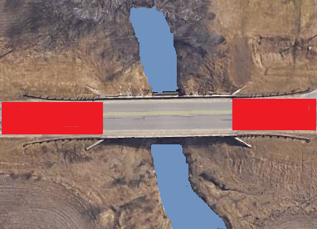
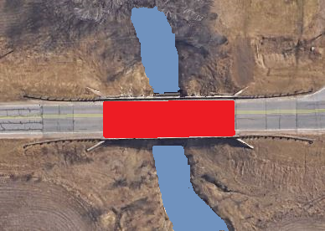
When does work* only on an existing approach roadway require work on a structure?
Note 18
Structures
1 of 21
Note 6
When does work* only on an existing structure require work on a roadway?
Note 22
* More than Maintenance
Part 2 of 2
428 NAC 2-001.03B, Note 6, Page 47
428 NAC 2-001.03B, Note 18, Page 53
428 NAC 2-001.03B, Note 22, Page 54
Slide 21
Notes:
There may be a misconception that standards for roads and bridges are two mutually exclusive, separate standards.
That way of thinking is not correct.
With Notes 18 and 22, on pages 53 and 54, respectively, the Board provides requirements which coordinate road work and bridge work.
Note 6 at the bottom of page 47 may also come into play in deciding a scope of work.
Work on a road could result in work on a structure, and work on a structure could result in work on a road or street.
The following slides discuss this.

Slide 22
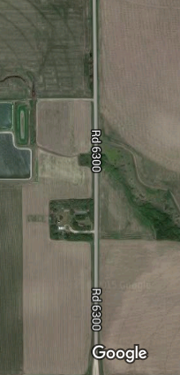
An Issue: Improper Segmentation
Project A
Mill 4” Fill 4” 3R Standards
Bridge/NBS –
Less Than 3R width
NOT ADDRESSED??
Project B
Mill 4” Fill 4” 3R Standards
Part 2 of 2
2 of 21
Slide 22
Notes:
An important issue that is addressed by Notes 6, 18 and 22 is segmentation, that is, doing projects up to a structure, or just short of a structure, and not addressing the structure itself. Thus, the structure is not updated to standards as it needs to be.

Slide 23

Roadways and Bridges
Work Together
Notes 18 and 22
Structures
3 of 21
Compatibility
Consistency
Safety
Driver Expectation
Plan Projects Accordingly!
Part 2 of 2
428 NAC 2-001.03B, Note 6, Page 47
428 NAC 2-001.03B, Note 18, Page 53
428 NAC 2-001.03B, Note 22, Page 54
Slide 23
Notes:
Roadways and Bridges are not in separate worlds!
In fact they are part of the same experience for drivers, who have expectations of compatibility, consistency and safety.
So, when putting together your 1- and 6-year program of work, plan wisely so a key part of your transportation system is not ignored.

Slide 24
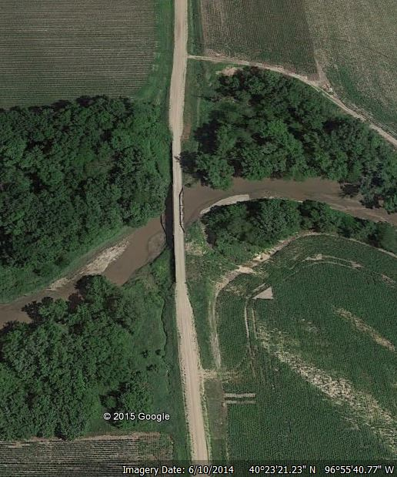

Avoid having a structure being a constriction
Note 18
Structures
4 of 21
Part 2 of 2
428 NAC 2-001.03B, Note 6, Page 47
428 NAC 2-001.03B, Note 18, Page 53
428 NAC 2-001.03B, Note 22, Page 54
Slide 24
Notes:
The purpose of this slide is to let you know that the Board of Public Roads wants to avoid the bridge being a constriction in the road or street, such as you can see in this aerial photo - the road is wider than the bridge.
The Board of Public Roads desires that, with respect to geometrics, bridges and roads be compatible and consistent.
Generally, if the road or street is built to minimum New & Reconstructed standards, the bridges and structures on the roadway should also meet minimum New & Reconstructed standards, and
If the roadway meets minimum 3R standards, bridges and structures on that roadway should also meet or exceed minimum3R standards.
The standards do have some flexibility, however. Refer to Note 18 on page 53 the paragraph in bold font (which begins “Clear bridge width for an existing bridge . . . “):
If the adjacent roadway is built to New & Reconstructed standards, it is best for the structure to have the minimum New & Reconstructed clear bridge width. However, Note 18 allows the flexibility to meet or exceed 3R standards if it makes sense from the perspective that the structure may have some good life remaining. This will be discussed more later.
NOT FOR AUDIO
Clear bridge width for an existing bridge or non-buried structure shall meet or exceed minimum 3R standards if the approach roadway; traveled way or paved shoulders are widened or reconstructed on either side. The roadway width for an existing buried non-bridge-size culvert shall meet or exceed minimum 3R standards if the approach roadway is widened or reconstructed on either side.
NOT FOR AUDIO
The Google Earth photo (near DeWitt) shows a road width that appears wider than the bridge width.

Slide 25
When does work* on an existing approach roadway require work on a structure?
Structures
5 of 21
Note 18
Type of Work on the approach Road or Street | Bridge/NBS/Culvert Minimum standards
N&R | 3R (per Note 18)
3R, traveled way or paved shoulders are widened | 3R (per Note 18)
3R, traveled way or paved shoulders are not widened | 3R if cost effective analysis (per Note 6) indicates the need
Note 6
* More than Maintenance
Part 2 of 2
428 NAC 2-001.03B, Note 6, Page 47
428 NAC 2-001.03B, Note 18, Page 53
428 NAC 2-001.03B, Note 22, Page 54
Slide 25
Notes:
The table on this slide shows what minimum standards apply to structures, when work (more than maintenance) is done on at least one of the approach roadways.
Referring to the first line in the table on the slide:
Generally, the bridge or non-buried structure must meet minimum 3R standards. Of course, if the type of roadway work is Reconstructed, it is desirable for the bridge to also meet New & Reconstructed standards for clear bridge width in order to be consistent with the roadway.
However, the Board of Public Roads in Note 18 allows some flexibility, i.e. if the bridge is in good shape and has some life remaining, the Board does not expect a relaxation of standards request, unless minimum 3R standards cannot be met. The decision to replace, and the subsequent liability lies with the county or municipality.
Referring to the second line in the table on the slide:
If the type of roadway work is 3R, and the traveled way or paved shoulders are widened, the structure must meet minimum 3R standards.
Referring to the third line in the table on the slide:
If the traveled way or paved shoulders are not widened with the 3R work, then the Board would not expect a relaxation of standards request unless a cost effective analysis (per Note 6) shows that it would be beneficial for the structure to meet 3R standards, and for some reason 3R standards cannot be met.

Slide 26
When does work* on an existing structure require work on a roadway?
Structures
6 of 21
Note 22
Type of Work on the Bridge/NBS/Culvert | Approach Road or Street Minimum standards
N&R, Rural Area, ADT < 400 VPD | N&R (conditional, per Note 22)
3R, CBW increased or culvert extended | 3R (conditional, per Note 6)
3R, CBW not increased | Maintenance
Note 6
* More than Maintenance
Part 2 of 2
428 NAC 2-001.03B, Note 6, Page 47
428 NAC 2-001.03B, Note 22, Page 54
428 NAC 2-003, Pages 88-91
Slide 26
Notes:
The table on this slide shows what minimum standards apply to the approach road or street on either side of a structure when work (more than maintenance) is done on the structure.
Referring to the first line in the table:
The Board of Public Roads in Note 22 does allow for some flexibility for very low volume roads (ADT fewer than 400 VPD), where Rural standards apply. For those roads, some design criteria need to meet minimum New & Reconstructed standards only if a cost effective analysis indicates it.
Referring to the second line:
If the type of bridge work on the structure is 3R, and the clear bridge width is increased or a culvert extended, the roadway must meet minimum 3R standards if a cost effective analysis requires it (per Note 6).
Referring to the bottom line in the table:
If the clear bridge width is not increased, work on the approach road or street would be to Minimum Maintenance standards unless for some other reason the scope of work on the approach road or street requires a higher standard.
Finally, although it is not included as a line in the table, if the type of work is New & Reconstructed for the bridge structure, the approach road or street should also meet New & Reconstructed standards in order to be consistent with the structure.
NOT FOR AUDIO
Note 22:
For roads with ADT fewer than 400 VPD, where Rural Area standards apply, the roadway and roadside within the limits of the work on either side of a reconstructed or replacement bridge, non-buried structure, culvert, low water stream crossing or ford shall meet standards as defined in this regulation; however, the following need to meet New and Reconstructed standards only if (a) there is a significant crash history related to its respective criterion and (b) a cost effective analysis shows that user benefits are greater than the cost of meeting New and Reconstructed standards: lane width, shoulder width, horizontal curve radius, superelevation, K values, grade, stopping sight distance and horizontal clear zone.

Slide 27
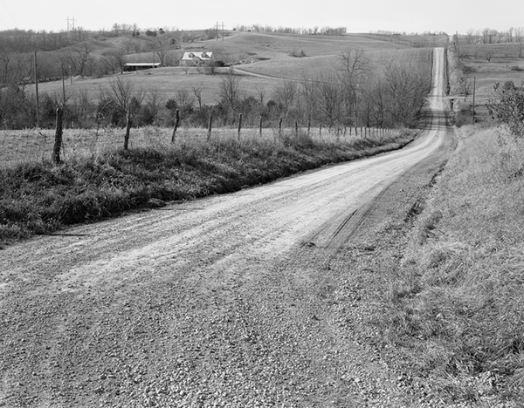
Structure Replacement
Note 22
Road either side of Structure
17 of 21
    2016 Standards applicable to road on either side:
    New and Reconstructed
Life-span of structures
Part 2 of 2
Neb. Rev. Stat. §39-2101
Slide 27
428 NAC 2-001.03B, Note 22, Page 54
Notes:
Let’s look at Note 22 in more detail. It addresses approach roadway requirements for structure replacements on very low-volume roads where Rural Standards apply.
Note 22 implies that the approach roadway on either side should meet New & Reconstructed standards if the type of work for a bridge or structure is New & Reconstructed, on roads with an ADT of 400 VPD and greater. Considering the 60- to 70-year life span of structures, it might make sense to correct deficiencies, such as a sub-standard vertical curve, or a horizontal curve that is too sharp. Remember, State Statute 39-2101 requires roadways eventually to be brought up to reconstructed standards.
Note 22, however, allows some flexibility in the standards for very low-volume Rural roads (less than 400 VPD).

Slide 28
Structure Replacement
ADT < 400 VPD (Very Low-Volume)
Where Rural Area Standards Apply
Note 22 (new)
Road either side of Structure
18 of 21
Part 2 of 2
Slide 28
    If no significant related crash history,
    N&R standards are not required for:
Lane Width | Horizontal Curve Radius | Superelevation
Shoulder Width | Stopping Sight Distance | Grade
Vertical Alignment | Horizontal Clear Zone
428 NAC 2-001.03B, Note 22, Page 54
Notes:
For structure replacements on very low-volume roads, less than 400 VPD where Rural Standards apply
If there is no significant, relevant crash history, the Board of Public Roads does not expect any requests for relaxation of New and Reconstructed standards for the eight criteria listed on the slide.
Note 22 potentially allows lower project costs for very low-volume roads that do not have a significant, relevant history of crashes, by not requiring full New & Reconstructed standards for some criteria. However, a cost effective analysis is required for the eight listed criteria, and therefore improvements may be required by the standards depending on the outcome of that analysis.
Note 22 may be most appropriate and applicable if the grade is the same, or approximately the same, before and after the work.
Use good judgment; it may be best to make an improvement even if standards do not require it. It is important to consider safety, continuity and consistency with respect to driver expectation. Keep in mind State Statute 60-6,190 which requires a minimum 35 MPH posted speed limit in rural areas. Also, the roadway must have proper signage. Considering the life span of structures, it might make good sense to not have a potential liability out there for the next 60 or 70 years. Remember – these are minimum design standards.
NOT FOR AUDIO
Note approved by Roger Figard on November 3, 2015.
It requires that, for a structure replacement on a low-volume road where Rural Area standards apply, certain design criteria for the approach roadway are required to meet New & Reconstructed standards only if there is a significant, relevant crash history and a cost effective analysis shows that the user benefits exceed the cost of meeting those standards.
Refer to 11/2/2015 minutes of meeting with Roadway Design, e-mail thread 10/29/2015 – 11/2/2015, and 11/3/2015 minutes of meeting with Association of County Engineers, Highway Superintendents and Surveyors for background information.
Reference 12/10/2015 Letter from Nebraska Association of County Engineers, Highway Superintendents and Surveyors
The addition of Note 22 will allow counties to replace a bridge, non-buried structure, culvert or low water stream crossing without having to apply new & reconstructed standards to the roadway on either side of the project unless there is significant crash history.

Slide 29
Notes 6, 18 and 22
Initial Planned Work Scope | 2016 Minimum Design Standards
 | Bridge/NBS Clear Bridge Width (CBW) | Note | Roadway Lane Width (Traveled Way)
Roadway-only N&R | 3R | 6, 18
Roadway-only 3R (widened) | 3R | 18
Roadway-only 3R (not widened) | 3R (conditional*) | 6
Structure-only N&R (reconstructed, i.e. replaced or lengthened) |  |  | ADT, VPD
 |  | 22 | < 400 | N&R (conditional where Rural Area standards apply)
Structure-only 3R (CBW increased, or culvert extended) |  | 6 | 3R (conditional*)
Bridge/NBS-only 3R work (CBW not increased) work termini within the structure e.g. re-deck or add bent or stiffeners |  |  | Maintenance
7 of 21
Part 2 of 2
Flexibility
* Conditional - if significant related crash history and B/C ≥ 1.0
Slide 29
Neb. Rev. Stat. §39-2101
Notes:
This slide is a summary of the previous several slides, to have all of the information on one slide, as to when road or street work causes work on a structure, and when work on a structure causes work on a road or street. Let’s go through each row in the table.
In the first row, the scope of work on a road or street is assumed to be reconstructed: it’s desirable that structures also meet minimum N&R standards, but the Board did not want to require replacing good bridges or structures prematurely so the requirement is to meet or exceed minimum 3R standards. However, if there is a significant crash history related to CBW, a safety improvement to widen the bridge should be considered. And if there is a need to widen the bridge, it may be cost effective to just replace it. There is flexibility in the 2016 standards! But along with that comes responsibility to do a good job analyzing the situation in the pre-construction phase.
Referring to The second line, the scenario where the Roadway is widened under a 3R scope of work: a structure must meet minimum 3R standards.
The third line, the Roadway is assumed to have a 3R scope of work, but is not widened – assume it already meets the 3R standard width: a road or street structure within the project limits needs to meet or exceed the minimum 3R standard clear bridge width, if it doesn’t already, if a cost-effective analysis requires it per Note 6.
Referring to The fourth line, the scenario is that a structure is being replaced or lengthened: if the ADT is 400 VPD or greater, the approach roadway should meet New & Reconstructed standards. Structures are built to last 75 years. The Board of Public Roads would not want a new structure located, for example, on a sub-standard horizontal curve or sub-standard vertical curve. If the ADT for a rural road is fewer than 400 VPD, Note 22 in the standards offers some flexibility in that some design criteria for the approach road need to meet New & Reconstructed standards only if a cost-effective analysis requires it.
In The fifth line, the assumed scope of 3R work is widening a structure: Note 6 may require that the approach traveled way or paved shoulder be widened if there is a significant, relevant crash history related to the roadway width.
Referring to The bottom row, if a structure is being improved with a 3R scope of work but the clear bridge width is not increased, the approach roadway need not meet minimum 3R design standards. Unless there is some other reason such as a new guardrail installation.
Don’t forget Neb. Rev. Stat. 39-2101
State Statute 39-2101 requires roads and streets eventually to be brought up to reconstructed standards.
NOT FOR AUDIO
39-2101 excerpt
“Recognizing that highway financing heretofore has been inadequate to meet the needs of a modern transportation system, and that the distribution of revenue has resulted in disparities of treatment, it is the intent of the Legislature to provide reasonable financing and more equitable distribution of revenue. The objectives of this total program are to bring the state highway system up to adequate standards in a twenty-year period, and to bring the road systems of its counties, and the street systems of its municipalities, up to adequate standards over a twenty-year period.“

Slide 30
Example: 3R Work* on a Bridge or NBS
Existing Sub-standard (narrow) 2-lane Road
Road either side of Structure
1 of 2
8 of 21
Example
18 ft bridge needs 3R work
3R standards require widening CBW to 22 ft
18 ft traveled way approach; 20 ft is 3R std.
Do standards require widening the approach traveled way?
* Such as re-decking or adding a bent or adding stiffeners, i.e. work more than maintenance
Part 2 of 2
Slide 30
Notes:
This slide demonstrates by an example what is required for roadway work if a structure needs 3R work and part of the scope is to widen the structure. It is an 18 ft bridge with a 3R scope of work, requiring widening to 22 ft. The traveled way is 18 ft. The question is: do standards require the approach roadway to be widened?

Slide 31
Example: 3R Work* on Bridge
Existing Narrow (sub-standard) Roadway
Road either side of Structure
9 of 21
2 of 2
Generally, NO roadway widening is required unless a cost effective analysis requires it
May require a wider approach traveled way – such as approach guardrail upgrade
Widen Bridge to 3R CBW or
Request a Relaxation of Standards
Part 2 of 2
* Such as re-decking or adding a bent or adding stiffeners, i.e. work more than maintenance
Slide 31
428 NAC 2-001.03B, Note 6, Page 47
Notes:
In this example, standards would not require widening the roadway unless a cost effective analysis (per Note 6 on page 47) requires it, or there is something else which causes the roadway to meet minimum design standards.
For 3R work, Note 6 requires a review of crash history, and if that review results in a significant, relevant crash history related to traveled way width, then widening the approach roadway would be necessary.
Of course, since the bridge is being widened, part of the scope is likely to include approach guardrail, so that part of the approach roadway will need to meet 3R standards and thus required by standards to be widened.
If there is a relaxation of standards request for CBW in this case, the Board may be interested in why neither the road nor the bridge are being brought up to minimum standards.

Slide 32
3R Bridge-Only Project
Structural Capacity (Only) Work*
Effect on Roadway Work Scope
Note 6
Structures
10 of 21
Does not by itself require work on approach traveled way
* Such as adding a bent or adding stiffeners, i.e. work more than maintenance. But not widening.
Part 2 of 2
Slide 32
428 NAC 2-001.03B, Note 6, Page 47
Notes:
If 3R work on a structure only involves improving or maintaining the structural capacity, the intent of the Board of Public Roads is that the scope by itself does NOT require any work on the approach traveled way. In other words, the Board does not expect any relaxation requests for Roadway work if all that is being done is to shore up the structure.
However, Note 6 requires a cost effective analysis to be done for 3R work. If there is a significant crash history related to clear bridge width, standards may require widening the structure depending on the outcome of the benefit/cost analysis.
NOT FOR AUDIO
It is the Board’s intent (verified by Roger Figard per 12/30/2015 phone call with Jim Wilkinson) that standards not require changes to the roadway if work, which doesn’t change a structure’s CBW, does not extend beyond the structure.

Slide 33
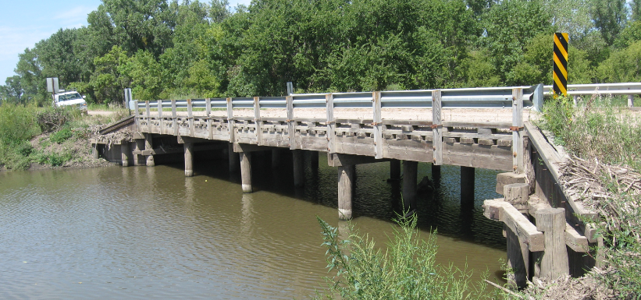
Timber Bridges In-Kind*
Superstructure Replacement
Note 20
Structures
*
Same or similar materials and dimensions (length, CBW)
ADT < 400 VPD
NF Classification: Local
Maintenance Standards
Part 2 of 2
428 NAC 2-001.03B, Note 20, Page 54
Neb. Rev. Stat. 81-3421, 81-3445
Slide 33
Notes:
Note 20 on page 54 of the standards provides that a timber bridge, under certain conditions, can have its superstructure replaced in-kind under Maintenance standards. The conditions are that the national functional classification is Local and the ADT (traffic volume) is fewer than 400 VPD.
Superstructure: The portion of the bridge that supports the deck and is supported by the substructure.
In-kind means using the same or similar materials and building to the same dimensions (length and CBW).
A reminder: Replacing in-kind may involve the practice of engineering (see §81-3421).
If an in-kind timber superstructure replacement is done under Maintenance Standards, and it costs more than the statutory threshold –– currently $109,000, the reference statute is §81-3445) –– it does not necessarily relieve the political jurisdiction of the responsibility or possibly the legal requirement to hire a Nebraska licensed engineer.
NOT FOR AUDIO
81-3421.
Practice of engineering, defined.
(1) Practice of engineering means any service or creative work that requires engineering education, training, and experience in the application of special knowledge of the mathematical, physical, and engineering sciences. The services may include, but not be limited to, planning, providing studies, designs, drawings, specifications, and other technical submissions, and administering construction contracts. The practice of engineering does not include the practice of architecture.
81-3445.
State and political subdivisions; construction projects.
Except as otherwise provided in this section and sections 81-3449 and 81-3453, the state and its political subdivisions shall not engage in the construction of any public works involving architecture or engineering unless the plans, specifications, and estimates have been prepared and the construction has been observed by an architect, a professional engineer, or a person under the direct supervision of an architect, professional engineer, or those under the direct supervision of an architect or professional engineer. This section shall not apply to any public work in which the contemplated expenditure for the complete project does not exceed one hundred thousand dollars. The board shall adjust the dollar amount in this section every fifth year. The first such adjustment after August 27, 2011, shall be effective on July 1, 2014. The adjusted amount shall be equal to the then current amount adjusted by the cumulative percentage change in the Consumer Price Index for All Urban Consumers published by the Federal Bureau of Labor Statistics for the five-year period preceding the adjustment date. The amount shall be rounded to the next highest one-thousand-dollar amount.
Source
Laws 1997, LB 622, § 45;
Laws 1999, LB 253, § 2;
Laws 2004, LB 599, § 2;
Laws 2011, LB45, § 11.
81-3453.
Practice of engineering; exempted activities.
The provisions of the Engineers and Architects Regulation Act regulating the practice of engineering do not apply to the following activities:
(1) The construction, remodeling, alteration, or renovation of a detached single-family through four-family dwelling of less than five thousand square feet above grade finished space. Any detached or attached sheds, storage buildings, and garages incidental to the dwelling are not included in the tabulation of finished space. Such exemption may be increased by rule and regulation of the board adopted pursuant to the Negotiated Rulemaking Act but shall not exceed the Type V, column B, limitations set forth by the allowable height and building areas table in the state building code adopted in section 71-6403;
(2) The construction, remodeling, alteration, or renovation of a one-story commercial or industrial building or structure of less than five thousand square feet above grade finished space which does not exceed thirty feet in height unless such building or structure, or the remodeling or repairing thereof, provides for the employment, housing, or assembly of twenty or more persons. Any detached or attached sheds, storage buildings, and garages incidental to the building or structure are not included in the tabulation of finished space. Such exemption may be increased by rule and regulation of the board adopted pursuant to the Negotiated Rulemaking Act but shall not exceed the Type V, column B, limitations set forth by the allowable height and building areas table in the state building code adopted in section 71-6403;
(3) The construction, remodeling, alteration, or renovation of farm buildings, including barns, silos, sheds, or housing for farm equipment and machinery, livestock, poultry, or storage and if the structures are designed to be occupied by no more than twenty persons. Such exemption may be increased by rule and regulation of the board adopted pursuant to the Negotiated Rulemaking Act but shall not exceed the Type V, column B, limitations set forth by the allowable height and building areas table in the state building code adopted in section 71-6403;
(4) Any public works project with contemplated expenditures for the completed project that do not exceed one hundred thousand dollars. The board shall adjust the dollar amount in this subdivision every fifth year. The first such adjustment after August 27, 2011, shall be effective on July 1, 2014. The adjusted amount shall be equal to the then current amount adjusted by the cumulative percentage change in the Consumer Price Index for All Urban Consumers published by the Federal Bureau of Labor Statistics for the five-year period preceding the adjustment date. The amount shall be rounded to the next highest one-thousand-dollar amount;
(5) Any alteration, renovation, or remodeling of a building if the alteration, renovation, or remodeling does not affect architectural or engineering safety features of the building;
(6) The teaching, including research and service, of engineering subjects in a college or university offering an ABET-accredited engineering curriculum of four years or more;
(7) A public service provider or an organization who employs a licensee performing professional services for itself;
(8) The practice by a qualified member of another legally recognized profession who is otherwise licensed or certified by this state or any political subdivision to perform services consistent with the laws of this state, the training, and the code of ethics of such profession, if such qualified member does not represent himself or herself to be practicing engineering and does not represent himself or herself to be a professional engineer;
(9) The offer to practice engineering by a person not a resident of and having no established place of business in this state if the person is legally qualified by licensure to practice engineering in his or her own state or country. The person shall make application to the board in writing and after payment of a fee established by the board may be granted a temporary permit for a definite period of time not to exceed one year to do a specific job. No right to practice engineering accrues to such applicant with respect to any other work not set forth in the permit;
(10) The work of an employee or a subordinate of a person holding a certificate of licensure under the Engineers and Architects Regulation Act or an employee of a person practicing lawfully under subdivision (9) of this section if the work is done under the direct supervision of a person holding a certificate of licensure or a person practicing lawfully under such subdivision;
(11) Those services ordinarily performed by subordinates under direct supervision of a professional engineer or those commonly designated as locomotive, stationary, marine operating engineers, power plant operating engineers, or manufacturers who supervise the operation of or operate machinery or equipment or who supervise construction within their own plant;
(12) Financial institutions making disbursements of funds in connection with construction projects;
(13) Earthmoving and related work associated with soil and water conservation practices performed on farmland or any land owned by a political subdivision that is not subject to a permit from the Department of Natural Resources or for work related to livestock waste facilities that are not subject to a permit by the Department of Environmental Quality;
(14) The work of employees and agents of a political subdivision or a nonprofit entity organized for the purpose of furnishing electrical service performing, in accordance with other requirements of law, their customary duties in the administration and enforcement of codes, permit programs, and land-use regulations and their customary duties in utility and public works construction, operation, and maintenance;
(15) Work performed exclusively in the exploration for and development of energy resources and base, precious, and nonprecious minerals, including sand, gravel, and aggregate, which does not have a substantial impact upon public health, safety, and welfare, as determined by the board, or require the submission of reports or documents to public agencies;
(16) The construction of water wells as defined in section 46-1212, the installation of pumps and pumping equipment into water wells, and the decommissioning of water wells, unless such construction, installation, or decommissioning is required by the owner thereof to be designed or supervised by an engineer or unless legal requirements are imposed upon the owner of a water well as a part of a public water supply;
(17) Work performed in the exploration, development, and production of oil and gas or before the Nebraska Oil and Gas Conservation Commission; and
(18) Siting, layout, construction, and reconstruction of a private onsite wastewater treatment system with a maximum flow from the facility of one thousand gallons of domestic wastewater per day if such system meets all of the conditions required pursuant to the Private Onsite Wastewater Treatment System Contractors Certification and System Registration Act unless the siting, layout, construction, or reconstruction by an engineer is required by the Department of Environmental Quality, mandated by law or rules and regulations imposed upon the owner of the system, or required by the owner.
Source
Laws 1997, LB 622, § 53;
Laws 1999, LB 253, § 4;
Laws 1999, LB 440, § 2;
Laws 2000, LB 900, § 252;
Laws 2003, LB 94, § 19;
Laws 2004, LB 599, § 5;
Laws 2011, LB45, § 17;
Laws 2015, LB23, § 48.
Deck: The portion of the bridge that directly carries traffic.
Superstructure: The portion of the bridge that supports the deck and connects one substructure element to another.
Substructure: The portion of the bridge that supports the superstructure and distributes all bridge loads to below-ground bridge footings.
Culvert: (Not pictured.) A pipe or small structure used for drainage under a road, railroad or other embankment. A culvert with a span length greater than 20 feet is included in the National Bridge Inventory and receives a rating using the NBI scale.

Slide 34
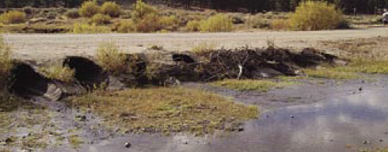
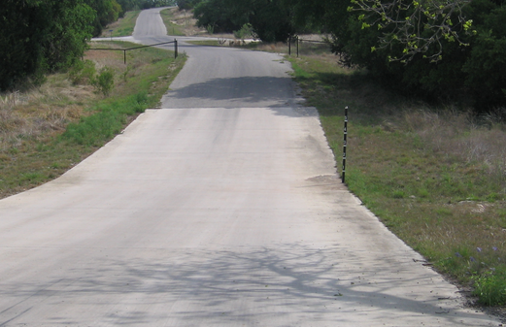
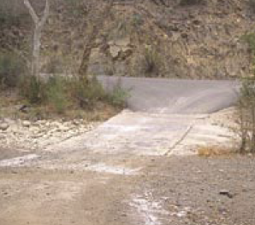
Low Water Stream Crossings and Fords
Note 21
Structures
structure
natural
Low Water Stream crossings convey normal stream flow below the driving surface but are normally overtopped at least once annually
Part 2 of 2
428 NAC 2-001.03A5d, Page 44
Slide 34
428 NAC 2-001.03B, Note 21, Page 54
Notes:
Note 21 on page 54 of the standards addresses Low Water Stream Crossings and Fords.
These are defined on page 44 of the standards. A low-water stream crossing passes normal stream flow below the driving surface but is normally overtopped with water at least once annually.
Low Water Stream Crossings are man-made structures, as shown in the photo,
Stream Fords are considered mostly a natural phenomenon.
NOT FOR AUDIO (it is for an unused photo, which is underneath the photo that is shown)
This photo shows a low-water stream crossing, with water height meter post and a gate to prevent entry during high water events.

Slide 35
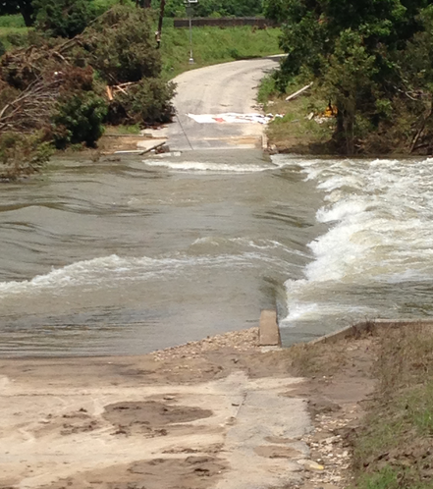
Low Water Stream Crossings and Fords
Some Considerations
Note 21
Structures
Ephemeral stream or low base flow
Low Traffic Use
Traffic Delays are Acceptable
Broad Flat Channel
Least Cost Alternative
Part 2 of 2
428 NAC 2-001.03A5d, Page 44
428 NAC 2-001.03B, Note 21, Page 54
428 NAC 2-001.03O, Page 79
Slide 35
Notes:
Low Water stream crossings and fords may be used in certain circumstances, in particular when
flows are “flashy” meaning that they come and go relatively quickly, such as intermittent or ephemeral streams, or the stream has a low base flow
traffic volumes are very low
delays are acceptable
the stream channel is broad and flat and
it is the least cost alternative
There are many considerations, including the passage of aquatic organisms
For rivers and streams that convey large flows, bridges and large culverts are better-suited.
Low-water stream crossings and fords are not appropriate for many situations and their application is limited.

Slide 36
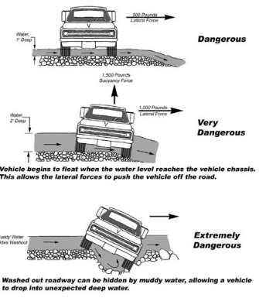
Low Water Stream Crossings and Fords
Risks
Note 21
Structures
Caution:
These types of crossings don’t come without risk – and liability
Part 2 of 2
Slide 36
428 NAC 2-001.03B, Note 21, Page 54
Notes:
Because Low water stream crossings and fords may be frequently overtopped by flooding they have a certain amount of risk and are generally not recommended. That is why any low-water stream crossing or ford needs to be brought to the Board of Public Roads and be granted a relaxation of standards prior to construction.

Slide 37
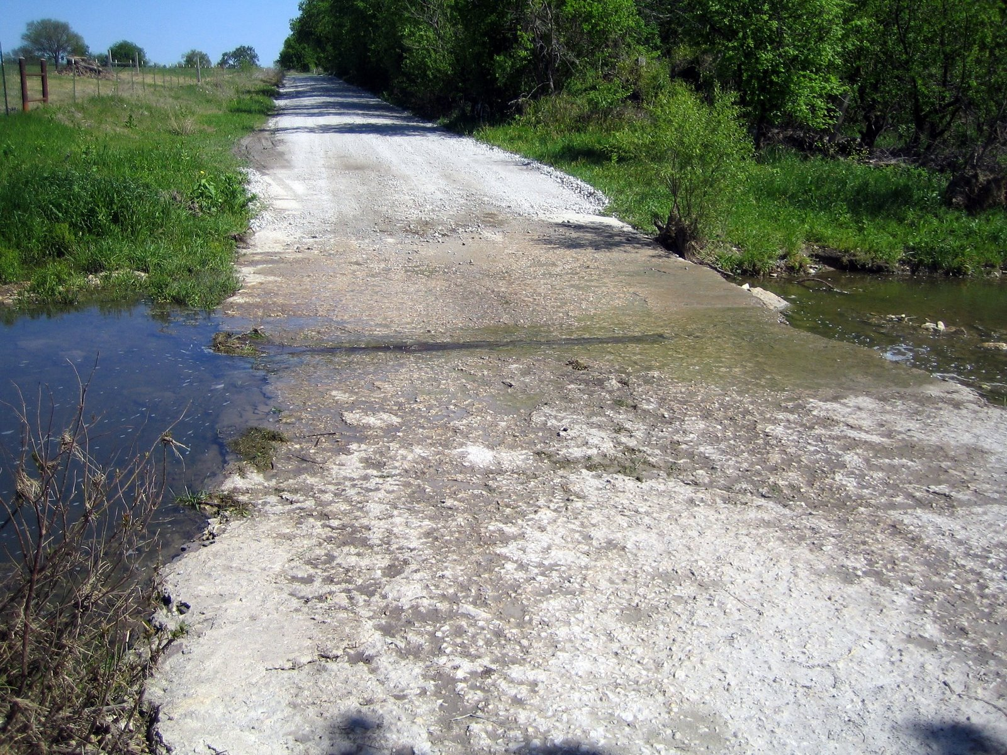
Low Water Stream Crossings and Fords may be built on certain County roads if
Note 21
Structures
Not the only access to an occupied dwelling
SFC Minimum Maintenance, or
ADT < 50 VPD
SFC Local
Relaxation of standards must be granted
Part 2 of 2
Slide 37
428 NAC 2-001.03B, Note 21, Page 54
Notes:
The NBCS Minimum Design Standards allow low-water stream crossings or fords to be be built only on some county roads and only under certain conditions.
The conditions are:
The road cannot be the only access to an occupied dwelling
The state functional classification must be minimum maintenance or Local and
The ADT must be fewer than 50 VPD.
As mentioned on the previous slide, A low water stream crossing or ford must get a relaxation of standards granted by the Board of Public Roads before being built.
New low water stream crossings or fords shall not be built on county roads with State functional classifications of Other Arterial, Collector, Remote Residential or Scenic-Recreation or, as already implied, on roads classified as Local (and with an ADT of 50 VPD and greater).

Slide 38
Wrap-up and Review
Structures
Part 2 of 2
Slide 38
Notes:
This next segment is a short review of the information presented, including some quiz questions.

Slide 39
Learning Objectives
Video Series - Overall
Know Functional Classification
Find and use the correct minimum design standards table
Be familiar with Definitions
Know and Understand the Notes
Understand 3R requirements
Know which work to apply to One- and Six-Year Plans
Know fundamentals of horizontal clear zone
Review current ADA requirements
Part 2 of 2
Slide 39
Notes:
To recap, these are the 8 learning objectives for the entire video series on the minimum design standards for county roads and municipal streets.

Slide 40
Learning Objectives
Structures
Know Functional Classification
Find and use the correct minimum design standards table
Be familiar with Definitions
Know and Understand the Notes
Understand 3R requirements
Know which work to apply to One- and Six-Year Plans
Know fundamentals of horizontal clear zone
Review current ADA requirements
Length, Bridge, NBS
6, and 18-22
vs. N&R and Maint.
Part 2 of 2
Slide 40
Notes:
The two videos for Bridges and Structures presented
Definitions – length, bridge and non-buried structure
Notes 6 and 18 through 22, and
3R requirements
in the 2016 minimum design standards for county roads and municipal streets.
Let’s do a review.
When it comes time to answering a review question, you have the option of pausing the video before the answer is given.

Slide 41
Type of Work
Definitions
Structures
With respect to bridges and structures, how would you distinguish type of work between
New & Reconstructed and 3R?
A New & Reconstructed structure is (a) new (a) replacement, or (c) lengthened along the center of the road (e.g. jump span)
3R involves a scope of work less than described above
Part 2 of 2
428 NAC 2-001.03A1, Pages 37-40
428 NAC 2-001.03A1b, A1c and A1d3
Slide 41
Notes:
The next two slides review the type of work with respect to bridges and structures.
The question is: how would you distinguish between New & Reconstructed work and 3R work?
For the answer, it will be easier to define New & Reconstructed work, and then define 3R work relative to that.
A New & Reconstructed structure is (a) new, (b) replacement of an existing structure, or (c) lengthened along the center of the road.
Replacement means the foundation, substructure, superstructure and deck – the entire structure.
Another phrase you may hear for lengthening a structure is adding a jump span. A “jump span” is an extension at the end of an existing structure, necessitated usually by a flood event or events which severely scour an erodible embankment at the structure. [NOT FOR AUDIO: reference 7/16/2014 meeting minutes]
Now that we know what New & Reconstructed work consists of, we can simply say that 3R work involves a scope of work less than New & Reconstructed.
Examples of 3R work are: bridge rail and guardrail upgrades, replacement of the superstructure, extension of culverts (perpendicular to the road), re-decking, widening, and thin Portland cement concrete overlays.

Slide 42
Type of Work
Definitions
Structures
With respect to bridges and structures, how would you distinguish between
Maintenance work and 3R work?
Maintenance is cleaning, painting, repairing, in-kind replacement of rails, floors, stringers, piling and beams, but nothing extensive or costly. Rotted timber piling can be replaced with steel piling. (Page 89)
3R is a scope of work beyond Maintenance
Part 2 of 2
428 NAC 2-003.01C4, Page 89
428 NAC 2-001.03A1c and A1d3 Pages 38 and 40
Slide 42
Notes:
The question is: how would you distinguish between Maintenance work and 3R work?
For the answer, it will be easier to define Maintenance work, and then define 3R work relative to that.
For Maintenance work on structures, refer to the page 89 of the minimum standards.
Maintenance is defined in the standards by a list of activities - cleaning, painting, repairing, in-kind replacement of rails, floors, stringers, piling and beams, but nothing extensive or costly. Rotted timber piling can be replaced with steel piling
Now that we know what Maintenance work consists of, we can simply say that 3R work involves a scope of work more than Maintenance work.
To summarize this slide and the previous slide, 3R work is any scope between New & Reconstructed work and Maintenance work.

Slide 43
Structures – Type of Work
Quiz Questions
Definitions
Structures
When upgrading the approach guardrail to an existing bridge, the lane and shoulder widths of the approach roadway must meet minimum New & Reconstructed standards. T or F
A culvert under a road is replaced, and therefore the approach roadway must meet minimum New & Reconstructed standards. T or F
Part 2 of 2
428 NAC 2-001.03A1b and .03A1c
Pages 37-38
Slide 43
Notes:
This slide and the next slide pose specific questions related to the type of work.
(I) False. Upgrading guardrail is a 3R activity, see page 38 of the standards [428 NAC 2-001.03A1c]; therefore, the approach lane width and shoulder width must meet minimum 3R standards. If the existing bridge meets the New & Reconstructed standard clear bridge width, it would be prudent for the approach lanes and shoulders to meet New & Reconstructed standard widths; however, that is not a minimum requirement of the minimum design standards, and would be considered more of a best practice.
(II) True. Culvert replacement is a New & Reconstructed type of work, see page 37 of the standards [428 NAC 2-001.03A1b ]; therefore, the approach lane width and shoulder width must meet minimum New & Reconstructed standards.

Slide 44
Structures – Type of Work
Quiz Questions (continued)
Definitions
Structures
When adding a jump span, what standards apply?
When replacing the superstructure of a steel girder bridge, what standards apply?
New & Reconstructed
3R
Part 2 of 2
428 NAC 2-001.03A1b and .03A1c
Pages 37-38
428 NAC 2-001.03B, Note 18, Page 53
Slide 44
Notes:
(III) New & Reconstructed standards apply to a jump span. A “jump span” is an extension at the end of an existing structure, necessitated usually by a flood event or events which severely scour an erodible embankment.
(IV) 3R standards apply. Replacement of a superstructure (while using the existing substructure) is a 3R activity; see page 38 of the standards. Note 18 on page 53 indicates that it is desirable to meet New & Reconstructed clear bridge width. The word “Desirable” does not indicate a requirement, only that it is a preference.

Slide 45
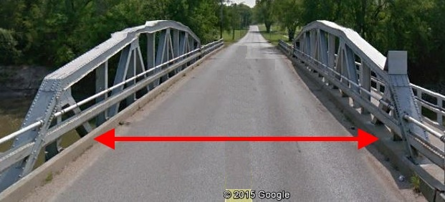
Structures – Notes summary
Notes
Structures
6 – for 3R work, check crash history
18 – clear bridge width
19 – design structural loading capacity
20 – timber bridges
21 – low-water stream crossings/fords
22 – structure replacement – approach roadway requirements
Part 2 of 2
428 NAC 2-001.03B, Pages 47-54
Slide 45
Notes:
This slide is a summary of notes related directly to bridges and other structures. Refer to pages 47-54 of the standards.
6 – requires checking crash history to see if clear bridge width is a cause of crashes. The term used in the MDS is cost effective analysis, and a crash history is part of that process.
18 and 19, on pages 53 and 54, respectively, are the main notes for structures
18 – on page 53, covers clear bridge width, which is calculated by the simple formulas (A)-(H) in the note but cannot be less than the applicable value in the table, without a relaxation of standards.
18 – also provides minimum requirements for structures if the roadway or paved shoulders on either side are widened or reconstructed; in those cases the structure must at least meet 3R standards.
19 – on page 54, covers structural capacity minimum standards
20 –allows, for certain timber bridges, replacement of the timber superstructure with an in-kind timber superstructure, under minimum maintenance standards
21 – provides conditions and requirements for low-water stream crossings and fords
22 – on page 54 provides minimum requirements for the roadway and roadside on either side of a structure replacement for very low volume roads when rural area standards apply.

Slide 46
Structures – Notes - Quiz
Notes
Structures
Note 18 applies only to bridge-size structures (NBIS bridge length over 20 ft). T or F
The width of paved shoulders cannot affect the minimum clear bridge width of an adjacent structure. T or F
An existing structure must meet minimum New & Reconstructed clear bridge width if the roadway is reconstructed. T or F
Part 2 of 2
428 NAC 2-001.03B, Note 18, Page 53
Slide 46
Notes:
False, Note 18 applies to structures 4 ft and longer, i.e. to non-buried structures and bridges.
False, Note 18 requires checking the sum of the traveled way and paved shoulder widths because if that sum exceeds the width calculated by the applicable formula (A) thru (H), or the width in the table, it must be used as the minimum clear bridge width.
False, although it would be desirable to meet N&R CBW, Note 18 sets the minimum requirement of 3R clear bridge width if the adjacent roadway is widened or reconstructed. For these situations, the Board of Public Roads felt it was better to set the minimum requirement to take advantage of structures that have remaining life. Of course, these are minimum standards and it is up to the county or municipality to decide if a replacement would make more sense for the given situation.

Slide 47
Structures – Notes – Quiz
(continued)
Notes
Structures
Note 20 allows any timber superstructure to be replaced with any type of superstructure as a maintenance activity. T or F
Part 2 of 2
Slide 47
428 NAC 2-001.03B, Notes 19 and 20, Page 54
Notes:
(d) False. The road must have a National Functional Classification of Local, an ADT of fewer than 400 VPD and the replacement superstructure cannot be just any type, it has to be replaced in-kind which means the same or similar materials and dimensions.
Note 20 applies only to bridge-size timber structures, those with an opening of 20 ft and longer as measured along the center of the road.

Slide 48
Structures – Notes – Quiz
(continued)
Notes
Structures
As long as a low-water stream crossing project is on the One- and Six-Year Plan, the county can go ahead and build it. T or F
When replacing a structure on a very low-volume road (< 400 VPD) where rural standards apply, a sub-standard horizontal curve must be corrected. T or F or it depends
Part 2 of 2
428 NAC 2-001.03B, Note 21, Page 54
428 NAC 2-001.03O, Page 79
428 NAC 2-001.03B, Note 22, Page 54
Slide 48
Notes:
(g) False. Note 21 on page 54 requires the Board of Public Roads to review design documents and approve prior to construction.
(h) It depends. Note 22 would require the curve to be brought up to standards only if there is a significant crash history related to or caused by the deficient horizontal curve, and a cost effective analysis indicates that user benefits are greater than the cost of correcting the curve.

Slide 49
Learning Objectives
Structures
Tables – the part for Structures and how it works – in the Minimum Design Standards
The Two Design Criteria for Structures
Basis of Values for Design Criteria
Design Structural Loading Capacity
Minimum Clear Bridge Width
Scope of Work – how work on the roadway and the structure can affect one another
Low Water Stream Crossings and Stream Fords
Slide 49
Notes:
This is a reminder of the seven Structures-specific learning objectives established at the outset of this two-part video.
They include
The tables and how they work for bridges and other structures
The two design criteria for structures and the bases for their values
How the scope of work on a road or street can potentially cause work on a structure and how work on a structure can potentially cause work on a road or street
And
Low-water stream crossings and fords.

Slide 50
Structures-Specific Learning Objectives - Review
Structures
When could work on a roadway cause work on a structure?
The minimum structural capacity of all New & Reconstructed bridges, non-buried structures and culverts is HL93. T or F
Widening a bridge is a 3R activity. T or F
Resurfacing the deck of a structure is a New & Reconstructed activity. T or F
Reconstruction, or widening.
Part 2 of 2
428 NAC 2-001.03 Tables Pages 55-78
428 NAC 2-001, Pages 2 and 3
428 NAC 2-001.03B, Note 18, Page 53
Slide 50
Notes:
Reconstructing or widening the traveled way or paved shoulders on a road or street adjacent to a bridge or other structure requires the bridge or structure to meet or exceed 3R standards, possibly adding to the scope of work for the project.
True. HL93 is the minimum structural capacity requirement for all New & Reconstructed structures.
True, widening a bridge is considered a 3R scope of work. See page 38 of the standards.
False, resurfacing the deck of a structure is considered a 3R scope of work. See page 38 of the standards.

Slide 51
Structures-Specific Learning Objectives – Review (continued)
Structures
Clear Bridge Width values depend on traffic volume. T or F
If a road or street is widened over the top of a buried 48-inch culvert, the road or street width must meet or exceed 3R standards. T or F
A low-water stream crossing or ford can be constructed on a very, very low-volume road if it is the only access to an occupied dwelling. T or F
Part 2 of 2
428 NAC 2-001.03 Tables Pages 55-78
428 NAC 2-001.03B, Note18, Page 53
428 NAC 2-001.03B, Note 21, Page 54
428 NAC 2-001.03O, Page 79
Slide 51
Notes:
v. True, See any of the first 12 tables, pages 55 thru 78.
vi. True. See Note 18 on page 53, the paragraph in bold font, second sentence . [“The roadway width for an existing buried non-bridge-size culvert shall meet or exceed minimum 3R standards if the approach roadway is widened or reconstructed on either side”]
vii. False, see Table 001.03O on page 79 and also Note 21 on page 54. It cannot be the only access to an occupied dwelling.

Slide 52
Structures-Specific Learning Objectives – Review (continued)
Structures
For low-water stream crossings and fords, what is the one required piece of information, in addition to the other usual information, to be included in the relaxation of standards submittal to the NBCS?
If work more than maintenance is done to strengthen a bridge, the bridge must be widened if its clear bridge width does not meet the 3R standard. T or F
Not the only access to an occupied dwelling
Part 2 of 2
428 NAC 2-004.01c, Page 94
428 NAC 2-001.03B, Note 1, Page 47
Slide 52
Notes:
viii. That the road is not the only access to an occupied dwelling.
ix. True. The bridge must meet all 3R standards if work more than maintenance is done, or a relaxation of standards must be granted by the Board of Public Roads.

Slide 53
Structures-Specific Learning Objectives – Review (continued)
Structures
A new or replacement 36-inch corrugated metal pipe culvert under a road or street must meet the minimum design standard for structural capacity, HL93. T or F
Part 2 of 2
Slide 53
428 NAC 2-001.03B, Note 19, Page 54
Notes:
x. True, the minimum standards for the structural capacity criterion are not a function of opening size or length. Refer to Note 19 on Page 54 and the tables from page 55 through 86.

Slide 54
Structures-Specific Learning Objectives – Review (continued)
Structures
What is the minimum clear bridge width for a replacement bridge on a rural two-lane county road with earth shoulders, classified as Minor Collector, with 12 ft lane widths and an ADT of 550 VPD?
What is the minimum design structural loading capacity for a bridge on a street in North Platte with a National Functional Classification of Minor Arterial if the scope of work is a deck overlay?
30 ft.
Original Design Loading or, if unknown, HS15
Part 2 of 2
428 NAC 2-001.03I, Pages 67- 68
428 NAC 2-001.03A2a, Page 42
428 NAC 2-001.03C, Pages 55- 56
428 NAC 2-001.03B, Note 19, Page 54
Slide 54
Notes:
x. The answer is 30 ft. minimum clear bridge width. The National Functional Classification is minor collector, in a Rural Area, therefore the correct table is Table I starting on page 67 and the bridge standards are on page 68. A replacement means that the type of work is New & Reconstructed. Looking at Table I on Page 68, an ADT of 550 VPD is in the 400-1,499 VPD group, and Formula (C) applies to that group. Note 18 on page 53 indicates that Formula (C) is the traveled way width plus 3 ft each side. The traveled way is 2 x 12 ft = 24 ft. Adding 3 ft. each side makes it a 30 ft. minimum clear bridge width according to the formula. The value in the table is 28 ft., which is less than the value calculated by the formula. Therefore, use 30 ft. as the minimum clear bridge width. Anything less than 30 ft requires a request for a relaxation of standards from the Board of Public Roads.
ix. Original Design Loading or, if unknown, HS15. The National Functional Classification is given as Minor Arterial. North Platte is over 5,000 population therefore this is an Urban Area; see page 42 of the standards for the definition of Urban Area. Therefore, the correct table is Table C starting on page 55 with the bridge standards on page 56. A deck overlay is a 3R scope of work; see page 38 of the standards. Table C, for structural capacity, refers to Note 19 on page 54. Note 19 indicates that for 3R work, the minimum structural capacity is the original design loading or, if that is unknown, it would be HS15.

Slide 55

2016 Minimum Design Standards
Boards - Liaison Services Section
Structures- Bridges, Non-Buried Structures, Culverts
Part 2 of 2
County Roads and Municipal Streets
8/8/2019
Notes:
This concludes Part II of II, of Nebraska’s 2016 Minimum Design Standards for County Roads and Municipal Streets, with respect to bridges, non-buried structures and culverts.

