Slide 1


2016 Standards
Video 05
Finding the Correct MDS Table
Nebraska Administrative Code
Title 428
Rules and Regulations of the
Board of Public Roads Classifications and Standards
(Administrative Host: Nebraska Department of Transportation)
County Roads and Municipal Streets
Neb. Rev. Stat. 39-2113
https://dot.nebraska.gov/media/5593/nac-428-rules-regs-nbcs.pdf
Boards - Liaison Services Section
8/8/2019
Notes:
8/8/2019 Updated first and last slides – Administrative Host: Nebraska Department of Transportation, not Nebraska Department of Roads.
8/6/2019 Updated to reflect changes per LB82 (2019). Previous version dated 12/19/2016. Five slides deleted and 22 slides revised. Slides 3 thru 8 deleted of the 12/19/2016 version deleted. Slide 2 updated NDOR to NDOT. Slides 11 thru 14, 16, 18, 20 thru 22, 27, and 34 (17 thru 20, 22, 24, 26 thru 28, 33, and 40 in 12/19/2016 version) updated web links and change NDOR to NDOT. Slide 11 has an audio media change (NDOR to NDOT). Slide 14 had to change out the NFC map and adjust audio media because of map changes made by NDOT. Slides 17 and 19 (23 and 25 in 12/19/2019 version) had to update the Functional Classification of the example segment since NDOT updated their Scottsbluff City map showing the new Federal Fct. Class. System change from Minor Arterial to Major Collector. Slides 34 and 35 (40 and 41 in the 12/29/2016 version) updated web link to https:// changed out the Legend and map because NDOT updated the legend, and both have an audio media change (NDOR to NDOT). Slides 41, 44 and 47 (slides 47, 50 and 53 in the 12/19/2019 version) updated map and legend, and web link, and one audio media each. Slides 30, 32 and 50 (slides 36, 38 and 56 in the 12/19/2019 version) changed NDOR to NDOT in audio media.
This is one of a series of videos on Nebraska’s system of
Classifying and applying standards to its highways, roads and streets.
This video provides general instructions for finding the Minimum Design Standards table that applies to a particular county road or city street work or project.

Slide 2
Terminology and Acronyms used in this video
NBCS = Nebraska Board of Public Roads Classifications and Standards = “The Board” = “The Board of Public Roads”
NDOT = Nebraska Department of Transportation
Standards vs. Minimum Design Standards (MDS)
Neb. Rev. Stat. = Nebraska Revised Statutes
NAC = Nebraska Administrative Code
Highways = Roads = Streets (§39-101(3), §60-624)
3R = Resurfacing, Restoration and Rehabilitation
FC = Functional Classification
CFR = Code of Federal Regulations
AASHTO = American Association of State Highway Transportation Officials
Notes:
8/4/2019 Updated to change NDOR to NDOT
First, some terminology and acronyms . . .
NBCS is the Nebraska Board of Public Roads Classifications and Standards; it may also be called the Board of Public Roads, or just The Board.
NDOT is the Nebraska Department of Transportation
Standards refers to the NBCS standards, including design, construction, maintenance and relaxation of standards. MDS refers to the Minimum Design Standards, which address only the design aspect of a work or project. Standards are often termed “minimum” but realize there are maximums (for superelevation, grade) and ranges ( for cross slopes). When we say “minimum” – sometimes it refers to all of those.
Neb. Rev. Stat. refers to the Nebraska Revised Statutes
NAC is the Nebraska Administrative Code. These are regulations, that have the force of law.
The word “Highway” in Nebraska law also refers to roads and streets. Highway means the entire width between the boundary limits of any street, road, avenue, boulevard, or way which is publicly maintained when any part is open to the use of the public for purposes of vehicular travel.
3R is short for resurfacing, restoration and rehabilitation. For more details, see the video dedicated to 3R.
FC is Functional Classification.
CFR is the acronym for the Code of Federal Regulations.

Slide 3
Chapter 2 (428 NAC 2)
Procedures for Standards
Title 428 Chapter 2
Slide 3
428 NAC 2
Notes:
This video provides more details on the Minimum Design Standards
Specifically, for County Roads and Municipal Streets, pages 35-86.
State Highway Standards, pages 5-34, are not covered in this video.

Slide 4
2016 Design Standards
15 Tables
Minimum Design Standards
Which table is most appropriate for my road or street work?
4 – Urban Areas
4 – Rural Areas
4 – Scenic-Recreation
1 – Low Water Stream Crossings and Fords
1 – Minimum Maintenance Roads
1 – Remote Residential Roads
Slide 4
428 NAC 2-001.03 Pages 55-86
Notes:
There are 15 design standards tables
In subsection 03, which applies to county roads and municipal streets.
They are in this order in the rule, starting on page 55, with the last table (Remote Residential Roads) on page 86
READ THE SLIDE
This video demonstrates the process for finding the table that applies to a work or project.

Slide 5
2016 Design Standards
15 Tables
Minimum Design Standards
Which table is most appropriate for my road or street work?
4 – Urban Areas
4 – Rural Areas
4 – Scenic-Recreation
1 – Low Water Stream Crossings and Fords
1 – Minimum Maintenance Roads
1 – Remote Residential Roads
Slide 5
428 NAC 2-001.03, C thru J, Pages 55-70
Notes:
Let’s focus on the first two categories:
Urban Areas and Rural Areas
The first 8 tables, parts C thru J, pages 55-70
These eight tables apply to most of the mileage on Nebraska’s county road and municipal street systems.
It is important to understand if an Urban Area standards table or a Rural Area standards table applies to your work or project.
Later we will discuss
Low Water Stream Crossings and Fords
and the optional state functional classifications:
Scenic-Recreation
Minimum Maintenance
And Remote Residential
By State law, only roads outside of municipal corporate limits can have these designations
And have relatively far fewer miles than the first eight tables cover.

Slide 6
Finding the Table
That Applies to a Segment of a
County Road or Municipal Street
Minimum Design Standards
Need to know:
Area (Urban or Rural) Standards that apply
Functional Classification
Type of Work (N&R/3R/Maintenance)
ADT
%HT (3R)
Surface – paved or unpaved (3R)
Type of Section – curbed or non-curbed
Slide 6
Notes:
You need to know two things in order to find the standards table that applies to a work or project:
Which category to use: Urban Area or Rural Area standards
And the Functional Classification of the segment or street or road

Slide 7
Minimum Design Standards
Finding the Table
That Applies to a Segment
of a
County Road or Municipal Street
Need to know:
Area (Urban or Rural) Standards that apply
Functional Classification
Type of Work (N&R/3R/Maintenance)
ADT
%HT (3R)
Surface – paved or unpaved (3R)
Type of Section – curbed or non-curbed
Urban Area:
Defined in MDS, Page 42
428 NAC 2-001.03A2, Page 42
Slide 7
428 NAC 2-001.03, C thru J, Pages 55-70
Notes:
The video on Functional Classification basics explained the term Urban Area, and showed an example.
Urban Area is defined on page 42 [of 428 NAC 2-001.03, Nebraska’s] the MDS.

Slide 8
Area
National FC System
Cities of the First Class, and Lincoln and Omaha
Urban
  Dense development
  Determined by census
  Populations 5,000 and more
  Local and State officials decide, US Secretary of Transportation approves
  NOT always the same as corporate limits
Rural
  Sparse development
  All areas not designated Urban
Slide 8
428 NAC 2-001.03A2, Page 42
Notes:
8/5/2019 Update the first and fifth audio media.
This screen describes Urban and Rural areas as used in the national system of functional classification.
Urban areas are the more densely populated areas, are determined by census, and defined as populations 5,000 and greater. The actual boundaries are determined by local and state officials, with approval by the US Secretary of Transportation.
Rural areas, in this context, are all areas not designated as Urban.
State statute 16-101 requires Cities of the First Class to have a population more than 5,000,
Therefore, the way the national system is defined, by definition
Urban applies only in, and possibly some surrounding areas of,
Cities of the First Class, and the Lincoln and Omaha areas.
If your highway, road or street of interest is in one of these cities, it is in an Urban area
and if it is near the corporate limits of any one of these then you need to verify if it is in the Urban area.
How you do that is to check the map on NDOR’s website, which we will show momentarily.
But first, let’s review
NOT FOR AUDIO
To know if your road is in an urban or rural area:
It is only an issue for cities with population 5,000 and greater.
If your road is near a city of the first class, or near Lincoln or Omaha, check the map on NDOT’s website.

Slide 9
Minimum Design Standards
Finding the Table
That Applies to a Segment
of a
County Road or Municipal Street
Need to know:
Area (Urban or Rural) Standards that apply
National Functional Classification
Type of Work (N&R/3R/Maintenance)
ADT
%HT (3R)
Surface – paved or unpaved (3R)
Type of Section – curbed or non-curbed
Tables C thru J, Pages 55-70
428 NAC 2-001.03A2, Page 42
Slide 9
428 NAC 2-001.03, C thru J, Pages 55-70
Notes:
Urban is not to be confused with the term Municipal – as in municipal corporate limits –
which is defined by, and used in, the State FC System.
Regarding #2 on the screen, There is not always a direct correlation between the State and National FC systems.
Since the AASHTO green book and other industry references are organized by National FC,
The NBCS chose to organize the first eight tables by National Functional Classification

Slide 10
Minimum Design Standards
Finding the Table
That Applies to a Segment
of a
County Road or Municipal Street
Need to know:
Area (Urban or Rural) Standards that apply
National Functional Classification
Type of Work (N&R/3R/Maintenance)
ADT
%HT (3R)
Surface – paved or unpaved (3R)
Type of Section – curbed or non-curbed
Tables C thru J, Pages 55-70
Example – Scotts Bluff
County Road 23 / City Street 21st Ave
428 NAC 2-001.03A2, Page 42
Slide 10
428 NAC 2-001.03, C thru J, Pages 55-70
Notes:
Let’s walk through an example to demonstrate how to find the table that applies
To a project in Scotts Bluff, on County Road 23 which becomes 21st Ave in the city.

Slide 11

Maps on NDOT Website
Finding Maps
https://dot.nebraska.gov
Slide 11
Notes:
8/5/2019 Updated web link to https:// and changed NDOR to NDOT in the slide header. One audio media change (NDOR to NDOT)
In order to find the National Functional Classification map for your highway, road or street of interest,
On NDOR’s Nebr DOT’s main web page, on the Travel tab, select the Map Library.

Slide 12
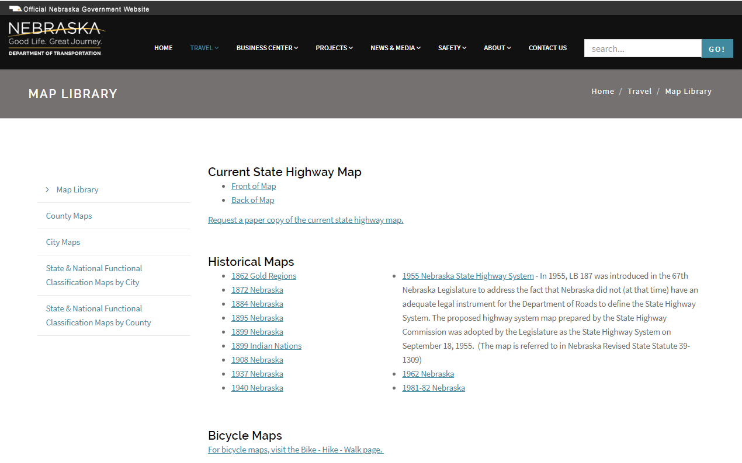
Maps on NDOT Website
Finding Maps
https://dot.nebraska.gov/travel/map-library/
Slide 12
Notes:
8/5/2019 Updated web link to https:// changed NDOR to NDOT in the slide header and made changes to audio media
In the Map Library, select the
State & National Functional Classification Maps – Cities Within Counties – by City if the highway or street of interest is in Urban Area. Remember, Urban Areas in Nebraska are located at Cities of the First Class, and Lincoln and Omaha.
Scotts Bluff is a City of the First Class

Slide 13
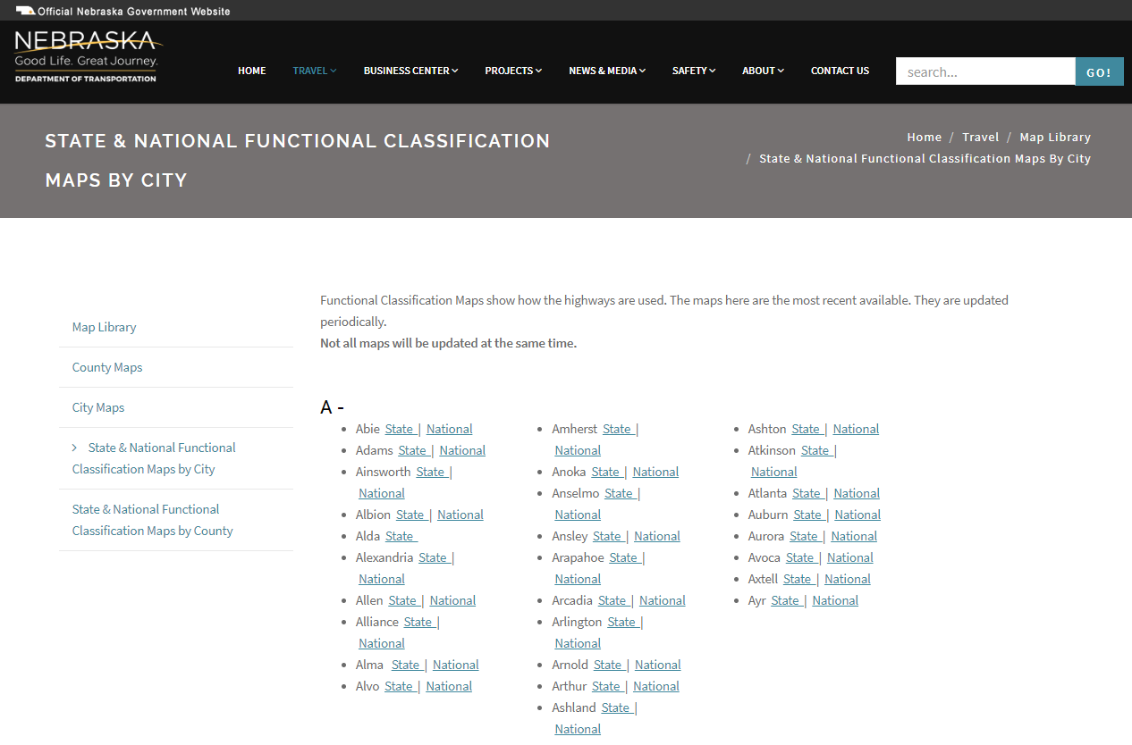
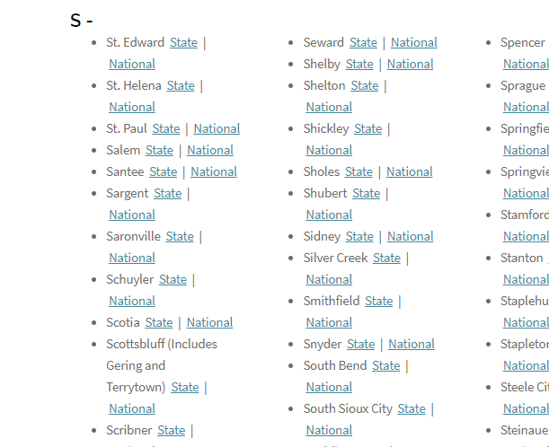
National FC Maps on NDOT Website
Finding Maps
https://dot.nebraska.gov/travel/map-library/func-by-county/
Slide 13
Notes:
8/5/2019 Updated web link to https:// changed NDOR to NDOT in the slide header, changed the screen images because of NDOT updated their website, and changed out three audio media because of those NDOT website changes.
That will bring up the County City map index.
Click on the “National” link to get to the National Functional Classification map for the County City of interest.
In this case, the City of Scotts Bluff County.

Slide 14
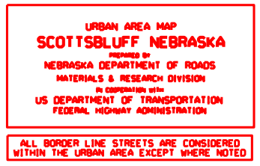
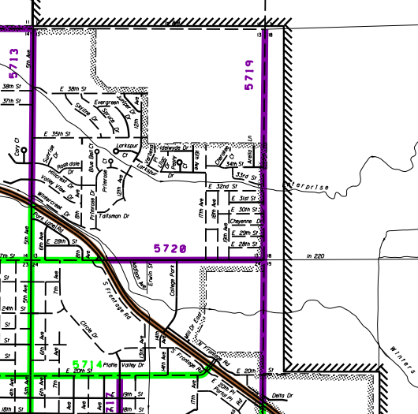
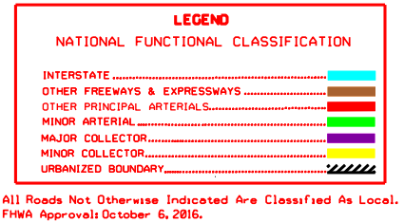
National FC Maps on NDOT Website
Finding Maps
https://dot.nebraska.gov/media/9710/scottsbluffgeringterrytownnfc.pdf
Urban Area Boundary
42nd St/Co Rd J
Corporate Limits
Co Rd 23
21st Ave
E 35th St
E 27th St
Slide 14
Notes:
8/5/2019 Updated web link to https:// for the actual Scottsbluff County map and changed NDOR to NDOT in the slide header. Had to change out the map and legend since those have changed since the Dec 2016 version of this video. The urban boundary shifted just east of the 21st Ave and is no longer coincident with the corporate limits on the ½ mile stretch between E 27th St and E 35th St.
That gets you to Scottsbluff county’s the City of Scottsbluff’s National Functional Classification map.
Scotts Bluff County, in this example.
The legend identifies the map as an NFC map.
21st Ave is on the east edge of the City of Scottsbluff, a City of the First Class.
County Road 23 is the name of that same road extended beyond corporate limits.
A common name for this is Sugar Factory Road.
As you can see on the screen, it is labeled Federal-aid Route #5719 up to County Road J.
Notice the Urban Area boundary is the same as Corporate Limits in some places,
such as the lower right part of the map shown, and the short segment of 42nd St/Co Rd J in the upper left,
And outside of Corporate Limits in other places. everywhere else in the part of the map shown on this screen For this example, two segments:
the northernmost ½ mile (E 35th St up to Co Rd J)
and the segment, not quite ½ mile long, just south of E 27th St.
Road 23, owned by the County, is therefore within the Urban Area boundary
And has a National Functional Classification of Minor Arterial Major Collector.
There is one more item to check before determining if Urban Area standards will be applied.

Slide 15
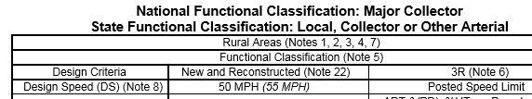

High Speed – in Urban Areas
Note 2
  Rural Area standards required when posted speed limit is anticipated to be 50 MPH or greater
Slide 15
428 NAC 2-001.03B Note 2, Page 47
Notes:
Notes are covered in more detail in another video, however, it is necessary to introduce Note 2 on Page 47 at this time.
Note 2 requires Rural Area standards to be used when the posted speed limit is, or is anticipated to be, 50 MPH or more.
Let’s check the road in the example.

Slide 16
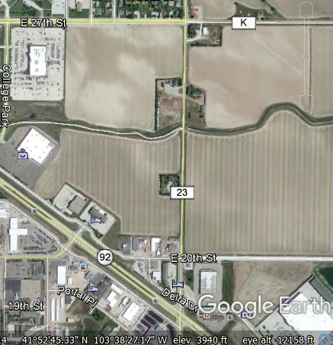
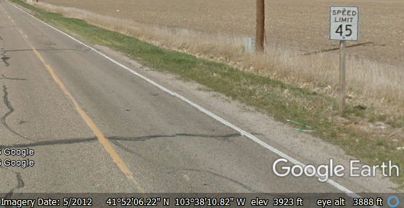
National FC Maps on NDOT Website
Note 2
https://dot.nebraska.gov/travel/map-library/
Urban Area Boundary
42nd St/Co Rd J
Corporate Limits
E 35th St
Urban Area Standards
E 27th St
Aerial View
E 27th St
Co Rd 23
Slide 16
Notes:
8/5/2019 Updated web link to https:// and changed NDOR to NDOT in the slide header and change out the base NFC map
First, check the short segment south of E 27th St.
It is posted 45 MPH.
As long as the anticipated speed limit is less than 50 MPH,
Urban Area standards are required for this segment
because the road is in an Urban Area.

Slide 17
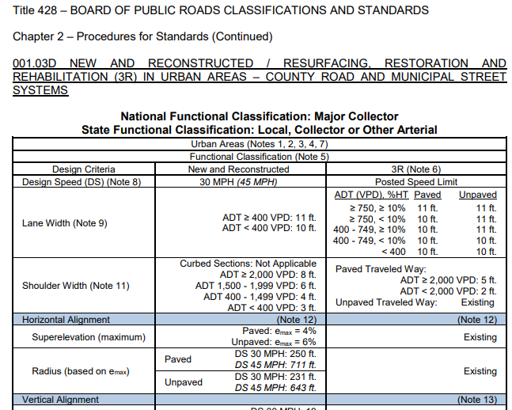
Minimum Design Standards
428 NAC 2-001.03D, Pages 57-58
Slide 17
Notes:
8/5/2019 Updated change to Major Collector
For this segment, knowing that Urban Area standards apply, and the National Functional Classification is Minor Arterial Major Collector, you can find the table that would apply to a work or project on pages 55 57 and 56 58 of the MDS.

Slide 18
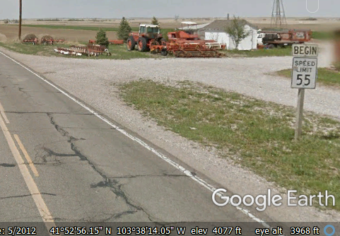
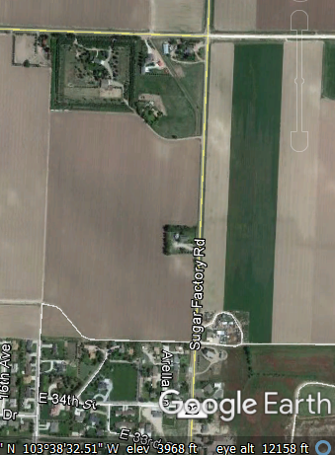
National FC Maps on NDOT Website
Note 2
https://dot.nebraska.gov/travel/map-library/
Urban Area Boundary
Co Rd J
Corporate Limits
Co Rd 23
Rural Area
Design Standards
Slide 18
Notes:
8/5/2019 Updated web link to https:// and changed NDOR to NDOT in the slide header
Now, Check the ½ mile segment south of County Road J.
As you can see in the aerial view, courtesy of Google Earth, the area on both sides of the road appears to be rural in character.
It is posted 55 MPH, as you can see in the Google image on the right.
Note 2 therefore requires Rural Area design standards, because the road is posted, or anticipated to be posted, at 50 MPH or greater.
Even though this segment of road is within an Urban Area.

Slide 19
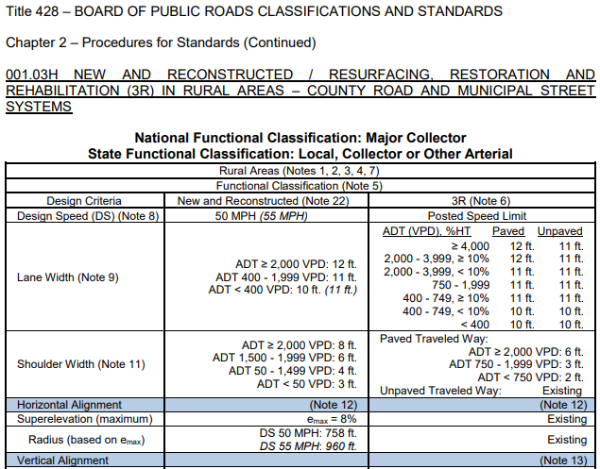
Minimum Design Standards
428 NAC 2-001.03H, Pages 65-66
Slide 19
Notes:
8/5/2019 Updated change to Major Collector
For this segment, knowing that Rural Area standards apply,
and the National Functional Classification is Minor Arterial Major Collector,
find the table that would apply to a work or project on this segment of road
on pages 63 65 and 64 66 of the MDS.

Slide 20
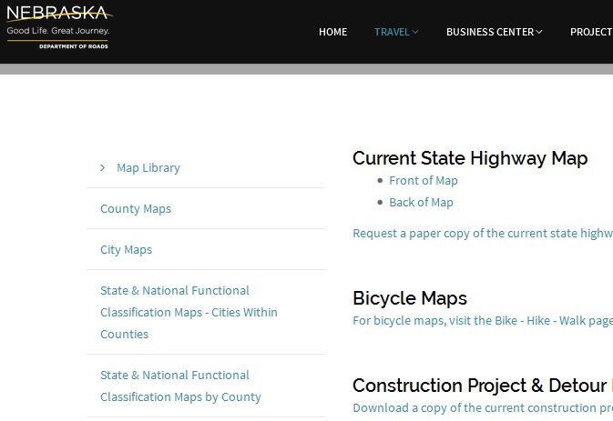
Maps on NDOT Website
Finding Maps
https://dot.nebraska.gov/travel/map-library/
Slide 20
Notes:
8/5/2019 Updated web link to https:// and changed NDOR to NDOT in the slide header
Let’s check the extension of Co Rd 23 north of the Urban Area.
On the Map Library screen, click on State & National Functional Classification Maps by County

Slide 21
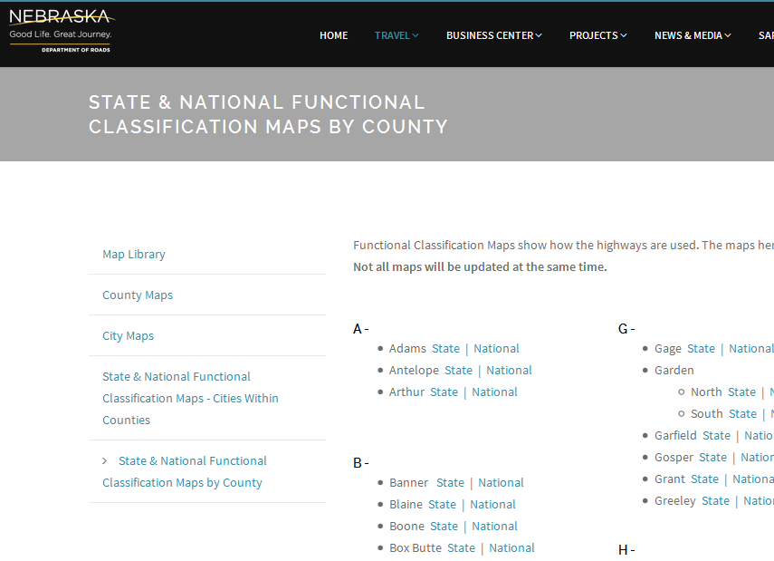
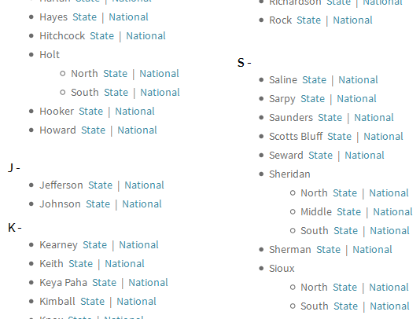
National FC Maps on NDOT Website
Finding Maps
https://dot.nebraska.gov/travel/map-library/func-by-county/
Slide 21
Notes:
8/5/2019 Updated web link to https:// and changed NDOR to NDOT in the slide header
That will bring up the County map index.
Click on the “National” link to get to the National Functional Classification map for the County of interest.
In this case, Scottsbluff County.

Slide 22
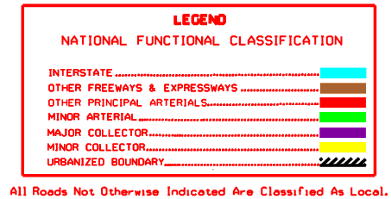
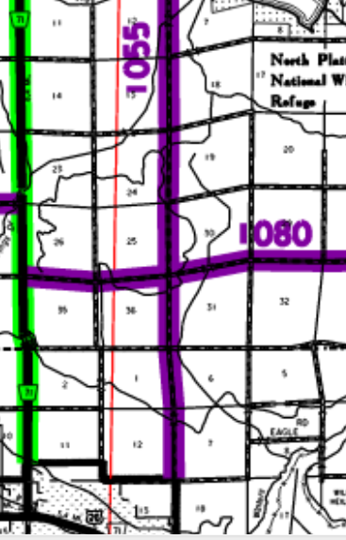
National FC Maps on NDOT Website
Finding Maps
https://dot.nebraska.gov/media/8733/cfuncscottsbluffnfc.pdf
Co Rd 23
Co Rd F
Lake Minatare Rd
Rural Area
Co Rd G
Co Rd H
Scottsbluff County
Co Rd J
Urban Area Boundary
Slide 22
Notes:
8/5/2019 Updated web link to https:// for the actual Scottsbluff County map and changed NDOR to NDOT in the slide header
That gets you to the county’s National Functional Classification map.
Scotts Bluff County, in this example.
The legend identifies the map as an NFC map.
County Road 23, is outside of the Urban Area boundary. Therefore it is in the Rural area.
Notice that the Federal-aid Route #1055, is different that the route number [#5719] that is inside the Urban Area.
The color indicates that it has a National Functional Classification of Major Collector.
There is one more item to check before determining if Rural Area standards will be applied.

Slide 23
Low Speed, Urban-like Roads in Rural Areas
Note 3
  Allows use of urban standards in rural areas with urban characteristics
    Low-speed (45 mph maximum)
    Residential and commercial areas
  Possible applications:
    Cities of the Second Class
    Villages
    Within the zoning jurisdiction of the above
    Sanitary Improvement Districts (SIDs)
Use the same Functional Classification
Slide 23
428 NAC 2-001.03B Note 3, Page 47
Notes:
The MDS allow the application of Urban Area standards in Rural Areas that are low speed, i.e. 45 MPH or less, and are commercial or residential in character.
Common examples are Cities of the Second Class, Villages, areas within the zoning jurisdiction of cities and villages, and Sanitary Improvement Districts.
Within the zoning jurisdiction, quite often populated areas increase and traffic slows down. Note 3 allows a transition from high-speed to low-speed in these areas, even though they may lie beyond the Urban Area boundary.
If the county chooses to apply Urban Area standards, the expectation is to use the Functional Classification designated on the National Functional Classification map, and it is good practice to document that decision.
Continuing with the Scotts Bluff example, let’s see how Note 3 applies.
NOT FOR AUDIO
“Functional classifications should be assigned based on actual functional criteria, rather than the location of the roadway within an urban or rural context.” Highway Functional Classification, Concepts and Procedures, FHWA, 2013, Page 19.

Slide 24
Rural Area
Just north of the City of Scotts Bluff
Note 3
Does not have a
Village
City of the Second Class
Sanitary Improvement District
Co Rd 23
Co Rd F
Co Rd G
Co Rd H
Co Rd J
Urban Area Boundary
Notes:
Looking at the Scottsbluff County map, north of the Urban Area Boundary of the city of Scotts Bluff,
There is no village, city of the second class or sanitary improvement district.

Slide 25
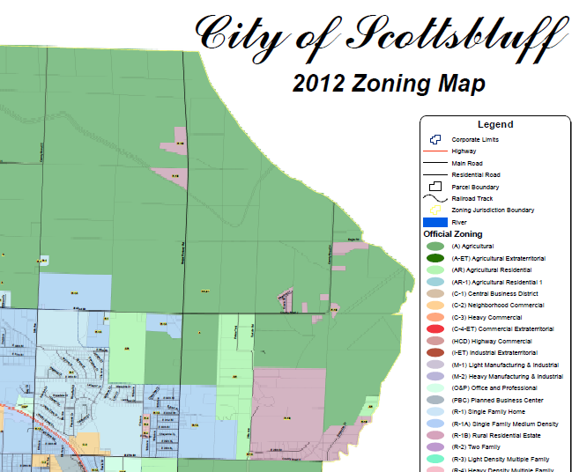
Note 3
Co Rd G
Co Rd H
Co Rd J
Sugar Factory Rd
http://www.scottsbluff.org/departments/development_services/gis/docs/Zoning_April_12.pdf
Notes:
What about the Zoning Jurisdiction?
It extends two miles beyond the corporate limits, by state law. [§16-901]
This screen shows a portion of the city’s zoning map.
North on Sugar Factory Road it extends to just south of Co Rd G.
Most of the land along the Road is zoned Agriculture.
There are two small R1B zones called “Rural Residential Estate” zones
The next screen focuses on the area in the rectangle, a little over one mile from Co Rd J north to around Co Rd H.

Slide 26
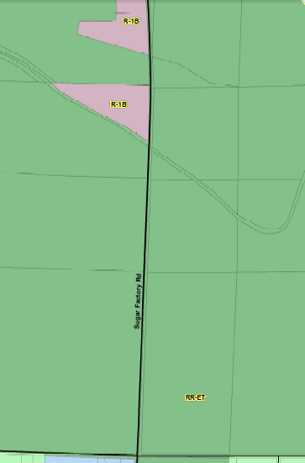
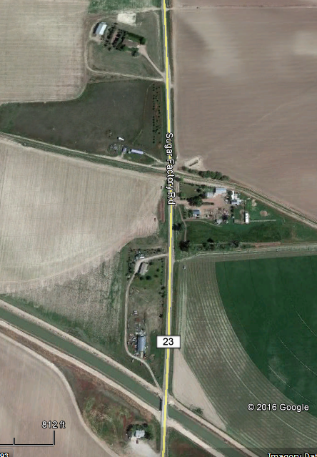
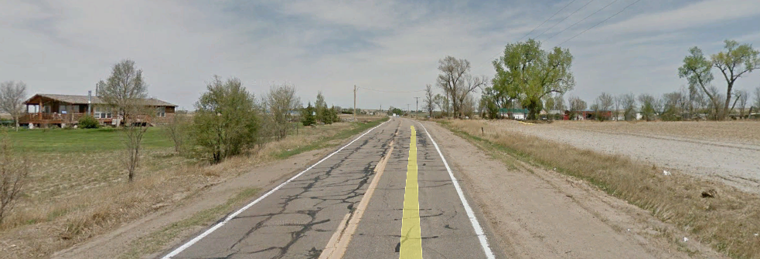
Note 3
Co Rd H
R-1B is sparsely populated
Co Rd J
Notes:
Focusing on the two R1B areas
A Google Earth aerial view shows that they are sparsely populated areas, with few access points and little congestion.
The street view confirms this.
They would not be considered a residential area as intended by Note 3.
Finally, let’s get an overall view of Sugar Factory Rd beyond the Urban Area boundary and several miles north to make sure we haven’t missed anything.

Slide 27
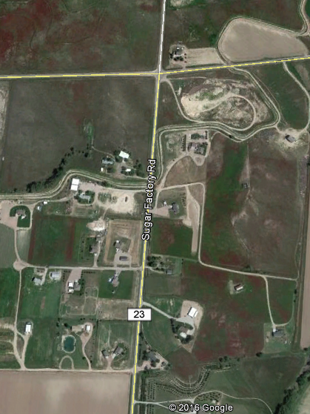
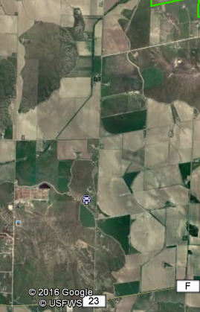
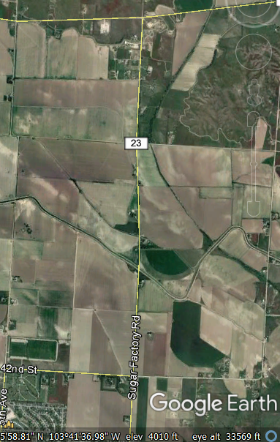
National FC Maps on NDOT Website
Note 3
https://dot.nebraska.gov/travel/map-library/
Lake Minatare Rd
Co Rd 23
Co Rd F
Lake Minatare Rd
Scottsbluff County
Co Rd J
Urban Area Boundary
Slide 27
Notes:
8/5/2019 Updated web link to https:// and changed NDOR to NDOT in the slide header
Looking at the Google Earth aerial view overlaid on top of the NFC map,
You can see the land on both sides of the road is rural in character.
There is a small area, just south of Minatare Rd, that looks like it might be residential in character.
A commercial area or a residential area within the work or project limits,
would be allowed to use Urban Area standards, if the road is posted at 45 MPH or less.
Taking a closer look with the help of Google Earth, it appears to be acreages, mostly on the west side.
In this case, apparently because it is not a densely populated residential area, i.e. acreages with somewhat limited access points, the road is posted 55 MPH.
And there is a stop condition at Lake Minatare Road, which abuts the development, so traffic is inherently slower along this short stretch of road.
Rural Area standards would be applied to a work or project on this entire stretch of county road because it is outside the Urban Area and is posted at 55 MPH.

Slide 28
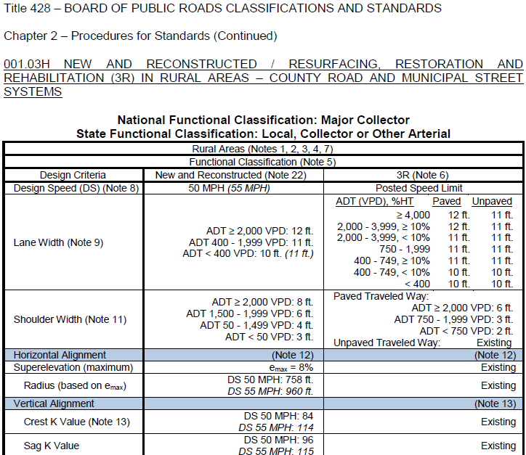
Minimum Design Standards
428 NAC 2-001.03H, Pages 65-66
Slide 28
Notes:
For this segment, knowing that Rural Area standards apply, and the National Functional Classification is Major Collector, you can then find the table that would apply to a work or project on pages 65 and 66 of the MDS.
To summarize,
If there is a village, city of the second class, or a SID,
Or for roads and streets within the zoning jurisdiction where traffic slows to low-speed as populated areas increase,
the decision to apply Urban Area standards in a Rural Area is likely to be clear.
That should take care of the vast majority of situations with regard to Note 3.
For other situations, which will be very few, when there is a commercial or residential area, the decision could be subjective.
Documenting the decision is good practice.

Slide 29
2016 Design Standards
15 Tables
Minimum Design Standards
National Functional Classification Map – Cities Within Counties
4 – Urban Areas
4 – Rural Areas
4 – Scenic-Recreation
1 – Low Water Stream Crossings and Fords
1 – Minimum Maintenance Roads
1 – Remote Residential Roads
Check Note 2
National Functional Classification Maps by County
Check Note 3
Slide 29
428 NAC 2-001.03, C thru J, Pages 55-70
Notes:
We just discussed how to generally find Urban Area and Rural Area tables that would apply to a project
These are the first 8 tables, parts C thru J, pages 55-70
These eight tables apply to most of the mileage on Nebraska’s county road and municipal street system.
The example was a road within an Urban Area that also extends into the Rural Area. In order to identify which standards apply to specific segments of that road, we first identified where it is located – within the Urban Area, or in the Rural Area – found the applicable National Functional Classification map, and introduced Notes 2 and 3 on page 47 to confirm which table applies, and then found the table that applies in the MDS.

Slide 30
2016 Design Standards
15 Tables
Minimum Design Standards
Which table is most appropriate for my road or street work?
4 – Urban Areas
4 – Rural Areas
4 – Scenic-Recreation
1 – Low Water Stream Crossings and Fords
1 – Minimum Maintenance Roads
1 – Remote Residential Roads
Slide 30
428 NAC 2-001.03 Pages 71-86
Notes:
8/5/2019 Updated change NDOR to NDOT in audio media
As for
Low Water Stream Crossings and Fords
and the optional state functional classifications:
Scenic-Recreation
Minimum Maintenance
And Remote Residential
These tables apply only to roads outside of corporate limits of villages and cities.
They have relatively far fewer miles than the overall mileage of roads and streets covered by first eight tables, and there are few low-water stream crossings and fords.
It is important to know your system, to know which roads have the optional State functional classifications – Scenic-Recreation, Minimum Maintenance and Remote Residential.
You can always verify classifications in the online NDOR Nebr DOT map library, or by contacting the NDOR Nebr DOT.

Slide 31
2016 Design Standards
15 Tables
Minimum Design Standards
Which table is most appropriate for my road or street work?
4 – Urban Areas
4 – Rural Areas
4 – Scenic-Recreation
1 – Low Water Stream Crossings and Fords
1 – Minimum Maintenance Roads
1 – Remote Residential Roads
Slide 31
428 NAC 2-001.03K thru N, Pages 71-78
Notes:
We won’t spend a lot of time of Scenic-Recreation, because there are very few miles statewide designated Scenic-Recreation, and several of those miles are on the State Highway System.
NOT FOR AUDIO
Scenic-Recreation Roads are in ten counties:
Knox
Keya Paha
Cherry
Morrill
Washington
Douglas
Sarpy
Lancaster
Frontier
Box Butte
Also . . .

Slide 32
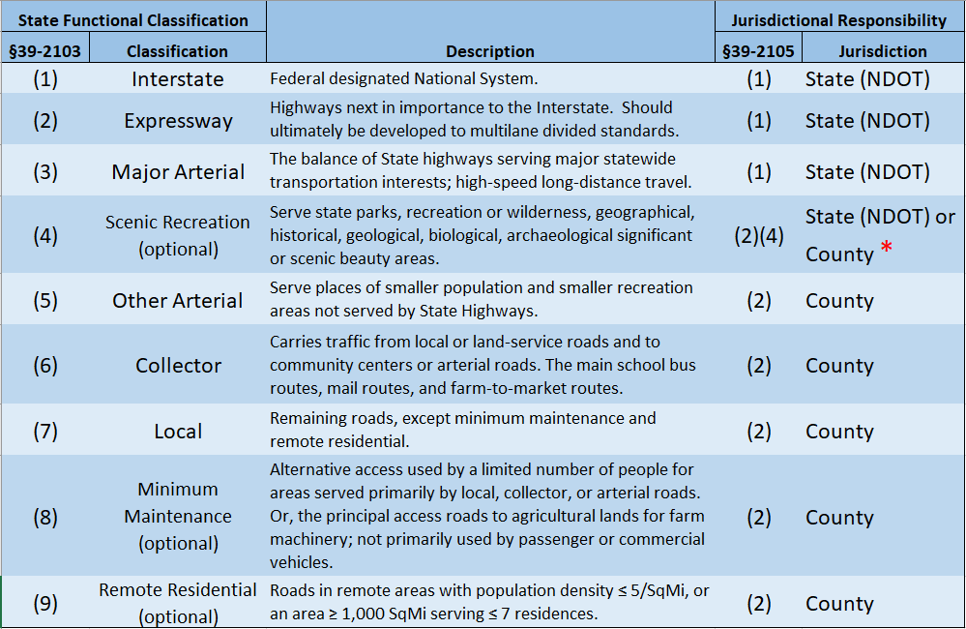
State Rural Functional Classification – Scenic-Recreation
428 NAC 1 pages 14 - 17
Scenic-Recreation possible State Functional Classifications:
Scenic-Recreation Major Arterial
Scenic-Recreation Other Arterial
Scenic-Recreation Collector
Scenic-Recreation Local
§39-2113(2)
  * Remains with government subdivision responsible before change in classification
Slide 32
Notes:
8/6/2019 Updated changed NDOR to NDOT on slide.
It is the only classification that goes with another classification.
What that means is that any rural highway or road, which already has a State Functional Classification of Major Arterial, Other Minor Arterial, Collector or Local, may also be classified as Scenic-Recreation. Roads with a state functional classification of Interstate or Expressway are not eligible for the Scenic-Recreation classification.
This screen lists all of the possible Scenic-Recreation state functional classifications. There are four possibilities. Scenic-Recreation Major Arterial, Scenic-Recreation Other Minor Arterial, Scenic-Recreation Collector, and Scenic-Recreation Local. Refer to Title 428 NAC Chapter 1 pages 14-17 for the criteria for each of these classifications.
Referring to the footnote at the bottom of the screen, the jurisdictional responsibility of all scenic-recreation roads and highways shall remain with the governmental subdivision which had jurisdictional responsibility for such road or highway prior to its change in classification to scenic-recreation [ NOT FOR AUDIO: made pursuant to this section and sections 39-2103, 39-2109, and 39-2113].
The Scenic-Recreation classification can be thought of as an added layer of classification, on top of the road’s required functional classification.
Referring to State Statute 39-2113(2).
The purpose of this classification is to allow less restrictive and more flexible design standards, and to minimize environmental disruption.

Slide 33
Scenic-Recreation in the Design Standards
Organized by National Functional Classification – just like Urban and Rural
NFC:
  Scenic-Recreation Major Arterial
  Scenic-Recreation Minor Arterial
  Scenic-Recreation Major Collector
  Scenic-Recreation Minor Collector
  Scenic-Recreation Local
State Highway Design Standards
428 NAC 2-001.02
County Roads Design Standards
428 NAC 2-001.03
Tables K - N
428 NAC 2-001.03K thru N, Pages 71-78
Slide 33
Notes:
8/5/2019 Updated change NDOR to State in the script (the audio media already had “State”)
As explained in the FC Basics video, because there is not a direct correlation between the State FC system and the NF classification system,
Instead of coupling the optional Scenic-Recreation classification with its required State FC,
County Roads design standards couple the optional state Scenic-Recreation designation with the National FC of the road.
There are five possible combinations:
READ THEM
Scenic-Recreation Major Arterial: recall that Major Arterial is a FC assigned to the NDOR State, so design standards are covered in State Highway Design Standards, in subsection 02, page 18 for N&R work and page 29 for 3R work.
The other four are covered in subsection 03, pages 71-78 of the County Roads standards:
Scenic-Recreation Minor Arterial
Scenic-Recreation Major Collector
Scenic-Recreation Minor Arterial
Scenic-Recreation Local
The four Scenic-Recreation tables, K – N on pages 71-78, are therefore organized by the road’s National Functional Classification,
Thus, finding the Scenic-Recreation table that applies to a work or project is similar to what was demonstrated earlier in this video for the Urban Area and Rural Area tables.
However, a necessary additional step, unless you are certain that the road has the Scenic-Recreation classification, is to check the “State Functional Classification Maps by County.”

Slide 34
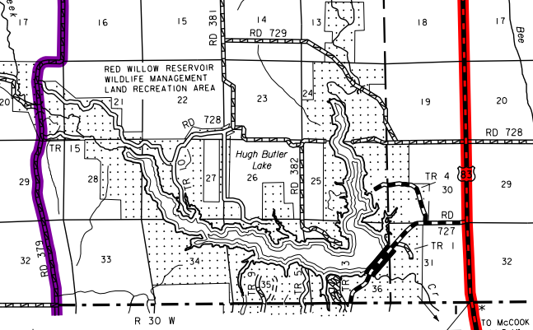
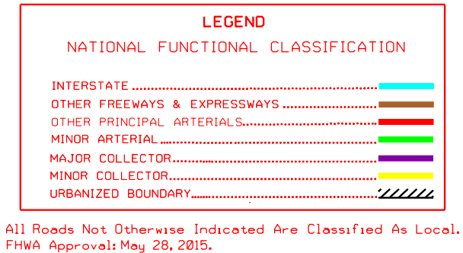
Example
Frontier County
https://dot.nebraska.gov/media/8683/cfuncfrontiernfc.pdf
Slide 34
Notes:
8/5/2019 Updated web link to https:// and changed out the Legend and map because NDOT updated the legend. One Audio media re-do.
This screen shows an example.
On NDOR’s Nebr DOT’s online Map Library, click on “State and National Functional Classification Maps by County.”
Go to Frontier County and click on the “National” map.
This screen shows the southwestern part of the National Functional Classification Map (verify this just below the word “Legend”).
The road on the north east side of Hugh Butler Lake has a National Functional Classification of Local.
Refer to the bottom of the Legend which indicates that “All Roads Not Otherwise Indicated Are Classified as Local”.
There is no indication on the National FC map that the road is also classified as Scenic-Recreation, and there will never be, because it is a functional classification allowed in Nebraska law, not in Federal law.
In order to find out if the road has the optional Scenic-Recreation classification, and get you to the design standards table that applies to the road,
you also need to check the county’s State Functional Classification map.

Slide 35
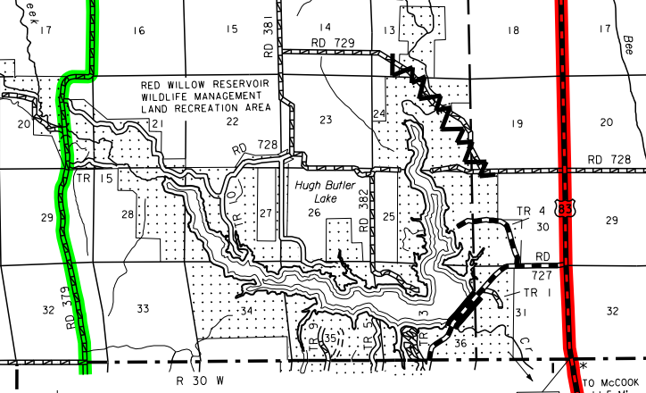
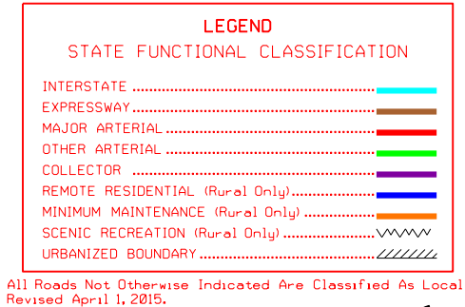
Scenic-Recreation - Example
Frontier County
https://dot.nebraska.gov/media/5195/cfuncfrontiersfc.pdf
Slide 35
Notes:
8/5/2019 Updated web link to https:// and changed out the Legend and map because NDOT updated the legend. One audio media re-do.
On NDOR’s Nebr DOT’s online Map Library, click on “State and National Functional Classification Maps by County.”
Go to Frontier County and click on the “State” map.
If there is a road designated Scenic-Recreation in this county, the State functional classification map legend will include a special symbol for this classification.
If there are no roads classified as Scenic-Recreation in the county, there will not be a special symbol included in the legend.
This screen shows an example. This is the southwestern part of Frontier County.
The symbol on the map indicates that part of the road on the north east side of Hugh Butler Lake has a State Functional Classification of Scenic-Recreation.
To summarize,
Find the road’s NFC on the county’s NFC map,
If you don’t know, or need to verify, that the road also has the S-R FC,
Find the road’s SFC on the county’s SFC map.

Slide 36
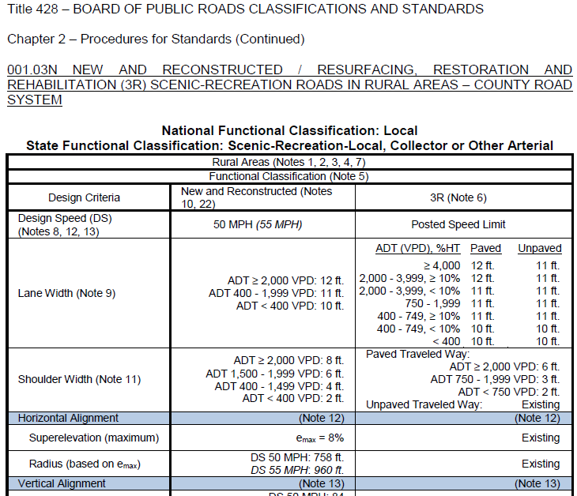
Minimum Design Standards
428 NAC 2-001.03N, Pages 77-78
§39-2113(2)
Slide 36
Notes:
For this segment, knowing that the National Functional Classification is Local, and the road also is classified as Scenic-Recreation, you can then find the table that would apply to a work or project on this segment of road on pages 77 and 78 of the MDS.
The Scenic-Recreation classification and standards allow less restrictive standards as reflected in the tables on pages 71-78.
As required in state statute 39-2113(2).
Knowing your road system has advantages – in this case, that less restrictive standards apply.
If you compare this table, Table N, to Table J, Rural Areas Local, pages 69-70,
you will see that Scenic-Recreation Roads are allowed a lesser shoulder width for very-low-volume traffic levels, and a horizontal clear zone that is not as wide.

Slide 37
2016 Design Standards
15 Tables
Minimum Design Standards
Which table is most appropriate for my road or street work?
4 – Urban Areas
4 – Rural Areas
4 – Scenic-Recreation
1 – Low Water Stream Crossings and Fords
1 – Minimum Maintenance Roads
1 – Remote Residential Roads
Slide 37
428 NAC 2-001.03, C thru N, Pages 55-78
Notes:
This video has covered the first 12 design standards tables.
Most of the mileage on the county road and municipal street system in Nebraska are covered by the first 8 tables –
the 4 Urban Area and 4 Rural Area tables.
Finding the correct Scenic-Recreation table is a process similar to finding one of the Urban Area or Rural Area tables, with the exception that you need to find or confirm the Scenic-Recreation classification on the applicable State Functional Classification county map.

Slide 38
2016 Design Standards
15 Tables
Minimum Design Standards
Which table is most appropriate for my road or street work?
4 – Urban Areas
4 – Rural Areas
4 – Scenic-Recreation
1 – Low Water Stream Crossings and Fords
1 – Minimum Maintenance Roads
1 – Remote Residential Roads
Slide 38
428 NAC 2-001.03 Pages 79-86
Notes:
Let’s take a closer look at the other three design standards tables.
These apply only to County Roads, i.e. roads outside the corporate limits of villages and cities.

Slide 39
The Other Three (3) Tables
Minimum Design Standards
Low-Water Stream Crossings and Fords, Table 03O, pages 79-80
Minimum Maintenance, Table 03P, pages 81-85
Remote Residential, Table 03Q, page 86
Slide 39
428 NAC 2-001.03, Tables, Pages 79-86
Notes:
The other three tables begin on page 79 and end on page 86.
When you look at these, you will realize that they are a different format than the preceding twelve tables. There are not as many design criteria and the presence of signage requirements make them very different from the other tables.
Low-Water Stream Crossings and Fords is the only table that is not a functional classification. However, it needs its own table in order to establish minimum standards requirements.
Minimum Maintenance and Remote Residential are two of the optional state functional classifications. If you have a road with either of these classifications, the applicable minimum standards would be either Table P or Q depending on its functional classification - Minimum Maintenance or Remote Residential.
For that same road, a relaxation of standards request is not required if the county chooses to meet or exceed the minimum design standards for National Functional Classification Local, which is Table J in subsection 03 on pages 69-70.
Low-water stream crossings or fords always need a relaxation of standards request from the NBCS prior to construction.

Slide 40
2016 Design Standards
15 Tables
Minimum Design Standards
Which table is most appropriate for my road or street work?
4 – Urban Areas
4 – Rural Areas
4 – Scenic-Recreation
1 – Low Water Stream Crossings and Fords
1 – Minimum Maintenance Roads
1 – Remote Residential Roads
Slide 40
428 NAC 2-001.03P Pages 81-85
Notes:
Skipping over Low Water Stream Crossings and Fords momentarily.
Minimum Maintenance is an optional state functional classification.
You will not find these roads color coded on National FC maps.
These need to be verified on the State Functional Classification Maps by County,
that the State functional classification of a road is Minimum Maintenance.

Slide 41
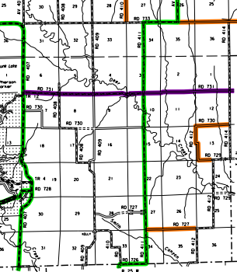
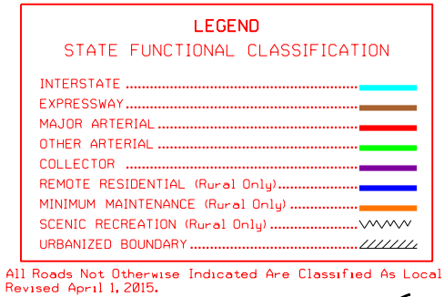
Example
Minimum Maintenance Roads
Frontier County
https://dot.nebraska.gov/media/5195/cfuncfrontiersfc.pdf
Slide 41
Notes:
8/5/2019 Updated – map and legend, and web link, and one audio media
This screen shows an example.
On NDOR’s NDOT’s online Map Library, click on “State and National Functional Classification Maps by County.”
Find Frontier County and click on the “State” map.
This screen shows the southeastern part of the State Functional Classification Map (verify this just below the word “Legend”).
Several county roads in this corner of the county have the State functional classification of Minimum Maintenance.
Building a work or project to Minimum Maintenance Standards, [Table P on pages 81-85], requires a Relaxation of Standards request to the NBCS prior to construction.
If you check the National Functional Classification map for Frontier County, you would see there are no color markings on these roads.
Which indicates that the road has a NFC of Local.
The County can elect to build the work or project to those standards – i.e. Rural Areas NFC Local which is Table J on pages 69-70.
By doing so, the County can avoid requesting a relaxation of standards for the work or project.
You might see in the National FC map in the legend that these roads are marked as “Unimproved Roads”
However, for verification you should always check the State FC map.

Slide 42
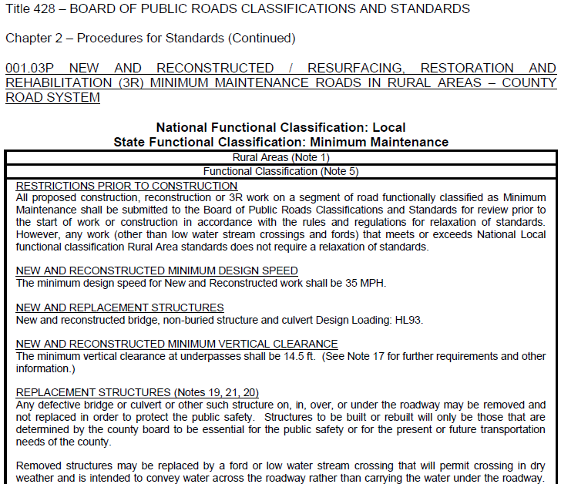
Minimum Design Standards
428 NAC 2-001.03P Pages 81-85
§39-2113(3)
Slide 42
Notes:
After determining that the State Functional classification is Minimum Maintenance,
You know the minimum design standards for the work or project on that road is in Table P on pages 81-85.
Minimum Maintenance Roads have fewer minimum design standards criteria than the first 12 design tables
and also allows defective bridges and structures, which are on, in, over or under the roadway, to be removed and not replaced, or to be replaced with a Low Water Stream Crossing or Ford,
in accordance with state statute 39-2113(3).

Slide 43
2016 Design Standards
15 Tables
Minimum Design Standards
Which table is most appropriate for my road or street work?
4 – Urban Areas
4 – Rural Areas
4 – Scenic-Recreation
1 – Low Water Stream Crossings and Fords
1 – Minimum Maintenance Roads
1 – Remote Residential Roads
Slide 43
428 NAC 2-001.03 Page 86
Notes:
Remote Residential is an optional state functional classification.
You will not find these roads color coded on National FC maps.
You need to verify, on the State Functional Classification Maps by County,
that the State functional classification of a road is Remote Residential.

Slide 44
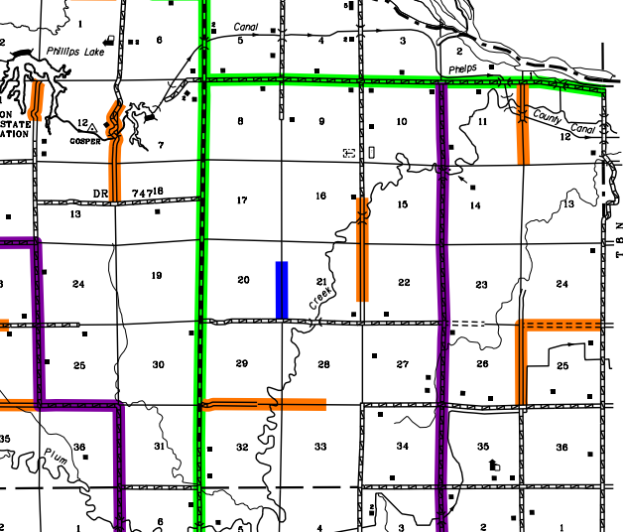
Example
Remote Residential Road
Gosper County
https://dot.nebraska.gov/media/5201/cfuncgospersfc.pdf
Slide 44
Notes:
8/5/2019 Updated – map and legend, and web link, and one audio media
This screen shows an example.
On NDOR’s NDOT’s online Map Library, click on “State and National Functional Classification Maps by County.”
Find Gosper County and select the “State” map.
This screen shows the northeastern part of the State Functional Classification Map for Gosper county (verify that it’s the State FC map just below the word “Legend”).
Building a work or project to Remote Residential Standards, i.e. Table Q on page 86, requires a Relaxation of Standards request to the NBCS prior to construction.
If you check the National Functional Classification map for Gosper County, there is no color marking on this road.
This would indicate that the road has a NFC of Local.
The County can elect to build the work or project to those standards – i.e. Rural Areas NFC Local which is Table J on pages 69-70.
By doing so, the County can avoid requesting a relaxation of standards for the work or project.
You might see in the National FC map in the legend that these roads are marked as “Unimproved Roads”
However, for verification you should always check the State FC map.
NOT FOR AUDIO
[At the time this video is being made – December, 2016 – this is the only stretch of road classified as Remote Residential not only in Gosper County but in all of Nebraska.]

Slide 45
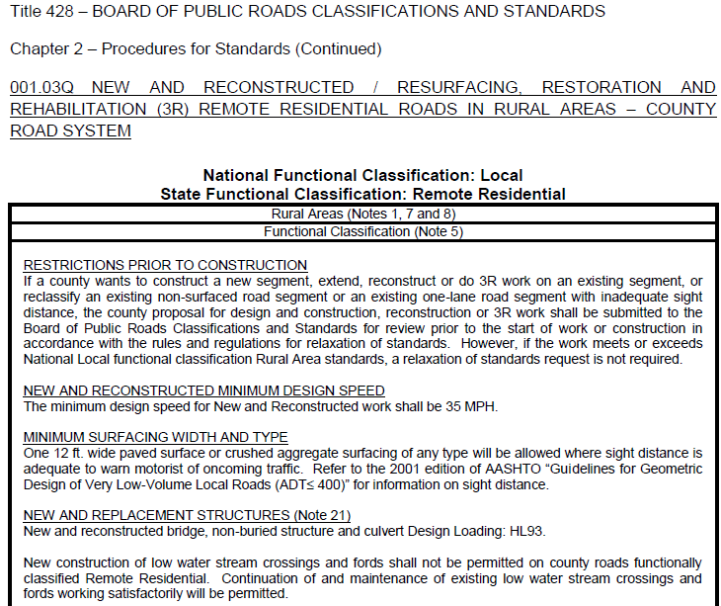
Minimum Design Standards
428 NAC 2-001.03Q Page 86
§39-2113(4)
Slide 45
Notes:
After determining that the State Functional classification is Remote Residential,
You know the minimum design standards for the work or project on that road is Table Q on page 86.
Remote Residential Roads have fewer minimum design standards criteria than the first 12 design tables
and are allowed to have one lane of 12 ft wide paved surface or crushed aggregate surfacing of any type where there is adequate sight distance.
in accordance with state statute 39-2113(4).
New Low Water Stream Crossings and Fords are not allowed to be constructed on Remote Residential roads.

Slide 46
2016 Design Standards
15 Tables
Minimum Design Standards
Which table is most appropriate for my road or street work?
4 – Urban Areas
4 – Rural Areas
4 – Scenic-Recreation
1 – Low Water Stream Crossings and Fords
1 – Minimum Maintenance Roads
1 – Remote Residential Roads
Slide 46
428 NAC 2-001.03O Pages 79-80
Notes:
If the county proposes to construct a Low Water Stream Crossing or Ford, Table “O” on pages 79-80 applies to only the work on the low water stream crossing or ford.
Design standards apply to Low Water Stream Crossings and Fords only on county roads (i.e. outside of corporate limits) with a State functional classification of Local or Minimum Maintenance.
A Low Water Stream Crossing or Ford may be constructed only after submitting the proposed work to the NBCS in accordance with the relaxation of standards Rule 428 NAC 2-004.

Slide 47
Example
Low Water Stream Crossings and Fords
Frontier County
https://dot.nebraska.gov/media/5195/cfuncfrontiersfc.pdf
Slide 47
Notes:
8/5/2019 Updated – map and legend, and web link
This screen shows an example.
You need to verify, if you don’t already know, on the State Functional Classification Maps by County, that the State functional classification of the road is Local or Minimum Maintenance.
New Low Water Stream Crossings and Fords are not allowed on any roads with a State functional classification of Other Arterial, Collector, Remote Residential or Scenic-Recreation.
This screen shows an example.
It is the southeastern part of the State Functional Classification Map for Frontier County.
Several county roads in this corner of the county have the State functional classification of Minimum Maintenance, as indicated by the arrows.
Any road that is not colored has a State Functional Classification of Local.
Before requesting a relaxation of standards, verify that the road has an Average Daily Traffic volume (ADT) fewer than 50 VPD, and that it is not the only access to an occupied dwelling.

Slide 48
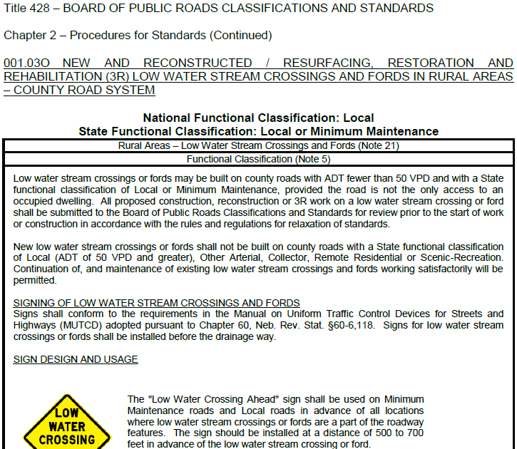
Minimum Design Standards
Slide 48
428 NAC 2-001.03O Pages 79-80
Notes:
Once a tentative decision is made to construct a Low Water Stream Crossing or Ford,
You know the minimum design standards for the work or project to construct the Low Water Stream Crossing or Ford is in Table O on pages 79-80.
If there is work or a project on either side of the low-water stream crossing or ford,
it would be covered by either
Table J on pages 69-70, Rural Areas with a Functional Classification of Local,
or Table P on pages 81-86, which covers roads with a SFC of Minimum Maintenance.
For more information on Low Water Stream Crossings and Fords, see the Bridges and Structures video, Part 2.

Slide 49
Other Principal Arterial (OPA)
Note 4
Use Applicable State Highway Standards
428 NAC 2-001.02 (Pages 5-34)
Other Principal Arterial
Minor Arterial
Major Collector
Minor Collector
Local
428 NAC 2-001.03
(Pages 35-86)
428 NAC 2-001.03B Note 4, Page 47
428 NAC 2-001.02, Pages 5-34
Slide 49
Notes:
Most roads with a NFC of Other Principal Arterial are on the State Highway System.
There are a few miles of Other Principal Arterials on the County Road and Municipal Street System.
The County or Municipality is responsible for those.
According to Note 4 on page 47, Any highway, road or street with an NFC of Other Principal Arterial
is required to use State Highway design standards, which are in subsection 02 (pages 5-34)
Any highway, road or street on the National Highway System is required to use State Highway standards.
Most of the OPA highways, roads and streets are on the NHS.
As discussed throughout this video, subsection 03 covers the county road and municipal street system

Slide 50
2016 Design Standards
Tables
Minimum Design Standards
Functional Classification Maps
National*
National*
National and State
State
State
State
4 – Urban Areas
4 – Rural Areas
4 – Scenic-Recreation
1 – L-W Stream Xings and Fords
1 – Minimum Maintenance Roads
1 – Remote Residential Roads
* Cities Within Counties maps show Urban Area boundaries
Slide 50
428 NAC 2-001.03 Pages 55-86
Notes:
8/5/2019 Updated change NDOR’s to NDOT’s in audio media
To summarize, this video provided guidance on the process for finding the design standards table that applies to a work or project on any given segment of county road or municipal street
There are 15 tables in subsection 003 for county roads and municipal streets.
In order to find the table that applies to a work or project on any particular county road or municipal street:
It is a matter of determining
If Urban Area standards or Rural Area standards apply.
And the National Functional Classification of the road or street.
This works for most county roads and municipal streets because most of the mileage on Nebraska’s county road system, and all of the mileage on municipal street system, are covered by the first 8 tables – Urban Areas and Rural Areas
Notes 2 and 3 on page 47 of the design standards need to be accounted for when making the decision to apply either Urban Area standards or Rural Area standards
Maps found online in NDOR’s Nebr DOT’s Map Library are available to help determine Urban Area boundaries and functional classifications of any road or street.
The National Functional Classification (NFC) maps for Cities Within Counties, help determine if a road is within an Urban Area, or outside of the Urban Area boundary in the Rural Area. Urban areas, by definition, are only in and around Cities of the First Class, Lincoln, and Omaha.
The remaining 7 tables cover some county roads, i.e. roads outside of corporate limits of villages and cities, that have any of the optional state functional classifications or involve construction of a Low Water Stream Crossing or Ford.
The Scenic-Recreation classification can be thought of as an added layer of classification, on top of the road’s required functional classification.
In the design standards, the Scenic-Recreation classification goes with any one of several National Functional Classifications.
Finding the table that applies to a work or project with a Scenic-Recreation classification is similar to the process for Urban Area and Rural Area standards, and also involves confirming the Scenic-Recreation classification on the county’s State FC (SFC) map.
Low Water Stream crossings and Fords are only allowed on certain county roads – those with a State Functional Classification of Local or Minimum Maintenance, with an ADT < 50 VPD and where the road is not the only access to an occupied dwelling.
Again, this involves confirming the functional classification on the county’s State FC map.
As it also does for roads with optional State FC’s Minimum Maintenance and Remote Residential.

Slide 51
2016 Standards
Video 05
Finding the Correct MDS Table
Nebraska Administrative Code
Title 428
Rules and Regulations of the
Board of Public Roads Classifications and Standards
(Administrative Host: Nebraska Department of Transportation)
County Roads and Municipal Streets
Neb. Rev. Stat. 39-2113
https://dot.nebraska.gov/media/5593/nac-428-rules-regs-nbcs.pdf
Boards - Liaison Services Section
8/8/2019
Notes:
This is one of a series of videos on Nebraska’s system of
Classifying and applying standards to its highways, roads and streets.

