Slide 1
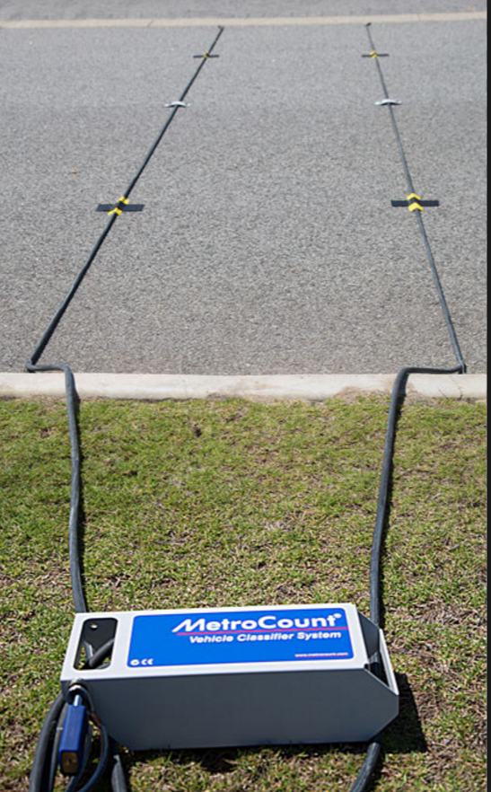
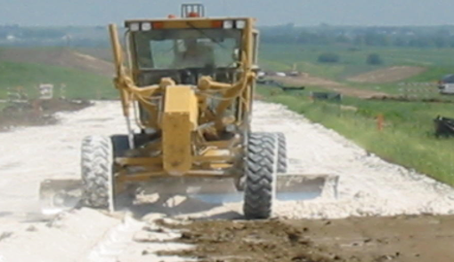
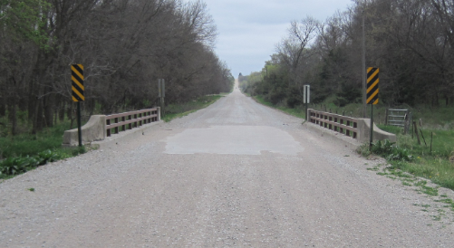
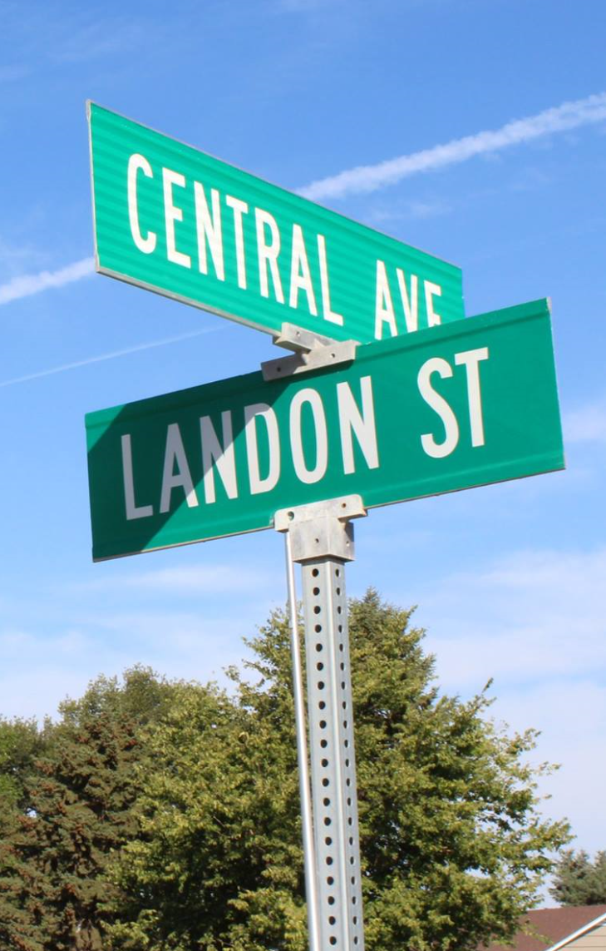
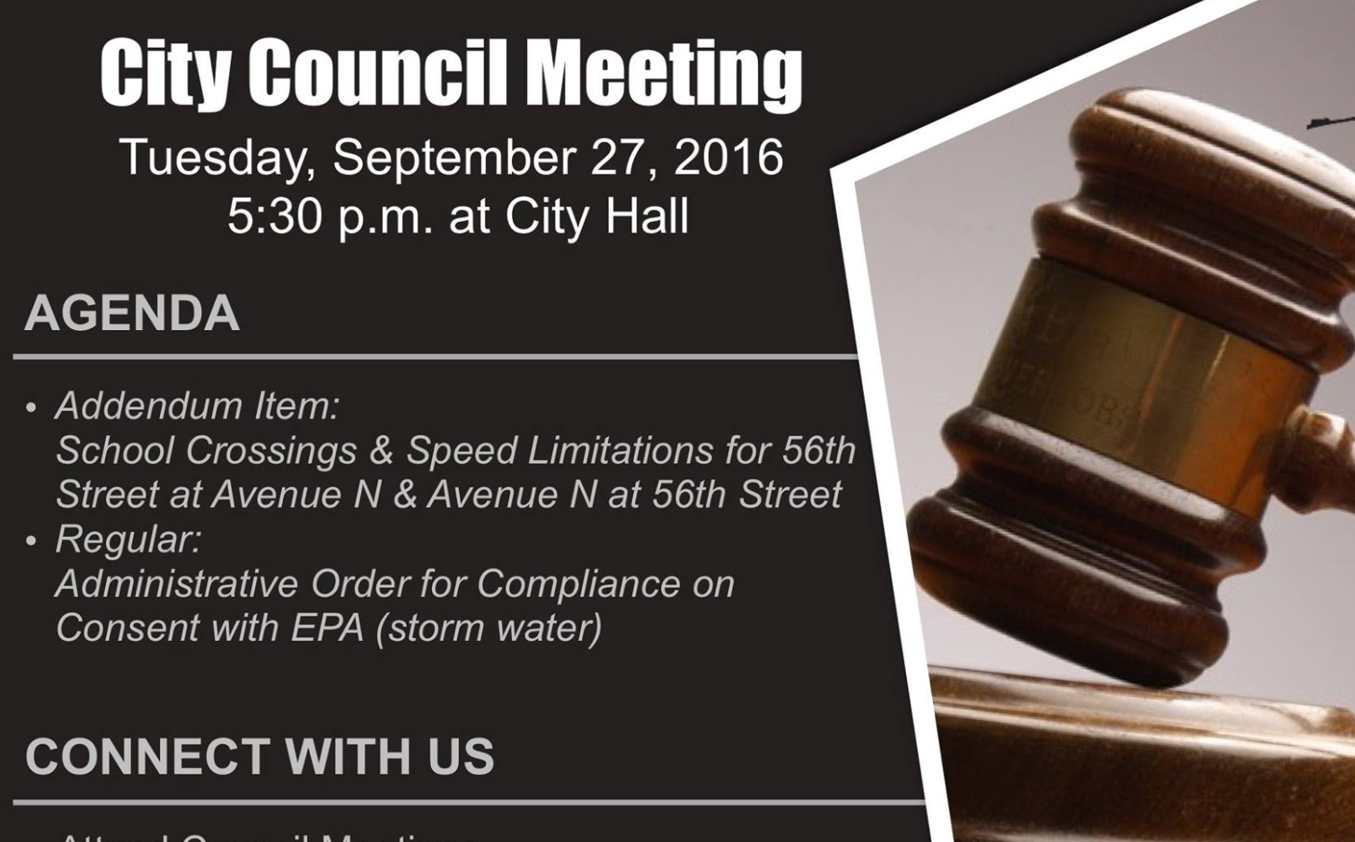
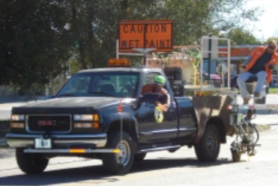

Managing Nebraska’s
Public Roads and Streets
The Basics of
Functional Classification
428 NAC 1, §39-2113
Boards - Liaison Services Section
https://dot.nebraska.gov/business-center/lpa/boards-liaison/training/
8/6/2019
Video B02
Notes:
8/6/2019 Updated – slides 13-16 corrected Rural Fct Class tables Scenic Rec Rd statute reference should be (2)(4) not (3).
8/4/2019 Updated with changes per LB82 (2019). The previous version was dated 12/21/2017. Slides 5 and 6 (from the 12/21/2017 version) are deleted (showed 428 NAC organization, which is only two chapters now, effectively, because of LB82). Web links on 13 slides are updated: the first and last slides, and slides 25, 27 thru 30, 38, 39, 42, 46, 47 and 53. Contact information for NDOT Roadway Asset Management on Slides 27 and 55 (now Slides 25 and 53) is updated.
8/5/2019 Updated with QC changes to 13 slides. Slide 11 (NDOR→NDOT), Slide 12 “Blue Sheet in Notebook” at top of slide removed (it’s an old reference to the 3-ring binder), Slides 13 thru 16 (NDOR→NDOT), Slide 24 updated Board’s help email address, Slides 26 and 35 thru 37 and 40 and 41 updated web link (http→https). Also modified slides 25 and 53 with titles only (no names) and the section phone number instead of individual phone numbers.
This is one of a series of videos on Nebraska’s system of
Classifying and applying standards to its highways, roads and streets.
This video introduces basic information about
Nebraska’s functional classification system, and
The National Functional Classification system.
There is also discussion about jurisdictional responsibility for highways, roads and streets in Nebraska.

Slide 2
Terminology and Acronyms used in this video
NBCS = Nebraska Board of Public Roads Classifications and Standards = “The Board” = “The Board of Public Roads”
NDOT = Nebraska Department of Transportation
Standards vs. Minimum Design Standards (MDS)
Neb. Rev. Stat. = Nebraska Revised Statutes
NAC = Nebraska Administrative Code
Highways = Roads = Streets (§39-101(3), §60-624)
3R = Resurfacing, Restoration and Rehabilitation
FC = Functional Classification
CFR = Code of Federal Regulations
AASHTO = American Association of State Highway Transportation Officials
Notes:
First, some terminology and acronyms . . .
NBCS is the Nebraska Board of Public Roads Classifications and Standards; it may also be called the Board of Public Roads, or just The Board.
NDOT is the Nebraska Department of Transportation
Standards refers to the NBCS standards, including design, construction, maintenance and relaxation of standards. MDS refers to the Minimum Design Standards, which address only the design aspect of a work or project. Standards are often termed “minimum” but realize there are maximums (for superelevation, grade) and ranges ( for cross slopes). When we say “minimum” – sometimes it refers to all of those.
Neb. Rev. Stat. refers to the Nebraska Revised Statutes
NAC is the Nebraska Administrative Code. These are regulations, that have the force of law.
The word “Highway” in Nebraska law also refers to roads and streets. Highway means the entire width between the boundary limits of any street, road, avenue, boulevard, or way which is publicly maintained when any part is open to the use of the public for purposes of vehicular travel.
3R is short for resurfacing, restoration and rehabilitation. For more details, see the video dedicated to 3R.
FC is Functional Classification.
CFR is the acronym for the Code of Federal Regulations.

Slide 3
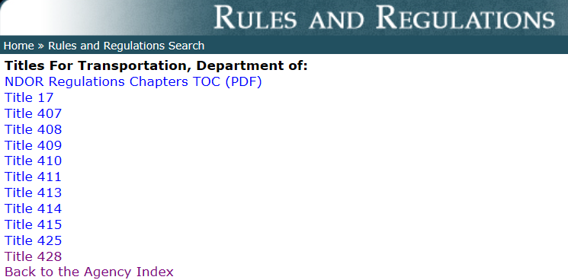
Title 428
NBCS Regulations
http://www.sos.ne.gov/rules-and-regs/regsearch/Rules/index.cgi?l=Transportation_Dept_of&t=Title-428
Notes:
NBCS rules and regulations in Title 428 can be found on the Secretary of State’s website, listed under the Department of Transportation.

Slide 4
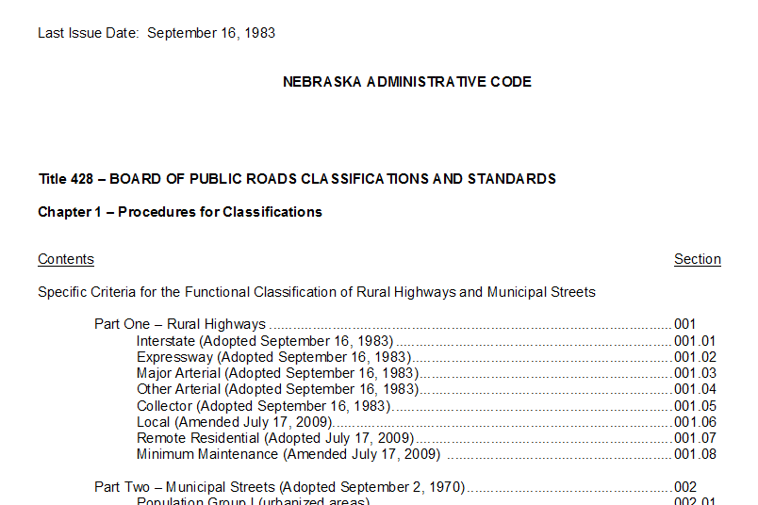
Title 428 Chapter 1
http://www.sos.ne.gov/rules-and-regs/regsearch/Rules/Transportation_Dept_of/Title-428/Chapter-1.pdf
Notes:
Title 428 NAC Chapter 1 can be accessed at the web link shown on this screen.
It can also be accessed on the Dept of Transportation’s website, under “Business Center” Local Public Agencies “Boards-Liaison Services”, and then clicking on the “Downloadable Documents” link.

Slide 5


Chapter 39 Article 21
§39-2101 Provides
“The Big Picture”
State Law
In 1969, Nebraska Legislature declared the importance of:
Safe and efficient transportation over public roads
  An integrated system of public roads
  Adequate Public Roads
Slide 5
Notes:
State Statute 39-2101 is a declaration that provides a broad overview, or the Big Picture view of 1969 legislation, which was a significant change in Nebraska’s approach to its system of highways, roads and streets. The Nebraska Legislature recognized, determined and declared that
Safe and efficient transportation over public roads is a matter of major importance to all Nebraskans
An integrated system of public roads is essential to the general welfare of the State
Adequate Public Roads
- Provide for the free flow of traffic
Protect the health and safety of the citizens of the state,
result in lower cost of motor vehicle operation
- Increase property values
- Generally promote the economic and social progress of the state

Slide 6
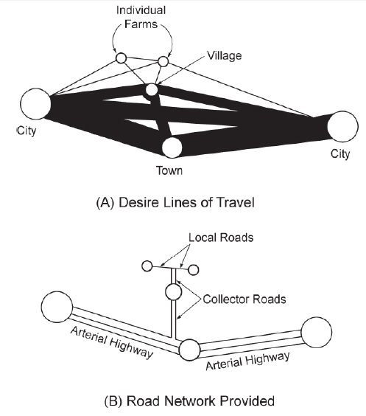
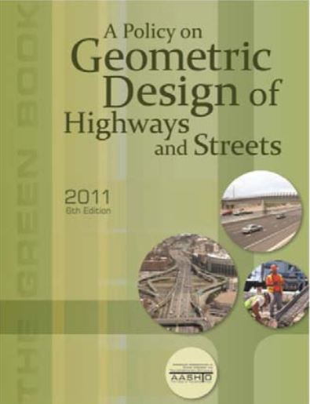
Integrated System of Roads
A Policy on Geometric Design of Highways and Streets, Figure 1-2, AASHTO “Green Book”
Slide 6
Notes:
This concept of an integrated system of roads shown here is taken from
AASHTO’s A Policy on Geometric Design of Highways and Streets, also known as The Green Book, 6th Edition, 2011.
The schematic illustration shows desire lines of travel, with the circles representing trip origins and destinations, and line thickness representing relative amounts of travel desire. The sizes of the circles indicate the relative trip-generating and attracting power of the places shown. The thicker lines represent more desire (or volume), as between cities and towns, and the smaller lines represent less desire, as between farms and villages.
Because it is impractical to provide direct-line connections for every desire line, trips should be channelized on a limited road network in the manner shown in the bottom schematic illustration.
Heavy travel movements are served directly or nearly so, and the smaller movements are channeled into
somewhat indirect paths.
The facilities in the illustration are labeled local access, collector, and arterial, which are terms that describe their functional relationships. In this scheme, the functional hierarchy is also seen to be related to the hierarchy of trip
distances served by the network.

Slide 7
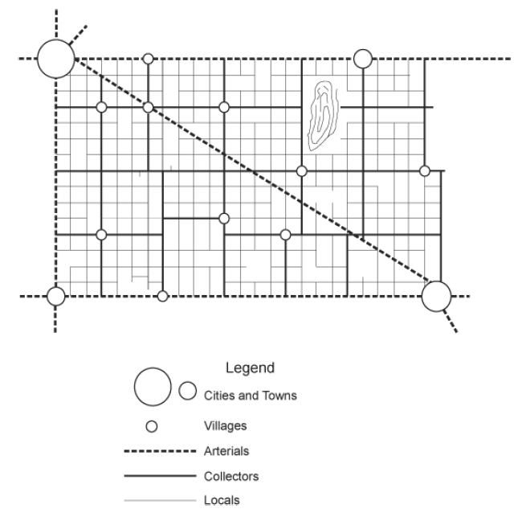
Integrated System of Roads
Rural
A Policy on Geometric Design of Highways and Streets, Figure 1-3, AASHTO “Green Book”
Slide 7
Notes:
A more complete illustration of a functionally classified rural network is shown in this figure,
Which is also taken from The Green Book.
Arterial highways generally provide direct service between cities and larger towns that generate and attract a large proportion of the relatively longer trips.
Roads of the intermediate functional category (collectors) serve small towns directly, connecting them to the arterial network.
Roads of this category collect traffic from the local roads serving individual farms and other rural land uses or distribute traffic to these local roads from the arterials.

Slide 8
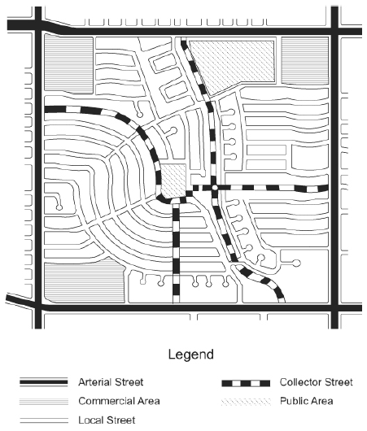
Integrated System of Roads
Slide 8
Urban/Suburban
A Policy on Geometric Design of Highways and Streets, Figure 1-4, AASHTO “Green Book”
Notes:
The previous screen had a rural setting. The same basic concepts apply in urban and suburban areas, and a similar hierarchy of systems can be defined. This screen shows a schematic illustration of a functionally classified suburban street network.
Because of the high intensity of land use and travel in urban and suburban areas, specific travel-generation centers are more difficult to identify. In these areas, additional considerations, such as the spacing of intersections, become more important in defining a logical and efficient network.

Slide 9
§39-2101
“The Big Picture”
State Law
Establish a system of functional classification
Each segment of public road identified according to the function it serves
Identification by function will permit the establishment of uniform standards for each classification:
  - Design
  - Construction
  - Maintenance
Slide 9
Notes:
Fundamental to the development of an integrated system of public roads is a determination of the function that each road segment serves. That is how this video fits into the big picture.
Through adoption by law of a functional classification system, it is the intent of the Legislature that each segment of public road shall be identified according to the function it serves
That permits the establishment of uniform standards for design, construction and maintenance.
NOT FOR AUDIO
Identifying functional classifications permits the establishment of uniform standards for:
- Design
- Construction
- Maintenance
This is where the videos on the Standards fits in the big picture.

Slide 10
§39-2102 State
Functional Classification
State Law
http://www.nebraskalegislature.gov/laws/browse-chapters.php?chapter=39
Two (2) separate categories identified for the purpose of Classification:
  Municipal Streets
    Public streets within the limits of any incorporated municipality
  Rural Highways
    Public highways and roads outside the limits of any incorporated municipality
Slide 10
Notes:
For the purposes of functional classification, State Statute 39-2102 creates two broad categories: rural highways and municipal streets.
Note the word “public” - not all roads are public.
Examples: Internal cemetery & park roads that are not open to traffic 24 hours a day. Roads in Sanitary Improvement Districts, and roads and streets that have blue street name signs are not public.
NOT FOR AUDIO
39-2102. Functional classification; categories. For purposes of functional classification thereof, the public highways, roads, and streets of this state are hereby divided into the two broad categories of rural highways and municipal streets. Rural highways shall consist of all public highways and roads outside the limits of any incorporated municipality and municipal streets shall consist of all public streets within the limits of any incorporated municipality. (Emphasis added)
Section 39-2102. Functional classification; categories. For purposes of functional classification thereof, the public highways, roads, and streets of this state are hereby divided into the two broad categories of rural highways and municipal streets. Rural highways shall consist of all public highways and roads outside the limits of any incorporated municipality and municipal streets shall consist of all public streets within the limits of any incorporated municipality. (Emphasis added)
Source: Laws 1969, c. 312, § 2, p. 1119
From FHWA’s Highway Functional Classification Concepts, Criteria and Procedures, Section 3.2, Page 19 (for a complete comparison of urban vs. rural, see pages 15-19):
When comparing urban and rural areas, perhaps the most relevant characteristic is the density of the roadway network. Even with a cursory view of a map of an urban area’s roadway network, the functional classification of many roadways can be discerned due the differences in roadway size. In contrast, the functional classification of the roadway network in many rural areas is less readily apparent, primarily due to the relatively inconsistent roadway spacing.
Nevertheless, functional classifications should be assigned based on actual functional criteria, rather than the location of the roadway within an urban or rural context.

Slide 11
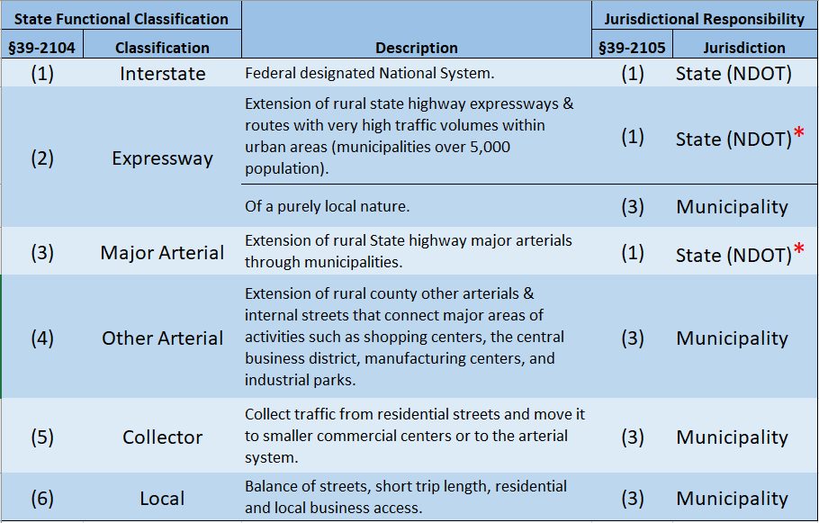
State Municipal Functional Classifications (6)
428 NAC 1 pages 10-12
Mobility
Access
  * Exception: Municipality is responsible for that portion that exceeds the design of the rural highway that leads into the municipality (next slide)
Slide 11
Notes:
8/5/2019 Updated instances of NDOR→NDOT in the slide, no audio media changes
This screen summarizes the six Nebraska Municipal functional classifications in State Statute 39-2104 and starting on page 10 of Title 428 NAC Chapter 1.
The six classifications are Interstate, Expressway, Major Arterial, Other Arterial, Collector and Local. A short description is shown for each on this screen.
The entity responsible – the State or the Municipality - for each classification within corporate limits is also listed; state statute 39-2105 assigns these responsibilities. The State is responsible for all Interstate, for all Expressway except for those of a purely local nature, and for Major Arterial.
The exception in the footnote at the bottom of the screen will be explained on the next screen.
In this system of classification . . .
there is a tradeoff between mobility and access. The Interstate system is high-speed, with relatively few access points, providing excellent mobility. Expressways typically have a lesser speed limit; some allow at-grade accesses at certain intervals, and therefore don’t have as much mobility relative to an Interstate.
Skipping down to the Local classification, a street may have many driveways, providing frequent access, and traffic moves slower.
Thus, mobility increases going up the list, and access increases going down the list.
NOT FOR AUDIO
DORI 60-11, July 2005, Page F-15, Municipal Cost Sharing (non-Interstate projects), Projects determined by NDOT to be economic development projects are negotiated on a case-by-case basis.
Section 4 – Municipalities with a Population of 5,000 or less. Generally, no financial participation is required. Constructing parking areas at the request of the Municipality is paid 100% by the Municipality. Federal-aid Safety projects off the State Highway System requires 20% matching funds from the Municipality. On 3R projects, if Municipality requests reconstruction of sidewalks, it pays 100% of sidewalks, but the NDOT pays for ADA ramps and blending back to the sidewalk.
Section 5 – Municipalities with a Population over 5,000. May require participation. Depends on the number of thru traffic lanes. No cost if only two thru traffic lanes. 20% if there are four thru traffic lanes. And more if there are more than four thru traffic lanes.
39-2104. Municipal streets; functional classifications.
Municipal streets are hereby divided into six functional classifications as follows:
(1) Interstate, which shall consist of the federally designated national system of interstate and defense highways;
(2) Expressway, which shall consist of two categories: Extensions of rural expressways and some additional routes which serve very high volumes of local traffic within urban areas;
(3) Major arterial, which shall generally consist of extensions of the rural major arterials which provide continuous service through municipalities for long-distance rural travel. They are the arterial streets used to transport products into and out of municipalities;
(4) Other arterial, which shall consist of two categories: Municipal extensions of rural other arterials, and arterial movements peculiar to a municipality's own complex, that is streets which interconnect major areas of activity within a municipality, such as shopping centers, the central business district, manufacturing centers, and industrial parks;
(5) Collector, which shall consist of a group of streets which collect traffic from residential streets and move it to smaller commercial centers or to higher arterial systems; and
(6) Local, which shall consist of the balance of streets in each municipality, principally residential access service streets and local business streets. They are characterized by very short trip lengths, almost exclusively limited to vehicles desiring to go to or from an adjacent property.
Source: Laws 1969, c. 312, § 4, p. 1120.
39-2105. Functional classifications; jurisdictional responsibility.
Jurisdictional responsibility for the various functional classifications of public highways and streets shall be as follows:
(1) The state shall have the responsibility for the design, construction, reconstruction, maintenance, and operation of all roads classified under the category of rural highways as interstate, expressway, and major arterial, and the municipal extensions thereof, except that the state shall not be responsible for that portion of a municipal extension which exceeds the design of the rural highway leading into the municipality. When the design of a rural highway differs at the different points where it leads into the municipality, the state's responsibility for the municipal extension thereof shall be limited to the lesser of the two designs. The state shall be responsible for the entire interstate system under either the rural or municipal category and for connecting links between the interstate and the nearest existing state highway system in rural areas, except that if such a connecting link has not been improved and a sufficient study by the Department of Transportation results in the determination that a link to an alternate state highway would provide better service for the area involved, the department shall have the option of providing the alternate route, subject to satisfactory local participation in the additional cost of the alternate route;
(2) The various counties shall have the responsibility for the design, construction, reconstruction, maintenance, and operation of all roads classified as other arterial, collector, local, minimum maintenance, and remote residential under the rural highway category;
(3) The various incorporated municipalities shall have the responsibility for the design, construction, reconstruction, maintenance, and operation of all streets classified as expressway which are of a purely local nature, that portion of municipal extensions of rural expressways and major arterials which exceeds the design of the rural portions of such systems, and responsibility for those streets classified as other arterial, collector, and local within their corporate limits; and
(4) Jurisdictional responsibility for all scenic-recreation roads and highways shall remain with the governmental subdivision which had jurisdictional responsibility for such road or highway prior to its change in classification to scenic-recreation made pursuant to this section and sections 39-2103, 39-2109, and 39-2113.
Source: Laws 1969, c. 312, § 5, p. 1121; Laws 1971, LB 738, § 1; Laws 1980, LB 873, § 2; Laws 1983, LB 10, § 4; Laws 2008, LB1068, § 5.

Slide 12
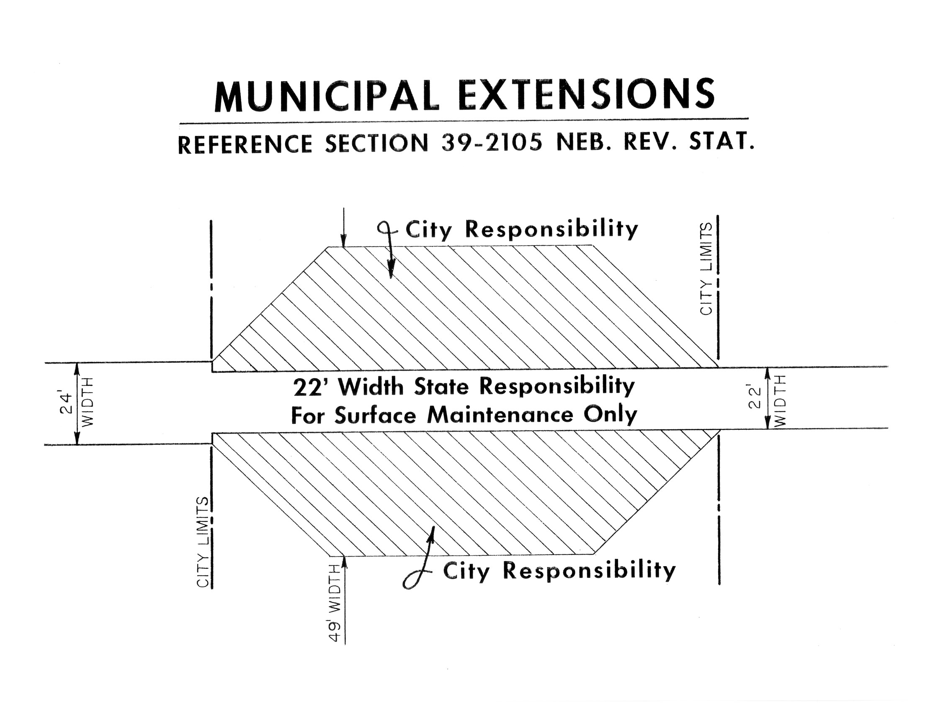
State Law
http://www.nebraskalegislature.gov/laws/browse-chapters.php?chapter=39
Expressway or
Major Arterial
Interlocal agreements with NDOT (for mowing, snow removal, etc.)
Slide 12
Notes:
8/5/2019 Updated removed reference to “Blue Sheet in Notebook”, no audio media changes
Regarding the footnote on the previous screen which read: The Municipality is responsible for that portion that exceeds the design of the rural highway that leads into the municipality.
Since the State is responsible for all roads classified as Interstate, the footnote applies only to municipal extensions of state highways with a State functional classification of Expressway or Major Arterial.
State Statute 39-2105 reads: When the design of a rural highway differs at the different points where it leads into the municipality, the state's responsibility for the municipal extension thereof shall be limited to the lesser of the two designs.
This screen shows an example of what this means. On the right side of the screen the rural State highway entering corporate limits is 22 ft wide. On the left side of the screen the rural highway leaving corporate limits is 24 ft wide. According to State Statute 39-2105, the municipality has jurisdictional responsibility for that portion which exceeds the design of the rural portion. If the two rural portions are different, which they are in the example, the municipality is responsible for that portion which exceeds the lesser of the two designs. So, in this example, the State is responsible for the 22 ft width and the municipality is responsible for that portion which exceeds 22 ft width..
For works or projects on a State highway, there may be some cost sharing required for the Municipality. Usually, this affects only cities with a population of over 5,000, and is a function of the number of thru traffic lanes. For further information, you may request a copy of Department of Transportation Instruction 60-11, Municipal Sharing.
And also note that there are usually interlocal agreements between the municipality and the Nebraska Department of Transportation for mowing, snow removal and other activities.
NOT FOR AUDIO
39-2105. Functional classifications; jurisdictional responsibility.
Jurisdictional responsibility for the various functional classifications of public highways and streets shall be as follows:
(1) The state shall have the responsibility for the design, construction, reconstruction, maintenance, and operation of all roads classified under the category of rural highways as interstate, expressway, and major arterial, and the municipal extensions thereof, except that the state shall not be responsible for that portion of a municipal extension which exceeds the design of the rural highway leading into the municipality. When the design of a rural highway differs at the different points where it leads into the municipality, the state's responsibility for the municipal extension thereof shall be limited to the lesser of the two designs. The state shall be responsible for the entire interstate system under either the rural or municipal category and for connecting links between the interstate and the nearest existing state highway system in rural areas, except that if such a connecting link has not been improved and a sufficient study by the Department of Transportation results in the determination that a link to an alternate state highway would provide better service for the area involved, the department shall have the option of providing the alternate route, subject to satisfactory local participation in the additional cost of the alternate route;
(2) The various counties shall have the responsibility for the design, construction, reconstruction, maintenance, and operation of all roads classified as other arterial, collector, local, minimum maintenance, and remote residential under the rural highway category;
(3) The various incorporated municipalities shall have the responsibility for the design, construction, reconstruction, maintenance, and operation of all streets classified as expressway which are of a purely local nature, that portion of municipal extensions of rural expressways and major arterials which exceeds the design of the rural portions of such systems, and responsibility for those streets classified as other arterial, collector, and local within their corporate limits; and
(4) Jurisdictional responsibility for all scenic-recreation roads and highways shall remain with the governmental subdivision which had jurisdictional responsibility for such road or highway prior to its change in classification to scenic-recreation made pursuant to this section and sections 39-2103, 39-2109, and 39-2113.
Source: Laws 1969, c. 312, § 5, p. 1121; Laws 1971, LB 738, § 1; Laws 1980, LB 873, § 2; Laws 1983, LB 10, § 4; Laws 2008, LB1068, § 5.
DORI 60-11, July 2005, Page F-15, Municipal Cost Sharing (non-Interstate projects), Projects determined by NDOT to be economic development projects are negotiated on a case-by-case basis.
Section 4 – Municipalities with a Population of 5,000 or less. Generally, no financial participation is required. Constructing parking areas at the request of the Municipality is paid 100% by the Municipality. Federal-aid Safety projects off the State Highway System requires 20% matching funds from the Municipality. On 3R projects, if Municipality requests reconstruction of sidewalks, it pays 100% of sidewalks, but the NDOT pays for ADA ramps and blending back to the sidewalk.
Section 5 – Municipalities with a Population over 5,000. May require participation. Depends on the number of thru traffic lanes. No cost if only two thru traffic lanes. 20% if there are four thru traffic lanes. And more if there are more than four thru traffic lanes.

Slide 13
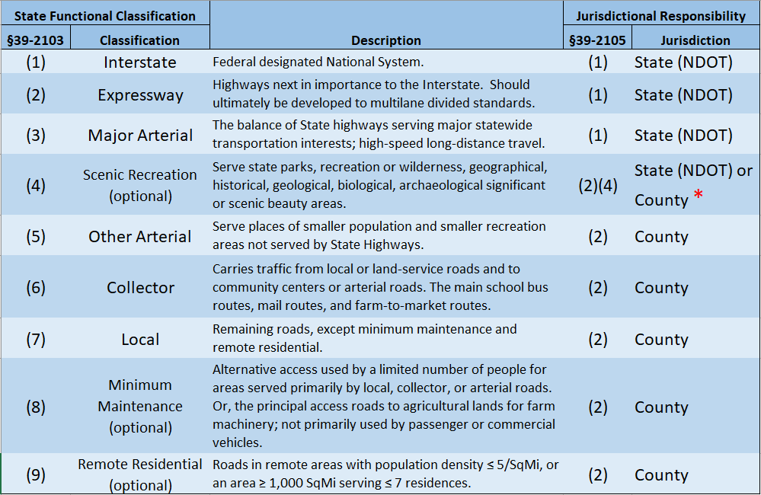
State Rural Functional Classifications (9)
428 NAC 1 pages 2 - 9
Mobility
Access
  * Remains with the government subdivision responsible before the change in classification
Slide 13
Notes:
8/5/2019 Updated instances of NDOR→NDOT in the slide, no audio media changes
This screen summarizes the nine Nebraska Rural functional classifications in State Statute 39-2103 and starting on page 2 of Title 428 NAC Chapter 1.
The Rural category means that only roads outside corporate limits can have these classifications.
The nine classifications are Interstate, Expressway, Major Arterial, Scenic-Recreation, Other Arterial, Collector, Local, Minimum Maintenance and Remote Residential. A short description is shown for each.
Three additional classifications made available by the Legislature for the Rural category that weren’t included in the Municipal category are: Scenic-Recreation, Minimum Maintenance and Remote Residential.
A road classified as Local that meets the Minimum Maintenance classification criteria may be re-classified as Minimum Maintenance. Likewise, a road classified as Local that meets Remote Residential criteria may be re-classified as Remote Residential. In a sense, the Minimum Maintenance and Remote Residential classifications are Optional classifications.
Scenic-Recreation is the only classification that goes with another classification, and is also considered an optional classification; the next screens will explain this.
The entity responsible – the State or the County - for each classification outside corporate limits is also listed; state statute 39-2105 assigns these responsibilities.
The State is responsible for Rural Interstate, Rural Expressway, Rural Major Arterial, and for any Scenic-Recreation-Major Arterials that the State was responsible for prior to the addition of the Scenic-Recreation classification.
Similar to the municipal classification,
Mobility increases going up the list, and access increases going down the list.
NOT FOR AUDIO
Section 39-2103. Rural highways; functional classifications. Rural highways are hereby divided into nine functional classifications as follows:
(1) Interstate, which shall consist of the federally designated National System of Interstate and Defense Highways;
(2) Expressway, which shall consist of a group of highways following major traffic desires in Nebraska which rank next in importance to the National System of Interstate and Defense Highways. The expressway system is one which ultimately should be developed to multilane divided highway standards;
(3) Major arterial, which shall consist of the balance of routes which serve major statewide interests for highway transportation. This system is characterized by high-speed, relatively long-distance travel patterns;
(4) Scenic-recreation, which shall consist of highways or roads located within or which provide access to or through state parks, recreation or wilderness areas, other areas of geographical, historical, geological, recreational, biological, or archaeological significance, or areas of scenic beauty;
(5) Other arterial, which shall consist of a group of highways of less importance as through-travel routes which would serve places of smaller population and smaller recreation areas not served by the higher systems;
(6) Collector, which shall consist of a group of highways which pick up traffic from many local or land-service roads and carry it to community centers or to the arterial systems. They are the main school bus routes, mail routes, and farm-to-market routes;
(7) Local, which shall consist of all remaining rural roads, except minimum maintenance roads and remote residential roads;
Section 39-2103 Rural highways; functional classifications. Rural highways are hereby divided into nine functional classifications as follows:
(1) Interstate, which shall consist of the federally designated National System of Interstate and Defense Highways;
(2) Expressway, which shall consist of a group of highways following major traffic desires in Nebraska which rank next in importance to the National System of Interstate and Defense Highways. The expressway system is one which ultimately should be developed to multilane divided highway standards;
(3) Major arterial, which shall consist of the balance of routes which serve major statewide interests for highway transportation. This system is characterized by high-speed, relatively long-distance travel patterns;
(4) Scenic-recreation, which shall consist of highways or roads located within or which provide access to or through state parks, recreation or wilderness areas, other areas of geographical, historical, geological, recreational, biological, or archaeological significance, or areas of scenic beauty;
(5) Other arterial, which shall consist of a group of highways of less importance as through-travel routes which would serve places of smaller population and smaller recreation areas not served by the higher systems;
(6) Collector, which shall consist of a group of highways which pick up traffic from many local or land-service roads and carry it to community centers or to the arterial systems. They are the main school bus routes, mail routes, and farm-to-market routes;
(7) Local, which shall consist of all remaining rural roads, except minimum maintenance roads and remote residential roads;
(8) Minimum maintenance, which shall consist of (a) roads used occasionally by a limited number of people as alternative access roads for areas served primarily by local, collector, or arterial roads or (b) roads which are the principal access roads to agricultural lands for farm machinery and which are not primarily used by passenger or commercial vehicles; and
(9) Remote residential, which shall consist of roads or segments of roads in remote areas of counties with (a) a population density of no more than five people per square mile or (b) an area of at least one thousand square miles, and which roads or segments of roads serve as primary access to no more than seven residences. For purposes of this subdivision, residence means a structure which serves as a primary residence for more than six months of a calendar year. Population shall be determined using data from the most recent federal decennial census.
The rural highways classified under subdivisions (1) through (3) of this section should, combined, serve every incorporated municipality having a minimum population of one hundred inhabitants or sufficient commerce, a part of which will be served by stubs or spurs, and along with rural highways classified under subdivision (4) of this section, should serve the major recreational areas of the state.
For purposes of this section, sufficient commerce means a minimum of two hundred thousand dollars of gross receipts under the Nebraska Revenue Act of 1967. (Emphasis added)
Source
Laws 1969, c. 312, § 3, p. 1119; Laws 1972, LB 866, § 2; Laws 1976, LB 724, § 1; Laws 1980, LB 873, § 1; Laws 1983, LB 10, § 3; Laws 2008, LB 1068, § 4.July 18, 2008
Cross References: Nebraska Revenue Act of 1967, see section 77-2701.

Slide 14
State Rural Functional Classifications (9)
428 NAC 1 pages 14 - 17
  * Remains with the government subdivision responsible before the change in classification
Slide 14
Notes:
8/5/2019 Updated instances of NDOR→NDOT in the slide, no audio media changes
About the Scenic-Recreation classification . . .

Slide 15
State Rural Functional Classification – Scenic-Recreation
  * Remains with the government subdivision responsible before the change in classification
Slide 15
Notes:
8/5/2019 Updated instances of NDOR→NDOT in the slide, no audio media changes
About the Scenic-Recreation classification . . .

Slide 16
State Rural Functional Classification – Scenic-Recreation
428 NAC 1 pages 14 - 17
Scenic-Recreation possible State Functional Classifications:
Scenic-Recreation Major Arterial
Scenic-Recreation Other Arterial
Scenic-Recreation Collector
Scenic-Recreation Local
§39-2113(2)
  * Remains with the government subdivision responsible before the change in classification
Slide 16
Notes:
8/5/2019 Updated instances of NDOR→NDOT in the slide, no audio media changes
It is the only classification that goes with another classification.
What that means is that any rural highway or road, which already has a State Functional Classification of Major Arterial, Other Minor Arterial, Collector or Local, may also be classified as Scenic-Recreation. Roads with a state functional classification of Interstate or Expressway are not eligible for the Scenic-Recreation classification.
This screen lists all of the possible Scenic-Recreation state functional classifications. There are four possibilities. Scenic-Recreation Major Arterial, Scenic-Recreation Other Minor Arterial, Scenic-Recreation Collector, and Scenic-Recreation Local. Refer to Title 428 NAC Chapter 1 pages 14-17 for the criteria for each of these classifications.
Referring to the footnote at the bottom of the screen, the jurisdictional responsibility of all scenic-recreation roads and highways shall remain with the governmental subdivision which had jurisdictional responsibility for such road or highway prior to its change in classification to scenic-recreation [ NOT FOR AUDIO: made pursuant to this section and sections 39-2103, 39-2109, and 39-2113].
The Scenic-Recreation classification can be thought of as an added layer of classification, on top of the road’s required functional classification.
Referring to State Statute 39-2113(2).
The purpose of this classification is to allow less restrictive and more flexible design standards, and to minimize environmental disruption.

Slide 17
Other Classification Laws
State Law
http://www.nebraskalegislature.gov/laws/browse-chapters.php?chapter=39
§39-2103 - Interstate, Expressway & Major Arterial State Highways should, combined, serve every incorporated municipality having a minimum population of one hundred (100) or sufficient commerce, a part of which will be served by stubs or spurs, and along with Scenic-Recreation state highways & county roads, should serve the major recreational areas of the state.
§39-2105(1) – the State (NDOT) is responsible for connecting links between the Interstate and the nearest existing State Highway system in rural areas (or an acceptable alternative route).
Slide 17
Notes:
The State Highway System is required to serve every incorporated municipality having a minimum population of 100, or sufficient commerce. This may be provided by stubs or highway spurs.
Nebraska’s major recreational areas must be served by stubs, spurs, county roads, or roads classified as Scenic-Recreation.
The State is responsible, in rural areas, to provide connecting links between the Interstate and the nearest existing State Highway – or provide an acceptable alternative route.

Slide 18
§39-2109
NBCS Responsible to Develop
Functional Classification Criteria
http://www.nebraskalegislature.gov/laws/browse-chapters.php?chapter=39
State Law broadly defines FC criteria in:
§39-2103 (Rural)
§39-2104 (Municipal)
NBCS developed the details
in regulation:
428 NAC 1
Slide 18
Notes:
The Legislature, in State Statute 39-2109, made the Board of Public Roads Classifications and Standards responsible to develop criteria for functional classification. Those criteria are expressed in Title 428 NAC 1.
NOT FOR AUDIO
Section 39-2109. Board of Public Roads Classifications and Standards; functional classification; criteria; adoption; hearing; publication; filing. (1) The Board of Public Roads Classifications and Standards shall develop the specific criteria for each functional classification set forth in sections 39-2103 and 39-2104, which criteria shall be consistent with the general criteria set forth in those sections. No such criteria shall be adopted until after public hearings have been held thereon at such times and places as to assure interested parties throughout the state an opportunity to be heard thereon. Following their adoption, such criteria shall be printed and published and copies thereof shall be deposited with the Secretary of State, the Clerk of the Legislature, the county clerk of each county, and the clerk of each incorporated municipality.
(2) Within eighteen months after July 18, 2008, the Board of Public Roads Classifications and Standards shall adopt and promulgate the specific criteria for remote residential roads. (Emphasis added)

Slide 19

§39-2110
Assignment of Functional Classification (FC) by NDOT
State Law
http://www.nebraskalegislature.gov/laws/browse-chapters.php?chapter=39
  Requests go to NDOT
  NDOT assigns FC after consulting with local authority
Initially (early 1970’s), all roads were classified “from scratch”
Now, this applies to new roads
Slide 19
Notes:
The Legislature, in State Statute 39-2110, made the Nebraska Department of Transportation responsible to assign each public highway, road and street a functional classification.
For county roads and municipal streets, the Department consults with the county or the municipality, respectively.
Since all streets and roads now have a functional classification, requests are for new streets and roads.
NOT FOR AUDIO
Section 39-2110. Functional classification; specific criteria; assignment to highways, roads, streets. Following adoption and publication of the specific criteria required by section 39-2109, the Department of Transportation, after consultation with the appropriate local authorities in each instance, shall assign a functional classification to each segment of highway, road, and street in this state. Before assigning any such classification, the department shall make reasonable effort to resolve any differences of opinion between the department and any county or municipality. Whenever a new road or street is to be opened or an existing road or street is to be extended, the department shall, upon a request from the operating jurisdiction, assign a functional classification to such segment in accordance with the specific criteria established under section 39-2109. (Emphasis added)
Note:
Initially, all roads were classified “from scratch”.
Now, this applies to new roads.

Slide 20
§39-2111
NBCS Responsibility
Functional Classification
Appeal Requests
State Law
http://www.nebraskalegislature.gov/laws/browse-chapters.php?chapter=39
  Board (NBCS) reviews FC appeals
  Holds Public Hearing if deemed advisable
  Renders decision
Decision can be appealed in accordance with the Administrative Procedure Act
(NDOT, County or Municipality has 30 days from date of decision to appeal in district court)
Slide 20
Notes:
A county or municipality may appeal to the Board of Public Roads Classifications and Standards (NBCS) for any functional classification assignment made by the Nebraska Department of Transportation. A public hearing may be held. The NBCS makes their decision, which can be further appealed.
NOT FOR AUDIO
Note: NDOT did take the NBCS to court on the on the Calumus Lake Road FC about 25 years ago.
Section 39-2111. Functional classification; assignment; appeal. The county or municipality may appeal to the Board of Public Roads Classifications and Standards from any action taken by the Department of Transportation in assigning any functional classification under the provisions of section 39-2110. Upon the taking of such an appeal, the board shall review all information pertaining to the assignment, hold a hearing thereon if deemed advisable, and render a decision on the assigned classification. The decision of the board may be appealed, and the appeal shall be in accordance with the Administrative Procedure Act. (Emphasis added)

Slide 21
§39-2112
Requests to NDOT to
Reclassify Roads and Streets
State Law
http://www.nebraskalegislature.gov/laws/browse-chapters.php?chapter=39
  Changed circumstances causing a change in traffic pattern(s) and possibly traffic types and volumes
    new development
    bypass of a community
    Jurisdiction changes
  Examples:
    A new road or bypass is built, or a two-lane road is widened to four lanes, causing a change in traffic patterns and volumes adjacent roads and streets
    A City’s annexation brings several roads within corporate limits
    A County wants a road to be declared Scenic-Recreation
    A County requests a road classified as Local to be re-classified as Minimum Maintenance because it would be too expensive to replace a bridge
Slide 21
Notes:
State law provides for re-classifying existing highways, roads and streets. A change in traffic patterns, traffic types and volumes may trigger a re-classification request.
This screen shows some examples, such as a new bypass, an annexation, adding the Scenic-Recreation classification, or changing to a Minimum Maintenance classification.
NOT FOR AUDIO
Section 39-2112. Functional classification; assignment; Department of Transportation; request to reclassify; county board; public hearing; decision; appeal. Any county or municipality may, based on changing traffic patterns or volume or a change in jurisdiction, request the Department of Transportation to reclassify any segment of highway, road, or street. Any county that wants to use the minimum maintenance, remote residential, or scenic-recreation functional classification or wants to return a road to its previous functional classification may request the department to reclassify an applicable segment of highway or road. If a county board wants a road or a segment of road to be classified as remote residential, it shall hold a public hearing on the matter prior to requesting the department to reclassify such road or segment of road. The department shall review a request made under this section and either grant or deny the reclassification in whole or in part. Any county or municipality dissatisfied with the action taken by the department under this section may appeal to the Board of Public Roads Classifications and Standards in the manner provided in section 39-2111. (Emphasis added)

Slide 22

§39-2112
Requests to Reclassify
Roads and Streets
State Law
http://www.nebraskalegislature.gov/laws/browse-chapters.php?chapter=39
  Reclassification affects
    The standards to which a road or street is built
    Possible Federal eligibility and funding
Slide 22
Notes:
Reclassification affects the standards to which a highway, road or street is built and may also have funding implications.
NOT FOR AUDIO
Section 39-2112. Functional classification; assignment; Department of Transportation; request to reclassify; county board; public hearing; decision; appeal. Any county or municipality may, based on changing traffic patterns or volume or a change in jurisdiction, request the Department of Transportation to reclassify any segment of highway, road, or street. Any county that wants to use the minimum maintenance, remote residential, or scenic-recreation functional classification or wants to return a road to its previous functional classification may request the department to reclassify an applicable segment of highway or road. If a county board wants a road or a segment of road to be classified as remote residential, it shall hold a public hearing on the matter prior to requesting the department to reclassify such road or segment of road. The department shall review a request made under this section and either grant or deny the reclassification in whole or in part. Any county or municipality dissatisfied with the action taken by the department under this section may appeal to the Board of Public Roads Classifications and Standards in the manner provided in section 39-2111. (Emphasis added)

Slide 23
§39-2112
Requests to Reclassify
Roads and Streets
State Law
http://www.nebraskalegislature.gov/laws/browse-chapters.php?chapter=39
  Requests must be filed with NDOT
  For the Minimum Maintenance, Remote Residential or Scenic-Recreation FC, County must request NDOT to reclassify
- Remote Residential - County Board holds public hearing
NDOT grants or denies reclassification in whole or in part
County or Municipality may appeal to the Board of Public Roads Classifications and Standards (39-2111)
Slide 23
Notes:
Reclassification requests are submitted to the Nebraska Department of Transportation.
If the request involves the Remote Residential classification, the county must hold a public hearing prior to the request.
Requests will be granted in whole or in part, or will be denied, by the Nebraska Dept of Transportation.
Counties and municipalities may appeal to the Board of Public Roads Classifications and Standards, as mentioned previously in this presentation.
NOT FOR AUDIO
Section 39-2112. Functional classification; assignment; Department of Transportation; request to reclassify; county board; public hearing; decision; appeal. Any county or municipality may, based on changing traffic patterns or volume or a change in jurisdiction, request the Department of Transportation to reclassify any segment of highway, road, or street. Any county that wants to use the minimum maintenance, remote residential, or scenic-recreation functional classification or wants to return a road to its previous functional classification may request the department to reclassify an applicable segment of highway or road. If a county board wants a road or a segment of road to be classified as remote residential, it shall hold a public hearing on the matter prior to requesting the department to reclassify such road or segment of road. The department shall review a request made under this section and either grant or deny the reclassification in whole or in part. Any county or municipality dissatisfied with the action taken by the department under this section may appeal to the Board of Public Roads Classifications and Standards in the manner provided in section 39-2111. (Emphasis added)

Slide 24
What is the State Functional Classification of My Highway, Road or Street?
Online: NDOT’s Map Library
Paper: Request from NDOT Boards-Liaison Services Section
mailto:NDOT.BLSHelp@nebraska.gov
Notes:
8/5/2019 Updated “mailto” address from NDOR to NDOT
For any segment of highway, road or street, how does a person find its functional classification?
The Nebraska Department of Transportation maintains this information in its databases and on maps.
Your county or municipality may have its own matching records identifying the functional classification of each road or street.
A county or municipality wishing to identify the functional classification of a road or street would therefore
Review its own records, or
Get the appropriate map from the DOT, in one of two ways:
Online – there will be a short tutorial in a few moments how to do that, or
Paper – which can be requested from the DOT.
Just a cautionary note that maps do change, occasionally.
The map that is online in the DOT’s map library may not always be the latest.
For classification or re-classification,
Consultation between the NDOT and political jurisdictions is required by State Statute 39-2110.
Therefore, the responsible party at the county or municipality should be aware of any pending changes.
NOT FOR AUDIO
From the interim instructions for proposed combined Form7+10:
NDOT functional classification maps are located online at http://dot.nebraska.gov/travel/map-library/ or may be requested from NDOT Boards-Liaison Services Section at DOR.BLSHelp@nebraska.gov. For map clarifications or corrections contact the NDOT Materials & Research Division.

Slide 25

Functional Classification
Neb. Rev. Stat. 39-2110
http://www.nebraskalegislature.gov/laws/browse-chapters.php?chapter=39
Work with NDOT to verify or establish functional classification. Call 402-479-4750, ask for the
    Highway Materials & Test Manager, or the
    Roadway Asset Management Engineer
Online maps
    https://dot.nebraska.gov/travel/map-library/
Reclassification Guides
    https://dot.nebraska.gov/travel/map-library/
Slide 25
Notes:
If there is any question, or a need for help in verifying or establishing functional classification of a public highway, road or street, contact the Nebraska Dept of Transportation as shown on this screen.
Maps and re-classification guidance can be found online, using the weblinks shown on this screen.
NOT FOR AUDIO
The reference to maps is removed; they are not always up-to-date; proposed guidance is to contact NDOT.
Your agency works with NDOT in order to establish functional classification, so you should have records.
NDOT maps may not be up to date. Call Dave Brokaw for confirmation/verification
Design must be done in consistent with the anticipated functional classification.
You can go to the following website and view NDOTs Reclassification Guides http://www.transportation.nebraska.gov/maps/#class once there you can open up one of the following:
Local - Remote Residential Roads
Counties Eligible for Remote Road Classification
Local - Minimum Maintenance Roads
Change to Add Roads to State Highway System
Change to Only County or City System

Slide 26
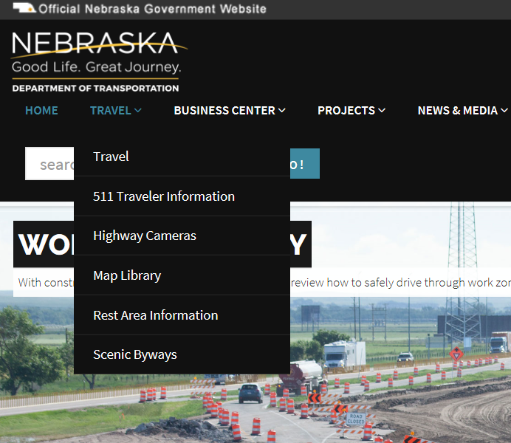
Maps on NDOT Website
Finding Maps
https://dot.nebraska.gov/travel/map-library/
Slide 26
Notes:
8/5/2019 Updated web link (http→https)
In order to find the State Functional Classification map for your highway, road or street of interest,
On the DOT’s main web page, on the Travel tab, select the Map Library.

Slide 27
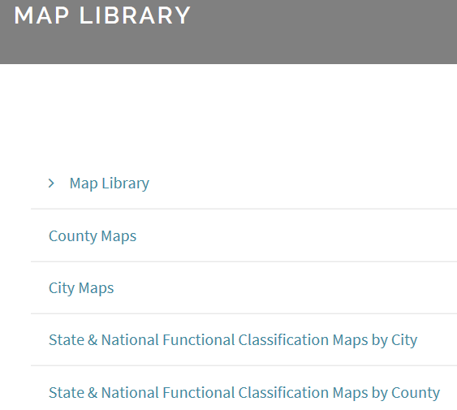
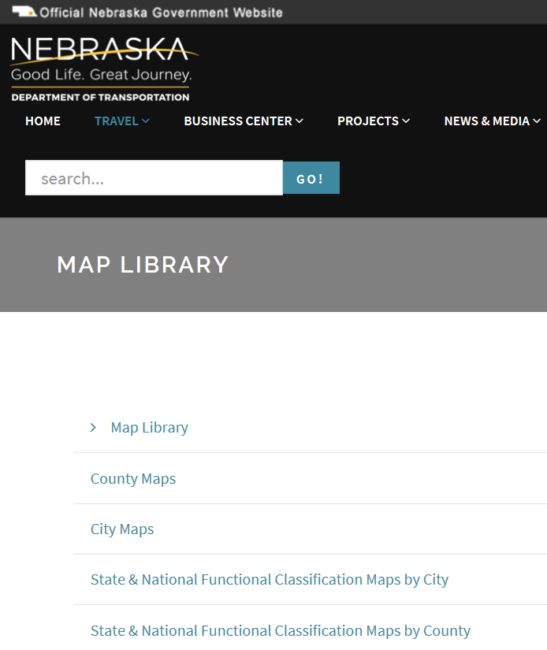
Maps on NDOT Website
Finding Maps
https://dot.nebraska.gov/travel/map-library/
State & National Functional Classification Maps by County
Slide 27
Notes:
In the Map Library, select the
State & National Functional Classification Maps – by City – if the highway or street of interest is within the corporate limits of a municipality.
Or, just below that, the State & National Functional Classification Maps by County – if the highway or road of interest is in a rural area.
Shortly, this video will address the National Functional Classification.
As an example, let’s find the State FC for 325th Avenue, south of St. Edward in Boone County.
On the Map Library screen, click on State & National Functional Classification Maps by County

Slide 28
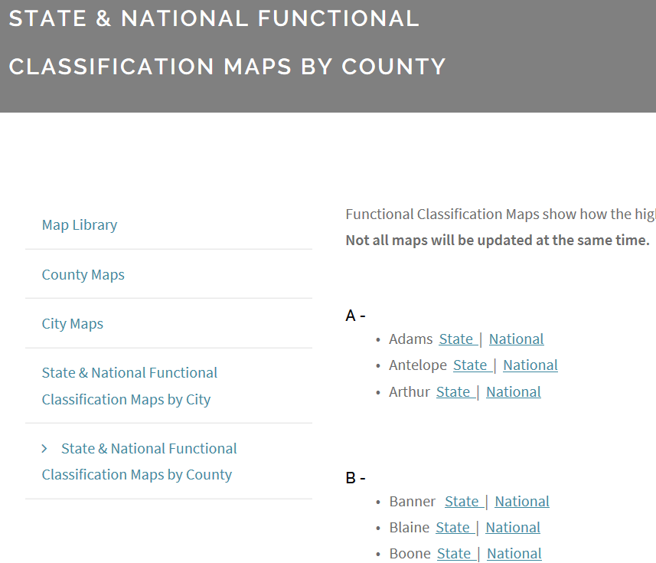
State FC Maps on NDOT Website
Finding Maps
https://dot.nebraska.gov/travel/map-library/
Slide 28
Notes:
That will bring up the County map index.
Click on the “State” link to get to the State Functional Classification map for the County of interest.
In this case, Boone County.

Slide 29
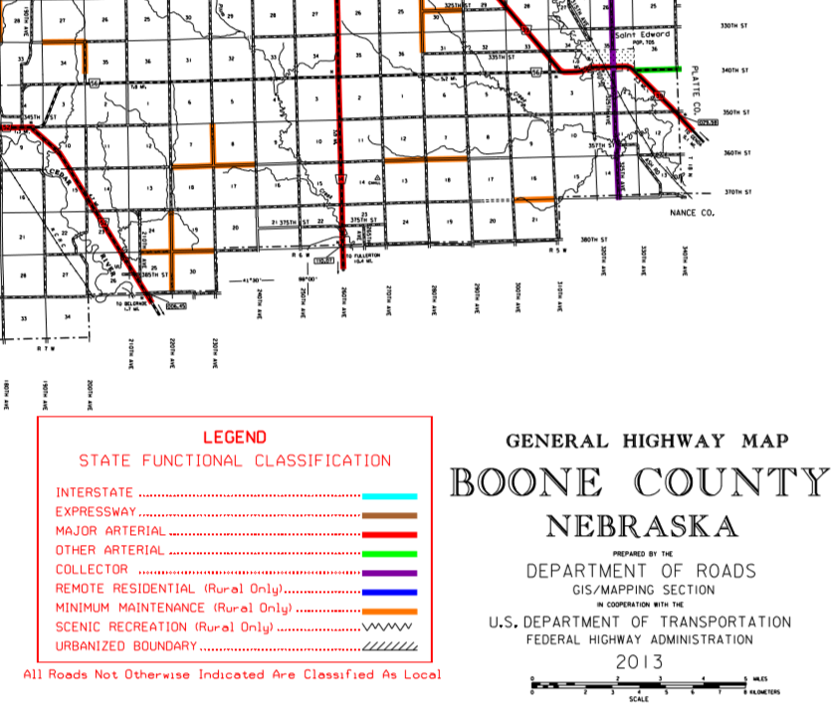
State FC Maps on NDOT Website
Finding Maps
https://dot.nebraska.gov/travel/map-library/func-by-county/
Saint Edward
Slide 29
Notes:
That gets you to the county’s State Functional Classification map.
Boone County, in this example.
The legend identifies the map as SFC.
Saint Edward is in the southeastern corner of the county.

Slide 30
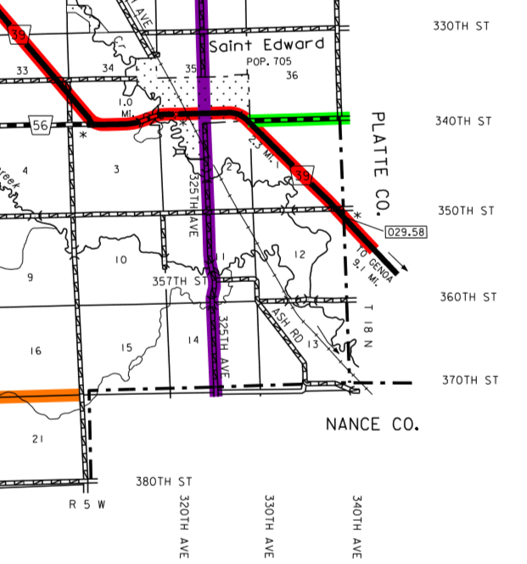
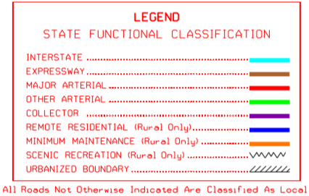
State FC Maps on NDOT Website
Finding Maps
https://dot.nebraska.gov/travel/map-library/func-by-county/
325th Avenue
Slide 30
Notes:
325th Avenue south of St. Edward is color coded yellow purple on the map.
Therefore, it has a State Functional Classification of Collector.

Slide 31
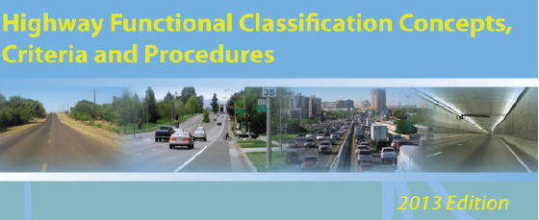
National Functional Classification
National System
National Publication Number FHWA PL-13-026 https://www.fhwa.dot.gov/planning/processes/statewide/related/highway_functional_classifications/fcauab.pdf
Slide 31
23 CFR 470
Notes:
As mentioned previously, The Federal government has its own system of Functional Classification.
Refer to the Code of Federal Regulations (CFR) Title 23 Part 470, known as 23 CFR 470.
Refer to the publication shown on the screen, Highway Functional Classification Concepts, Criteria and Procedures, for more information about the National Functional Classification system. It is available online.
Classification is a Systematic hierarchy of roads which depends on the character of travel service it provides.
Mobility and access are the two main determining factors as to how to classify roads.
Other factors are trip length, speed limit, traffic volume and vehicle mix.
The national system has some differences with the state system of classification.
Nebraska State Statutes created two broad categories – Municipal and Rural.
Municipal is defined as the corporate limits.
The national system also creates two broad categories, but they are slightly different, and are termed Urban and Rural.
Urban is the urbanized area, which is sometimes, but not necessarily, the same as corporate limits.

Slide 32
Area
National FC System
Urban
  Dense development
  Determined by census
  Populations 5,000 and more
  Local and State officials decide, US Secretary of Transportation approves
  NOT always the same as corporate limits
Rural
  Sparse development
  All areas not designated Urban
428 NAC 2-001.03A2, Page 42
Slide 32
Notes:
This screen describes Urban and Rural areas. as used in the national system of functional classification.
Urban areas are the more densely populated areas, are determined by census, and defined as populations 5,000 and greater. The actual boundaries are determined by local and state officials, with approval by the US Secretary of Transportation.
Rural areas are all areas not designated as Urban.
State statute 16-101 requires Cities of the First Class to have a population more than 5,000,
Therefore, the way the national system is defined,
Urban applies only in and around Cities of the First Class, and the Lincoln and Omaha areas.
If your highway, road or street of interest is in one of these cities, it is in an Urban area
and if it is near the corporate limits of any one of these then you need to verify if it is in the Urban area.
How you do that is to check the map on the DOT’s website, which we will show momentarily.
But first, let’s review

Slide 33
National Functional Classification (NFC)
Highway Functional Classification Concepts, Criteria and Procedures 2013 Edition, Pub. No. FHWA PL-13-026
National FC System
Interstate
Other Freeways and Expressways
Other Principal Arterial
Minor Arterial
Major Collector
Minor Collector
Local
Slide 33
Notes:
There are seven classifications in the national system.
They are Interstate, Other Freeways and Expressways, Other Principal Arterial, Minor Arterial, Major Collector, Minor Collector and Local.
Urban areas and Rural areas both use these classifications.
Classifications in Bold font are those that typically would apply to roads and streets within counties and municipalities.
Although most of the Other Principal Arterial classification is on the State Highway System.
Interstate is always, and Other Freeways and Expressways are typically, on the State Highway System.

Slide 34
What is the National Functional Classification of My Highway, Road or Street?
Online: NDOT’s Map Library
Paper: Request from NDOT Boards-Liaison Services Section
mailto:NDOT.BLSHelp@nebraska.gov
Notes:
For any segment of highway, road or street, how does a person find its functional classification?
As it does with the State Functional Classification system, The Nebraska Department of Transportation also maintains National Functional Classification information in its databases and on maps.
Finding the National Functional Classification is the same process that was demonstrated earlier for the State Functional Classification system.
There are maps available online or by request.
Just a cautionary note that maps do change, occasionally.
The map that is online in the DOT’s map library may not always be the latest.
NOT FOR AUDIO
From the interim instructions for proposed combined Form7+10:
NDOT functional classification maps are located online at http://dot.nebraska.gov/travel/map-library or may be requested from NDOT Boards-Liaison Services Section at DOR.BLSHelp@nebraska.gov. For map clarifications or corrections contact the NDOT Materials & Research Division.

Slide 35
Maps on NDOT Website
Finding Maps
https://dot.nebraska.gov/travel/map-library/
Slide 35
Notes:
8/5/2019 Updated web link (http→https)
In order to find the National Functional Classification map for your highway, road or street of interest,
On NDOT’s main web page, on the Travel tab, select the Map Library.

Slide 36
Maps on NDOT Website
Finding Maps
https://dot.nebraska.gov/travel/map-library/
State & National Functional Classification Maps by County
Slide 36
Notes:
8/5/2019 Updated web link (http→https)
In the Map Library, select the
State & National Functional Classification Maps – by City – if the highway or street of interest is in Urban Area. Remember, Urban Areas in Nebraska are located at Cities of the First Class, and Lincoln and Omaha.
Or, just below that, the State & National Functional Classification Maps by County – if the highway or road of interest is in a rural area.
As an example, let’s find the National FC for 325th Avenue, south of St. Edward in Boone County.
On the Map Library screen, click on State & National Functional Classification Maps by County

Slide 37
State FC Maps on NDOT Website
Finding Maps
https://dot.nebraska.gov/travel/map-library/
Slide 37
Notes:
That will bring up the County map index.
Click on the “National” link to get to the National Functional Classification map for the County of interest.
In this case, Boone County.

Slide 38
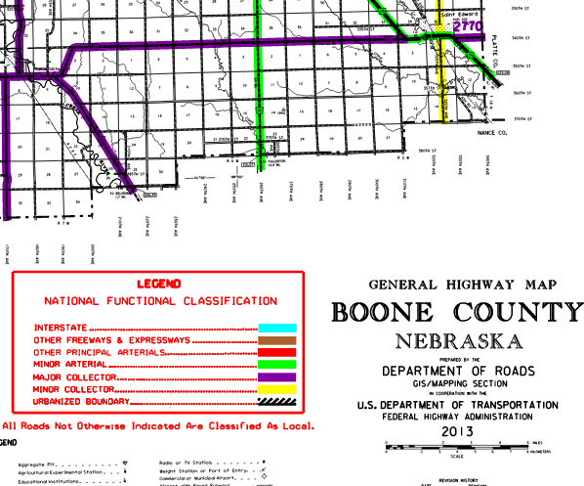
National FC Maps on NDOT Website
Finding Maps
https://dot.nebraska.gov/travel/map-library/
Saint Edward
Slide 38
Notes:
8/5/2019 Updated web link (http→https)
That gets you to the county’s National Functional Classification map.
Boone County, in this example.
The legend identifies the map as NFC.
Saint Edward is in the southeastern corner of the county.

Slide 39
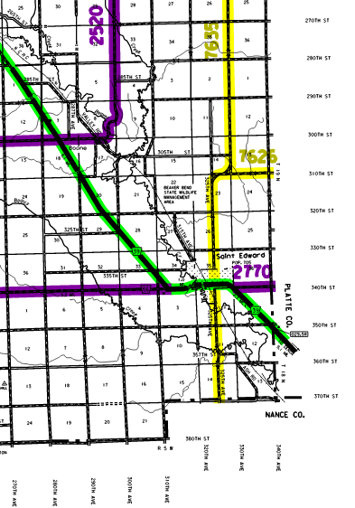
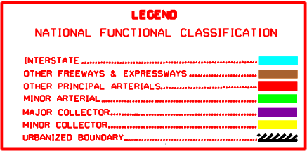
National FC Maps on NDOT Website
Finding Maps
https://dot.nebraska.gov/travel/map-library/
325th Avenue
Slide 39
Notes:
325th Avenue south of St. Edward is color coded yellow on the map.
Therefore, it has a National Functional Classification of Minor Collector.

Slide 40
Maps on NDOT Website
Finding Maps
https://dot.nebraska.gov/travel/map-library/
Slide 40
Notes:
8/5/2019 Updated web link (http→https)
Let’s do an example for a highway, road or street of interest near an urban area.
Remember, an Urban area, defined in the National system, is an area with 5,000 population and greater.
So we need to be near a City of the First Class, or Lincoln, or Omaha.
The City of Hastings is a City of the First Class.
In the Map Library, select the
State & national Functional Classification Maps – by City

Slide 41
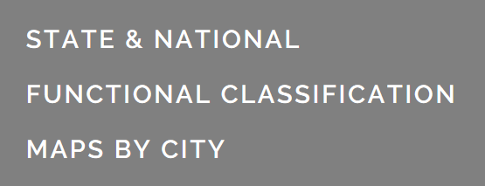
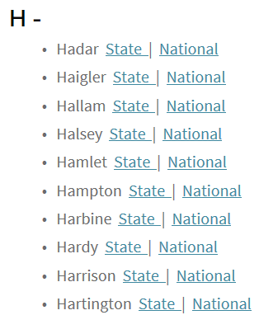

Maps on NDOT Website
Finding Maps
Finding Urban Area
https://dot.nebraska.gov/travel/map-library/func-by-city/
Slide 41
Notes:
8/5/2019 Updated web link (http→https)
Select the National map for the City of Hastings.
Only the National map will show Urban Area boundaries.

Slide 42
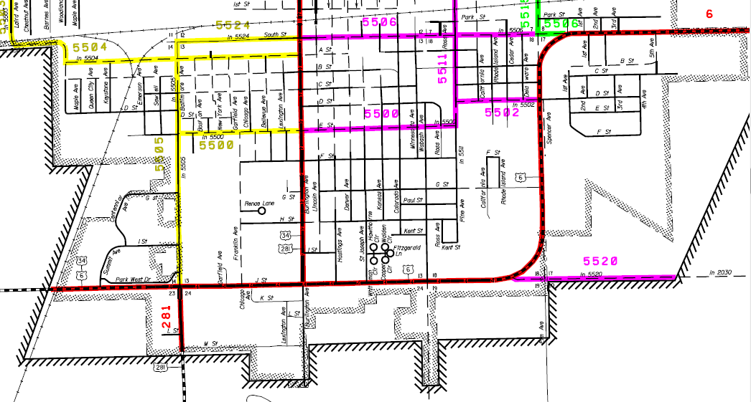
National FC on NDOT Maps
Urban Area - Example
Finding Maps
https://dot.nebraska.gov/media/9514/hastingsnfc.pdf
Corporate Limits
Urban Area Boundary
Slide 42
428 NAC 2-001.03A2, Page 42
Notes:
This is the southeast part of the City of Hastings, in Adams County.
The map identifies the corporate limits.
The Urban Area Boundary is the cross-hatched line.
As you can see the Urban Area Boundary is not always the same as the corporate limits.

Slide 43
State vs. National
Rural Highways
Neb. Rev. Stat. 39-2105 (2)
Interstate
Expressway
Major Arterial
Other Arterial
Collector
Local
Scenic-Recreation
Minimum Maintenance
Remote Residential
National System
23 CFR 470
Interstate
Other Freewys/ Exprsswys
Other Principal Arterial
Minor Arterial
Major Collector
Minor Collector
Local
Slide 43
Notes:
The State and National systems do not correlate with one another exactly.
Several classification names are different.
The criteria used to define each classification is not described exactly the same.
The two broad categories differ slightly – the State uses corporate limits, the Federal government uses the Urban boundary.
Nebraska has the three additional rural classifications, listed at the bottom.
A road classified nationally as Local is not necessarily classified as Local on the State FC system; it could be any of the three optional classifications, or even a higher classification such as collector.

Slide 44

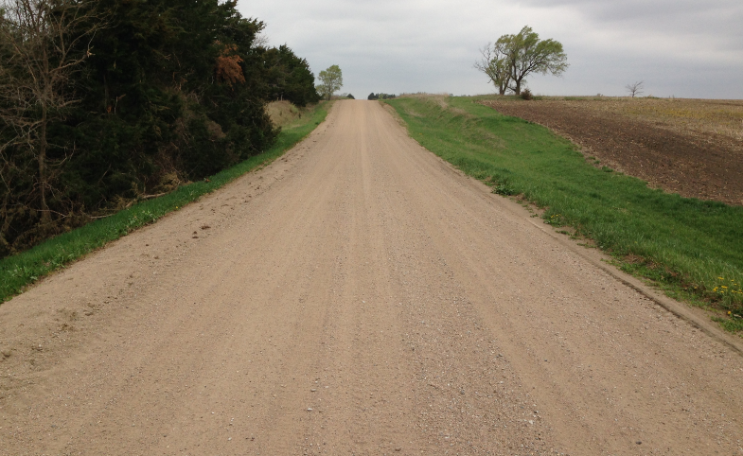
County Road
Find the State and Functional Classifications
PRACTICAL
EXAMPLE
Notes:
Let’s do another example.

Slide 45
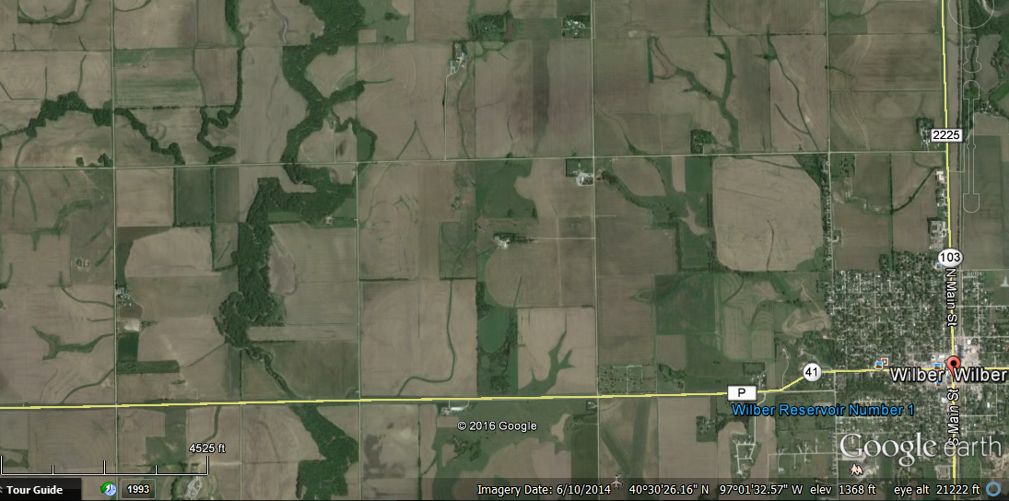
Example – Rural Area
Location:
Saline County Road O (north of Wilber)
8x10 NBS
26’ CBW
3.5 miles
Gravel Surfacing
Rd 1900
Route 3025
Google Earth Image 6/10/2014
Slide 45
Notes:
You want to find both the state and national functional classifications of the east-west county road just north of Wilber in Saline County.

Slide 46
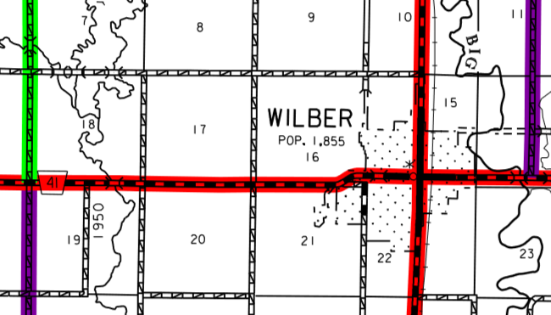
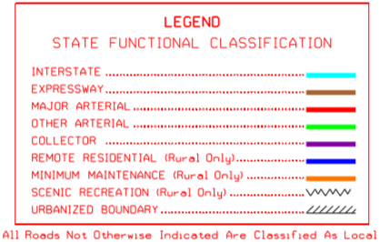
Example – Rural Area
https://dot.nebraska.gov/media/5136/cfuncsalinesfc.pdf
Local
Slide 46
Notes:
First, the State Functional Classification.
You get to the map for Saline County by selecting the State & National Functional Classification Maps by County on the DOT’s Map Library web page, then selecting the “State” option for Saline County on the county index web page.
This is the map of the area. The road is not color coded. The State FC is Local. See the note at the bottom of the Legend.

Slide 47
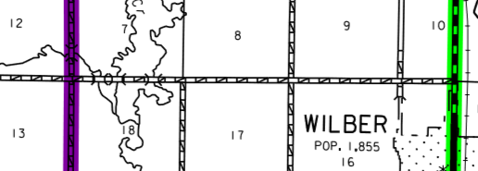
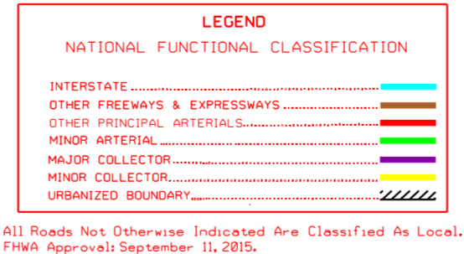
Example – Rural Area
https://dot.nebraska.gov/media/8729/cfuncsalinenfc.pdf
Local
Slide 47
Notes:
Next, the National Functional Classification.
You get to the map for Saline County by selecting the State & National Functional Classification Maps by County on the DOT’s Map Library web page, then selecting the “National” option for Saline County on the county index web page.
If Wilber happened to be a City of the First Class, which it is not, you may need to check
State & National Functional Classification Maps – by City
This is the map of the area. The road is not color coded. The National FC is Local. See the note at the bottom of the Legend.

Slide 48
Review and Questions
Classification and Standards
428 NAC 1
Functional Classification
Slide 48
Notes:
This final segment is a short review of what was discussed in this video, with questions.
When it comes time to answering a review question, you have the option of pausing the video before the answer is given.

Slide 49
State Law
Review - Functional Classification & Jurisdictional Responsibility
http://www.nebraskalegislature.gov/laws/browse-chapters.php?chapter=39
  State responsible for three (3) higher classifications
  Counties & Municipalities: Three (3) lower classifications
  Special cases:
    - Rural Optional Classifications: Scenic Recreation; Remote Residential; Minimum Maintenance
    - Municipal: extensions exceeding rural design; internal (“of a local nature”) expressways
§39-2105
Slide 49
Notes:
This video provided basic information on
Nebraska’s functional classification system,
Jurisdictional responsibility of public highways, roads and streets in Nebraska,
and
The National Functional Classification system.

Slide 50
Review Questions
State Law
  Which entity is responsible to assign the Nebraska State Functional Classifications?
  NDOT (Nebraska Dept. of Transportation)
  NE Dept. of Health and Human Services
  Federal Highway Administration
  County Board
Neb Rev State §39-2110
http://www.nebraskalegislature.gov/laws/browse-chapters.php?chapter=39
Slide 50
Notes:
The Nebraska Dept of Transportation is responsible for assigning each highway, road and street segment a state functional classification.

Slide 51
Review Questions (cont’d)
State Law
  Which entity hears appeals of assigned Nebraska State Functional Classifications?
  Board of Examiners
  The NBCS
  The League of Municipalities
  NE Board of Engineers and Architects
Neb Rev State §39-2111
http://www.nebraskalegislature.gov/laws/browse-chapters.php?chapter=39
Slide 51
Notes:
From file Tab.11 Functional Classification Slide.24

Slide 52
Review Questions (cont’d)
State Law
  Which entity approves the assignment of National Functional Classification to highway, road and street segments?
  Board of Examiners
  The NBCS
  The League of Municipalities
  The Federal Highway Administration
Slide 52
Notes:
From file Tab.11 Functional Classification Slide.24
The Federal Highway Administration, or FHWA, approves National Functional Classification assignments proposed by the DOT

Slide 53
Functional Classification
Neb. Rev. Stat. 39-2110
http://www.nebraskalegislature.gov/laws/browse-chapters.php?chapter=39
Work with NDOT to verify or establish functional classification. Call 402-479-4750, ask for the
    Highway Materials & Test Manager, or the
    Roadway Asset Management Engineer
Online maps
    https://dot.nebraska.gov/travel/map-library/
Reclassification Guides
    https://dot.nebraska.gov/travel/map-library/
Slide 53
Notes:
This is a reminder
if there is any question, for help in verifying or establishing functional classification of a highway, road or street,, contact the NDOT as shown on this screen.
Maps and re-classification guidance can be found online, using the weblinks shown on this screen.
NOT FOR AUDIO
The reference to maps is removed; they are not always up-to-date; proposed guidance is to contact NDOT.
Your agency works with NDOT in order to establish functional classification, so you should have records.
NDOT maps may not be up to date. Call Dave Brokaw for confirmation/verification
Design must be done in consistent with the anticipated functional classification.
You can go to the following website and view NDOTs Reclassification Guides http://www.transportation.nebraska.gov/maps/#class once there you can open up one of the following:
Local - Remote Residential Roads
Counties Eligible for Remote Road Classification
Local - Minimum Maintenance Roads
Change to Add Roads to State Highway System
Change to Only County or City System

Slide 54
Managing Nebraska’s
Public Roads and Streets
The Basics of
Functional Classification
428 NAC 1, §39-2113
Boards - Liaison Services Section
https://dot.nebraska.gov/business-center/lpa/boards-liaison/training/
8/6/2019
Video B02
Notes:
This is one of a series of videos on Nebraska’s system of
Classifying and applying standards to its highways, roads and streets.
This video introduced basic information about
Nebraska’s functional classification system, and
The National Functional Classification system.
There is also discussion about jurisdictional responsibility for highways, roads and streets in Nebraska.

