Slide 1
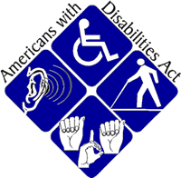
Video 09
Americans with Disabilities Act (ADA)
Boards - Liaison Services Section
8/6/2019
Notes:
8/6/2019 Updated slides. The previous version was 12/30/2016. Updated contact info Slide 16. First and last slides updated NDOR logo to NDOT logo. Slides 15 (required two audio media changes) and 17 updated NDOR→NDOT and the web link for ADA on Slide 17 is updated.
The purpose of this video is to provide basic information on the Americans with Disabilities Act.
The target audience is Nebraska’s County Highway Superintendents and City Street Superintendents
It would also be appropriate for elected officials and anyone else who is interested

Slide 2
The Need for Accessible Programs and Facilities
11.9% (34 million) of the US Population has a disability (2010 census)
10 million Americans have serious hearing disabilities
6 million have visual impairments
Slide 2
Notes:
Approximately 12% of the US population has a disability, according to the 2010 census

Slide 3
The Need for Accessible Programs and Facilities
70 percent of us will eventually have a temporary or permanent disability that makes climbing stairs impossible
Slide 3
Notes:
An estimated 70% of us, during our lives, will have some sort of disability that will make climbing stairs impossible, either temporarily or permanently

Slide 4
Section 504 of the Rehabilitation Act of 1973
Primary purpose:
ensure that pedestrians with disabilities have the opportunity to use the transportation system in an accessible and safe manner.
Slide 4
Notes:
Prior to enactment of the ADA in 1990,
Federal Law, through Section 504 of the Rehabilitation Act of 1973, ensured that pedestrians with disabilities would have the opportunity to use the transportation system in an accessible and safe manner.
Section 504 was modelled after previous laws which banned race, ethnic origin and sex-based discrimination by recipients of federal funds. For the first time people with disabilities were viewed as a class – a minority group.
It was administered by the US Dept of Health, Education and Welfare and addressed architectural and communication barriers.
Including those barriers within the transportation system
The point is, Federal law striving to accommodate those with disabilities has been around for several decades, applying to transportation facilities.
NOT FOR AUDIO
Title III of the Americans with Disabilities Act requires public accommodations to provide goods and services to people with disabilities on an equal basis with the rest of the general public. The goal is to afford every individual the opportunity to benefit from our country’s businesses and services, and to afford our businesses and services the opportunity to benefit from the patronage of all Americans. [ADA Checklist for Existing Facilities https://www.ada.gov/racheck.pdf]

Slide 5
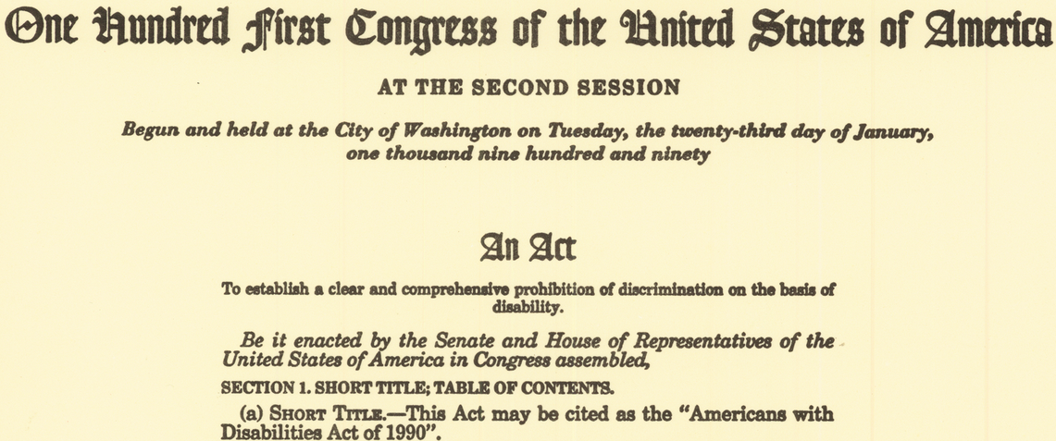
Americans with Disabilities Act (ADA ) of 1990
Slide 5
Notes:
The Americans with Disabilities Act, i.e. ADA, was passed by the Federal Government in 1990.
It extended the prohibition on discrimination established by section 504 of the Rehabilitation Act to all activities of State and local governments, whether or not they receive Federal funds

Slide 6
Americans with Disabilities Act (ADA )
A civil rights statute
Prohibits discrimination against people with disabilities in all aspects of life, including transportation.
USDOJ has designated USDOT as the federal agency responsible for overseeing and implementing ADA compliance
FHWA’s Responsibility: The implementation of ADA pedestrian access requirements.
http://www.fhwa.dot.gov/civilrights/memos/ada_memo_clarificationa.htm
Slide 6
Notes:
The ADA is a Civil Rights statute prohibiting discrimination against people with disabilities in not just transportation but in other aspects of life
Both US DOJ and US DOT have enforcement authority.
The FHWA, which is under the US DOT, is responsible for pedestrian access requirements.
NOT FOR AUDIO
Title II applies to State and local government entities, and, in subtitle A, protects qualified individuals with disabilities from discrimination on the basis of disability in services, programs, and activities provided by State and local government entities. Title II extends the prohibition on discrimination established by section 504 of the Rehabilitation Act of 1973, as amended, 29 U.S.C. 794, to all activities of State and local governments regardless of whether these entities receive Federal financial assistance. [ADA Information and Technical Assistance https://www.ada.gov/ada_title_II.htm]

Slide 7
Title II of the ADA State and Local Governments
Applies to:
“New” Facilities (built after January 26, 1992);
Pre-existing facilities (existed on January 26, 1992);
All public entities, such as State and local governments, even if they are not recipients of federal funding.
https://www.ada.gov/ada_title_II.htm
https://www.ada.gov/t2hlt95.htm
https://www.ada.gov/taman2.html
Slide 7
Notes:
Title II of the ADA, which became effective January 26, 1992, applies to State and Local governments.
It protects qualified individuals with disabilities from discrimination on the basis of disability in services, programs, and activities provided by State and local government entities.
Public entities must ensure that individuals with disabilities are not excluded from services, programs, and activities because existing buildings are inaccessible. A State or local government's programs, when viewed in their entirety, must be readily accessible to and usable by individuals with disabilities. This standard, known as "program accessibility," applies to facilities of a public entity that existed on January 26, 1992. There was a three year grace period, but that is long gone.
Public entities do not necessarily have to make each of their existing facilities accessible. They may provide program accessibility by a number of methods including alteration of existing facilities, acquisition or construction of additional facilities, relocation of a service or program to an accessible facility, or provision of services at alternate accessible sites. [ADA FAQs]
For facilities that were existing prior to the effective date of the ADA, architectural and communication barriers that are structural must be removed in public areas of existing facilities when their removal is readily achievable—in other words, easily accomplished and able to be carried out without much difficulty or expense. [Existing Facilities Checklist]
The ADA applies to all cities and counties, even those not receiving any federal funding.
NOT FOR AUDIO
Title II applies to State and local government entities, and, in subtitle A, protects qualified individuals with disabilities from discrimination on the basis of disability in services, programs, and activities provided by State and local government entities. Title II extends the prohibition on discrimination established by section 504 of the Rehabilitation Act of 1973, as amended, 29 U.S.C. 794, to all activities of State and local governments regardless of whether these entities receive Federal financial assistance. [ADA Information and Technical Assistance https://www.ada.gov/ada_title_II.htm]
The regulations require that architectural and communication barriers that are structural must be removed in public areas of existing facilities when their removal is readily achievable—in other words, easily accomplished and able to be carried out without much difficulty or expense. Public accommodations that must meet the barrier removal requirement include a broad
range of establishments (both for-profit and nonprofit)—such as hotels, restaurants, theaters, museums, retail stores, private schools, banks, doctors’ offices, and other places that serve the public. People who own, lease, lease out, or operate places of public accommodation in existing buildings are responsible for complying with the barrier removal requirement. [ADA Checklist for Existing Facilities https://www.ada.gov/racheck.pdf]

Slide 8
Why must curb ramps be provided?
To ensure a person with a mobility disability can travel from a sidewalk on one side of the street, over or through any curbs or traffic islands, to the sidewalk on the other side of the street.
Where must curb ramps be provided?
Wherever a sidewalk or other pedestrian walkway crosses a curb
https://www.fhwa.dot.gov/civilrights/programs/doj_fhwa_ta.cfm
Slide 8
Notes:
Why must curb ramps be provided?
Generally, curb ramps ensure that a person with a mobility disability can travel from a sidewalk on one side of the street, over or through any curbs or traffic islands, to the sidewalk on the other side of the street.
Where must curb ramps be provided?
Generally, curb ramps are needed wherever a sidewalk or other pedestrian walkway crosses a curb. [https://www.fhwa.dot.gov/civilrights/programs/doj_fhwa_ta.cfm]

Slide 9
Where are curb ramps not required?
If there is no walkway with a prepared surface* for pedestrian use
If there is no curb, elevation or other barrier between the street and the walkway
* Prepared Surface: concrete, asphalt, etc. the material doesn’t matter as long as it is designed to be a pedestrian access route.
https://connectdot.connectsolutions.com/p7r08bvr75l/?launcher=false&fcsContent=true&pbMode=normal
Slide 9
Notes:
Where are curb ramps NOT required?
The ADA does not require installation of ramps or curb ramps in the absence of a pedestrian walkway that has a prepared surface for pedestrian use. Nor are curb ramps required in the absence of a curb, elevation, or other barrier between the street and the walkway. [https://www.fhwa.dot.gov/civilrights/programs/doj_fhwa_ta.cfm]
What is a prepared surface?
Concrete, asphalt, brick, stones, or even compacted earth, it doesn’t matter what the material is as long as it is designed to be a pedestrian access route. Individuals just walking and wearing a path is not considered a “prepared surface” pedestrian access route.
https://connectdot.connectsolutions.com/p7r08bvr75l/?launcher=false&fcsContent=true&pbMode=normal
36 Minutes 20 seconds into the webinar

Slide 10
When must curb ramps be provided?
whenever streets, roadways, or highways are altered, curb ramps must be provided at street level pedestrian walkways that cross curbs
Applies to facilities altered after January 26, 1992
Temporary Structures/Construction Zones must also be accessible
https://www.fhwa.dot.gov/civilrights/programs/doj_fhwa_ta.cfm
DOJ Regulation (28 CFR 35.151(i))
★ Alteration: a change that affects or could affect the usability of all or part of a building or facility.
DOJ Regulation (28 CFR 35.151(b))
https://www.fhwa.dot.gov/civilrights/programs/doj_fhwa_ta.cfm
Slide 10
Notes:
When must curb ramps be provided?
Curb ramps must be provided Whenever a highway, road or street is altered.
That includes temporary structures and construction zones.

Slide 11
Pavement Treatment Types (Maintenance vs. Alteration)
MAINTENANCE
Chip Seals Fog Seals Scrub Sealing
Crack Filling and Sealing Joint Crack Seals Slurry Seals
Diamond Grinding Joint repairs Spot High-Friction Treatments
Dowel Bar Retrofit Pavement Patching Surface Sealing
ALTERATION
Addition of New Layer of Asphalt Mill & Fill / Mill & Overlay
Cape Seals New Construction
Hot In-Place Recycling Open-graded Surface Course
Microsurfacing / Thin-Lift Overlay Rehabilitation and Reconstruction
https://www.fhwa.dot.gov/civilrights/programs/doj_fhwa_ta.cfm
Slide 11
Notes:
With regard to Alterations, This screen is a decision tool representing a negotiated agreement between the Department of Justice and the FHWA
When is resurfacing considered to be an alteration?
Resurfacing is an alteration that triggers the requirement to add curb ramps if it involves work on a street or roadway spanning from one intersection to another, and includes overlays of additional material to the road surface, with or without milling.
Examples include, but are not limited to the following treatments or their equivalents: addition of a new layer of asphalt, reconstruction, concrete pavement rehabilitation and reconstruction, open-graded surface course, micro-surfacing and thin lift overlays, cape seals, and in-place asphalt recycling.
A Cape Seal is a chip seal covered with a slurry or micro-surface. [The benefits from using a cape seal include a very smooth surface with an increased durability by sealing the subbase.] [Google search]
What kinds of treatments constitute maintenance rather than an alteration?
Treatments that serve solely to seal and protect the road surface, improve friction, and control splash and spray are considered to be maintenance because they do not significantly affect the public's access to or usability of the road.
Some examples of the types of treatments that would normally be considered maintenance are: painting or striping lanes, crack filling and sealing, surface sealing, chip seals, slurry seals, fog seals, scrub sealing, joint crack seals, joint repairs, dowel bar retrofit, spot high-friction treatments, diamond grinding, and pavement patching.
In some cases, the combination of several maintenance treatments occurring at or near the same time may qualify as an alteration and would trigger the obligation to provide curb ramps.
NOT FOR AUDIO
https://www.fhwa.dot.gov/civilrights/programs/doj_fhwa_ta.cfm
This was not an engineering decision. It was a negotiated decision (between DOJ and FHWA).
Curb ramps should be addressed in your ADA transition plan
Maintenance applications do not require the installation of curb ramps at the time of the improvement.
From the FHWA website shown in the slide

Slide 12
Examples of Implementation
Current Fiscal Year Plan
Project A = Slurry Seal
Project B = Mill & Fill
Project C = Microsurfacing
Project D = Reconstruction
Updated Fiscal Year Plan
Project A = Slurry Seal
Project B = Mill & Fill
Project B1 = Install Curb Ramp
Project C = Microsurfacing
(project does not have sidewalks)
Project D = Reconstruction (including curb ramp work)
Maintenance, curb ramps not required
Curb ramps not required
Slide 12
Notes:
This screen shows some work or project examples.
Project A is a slurry seal, which is not considered an Alteration. Therefore, no curb ramps are required by the ADA.
Project B is Mill & Fill work, which is considered an Alteration and therefore requires building curb ramps. In this example, the curb ramps are built in the second phase of the project.
Project C is a Microsurfacing project which is considered an alteration. However, there are no existing sidewalks, and therefore curb ramps are not required.
Project D is a reconstructed scope of work which is considered an alteration requiring curb ramps.

Slide 13
Accessibility Guidelines
Americans with Disabilities Act Accessibility Guidelines (ADAAG)
Two versions: USDOJ version and USDOT version
Both must be followed and have the force of law
Slide 13
Notes:
When the ADA regulations were implemented in 1992, the ADAAG was adopted as the accessibility standard for ADA compliance.
Both the US DOJ and the US DOT have their own versions and both must be followed.
These guidelines were generally developed with buildings and building sites in mind.
Special challenges and conflicts associated with sidewalks along and across roadways (e.g., there aren’t usually utility poles in building hallways) were not completely addressed, and rehabilitation (versus new construction) of street-related pedestrian pathways has relied on adaptations and interpretations of ADAAG.

Slide 14
PROWAG – Update Public Right-of-Way Accessibility Guidelines
Link to the most current version of proposed PROWAG guidelines:
http://www.access-board.gov/guidelines-and-standards/streets-sidewalks/shared-use-paths/supplemental-notice
Notes:
The Public Right-of-Way Accessibility Guidelines, i.e. PROWAG, will resolve most, if not all, of the shortcomings of ADAAG relative to the public right of way.
PROWAG is expected to become effective in 2017, but many state and local governments are already using it, as a Best Practice, in anticipation of its adoption.
NOT FOR AUDIO
12/30/2016 and 12/20/2015 e-mails from Mr. Scott Windley.

Slide 15
Documentation Requirements
ADA Policy and Assurances – on file with NDOT if receiving federal funds through NDOT
Questions? Check with the NDOT (see next slide)
ADA Self-Evaluation and ADA Transition Plan
If any physical or structural changes for ADA compliance are planned
Even if not receiving federal funds
Should have been done over 20 years ago
Have them on file; do not need to submit to NDOR unless requested
Federal or State can ask to see documents at any time
Notes:
8/6/2019 Updated NDOR→NDOT (required two audio media changes).
Cities and Counties receiving Federal funds through NDOR the Nebr DOT must have an ADA Policy and Assurances on file with the NDOR Nebr DOT.
All public entities need an ADA Self-Evaluation and all public entities who plan to make physical or structural changes for ADA compliance (as opposed to programmatic changes) must have an ADA Transition Plan.
The self-evaluation and the transition plan have nothing to do with receiving fed aid, they’re requirements of the ADA itself.
All cities and counties had to have these documents in place over 20 years ago back in the 1990’s. If your city or county does not have these in place yet, it is important to get that done. The Federal Government or the NDOR NDOT can ask to see them at any time.
NOT FOR AUDIO
Chris Hassler 12/22/2015 e-mail:
In terms of documents that the LPAs need to have on file, each LPA that is a recipient of fed aid through NDOR must have an ADA Policy and Assurances document on file with us. So if they don’t have one, but are receiving fed aid, they need to have one. Many will probably remember that I sent a lot of emails about this in 2013 and a lot of them got this policy/assurance document in then.
All public entities need an ADA Self-Evaluation and all public entities who plan to make physical or structural changes for ADA compliance (as opposed to programmatic changes) must have an ADA Transition Plan. These requirements have nothing to do with receiving fed aid, they’re requirements of the ADA itself, and all public entities need to have these documents in place as of 1992. Many do not have these documents, and it’s uncommon that NDOR would ask to see them, but they are on the hook for them and the US DOJ has been known to come into cities and counties around the country and audit for ADA compliance, so it’s important to get them done if they haven’t already.

Slide 16
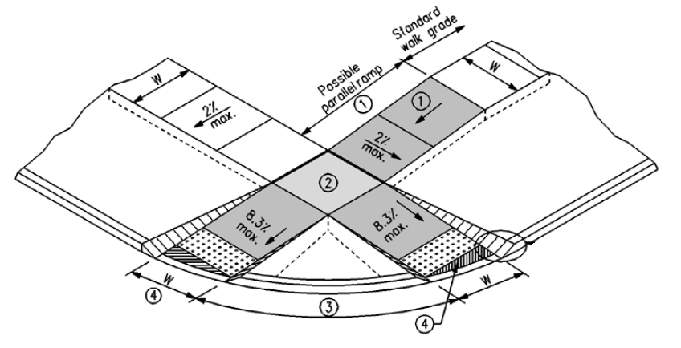
Americans with Disabilities Act
Design Requirements Not addressed
in Minimum Design Standards
ADA information on NDOT Website:
https://dot.nebraska.gov/business-center/civil-rights/
Slide 16
428 NAC 2-001.03A1c, Page 38
Notes:
8/6/2019 replaced web link (http://www.transportation.nebraska.gov/humanres/title6.html).
In Nebraska’s minimum design standards for county roads and municipal streets, the only reference to curb ramps or “barriers to access for the disabled” is on the bottom of page 38. It says that building curb ramps does not, by itself, require the application of 3R or New & Reconstructed standards.
ADA minimum design requirements are not addressed in the minimum design standards for county roads and municipal streets.
ADA is not a state law, it is a separate Federal law.

Slide 17
ADA and PROWAG
Highway Civil Rights Coordinator NDOT
402-479-3553
Civil Rights Specialist, FHWA-NE
402-742-8464
http://www.ada.gov/
http://www.access-board.gov/
Slide 17
Notes:
8/6/2019 Updated contact info.
For guidance, contact Christopher Hassler at the NDOR. the Civil Rights Coordinator at the Nebr DOT.

Slide 18
Video 09
Americans with Disabilities Act (ADA)
Boards - Liaison Services Section
8/6/2019
Notes:
The purpose of this video is to provide basic information on the Americans with Disabilities Act.

