Slide 1
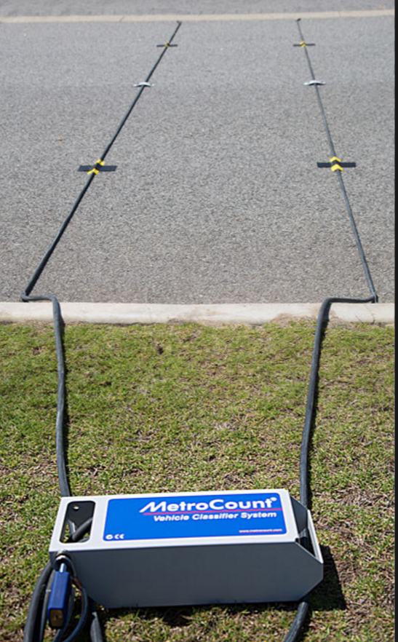
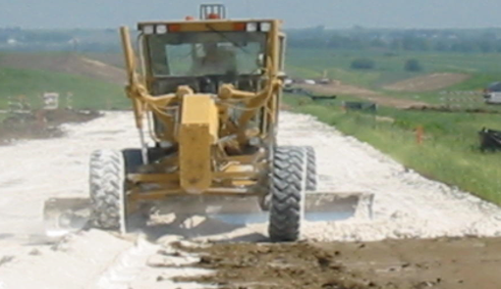
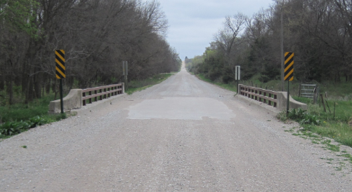
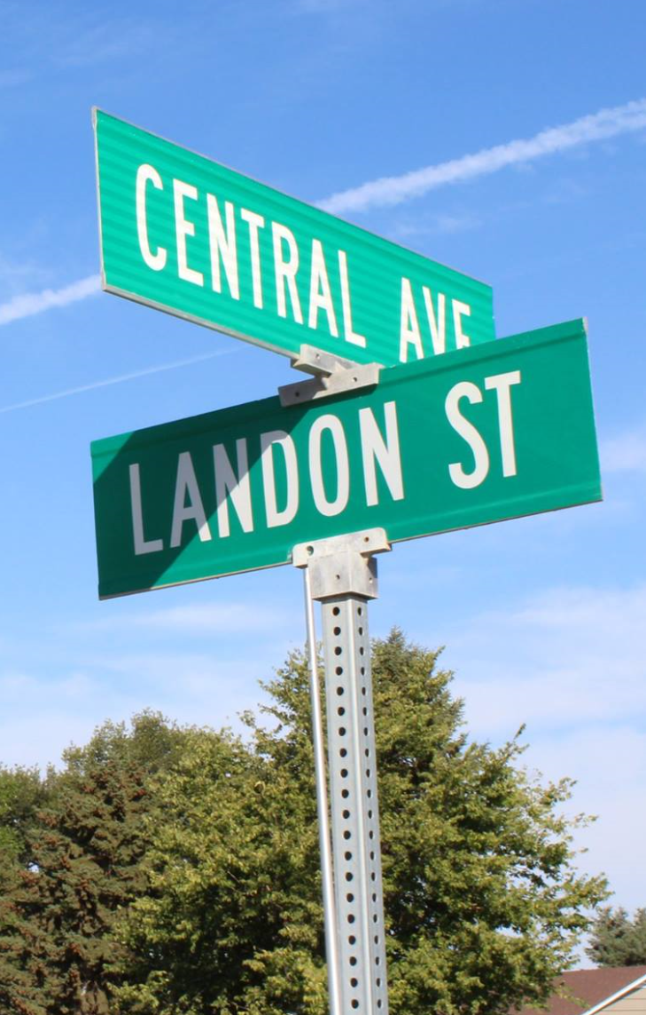
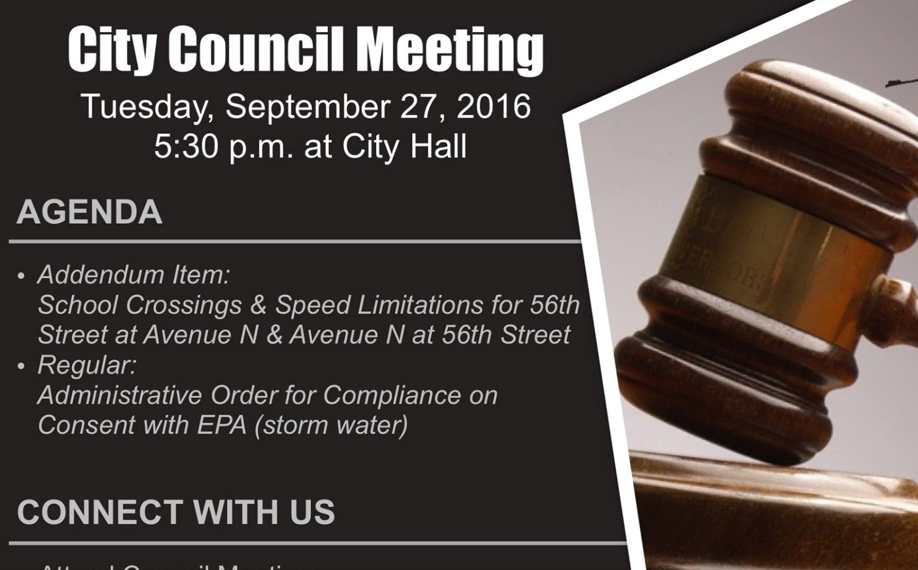
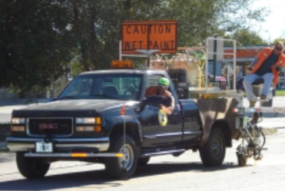

Managing Nebraska’s
Public Roads and Streets
Prelude to Video Series
Boards - Liaison Services Section
https://dot.nebraska.gov/business-center/lpa/boards-liaison/training/
8/3/2019
Video: Prelude
Notes:
8/3/2019 Updated to reflect changes per LB82 (2019). The previous version of this video was 2/20/2018. This slide (Slide 1) changed title from “Introduction” to “Prelude” and web link updated from “http:” to “https:” (ref: Barb Hasterlo’s 8/2/2019 email). Slides 7, 8, 24 and 29 (was slide 27 in previous version) were updated. Slides 25 and 26 added (to display the two Boards downloads websites) and what were slides 25 and 26 (in the previous version) are now slides 27 and 28, respectively.
Welcome to this prelude to a series of videos called “Managing Nebraska’s Public Roads and Streets,” which summarizes Nebraska’s management of public roads and streets as directed by state law and also by rule and regulation.
The target audience is county highway and city street superintendents, and those aspiring to attain those positions. Elected officials and anyone interested in the management of the state’s public roads and streets are also encouraged to view these videos to learn about Nebraska’s system of roads and streets.

Slide 2
This Video . . .
Gives a broad overview of Nebraska’s system of managing its highways, roads and streets
Shows the numbering system for state statutes and for regulations
And provides a brief description of the videos in this series.
Slide 2
Notes:
This video
Gives a broad overview of Nebraska’s system of managing its highways, roads and streets
Shows the numbering system for state statutes and for regulations
And provides a brief description of the videos in this series.

Slide 3
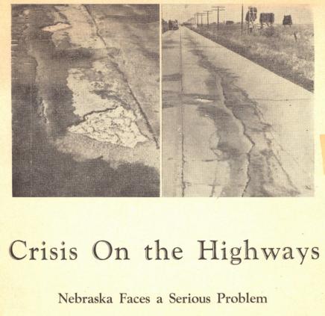
Leading up to . . .
Nebraska’s Landmark Legislation in 1969
Crisis on the Highways, September/October 1948, Omaha World Herald
Slide 3
Notes:
First, a broad overview of Nebraska’s system of managing its highways, roads and streets.
After World War II, through the 1950’s and into the 1960’s, problems with the state’s highways, roads and streets outpaced funds available to correct those problems.

Slide 4




Nebraska’s Landmark Legislation
1969
Slide 4
Notes:
In the latter part of the 1960’s the State of Nebraska did a special study and debated the future of its system of highways, roads and streets, and followed that with the enactment of state statutes that remain in effect today as the basic system (with a few modifications) of managing and funding that system. The original statutes were phased in over four years starting in 1969.

Slide 5
Nebraska’s Landmark Legislation
1969
NBCS
Nebraska Board of Public Road Classifications and Standards
BEX
Nebraska Board of Examiners for County Highway and City Street Superintendents
Slide 5
Notes:
1969 Legislation established two regulatory boards:
The Nebraska Board of Public Roads, Classifications and Standards, referred to as the NBCS.
The Nebraska Board of Examiners for County Highway and City Street Superintendents, referred to as the BEX.
The first video in the series provides basic information on these boards.

Slide 6
Key Regulations
NAC = Nebraska Administrative Code
NBCS
428 NAC
BEX
425 NAC
Slide 6
Notes:
State regulations related to highways, roads and streets were developed as a result of the 1969 legislation.
A regulation is a rule made by an authority and has the force of law. Essentially, a regulation is an extension of state statutes, only with more details as to how to carry out the law.
These two regulations are discussed in this video and throughout the video series. Most of the attention is on Title 428 Nebraska Administrative Code (aka 428 NAC).

Slide 7
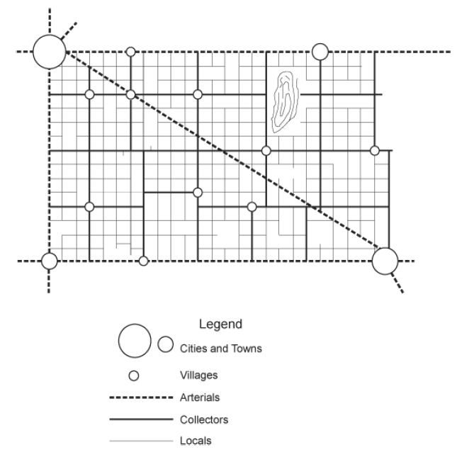

Nebraska’s System - Overview
Functional Classification
Standards
ONE-AND SIX-YEAR PLANNING & PROGRAMMING
FOR
HIGHWAY, ROAD & STREET IMPROVEMENTS
SYSTEMS OF BUDGETING, ACCOUNTING AND INVENTORY FOR HIGHWAY,
ROAD, & STREET & PROGRAMS
Other Statutory Requirements
Slide 7
Notes:
7/31/2019 Updated to reflect changes per LB82 (2019).
State Statutes, supplemented by the rule 428 NAC, set up require
A functional classification system
Uniform standards of design, construction and maintenance
One- and Six-Year Planning and Programming of works and projects.
Systems of budgeting, accounting and inventory for revenues, expenditures, supplies, equipment and operations.
An entity is required by state law to expend all tax revenues for highway, road or street purposes in accordance with approved plans, programs and NBCS standards, including county and municipal tax revenue as well as highway-user revenue allocations.
How all of these work together is briefly summarized on the next screen.

Slide 8
Nebraska’s System - Overview
Functional Classification
428 NAC 1
Basis for
Standards
428 NAC 2
Each Highway, Road and Street is assigned a Classification, by its Function
Uniform Standards for Each Functional Classification
Projects Meet Standards
ONE-AND SIX-YEAR PLANS & PROGRAMS
FOR
HIGHWAY, ROAD & STREET IMPROVEMENTS
Annual Certification of Program Compliance
Other Requirements
SYSTEMS OF BUDGETING, ACCOUNTING AND INENTORY FOR
ROAD, STREET & HIGHWAY PROGRAMS
to NBCS
Slide 8
Notes:
7/31/2019 Updated to reflect changes per LB82 (2019).
A functional classification system is a system of classifying our highways, roads and streets according to the function each one serves, such as local access, collector, arterial, expressway and interstate. This is fundamental to the development of an integrated system of roads. 428 NAC 1 covers functional classification.
A functional classification system permits the establishment of uniform standards of design, construction, and maintenance for each classification of road. Such standards promote the general safety of the traveling public, enhance the free flow of traffic, and also provide improved utilization of highway financing. 428 NAC 2 covers standards.
Maintaining and improving the system is important, and statutes emphasize transparency by requiring annual disclosure of upcoming projects. These are called One- and Six-Year Plans or Programs; as the name indicates, these cover the next six years of planned works and projects. They As a minimum, state law requires that the One-Year Plan or Program of Works and Projects are disclosed to the public via a public hearing, and reported to the NBCS. Works and Projects must meet Board standards. 428 NAC 3 covers One- and Six-Year Plans and reporting.
What public funds are spent and how they are spent is very important. Again, statutes emphasize transparency by requiring annual disclosure of expenditures and revenues along with certification that state statutes were followed. There are statutory requirements for counties, cities, municipalities and the State DOT to have in place systems of budgeting, accounting and inventory for its highways, roads and streets budgets, expenditures, revenues, equipment, supplies and operations. They are disclosed to the NBCS and are available to the public. 428 NAC 4 covers the Standardized System of Annual Reporting. Aka SSAR. In this report to the NBCS, the local public agency certifies that all of its works and projects met NBCS standards.
An annual Certification of Program Compliance is required by state law to be submitted by each county, city, municipality and the State DOT to the NBCS. It certifies that NBCS standards were met on all works and projects, that all required systems were in place, and all State laws were met.
NOT FOR AUDIO
Nebraska's public roads system is one of the largest in the nation; yet its population is relatively
small and ranges from high concentrations of people in urban centers to vast rural areas in which
the population is sparsely located. The citizens in these diverse areas have the same need,
however, for a transportation system which will meet their respective needs. It is not economically feasible to develop all public roads throughout the state to the same high standards, and thus it
became incumbent upon the Legislature to devise a program under which the roads most
important to these diverse areas are developed to modern standards. Adoption of a functional
classification system and implementation of modern management methods will combine to bring
such a program into being and result in improved utilization of highway financing.

Slide 9

Referencing Nebraska
Laws, Rules, Regulations
Boards - Liaison Services Section
Notes:
The following screens provide the numbering scheme and online web links for Nebraska state statutes and for Nebraska rules and regulations. Statutes and regulations provide the foundation for Nebraska’s system of managing its highways, roads and streets. To know the system, it is important to be able to understand the numbering scheme used to identify and locate statutes and regulations.

Slide 10
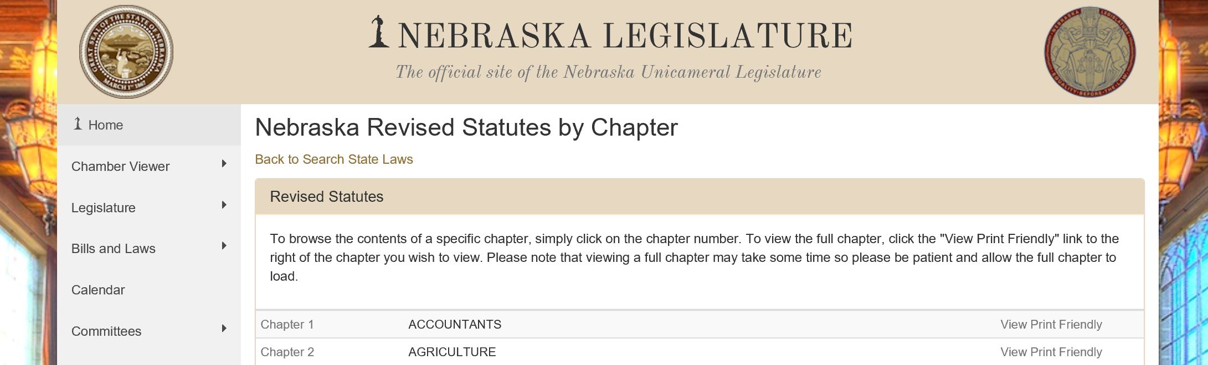
Nebraska
State Statutes
https://nebraskalegislature.gov/laws/browse-statutes.php
Slide 10
Notes:
First, the numbering system for Nebraska state statutes.

Slide 11
State Law
Referencing
State Laws
https://nebraskalegislature.gov/laws/browse-chapters.php?chapter=39
Identifying and referring to laws
- Individual Nebraska statutes are referred to as “Section (hyphenated number)”
- Example: §39-2307
Chapter 39
Article 23
Section 7
Article 8
Section 107
§39-8,107
Slide 11
Notes:
When referring to or identifying Nebraska state statutes . . .
The numbering pattern for statutes is Chapter, Article, Section.
If there is a comma within the number after the dash:
the part before the comma is the Article number and the part after the comma is the Section number.
An example is §39-8,107. Chapter 39, Article 8, Section 107.

Slide 12
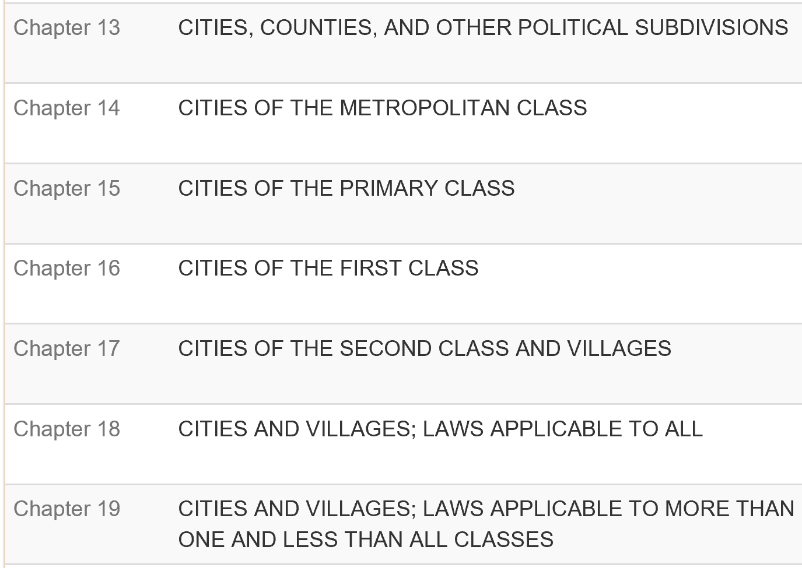
State Law
Nebraska Statutes Pertaining to
Highway and Street Programs
https://nebraskalegislature.gov/laws/browse-statutes.php
Slide 12
Notes:
Nebraska state statutes are all online. The web link is shown toward the top of this screen.
Many Nebraska statues govern Nebraska’s highway, road and street system

Slide 13
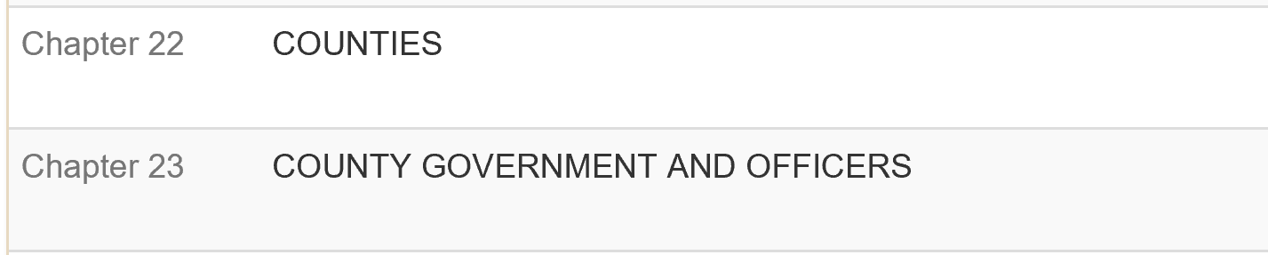
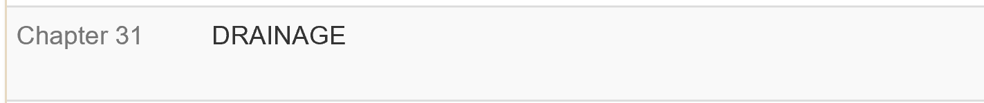
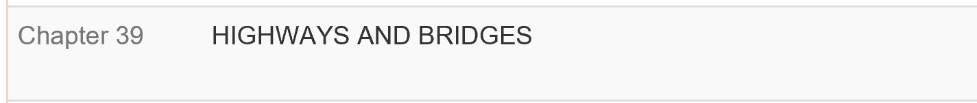


State Law
Nebraska Statutes Pertaining to
Highway and Street Programs
https://nebraskalegislature.gov/laws/browse-statutes.php
Slide 13
Notes:
Chapter 39, addresses highways, roads, streets and bridges.
Rules of the Road are addressed in Chapter 60.

Slide 14

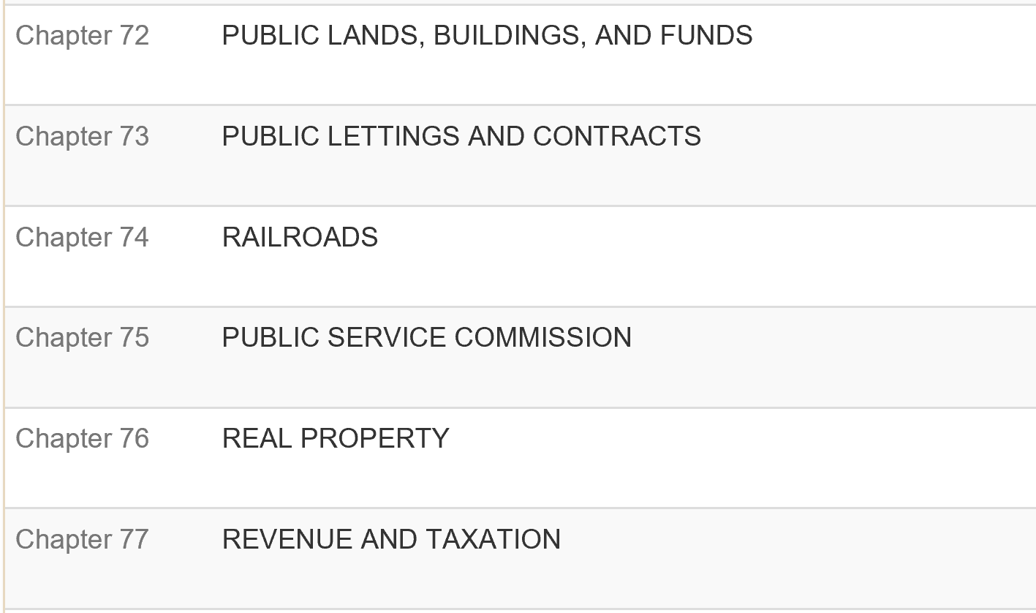
State Law
Nebraska Statutes Pertaining to
Highway and Street Programs
https://nebraskalegislature.gov/laws/browse-statutes.php
Slide 14
Notes:
This screen shows more chapters that affect highways, roads and streets.

Slide 15
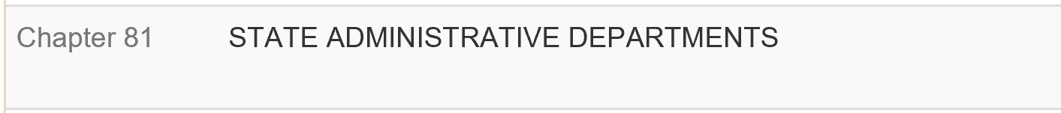
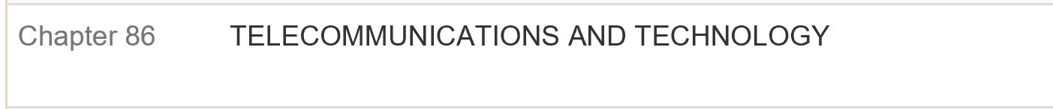
State Law
Nebraska Statutes Pertaining to
Highway and Street Programs
https://nebraskalegislature.gov/laws/browse-statutes.php
Chapter | Subject (Selected Articles in parenthesis)
81 | State Administrative Departments (Article 7 - NDOT; Article 8 – Independent Boards & Commissions [incl. State Tort Claims Act]; Article 34 - Engineers & Architects Regulation Act)
84 | State Officers (Article 7 – General Provisions [including Public Records]; Article 9 – Administrative Procedure Act [incl. Rules & Regulations]; Article 14 – Public Meetings [Open Meetings Act])
86 | Telecommunications and Technology
Slide 15
Notes:
As well as this screen, such as the Engineers & Architects Regulation Act, the Administrative Procedure Act and the Open Meetings Act.

Slide 16
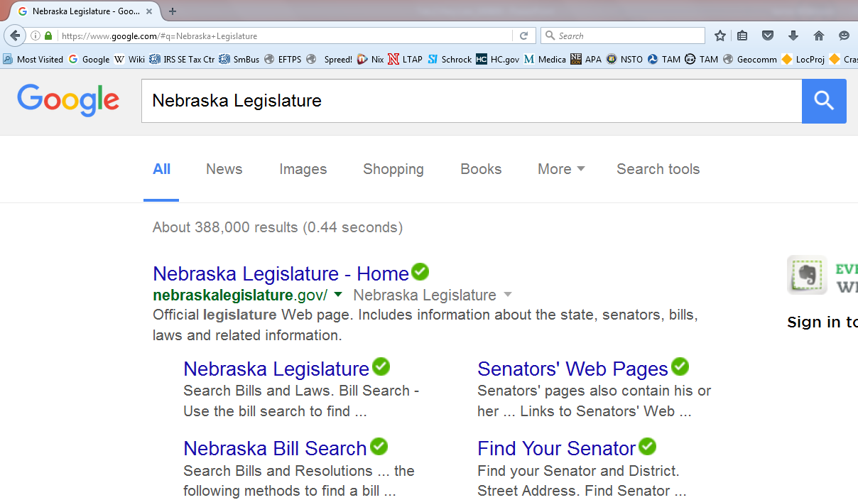
Highway Law
Slide 16
Notes:
You can get to Nebraska’s laws online by searching for Nebraska Legislature.

Slide 17
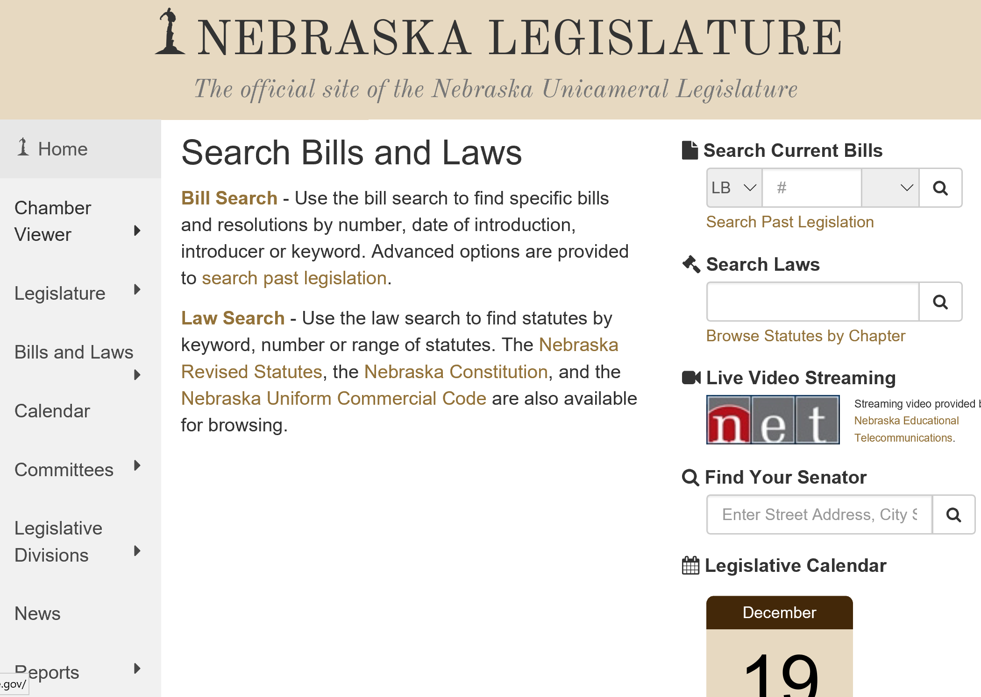
Highway Law
https://nebraskalegislature.gov/
All Nebraska State Laws are available online
Slide 17
Notes:
You can search online for legislative bills and for state statutes.

Slide 18
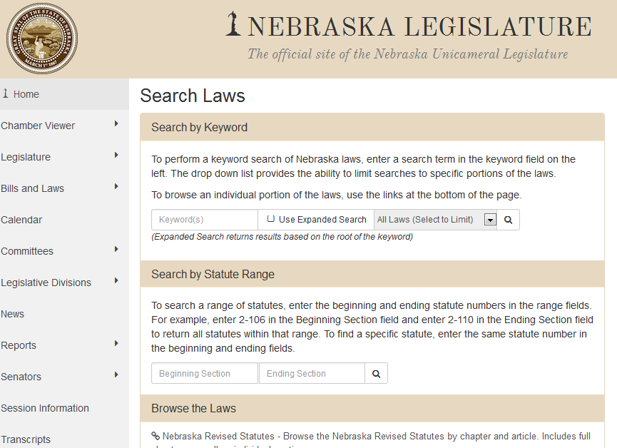
Highway Law
Searching
Search by Keyword
Search by Statute Range
Browse the Laws
Slide 18
Notes:
For laws,
You can search by Keyword, by Statute Range, or by Section and Article numbers.

Slide 19
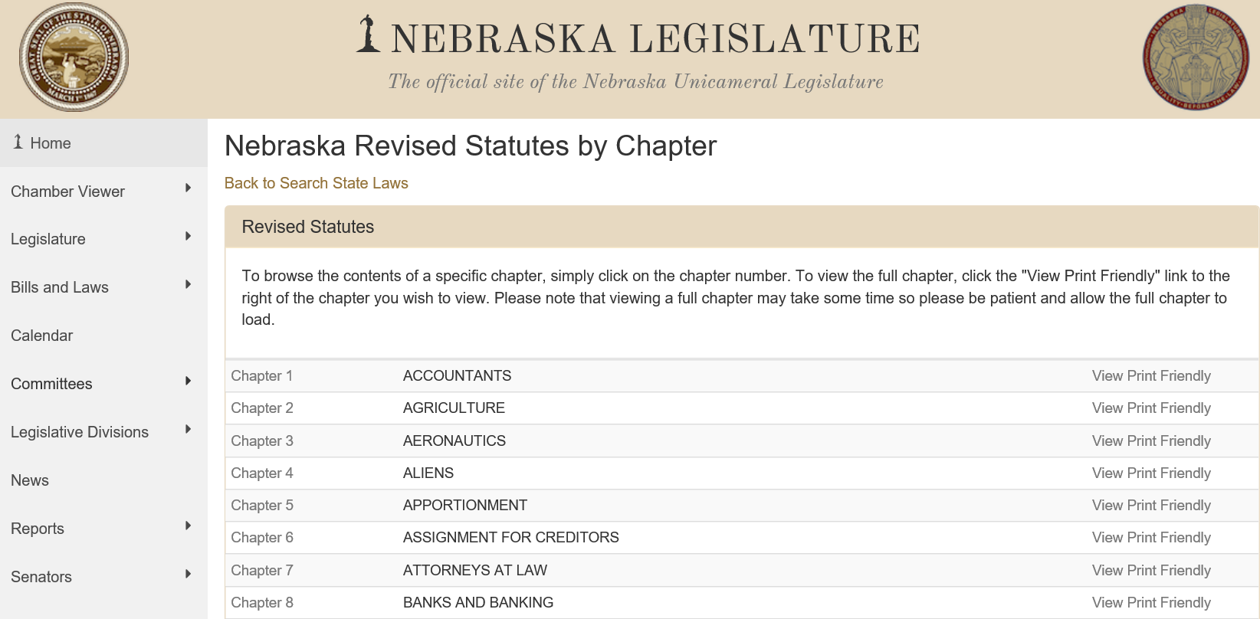
Browse By Chapter
Highway Law
https://nebraskalegislature.gov/laws/browse-statutes.php
Slide 19
Notes:
Say that you are looking for Nebraska Law pertaining to Highways, Roads and Streets, knowing it is Chapter 39, an efficient way of searching state statutes is by Chapter . . .

Slide 20
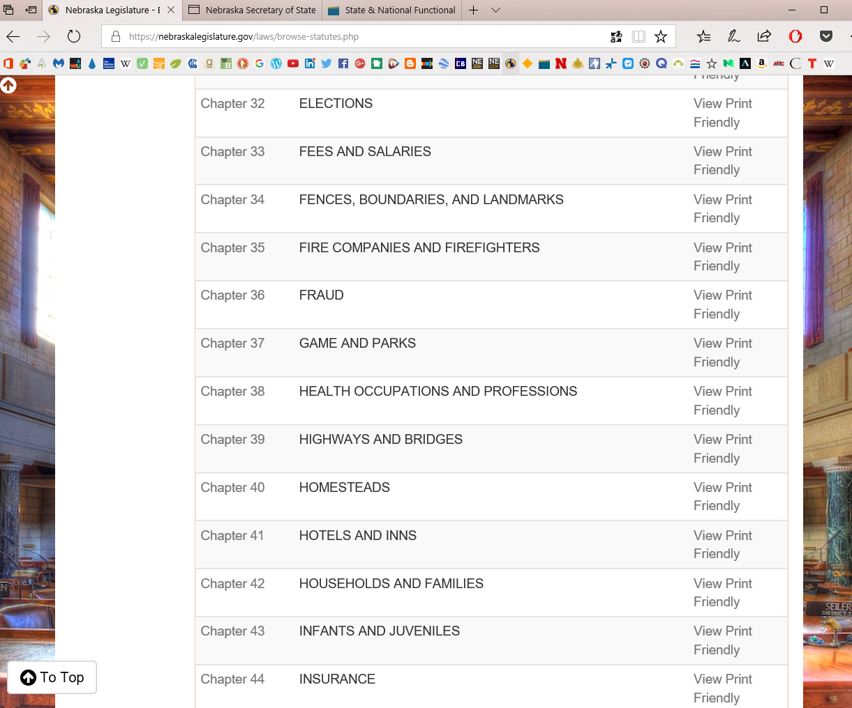
Chapter 39
Highways and Bridges
Highway Law
Slide 20
Notes:
and simply clicking on the Chapter 39 link

Slide 21
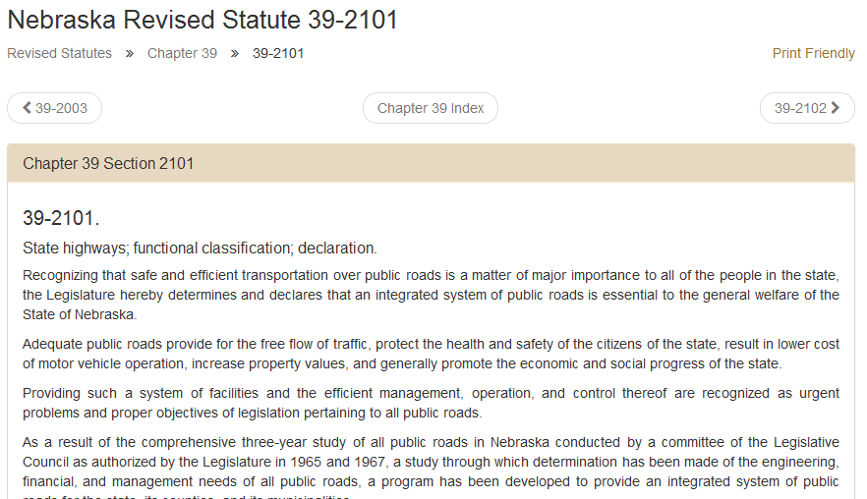
Example Statute
Highway Law
Slide 21
Notes:
Then clicking on any statute of interest.

Slide 22
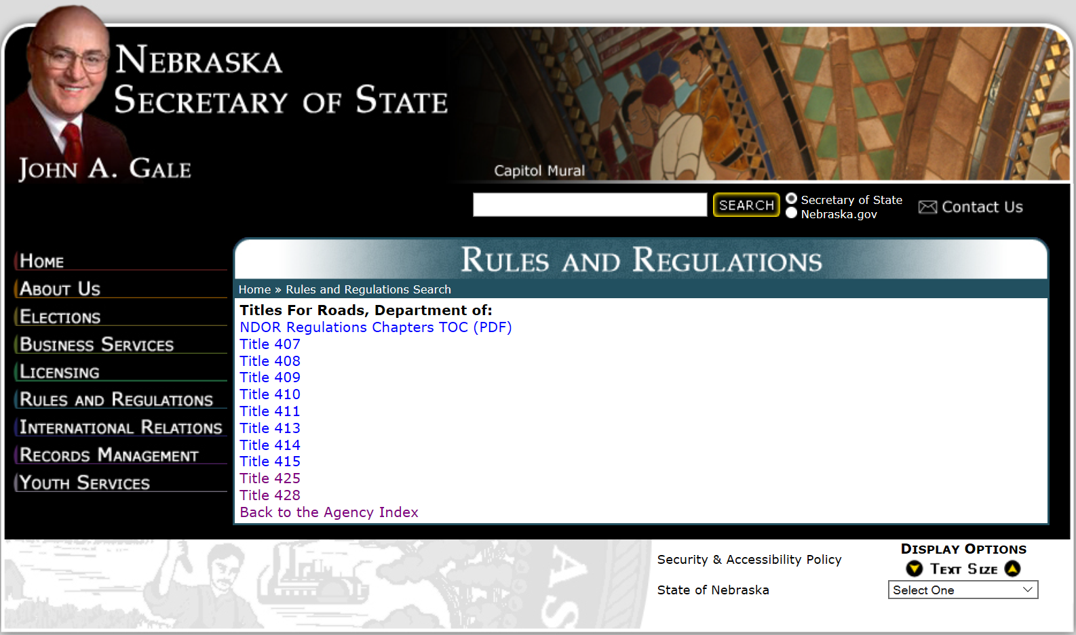
Nebraska
Rules and Regulations
Slide 22
Notes:
Nebraska Rules and Regulations have their own unique numbering scheme.

Slide 23

Referencing Nebraska
Rules and Regulations
Chapter 2
Chapter 2 is Standards, Chapter 1 is
Classification
Example: 428 NAC 2-001.02A
428 = Title Number
NAC = Nebraska Administrative Code
2 = Chapter 2
001 = Section 1 (Chap. 2 has 5 sections)
02 = Subsection 2
A = Part A
Boards - Liaison Services Section
Slide 23
Notes:
Throughout this series of videos there will be references to the Nebraska Administrative Code (NAC) Title 428.
The numbering system for the NAC is shown here.
The Title number, in this case 428, comes first
Then the initials “NAC”
The number directly after NAC is the chapter number.
The numbers after the dash (“-”) indicate the section, subsection and part designations.

Slide 24
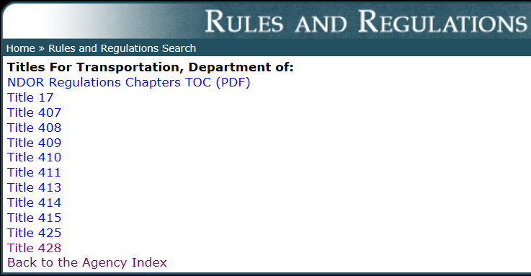
The NAC – NDOT Regulations
Includes BEX and NBCS Regulations
This is a screen shot of the Secretary of State’s website showing the Table of Contents for NDOT regulations
BEX
NBCS
http://www.sos.ne.gov/rules-and-regs/regsearch/Rules/index.cgi?l=Transportation_Dept_of
Notes:
8/3/2019 Updated.
This screen shows the table of contents for various rules and regulations issued by the Nebraska Department of Transportation and the two regulatory Boards – the Board of Examiners for County Highway and City Street Superintendents, and the Nebraska Board of Public Roads Classifications and Standards.
Online, these regulations can be found on the Secretary of State’s website, listed under the Department of Transportation.
They can also be accessed on NDOT’s website, under “Business Center” “Local Public Agencies” “Boards-Liaison Services”, at the “Downloads” link under the appropriate Board. (8/3/2019 next two slides inserted to explain this)
The BEX rules and regulations are Title 425 NAC
The NBCS rules and regulations are Title 428 NAC.
NOT FOR AUDIO
As you can see on the screen, there are nine other rules associated with the Nebraska Department of Transportation. These range from:
Title 407 is NDOT: Hearing Practice and Procedure.
[Title 408 is NDOT: Hay Harvesting Permits. ]
[Title 409 is Construction Division: the rule for Bidding State Highway Work. ]
[Title 410 is Utilities Section: Utility Permits.]
Title 411 is Traffic Division: the Manual on Uniform Traffic Control Devices, [release of Blood Alcohol content information, etc.]
[Title 413 is Agreements Section: Consultant Services]
[Title 414 is Scenic Byways]
[Title 415 is Rail & Public Transportation Division: for Public Transportation Assistance Program, Rail Crossings, etc.]
Title 425, regulations for the Board of Examiners for County Highway and City Street Superintendents: Hearing Practice and Procedure for Contest Cases. This is the Board that conducts examinations twice per year. 39-2304.
Title 428, the one we are most concerned with for this video series, has regulations for the Board of Public Roads Classification and Standards.

Slide 25
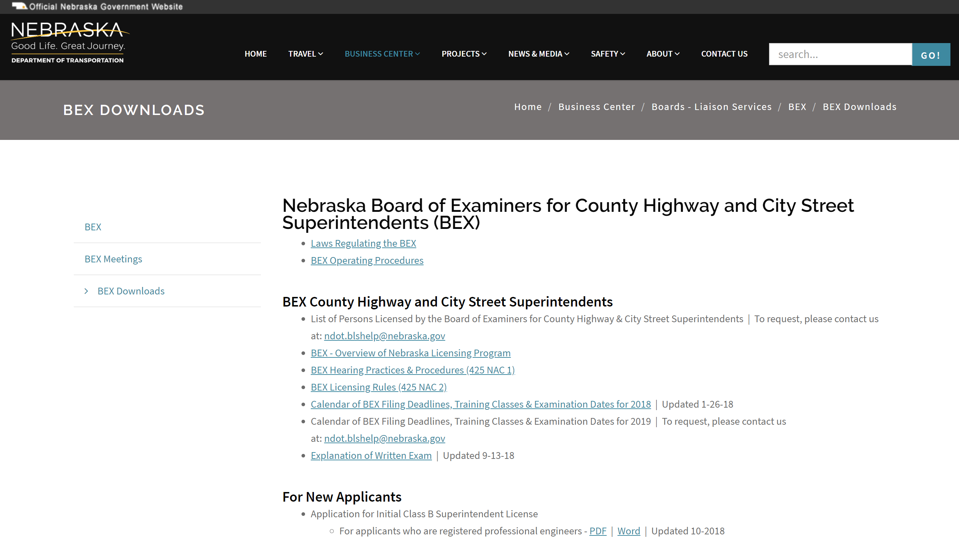
https://dot.nebraska.gov/business-center/lpa/boards-liaison/bex/downloads/
Slide 25
Notes:
8/2/2019 new slide
The Board of Examiners for County Highway and City Street Superintendents Rules and Regulations can also be found on the BEX Downloads web page, shown here.
To get there - use the link shown on this screen, OR
Start on NDOT’s website, under “Business Center” left-click on “Information and Policies” (top, right-hand side) then scroll down to the bottom of the page, lower-left side to: “Local Public Agencies” “Boards-Liaison Services”, and click there
click on “BEX” and, finally, click on “BEX Downloads”

Slide 26
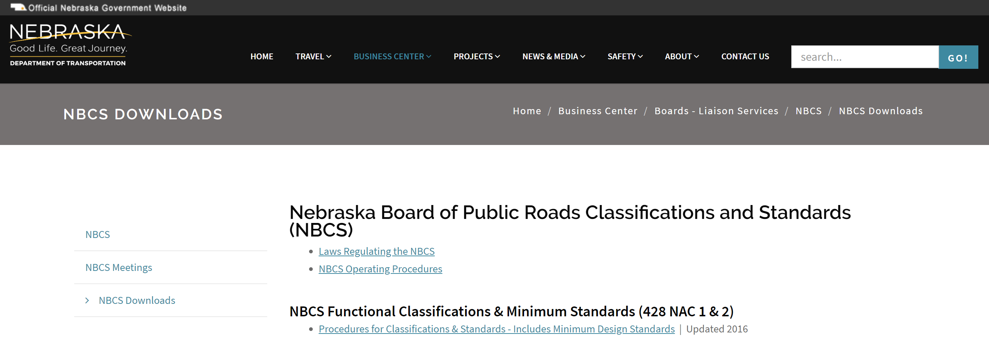
https://dot.nebraska.gov/business-center/lpa/boards-liaison/nbcs/downloads/
Slide 26
Notes:
8/2/2019 new slide
Likewise, for rules and regulations relating to the Board of Public Roads Classifications and Standards (NBCS), go to the NBCS Downloads web page.
To get there – use the link shown on this screen, OR
Start on NDOT’s website, under “Business Center” left-click on “Information and Policies” (top, right-hand side) then scroll down to the bottom of the page, lower-left side to: “Local Public Agencies” “Boards-Liaison Services”,
Left-click on “NBCS” and, finally, “NBCS Downloads”

Slide 27
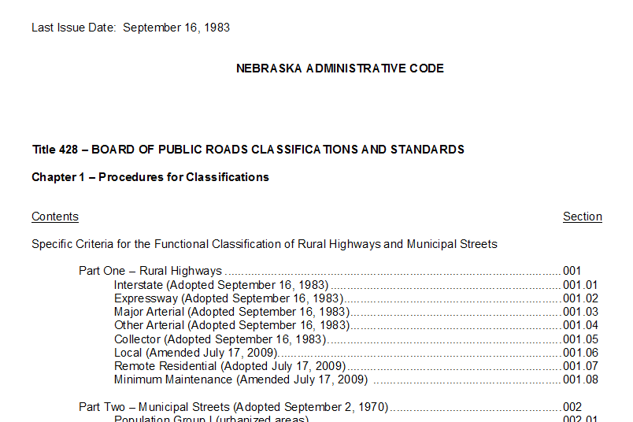
Title 428 Chapter 1
http://www.sos.ne.gov/rules-and-regs/regsearch/Rules/Transportation_Dept_of/Title-428/Chapter-1.pdf
Notes:
8/3/2019 Updated to reflect changes per LB82 (2019). This was Slide 25 but is now Slide 27 because of the insertion of two slides (25 and 26, the two Boards downloads websites).
This slide shows an example of a Board of Public Roads rule and regulation. It is Title 428 Chapter 1 which addresses the functional classification of highways roads and streets.

Slide 28
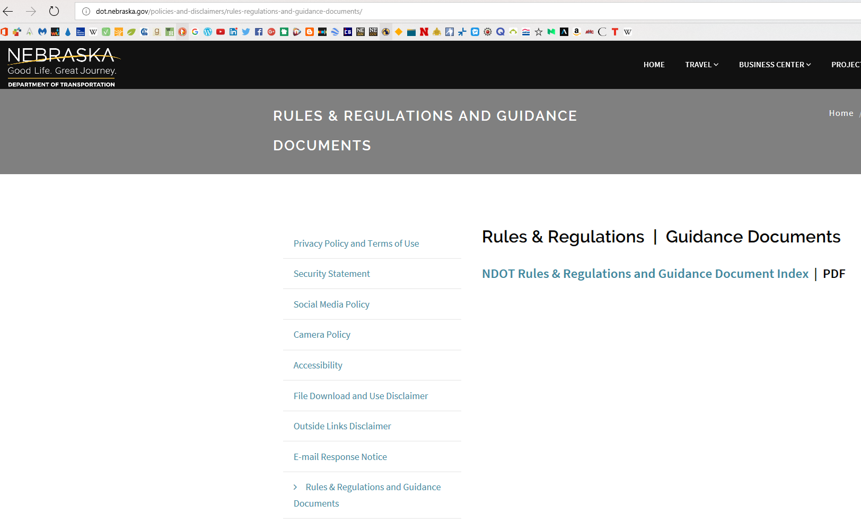
https://dot.nebraska.gov/policies-and-disclaimers/rules-regulations-and-guidance-documents/
Slide 28
Notes:
8/3/2019 Updated to reflect changes per LB82 (2019). Verified the validity of the website. This was Slide 26 but is now Slide 28 because of the insertion of two slides (25 and 26, the two Boards downloads websites).
In the future, NDOT Rules , Regulations and Guidance Documents will be accessed through the Website shown on this screen.
This will be the main go-to site for NDOT, Board of Public Roads (NBCS) & and Board of Examiners (BEX) regulations.
This website will comply with § 84-901.03.
NOT FOR AUDIO
84-901.03. Agency; guidance document; issuance; availability; notice; request to revise or repeal; response; agency publish index. (1) Upon the issuance of a guidance document, an agency shall make such document available at one public location and on the agency’s web site. The agency shall also publish on its web site an index summarizing the subject matter of all currently applicable rules and regulations and guidance documents. Such agency shall provide the index electronically to the Clerk of the Legislature by December 31 of each year.
(2) An agency shall ensure that the first page of each guidance document includes the following notice: This guidance document is advisory in nature but is binding on an agency until amended by such agency. A guidance document does not include internal procedural documents that only affect the internal operations of the agency and does not impose additional requirements or penalties on regulated parties or include confidential information or rules and regulations made in accordance with the Administrative Procedure Act. If you believe that this guidance document imposes additional requirements or penalties on regulated parties, you may request a review of the document.
(3) A person may request in writing that an agency revise or repeal a guidance document or convert a guidance document into a rule or regulation. No later than sixty calendar days after the agency receives such a request, the agency shall advise the requestor in writing of its decision to (a) revise or repeal the guidance document, (b) initiate a proceeding to consider a revision or repeal of a guidance document, (c) initiate the rulemaking or regulationmaking process to convert the guidance document into a rule or regulation, or (d) deny the request and state the reason for the denial.
(4) All decisions made by an agency under this section shall be made available at one public location and on the agency’s web site.
Source: Laws 2016, LB867, § 5; Laws 2017, LB209, § 2.
Effective Date: August 24, 2017

Slide 29
Video Series – Topics Summary
Managing Nebraska’s Public Roads and Streets
Introduction – The “Big Picture”
Classification and Standards – a series of videos
Transportation Asset Management
Bridge Inspections
Records Management
Notes:
8/3/2019 Updated to reflect changes per LB82 (2019). Items on this slide changed to bullets; since OneAndSix reporting and SSAR are going away per LB82, this avoids the confusion of having a gap in the lettering or assigning new letters to the remaining videos. This was Slide 27 but is now Slide 29 because of the insertion of two slides (25 and 26, the two Boards downloads websites). OneAndSix and Budgeting/Accounting/Inventory (formerly SSAR) slides to be modified and included in the “Introduction – The Big Picture” video, therefore they are to e removed from the video series – as a result of LB82.
This screen will show the topics covered in this series of videos.
The first video provides an overview of the legal and structural framework for Nebraska’s program of public roads and streets. It also briefly addresses requirements for OneAndSix Year Planning and Programming, and systems for budgeting, accounting, and inventory.
Following the first video is the Classification of, and Standards for, Nebraska’s public roads and streets. This is actually its own series of videos. The first four videos provide a broad overview of Nebraska’s functional classification system and the standards for public roads and streets. The videos that follow the first four are more detail oriented – with guidance and examples how to determine which standards to apply. If you are only interested in the basics of Classification and Standards, watch the first four videos. If you are a practitioner, or a candidate for a superintendent’s license, the recommendation is to watch all of Classification and Standards videos.
The topic following Classification and Standards is an overview of One- and Six-Year Planning, and reporting requirements.
And then a summary of the Standardized System of Annual Reporting, or SSAR. Funding distribution and accounting will also be addressed.
A broad overview of Transportation Asset Management, a powerful supporting tool for a good public roads management system, is provided in a short video, as a best practice. State laws and regulations for Nebraska’s public roads and streets, although not specifically mentioning transportation asset management by name, has some of its elements by requiring One- and Six-Year plans or programs, systems of budgeting, accounting and inventory, and by encouraging orderly development and good management of road and street programs.
The next video is dedicated to an overview of bridge inspection requirements.
Records Management is an important component of a good public roads management system. Requirements are summarized in the Records Management video.

Slide 30
Managing Nebraska’s
Public Roads and Streets
Introduction to Video Series
Boards - Liaison Services Section
https://dot.nebraska.gov/business-center/lpa/boards-liaison/training/
8/3/2019
Video: Prelude
Notes:
The entire series of videos can be found online at the web link shown on the screen.
It would be most efficient to watch the videos in the order they are listed on the website.
it is recommended that you print out the accompanying PowerPoint presentation 1st (3 slides per page with the notes section), then, watch the video with the PowerPoint print-out in front of you”. (to aid in note taking). [Barb H. 12/21/2017]

