Slide 1


2016 Standards
Video 07
MDS – 3R Standards
Nebraska Administrative Code
Title 428
Rules and Regulations of the
Board of Public Roads Classifications and Standards
(Administrative Host: Nebraska Department of Transportation)
County Roads and Municipal Streets
Neb. Rev. Stat. 39-2113
https://dot.nebraska.gov/media/5593/nac-428-rules-regs-nbcs.pdf
Boards - Liaison Services Section
8/8/2019
Notes:
8/8/2019 Updated first and last slides – Administrative Host: Nebraska Department of Transportation, not Nebraska Department of Roads.
8/6/2019 Updated to reflect changes per LB82 (2019). The previous version was 12/27/2016. Six slides deleted and four slides updated. First and last slides updated web link and NDOT logo. Deleted slides 3, 4, 5, 6, 7 and 8 (of the 12/27/2016 version). Slide 44 (Slide 50 of the 12/27/2016 version) updated NDOR→NDOT and updated two corresponding audio media. Slide 48 (Slide 54 of the 12/27/2016 version) Hwy Safety Office contact information updated and made more generic, deleted Co-NECTAR link and reference because the NDOT no longer supports it, also, instances of NDOR→NDOT requiring two audio media revisions.
This is one of a series of videos on Nebraska’s system of
Classifying and applying standards to its highways, roads and streets.
This video addresses design standards and requirements for Resurfacing, Restoration and Rehabilitation – Commonly known as 3R

Slide 2
Terminology and Acronyms used in this video
NBCS = Nebraska Board of Public Roads Classifications and Standards = “The Board” = “The Board of Public Roads”
NDOT = Nebraska Department of Transportation
Standards vs. Minimum Design Standards (MDS)
Neb. Rev. Stat. = Nebraska Revised Statutes
NAC = Nebraska Administrative Code = “The Rule”
Highways = Roads = Streets (§39-101(3), §60-624)
3R = Resurfacing, Restoration and Rehabilitation
FC = Functional Classification
CFR = Code of Federal Regulations
AASHTO = American Association of State Highway Transportation Officials
ACET = Asphaltic Concrete Equivalent Thickness
Notes:
8/6/2019 Updated NDOR→NDOT.
First, some terminology and acronyms . . .
NBCS is the Nebraska Board of Public Roads Classifications and Standards; it may also be called the Board of Public Roads, or just The Board.
NDOR NDOT is the Nebraska Department of Roads Transportation
Standards refers to the NBCS standards, including design, construction, maintenance and relaxation of standards. MDS refers to the Minimum Design Standards, which address only the design aspect of a work or project. Standards are often termed “minimum” but realize there are maximums (for superelevation, grade) and ranges ( for cross slopes). When we say “minimum” – sometimes it refers to all of those.
Neb. Rev. Stat. refers to the Nebraska Revised Statutes
NAC is the Nebraska Administrative Code. It may be referred to as “The Rule” or “The Regulation.”
The word “Highway” in Nebraska law also refers to roads and streets. Highway means the entire width between the boundary limits of any street, road, avenue, boulevard, or way which is publicly maintained when any part is open to the use of the public for purposes of vehicular travel.
3R is short for resurfacing, restoration and rehabilitation. For more details, see the video dedicated to 3R.
FC is Functional Classification.
CFR is the acronym for the Code of Federal Regulations.
AASHTO is the acronym for the American Association of State Highway Transportation Officials
ACET is Asphaltic Concrete Equivalent Thickness

Slide 3
Chapter 2 (428 NAC 2)
Procedures for Standards
Title 428 Chapter 2
Slide 3
428 NAC 2
Notes:
This video provides more details on the Minimum Design Standards
Specifically, for County Roads and Municipal Streets, pages 35-86.
State Highway Standards, pages 5-34, are not covered in this video.

Slide 4
Resurfacing, Restoration and Rehabilitation
3R
Design Standards
3R Design Standards
428 NAC 2-001.03A1c , Pages 37-38
428 NAC 2-001.03B Note 6, Page 47
Notes:
Nebraska’s design standards for county roads and municipal streets did not have 3R design standards until the 2016 standards became effective in May, 2016.

Slide 5
3R – what is it?
Resurfacing, Restoration, Rehabilitation
Definition of 3R
Work scope beyond maintenance, but less than reconstructed
Asset Preservation, Extending the Service Life
Safety conscious design
428 NAC 2-001.03A1c , Pages 37-38
428 NAC 2-001.03B Note 6, Page 47
Slide 5
Notes:
A 3R scope of work is work beyond maintenance, but less than a full reconstruction scope of work.
3R is defined on pages 37 and 38 of the design standards.
The purpose of 3R is to preserve the transportation asset and extend its life.
A key component in the 3R process to be discussed later in this video is Safety Conscious Design.
In this video, 3R will be compared and contrasted with Maintenance and Reconstruction scopes of work
Reconstruction is defined on page 37 of the design standards.
Maintenance is defined in 428 NAC 2-003 pages 88-91

Slide 6

The Life Cycle
Routine Maintenance
Oil/filter changes
Keep air in the tires
Non-routine Maintenance
New brakes, tires
Serpentine Belt
Replace It
New Vehicle
Quick, Short-term, low cost
Longer lasting, higher cost
Economic Cost Effectiveness
Reasonable Repairs
Being smart with your money
Slide 6
Notes:
Thinking of the life cycle of a vehicle,
After its purchase, there is routine maintenance that is necessary, such as changing the oil and filter. These are done relatively quickly and are low cost.
Then there are those occasions that hit your pocket book more – things like new tires, or replacing a serpentine belt. These are more extensive and expensive.
As those types of expenses come with more frequency, you decide it’s not worth it to put more money into vehicle,
and - being smart with your money - trade it in for a new or newer vehicle – a big hit on the pocket book.
and the cycle starts all over again.
NOT FOR AUDIO
Bridge 3R structural capacity (June 8, 2015 meeting minutes – comments by Mark Traynowicz, NDOT Bridge Engineer):
3R definitions and standards help in determining what Maintenance is and what is more than Maintenance. Maintenance is usually more of a short term, quick fix. 3R is more extensive and longer lasting.
Economic cost effectiveness should lead to reasonable repairs. At some point, like a car, it just doesn't pay to put more money into maintenance. It is up to the owner to be smart with public money.

Slide 7
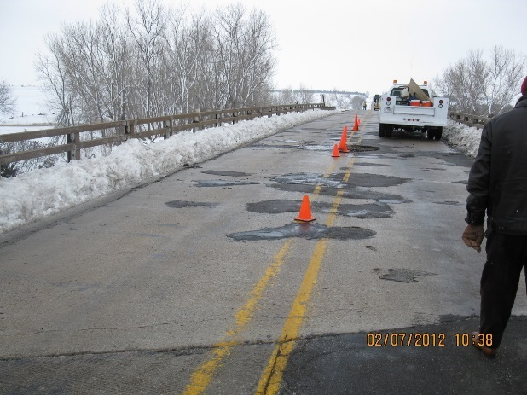
The Life Cycle
Maintenance
428 NAC 2-003
Pages 88-91
3R
Reconstructed
428 NAC 2-001.03b
Page 37
Quick, Short-term, low cost
Longer lasting, higher cost
Economic Cost Effectiveness
Reasonable Repairs
Being smart with public money
Slide 7
428 NAC 2-001.03A1c, Pages 37-40
Notes:
It is similar for the life cycle of a road or street,
After building it, there is routine maintenance such as crack sealing, patching and thin resurfacing. This is quick, low-cost work, done possibly by city or county crews.
Occasionally, there is a need to upgrade some guardrail, add an auxiliary lane, widen the shoulders, or do a thick resurfacing. These are 3R scopes of work. They are larger projects, costing more, and likely done by contractors.
After so many years of patching, and resurfacing, there is eventually a need to rebuild the road or street from the bottom up – replacing the base and the surfacing, or replacing a bridge or culvert. This is a Reconstructed scope of work, typically the most expensive.
The cycle then starts over.
Choosing the right scope of work for the road or street over the years is being smart with public money.
3R standards allow more flexibility to make good choices without having to come to the Board of Public Roads for a relaxation of standards.
NOT FOR AUDIO
Bridge 3R structural capacity (June 8, 2015 meeting minutes – comments by Mark Traynowicz, NDOT Bridge Engineer):
3R definitions and standards help in determining what Maintenance is and what is more than Maintenance. Maintenance is usually more of a short term, quick fix. 3R is more extensive and longer lasting.
Economic cost effectiveness should lead to reasonable repairs. At some point, like a car, it just doesn't pay to put more money into maintenance. It is up to the owner to be smart with public money.

Slide 8
3R Standards
Relative Scope and Costs
New/Reconstructed
$$$$$$$$$
3R
$$$$$$
Maintenance
$$$
428 NAC 2-001.03A1c , Pages 37-38
428 NAC 2-001.03B Note 6, Page 47
Slide 8
Notes:
This screen shows generally how 3R work fits with respect to scope of work and costs, relative to Maintenance work and New & Reconstructed work. It is only a pictorial, and not based on actual statistics or numbers.

Slide 9
3R Boundaries
what is the boundary between 3R and Maintenance standards?
What is the boundary between 3R and New and Reconstructed?
Maintenance
3R
New/Reconstructed
Slide 9
428 NAC 2-001.03A1d, Pages 39-40
Notes:
This video will summarize the boundaries between 3R work and Maintenance work And 3R work and New & Reconstructed work.
As you study the design standards, you will see words such as “minor”, “major”, “extensive” and “selected locations” that provide design flexibility and at the same time are gray areas in the standards.

Slide 10

Chapter 2 (428 NAC 2)
Procedures for Standards
Title 428 Table of Contents
Slide 10
428 NAC 2-003, Pages 88-91
Notes:
Minimum Maintenance Standards were addressed in a previous video in this series of Classification and Standards videos.
Minimum Maintenance Standards are covered in Section 003 of Chapter 2.
See pages 88-91 for the definition and limits of maintenance, and a listing of physical maintenance activities.

Slide 11
3R Boundaries
------------------------------------------------------------------------------------------
Defined By Scope of Work for:
3R Boundaries
Base
Pavement Strategy (thickness)
Bridges and Structures*
Unpaved Roads
* Covered later in the Bridges and Structures Video
Slide 11
428 NAC 2-001.03A1d, Pages 39-40
Notes:
There are four ways the design standards distinguish a 3R scope of work from the other types of work.
READ THEM
The following screens discuss each of these.
Except Bridges and Structures, which are addressed in a separate video
Typically, maintenance is defined, and reconstruction is defined, so 3R usually ends up being whatever scope is in between.
That is a simplification, but it generally holds true.

Slide 12
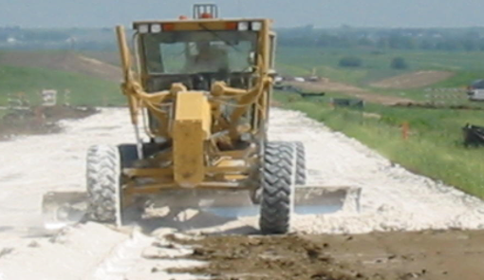
3R Boundaries - Base
Traveled Way:
Existing Base
Quick, Short-term, low cost
Longer lasting, higher cost
Maintenance
Replace unsuitable base materials in patching operations
Nothing extensive or costly
3R
Remove surface structure down to base
Minor base repairs
Recycling strategies which incorporate road structure into base
Reconstructed
Replacement of entire existing base
428 NAC 2-001.03A1d1, 3R Page 39
428 NAC 2-001.03A4a, Base, Page 42
428 NAC 2-003 (Maintenance) Page 88
Slide 12
Notes:
The base of a road or street is defined on page 42 as all layers directly or sequentially underneath the roadway surface including layers such as a foundation course and/or subgrade.
For the base of a road or street,
the design standards establish boundaries between 3R work and Maintenance work, and between 3R work and New & Reconstructed work
Minimum Maintenance Standards, on page 88, allow replacement of unsuitable base materials in patching operations,
but on the bottom or page 89 anything extensive or costly would be considered a 3R scope of work or possibly a Reconstructed scope of work.
Replacement of the entire base, or construction of an entire new base, is considered a Reconstructed scope of work, according to the definition of Reconstruction on page 39.
The intent of the 2016 design standards, for the purpose of establishing the boundary between 3R and Reconstructed types of work, is that the base being referred to does not include the base under the shoulders.
For example, if the scope of work is only to reconstruct the shoulders including replacement of the base underneath the shoulders, the Board of Public Roads does not require reconstruction of the entire road or street to New & Reconstructed standards.
A 3R scope of work is anything in between Maintenance and Reconstructed. See page 39. If the surfacing is removed down to its base, but the base is not removed, replaced or strengthened, it is considered a 3R scope of work and minimum 3R standards apply.
Minor base repairs are allowed.
Recycling strategies which incorporate the road structure into the base are allowed.
For unpaved roads, Standards allow replacement of the base at selected safety improvement locations; this will be addressed in more detail, momentarily.
NOT FOR AUDIO
Applies to all roads and streets – paved and unpaved
From 1/7/2016 Meeting Minutes:
Definition of Base 001.03A1d1 and the Board’s intent with respect to 3R safety improvements such as Vertical Curve sight distance improvements and which standards apply to the work even if the base needs to be completely removed and replaced. Summary of Discussion: The Board’s intent is for this work to be designed and built to minimum 3R standards as stated in the appropriate table. The Board’s intent is not to require New & Reconstructed standards for these “minor” or “spot” improvements as that could tend to discourage going forward with the safety improvement. Nathan explained that the State builds the section back to previous standards which may be less than current New and Reconstructed standards but more than current 3R standards. JW proposed adding an allowance for “, replacing the base at selected safety improvement locations (minor alterations of grades, vertical and horizontal curves),” in the first bullet, second sentence after “repairs to base.” Roger approved that verbiage.

Slide 13
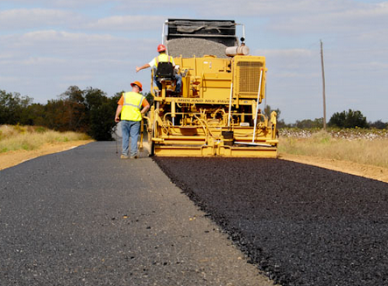
3R Boundaries - Pavement
Traveled Way:
Existing Paved Surfaces
Quick, Short-term, low cost
Longer lasting, higher cost
Maintenance
Patching, repairing
Surface treating
Joint filling
Resurfacing
  2 inches or less ACET*
Nothing extensive or costly
3R
Resurfacing, more than 2 inches ACET* up to and including 6 inches ACET*
Reconstructed
More than 6 inches ACET*
* Asphalt Concrete Equivalent Thickness (ACET)
428 NAC 2-001.03A1d2, Pages 39-40
428 NAC 2-003 (Maintenance) Pages 88-89
Slide 13
Notes:
For pavement rehabilitation strategies,
the design standards establish boundaries between 3R work and Maintenance work, and between 3R work and New & Reconstructed work
Minimum Maintenance Standards, on page 88, allow patching, repairing, surface treating, joint filling and mudjacking on bituminous and concrete surfaces, and resurfacing.
but on the bottom or page 89 anything extensive or costly would be considered a 3R scope of work or possibly Reconstructed.
Furthermore, page 39 of the design standards limits maintenance resurfacing to a depth of 2 inches or less, equivalent structure, of any pavement material.
Equivalent structure, or asphaltic concrete equivalent thickness (ACET), will be explained momentarily.
Page 40 indicates that placement of more than six inches of asphaltic concrete equivalent thickness, of bituminous materials, or six inches nominal structure depth, of Portland cement concrete materials, requires the application of New & Reconstructed standards to the work or project.
With respect to pavement rehabilitation, anything in between Maintenance and New & Reconstructed requires the application of minimum 3R standards.

Slide 14

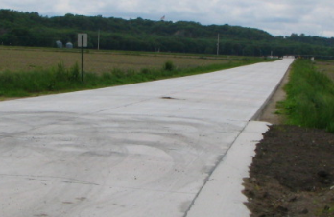
ACE or PCC Thickness, ACET*
3R Boundaries - Pavement
Quick, Short-term, low cost
Longer lasting, higher cost
Maintenance 3R Reconstruction
≤ 2” 2(+)” to 6” > 6”
* Asphalt Concrete Equivalent Thickness (ACET)
Overlay over existing paved surfaces
Slide 14
428 NAC 2-001.03A1d2, Pages 37, 39-40
Notes:
This screen summarizes the thresholds for 3R standards with respect to pavement rehabilitation thickness or depth.
Whenever the term overlay is used, it means an overlay over existing paved surfaces. The application of hard surfacing on an existing unpaved road is a New & Reconstructed scope of work; see page 37 of the design standards.
NOT FOR AUDIO
Asphalt photo: image from web www.charlestonctc.org ultra-thin overlay
PCC Overlay photo: Fullerton 535th St, from Bill Cook

Slide 15
Asphaltic Concrete Equivalent Thickness
ACET
?
Bituminous Materials – Asphalt, and Recycling Strategies
Pavement Structural Strength depends on
Soil Support
Traffic Loads
Service Life
Environment
etc
Slide 15
428 NAC 2-001.03A1d2, Page 40
Notes:
To understand asphaltic concrete equivalent thickness (ACET),
Let’s start with the fact that one of the purposes of many pavement rehabilitation strategies is to improve the load carrying capacity , i.e. structural strength, of the road or street.
For bituminous materials, which includes asphalt and recycling strategies,
Structural Strength Depends on soil support, traffic loads, service life and the effects of the environment.
For bituminous materials, different strategies can result in different levels of structural strength.
Asphaltic Concrete Equivalent Thickness (ACET) is a number that provides a way of determining and directly comparing the different levels of structural strength for those different strategies.
It is based on structural number values attributed to the factors listed on the screen.

Slide 16

Asphaltic Concrete Equivalent Thickness
Example Strategy:
2” Recycle with 1½“ Hot Mix Asphalt (HMA) = 3½“ Total
ACET Strength Assumption: 1” HMA = 4” Recycle
1.5” New HMA
1.5
2” New HMA
=
2” Hot In Place
Recycle
  2 x (1/4) = 0.5
Maintenance Standards Apply
2.0
Slide 16
428 NAC 2-001.03A1d2, Page 39
Notes:
This screen provides an example of Asphaltic Concrete Equivalent Thickness.
Application of Two inches of hot-mix asphalt overlay would be considered a maintenance scope of work. By itself, It would not require 3R standards or New & Reconstructed standards to be applied.
Assume that 4 inches of recycled bituminous material has the strength equivalent to one inch of hot-mix asphalt.
It is a common ratio
Would 2 inches of recycle combined with 1½ inches of hot-mix asphalt, for a total of 3½ inches, be a maintenance scope of work, or a 3R scope of work?
First, figure the equivalent strength of 2 inches of recycle.
The assumed ratio is one-inch of hot-mix asphalt to four inches of recycle bituminous material, or 1:4.
2 inches of recycle is multiplied by the 1:4 ratio of HMA to Recycle, 2 x ¼ = ½ inch of equivalent structural thickness
Add that ½“to the 1½“ of new HMA, and the total ACET is 2 inches of thickness.
The strategy in this hypothetical example would be considered a Maintenance strategy, because it is 2 inches of ACET. See page 39 of the standards.
The only way 3R standards would be applied to the project is if other scope of work included would be considered a 3R scope.

Slide 17

Maintenance
(2” or less)
3R
(>2” to 6”)
New & Reconstructed
(>6”)
ACET:
2” New HMA
2.5” New HMA
6.5” New HMA
over existing
HMA
7” New HMA
6” New HMA
Subgrade
Preparation
1.5” New HMA
6” PCC
+
2” Hot In Place
Recycle
8” Doweled PCC
over existing
HMA
Subgrade
Preparation
Slide 17
Notes:
This screen will show various hypothetical pavement strategies, and the standards that would apply to each.
The first panel shows two maintenance pavement rehabilitation strategies, a 2” HMA thin overlay, and a 3.5” strategy that the previous screen explained has a two-inch ACET.
The second panel shows three strategies that would require 3R design standards for the work or project:
A 2½“ hot mix asphalt overlay
A 6” hot mix asphalt
And a 6” Portland cement concrete depth over existing asphalt
The third panel shows three New and Reconstructed strategies:
A 6½“ hot mix asphalt over existing asphalt
A 7” hot mix asphalt over prepared subgrade
And an 8” doweled Portland Cement Concrete depth over prepared subgrade

Slide 18
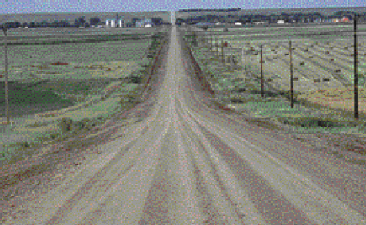
3R Boundaries - Unpaved
Quick, Short-term, low cost
Longer lasting, higher cost
Maintenance
Scarifying, reshaping, and restoring material losses
Applying dust palliatives
Nothing extensive or costly
3R
Add or modify guardrail
Minor adjustments to vertical and/or horizontal alignment
Reconstructed
Replacement of entire existing base
Unpaved Roads
428 NAC 2-001.03A1d4, Page 40
428 NAC 2-003 (Maintenance) Page 88
Slide 18
Notes:
For unpaved roads,
the design standards establish boundaries between 3R work and Maintenance work, and between 3R work and New & Reconstructed work
Minimum Maintenance Standards, on page 88, allow scarifying, reshaping, restoring material losses, and applying a dust palliative.
but on the bottom or page 89 anything extensive or costly would be considered a 3R scope of work or possibly Reconstructed.
A Reconstructed scope of work for unpaved roads is defined by replacement of the entire existing base, as previously discussed.
Page 40 of the design standards defines situations for unpaved roads that would allow the application of 3R standards.
Adding, modifying or upgrading guardrail
And minor adjustments to vertical alignment and/or horizontal alignment.
Regarding minor alignment adjustments being allowable , the Board is encouraging such adjustments by not requiring the entire work or project to be built to New & Reconstructed standards.
NOT FOR AUDIO
From 1/7/2016 Meeting Minutes:
Definition of Base 001.03A1d1 and the Board’s intent with respect to 3R safety improvements such as Vertical Curve sight distance improvements and which standards apply to the work even if the base needs to be completely removed and replaced. Summary of Discussion: The Board’s intent is for this work to be designed and built to minimum 3R standards as stated in the appropriate table. The Board’s intent is not to require New & Reconstructed standards for these “minor” or “spot” improvements as that could tend to discourage going forward with the safety improvement. Nathan explained that the State builds the section back to previous standards which may be less than current New and Reconstructed standards but more than current 3R standards. JW proposed adding an allowance for “, replacing the base at selected safety improvement locations (minor alterations of grades, vertical and horizontal curves),” in the first bullet, second sentence after “repairs to base.” Roger approved that verbiage.

Slide 19
3R Work Scope Examples
3R Design Standards
Resurfacing 2(+)”-6”
Lane widening
Shoulder widening
Curves – Minor or “Spot” Corrections
  Vertical
  Superelevation
  Horizontal radius
Roadside obstacles removal or protection
Guardrail and bridge rail upgrade
Bridge superstructure replacement
Bridge widening
Bridge thin bonded PCC overlay
Culvert extension
Slide 19
428 NAC 2-001.03A1c, Page 38
Notes:
This screen shows several examples of 3R scopes of work. Page 38 of the design standards show 3R work scope examples.
Bridge widening is a 3R scope of work (page 38), but lengthening a bridge or non-buried structure is a New & Reconstructed scope of work (page 37).
Paving an existing unpaved road is New & Reconstructed work (page 37).
Replacement of a culvert, even if it is in-kind, is a new & Reconstructed scope of work (page 37).
NOT FOR AUDIO
From 1/7/2016 Meeting Minutes:
Definition of Base 001.03A1d1 and the Board’s intent with respect to 3R safety improvements such as Vertical Curve sight distance improvements and which standards apply to the work even if the base needs to be completely removed and replaced. Summary of Discussion: The Board’s intent is for this work to be designed and built to minimum 3R standards as stated in the appropriate table. The Board’s intent is not to require New & Reconstructed standards for these “minor” or “spot” improvements as that could tend to discourage going forward with the safety improvement. Nathan explained that the State builds the section back to previous standards which may be less than current New and Reconstructed standards but more than current 3R standards. JW proposed adding an allowance for “, replacing the base at selected safety improvement locations (minor alterations of grades, vertical and horizontal curves),” in the first bullet, second sentence after “repairs to base.” Roger approved that verbiage.

Slide 20
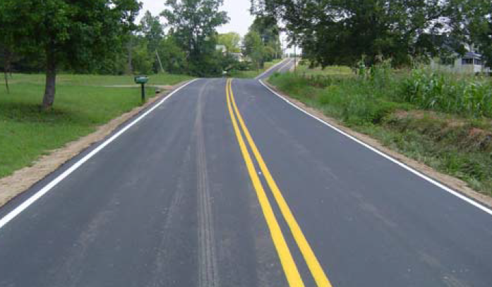
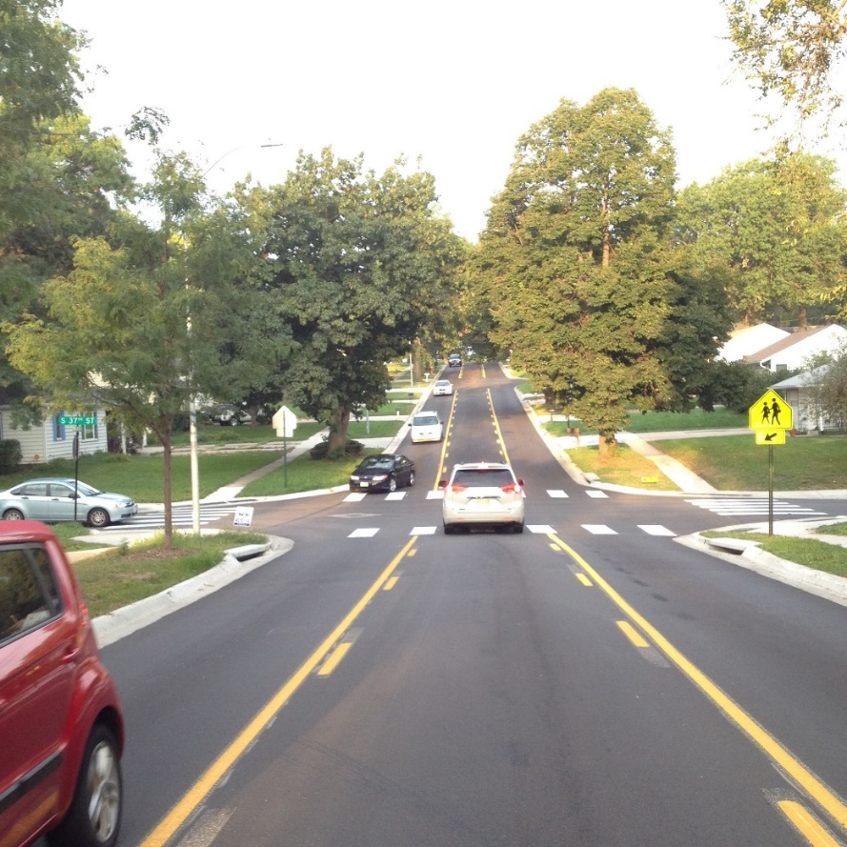
Resurfacing
3R – Allowed Scope of Work
Thicker Layers for Longer Lifespan
Slide 20
Notes:
This screen and the following screens show some scopes of work that would require the application of 3R standards, or higher.
Resurfacing up to, and including, six inches is allowed under 3R standards, extending the lifespan of the road or street.
As long as the base is not removed, reconstructed or strengthened.
Minor base repairs are allowed under a 3R scope of work.
NOT FOR AUDIO
All Presentations Slide – Examples Slides – What Can You Do More Efficiently and Cost Effectively? Thicker Overlays 33rd Street Looking South, Lincoln
Notes for Presenter:
An overlay of more than two inches (structural equivalent) may require a relaxation of standards.
3R is an opportunity to use existing alignments.
From the 9/24/2015 Annual League of Nebraska Municipalities Conference
This is a picture (slide) of Van Dorn Street near our Southeast High School. That stretch of roadway did not have a turn lane; needed all new curbs; it was a little bit narrow, we also had to come in and ask for a relaxation. We spent time, money, effort; upset the neighbors as we were asking for that relaxation. Clearly, this heavier-duty resurfacing –we put in new curbs, restriped it, put in a center turn lane, replaced all of the driveways, that street should last at least another 15 or 20 years. All that work could have been done, simply, under 3R without coming to the Board, and spent quite a bit of less money getting to that point.
From 2015 Asphalt Conference (the following was spoken for the rural road resurfacing slide that is removed for this League presentation):
Here’s one that just gripes me to death- resurfacing. It also is an issue with federal aid. Maybe another two-lane, county road spun into the city, the pavement’s good, we can’t afford to widen it out – the traffic volumes don’t say you can do that. There’s a bit of an argument going on that even amongst the Board and the folks at NDOR, two (2) inches or more in an Overlay is not Maintenance. But in reality, if you needed two (2) inches to preserve that roadway to extend the life, you’re really suppose to bring that road up to all the New & Reconstructed Standards, work them out with the Board and ask for a Relaxation. We’ve got lots of these roads___, we’ve got shoulders, we’ve got fore slopes, we don’t have crash problems. We’re totally okay to use- with 3R Standards, you won’t have to do that. You could actually go in, under the proposed 3R Standards, and the alignment’s okay, you can go in and remove the entire pavement depth and put it back, all brand-new, under 3R, using existing alignment, the issue again, you don’t have safety problems. Think about what kind of an opportunity that is for you to do those.
From 2015 Asphalt Conference:
This is North 33rd Street in Lincoln, from O Street North to Holdrege. It’s about a mile long. It’s an existing street that was already 2+1. It had 10-foot lanes- I can’t imagine how it got to 10-foot lanes in my tenure that did it. We did not have a Relaxation. Trees are very close; yards and sidewalks set-up high. We needed a Relaxation. We were going to come back in and try to rehab it to the way it was. Huge social impacts. If we were going to go to 11-foot lanes, replace the curbs and fix the sidewalks, we were going to remove every tree between curb and property line, grading up into the yards, huge social impact. While I’m not a fan of the 10-foot lanes, we didn’t have a significant crash problems that year, so we came to the Board and the Board did approve that Relaxation because of huge, social and environmental costs on the particular project.
33rd Street, done. Reseal, overlay, ready to go. Won’t have to come back. That is one of those stretches I don’t think we received a single pothole complaint a few weeks ago. Pot holes were exploding everywhere and the mayor was beside himself. Some of our concrete streets were falling apart. Preventive maintenance pays dividends. 3R helps us do more with preventative maintenance.

Slide 21
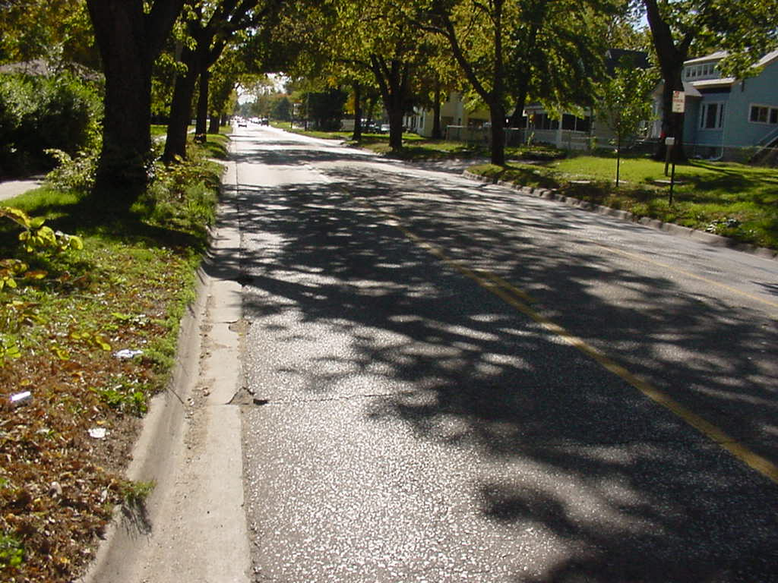
Add an Auxiliary Lane
3R – Allowed Scope of Work
Slide 21
Notes:
Adding an auxiliary lane is a 3R scope of work.
Re-striping an existing road or street to do that may require a relaxation of standards for lane width.
NOT FOR AUDIO
All Presentations Slide – Examples Slides – What Can You Do More Efficiently and Cost Effectively? Adding Auxiliary Lanes
Notes for Presenter:
May need a relaxation of standards for lane width.
From the 9/24/2015 Annual League of Nebraska Municipalities Conference
Adding an auxiliary lane. Lincoln adopted a way to try and improve capacity and help safety on a lot of our collector and arterial streets in the older part of town without necessarily having to come in You can all think what a fight it is to go through a residential area and take a two-lane road and try to convert it into a four-lane roadway. We adopted what we call a ‘two-plus-one’ (2+1) we will widen half to 35 feet and put a center turn lane down the middle so that everybody has a safe turn lane to turn into their driveways. All that work that can be done with the new standards under 3R without invoking the new and reconstructed standards. That would be a step you can do automatically.
From 2015 Asphalt Conference:
This is just a picture of a local street, in Lincoln, this is actually a street that we would like to convert to a 2+1, tons of driveways on it, we’ve had some rear-end crashes. There’s plenty of trees in there. Today, if we were going to go in there and widen it out to 2+1, you’re obligated to meet all of the New & Reconstructed Standards, or come to the Board and ask for a Relaxation. With 3R Standards, you can add an auxiliary lane, a center turn lane, you can add a right turn lane. You can do those kinds of things under these proposed 3R Standards without coming to the Board. You can also use a 10 foot lane if there is a particular reason why that fits and is a good reason to do that. We’ve been doing a number of these in Lincoln and each time you want that 10 foot lane, you need to come to the Board and talk about that.

Slide 22
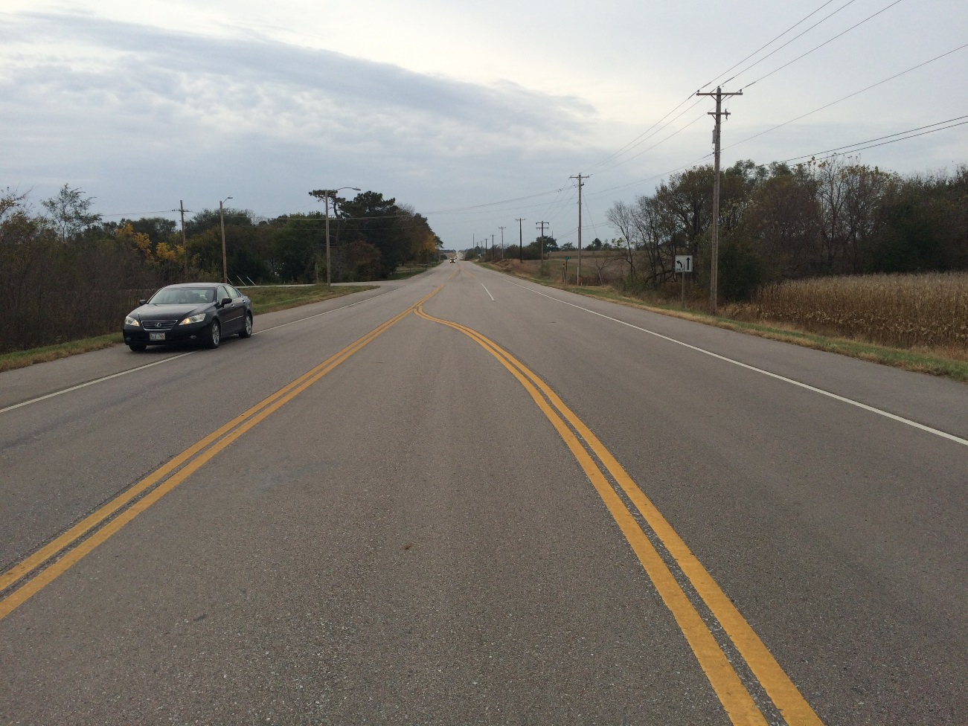
Minor Widening -
Lanes and Shoulders
3R – Allowed Scope of Work
Slide 22
Notes:
Lanes and Shoulders are allowed to be widened with 3R design standards,
unless something else drives the work or project to New & Reconstructed standards.
NOT FOR AUDIO
All Presentations Slide – Examples Slides – What Can You Do More Efficiently and Cost Effectively? Widening Lanes and Shoulders

Slide 23
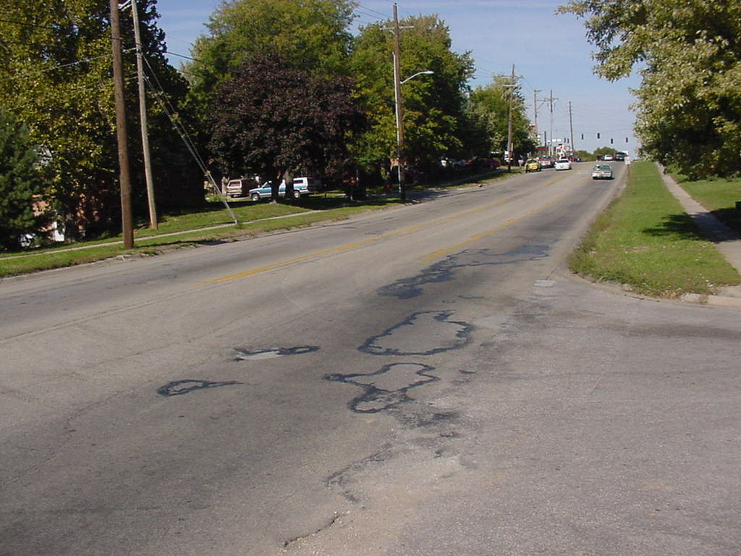
Minor Alterations -
Grades and Curves
3R – Allowed Scope of Work
Slide 23
Notes:
Minor alterations of grades and curves – vertical and horizontal – are allowed under 3R standards,
Unless something else drives the work or project to New & Reconstructed standards.
NOT FOR AUDIO
All Presentations Slide – Examples Slides – What Can You Do More Efficiently and Cost Effectively? Grades and Curves – Minor Alterations
Notes for Presenter:
Spot improvements are usually OK under 3R standards
From the 9/24/2015 Annual League of Nebraska Municipalities Conference
Every once and awhile you’ve got a street that is a little bit steeper, or maybe it has a horizontal curve that does not currently meet the design standards. Under 3R, you could come and grade a little bit of that street down; not blocks and blocks. But also, you could look at that and if you have a safety problem at the crest of the hill where people couldn’t see, you could grade and fix that without invoking the new and reconstructed standards and have to move ahead.
From 2015 Asphalt Conference:
This is actually a picture, I believe, of Van Dorn Street in Lincoln near Southeast High School. It’s kind of what we would call ‘more than a collector- less than an arterial’ and needs to be a 2+1. In this particular case, we had to come out and ask the Board for a Relaxation because that vertical alignment does not meet New & Reconstructed Standards. We’re also going to go to 2+1 and we also asked for a Relaxation and use 10 foot in there. We spent a lot of time and effort working on getting that additional engineering investigation, all the analysis and costs put together to come out and ask for a Relaxation. The other thing I would like to point out is you can do minor alterations, let’s say we’ve got a vertical curve or a sight distance issue just in one spot and you’ve got crashes there, you could go in and do a little grading and fix that or clean out the corner for sight distance and not kick you into New & Reconstructed Standards, under the 3R. So you could do some spot improvements in places and not have to necessarily work on the entire roadway from beginning to end of the actual project.

Slide 24
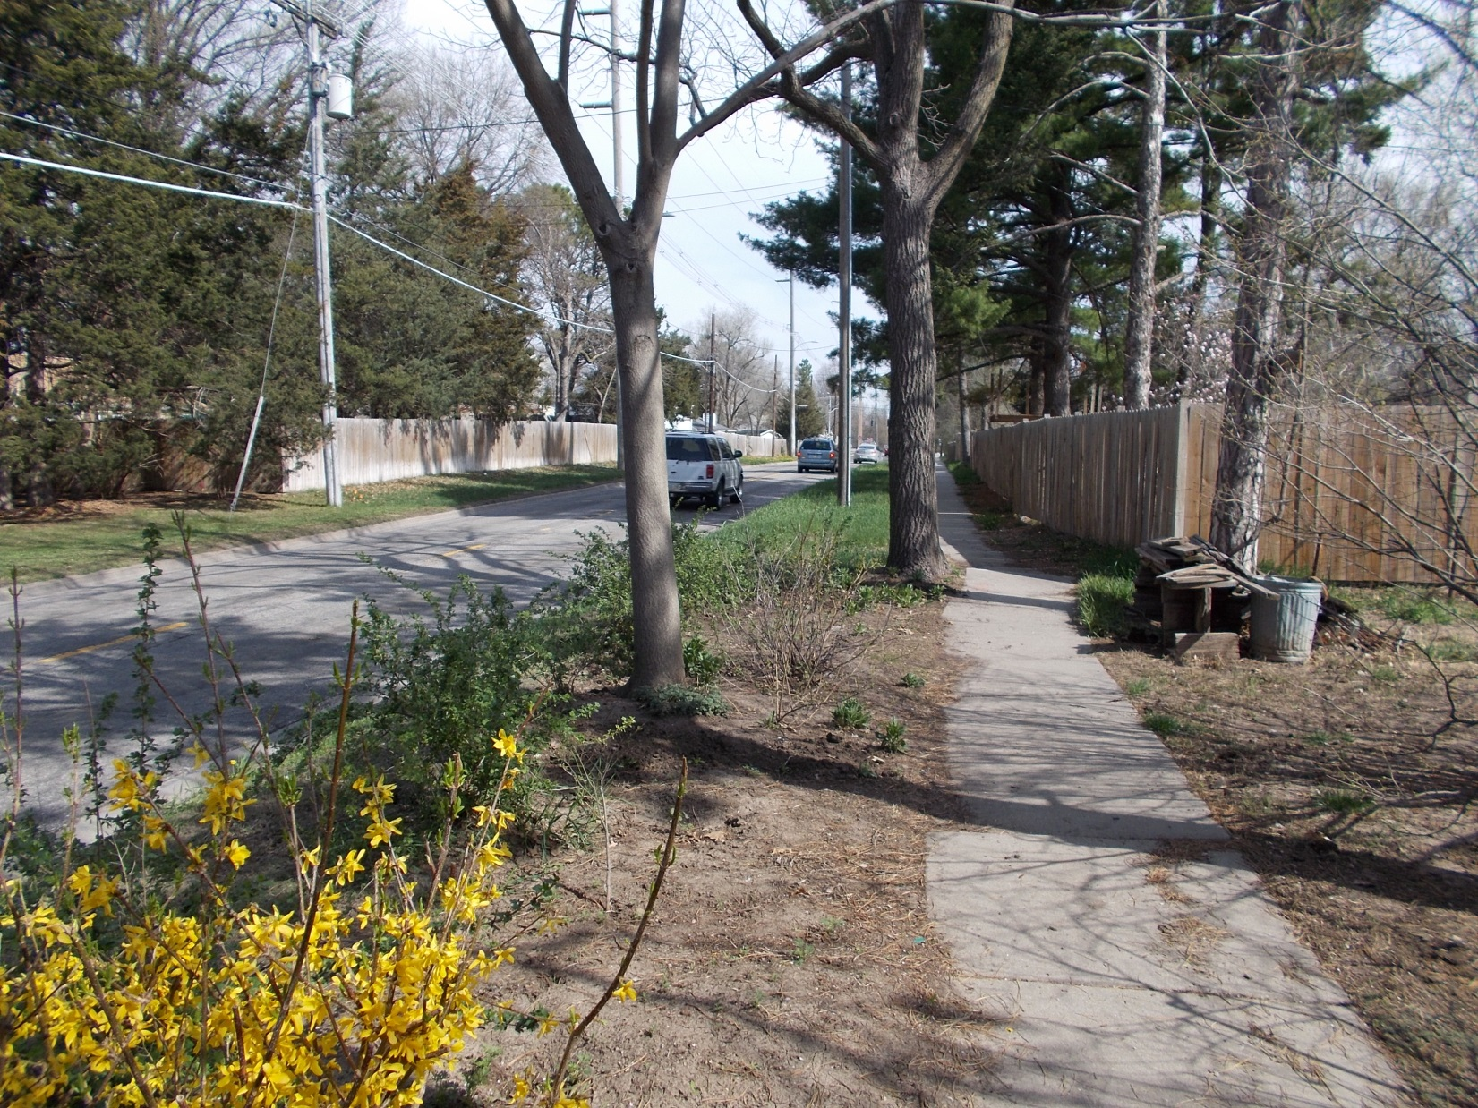
Rehabilitation - Before
3R – Allowed Scope of Work
Slide 24
Notes:
This is the “before” photo of Lincoln’s South 56th Street project.
NOT FOR AUDIO
All Presentations Slide – Examples Slides – What Can You Do More Efficiently and Cost Effectively? – Rehab project on South 56th ( ‘A’ to Randolph), Lincoln
Notes for Presenter:
From the 9/24/2015 Annual League of Nebraska Municipalities Conference
Here’s a picture (slide) of 56th Street here in Lincoln- it’s just a two-lane street. Trees on either side. We went to the Board and actually asked for a relaxation. We also wanted to put in a ‘two-plus-one.’
From 2015 Asphalt Conference:
This is another example, Lincoln has done a lot of 2+1 streets in the built environment. Trying to go to a 4-lane on a number of our mile-line roadways- it’s just a horrific social cost and financial cost. This stretch of 56th Street from A Street up to Randolph was just existing two-lanes, we needed to add the center lane, a narrow right-of-way, we asked for a Relaxation. We had a lot of feedback neighbors who didn’t want the project done. If we were going to do it, they wanted a narrower roadway. We went to the Board and asked for a Relaxation. We did not get it. There weren’t very many trees; most of the properties backed up had fences. We were able to move the sidewalk around, there was not a significant financial or social or environmental cost to meet minimum design standards. The Board did not agree with that request and we did not get it. My frustration with that was the time and money getting the plans and preparing for the Relaxation. We worked with the neighbors, the neighbors were very upset with us. They think it was our fault we couldn’t get that Relaxation. So, it created some consternation and conflict within the community that I don’t think we needed to have and with 3R, we wouldn’t have those problems.

Slide 25
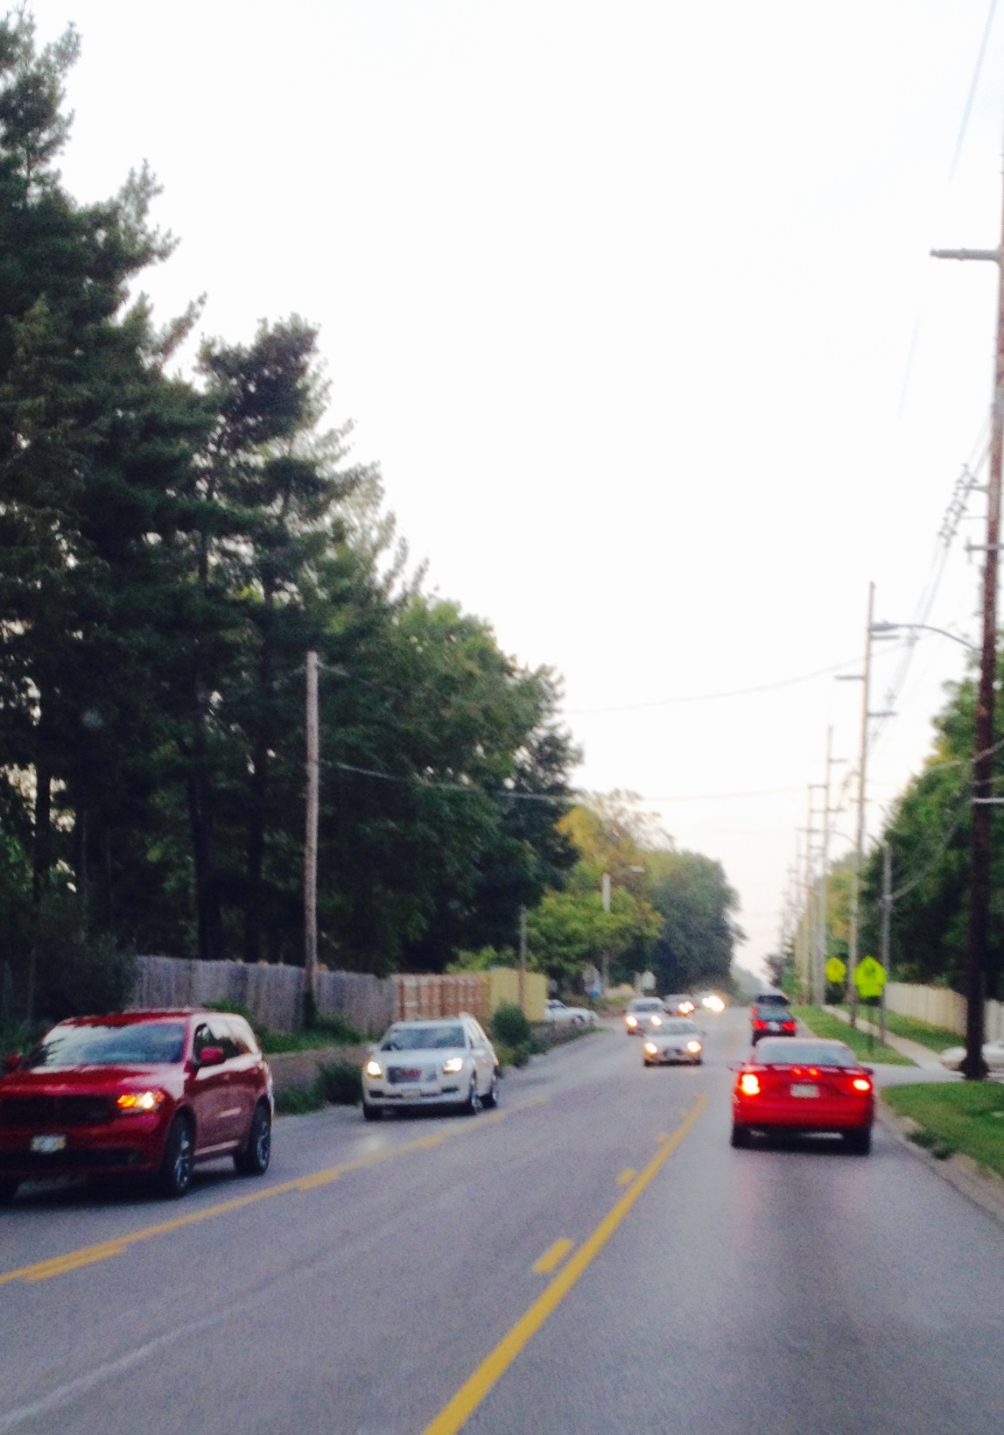
Rehabilitation - After
3R – Allowed Scope of Work
Change to 2-lane with TWLTL and Resurface
Slide 25
Notes:
This is the “after” photo of Lincoln’s South 56th Street project.
It was constructed prior to the effective date of the 2016 standards.
And needed a relaxation of standards in order to construct the project
2016 standards would have allowed this to be a 3R project.
Without a Relaxation of Standards
NOT FOR AUDIO
All Presentations Slide – Examples Slides – What Can You Do More Efficiently and Cost Effectively? – Rehab project on South 56th ( ‘A’ to Randolph), Lincoln
Notes for Presenter:
From the 9/24/2015 Annual League of Nebraska Municipalities Conference
This is a picture after we went ahead and made it ‘two-plus-one.’ The frustrating thing for me was we pitted neighbor against neighbor as we tried to figure out where to put the sidewalks in. We’ve requested going to ten-foot lanes. The minimum, in that urban setting, is an eleven-foot lane. Under 3R standards, you could actually do a ten-foot lane unless you’ve got a safety problem. The next time we have one of these again, the City of Lincoln could have moved ahead with this project without having to go through numerous public meetings; coming out to the Board and asking them for a relaxation, and we would save money and time.
From 2015 Asphalt Conference:
This is another example, Lincoln has done a lot of 2+1 streets in the built environment. Trying to go to a 4-lane on a number of our mile-line roadways- it’s just a horrific social cost and financial cost. This stretch of 56th Street from A Street up to Randolph was just existing two-lanes, we needed to add the center lane, a narrow right-of-way, we asked for a Relaxation. We had a lot of feedback neighbors who didn’t want the project done. If we were going to do it, they wanted a narrower roadway. We went to the Board and asked for a Relaxation. We did not get it. There weren’t very many trees; most of the properties backed up had fences. We were able to move the sidewalk around, there was not a significant financial or social or environmental cost to meet minimum design standards. The Board did not agree with that request and we did not get it. My frustration with that was the time and money getting the plans and preparing for the Relaxation. We worked with the neighbors, the neighbors were very upset with us. They think it was our fault we couldn’t get that Relaxation. So, it created some consternation and conflict within the community that I don’t think we needed to have and with 3R, we wouldn’t have those problems.

Slide 26

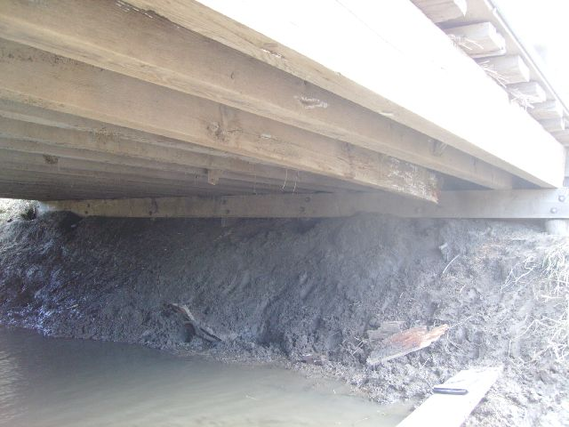
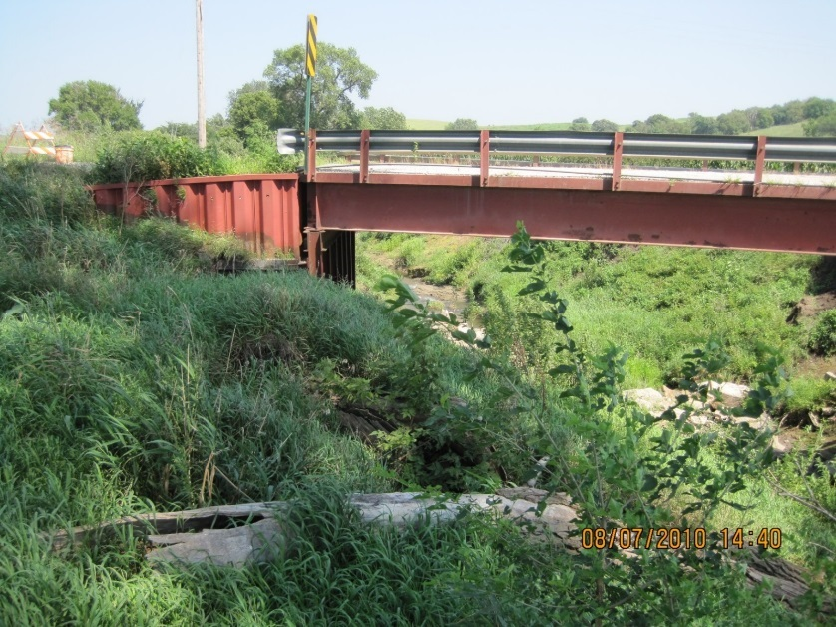
3R - Allowed Scope
3R – Allowed Scope of Work
Bridge Re-decking
Widening
Insert Picture Mark sends
Rail or Guardrail Upgrade
Slide 26
Notes:
Bridge re-decking, widening, and rail or guardrail modifications or upgrades are defined as 3R scopes of work.
Stiffeners and girder bracing can be added under 3R.
The bridge must meet 3R minimum bridge width and the original design loading,
And it can remain load-posted if the ADT is fewer than 400 VPD
NOT FOR AUDIO
Bridge Conference Slide – Proposed Definition of Bridges to Remain in Place (= 2R) and What is Allowed Scope – Remove/Replace Portions of Superstructure, Deck and Other Elements
Notes for Presenter:
From the 9/24/2015 Annual League of Nebraska Municipalities Conference
Today, you can’t come in and take off the deck of an existing bridge and put it back – that’s more than maintenance. It’s called new and reconstructed. That suddenly means your bridge now has to meet new, heavier design loading; needs to be wider; has to have different rail on it. Under 3R, we’ve changed that definition — if you don’t have some other structural issues, you can go ahead and redeck that bridge and continue to use it. You do need meet width and original design capacity loading, and it can also remain load-posted if you have less than 400 ADT (<400) on it.
Bridge Conference Slide – Proposed Definition for 3R bridges and What is Allowed Scope – Widen Substructure and Superstructure
Notes for Presenter:
The photo, dated 4/8/2007, shows structure number C005901705; provided by Marvin Taylor of Bridge Division. Not specifically a widening project, just a photo of a common county structure.
From the 9/24/2015 Annual League of Nebraska Municipalities Conference
You can come in and widen-out a substructure. Say you’ve got an area and you have a two-lane road way and you want to go to three lanes, in the old standards you couldn’t go and widen that out because that wasn’t maintenance – you had to build a new bridge. With these standards, you’d be able to do that.
Bridge Conference Slide – Proposed Definition of 3R Bridges standards and What is Allowed Scope – Update Bridge Rail and/or Guardrail
Notes for Presenter:
The photo was taken by Jim Wilkinson in Pierce County in 2010.
From the 9/24/2015 Annual League of Nebraska Municipalities Conference
This is a rural bridge (slide). Today you can’t come in and do maintenance and replace the bridge guardrail or the bridge rail without invoking the new and reconstructed standards. If you don’t have a safety problem under 3R, you can still do that.
Bridge Conference Slide – Proposed Definition of Bridges to Remain in Place (= 2R) and What is Allowed Scope – Other Items
Notes for Presenter:
FOR COUNTIES AND MUNICIPALITIES THESE REMAIN IN PLACE CHANGES IS A SIGNIFICANT CHANGE FROM CURRENT STANDARDS
County and Municipality bridges can now have a scope of work more than maintenance without going to the New & Reconstruction standard or asking for a Relaxation of Standards. Of course, for Remain in Place standards the minimum width also needs to be met or a Relaxation of Standards needs to be granted, or a new bridge built to New & Reconstructed standards.
LENGTHENING AN EXISTING STRUCTURE/BRIDGE is not an allowed Remain in Place scope activity. Lengthening causes the entire structure/bridge to meet New & Reconstructed standards, or get a relaxation of standards.

Slide 27
Example of 3R Work
Add or Upgrade Guardrail
3R Design Standards
Must meet all 3R standard criteria for that segment of roadway
Slide 27
428 NAC 2-001.03A1c, Part Two
Notes:
If guardrail is upgraded, that segment of roadway must meet 3R standards.
NOT FOR AUDIO
2010 standards would require the segment of roadway to meet New and Reconstructed standards.

Slide 28
Not 3R Work
3R Design Standards
Maintenance work 428 NAC 2-003 Pg 88
These do not by themselves require application of 3R or N&R standards:
  curb ramps
  sidewalks
  trails
New & Reconstructed work
Page 38
★ Requires good planning!
Slide 28
428 NAC 2-001.03A1c, Page 38
Notes:
We have discussed that a 3R scope of work is between Maintenance work and New & Reconstructed work.
Page 38 of the design standards lists construction of curb ramps, sidewalks and trails
as items that, by themselves, do not require the application of 3R standards or New & Reconstructed standards.
Curb ramps are commonly built as part of 3R or New & Reconstructed projects, so good coordination and planning are important.
If only curb ramp work is done, under the 2016 standards it is essentially considered maintenance work.
NOT FOR AUDIO
Don’t add curb ramps, then have to re-do them a year or two later due to a project.
More about ADA later.

Slide 29

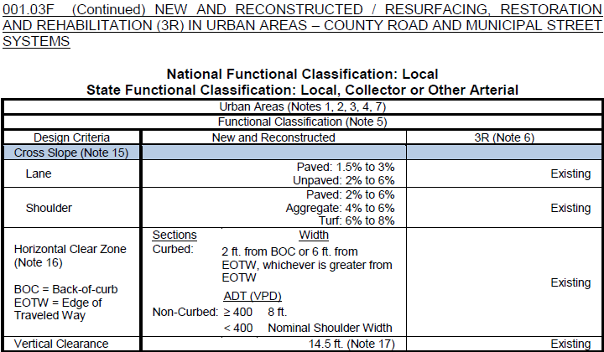
“Existing” in the Tables
Note 6 – “Existing”
Horizontal Clear Zone
3R Value: Existing
Means Existing Design Feature
Not the same as whatever is out there, and not a free pass
Legal Immunity?
  Likely: Features on previous plan(s)
  Not Likely: Maintenance work
Consider risks
428 NAC 2-001.03B Note 6, Page 47
428 NAC 2-001.03C-N, Pages 55-78
Slide 29
Notes:
Turn to any of the tables from pages 55 thru 78.
Look in the right column, which has values for 3R criteria.
Notice that the word “Existing” is used often.
It is not in the Definitions part of the standards, which are pages 37-46.
Note 6 on page 47 refers to, and defines, “Existing” as “existing design features.”
The NBCS would like to further clarify this.
What this refers to are the original previous design plans for the road or street.
The term “existing” therefore is not necessarily whatever is out there.
The term “Existing” does not include a feature on a road or street that was not preserved and maintained to the original or as-constructed condition.
A tree that is allowed to grow in the HCZ, or a utility pole that was allowed to be added to the HCZ, is not considered “Existing”, it is not grandfathered in by Note 6.
There may be legal immunity for features on previous design plans,
And maybe no legal immunity for poor maintenance and upkeep.
NOT FOR AUDIO
Similar to slide shown in the 3R segment
Explanation of “Existing” as a value – requested by 12/21/2015 dry run group
Examples: trees and utility poles
Per Jeff Schroeder and Matt Gaffey phone conversation 12/8/2015
Existing Design Feature (per plans) is grandfathered.
Anything beyond that (tree grows up in HCZ, utility pole is installed) is not grandfathered.
There is legal immunity with respect to design work.
There is no legal immunity with respect to maintenance work.

Slide 30
3R Standards Criteria in Tables
3R Design Standards
Numerical values for:
  Design Speed (Posted)
  Lane Width
  Shoulder Width
  Clear Bridge Width
  Structural Capacity
All other values are “Existing”
Slide 30
428 NAC 2-001.03, Pages 55-78
Notes:
The first twelve standards tables for county roads and municipal streets
Provide values for five criteria
READ THEM
All other values are listed as Existing
NOT FOR AUDIO
Numerical values only for 5 of the 13 criteria.
“Existing” for the other 8 criteria.

Slide 31
3R Criteria - value is “Existing”
General Information
Design Speed
Lane Width
Shoulder Width
Horizontal Alignment (Radius)
Superelevation
Vertical Alignment
Maximum Grade
Stopping Sight Distance
Cross Slope
Horizontal Clear Zone
Vertical Clearance
Bridge Clear Width
Structural Capacity
Bold Black font – items that have “Existing” as a value in the tables
Slide 31
Notes:
Eight criteria – the fourth through the eleventh on this screen shown in black, are those that have “Existing” as a value for 3R standards

Slide 32
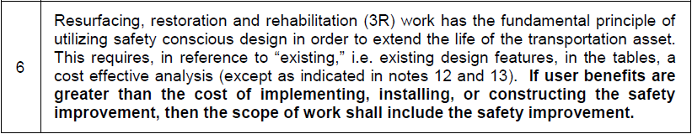
Safety Conscious Design
Note 6
3R Standards
428 NAC 2-001.03B Note 6, Page 47
428 NAC 2-001.03A1f, Page 41, Safety Conscious Design
428 NAC 2-001.03A1g, Page 41, Cost Effective Analysis
Slide 32
Notes:
Earlier in this video, the term “Existing” was discussed in connection with Note 6 and 3R standard values.
Note 6 is actually a broader note, dealing with the subject of Safety Conscious Design.
NOT FOR AUDIO
A 3R work or project, while extending the life of a road or street, involves the Safety Conscious Design process, including a Cost Effective Analysis and potential safety improvements.

Slide 33
3R Standards
Safety Conscious Design
Definition
Safety is an integral part of design, not a secondary objective
Systematically consider safety improvements (remove obstacles, add warning signs, add rumble strips, etc.)
Slide 33
428 NAC 2-001.03A1f, Page 41
Notes:
Safety Conscious Design is defined on page 41 of the design standards.
It goes hand-in-hand with 3R design work, requiring Cost Effective Analyses and potentially requiring safety improvements to be added to the scope of 3R works or projects.
Cost Effective Analysis is also defined on page 41 of the standards. A review of crash history is part of a cost effective analysis.
Highway designers must deliberately seek opportunities specific to each project and
apply sound safety and traffic engineering principles.
Designers of RRR projects work with existing roads and streets whose design and operational characteristics
can be observed and measured;
yet not all counties and municipalities take advantage of these favorable circumstances.
Greater attention to safety, along with greater documentation of the design process improves design decisions.
NOT FOR AUDIO
From TRB SR-214 page 5:
Highway designers must deliberately seek opportunities specific to each project and
apply sound safety and traffic engineering principles. Designers of RRR
projects work with existing highways whose design and operational characteristics
can be observed and measured; yet not all highway agencies take
advantage of these favorable circumstances. Greater attention to safety, along
with greater documentation of the design process improves design decisions.

Slide 34
Safety Conscious Design Overall Process
3R Design Process (TRB SR-214)
Assess current conditions
Determine project scope
Document the design process
Review the design
Slide 34
TRB SR-214 Page 5 and Page 190
Notes:
What might a Safety Conscious Design Process consist of?
[From TRB SR-214 page 5:]
• Assess current conditions: At the beginning of RRR project design,
highway designers should assess existing physical and operational conditions
affecting safety by using accident crash data, site inspections, and measurement of
existing design and traffic characteristics.
• Determine project scope: Will be covered in more detail on the next screen.
• Document the design process: Before developing construction plans and
specifications, designers should consider preparing a safety and design report that covers
existing design and operational characteristics, accident crash history, applicable
design standards, identified safety problems and related design options,
rationale for any proposed relaxation of standards, and the recommended design.
• Review the design: Ideally, Traffic and safety engineers should review safety and
design reports, as well as proposed RRR designs, before final approval.

Slide 35
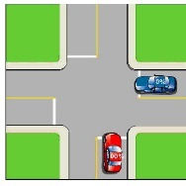


The Project Scope
3R Design Process (TRB SR-214)
Surfacing/Pavement repairs
Geometric improvements
Safety enhancements
  Intersections
    Increase sight distance, reduce vehicle conflicts
  Roadside
    Remove obstacles, upgrade bridge rail and guardrail, flatten slopes, regrade
  Traffic control
    New and improved signing, pavement markings
  Other?
Slide 35
TRB SR-214, Recommendation 2, Page 191
Notes:
Determining the Project Scope
Recommendation 2: In addition to pavement surfacing repairs and geometric improvements,
designers of RRR projects should consider and, where appropriate,
incorporate other intersection, roadside, and traffic control improvements that
may enhance safety.
Such improvements should be routinely considered by designers and should
include improvements at intersections and driveway entrances to increase
sight distance and reduce vehicle conflicts; replacement or rehabilitation of
obsolete bridge rails and guardrails; removal of roadside obstacles and
unnecessary guardrails; slope flattening; ditch relocation and regrading; and
new or improved signing, pavement markings, and other traffic control
devices.
These improvements can provide significant reductions in the frequency
and severity of accidents crashes. The safety benefits of these improvements, coupled
with their low costs, are such that they can be highly cost-effective on RRR
projects. In its review of completed federal-aid RRR projects, the FHWA
concluded that many highway agencies missed opportunities to enhance
safety, often at low cost, through improvements such as those described
(Chapter 2). Such omissions occur when Some designers may conceive their missions too
narrowly, for example, concentrating on pavement repairs or confining the
safety review to a few key highway features.

Slide 36
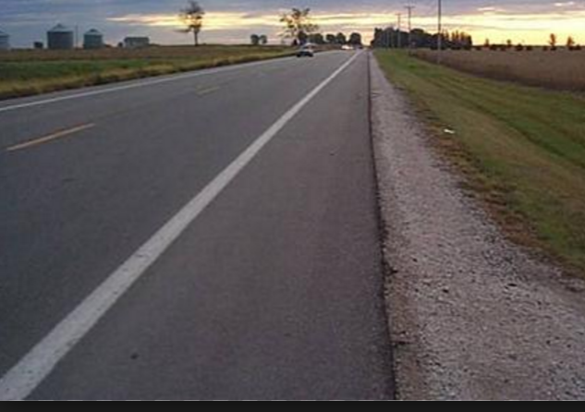
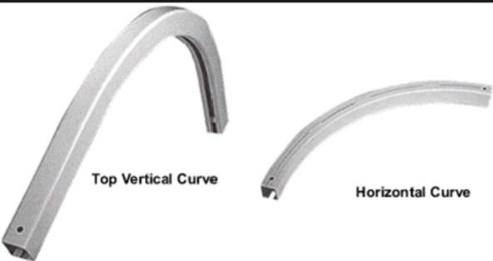



Cost Effective Analysis
3R Design Standards
Cost Effective Analysis
  What is the cost of a Safety Improvement?
  What does a crash cost society, a community?
  A Benefit/Cost (B/C) Analysis identifies costs of safety improvements with benefits compared to costs.
Slide 36
428 NAC 2-001.03A1g, Page 41
Notes:
Cost Effective Analyses are an integral part of the 3R design process.
The definition is on page 41 of the design standards.
The purpose is to determine if a safety improvement should be added to the scope of work
It involves a review of crash history in, and possibly near, the work or project
For some situations, a benefit-cost analysis is required to evaluate the need and justification for a safety improvement

Slide 37
Cost Effective Analysis
3R Design Standards
Cost Effective Analysis
Review of Crash History
  “Significant” – number and severity
  “Relevant” – linked to a criterion
Slide 37
428 NAC 2-001.03A1g, Page 41
Notes:
As part of a Cost Effective analysis
The significance of crashes is evaluated – considering the number of crashes and their severity
And the relevance of crashes to design criteria
Example:
A county determined that a significant number of crashes, three, within the past five years occurred on a vertical crest curve with poor sight distance.
One was fatal and two were serious-injury type crashes; the county judged their severity as significant.
And that the crashes were relevant to Vertical alignment, Crest K Value.
The county proposed a safety improvement, and estimated the Benefit/Cost ratio of that improvement to see if it should be included in the 3R project’s scope of work.

Slide 38
Crash History Relates to
Design Criteria in Standards
Design Speed
Lane Width
Shoulder Width
Horizontal Alignment (Radius)
Superelevation
Vertical Alignment
Maximum Grade
Stopping Sight Distance
Cross Slope
Horizontal Clear Zone
Vertical Clearance
Bridge Clear Width
Structural Capacity
Slide 38
Notes:
The relevance of crashes to the 13 design criteria must be reviewed as part of a cost Effective Analysis

Slide 39
Crash History Duration
Cost Effective Analysis
3 Years minimum is customary for many roads, mostly higher traffic volumes
5 years or even 10 years may be more appropriate
  Lower volume roads
  Some spot locations (bridge icing, etc)
MDS is silent on crash history duration
Slide 39
428 NAC 2-001.03A1g
Notes:
The Duration – how many years – of crash history –depends on the principles of statistics.
The Minimum Design Standards are silent on the number of years to use for crash history evaluations.
Some segments, such as a heavily traveled city street, may yield significant statistics by doing a two-year study.
Typical rural area crash studies are at least three years duration, although there may be locations when more than three years may be needed.
Low-volume roads likely need a longer duration such as five to ten years to collect statistically significant information.
NOT FOR AUDIO
Higher traffic volumes: 1,500 to 2,000 and above

Slide 40
Cost Effective Analysis – 3R
3R Design Standards
Cost Effective Analysis
Document
Place in project file
DO NOT SEND TO NBCS
Slide 40
428 NAC 2-001.03A1g, Page 41
Notes:
A cost effective analysis should be documented and placed in the project file.
Do not send it to the NBCS, unless, of course, it is part of a relaxation of standards request.
NOT FOR AUDIO
From 12/10/2015 Letter from Nebraska Association of County Engineers, Highway Superintendents and Surveyors
The cost effective analysis guidelines will not push counties to apply design standards that don’t make sense on very low volume roads where there is no crash history related to the design criteria.

Slide 41

Cost Effective Analysis – 3R
3R Design Standards
Cost Effective Analysis
Process in a nutshell
  No crash history? Document it, you’re done
  Significant, relevant crash history related to a criterion? Do a Benefit/Cost Analysis.
Slide 41
428 NAC 2-001.03A1g
Notes:
In a nutshell,
For a Cost Effective Analysis
If there is no crash history, you document that and you are done
If there is a significant crash history related to a design criterion, do a benefit/cost analysis to evaluate safety improvement options.
NOT FOR AUDIO
Don’t necessarily need to over-react to one single accident (one that may never happen again).
From 12/10/2015 Letter from Nebraska Association of County Engineers, Highway Superintendents and Surveyors
The cost effective analysis guidelines will not push counties to apply design standards that don’t make sense on very low volume roads where there is no crash history related to the design criteria.

Slide 42
Cost Effective Analysis
Applicable Notes
Notes 6, 12, 13
Cost Effective Analysis
  Note 6 – 3R work – applies to all criteria in tables
  ADT thresholds for two criteria:
    Horizontal Alignment – 750 VPD – Note 12
    Vertical Alignment – 1,500 VPD – Note 13
If ADT is less, no cost effective analysis is required by 428 NAC 2
Slide 42
428 NAC 2-001.03B, Part Two
Notes:
A previous video in this series covered Notes 6, 12 and 13
To summarize, with respect to Cost Effective Analyses,
Note 6 indicates that a Cost Effective Analysis is only required for Roads and streets, if there is a significant, relevant crash history, with
A traffic volume of 750 VPD and more, when reviewing horizontal curves
A traffic volume of 1,500 VPD and more, when reviewing vertical curves (K values)

Slide 43
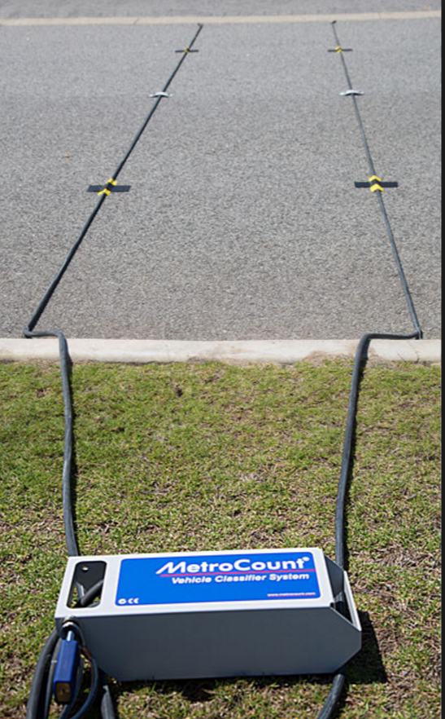
Cost Effective Analysis – Example
Cost Effective Analysis
This is only one method!
  Determine ADT at location
    ADT – Average DAILY Traffic
    Highway Capacity Manual (HCM)
    NE-LTAP has counters to loan
  ADT * 365 days/year = vehicles per year
    ÷ 1,000,000 = million vehicles per year (MV/yr)
Slide 43
Notes:
The Design Standards [NBCS in 428 NAC 2-001.03A1g (Cost Effective Analysis definition)] do not require a particular methodology for a Cost Effective Analysis.
This and the following screens show an example of a process for figuring costs and benefits.
The example assumes that crash history has been reviewed, and it has been determined that there is a significant crash history related to a design criterion.
The Board of Public Roads does not endorse this or any other particular process.
The first two steps are
determining the traffic volume – which may already been known, but can be counted and calculated if needed
And figuring the number of vehicles per year

Slide 44
Cost Effective Analysis - Example
Cost Effective Analysis
NDOT uses crash type instead of injury type
  Determine economic cost
    Mitigated (m) crashes – crashes type expecting to decrease
    Societal Costs of NE Traffic Crashes–
      Resource: NDOT Traffic Highway Safety Office for crash cost data (see Crash History slide)
      Mitigated crash type cost * m crashes at location
      total all m crash costs for a given location
  Determine average cost per mitigated crash
    total m crash cost ÷ total m crashes = $/m crash
Slide 44
Notes:
8/6/2019 Updated NDOR→NDOT and updated two corresponding audio media
The cost of crashes to society each year are then figured, in terms of dollars per crash expected to be mitigated, i.e. prevented, by the proposed safety improvement
The NDOR NDOT uses crash type, instead of injury type, to figure these costs
The NDOR NDOT Traffic Highway Safety Office can provide guidance, if needed

Slide 45
Cost Effective Analysis - Example
Cost Effective Analysis
  Determine mitigated (m) crash rate per MV
    m crashes ÷ years of crashes analyzed = m crashes/year
    m crashes/year ÷ MV/yr = m crashes/ MV
  Determine savings resulting from safety improvement
    m crashes/MV * MV/yr * safety improvement service life * $/m crash * crash modification factor = safety improvement savings ($)
      Crash modifications may be obtained with assistance from Crash Modification Factors Clearinghouse; http://www.cmfclearinghouse.org
      Reference Highway Safety Manual (HSM)
MV = Million Vehicles
Slide 45
Notes:
The mitigated crash rate is then calculated in Step 5
Followed by the anticipated savings that result from the proposed safety improvement, in terms of dollars, in Step 6
NOT FOR AUDIO
http://www.cmfclearinghouse.org/about.cfm
A crash modification factor (CMF) is a multiplicative factor used to compute the expected number of crashes after implementing a given countermeasure at a specific site.
For example, an intersection is experiencing 100 angle crashes and 500 rear-end crashes per year. If you apply a countermeasure that has a CMF of 0.80 for angle crashes, then you can expect to see 80 angle crashes per year following the implementation of the countermeasure (100 x 0.80 = 80). If the same countermeasure also has a CMF of 1.10 for rear-end crashes, then you would also expect to also see 550 rear-end crashes per year following the countermeasure (500 x 1.10 = 550).
The CMF Clearinghouse presents both CMFs and CRFs, or Crash Reduction Factors. The main difference between CRF and CMF is that CRF provides an estimate of the percentage reduction in crashes, while CMF is a multiplicative factor used to compute the expected number of crashes after implementing a given improvement. Both terms are presented in the Clearinghouse because both are widely used in the field of traffic safety.
Mathematically stated, CMF = 1 - (CRF/100). For example, if a particular countermeasure is expected to reduce the number of crashes by 23% (i.e., the CRF is 23), the CMF will be 1 - (23/100) = 0.77. On the other hand, if the treatment is expected to increase the number of crashes by 23% (i.e., the CRF is -23), the CMF will be = 1 - (-23/100) = 1.23.
It is important to note that a CMF represents the long-term expected reduction in crashes and this estimate is based on the crash experience at a limited number of study sites; the actual reduction may vary.

Slide 46
Cost Effective Analysis - Example
3R Design Standards
Cost Effective Analysis
  Determine Benefit/Cost for the safety improvement
    Safety improvement savings ÷ safety project costs = B/C of safety project
  Refer to Note 6. If the Benefit/Cost is >1, include the safety improvement in the scope of work.
Slide 46
428 NAC 2-001.03A1g and 001.03B Note 6
Notes:
Finally, in Step 7, the estimated safety improvement savings for society are compared to the costs of installing or constructing the proposed safety improvement, in terms of a Benefit/Cost ratio.
If the B/C ratio is greater than one, i.e. the estimated societal benefits of the proposed safety improvement are greater than the costs of installing or constructing that proposed safety improvement ,
Note 6 requires that the safety improvement be included in the scope of the work or project.

Slide 47
Request Relaxation of Standards
Only if . . .
3R Design Standards
Cost Effective Analysis
  Relevant, significant crash history and
  Benefits > Costs and
  Safety improvement would be a special hardship
Slide 47
428 NAC 2-001.03A1g and 001.03B Note 6
Notes:
If benefits of the safety improvement are greater than the costs of installing or constructing it, and it would be a special hardship to install or construct it, the county or municipality is required to request a Relaxation of Standards.
NOT FOR AUDIO
A request for relaxation of standards seems HIGHLY UNLIKELY
First Bullet: need to explain what “significant, related crash history” means. A link between crashes and a design criterion or criteria (e.g. vertical alignment, horizontal alignment, etc.) and a significant number and severity of crashes relevant to a design criterion or criteria, and no mitigating factors, then a benefit/cost analysis is performed.

Slide 48

Crash History Info
3R Design Standards
Cost Effective Analysis
Public agencies and its contractors call the NDOT Highway Safety office 402-479-4594 and ask for the
  Highway Safety Data Systems Manager, or
  Crash Analyst Supervisor, or
  Highway Safety Engineer
General public must contact NDOT Communication Division 402-471-4567
Slide 48
Related to Cost Effective Analysis, Page 41
Notes:
8/6/2019 Updated Contact information updated and made more generic, deleted Co-NECTAR link and reference because the NDOT no longer supports it. Also, one instance of NDOR→NDOT requiring two audio media revisions.
Crash History information can be found on NDOR’s website Co-NECTAR
NDOR’s NDOT’s Highway Safety Office is available for guidance, for counties and municipalities.
The general public must contact NDOR’s NDOT’s Communication Division.
NOT FOR AUDIO
Contact per Alan Brown 12/8/2015 phonecon with LeMoyne Schulz
Alan Brown (402.479.4665) is the main contact, or Sean Owings (402.479.4628), or Bob Grant (402.479-4645).
But the data provide by Highway Safety is not for public knowledge. It is only for the requester’s use to accomplish their job.
If someone in the public domain wants accident data, that has to be requested through Communication Division. They have to approve/coordinate any data that goes out to the public with our Legal office. If they determine the data is OK to give out, she will contact me/Sean/Bob for the data.
12/8/2015 e-mail from Alan Brown, Highway Safety Office
If a County Engineer or Superintendent (or someone contracted with them) needs accident data, they can contact me (402.479.4665) or Sean Owings (402.479.4628), or Bob Grant (402.479-4645). I’m including both Sean and Bob as we each can access accident data, but I’m the main person to contact. I just want to include them in case I’m not at work and someone needs data. But the data I give out is not for public knowledge. It is only for the requester’s use to accomplish their job.
If someone in the public domain wants accident data, that has to be requested through Mary Jo Oie. She has to approve/coordinate any data that goes out to the public with our Legal office. If Mary Jo/Legal office determines the data is OK to give out, she will contact me/Sean/Bob for the data.

Slide 49
Crash History
Protection of Data
Cost Effective Analysis
23 USC 409 (Federal) – not discoverable
No similar Nebraska law?
Neb. Rev. Stat. 84-712 Public Records Act
004.01A12 Sufficient Crash History Analysis. Identify Crash:
  Rate
    Optional: compare to similar routes
  Types
  Clusters
  Trends
Slide 49
23 USC 409 and 428 NAC 2-001.03A1g, Page 41
Notes:
Crash history data may be confidential under Federal and State law.
The Federal government has a strong law in place.
There is no analogous state statute.
Nebraska has a public records act.
In any case, When reporting crash data in public forums, you may want to confine it to rates, types, clusters and trends, and stay away from reporting private information.
NOT FOR AUDIO
Release of data may be governed by the Public Records Act provisions. Sunshine Law. Cite: Neb. Rev. Stat. 84-712 Et Seq
Confidentiality may be a factor as to what you do with that data. Contact your county or city attorney.
Ultimately, because of the FOIA, you may not be able to avoid providing crash data to requesters.

Slide 50
Crash History
Protection of Data
Cost Effective Analysis
23 USC 409 (Federal) – not discoverable
No similar Nebraska law?
Neb. Rev. Stat. 84-712 Public Records Act
004.01A12 Sufficient Crash History Analysis. Identify Crash:
  Rate
    Optional: compare to similar routes
  Types
  Clusters
  Trends
Contact your city or county attorney!
Slide 50
23 USC 409 and 428 NAC 2-001.03A1g, Page 41
Notes:
If you have any questions about confidentiality of crash history information, contact your city attorney or county attorney as appropriate

Slide 51

Why 3R Standards?
A Summary
3R Design Standards
Preserve and improve existing roadway, bridge and roadside features
Extend the life of the facility
Potential for Safety Improvements
WITHOUT cost of full reconstruction
WITHOUT requesting a Relaxation of Standards
A Good Use of Public Funds
Slide 51
Notes:
To summarize why design standards include criteria and values for 3R work:
3R strategies . . .
NOT FOR AUDIO
All Presentations Slide – 3R Standards Enable Municipalities and Counties
Notes for Presenter:
Audience should read the definitions in order to begin understanding what you can and cannot do under the 3R standard.
3R standards allow FREEDOM, FLEXIBILITY and ADDITIONAL OPTIONS and OPPORTUNITES to deal with limited public funding.
Could reiterate 39-2101, that the intention is not to avoid updating to New & Reconstruction standards forever.
From 2015 Asphalt Conference:
Again, just to reiterate, and reinforce what these 3R Standards for municipalities and counties will do, the words that I come up with I think it gives freedom, gives us flexibility, and it gives us additional opportunities to deal with the limited funding that we’ve got.

Slide 52
3R – an Interim Strategy
Neb. Rev. Stat. 39-2101 – Legislative intent
3R Design Standards
http://www.nebraskalegislature.gov/laws/browse-chapters.php?chapter=39
1969 law
Objective: bring roads and bridges up to new and reconstructed standards over a 20-year period.
Intent: to provide “reasonable” financing and more equitable distribution of revenue.
  Law assumed adequate financing going forward!
Slide 52
Notes:
3R is considered an interim strategy, with the idea that eventually each public road and street will be brought up to New & Reconstructed standards.
NOT FOR AUDIO
Note the State Statute 39-2101 that requires roadways eventually to be brought up to reconstruction standards, to emphasize that 3R is really an interim measure to extend the life of a facility yet improve its condition and safety during that extension. Quite often, however, “reasonable financing” is difficult to come by!
39-2101 excerpt
“Recognizing that highway financing heretofore has been inadequate to meet the needs of a modern transportation system, and that the distribution of revenue has resulted in disparities of treatment, it is the intent of the Legislature to provide reasonable financing and more equitable distribution of revenue. The objectives of this total program are to bring the state highway system up to adequate standards in a twenty-year period, and to bring the road systems of its counties, and the street systems of its municipalities, up to adequate standards over a twenty-year period.“

Slide 53
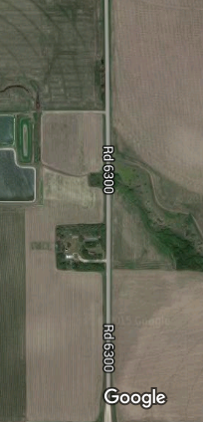
Application of Design Standards
Minimum Design Standards
Mill 4” Fill 4”
3R Standards
Replace Culvert
New & Reconstructed Standards
Mill 2” Fill 2”
Maintenance Standards
Slide 53
428 NAC 2-001.03A1e, Page 40
Notes:
Segments of a work or project could have different work scopes.
The hypothetical project on this screen starting at the bottom shows a maintenance overlay, at the top is a mill and overlay 3R scope of work, and in the middle is a culvert replacement – a New & Reconstructed type of work.
This is acceptable; see page 40 of the Minimum Design Standards.
It is not allowable to
mix and match different standards within a work segment.
Or to apply urban standards on one side of the road and rural standards on the other side of the road.

Slide 54

2016 Standards
Video 07
MDS – 3R Standards
Nebraska Administrative Code
Title 428
Rules and Regulations of the
Board of Public Roads Classifications and Standards
(Administrative Host: Nebraska Department of Transportation)
County Roads and Municipal Streets
Neb. Rev. Stat. 39-2113
https://dot.nebraska.gov/media/5593/nac-428-rules-regs-nbcs.pdf
Boards - Liaison Services Section
8/8/2019
Notes:
This is one of a series of videos on Nebraska’s system of
Classifying and applying standards to its highways, roads and streets.
This video addressed design standards and requirements for Resurfacing, Restoration and Rehabilitation –
Commonly known as 3R

