Slide 1
Jct. US-81/N-12
Safety Improvement Project
Community Engagement Event
Notes:
Speaker- Kimberly
Hi, I’m Kimberly Baker, External Affairs Director, for the Nebraska Department of Transportation. Thank you for joining us tonight.
We appreciate you taking the time to join us and learn more about this project.
We will have Mick Syslo, NDOT Deputy Director of Engineering and Matt Neemann, NDOT Traffic Engineer, provide a project overview and go into detail on how a roundabout will work at this location.

Slide 2
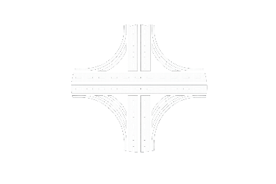


What We’ve Heard
Why not expand to a 4-lane highway with an interchange?
Is this too expensive?
Why not just install a
4-way stop?
Support for improving safety and reducing crashes in the area
Will semis/large trucks and farm equipment be able to get through?
Will drivers be able to see and navigate it safely?
Notes:
Speaker- Kimberly
Thanks to all of you who have shared your input with us. We’ve received hundreds of comments, questions, and concerns about this intersection and the roundabout project.
Here were some of the common themes we’ve heard and what we’ll talk about today.
We want to start with some background on the project, then we’ll talk through the features of the roundabout and go into more details about questions that were brought up.
Now I will hand it over to Mick Syslo to provide an overview of the project and the need for improvements at this location.

Slide 3
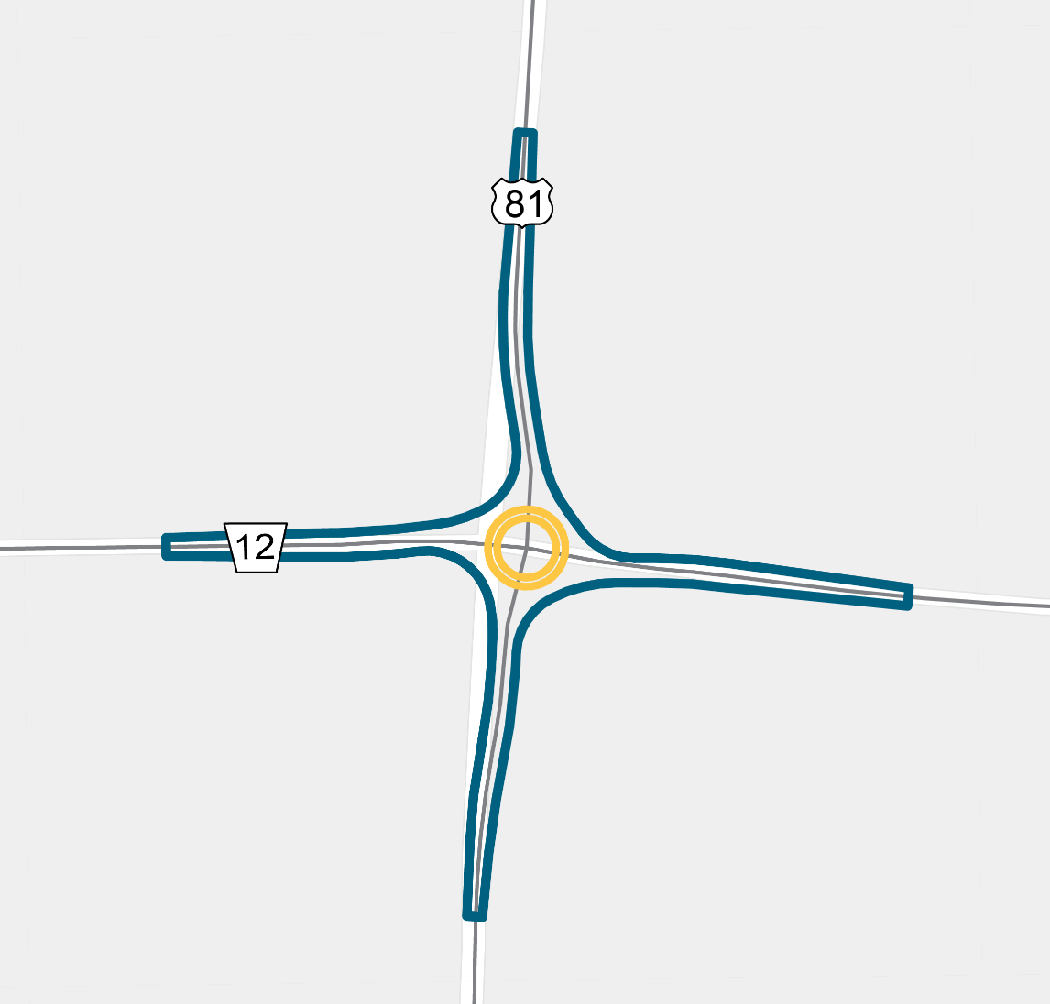
Project Overview
What’s being proposed?
A rural single-lane roundabout
Designed to reduce severe crashes
Includes lighting, signage, and geometric safety improvements
When would construction occur?
Tentatively spring 2027-fall 2027
How much would it cost?
Estimated $7.4 million funded through the federal Highway Safety Improvement Program (HSIP)
Notes:
Speaker- Mick
At a high level, this project would improve safety at the US-81 and N-12 intersection through a conversion to a rural single-lane roundabout.
It would include roadway reconstruction and safety upgrades designed to reduce severe crashes at this location.
Construction is anticipated to begin in the spring of 2027 and to be completed in the fall of 2027.
It’s estimated that it would cost $7.4 million, which would be funded through federal funds that NDOT receives from the Highway Safety Improvement Program – which are funds that must go to safety improvements like this.

Slide 4
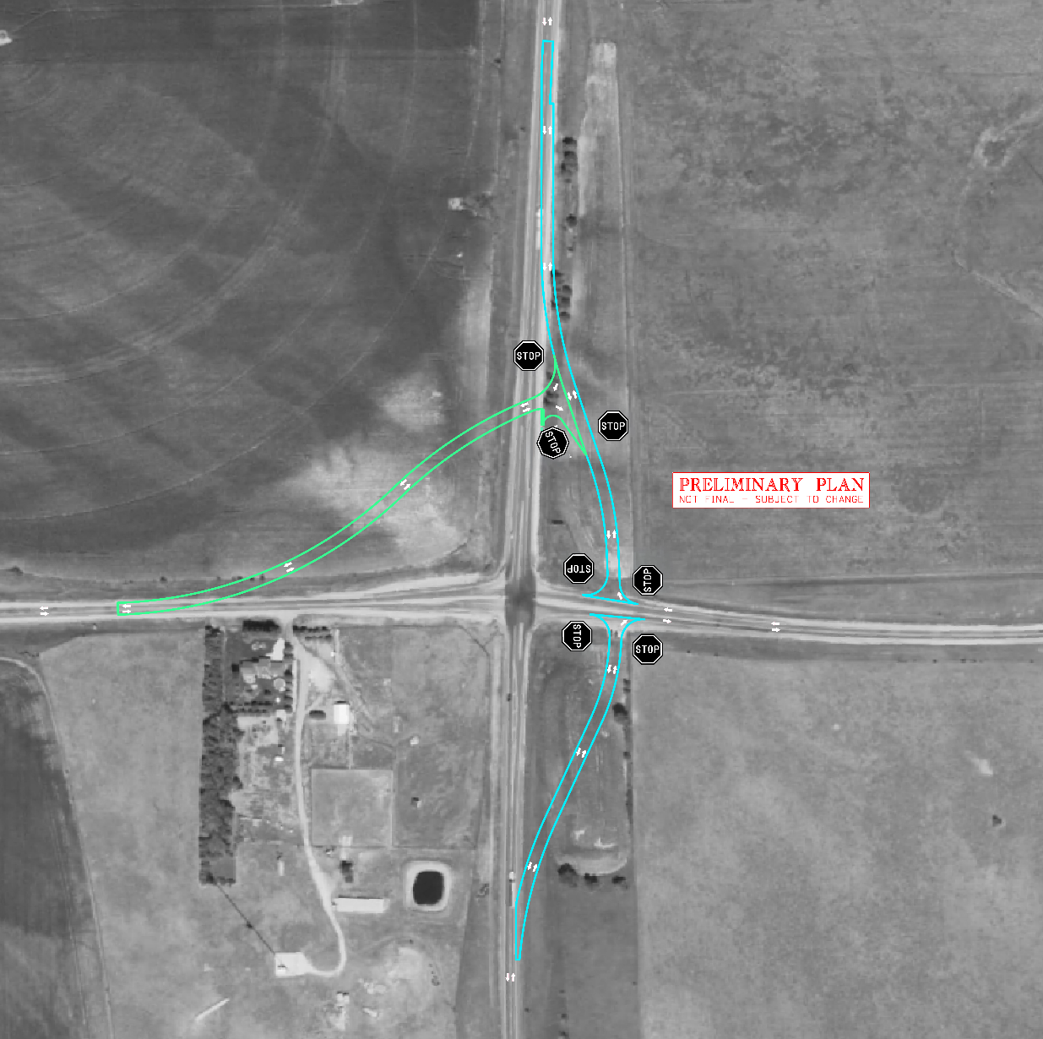
Project Update
Notes:
Speaker- Mick
We have heard feedback about how the detour would impact your community
We are accommodating all directions now
The proposed detour is no longer a part of this project
The project will be constructed under traffic
The intersections we are creating will be all-stop controlled
A temporary road will be constructed

Slide 5
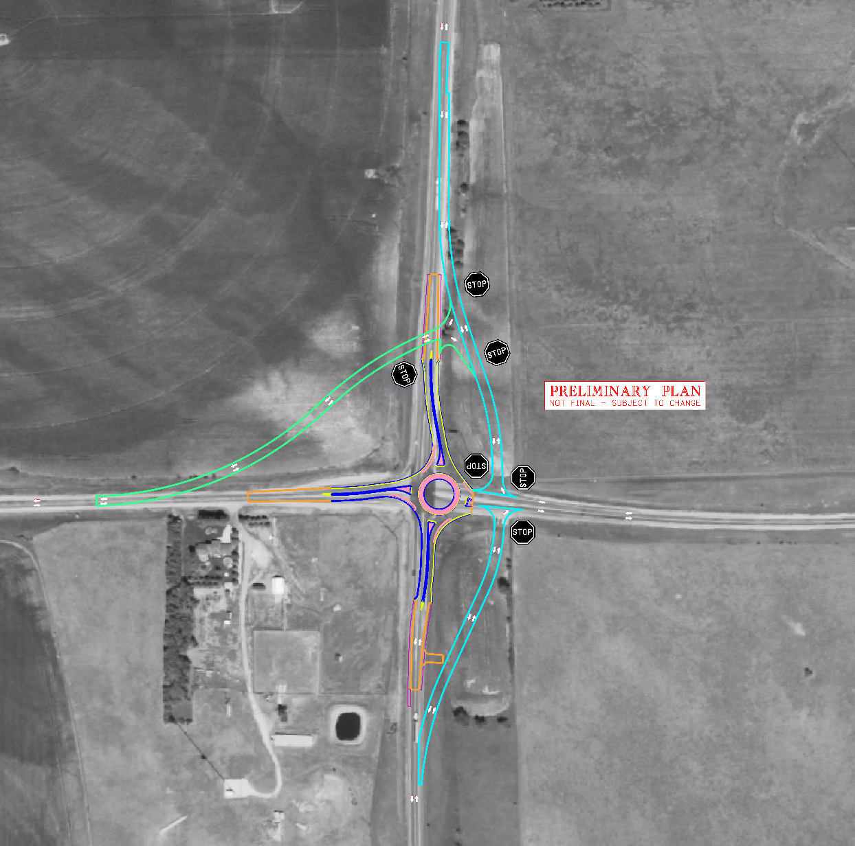
Project Update
Notes:
Speaker- Mick
We have heard feedback about how the detour would impact your community
We are accommodating all directions now
The proposed detour is no longer a part of this project
The project will be constructed under traffic
The intersections we are creating will be all-stop controlled
A temporary road will be constructed

Slide 6
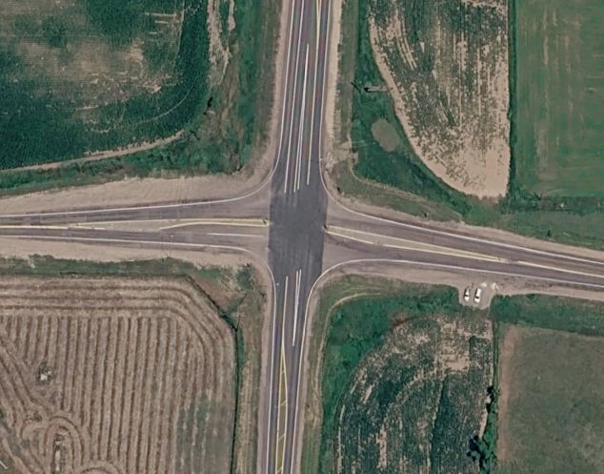
The Need for Improvements
  Why was this proposed?
  Crash data has been reviewed by safety and traffic teams
  Crash patterns indicate ongoing safety concerns
  A roundabout has been identified as a preferred mitigation strategy to reduce crash frequency and severity.
Notes:
Speaker- Mick
The goal of this project is really centered around safety, specifically reducing how often crashes happen and how severe they are.
We also want to make travel through this area more reliable, so people can expect a more consistent experience when driving here.
Overall, it’s about maintaining mobility and making sure traffic continues to move efficiently for everyone who uses this corridor.
When we look at this location, we’re seeing consistent crash patterns that point to ongoing safety concerns. These aren’t just one-time incidents, there are clear trends in the data.
Our safety and traffic teams, along with District 3, have taken a close look at that data to fully understand what’s happening here. Based on that analysis, this intersection meets the criteria for improvements to help address those crash patterns and improve overall conditions.

Slide 7
Crash History
From 2016 to 2025:
15
3
TOTAL CRASHES
FATAL CRASHES
73%
ANGLE CRASHES
Notes:
Speaker- Mick
This intersection has had 15 crashes over the past 10 years, including three that were fatal.
Most of these were angle crashes or T-bone crashes, which tend to be some of the most serious.
They often happen when drivers try to cross fast-moving traffic.
With support from federal safety funding, we have an opportunity to make this intersection safer by building a roundabout—a proven solution that’s worked well at similar locations across the state.

Slide 8


Results from Similar Nebraska Intersections
Reduced By
67%
South of Oakland
US-77 & N-32
Reduced By
100%
West of Bennington
N-31 & N-36
North of Pleasant Dale
US-6 & N-103
Reduced By
100%
Notes:
Speaker- Mick
These are three intersections with a similar crash history as US-81 & N-12.
NDOT’s most recent single-lane roundabout project at N-31 and N-36 had 4 serious crashes in 5 years. In the 5 years since the roundabout has been in place, they’ve had zero.
We’ve seen reductions in total crashes at all these locations too.

Slide 9
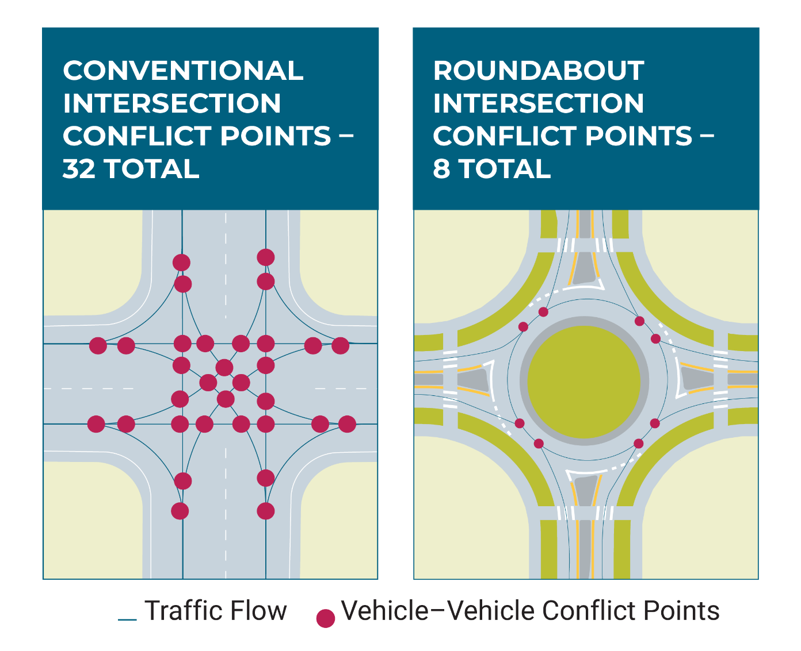
Why a Roundabout Works
 | Current | With Roundabout
Speeds | 65 mph | 20 mph
Conflict points | 32 | 8
Roundabouts reduce conflict points and have a lower risk for severe crashes.
73% of crashes at this location have been
angle crashes.
Notes:
Speaker- Mick
As mentioned, 73% of crashes at this location are from the side. A roundabout will help reduce those by:
Reducing speed to 20mph
Eliminates crossing conflicts – or places where you can hit other cars.
Converts severe crashes into reduced angle, low-speed events
Once traffic speeds are reduced and crossing conflicts are removed, the severity of crashes drops dramatically

Slide 10
What We’ve Heard
Is this too expensive?
Why not expand to a 4-lane highway with an interchange?
Why not just install a
4-way stop?
Support for improving safety and reducing crashes in the area
Will semis/large trucks and farm equipment be able to get through?
Will drivers be able to see and navigate it safely?
Notes:
Speaker- Matt Neemann
We’ve heard several consistent questions about this project.
These are the ones that have come up most often, so we want to address them directly before we move into discussion
Is this too expensive?
The cost is about reducing fatalities,
This is about saving lives and we want to see a reduction in fatalities.
Fatality costs over 20 million
Why not expand to a 4-lane highway with an interchange at the intersection?
Our program does not include a project to expand US-81 to four lanes in Cedar County. Based on projected traffic levels, a four-lane expansion is not anticipated. Growth would have to outpace projected traffic volumes by a significant amount - more than double for a 4-lane to even be considered.
Why not just install a 4-way stop?
Four-way stops work best when traffic is balanced. Here it’s not. US-81 carries about twice the traffic, so you’d end up stopping a lot more vehicles, adding delay, without really reducing speeds coming into the intersection.
We did receive comments in support of the project
Overall support for improving safety and reducing crashes in the area
Will trucks and farm equipment be able to get through?
Yes. Truck aprons are a design feature we have mentioned that allows for vehicles to navigate through the roundabout. We have real-life demonstrations of this later in our presentation.
Will drivers be able to see and navigate it safely?
Yes, this design improves visibility by raising the intersection 6 feet and adding lighting/signs. Let’s dive into the details of what this would look like.

Slide 11
Improving Visibility
The project would raise the intersection by approximately 6 feet and update lighting to improve visibility for vehicles approaching from all directions.
Updated features:
Raised profile
Updated lighting
Advance signage
Notes:
Speaker- Matt Neemann
Raised profile: Lifting the intersection improves the sightline. Drivers can see the roundabout from farther away.
Updated lighting: New intersection lighting would increase visibility at night and in low-light conditions.
Advance signage: Approach signage and markings would alert drivers in advance.

Slide 12
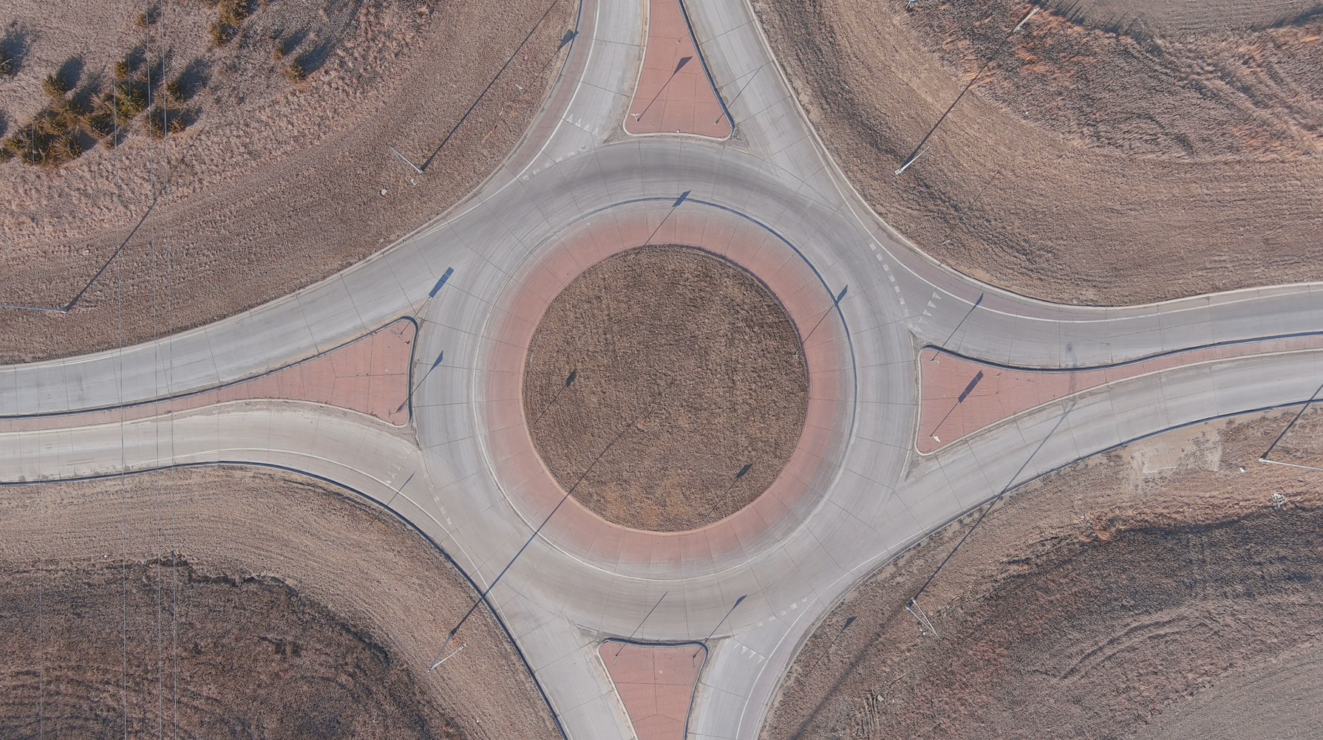
Design Features
Notes:
Speaker- Matt Neemann
Operation
Approaching vehicle waits for a safe gap in traffic.
Drivers slow down and stop if necessary.
Drivers yield to traffic on the left but do not need to stop if it is clear.
Truck Aprons
A raised, mountable concrete surface around the center island.
Large trucks can drive over with their rear wheels.
Gives drivers extra space needed to complete the turn.
Curbs
Use 6” curbs at the start of the approach curves to slow traffic
3” sloped curb between driving lane and truck apron in roundabout to make use of apron inviting
Geometry
Approach curves designed to slow traffic
Balance between cars and trucks

Slide 13
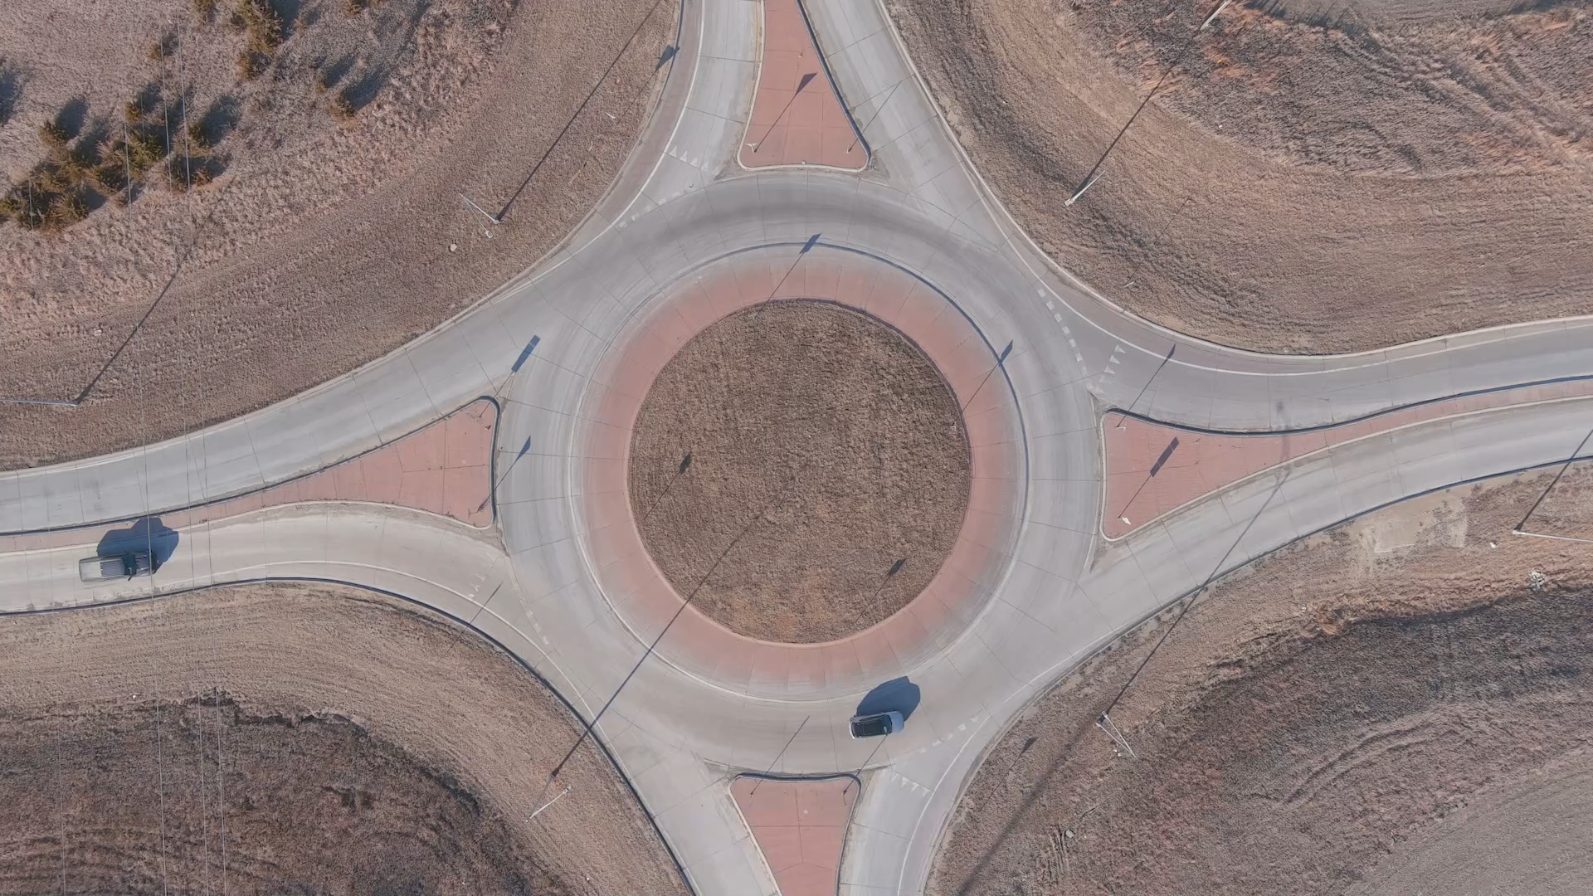
Notes:
Speaker- Matt Neemann

Slide 14
Small Group Q&A
Group 1
How It Works
Brandie Neemann, NDOT Roadway Design Engineer
Alan Swanson, NDOT Traffic Analysis Engineer
For questions/concerns related to:
How to navigate roundabouts
Trucks & farm equipment
Layout, turning, and visibility
Notes:
Speaker- Kimberly
For the remainder of the evening, we will be splitting up into smaller groups to allow for questions and hear from NDOT staff.
You are welcome to move from group to group.
Our first group is located over here, and Brandie and Alan will be available to discussion questions related to how roundabouts work and how large equipment navigate them.

Slide 15
Small Group Q&A
Group 2
Why This Option?
Khalil Jaber, NDOT Chief Operating Officer
Matt Neemann, NDOT Traffic Engineer
For questions/concerns related to:
Why a roundabout?
Why not 4-way stop, signal, or interchange?
Cost and funding
Notes:
Speaker- Kimberly
Our second group is located back in the corner with Khalil and Matt to address questions related to why a roundabout was selected for this intersection.

Slide 16
Small Group Q&A
Group 3
What To Expect
Mick Syslo, NDOT Chief Engineer, Deputy Director- Engineering
Kevin Domogalla, NDOT District 3 Engineer
For questions/concerns related to:
Safety improvements
Traffic flow / delays
Construction timing & impacts
Notes:
Speaker- Kimberly
Our 3rd group is located at that back corner. Mick and Kevin will be available to address questions related to what to expect for safety improvements, construction timing, and impacts.

Slide 17
Small Group Q&A
Group 1
How It Works
For questions/concerns related to:
How to navigate roundabouts
Trucks & farm equipment
Layout, turning, and visibility
Group 2
Why This Option?
For questions/concerns related to:
Why a roundabout?
Why not 4-way stop, signal, or interchange?
Cost and funding
Group 3
What To Expect
For questions/concerns related to:
Safety improvements
Traffic flow / delays
Construction timing & impacts
Notes:
Speaker- Kimberly
Again, thank you for sharing your time with us this evening. Feel free to walk between different groups to see the informational boards and ask any additional questions you may have.
Also, as the project progresses, NDOT will be available to come out and have small group discussions to provide more education on roundabouts and how to navigate them. This is something we have done with other communities and schools. Please reach out to any member of our team if this is something you are interested in discussing.

