Slide 1
Murray – Plattsmouth US-34/US-75 & N-1 Intersection
NH-75-2(128); CN 21209
Public Information Meeting
October 13, 2022

Slide 2
Welcome!
Thank you for joining us today!
Please sign-in at the welcome table if you haven’t already
Comment forms and a handout for the project are available
Staff are available following the presentation to discuss your questions and comments

Slide 3
Agenda
Project Overview
Why a Restricted Crossing U-Turn (RCUT) intersection?
Next Steps

Slide 4
Project Overview

Slide 5
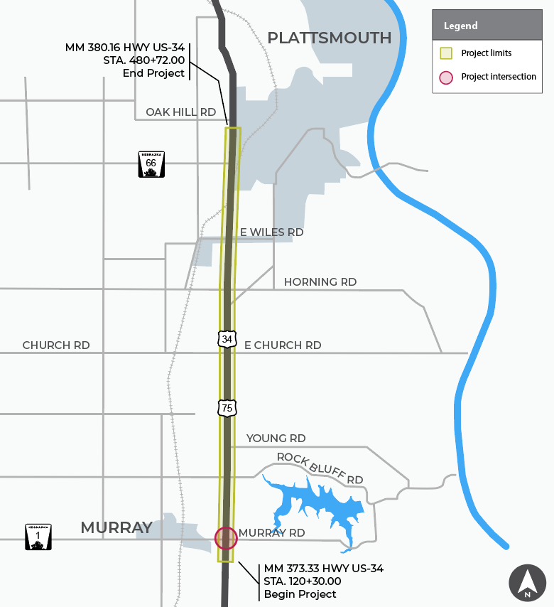
Project Location
US-34/US-75 & N-1 intersection RCUT would be part of the Murray – Plattsmouth project, which is currently under construction to build a four-lane expressway

Slide 6
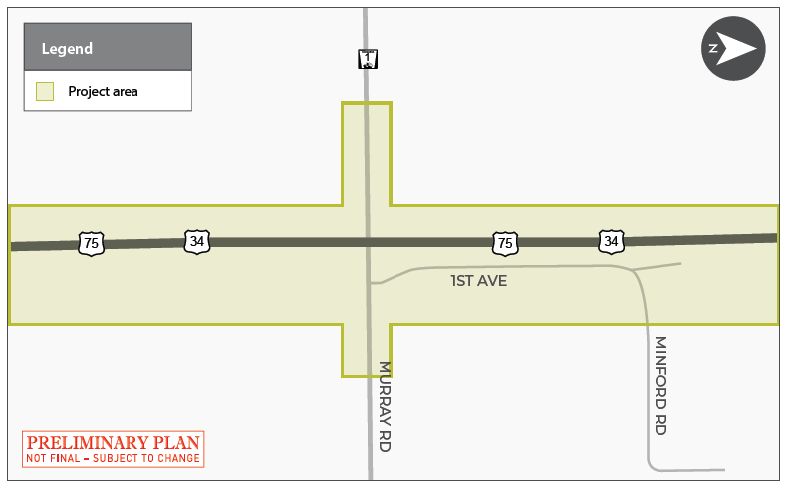
RCUT Location

Slide 7
Purpose & Need
The purpose of these improvements is to:
Reduce the frequency and severity of crashes at the intersection of US-34/US-75 & N-1
Improve the mobility of the traveling public
Improve the reliability of the transportation system
The need for the improvements is based on information from the NDOT Safety Committee, Strategic Safety Infrastructure Project Teams, Traffic Engineering Division, and District 2.

Slide 8
Scope of Work
The improvements include:
Construction of NB and SB left-turn lanes and bulb-outs on US-34/US-75
Construction of right-turn lanes for northbound US-34/US-75 to eastbound Murray Road and southbound US-34/US-75 to westbound N-1 traffic. The turn lanes would extend to connect to the bulb-out
Construction of medians on N-1 and Murray Road
Grading, signing and new permanent pavement markings
Utility and lighting relocations, and additional lighting

Slide 9
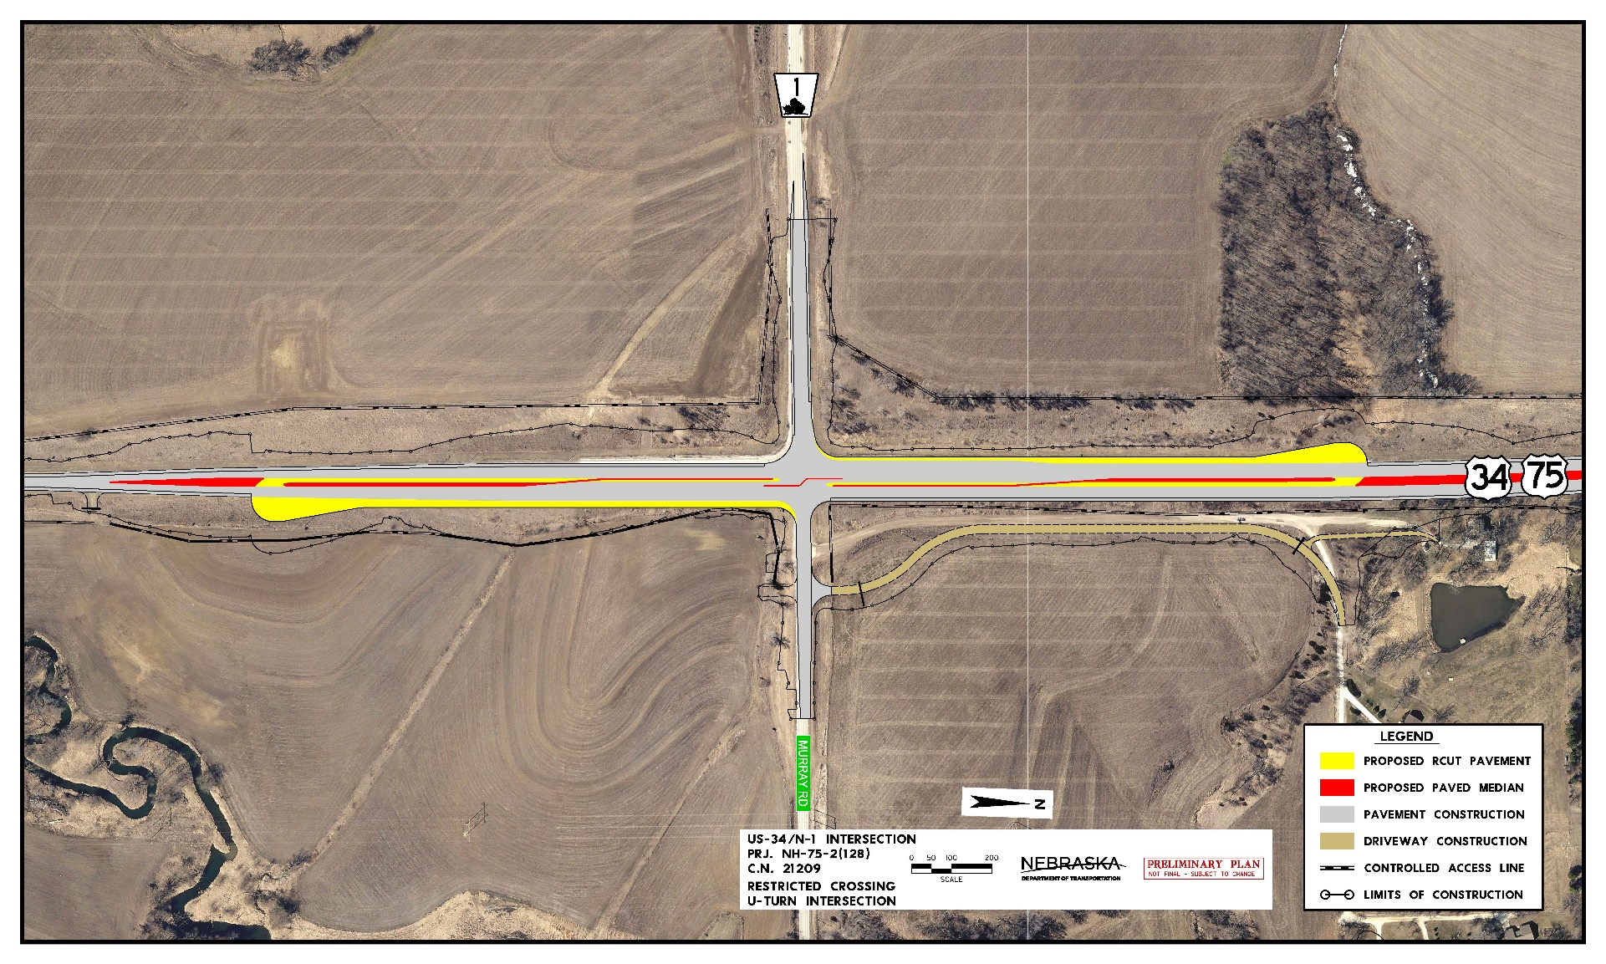
RCUT Footprint

Slide 10
Why an RCUT Intersection?

Slide 11
Review of Potential Solutions
NDOT reviews safety and traffic control improvements on a progressive scale to determine which solution provides the best overall benefits
Interchange
Stop Sign Controlled
Signalized Intersection, RCUT or Roundabout

Slide 12
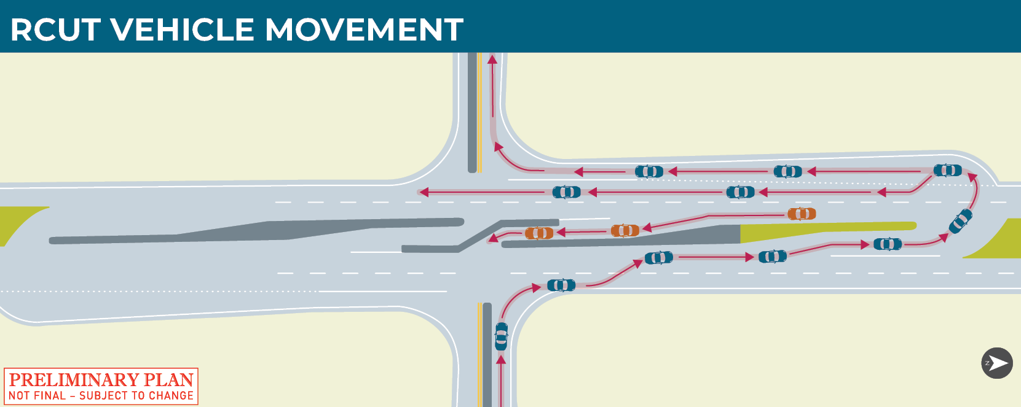
What is an RCUT?

Slide 13
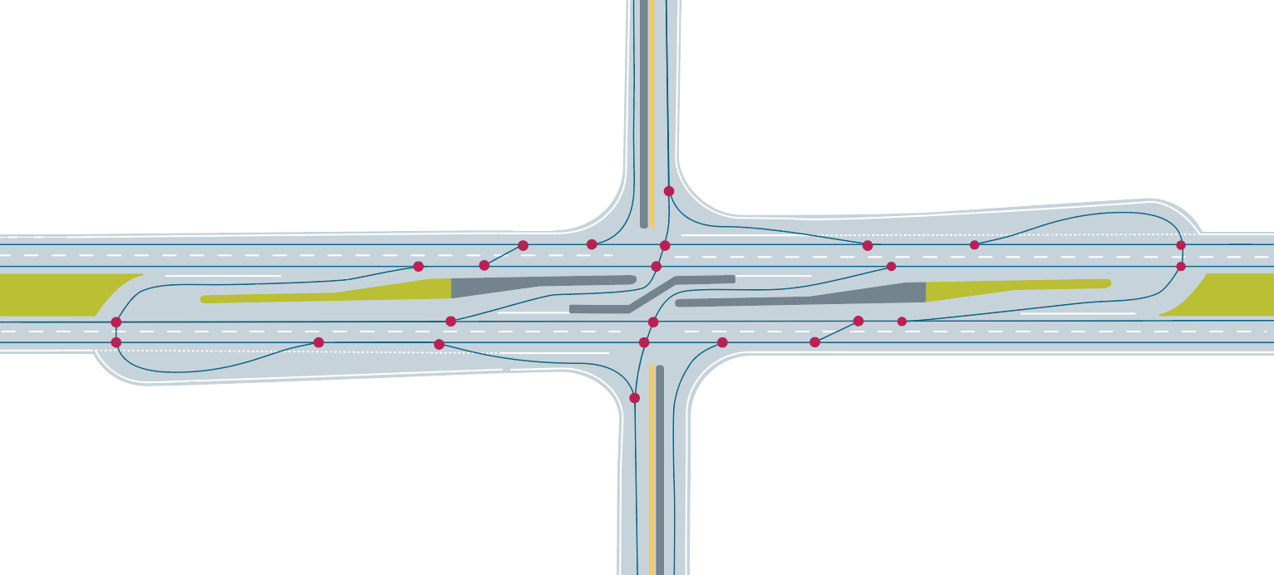
Why an RCUT intersection?
Traditional Design Conflict Points
42 Points Total
Reduce the points of conflict at the intersection of US-34/US-75 & N-1
Traffic Flow
Conflict Points
RCUT Design Conflict Points
24 Points Total

Slide 14
Why an RCUT Intersection?
Reduced number of crossing conflict points reduces the chance for right-angle crashes (i.e., T-bone crashes)
Compared to traditional unsignalized intersections, RCUT intersections have been shown to:
Reduce total crashes by 59%
Reduce injury and fatal crashes by 71%
FHWA research from 2020
Compared to signalized intersections, RCUT intersections have been shown to:
Have 28% fewer crashes
Have 43% fewer injury crashes
North Carolina DOT Research

Slide 15
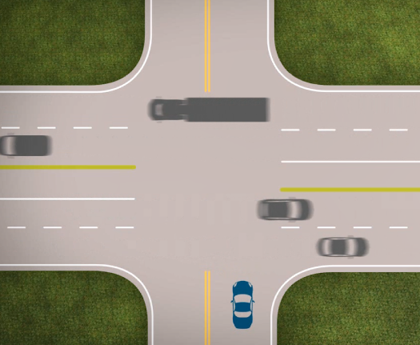
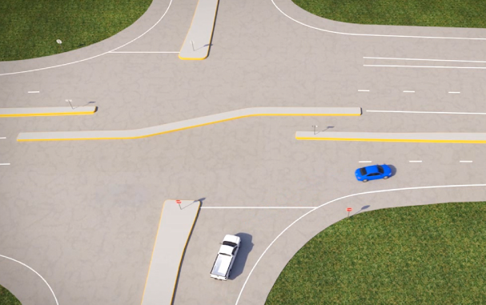
RCUT Travel Time
Generally, delay caused by waiting to cross both sets of lanes, or waiting for a traffic signal, is greater than the delay caused by the RCUT movement.
Traditional Intersection
RCUT Intersection

Slide 16
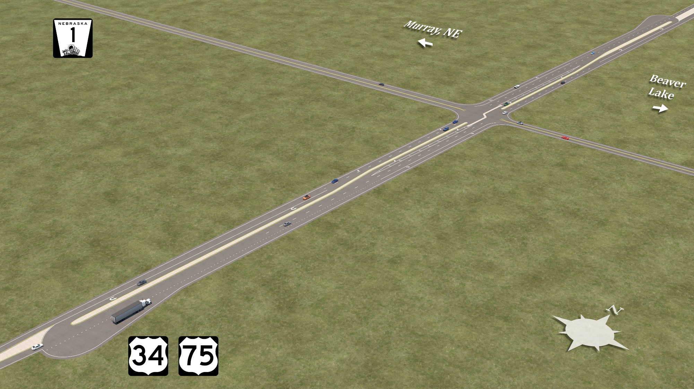
Rendering of rCUT
TBD – add in two camera views here

Slide 17
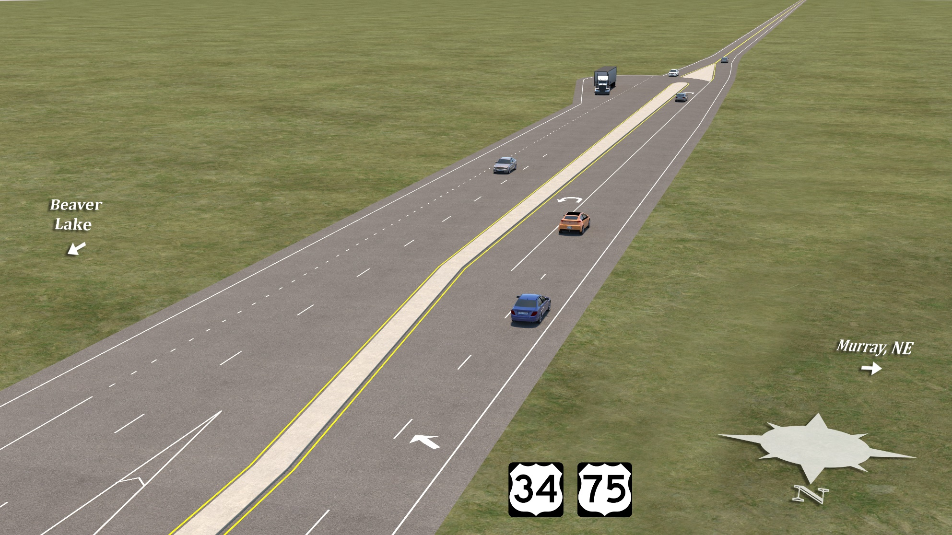
Rendering of rCUT
TBD – add in two camera views here

Slide 18
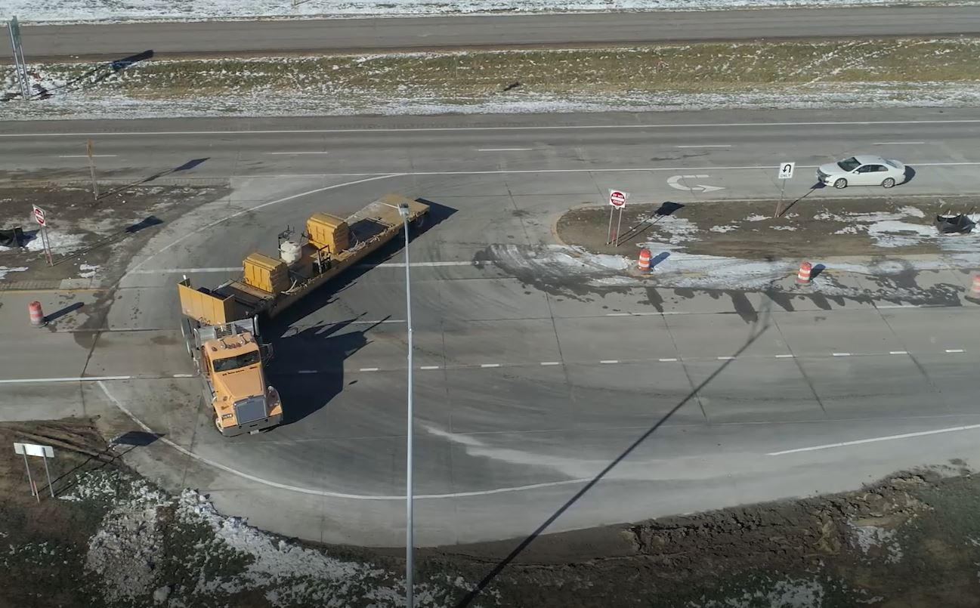
RCUT at US-81 / n-91
Located near Humphrey, NE
Built in 2020
Crash Data | Annual Daily Traffic (ADT)
June 2015 – February 2020 (pre-RCUT) | November 2020 – Present (post-RCUT)
24 Crashes | 1 Recorded Crash

Slide 19
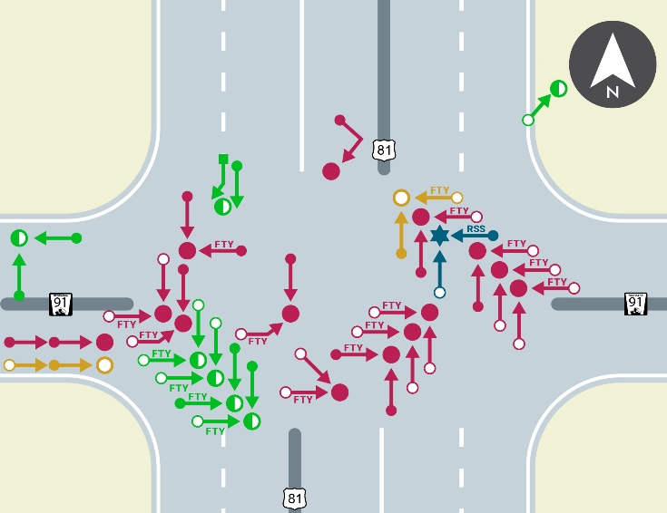
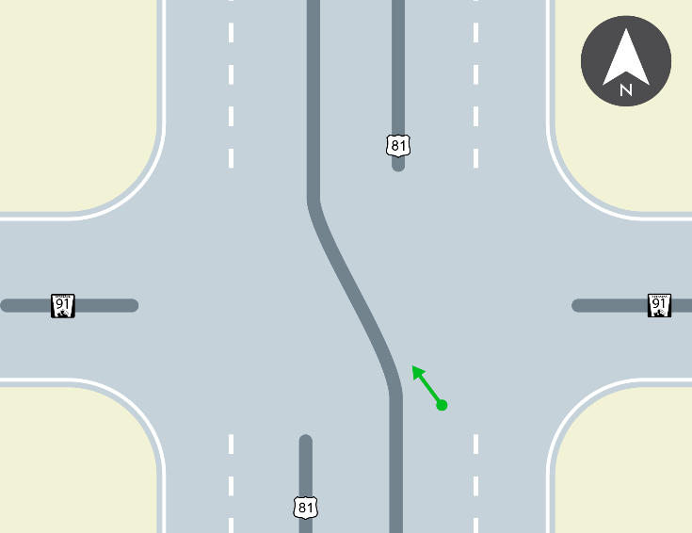
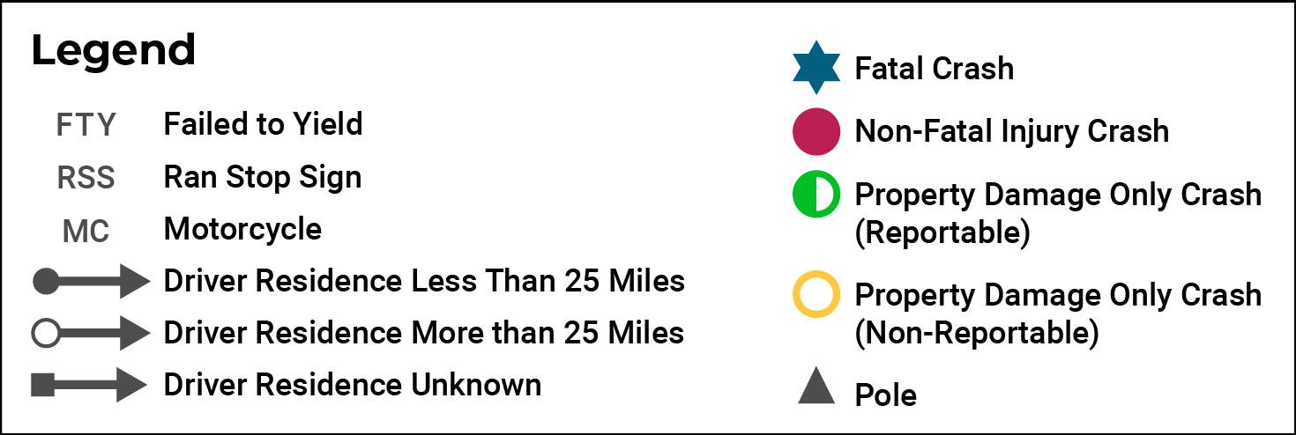
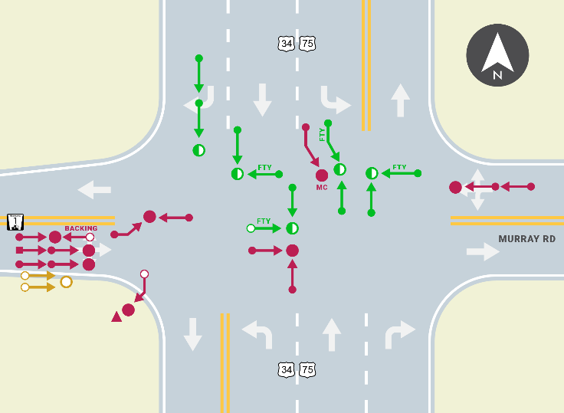
Humphrey AND MURRAY crash comparison
US-81/N-91 Intersection Crash Data Pre-RCUT (2015 – 2019)
US-81/N-91 Intersection Crash Data Post-RCUT
US-34/US-75 & N-1 Intersection Crash Data (2014 – 2018)

Slide 20
RCUT At US-81 / N-91 Survey

Slide 21
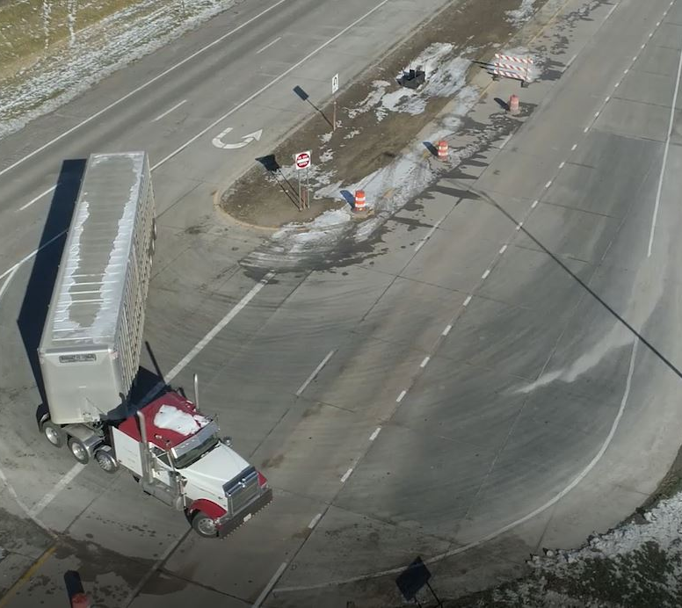
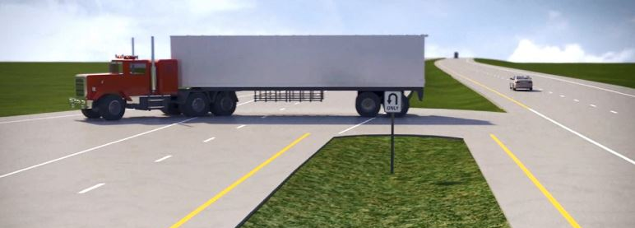
RcUT Intersection & Semis
The US-34/US-75 & N-1 RCUT would allow for more room for semis to turn at the intersection.

Slide 22
RCUT Design Features
Designed for 15 mph U-turn movements with a yield sign
The speed limit on US-34/US-75 is anticipated to be lowered to 60 miles per hour (mph)
Extended auxiliary lane to tie bulb-out to right-turn lane
Vehicles making the U-turn do not have to go back into traffic to utilize the right turn lane

Slide 23
Right-Of-Way
Additional right-of-way would be required for this project.

Slide 24
Next Steps

Slide 25
Anticipated Schedule & Cost
Schedule
Construction on the US-34/US-75 & N-1 intersection would occur as the US-34/US-75 project pavement is completed, with the RCUT intersection in service when all 4-lanes are open to traffic.
Cost
Total cost for the RCUT improvements is approximately $1.6M and funding would come from state sources.

Slide 26
Public Feedback
Questions, comments, or feedback should be submitted to:
Sarah Fisher NDOT Public Involvement
PO Box 94759
Lincoln, NE 68509-4759
402-479-3832
Sarah.Fisher@nebraska.gov
Comments will be collected through October 28, 2022

Slide 27
Questions?

Slide 28
Thank you

