Slide 1
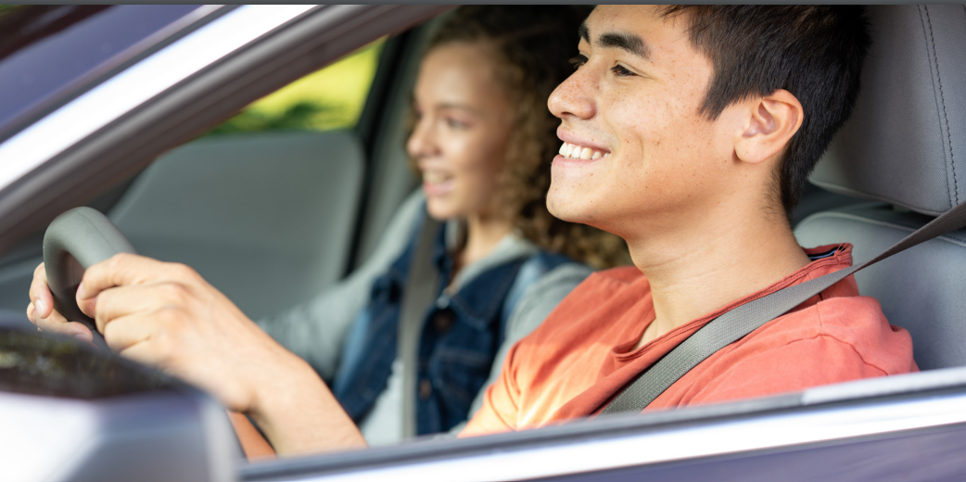
Teen Driver Safety Success: Where Do We Go From Here?
Pam Shadel Fischer
Senior Director of External Engagement

Slide 2
https://www.ghsa.org/resources/GHSA/young-drivers-spotlight-report23
Notes:
Report commemorates 20 years of the Driving Skills for Life program, a partnership between Ford Motor Company Fund and GHSA. The report includes an analysis of Fatality Analysis Reporting System data for 2002 through 2021 (the latest year for which complete data are available), identifies the policies and programs responsible for the gains in teen driver safety and makes recommendations for building on that success.

Slide 3
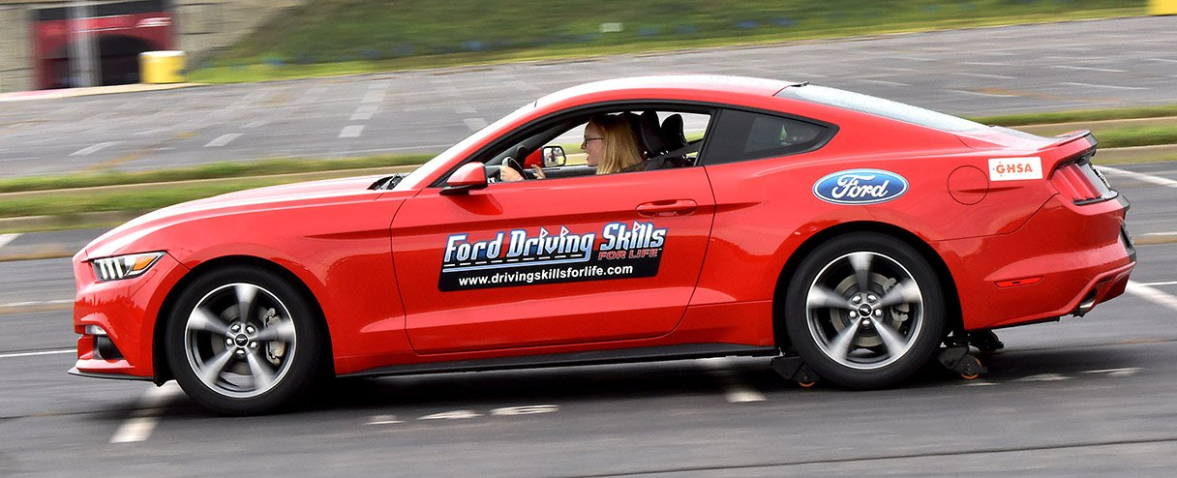
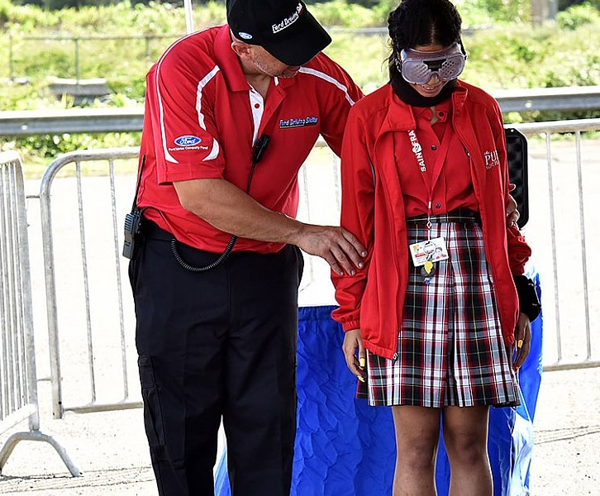
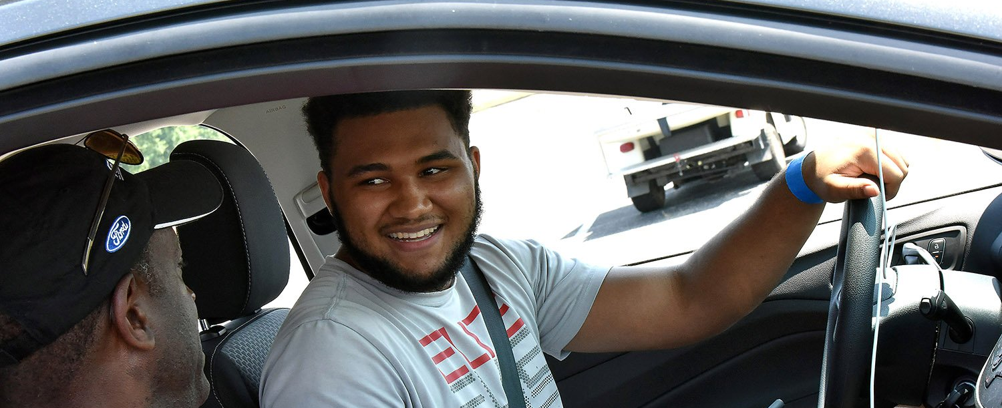
https://drivingskillsforlife.com/
Notes:
If not familiar with Driving Skills for Life, it’s a free behind-the-wheel program that teaches teens critical skills – hazard recognition, speed and space management, and vehicle control – they need to protect themselves and everyone else on the road.
There are also modules focusing on impaired and distracted driving and sharing the road with bicyclists and other vulnerable road users. The program has made stops in California many times of the past 20 years.
Will be in Arcadia, CA Nov. 18-19. Morning and afternoon sessions.

Slide 4
Notes:
For our analysis – we defined young or teen drivers as persons 20 and younger.
Older drivers are defined as people 21 and up.
Young drivers’ crash rates are nearly four times that of older drivers per mile driven (Insurance Institute for Highway Safety, 2023). However, progress is being made.
As Table 1 illustrates, GHSA’s analysis of FARS data found that fatal crashes involving a young driver decreased by 38.1%, while fatal crashes involving an older driver increased by 7.5%.
The findings from a comparison of traffic fatalities that involved and did not involve a young driver, shown in Table 2, are similar.
Important to note that in 2021, 63% of the people killed in crashes involving a young driver were their passengers, occupants of other vehicles or pedestrians or bicyclists.

Slide 5
Notes:
Our analysis also found that deaths of young drivers fell about 45%, compared to an 11% increase for older drivers.
In 2002, young drivers accounted for 14.8% of all driver fatalities. In 2021, that rate fell to 7.9%, a nearly 50% decrease.

Slide 6
Notes:
The best measure of young driver fatal crash involvement would be fatal crashes per vehicle miles traveled (VMT). But national VMT data by driver age are not available.
The next best measure is fatal crashes per licensed driver. Proportion of young persons who are licensed drivers has decreased in recent years, as shown in Table 4. This decline in teen licensure is being driven by a number of factors including increased anxiety, financial issues (licensing and vehicle ownership costs), environmental concerns, access to other modes of transportation (e.g., electric scooters, ride-hailing) and the ability to connect via social media (Osaka, 2023).
The number of licensed young drivers decreased by 6.1% while licensed older drivers increased by 21.6%. That leads to Table 5, which shows how the rate of fatal crash involvement has changed for both young and older drivers.
The young driver fatal crash rate — measured by fatal crashes per 10,000 licensed young drivers — decreased from 6.48 in 2002 to 4.27 in 2021, a 34.1% drop.
The older driver rate decreased from 1.84 to 1.63, a 11.6% drop.
While the young driver rate in 2021 was still substantially higher than the older driver rate, the difference has narrowed, though not by as much as the difference in fatal crash involvement. The drop in teen licensure accounted for less than one-quarter of the decline in young driver fatal crash involvement.

Slide 7
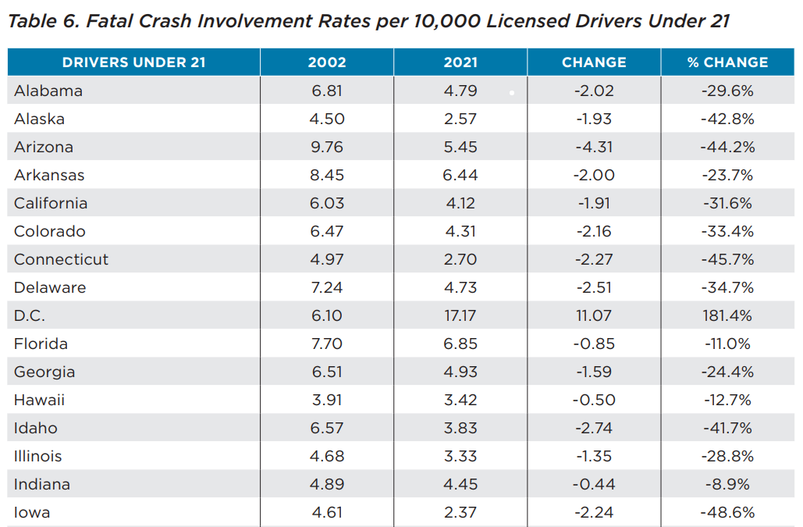
Notes:
Young driver fatal crash rates – and how those rates have changed over 20 years – vary substantially by state.
In 2021, the fata crash involvement rate ranged from 1.66 deaths per 10,000 licensed drivers in Minnesota to 17.17 in Washington, DC. The national average is 4.27.
Our analysis found that the rate decreased in all but three states (Mississippi, Montana and North Dakota) and DC.
What about Nebraska ? The rate fell 46.5% for young drivers. From 5.48 in 2002 to 2.93 in 2021.
The older driver rate was 2.03 in 2002 and it fell to 1.33, a 34.5% decrease.

Slide 8
Graduated driver license laws
Parental involvement
Driver education and behind-the-wheel training
Peer-to-peer traffic safety programs
Safer vehicles and teen specific technologies
Notes:
So, what’s behind the gains? The drop in young driver fatal crashes and crash rates can be attributed to five policy or program activities that research confirms has had the greatest impact.
Graduated driver license laws
Parental involvement
Driver education and behind-the-wheel training
Peer-to-peer traffic safety programs
Safer vehicles and teen specific technologies
GDL – most effective tool in our toolbox. 3-step licensing system is responsible for novice driver crash rates ranging from 20 to 40% (Shope as cited in Williams, 2011). IIHS research – strong restrictions on nighttime driving and teen passengers, along with delays in licensure age, reduce fatal crashes and insurance losses for young drivers (McCart et al., 2010; Trempel, 2009 as cited in IIHS, 2023). Delays in permit age reduces fatal crashes and increases in practice hours reduce insurance losses (IIHS, 2023).
Parents – Promoting critical role parents and guardians play in monitoring and coaching their teens also a contributor. CHOP research confirmed that teens are less likely to crash and violate the law if they have parents who set, monitor and enforce safe driving practices. These “authoritative” parents who set high expectations and nurture their young drivers, see their teens more likely to driver safety at far greater rates than teens with permissive or uninvolved parents (CHOP, 2009). Small number of states require parent education, others have developed voluntary programs.
Driver Ed/Training – Research confirms the value of DE&T. Oregon study found teens who completed a DOT-approved DE course had fewer crashes, convictions and suspensions compared to their peers who didn’t (Raymond et al., 2007). Nebraska teens that completed DE revealed similar findings that included not only lower crash and violation rates compared to their peers who didn’t complete formal training but also reductions in convictions involving alcohol during the first two years of licensure (Shell et al., 2015). About half the states currently require drivers under 18 to complete DE&T before they can be licensed (ANSTSE, 2021). CHOP conducted analysis of 130,000 Ohio drivers 16-24 years of age. Found that compared with drivers license at 18, those licensed at 16 had a 27% lower crash rate in their first two months of licensure and a 14% lower rate in the first. Rates were also lower when comparing teens licensed at 17 versus 18. Also, among drivers under 25, 16-year-olds were the most successful during their on-road license examination. Their failure rate was 22% compared to 37% for 18-year-olds (Walshe, et al., 2022).
Peer2Peer – Enlisting teens to educate their peers about traffic safety issues is a proven countermeasure that has played a role in young driver crash reduction. Teens who regularly participate in positive social projects designed to help their peers and others are less likely to engage in risky behaviors (Benton, as cited in Varenhorst, 2004). One caveat – to specifically prevent crashes, these programs should be one component of a broader environmental strategy that includes families, school, neighborhoods and communities (Fischer, 2019). Significant number of P2P programs in past 20 years. Teens in the Driver Seat (TX based) especially effective. Address the top teen driving risks – distraction, driving at night, speeding, lack of seat belt use and driving impaired. Awareness of these risks among teens in the program have increased by up to 200% with cell phone use dropping by 30% and seat belt use increasing 14%. A rigorous 20-county control group analysis in TX found the program produced an average decrease of 14.6% in injury and fatal crashes (total in counties where the program had been sustained for three or more years compared with areas without the program (TDS, 2023).
Vehicles/Technology – Vehicles have become increasingly safer for all drivers, but electronic stability control, required on vehicles starting in 2012, has been particularly beneficial to young drivers. ESC substantially reduces fatal crash risk resulting from loss of vehicle control (IIHS, 2023). Other safety features – blind spot monitoring, lane-keeping assist, automatic emergency braking, adaptive cruise control & speed limit recognition. Automakers developed technologies specifically designed for teens drivers – Ford’s MyKey, Kia’s UVO system, Hyundai Bluelink app, GM’s Teen Driver. Give parents ability to control speeds, radio (when teen isn’t buckled up), receive alerts when they exceed speed limit. Other apps life Life360 and Bouncie, along with insurance provided apps also have had an impact. Using crash data from 2016-2019, researchers examined the potential safety benefits of three crash avoidance features – front crash prevention, lane departure prevention and blind spot monitoring – and three teen driver specific-technologies – speeding prevention, nighttime curfew violation alerts and seat belt reminders/interlocks. Found that the teen driver tech have the largest potential for reducing young driver injuries and fatalities, followed by lane departure and front crash prevention and blind spot monitoring. Altogether, these technologies have the potential to prevent more than three quarters of teen driver fatalities, nearly half of teen driver injuries and 41% of crashes involving teen drivers (Mueller & Cicchino, 2022).

Slide 9
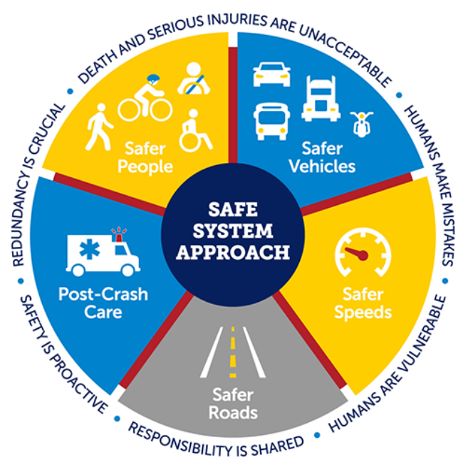
Notes:
How do we continue the gains made in young driver crashes and crash rates? And I would also posit how do we get to zero with this age? I believe that young drivers – more than any other group – has the greatest potential for reaching this milestone first. But what will it take to get there.
We must build on the five proven countermeasures I just discussed and add a sixth, which I’ll talk about in a minute. All the countermeasures support the six principles of the Safe System approach, the foundation of the National Roadway Safety Strategy.
They also align with three of the five Safe System elements – Safe Road Users, Safe Vehicles, Safe Speeds – which together create layers of protection to help keep young drivers and those they’re sharing the road with safe.
The Safe System approach also emphasizes equity across all disciplines and a greater focus on prioritizing the safety of all road users, not just drivers. More on that point in a bit.

Slide 10
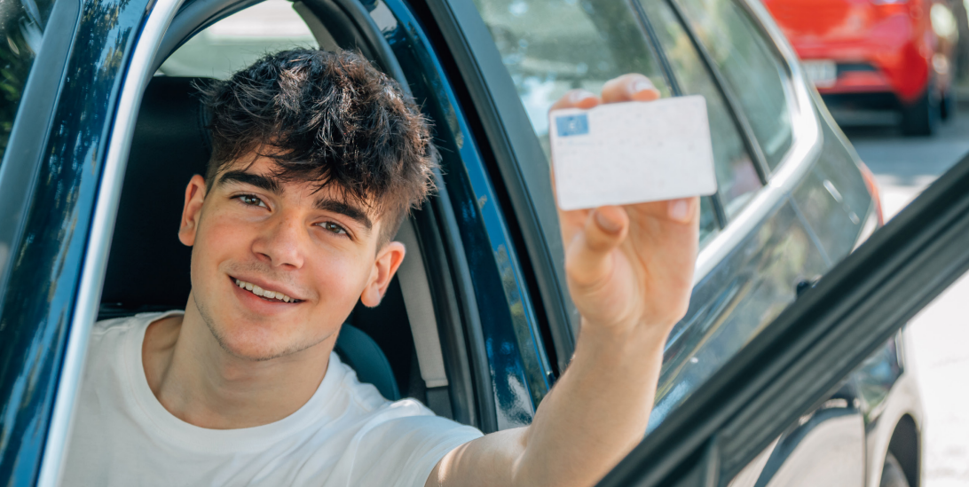
Notes:
Let me briefly walk you through the countermeasures and our recommendations.
We need to strengthen GDL laws. No state’s law is perfect particularly when you take into account current best practice that calls for a minimum permit age of 16 that includes at least 70 hours of supervised practice and an intermediate license age of 17. During this phase the nighttime driving restriction should start at 8 p.m. and no teen passengers should be permitted in the vehicle (IIHS, 2023). Yes, it sounds draconian, but it’s grounded in research.
Young drivers in states with older licensing ages have lower fatal crash rates and fewer insurance collision claims. Raising the license ag from 16 to 17 is associated with a 13% lower fatal crash rate among 15 to 17-year olds (McCartt et al., 2010) and a 9% reduction in collision claim rates among 16-year-old drivers (Trempel, 2009, as cited in IIHS, 2023).
NJ is state with a minimum intermediate license age of 17 – policy in effect longer than our GDL law. Not surprisingly, it eliminates most crashes involving 16-year-olds (that’s our minimum permit age) and it has resulted in much lower combined crash rates for 16- and 17-year-olds drivers compared to their peers in neighboring states (Ferguson et al., as cited in IIHS, 2023).
NJ’s law also applies to all young drivers under 21 and as a result the benefits of GDL hae resulted in reductions in crashes for 18-year-olds.
Studies conducted by researchers at CHOP support states extending GDL to 18- and 20-year-olds (Curry et al., 2017& 2018).
When it comes to practice, more is better. Recent Ohio study found that for every month in the learner’s permit stage, crash rates were reduced 2% (Walshe et al., 2022).
Lastly, strengthening GDL laws will not only benefit young drivers, but all road users. When teens crash, they don’t just injure or kill themselves and their peers. According to NHTSA, 5,565 people were killed in crashes involving young drivers in 2021.
If California raised the current permit age from 15 ½ to 16 – it could result in a 7% reduction in fatalities and a 2% reduction in collision claims.
Raising the intermediate license age from 16 to 17, could result in a 13% reduction in fatalities and a 5% reduction in collision claims.
(Used the IIHS’ GDL Calculator)

Slide 11
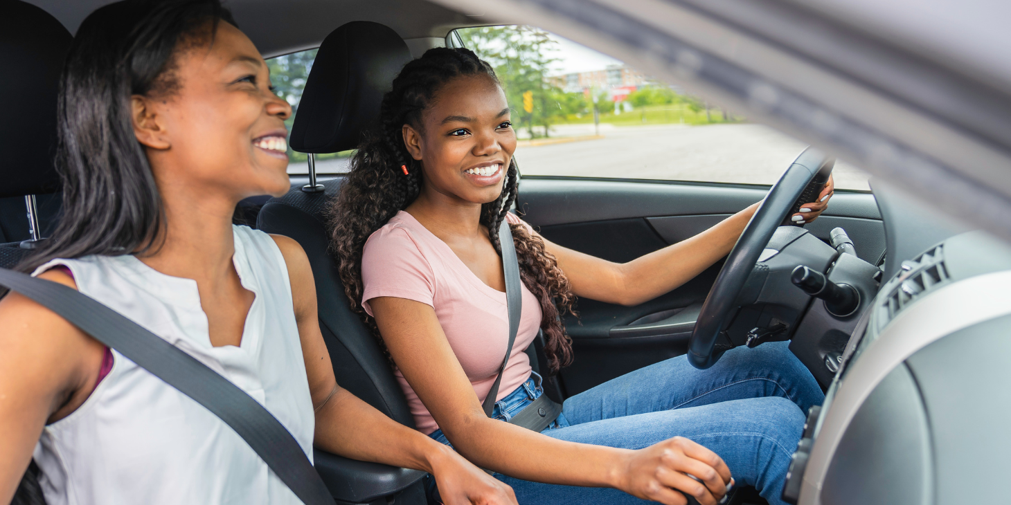
Notes:
Bolster parent/guardian and other adult involvement.
Parents and guardians play a key role in their child’s learning to driver experience and must understand and enforce the state’s GDL provisions. But surveys confirm that it’s a mix bag when it comes to parents knowing about GDL and awareness of the risk for their teens.
We recommend building a parent education component into state young driver licensing requirements. This can be delivered online or face-to-face. Research indicates the latter is optimal for clearing up confusion about how and why GDL works. The also help parents make the link between GDL restrictions and young driver risk. Once parents understand this, they’re more likely to view GDL as a supportive program rather than a government dictate. This is critical because GDL is first and foremost a parent program, one designed to help them their teen survive their most dangerous driving years.
Parents also need to understand their state’s GDL law is the minimum standard they may exceed, not a guideline or the maximum to aim for.
Other adult influencers also need to understand the risk for teens – why and how great it is, how GLD works to address that risk and the role they can play to promote it. Teachers, coaches, clergy, scouting leaders, club advisors… can all reinforce safe driving rules and practices.

Slide 12
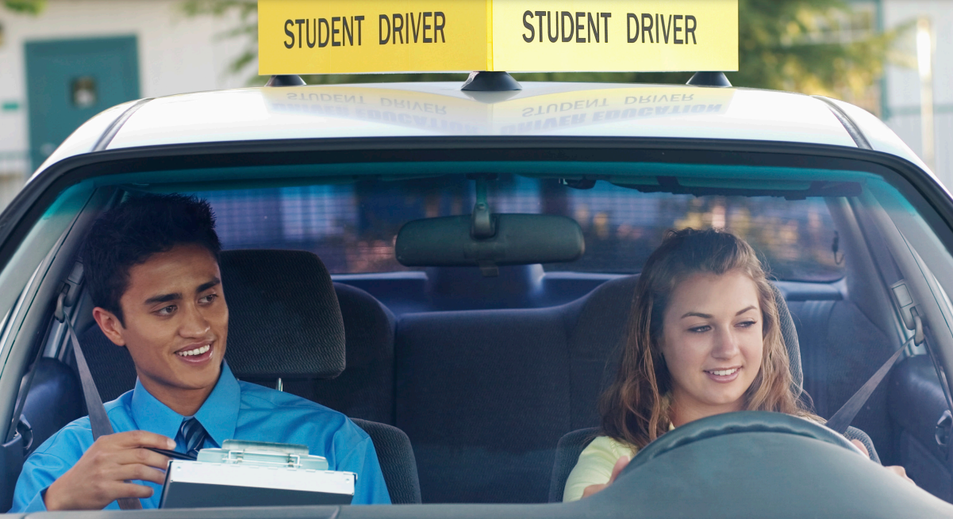
https://www.adtsea.org/webfiles/fnitools/documents/ntdetas-standards.pdf
Notes:
We need to ensure that the training our highest-risk driers receive meets their needs.
States are encouraged to improve DE&T by incrementally implementing the Novice Teen Driver Education and Training Administrative Standards developed by the Association of National Stakeholders in Traffic Safety (ANSTSE), of which GHSA is a member. The standards were developed and substantiated using research and the collective knowledge of subject matter experts in the field. You can find them online at the url shown here.
We must ensure that DE&T are available to all regardless of race, gender, language, age and any other characteristic and that the curricula are cultural equitable.
We also need to address financial barriers that may prevent some teens from enrolling in DE&T. This is critical because we know that young drivers who complete mandatory DE&T do better than their non-trained peers. But the cost associated with this training – particularly in states where it’s only available through private, for-profit schools can be prohibitive. As a result, some teens must wait until they’re 18 to get a license and that means they’re not realizing the benefits of GDL.
In Washington State, between 2016 and 202, 44% of drivers 25 and under completed a DE course. A survey conducted by the WA HSO found that non-white young people are more likely to wait until they’re 18 to obtain a license, with more than half citing cost as the reason. At the same time, Black, Indigenous and People of Color 15 to 24 years of age are disproportionately represented in the state’s fatal crashes. One WA HSO official said “they’re being sorted into that higher risk category because of the financial barrier” (Kroman, 2023).
WA State Legislature considering several bills that would require anyone 25 or younger to complete DE as a prerequisite for licensure and another bill that would provide vouchers to anyone who can’t afford the cost. The WA HSO estimates a 70% higher rate of injury or death for people who did not complete a DE course. In addition, young drivers who got their license at 18 were 50% more likely to get into a crash in their first year of driving compare to those who did so at 16 (Kroman, 2023).
Ohio and MO making scholarships available to youth.

Slide 13
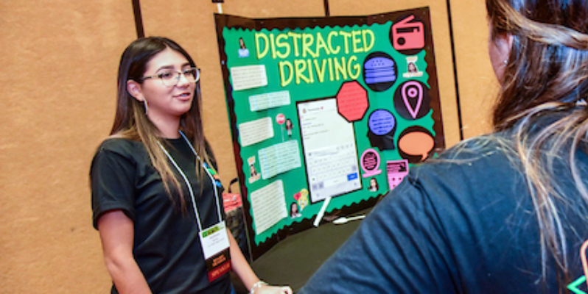
https://www.ghsa.org/resources/Peer-to-Peer19
Notes:
Peer-to-peer education is a viable component of a broader teen traffic safety strategy, but not all programs are created equally. It’s critically important that teens have a voice in leading these efforts. That’s one of 8 success indicators for these programs, the others are:
Inclusive
Sustainable
Facilitated training
Measurable objectives
Positive
Incentives & recognition
Evaluation
I encourage you to review NHTSA’s Peer-to-Peer Teen Traffic Safety Program Guide at the url shown on the screen for more information on the success indicators. The guide also includes a compendium of teen led programs that incorporate all or many of these elements. These programs are benchmarks against which you can assess your own program or others.
California’s Friday Night Live is included along with Teens in the Driver Seat, which I mentioned earlier, SADD and FCCLA, among others.

Slide 14
Notes:
Parents need to understand the importance of putting their teen in a vehicle that has as many safety features as possible. This gives them access to driver assistance features that have the potential to prevent or mitigate up to 75% of their fatal crashes (IIHS, 2023; 2021). This can be done through parent education programs and other materials.
At the same time, parents and teens need to understand how their technologies work. Drivers turning these systems off due to mistrust or annoyance, undermines their benefit. Lack of understanding, being overwhelmed by them or failing to take corrective action, negates effectiveness as well. Dealer observations found that front crash prevention systems were activated in 93% of the vehicles brought in for service and nearly all the blind spot detection and rear-cross traffic were activated (Reagan, et al, 2018, as cited in IIHS, 2023). Activation of systems that help with lane-keeping, however, were substantially lower at just 52% (IIHS, 2023). Many young drivers are involved in run-off the road crashes, often as a result of speeding.
Lane departure warning, blind spot monitoring and automatic emergency braking reduce the types of crashes they’re designed to prevent by 11%, 14% and 50%, respectively. Based on these percentages, it’s estimated that today’s lane departure waning tech could prevent approximately 6,500 young drivers crashes a year, while blind spot monitoring and AEB could avert another 4,500 and 110,000, respectively (IIHS, 2021). So we need to ensure automakers and dealers educate drivers of all ages about the lifesaving benefit of this technology.
Extend this education to vehicles equipped with young driver-specific tech. An IIHS study of parents who owner Ford vehicles equipped with MyKey found that only about half were aware their vehicles had this tech. Of the parents that knew, 1/3 didn’t use it with their teens, indicating they didn’t believe it provided a safety benefit. This technology can help parents address common risky driving behaviors such as speeding and lack of seat belt use, which contribute to about 40% of teen driver deaths. Having access to these data can help parents coach and monitor their teens. IIHS also estimates that “even if these technologies are only moderately effective, they could prevent many injuries” (IIHS, 2021).
Yes, this technology can be out of reach for some families. But there are low or no-cost apps. Cell phones are ubiquitous with teens; using these devices to keep tabs on teen drivers wouldn’t be difficult. For example, about 30% of fatalities involving 16 and 17-year-olds happen between 9 p.m. and 6 a.m. An app that notifies parents about curfew violations could help them better enforce a nighttime driving restriction. Of course, we not only need to promote the use of these apps, but also that parents monitor these alerts and act when their young drivers violate restrictions (IIHS, 2021).

Slide 15
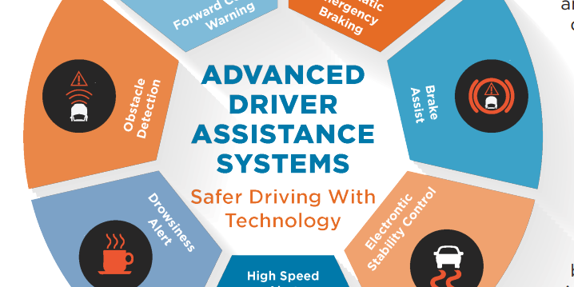
Notes:
I indicated there are six recommendations and here’s the last one: incorporate technology and driver responsibility into education.
As vehicle tech continues to evolve, ensuring that our youngest and riskiest drivers understand and use it correctly is critical. It should address how the tech functions, its limitations and the conditions or situation that it was or wasn’t designed for. Inaccuracies can lead to driver overreliance and/or overestimation of the tech’s capabilities, which can be deadly for young drivers (AAA Foundation, 2023).
Need to know about the safety features, including opportunities to try them out in a controlled setting – that can help bridge knowledge gap and bolster use and safety. This is critical because teens may assume that Level 2 or 3 automated vehicles can drive themselves without any attention from the drivers, which is simply isn’t the case. This misperception has been the cause of many crashes. This generation is more likely than their parents to embrace tech, but it’s vital they’re provided accurate information about what exists today and how it works so their interaction with it is safe and appropriate.
Also need to provide behind-the-wheel experience for electric vehicles. EV’s often feel faster due to their ability to quickly produce maximum torque, plus many have one-pedal driving. Teens may find it easy to adapt to the one-pedal, but no recognize the danger associated with the torque. Speed is a problem for young drivers; they account for a greater proportion of speed-related fatalities than older drivers (Retting & Fischer, 2021). As they get more comfortable behind the wheel, their speed tends to increase. Education can help temper a teen’s enthusiasm to see just how fast that EV can go.
DE must also address the safety of people outside the vehicle. U.S. pedestrian and bicyclist fatalities have reached record levels not seen in four decades. Educating teens about the critical role they play in keeping others safe is essential or reversing this trend.
I’m thrilled that our partners at Ford Fund have broadened their focus beyond drivers to call for safe mobility for all road users and they’re partnering with GHSA to incorporate this into the Driving Skills for Life program. We call on other providers of young driver programs to incorporate this into their curricula as well.

Slide 16
Notes:
Let me wrap up by stating again that young driver safety must be a priority in our quest to achieve zero traffic fatalities.
Teens historically have been among the most dangerous drivers, so investing in their safety benefits all road users.
This is best accomplished by continuing to leverage the proven countermeasures discussed in the GHSA report along with focusing on newer issues such as equity, vehicle technology and the responsibility drivers have for the safety of all road users.
My organization, in partnership with an array of national partners is committed to advancing these recommendations to ensure your driver fatal crashes and crash rates continues to decrease.

Slide 17
https://www.ghsa.org/resources/GHSA/young-drivers-spotlight-report23
Notes:
Encourage audience to check out the report at the link shown on the screen.

Slide 18
Pam Shadel Fischer
pfischer@ghsa.org
908-619-2786
Notes:
Please don’t hesitate to reach out to me if you have questions about the GHSA report and teen driver safety.

