Slide 1
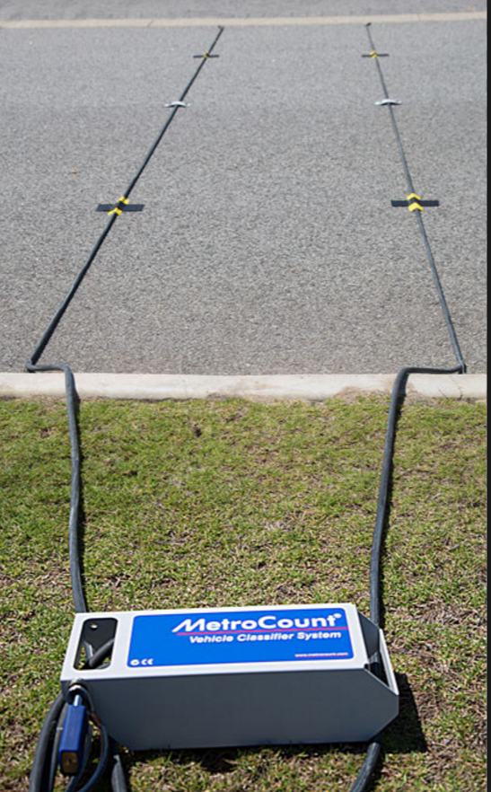
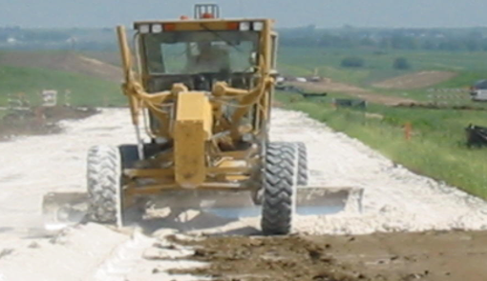
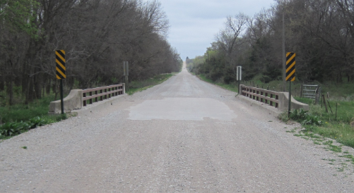
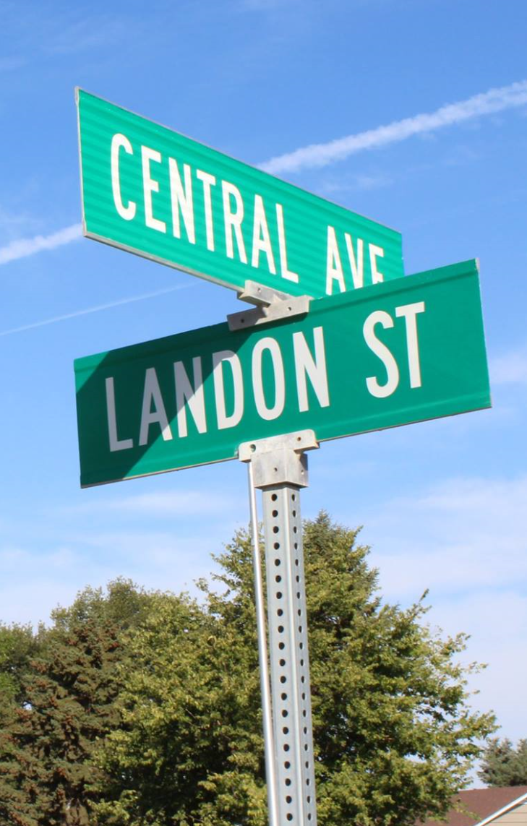
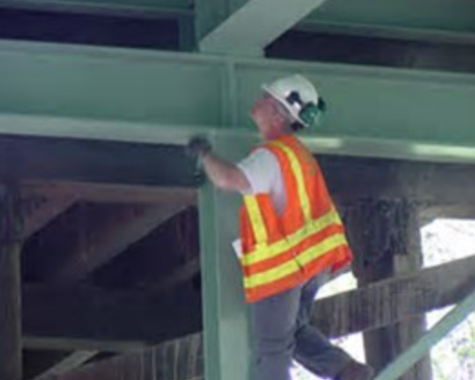
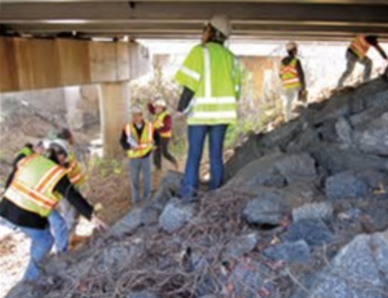


Managing Nebraska’s
Public Roads and Streets
Bridge Inspection and the NBIS
23 CFR 650-C
Boards - Liaison Services Section
Video F
8/10/2019
Notes:
8/10/2019 Made some minor changes, recorded updated audio media, and converted the Power Point into a video.
8/9/2019 Updated Slide 21 from 60 days to 30 days per Babrak Niazi’s 8/9/2019 email.
8/3/2019 Updated NDOR logo to NDOT logo in several slides. The previous version of this video dated 3/15/2017. 11 slides modified. Slides 1, 2, 6, 8 thru10, 18 thru 20, 23, and 26. Changed NDOR to NDOT, updated to NDOT logo, and updated web links as needed. On Slide 10 changed the BIP Manual cover to the current version March, 2018.
Welcome to “Managing Nebraska’s Public Roads and Streets, Bridge Inspection and the National Bridge Inspection Standards, or NBIS.
The focus of this video is on inspection requirements for bridge-size structures on county roads and municipal streets.
This is the sixth topic in a series of videos the purpose of which is to summarize Nebraska’s management of public roads and streets as directed by state law and also by rule and regulation.
The target audience is county highway and city street superintendents, and those aspiring to attain those positions. Elected officials and anyone interested in the management of the state’s public roads and streets are also encouraged to view this.

Slide 2
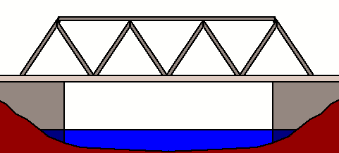
“Bridge” - What is it?
A structure over water, roadway, railway or other depression or obstruction with a track over it to move traffic
An opening measured along the center of the roadway of MORE THAN 20 feet between abutments
Could be culverts and multiple pipes that add up to more than 20 ft
Definition of Bridge
NDOT Bridge Inspection Program Manual (March 2018), Page 6
US Law – Title 23, Part 650
Bridges, Structures, and Hydraulics
Subpart C – National Bridge
Inspection Standards
NBCS Minimum Design Standards, Page 44
428 NAC 2-001.03A5a
Notes:
8/3/2019 Updated slide – changed NDOR to NDOT.
Federal and State regulations define a bridge. The NDOR’s Nebr DOT’s Bridge Inspection Program Manual also refers to this same definition.
Read the bullets.
NOT FOR AUDIO
001.03A5a BRIDGE
A structure including supports erected over a depression or an obstruction, such as water, highway, or railway, and having a track or passageway for carrying traffic or other moving loads, and having an opening measured along the center of the roadway of more than 20 feet between undercopings of abutments or spring lines of arches, or extreme ends of openings for multiple boxes; it may also include multiple pipes, where the clear distance between openings is less than half of the smaller contiguous opening.
For interstate bridges Neb. Rev. Stat. §39-892(5) currently has a similar definition.
Notice that the definition of bridge encompasses not only what you normally think of when you hear the work “bridge”, but also other types of structures. And these structures must have a length of more than 20 ft as measured along the center of the road.

Slide 3
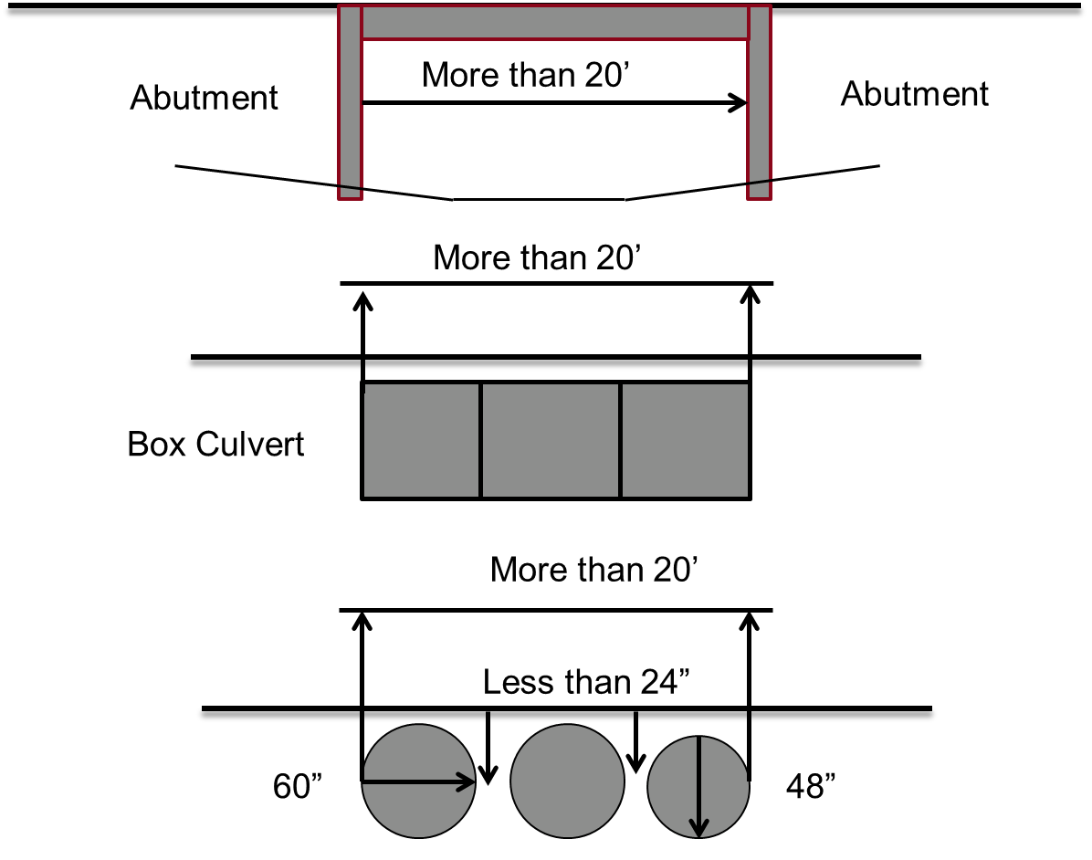
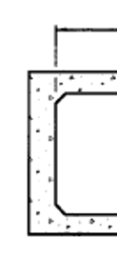
NBIS Bridge Length
Edge of Opening
Definition/Examples of Bridge
multiple chambers (pipes) where the distance between openings is less than ½ of the smaller contiguous opening
Notes:
This screen shows examples of bridges.
Length, of bridges and other structures, is a key measurement and important to understand what it is.
It has implications with respect to design standards, funding and inspections.
It is VERY important to understand that
Length of a structure is the OPENING measured along the CENTER OF THE ROAD,
no matter how a structure is oriented.
Bridge length is the NBIS Length.
In the upper sketch, it is measured between undercopings of abutments.
For culverts and multiple-pipe arrangements, such as the bottom two examples on this screen, NBIS
length is also measured along the center of the road, to the extreme ends of the openings.
The sketch at the bottom of the slide shows multiple pipes, a common arrangement. To be considered as acting together for the purposes of NBIS length, the clear distance between openings (i.e. pipes) must be less than half of the smaller contiguous opening. In the example, the smaller pipe is 48” therefore, the clear distance between the pipes must be less than half of that, or 24 inches and, by definition, the overall NBIS length of the arrangement must be more than 20 feet.
NOT FOR AUDIO
Do not confuse Structure Length with NBIS Bridge Length
The NDOT Bridge Inspection Program Manual has two different lengths:
Structure Length, Item 49 on Page 71
NBIS Bridge Length, Item 112 on Page 154
The MDS uses NBIS Bridge Length (Item 112) to distinguish between Bridges and Non-Buried Structures.

Slide 4
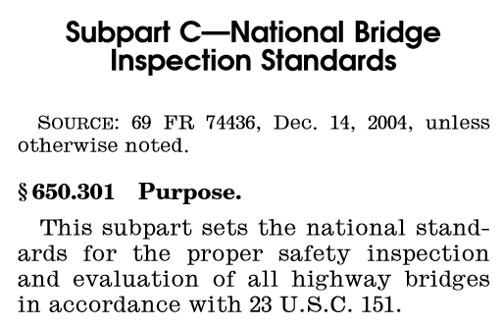
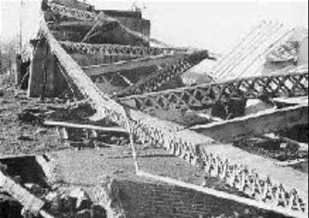
NBIS
National Bridge Inspection Standards
https://www.fhwa.dot.gov/bridge/nbis/
Notes:
A bridge failure in 1967 resulted in congressional action to assure the safety of bridges.
National Bridge Inspection Standards were created.
Frequently asked questions on the NBIS can be found online at the link shown on the screen

Slide 5
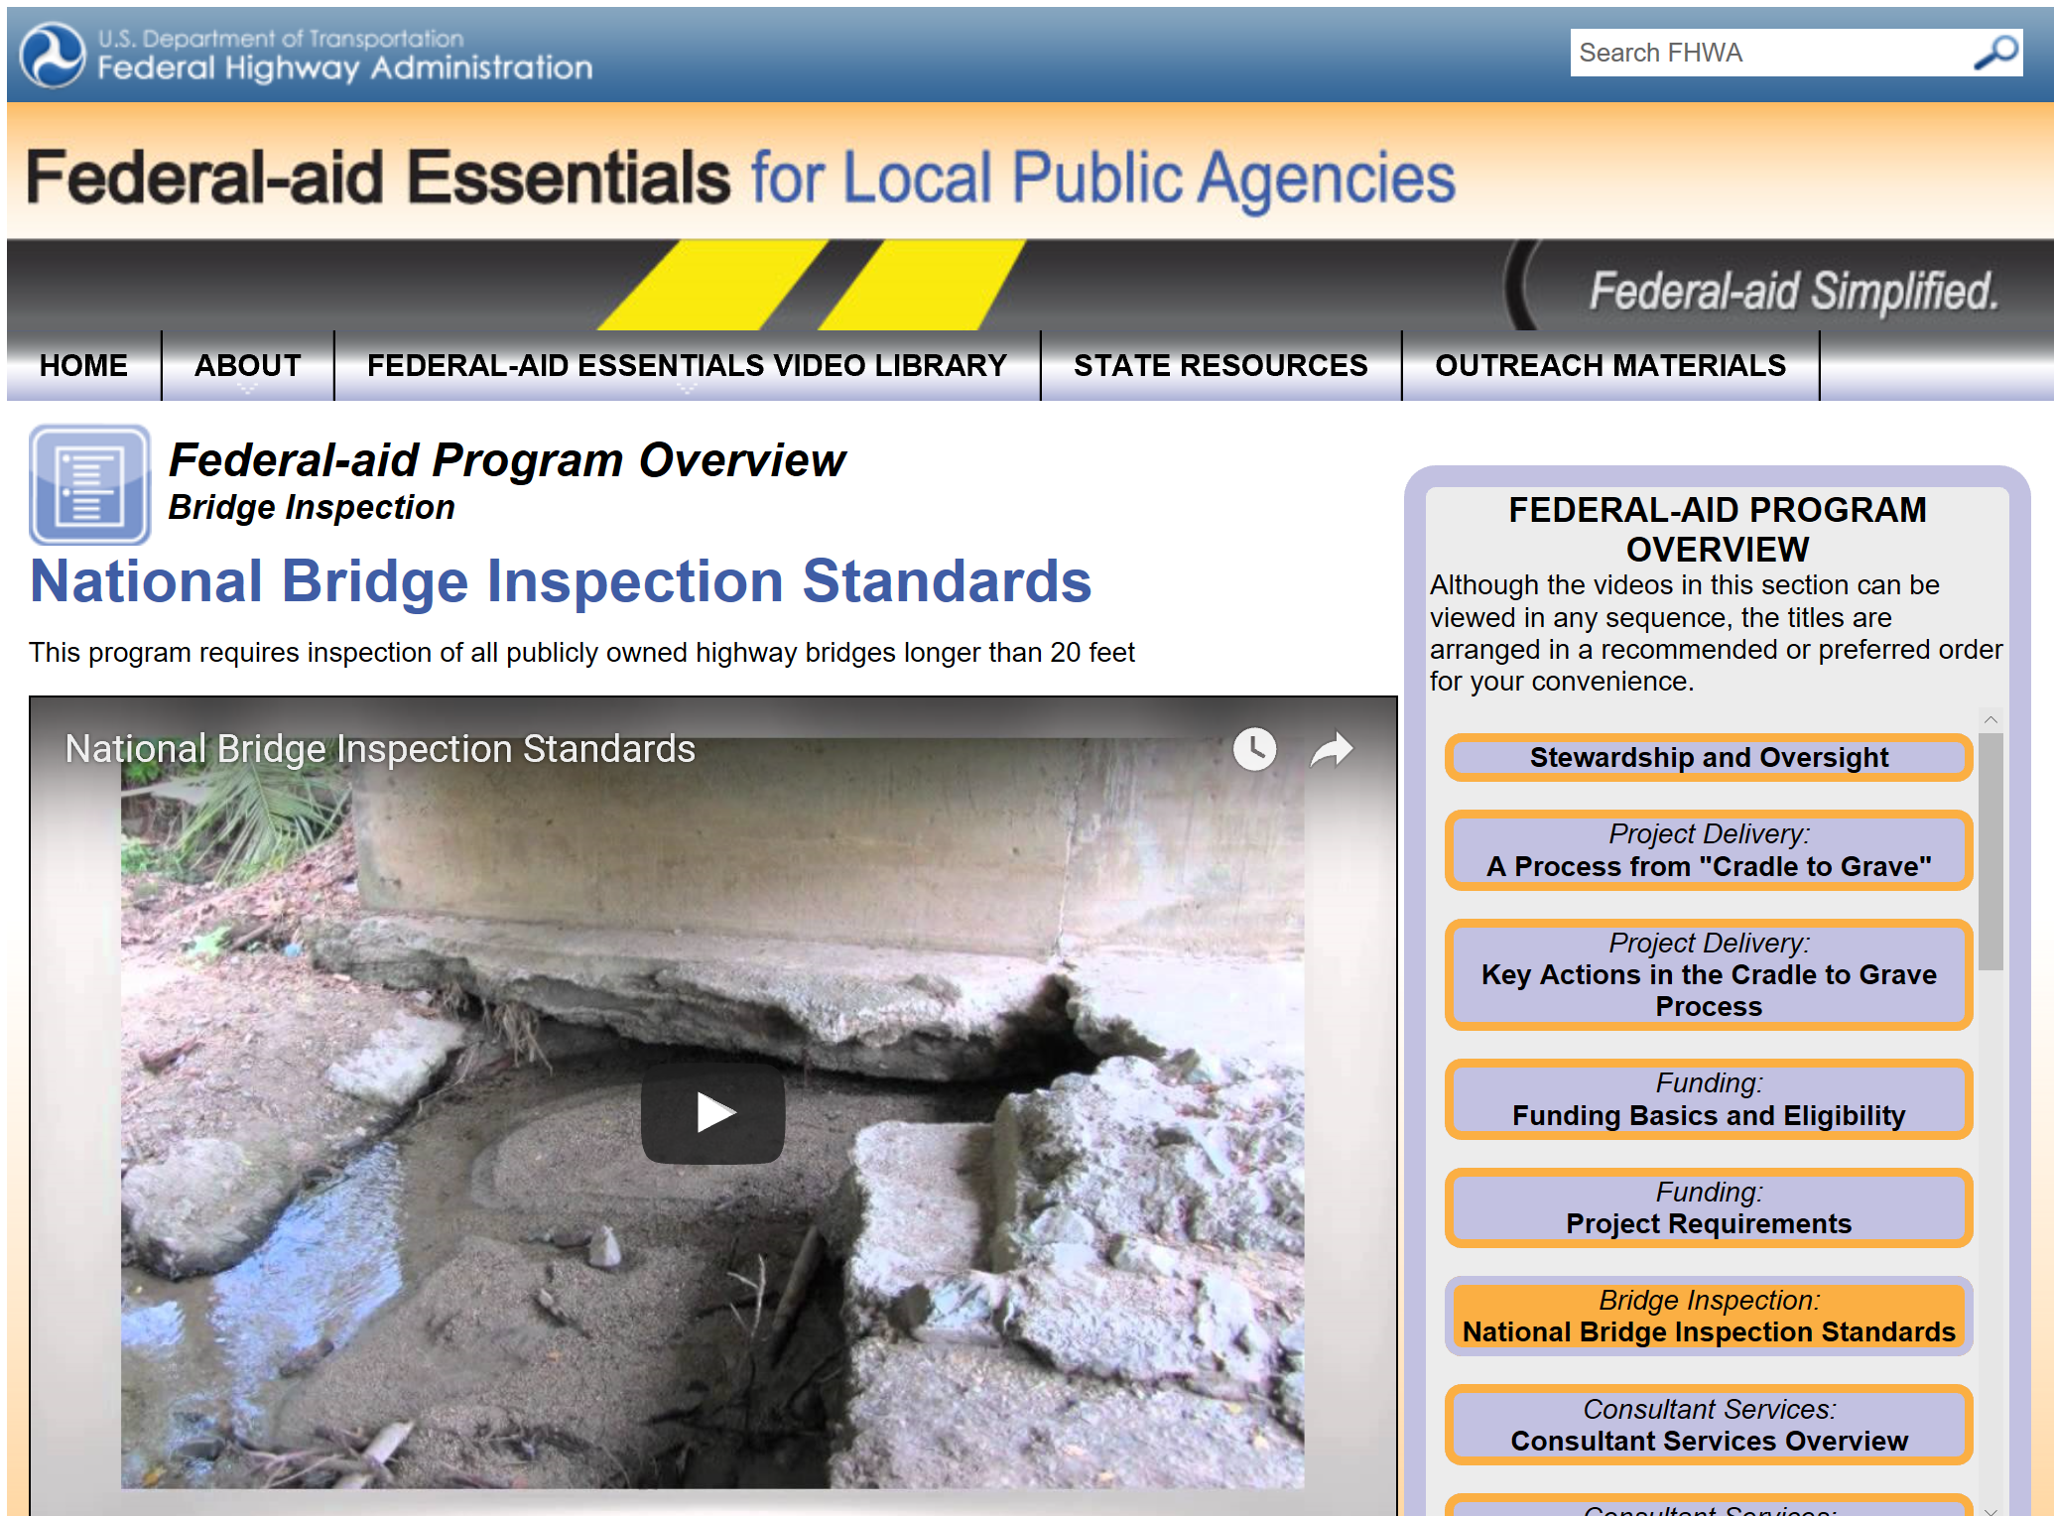

Federal-aid Essentials
National Bridge Inspection Standards
https://www.fhwa.dot.gov/federal-aidessentials/catmod.cfm?id=87
https://www.youtube.com/watch?v=uwa4y5dRBro
Notes:
The following is a short clip from the Federal Highway Administration’s video series called Federal-aid Essentials.
It is online at the link shown.
Federal-aid Essentials videos can also be viewed on YouTube.

Slide 6
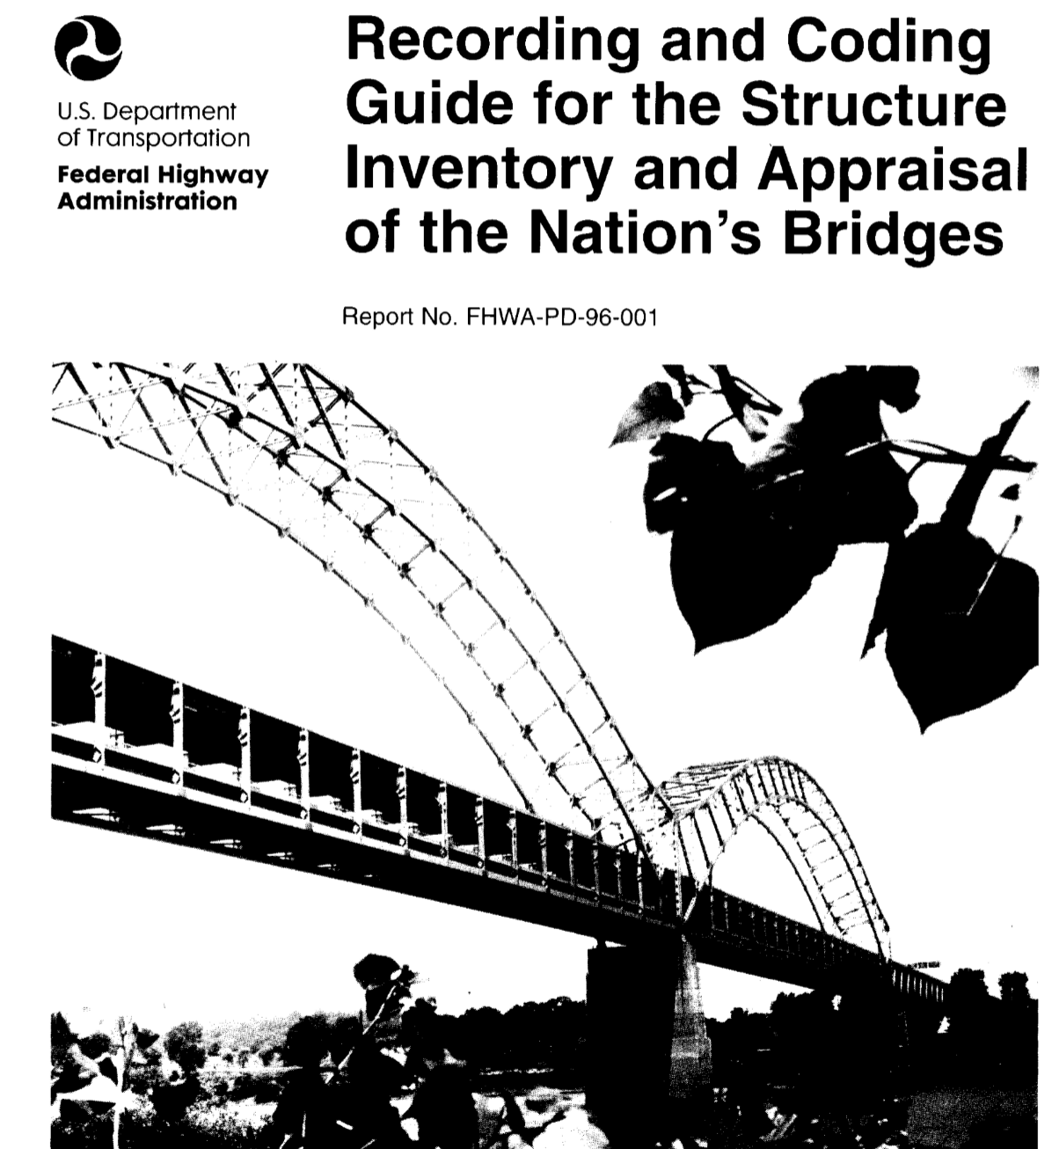
National Bridge Inspection Standards
Notes:
8/3/2019 Updated slide – changed NDOR to NDOT.
Bridge inspections for all of Nebraska’s over 15,000 bridge-size structures are mandatory, and the data is required to be reported.
NDOR The NebrDOT is the keeper of the database for Nebraska’s bridge inspections.

Slide 7
23 CFR Part 650C
  650.301 Purpose
  650.303 Applicability
  650.305 Definitions
  650.307 Bridge inspection organization
  650.309 Qualifications of personnel
  650.311 Inspection frequency
  650.313 Inspection procedures
  650.315 Inventory
  650.317 Reference manuals
National Bridge Inspection Standards
Notes:
Title 23 Code of Federal Regulations Chapter I (as in i) Subchapter G Part 650 Subpart C
Commonly known as Part 650C
Has several sections. This video provides brief summaries of the sections shown in bold font
Bridge inspection organization, bridge inspector qualifications, frequency of inspections, and inspection procedures.

Slide 8
650.307 Inspection Organization
Each State Transportation Department
  Must inspect, or
  Cause to be inspected,
Bridges located on public roads that are fully or partially located within the State's boundaries
  Except for bridges that are owned by Federal agencies
National Bridge Inspection Standards
Notes:
8/3/2019 Updated slide – changed NDOR to NDOT.
NDOR The Nebr DOT inspects approximately 3,500 bridge-size structures on the state highway system,
Off the state highway system, counties and municipalities in Nebraska are responsible to inspect their own bridges.
There are just-under 12,000 bridge-size structures off the state highway system. Over 11,000 of those are owned by Counties.

Slide 9
650.307 Inspection Organization
Each State Transportation Department or Federal Agency must include a bridge inspection organization that is responsible for:
  Bridge inspection policies and procedures
  Quality assurance and quality control, and
  Preparation and maintenance of a bridge inventory
  Bridge inspections, reports, load ratings and other requirements of these standards
National Bridge Inspection Standards
Notes:
8/3/2019 Updated slide – changed NDOR to NDOT.
NDOR The Nebr DOT provides bridge inspection policies and procedures, a quality assurance and quality control program, maintains the bridge inventory database, and provides reports on bridges.

Slide 10
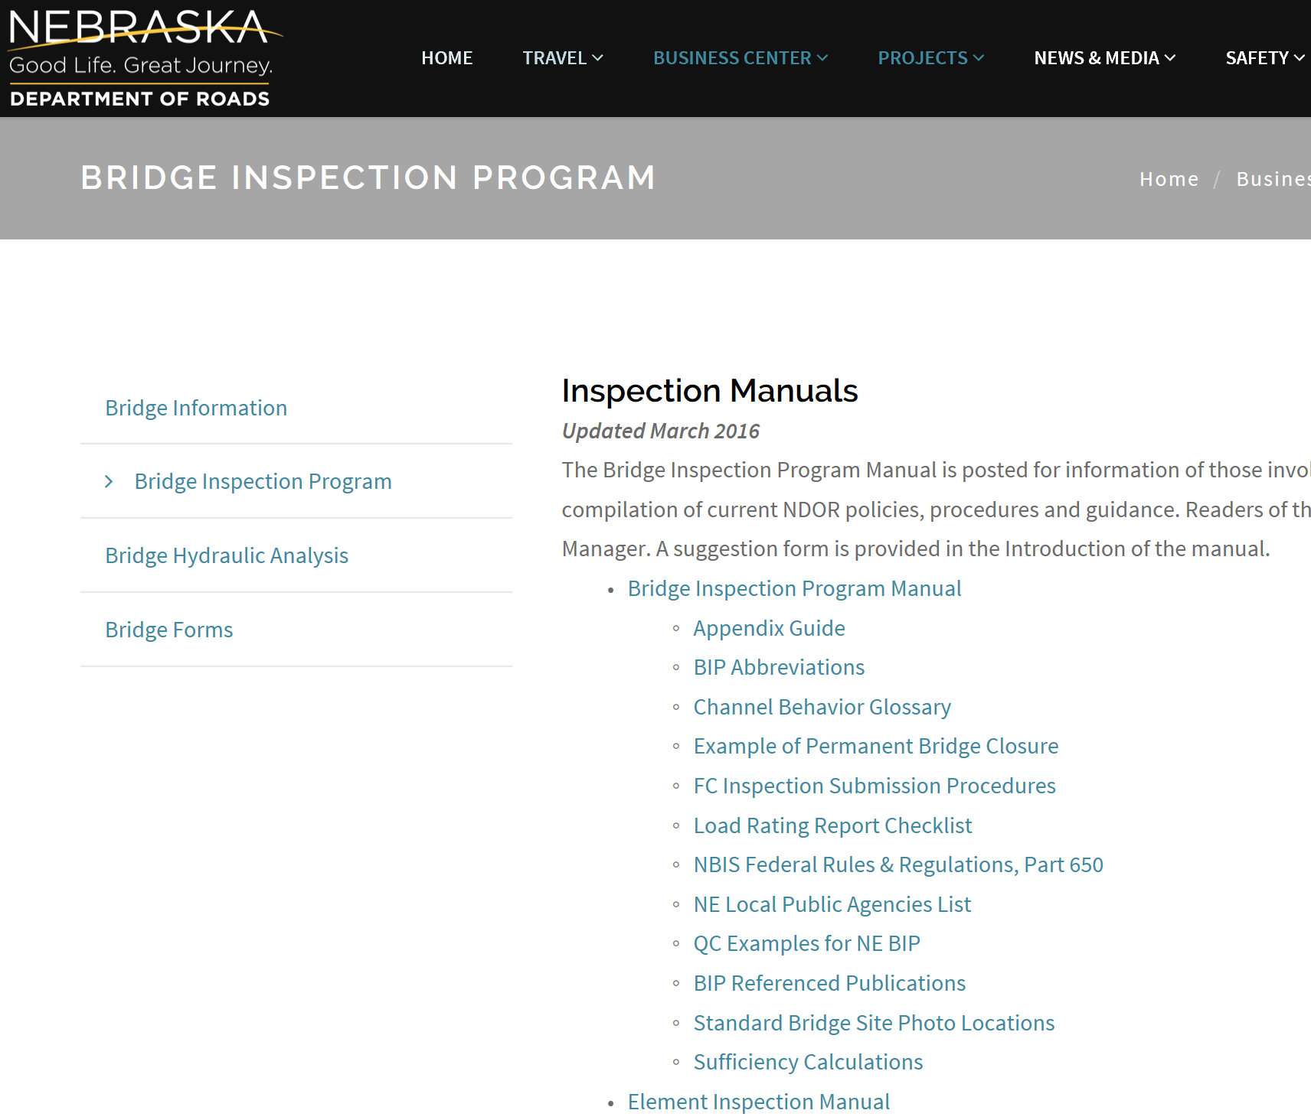
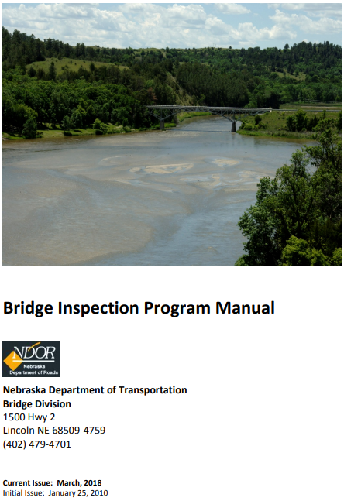
National Bridge Inventory Standards
https://dot.nebraska.gov/business-center/bridge/inspection/
Notes:
8/10/2019 Updated slide – changed the BIP Manual Cover to the March, 2018 version.
8/3/2019 Updated slide – changed NDOR to NDOT. Updated web link.
Policies, procedures and other resources can be found on NDOR’s The Nebr DOT ‘s website, under Business Center, Bridge Information.

Slide 11
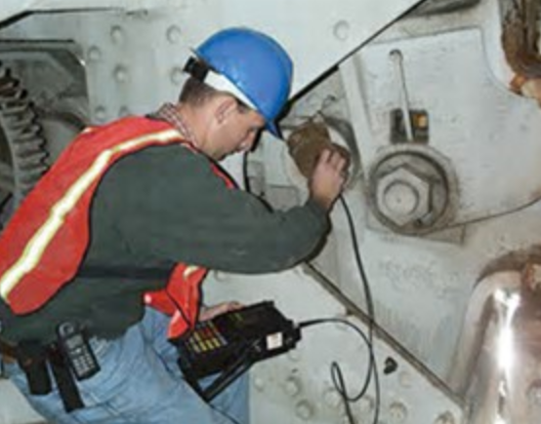
650.309 Personnel Qualifications
Program Manager
  In charge of a unit that performs bridge inspections, reporting, bridge load rating and inventory
Team Leader
  In charge of the bridge inspection team
National Bridge Inspection Standards
Notes:
The Bridge Inspection Program Manager is in charge of a unit that performs bridge inspections, reporting, bridge load rating and inventory.
The Bridge Inspection Team leader is in charge of the bridge inspection team.
NOT FOR AUDIO
From Babrak Niazi 3/14/2017:
Add Bridge Load Rating on Slide 11 under Program Manager responsibilities

Slide 12
650.309 Personnel Qualifications
Program Manager Qualifications
  Registered professional engineer
  10 years bridge inspection experience
AND
  Successfully completed FHWA approved comprehensive training course (2 week course)
National Bridge Inspection Standards
Notes:
Minimum qualifications for a Program Manager are
Registration as a professional engineer
10 years bridge inspection experience
And successful completion of a Federal Highway Administration approved bridge inspection training course

Slide 13


650.309 Personnel Qualifications
Team Leader Qualifications
  Same as Program Manager, OR
  Five years bridge inspection experience*, OR
  NICET Level III or IV Bridge Safety Inspector*
National Bridge Inspection Standards
http://www.nicet.org/
* AND successfully completed FHWA approved comprehensive training course
OR (continued)
Notes:
There are five ways to qualify as a Bridge Inspection Team Leader
One way is to have the same qualifications as a Program Manager, as previously described
A second way is to have 5 years of Active participation in bridge inspections in accordance with the NBIS, in a field inspection, supervisory, or management role and successful completion of a Federal Highway Administration approved bridge inspection training course
A third way to qualify is to achieve a NICET certification as a Level III or Level IV Bridge Safety Inspector
and successful completion of a Federal Highway Administration approved bridge inspection training course

Slide 14

650.309 Personnel Qualifications
Team Leader Qualifications
  Have ALL of the following:
    Bachelors Degree in engineering from an Accreditation Board for Engineering and Technology (ABET) accredited university or college and successfully pass the Fundamentals of Engineering Exam
    Two years bridge inspection experience, AND
    Successfully completed FHWA approved comprehensive training course
National Bridge Inspection Standards
http://www.abet.org/
OR (continued)
Notes:
A fourth way to be qualified as a Team Leader
is to have a bachelors degree in engineering from a university or college that is accredited by
the Accreditation Board for Engineering and Technology, or ABET
Along with two years of Active participation in bridge inspections in accordance with the NBIS
and successful completion of a Federal Highway Administration approved bridge inspection training course

Slide 15
650.309 Personnel Qualifications
Team Leader Qualifications
  Have ALL of the following:
    Associates Degree in engineering or engineering technology for ABET accredited college or university
    Four years of bridge inspection experience, AND
    Successfully completed FHWA approved comprehensive training course
National Bridge Inspection Standards
http://www.abet.org/
Notes:
A fifth way to be qualified as a Team Leader
is to have an associates degree in engineering from a university or college that is accredited by
the Accreditation Board for Engineering and Technology, or ABET
Along with four years of Active participation in bridge inspections in accordance with the NBIS
and successful completion of a Federal Highway Administration approved bridge inspection training course

Slide 16
650.311 Inspection Frequency
National Bridge Inspection Standards
Regular intervals not to exceed 24 months
Inspect certain bridges more often than every 24 months
Establish interval based on bridge deficiencies and characteristics
Fracture Critical Bridges may have members that require more frequent inspection
Notes:
How often a bridge is inspected depends on its characteristics and its deficiencies.
The maximum inspection interval for a routine inspection is 24 months. This may be increased to 48 months if approved by FHWA.
Underwater inspections have a maximum 60-month interval. This may be increased to 72 months if approved by FHWA.
FCM or Fracture Critical Members, may need to be inspected more often. A fracture critical member is a steel component in tension whose failure is expected to result in the collapse of the bridge or the inability of the bridge to perform it’s function.” Namely, a fracture-critical element is a non-redundant tensile member. Fracture critical members are not limited to old bridges; they can exist on new bridges also.
Some fracture critical members need to be inspected every six months!

Slide 17
650.313 Inspection Procedures
Inspect each bridge in accordance with the inspection procedures. Resource: AASHTO Manual for Bridge Element Inspection and Manual for Bridge Evaluation
Provide at least one team leader at the bridge at all times during each initial, routine, in-depth, fracture critical member and underwater inspection.
Rate each bridge as to its safe load-carrying capacity
Prepare bridge files
National Bridge Inspection Standards
Notes:
The general procedure is to inspect each bridge with at least one team leader present,
New and reconstructed bridges must have their initial inspection before opening the bridge to traffic
Rate each bridge to determine its safe load-carrying capacity. This will be discussed momentarily.
Prepare the bridge files – this record-keeping activity will be discussed later in this video
NOT FOR AUDIO
From Babrak Niazi 3/14/2017:
See section 4.10.3.2 BIP, New and reconstructed bridges must have their initial inspection before opening to the traffic,

Slide 18
650.313 Inspection Procedures
Identify bridges with special requirements
  With fracture critical members
  Bridges requiring underwater inspection
  Scour-critical bridges
NDOT requires that participants generating data and supporting reports submit them to NDOT as soon as QC has been completed, but within 90 days of the inspection date
National Bridge Inspection Standards
Notes:
8/3/2019 Updated slide – changed NDOR to NDOT.
Identify fracture critical members, bridges requiring underwater inspection, and scour critical bridges.
Bridge data and reports are to be submitted to the NDOR NDOT as soon as the Quality Control process is complete, but no later than 90 days after the inspection.
The Federal-aid Essentials clip mentioned 180 days. Nebraska’s rule is 90 days.
NOT FOR AUDIO
From Babrak Niazi 3/14/2017:
Slides 18 item F. Please confirm that it is correct and worded correctly. Also, the narrative states that if it’s a new bridge or a bridge that has been altered or reconstructed, you have 60 days to submit the plans and the initial inspection report; please confirm this.
See section 1.3.2 of Bridge Inspection Manual (BIP), page 9. Bridge Design Plans, Hydraulic Design and Analysis Report, and Load Rating Report should be submitted to NDOR Prior to construction.
See section 4.10.3.2 BIP, New and reconstructed bridges must have their initial inspection before opening to the traffic, but the report must be submitted to NDOR through BrM (bridge management software) within 90 days of the inspection date.
It is noteworthy to know that bridge owners must install weight limit signs after load rating as soon as possible but no later than 60 days (see section 5.4.3 BIP). And if a bridge needs to be re-rated, it should be load rated within 60 days after the inspection. (see section 5.4.1 BIP)

Slide 19
Load Rating
A Load Rating Evaluation determines load carrying capacity of a structure
Load Carrying Capacity is compared to Nebraska Legal Load thresholds
Nebraska Legal Loads
  Type 3 = 25 tons
  Type 3S2 = 37 tons
  Type 3-3 = 43 tons
National Bridge Inspection Standards
Bridge Inspection Program Manual, Chapter 5
https://dot.nebraska.gov/media/11212/ndot-bip-manual.pdf
Notes:
8/3/2019 Updated slide – web link at bottom of slide updated.
Each bridge has a load rating evaluation done to determine its load carrying capacity.
Which is compared to Nebraska’s legal load thresholds.
This screen shows the three Nebraska legal loads, represented by three hypothetical vehicles with each assigned a threshold.

Slide 20
Load Rating
Each bridge in the National Bridge Inventory (NBI) must have a current bridge load rating
  Completed by a Nebraska Licensed Engineer
Bridge owners and their Load Rating Engineers are
  Responsible for determining when a bridge must be re-rated
  If it must be re-rated, get it done within 60 days after inspection
Load Ratings Reports for new or reconstructed bridges
  Must be submitted to NDOT prior to construction
NDOT is in the process of re-load rating all bridges in the inventory for Special Haul Vehicles (trucks with more than 3 axles) in the next 10 years
National Bridge Inspection Standards
Notes:
8/3/2019 Updated slide – changed NDOR to NDOT.
Each bridge in the National Bridge Inventory or NBI must have a current bridge load rating.
The load rating evaluation must be done by a professional engineer licensed in Nebraska.
Bridge owners are responsible for determining when a bridge needs to be re-rated.
If a bridge needs to be re-rated, it should be load rated within 60 days after the inspection
The load rating report for a New bridge, or a bridge that is replaced, must be submitted to the NDOR NDOT prior to construction.
The NDOR NDOT is currently re-figuring the load rating for all bridges for trucks with more than three axles.
NOT FOR AUDIO
From Babrak Niazi 3/14/2017:
Slide 20 item 3. Please confirm that it is correct and worded correctly. Is this item in conflict with the narrative on Slide 18 item F (that if it’s a new bridge or a bridge that has been altered or reconstructed, you have 60 days to submit the plans and the initial inspection report).
See section 1.3.2 of Bridge Inspection Manual (BIP), page 9. Bridge Design Plans, Hydraulic Design and Analysis Report, and Load Rating Report should be submitted to NDOR NDOT Prior to construction. Item 3 is correct.
It is noteworthy to know that bridge owners must install weight limit signs after load rating as soon as possible but no later than 60 days (see section 5.4.3 BIP). And if a bridge needs to be re-rated, it should be load rated within 60 days after the inspection. (see section 5.4.1 BIP)

Slide 21
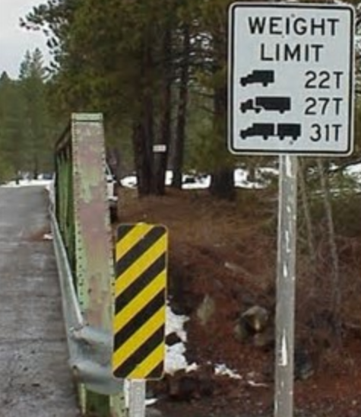
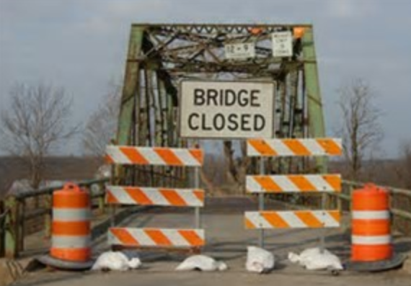
Load Posting and Closing
A Bridge must be load posted ASAP but no later than 30 days after load rating
  If its Load Carrying Capacity (LCC) is less than Nebraska Legal Load thresholds
A Bridge must be closed
  if its LCC is less than 3 tons
  Bridge Owner must
    install barricades immediately upon notification of the need to close
    Provide documentation of closure to NDOT within 3 days of barricade installation
National Bridge Inspection Standards
Notes:
8/9/2019 Updated slide – changed 60 days to 30 days after load rating. Per Babrak Niazi 8/9/2019 email.
8/3/2019 Updated slide – changed NDOR to NDOT.
A bridge must be load posted if the load carrying capacity is less than a Nebraska legal load threshold.
Bridge owners must install weight limit signs as necessary after the load rating evaluation as soon as possible but no later than 60 30 days. As mentioned previously, if a bridge needs to be re-rated, it should be load rated within 60 days after the inspection.
A bridge must be closed if the load carrying capacity is less than 3 tons
In that case, the bridge owner must install closure barricades immediately
And provide documentation of the closure to the NDOR Nebr DOT within three days of installing the barricade(s)
NOT FOR AUDIO
From Babrak Niazi 3/14/2017:
It is noteworthy to know that bridge owners must install weight limit signs after load rating as soon as possible but no later than 60 days (see section 5.4.3 BIP). And if a bridge needs to be re-rated, it should be load rated within 60 days after the inspection. (see section 5.4.1 BIP)

Slide 22
Record Keeping
Bridge File and Bridge Records
  Allows assessment of current bridge condition
    Safety of the public
    Cost-effective management of a significant asset
  Bridge File has many components
    Bridge inspection documents and reports
    Records of any action taken to address the findings of such inspections
    Photographs
    and more
National Bridge Inspection Standards
Notes:
Record keeping is an important element of compliance with NBIS.
The Bridge File, kept at the Bridge Owners’ facilities, is necessary for future assessments of the bridge. [NOT FOR AUDIO: this can be done with software such as AASHTOWare]
Findings and results of bridge inspections must be recorded on standard State or Federal agency forms
The Bridge File generally includes design plans and specifications, correspondence, inspection documents and reports, findings and actions taken to address those findings, photographs, the Bridge Load Rating and Posting data, Structure Inventory & Appraisal Sheet, Maintenance and Repair History, and Crash History.
It may also have, if applicable, Fracture Critical information and a Scour Plan of Action.
NOT FOR AUDIO
From Babrak Niazi 3/14/2017:
Record keeping (Bridge File) is an important element of the NBIS compliance with NBIS. Although it is briefly described in the FHWA video, you may consider adding a slide explaining the requirements. Please read Section 1.4.2 BIP, 2.3.2 BIP, 2.4.2.1 BIP, 2.4.2.2 BIP. It could be as simple as “ The Individual Bridge Record is a file kept at the Owners’ facilities that will contain all components of each Bridge Record” It generally includes design plans, Bridge Load Rating, SI&A Sheet, Maintenance Records, Scour Plan of Action, if applicable, and Access to BrM for inspection reports and pictures.

Slide 23
Maintaining a Bridge File at the site or office
Providing access to the Bridge File
Keeping backup of electronic documents
Storing bridge documents in an organized and uniform system
Knowing bridge inspection requirements
Familiarity with records/information provided by consultants
Compliance with NDOT’s Bridge Division Policy for Design, Load-Rating and Inspection of Public Road Bridges
Having bridges load rated when required
Taking action to resolve any critical findings
Reporting closures to Nebraska DOT
Nebraska Bridge Owners’ Responsibilities
Notes:
8/3/2019 Updated slide – changed NDOR to NDOT.
This screen will list some basic responsibilities of the owners of public bridges in Nebraska, including counties and municipalities that own bridge-size structures.
Read the bullets
NOT FOR AUDIO
Reference: BIP Manual 2.1.2

Slide 24
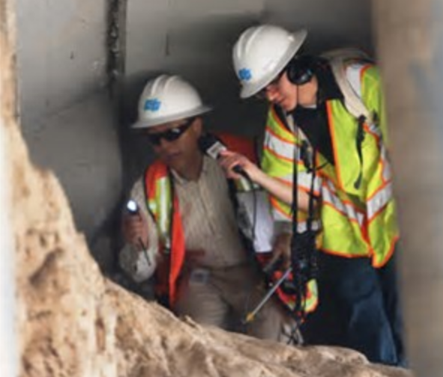
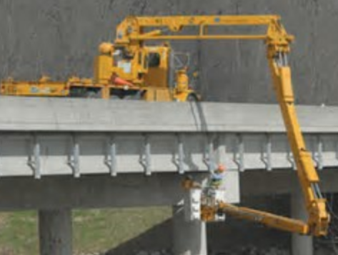
Bridge Inspection Tips
Go in Two’s
Wear personal protective equipment
  OSHA approved harness
Take photos and notes
National Bridge Inspection Standards
Notes:
When doing bridge inspections, do not go alone, it is best to go in teams of at least two.
Wear personal protective equipment – safety vest, hard hat – and an OSHA approved harness if you are working at heights
Be sure to take photos and plenty of notes
NOT FOR AUDIO
From Babrak Niazi 3/14/2017:
Slide 22 bottom bullet. Not sure what “plan of action” is with respect to going out and inspecting bridges. Is there supposed to be a plan of action for inspecting each bridge. Can you help me understand this bullet? If I understand it, I might want to change the narrative.
A Scour Plan of Action (POA) is required for any bridge that is vulnerable to scour problems determined by Hydraulic assessment of the bridge. This is not applicable to the vast majority of our bridge inspections. I do not see it a good fit in this specific slid. On Fracture Critical and complicated bridge inspections, inspectors are should follow Inspection Procedures recorded on inspection reports for efficiencies and inspector safety.

Slide 25
Best Practice
Inspect bridges and structures, even if less than 20 feet opening
Bridge Inspections – Best Practice
However, only those that meet the Federal definition of a bridge are reportable to the National Bridge Inventory (NBI)
Notes:
Although only bridges and structures that meet the Federal Definition of a Bridge are reportable in the National Bridge Inventory, it would be a best practice to inspect all structures, no matter the size.
Smaller structures deteriorate over time much the same as bridge-size structures, being subjected to stresses from traffic and the forces of nature.
The Nebraska Board of Public Roads minimum standards for county roads and municipal streets, which apply whenever work is done, has two criteria for bridges, non-buried structures and culverts. They are structural capacity and clear bridge width.
Structural Capacity applies to all sizes of structures, including those with openings of 20 ft and less, and Clear Bridge Width applies to bridges and non-buried structures with a four foot opening, or greater.
So it is a best practice to inspect, maintain and keep records on all structures, no matter the size.
After all, a structure with less than a 20 ft opening that needs to be repaired or replaced can cause as much inconvenience to the travelling public as a structure with an opening of more than 20-ft.

Slide 26
Managing Nebraska’s
Public Roads and Streets
Bridge Inspection and the NBIS
23 CFR 650-C
Boards - Liaison Services Section
Video F
8/10/2019
Notes:
This was the sixth topic in a series of videos the purpose of which is to summarize Nebraska’s management of public roads and streets as directed by state law and also by rule and regulation.
It was an overview of inspection requirements for bridge-size structures on county roads and municipal streets.

