Slide 1

2016 Minimum Design Standards
Structures- Bridges, Non-Buried Structures, Culverts
Part 1 of 2
Nebraska Administrative Code
Title 428
Rules and Regulations of the
Board of Public Roads Classifications and Standards
(Administrative Host: Nebraska Department of Transportation)
County Roads and Municipal Streets
Neb. Rev. Stat. 39-2113
https://dot.nebraska.gov/media/5593/nac-428-rules-regs-nbcs.pdf
Boards - Liaison Services Section
8/8/2019
Notes:
8/8/2019 Updated first slide – Administrative Host: Nebraska Department of Transportation, not Nebraska Department of Roads.
8/7/2019 Updated. The previous version (PV) was dated 11/14/2016. 13 slides updated. First and last slides updated Dept Logo and web link. Slides 6 thru 9, 32 thru 35 and 38 thru 40 updated.
This is one in a series of videos the purpose of which is to provide information on the Board’s county roads and municipal streets standards.
Reference Nebraska Administrative Code Title 428, Chapter 2.
The topic for this segment is minimum design standards for bridges, non-buried structures and culverts.
It is addressed in two videos. This is the first of the two.
NOT FOR AUDIO
Target Audience: Highway and Street Superintendents, and Consultants
Acknowledgements
Typical Roadway Cross Section: Phil TenHulzen, NDOT Roadway Design Division (Slides 93, 95, 98)
Asphalt Concrete Equivalent Thickness (ACET): Bruce Barrett, NDOT Materials & Research Division (Slides 153-154)
Several Photos of 3R Projects: Roger Figard and City of Lincoln Public Works Staff
Benefit/Cost Analysis: Nicole Frankl, NE-LTAP (Slides 196-200)
Several Bridge Photos: Bridge Division (Mark Traynowicz, Babrak Niazi, Marvin Taylor)
Horizontal Clear Zone: Bill Gulick, KY DOT (Slides 279, 281-284)
ADA: FHWA August 20-21, 2013 Webinar (Slides 304, 308, 311-319, 325-326) http://connectdot.connectsolutions.com/p7r08bvr75l/
ADA: NE-LTAP (Dan Cady) PROWAG presentation (Slides 306, 322-324)
ADA: Chris Hassler, NDOT (Slides 307, 309-310, 320-321)
ADA: Chris Malmberg, HDR Engineering (Slides 305, 328-330)

Slide 2

Overall Learning Objectives
2016 Standards Video Series
Know Functional Classification
Find and use the correct minimum design standards table
Be familiar with Definitions
Know and Understand the Notes
Understand 3R requirements
Know which work to apply to One- and Six-Year Plans
Know fundamentals of horizontal clear zone
Review current ADA requirements
Part 1 of 2
Slide 2
Notes:
Other videos in this series cover the learning objectives shown on this slide.
Some of the other videos should be viewed and understood before watching this video on bridges and structures.
The assumption is that you are already familiar with, or at least know where to find information on
Functional classification systems (Title 428 NAC Chapter 1)
How to Get to, and Use, the tables on pages 55-86 of the Minimum Design Standards
Terminology is important – Definitions are on pages 37-46 of the MDS
Notes, essentially an extension of the tables, are found on pages 47-54 of the MDS
Understanding 3R requirements is a point of emphasis because 3R standards for county roads and municipal streets were added to the Minimum Design Standards in 2016.
Learning Objectives 6, 7 and 8 will not be covered directly in [this video] the Bridges and Structures videos.
NOT FOR AUDIO
Minimum Maintenance Standards (pages 88-91 of the MDS)
Relaxation of Standards (pages 92-94)

Slide 3
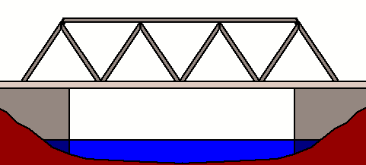
Learning Objectives
Structures
Know Functional Classification
Find and use the correct minimum design standards table
Be familiar with Definitions
Know and Understand the Notes
Understand 3R requirements
Know which work to apply to One- and Six-Year Plans
Know fundamentals of horizontal clear zone
Review current ADA requirements
Part 1 of 2
Slide 3
Notes:
In this 2-part series of videos on bridges and structures, definitions, notes and 3R requirements specific to bridges and structures will be covered.
Of those three, this video (Part I) will cover definitions, and introduce the two notes (18 and 19) that address the two design criteria for bridges and structures – clear bridge width and design structural loading capacity.
Part II, the second video, will go into more depth on notes 18 and 19, address other notes, and also provide a summary of 3R requirements for bridges and structures.
[In this video, definitions, notes and 3R requirements specific to bridges and structures will be covered.]

Slide 4
Learning Objectives
Structures
Tables – the part for Structures and how it works – in the Minimum Design Standards
The Two Design Criteria for Structures
Basis of Values for Design Criteria
Design Structural Loading Capacity – HL93, HS15
Clear Bridge Width – simple formulas
Scope of Work – how work on the roadway and the structure can affect one another
Low Water Stream Crossings and Stream Fords
Part 1 of 2
Slide 4
Notes:
In addition, [this video will cover] this 2-part series of videos covers other learning objectives specific to bridges and structures:
Tables and how those work for Structures
The Two design criteria directly related to structures, and the basis of values for those two criteria
The Two Design Criteria are:
Design Structural Loading Capacity; in particular Live Loads HL93 and HS15 will be explained, and
Clear Bridge Width is calculated from simple formulas
The type of work on a structure and the type of work on the road either side of the structure can affect the scope of work on each other; those requirements will be discussed
Low Water Stream Crossings and Stream Fords and their unique requirements will also be covered.
Of the learning objectives shown, this video (Part I) discusses and demonstrates how Tables in the Minimum Design Standards work for bridges and structures and introduces the two design criteria for structures and the basis of their values.
Part II, the second video, gets into more depth on Note 18 and clear bridge width, addresses how work on a roadway and work on a structure can affect one another, and also addresses low-water stream crossings and fords.

Slide 5
Learning Objective
Know Functional Classification
Find and use the correct minimum design standards table (slides
Be familiar with Definitions
Know and Understand the Notes
Understand 3R requirements (slides
Know which work to apply to One- and Six-Year Plans
Know fundamentals of horizontal clear zone
Review current ADA requirements
Length, Bridge, NBS
Part 1 of 2
Slide 5
Notes:
It is good to be familiar with terminology used in the standards and throughout this presentation.
It may be helpful to have a copy of the minimum design standards in front of you throughout this presentation.
What is meant by Length of a structure will be explained
Definitions for “Bridge” and “Non-buried Structure” are also provided

Slide 6
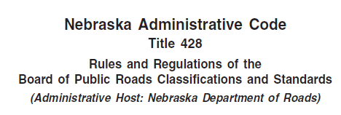
DEFINITIONS
Minimum Design Standards
Title 428 Chapter 2 Section 001
Secretary of State’s Website:
http://www.sos.ne.gov/rules-and-regs/regsearch/Rules/Transportation_Dept_of/Title-428/Chapter-2.pdf
428 NAC 2 001.03A5, Page 44
definitions of structures
Part 1 of 2
Slide 6
Notes:
8/7/2019 Updated web link
Nebraska’s minimum design standards for county roads and municipal streets, for its purposes, on page 44 provides definitions of Bridge, Non-Buried Structure, Culvert, Low-Water Stream Crossing and Ford.
Stopping the video and reviewing these definitions will be helpful for a better understanding of the material presented in this video.
When you think of a bridge, a certain image of a structure likely comes to your mind – that image may be something like the bridge over the Missouri River at Nebraska City, the bridge over the Niobrara River near Valentine, or something similar. However, for the purposes of the standards, as you read the definitions you will realize that a bridge can also be other types of structures – such as a concrete box culvert, or a culvert with multiple pipes – as long as their openings are more than 20 ft. in length along the center of the road.
The reason for this is that nationally, structures meeting the definition of “Bridge” are tracked in the National Bridge Inventory System (NBIS).
Similar to the definition of Bridge, the term Non-buried structure can include several types of structures, including a bridge type of structure! – as long as the opening is from 4 ft through 20 ft in length along the center of the road, and it has 2 ft or less of fill or pavement on top.
Understanding these definitions is important to avoid confusion between commonly used terminology for types of structures – in particular, bridge and non-buried structure – and how the minimum design standards define those same terms broadly, to include other types of structures – using length along the center of the road and the amount of fill on top as the distinguishing characteristics.

Slide 7
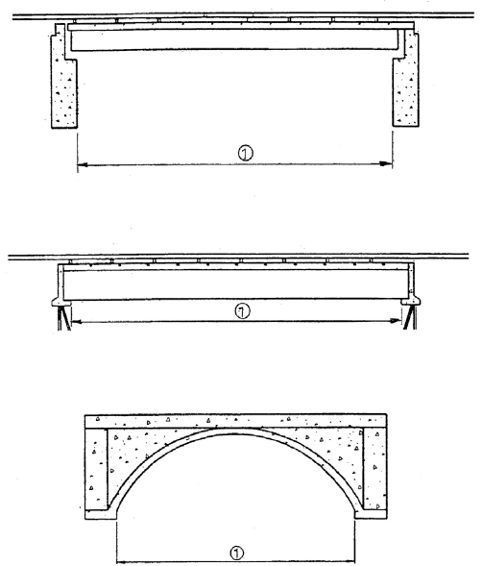
Definition – Length
Length is opening measured along the center of the road
Bridges are measured along the center of the road between undercopings of abutments or between spring lines of arches. It is the NBIS Bridge Length.
Between undercopings of abutments
Part 1 of 2
Between spring lines of arches
482 NAC 2-001.03A5, page 45
NDOT Bridge Inspection Program Manual, Chapter 3
Slide 7
Notes:
8/7/2019 Updated NDOR→NDOT on slide at the bottom.
Length, of bridges and other structures, is a key measurement and important to understand what it is.
It has implications with respect to design standards, funding and inspections.
It is VERY important to understand that
Length of a structure is the OPENING measured along the CENTER OF THE ROAD,
no matter how a structure is oriented.
For bridges, defined on page 45 of the MDS, length is the National Bridge Inventory System (NBIS) Length measured between undercopings of abutments as shown in the upper two sketches on the slide, Or between spring lines of arches as shown in the bottom sketch.
NOT FOR AUDIO
Do not confuse Structure Length with NBIS Bridge Length
The NDOT Bridge Inspection Program Manual has two different lengths:
Structure Length, Item 49 on Page 71
NBIS Bridge Length, Item 112 on Page 154
The MDS uses NBIS Bridge Length (Item 112) to distinguish between Bridges and Non-Buried Structures.

Slide 8
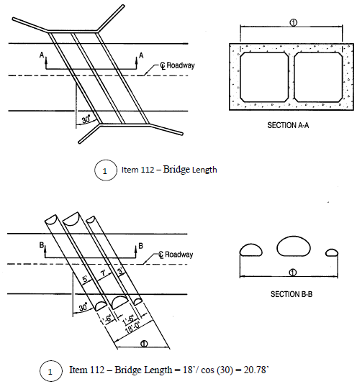
Definition – Structure Length
Between extreme ends of openings
Part 1 of 2
Slide 8
NDOT Bridge Inspection Program Manual, Chapter 3
Notes:
8/7/2019 Updated NDOR→NDOT on slide at the bottom
For culverts and multiple-pipe arrangements, structure length is also measured along the center of the road.
In examples shown on this slide, structure length is measured to the extreme ends of the openings.
For the box culvert, at the top of the slide, it is illustrated by the dimension lines, to the edges of the openings.
The sketch at the bottom of the slide shows multiple pipes, a common arrangement. To be considered as acting together for the purposes of structure length, the clear distance between openings (i.e. pipes) must be less than half of the smaller contiguous opening.
NOT FOR AUDIO
Do not confuse Structure Length with NBIS Bridge Length
The NDOT Bridge Inspection Program Manual has two different lengths:
Structure Length, Item 49 on Page 71
NBIS Bridge Length, Item 112 on Page 154
The MDS uses NBIS Bridge Length (Item 112) to distinguish between Bridges and Non-Buried Structures.

Slide 9
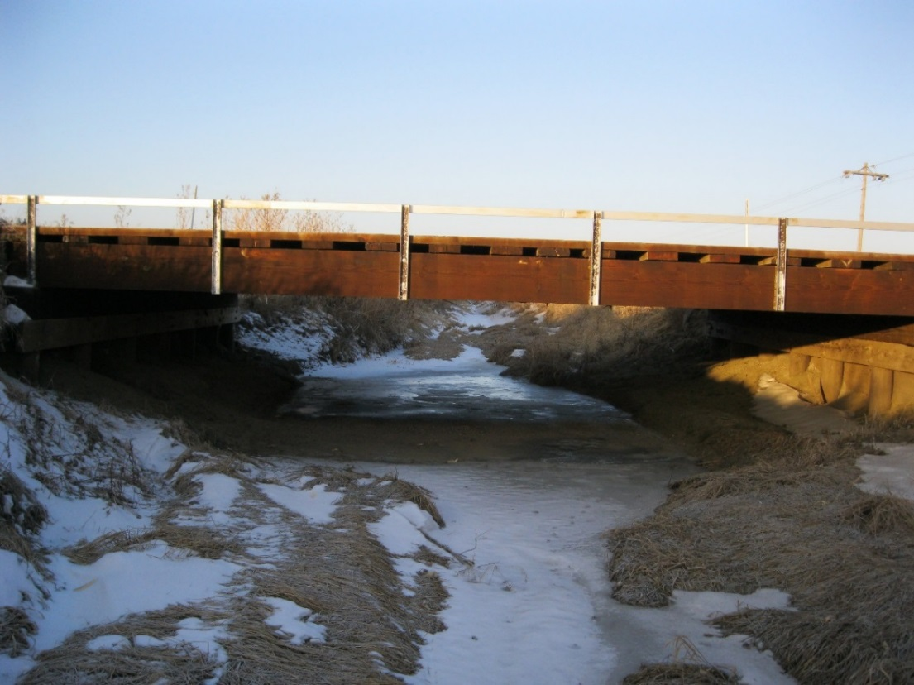
Bridge
Definitions
Federal definition (23 CFR 650.301)
Includes
  Bridges
  Culverts
  Multiple pipes
  etc.
Opening longer than 20 ft
Along center of road
Part 1 of 2
NDOT’s Bridge Inspection Program Manual (March 2018), Page 6
428 NAC 2-001.03A5a, Page 44
Slide 9
Notes:
8/7/2019 Updated NDOR→NDOT and replaced the one audio media with several; the BIP Manual and the CFR were updated since the previous version of this video.
NDOR’s NDOT’s Bridge Inspection Program Manual,
dated March 4, 2013 2018, [NOT FOR AUDIO: Section 1.3.1.1.1]
on Page 6,
refers to the Federal definition of Bridge in 23 CFR 650.305 650.301.
CFR is an acronym for Code of Federal Regulations.
The Board of Public Roads adopted this definition for consistency on page 44 of their 2016 Minimum Design Standards. [NOT FOR AUDIO 428 NAC 2-001.03A5a]
Several types of structures can apply to this definition including bridge type structures, culverts and multiple pipes.
Note that the length of the opening along the center of the roadway for a bridge, is defined as more than 20 ft.
NOT FOR AUDIO
001.03A5a BRIDGE
A structure including supports erected over a depression or an obstruction, such as water, highway, or railway, and having a track or passageway for carrying traffic or other moving loads, and having an opening measured along the center of the roadway of more than 20 feet between undercopings of abutments or spring lines of arches, or extreme ends of openings for multiple boxes; it may also include multiple pipes, where the clear distance between openings is less than half of the smaller contiguous opening.
For interstate bridges Neb. Rev. Stat. §39-892(5) currently has a similar definition.
Notice that the definition of bridge encompasses not only what you normally think of when you hear the work “bridge”, but also other types of structures. And these structures must have a length of more than 20 ft as measured along the center of the road.

Slide 10
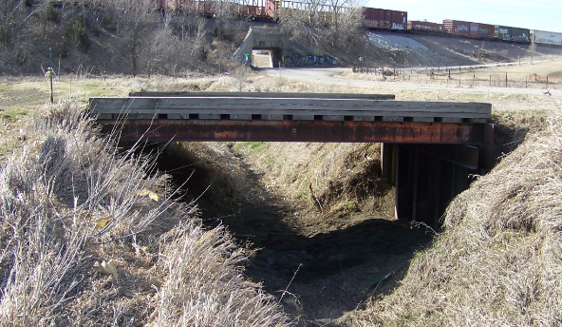
Non-buried Structure (NBS)
Definitions
1 of 3
2016 Standards address 4 ft - 20 ft* structures
What about structures less than 20 ft long?
Part 1 of 2
* Along center of road
Slide 10
428 NAC 2-001.03A5c, Page 44
Notes:
The Board of Public Roads minimum design standards for county roads and municipal streets also apply to structures with an opening 20 ft and less, down to 4 ft measured along the center of the road. The term “non-buried structure” is defined and used in the standards. There are design criteria that apply to non-buried structures, down to 4 ft in length, in the same way they apply to bridges.
NOT FOR AUDIO
001.03A5c NON-BURIED STRUCTURE
A non-buried structure is a structure including supports erected over a depression or an obstruction, such as water or a trail, having a track or passageway for carrying traffic or other moving loads, an opening measured along the center of the roadway of 20 feet or less, and has 2 feet or less of fill or pavement material placed on top of the structure. Examples include concrete, steel and timber structures, concrete slab structures, culverts, corrugated metal pipes, etc.
Timber bridge less than 20 ft long photo from Marvin Taylor of Bridge Division
In the past, in light of the Federal definition of a Bridge, there was some confusion regarding structures less than 20 feet in length and what standards apply to those structures. The 2016 standards explicitly cover structures 4 ft and longer. In order to make that clear, the term “non-buried structure” is defined, and it covers 4 ft to 20 ft lengths.
Non-buried structure essentially complements what the term “Bridge” covers, i.e. for lengths 20 ft and less.
Length measured along the center of the roadway.
Why 4 ft? It was somewhat arbitrary. (JJK had recommended 5 ft. but LS changed it to 4 ft).
Counties which have a Township form of administration typically take care of any structure 4 ft and larger. NBCS thought that 4 ft was therefore a good threshold.
4 ft. drains smaller areas more in line with Q=CIA formula limitations (the accuracy diminishes with larger areas, some say larger than 40 acres).
There wouldn’t be many concrete box culverts less than 4 feet.

Slide 11
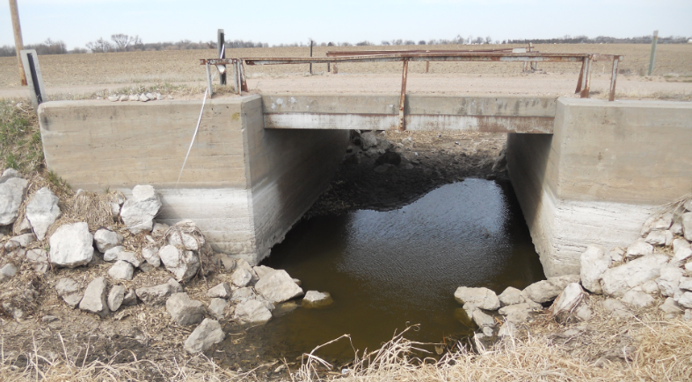
Non-buried Structure
Definitions
2 of 3
Definition similar to Bridge, EXCEPT
  Shorter lengths: 20 ft down to 4 ft
    along the center of the road
  2 ft or less of fill or pavement material on top.
Includes
  Concrete, steel and timber structures
  Concrete slab structures
  Culverts
  Pipes
  etc.
4 ft - 20 ft
Part 1 of 2
Slide 11
428 NAC 2-001.03A5c, Page 44
Notes:
For the definition of a Non-buried structure, see page 44 [428 NAC 2-001.03A5c] of the 2016 Minimum Design Standards.
The definition is similar to the definition of Bridge. But there are two important differences about non-buried structures.
Their length is defined as 4 ft through 20 ft, and
They have no more than 2 ft of fill or pavement material on top.
Thus, non-buried structures must meet the minimum clear bridge width, which will be discussed later in this video.
In the context of the NBCS Minimum Design Standards, non-buried structures can include several types of structures including bridge-type structures, culverts and multiple pipes.
NOT FOR AUDIO
001.03A5c NON-BURIED STRUCTURE
A non-buried structure is a structure including supports erected over a depression or an obstruction, such as water or a trail, having a track or passageway for carrying traffic or other moving loads, an opening measured along the center of the roadway of 20 feet or less, and has 2 feet or less of fill or pavement material placed on top of the structure. Examples include concrete, steel and timber structures, concrete slab structures, culverts, corrugated metal pipes, etc.
001.03A5a BRIDGE
A structure including supports erected over a depression or an obstruction, such as water, highway, or railway, and having a track or passageway for carrying traffic or other moving loads, and having an opening measured along the center of the roadway of more than 20 feet between undercopings of abutments or spring lines of arches, or extreme ends of openings for multiple boxes; it may also include multiple pipes, where the clear distance between openings is less than half of the smaller contiguous opening.
14 ft beam bridge with concrete deck – photo from Steve Riehle, Hall County Engineer

Slide 12
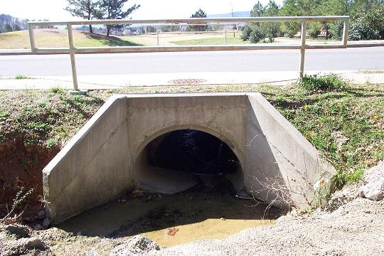
NON-BURIED STRUCTURE
Non-buried Structure
3 of 3
2 feet or less fill or pavement on top
4 ft to 20 ft in length
≤ 2 ft
4 ft - 20 ft
Part 1 of 2
Slide 12
428 NAC 2-001.03A5c, Page 44
Notes:
This slide shows a non-buried type of structure, with 2 ft or less of fill or pavement on top of the structure.

Slide 13
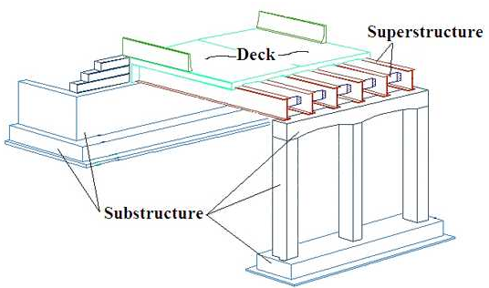

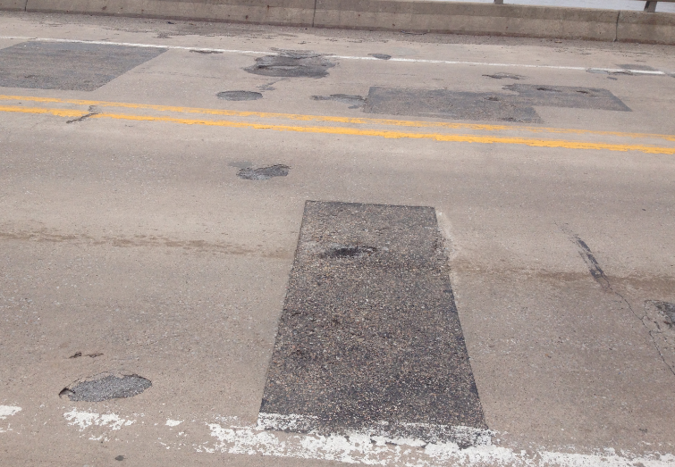
BRIDGE TYPE OF STRUCTURE
Part 1 of 2
428 NAC 2 001.03A5, Page 44
michigan.gov
FHWA Bridge Preservation Guide
Slide 13
Notes:
In this video, there are terms used that are specific to the major parts of a bridge type of structure.
This slide is referring to a bridge type of structure, as distinguished from the definition of bridge provided in the minimum design standards.
The three main portions of a bridge type of structure are:
Deck: The portion of the bridge that directly carries traffic.
Superstructure: The portion of the bridge that supports the deck and connects one substructure element to another.
Substructure: The portion of the bridge that supports the superstructure and distributes all bridge loads to below-ground bridge footings. Abutments and piers are typical parts of a substructure.
NOT FOR AUDIO
Culvert: (Not pictured.) A pipe or small structure used for drainage under a road, railroad or other embankment. A culvert with a span length greater than 20 feet is included in the National Bridge Inventory and receives a rating using the NBI scale.

Slide 14
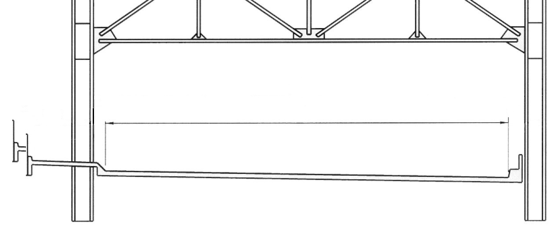
Clear Bridge Width
Minimum Design Standards
Two Criteria for Structures/Bridges:
Clear Bridge Width and Structural Capacity
structures
New & Reconstructed Clear Bridge Widths
  Based on AASHTO Green Book formulas
3R Clear Bridge Widths
  Based on TRB SR-214 formulas
Part 1 of 2
428 NAC 2-001.03A6i, Page 46
428 NAC 2-001.03B Note 18, Page 53
428 NAC 2-001.03C, .03D etc. (Tables)
Slide 14
Notes:
There are two criteria associated specifically with bridges and non-buried structures:
Clear Bridge Width
Structural Capacity
Structural Capacity also applies to buried culverts. If you find the first standards table, Table C on page 55 [428 NAC 2-001.03C] you will see these two criteria at the bottom of the table which is on Page 56. Most other tables are similar.
First, let’s focus on clear bridge width, and address structural capacity in a few minutes. ‘
Clear Bridge Width is defined in on Page 46 of the minimum design standards [428 NAC 2-001.03A6i ].
Clear bridge width is the total width of all lanes and shoulders on the bridge, measured between points on the bridge rail, curb, or other vertical elements that project the farthest onto the roadway.
N&R CBW standards are based on the AASHTO Green Book formulas.
3R CBW standards are based on the Transportation Research Board’s Special Report 214 formulas.
NOT FOR AUDIO
Notes for Presenter:
Refer to the proposed Bridge Table.
For N&R widths greater than current standards in the 401-750 ADT group there are only THREE bridges statewide.
Another Reminder: these are minimum standards. The bridge owner can build wider if they want or if they have policies for min widths they will build.
IF A BRIDGE IS LENGTHENED, THE ENTIRE STRUCTURE/BRIDGE MUST MEET NEW & RECONSTRUCTED STANDARDS, or get a Relaxation of Standards.

Slide 15
Learning Objective
Know Functional Classification
Find and use the correct minimum design standards table (slides 61-80)
Be familiar with definitions
Know and Understand Notes
Understand 3R requirements (slides 167-235)
Know which work to apply to One- and Six-Year Plans
Know fundamentals of horizontal clear zone
Review current ADA requirements
6, and 18-22
Slide 15
428 NAC 2-001.03B Notes 6 and 18-22, Pages 47 and 53-54
Notes:
A learning objective throughout these videos is to know and understand all of the notes.
This video covers notes 6, and 18 through 22. See pages 47, 53 and 54 in the MDS.

Slide 16
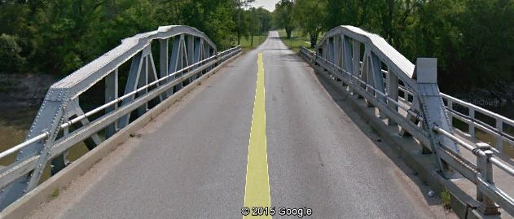
Clear Bridge Width (CBW)
-----------------------------------------------------------------------------------
Measured from Face-of-Curb?
Note 18
Structures
1 of 3
Yes
Part 1 of 2
FHWA Mitigation Strategies for Design Exceptions, July, 2007, Pages 40 and 64
428 NAC 2-001.03A6i, Page 46
428 NAC 2-001.03B Note 18, Page 53
Slide 16
Notes:
If a curb is the vertical element that projects the farthest onto the roadway, is that the point to which the clear bridge width is measured? The answer is Yes. Note on page 46 of the standards in the definition of clear bridge width that the word “curb” is included.
FHWA Mitigation Strategies for Design Exceptions, July, 2007 lists curb as a vertical roadside element (VRE) without regard to height. Some may argue that a so-called “brush curb”, similar to that shown in this slide, does not count as a vertical roadside element. That is not the Board of Public Road’s position.
For modern bridges, this will usually not be an issue. Usually a bridge rail will control CBW.
However, curbs may very well control clear bridge width for 3R work on existing bridges.
NOT FOR AUDIO
001.03A6i CLEAR BRIDGE WIDTH
Clear bridge width is the total width of all lanes and shoulders on the bridge, measured between points on the bridge rail, curb, or other vertical elements that project the farthest onto the roadway.

Slide 17
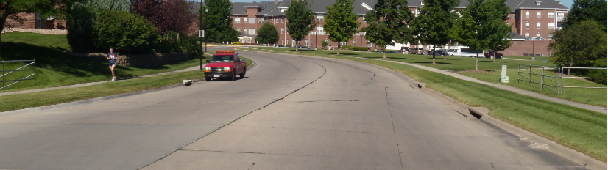
Clear Bridge Width (CBW)
-----------------------------------------------------------------------------------
Measured from Face-of-Curb?
Structures
2 of 3
Full approach curbed section carried across structure
No
Part 1 of 2
Urban Area
428 NAC 2-001.03A6i, Page 46
428 NAC 2-001.03B, Note 18, Page 53
Slide 17
Notes:
Staying on the issue of curb as a vertical roadside element, in this slide the Board of Public Roads is clarifying that a full approach curbed section which meets standards, including horizontal clear zone requirements, and is carried across a non-buried structure or a buried culvert is acceptable. There is no requirement to widen the roadway section at the structure in this case.
NOT FOR AUDIO
From 1/7/2016 Meeting Minutes:
Urban Area New and Reconstructed Standards for Curbed Approaches, Clear Bridge Width (001.03A6i) interpretation of curbs as vertical elements re: CBC (NBS CBC or Bridge-size CBC with 2-ft or less cover). Summary of Discussion: Will there be confusion that the definition of CBW requires curbs as vertical elements? Would plaintiff lawyers bring this up as an issue? The group was unanimous that (a) the 1.5 ft. (based on LOTO) is correct and needed for shy distance to any rails or barriers and (b) for the described situation it is acceptable and common sense for curbed approaches continue over the structure. Mark T. also pointed out 2010 MDS page 19 note A: “The clear roadway width of bridge shall be 1 ft wider than the gutter line to gutter line width of the approach roadway. The gutter line is defined as being 1 ft inside the back of the approach roadway curb.” This note has worked for years and years with no problem. Essentially Note 18 Formula (E) in combination with Note 9 (Lane Width) is saying the same thing. The group decided to leave the CBW definition (001.03A6i) as is and not add any verbiage to Note 18 either. It is to be treated as more of a training issue.

Slide 18
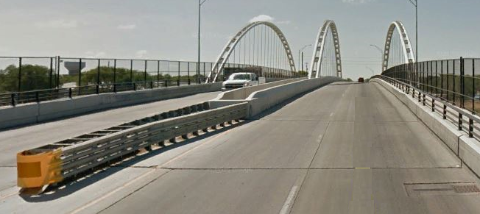
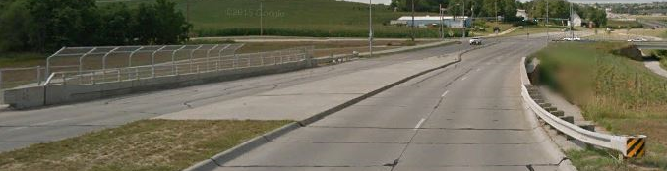
Minimum Design Standards
Clear Bridge Width (CBW)
Urban Standards
structures
3 of 3
Outer Bridge Rail Median Bridge Rail
1.5 ft clearance minimum to edge of traveled way (N&R)
Part 1 of 2
Curbed Median, Outer Bridge Rail
428 NAC 2-001.03A6i, Page 46
428 NAC 2-001.03B, Note 18 Formula E, Page 53
Notes:
This slide shows two bridges, both in urban areas.
The bridge in the upper photo has bridge rail on both sides; the clearance from the edge of traveled way to the nearest vertical element (the bridge rail) for New & Reconstructed work on a curbed section is 1.5 ft.
The bridge in the lower photo has bridge rail on the right and a curbed median on the left; on the right, the appropriate clearance for New & Reconstructed work for a curbed section is 1.5 ft and the (left) median side meets standards if, as shown on the previous slide, it has a full approach section which meets standards.
On a side note, It is generally accepted that metal guardrail typically attached to a concrete bridge rail and protruding at the ends does not count as a vertical roadside element (the assumption is that it will smash flat in the event of a crash).
NOT FOR AUDIO
Top photo (Columbus) – in terms of CBW, effectively two bridges here.
Bottom photo (Papillion) – curbed median

Slide 19
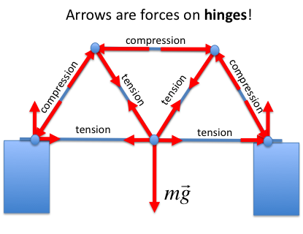
Note 19
Two Criteria for Structures/Bridges:
Clear Bridge Width and Structural Capacity
Structures
HL93 for New and Reconstructed work
HS15 for 3R work
Cannot be Load Posted after work EXCEPT
3R work - NFC Local with ADT < 400 VPD
Maintenance work
Nebraska Legal Load Thresholds
Neb. Rev. Stat. 60-6,294
Type 3 | Type 3S2 | Type 3-3
25 tons | 37 tons | 43 tons
Part 1 of 2
428 NAC 2-001.03A6j, Page 46
428 NAC 2-001.03B Note 19, Page 54
Slide 19
Notes:
Structural Capacity is the other criterion associated with bridges, non-buried structures, culverts and other structures.
Note 19 on page 54 addresses design structural loading capacity.
HL93 and HS15, shown in the slide, are AASHTO standard truck design “live” loadings.
Referring to the third bullet, what is Load Posting?
Posting a load limit is a way of retaining an existing structure in service, possibly without structural modifications, if the anticipated loading needs to be limited, usually as a structure’s condition deteriorates over its life.
Structures are required to be load-posted if the actual load carrying capacity, as determined by a load-rating evaluation, is less than Nebraska Legal Load thresholds.
Structures shall be closed if the load-carrying capacity, as determined by a load-rating evaluation, is less than 3 tons.
You can think of a load rating as the safe load carrying capacity of a bridge or structure.
Note 19 also addresses load posting when 3R or maintenance work is done on a structure. Regarding 3R work, a structure not meeting Nebraska Legal Load thresholds is required to be load-posted, unless the national functional classification is Local and has an ADT under 400 VPD – under those conditions the 3R work, by itself, does not require load-posting the structure.
Maintenance work, by itself, on a structure does not require load-posting the structure.
There are three Nebraska Legal Load Thresholds: 25 tons for a Type 3 truck, which is a 3-axle truck; 37 tons for a Type 3S2 truck which is a semi with 5 axles, commonly known as an “18-wheeler”; and 43 tons for a Type 3-3 truck which is a 3-axle truck with a 3-axle “pup”.

Slide 20
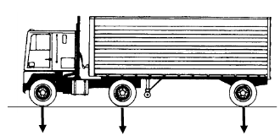
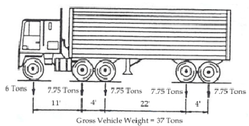
Live Loads (HS15, HL93)
General Information
Structures
HS15 loading
H = Highway truck
S = Highway Semi-trailer truck
15 = gross tractor weight, tons (3 + 12)
L = Load and resistance factor design
93 = 1993
Imaginary Truck
(Type 3S2)
Tons: 6 7.75 7.75 7.75 7.75
11’
4’
22’
4’
Part 1 of 2
Gross Vehicle Weight = 37 tons
428 NAC 2-001.03A6j, Page 46
428 NAC 2-001.03B, Note 19, Page 54
Slide 20
Notes:
Bridge Engineers consider many different loads or forces when mathematically figuring stresses and deflections (or deformations) of a structure.
The previous slide mentioned three Nebraska legal load thresholds (types 3, 3S2 and 3-3). These thresholds are associated with Live load which is the weight of vehicles on the structure.
Dead load is the weight of the structure itself.
Other loads and forces considered are: wind, temperature (expansion/contraction), settlement, and others. (NOT FOR AUDIO: vehicle braking, vehicle friction, friction (sliding surfaces), vehicle collision, wind, water, ice, pedestrian, earthquake).
With regard to Live Load, bridge engineers compute stresses and deflections by modeling hypothetical load configurations. The vehicles shown on the slide are not actual vehicles. The represent overall, hypothetical, vehicles with certain weight distributions on the axles, to be applied to a structure. The larger vehicle on the slide is the Type 3S2.
There are two ways engineers apply the hypothetical vehicles to a structure in order to analyze its stresses and deflections: truck loading and lane loading.
Truck loading applies the load of one vehicle in one lane. It is hypothetically “driven” along the structure. Truck loading typically determines member sizes for bridges less than 90 ft in length (NOT FOR AUDIO: per Fouad Jaber’s 1/16/2015 presentation to the Board of Public Roads).
Lane loading hypothetically puts a “platoon” of several imaginary trucks on a structure at the same time by applying a uniform load per lineal ft of traffic lane combined with the hypothetical truck loading itself to determine maximum stress in each bridge girder or member. Lane loading is accounted for when analyzing HL93 loads, but are not accounted for when analyzing “HS” loads such as HS15. Lane loading typically determines member sizes for bridges more than 90 ft in length (NOT FOR AUDIO: per Fouad Jaber’s 1/16/2015 presentation to the Board of Public Roads).
NOT FOR AUDIO
Bridge 3R structural capacity (June 8, 2015 meeting minutes – comments by Mark Traynowicz, NDOT Bridge Engineer):
Design Loading and Load Rating (and load posting if necessary) are two different attributes of a bridge or structure. Design loading is how bridge members are sized in its original design. After the bridge is built, at various points throughout its life it is inspected and load rated based on various factors including its condition; if necessary, it is load posted.
Bridges and structures are typically designed to support more than legal weight trucks. Repeated loading, fatigue, can weaken a structure over time; many times overweight trucks, permit loads, are required to cross bridges.
An existing bridge can be designed to original design loading and still be load posted. It can happen for various reasons. Loads have increased (bigger trucks/loads) over the years since initial construction, for example. Or, some structural members deteriorate which effectively reduces the cross sectional area its load supporting capability. It may be more cost effective (or the funds simply aren't available) to load post a bridge than to replace it or do extensive and costly work.
Any new element or component added to a bridge or structure under 3R work must meet 3R standards for structural capacity. For example, a widened portion must be sized and built to the original design loading.
9/27/2016 e-mail Babrak Niazi
Babrak,
I need your expertise.
I am fact checking slides intended to be presented to prospective superintendents. My question relates to Type 3S2 truck (5-axle, semi, 18-wheeler).
Information presented as facts in the slides:
Nebraska Legal Load threshold for Type 3S2: 37 tons.
Type 3S2 hypothetical loading HL93 (the same as HS20, right?): 4-16-16 tons.
Is the above information correct?
4+16+16=36 tons total.
36 tons does not equal 37 tons! Is this a discrepancy?
Am I missing something? I hope you can shed some light. Thank you.
----------
James,
It is a little complicated than simple additions of axle loads.
HL93 and HS20 are hypothetical imaginary trucks used for design that do not have the same loads. HL93 includes lane load that HS20 does not.
However, I think you are more interested on the actual trucks using nation’s highways. These are Type 3, 3S2, 3-3 and more. The loading for these tracks are determined by Nebraska Statute as 25, 37, and 43. These numbers are not directly derived from design trucks. These should be at least as high as AASHTO Legal trucks mandated by FHWA for all states for the same types which are 25, 36, 40 tons.
Also, design trucks are single axles while Actual Trucks have tandem axles, see below.
See below for more information.
Load ratings are normally completed for three types of trucks as well as for
design loading as required by AASHTO. Sometimes, other types of vehicles
are used to load rate a bridge; for example, if a special permit load to
transport a heavy load is used and has a unique axle spacing.
AASHTO requires that load ratings be completed with the AASHTO
standard rating vehicles as well as for AASHTO design vehicle loads.
Design live loads typically are larger than actual vehicles in use on the road.
See the AASHTO Manual for design live load information.
Load rating vehicles are representative of trucks typically using roads in the
United States. Each state determines by statue the maximum legal axle
weight and spacing for vehicles in their particular state. The right side of the
following figure shows the load rating vehicles Nebraska uses with their
corresponding Nebraska legal truck axle weights determined by Nebraska
statute. The AASHTO rating vehicles are on the left for comparison. Only
the Type 3 truck is the same for both.

Slide 21
Learning Objectives
Structures
Tables – the part for Structures and how it works – in the Minimum Design Standards
The Two Design Criteria for Structures
Basis of Values for Design Criteria
Design Structural Loading Capacity – HL93, HS15
Clear Bridge Width – simple formulas
Scope of Work – how work on the roadway and the structure can affect one another
Low Water Stream Crossings and Stream Fords
Slide 21
Notes:
This segment introduces the minimum design standards tables and how they work for structures.
See the tables starting on page 55 and ending on page 86.

Slide 22
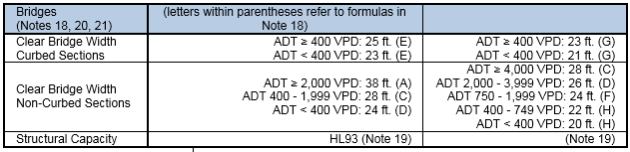
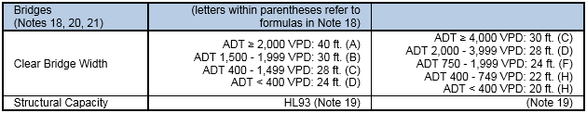
Clear Bridge Width (CBW)
Tables
Minor Arterial
Major Collector
Minor Collector
Local
Structures – The Tables
Design Criteria New and Reconstructed 3R
Urban (03D, Pg 58)
Rural (03I, Pg 68)
Part 1 of 2
428 NAC 2-001.03A6i, Page 46
428 NAC 2-001.03B Note 18, Page 53
428 NAC 2-001.03B Note 19, Page 54
428 NAC 2-001.03, Tables, Pages 55-76
Slide 22
Notes:
This slide shows two tables from Nebraska’s minimum design standards (one urban, the other rural) showing the design criteria associated with bridges.
Notice the references to notes, and to the formulas A-H that can be found in Note 18 on page 53 of the standards.
The clear bridge width values are minimums; these minimums must be increased if formulas A-H result in a larger value.
The first 12 standards tables, starting on page 55 and ending on page 76, have a format similar to that shown in this slide. The first four of these 12 tables cover Urban Area standards, the next four cover Rural Area standards, and the last four of the 12 cover Scenic-Recreation standards.
The standards tables in Subsection 03 [428 NAC 2-001,.03] apply to county roads and municipal streets that have the following National Functional Classifications:
Minor Arterial
Major Collector
Minor Collector
Local

Slide 23
The Other Three (3) Tables
Structures – the Tables
Low-Water Stream Crossings and Fords, Table 03O, pages 79-80
Minimum Maintenance, Table 03P, pages 81-85
Remote Residential, Table 03Q, page 86
All tables: HL93 Structural Capacity for New & Reconstructed bridges, NBS and culverts
Part 1 of 2
Slide 23
428 NAC 2-001.03, Tables, Pages 79-86
Notes:
The other three tables begin on page 79 and end on page 86. When you look at these, you will realize that they are a different format than the preceding twelve tables. There are not as many design criteria and the presence of signage requirements make them very different from the other tables.
Low-Water Stream Crossings and Fords is the only table that is not a functional classification. However, it needs its own table in order to establish minimum standards requirements.
Minimum Maintenance and Remote Residential are two of the optional state functional classifications. If you have a road with either of these classifications, the applicable minimum standards would be either Table P or Q depending on if the road is classified as Minimum Maintenance or Remote Residential; on the National system the same road is likely to have a functional classification of Local, but the minimum standards in Table 03J on pages 69-70 would not apply to that road.
However, for that same road, if the county chooses to meet or exceed the minimum design standards for National Functional Classification Local, Table 03J on pages 69-70, a relaxation of standards request is not required. This does not apply, however, to low-water stream crossings or fords.
Scenic-Recreation is the third optional state functional classification, but has its own four tables (pages 71-78) as previously mentioned.
With regard to design structural loading capacity, all three tables shown on this slide require HL93 for New & Reconstructed bridges, non-buried structures and culverts.
Be aware that there are other requirements in these three tables that this video does not address.

Slide 24


Basis of N&R Values
Basis of 3R CBW Values
Structures
428 NAC 2-001.03, Tables, Pages 55-78
Part 1 of 2
Slide 24
Notes:
Where do the values in the tables come from?
For New & Reconstructed values, the basis is the AASHTO Green Book, 11th Edition. This applies to clear bridge width and to design structural loading capacity.
For 3R values of clear bridge width, the basis is the Transportation Research Board’s Special Report 214.
For 3R design structural loading capacity, it was a Board of Public Roads decision to select the original design loading as the minimum, and if that is unknown, HS15 becomes the minimum.

Slide 25
Other Principal Arterial (OPA)
(and greater)
Note 4
Use Applicable State Highway Standards
428 NAC 2-001.02
Other Principal Arterial
Minor Arterial
Major Collector
Minor Collector
Local
428 NAC 2-001.03
Part 1 of 2
428 NAC 2-001.03B Note 4, Page 47
Slide 25
428 NAC 2-001.02, Pages 5-34, State Highway Minimum Design Standards
Notes:
We have talked about minimum design standards, for county roads and municipal streets, for the national functional classifications of Local, Minor Collector, Major Collector and Minor Arterial.
What if the National Functional Classification of a county road or municipal street is Other Principal Arterial, or greater?
Minimum design standards for these roads (and bridges and structures), through Note 4 on page 47, requires the application of state highway standards, which is in Section 02, pages 5 through 34.
For example, for a reconstructed municipal street with a National Functional Classification of Other Principal Arterial – Table 02L on page 22 is applicable, as well as all other requirements of Section 02 [428 NAC-001.02].

Slide 26
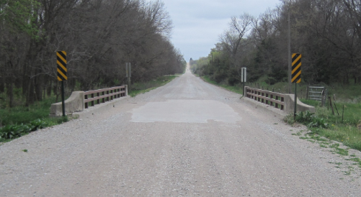
Find the Correct Standards Table
Example – Bridge Replacement
Finding the Standards Table
Procedure
Step 1: verify area standards (Rural or Urban) that apply
Step 2: verify functional classification
Step 3: determine correct table(s)
Step 5: determine minimum design speed
Step 6: determine traffic volume numbers
Step 7: determine all other values
Part 1 of 2
Slide 26
Notes:
Let’s look at an example for how to find the table that applies to a project.
The example is a bridge replacement on a county road.
The first two steps shown are the two things you need to know – FC and Area Standards – in order to find the applicable table.
Step three is then finding the correct table.

Slide 27
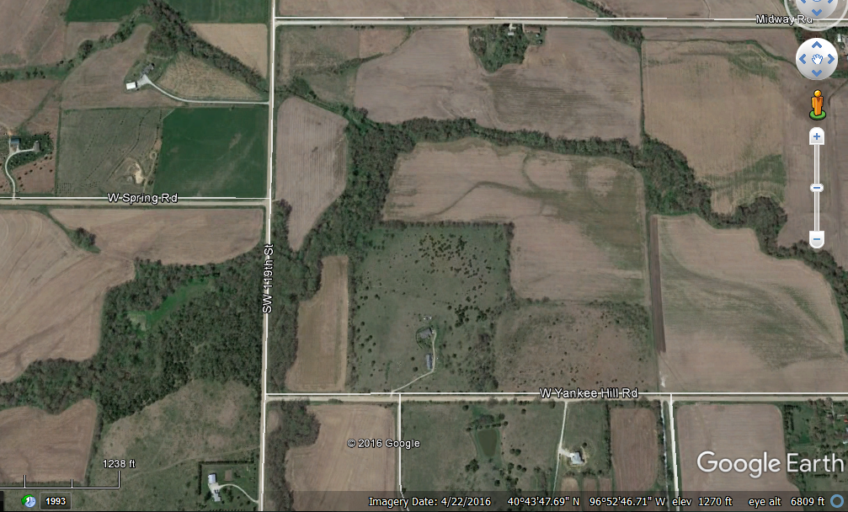
Example – Finding the Correct Standards Table
Part 1 of 2
Slide 27
Notes:
This is an aerial view of the project in Lancaster County, south and west of Denton.

Slide 28

Finding the Standards Table
Example – County Bridge, 2-lane
Location: Lancaster County, S. 119th St, South and West of Denton
ADT: 250 VPD Posted: 50 MPH
2’ 11’ 11’ 2’
Part 1 of 2
NBIS #C005500305P
Slide 28
Notes:
This is an actual Lancaster County bridge, but the example and the information are hypothetical.
The dimensions are assumed.
The bridge condition is assumed to be poor and in need of replacement.

Slide 29
Example – County Bridge, 2-lane
Location:
S. 119th St. South and West of Denton
Purpose of Project: upgrade the condition (poor) of the bridge.
Anticipated Scope of Project:
Replace bridge C005500305P
Anticipated Type of Work: Reconstruction
Part 1 of 2
Slide 29
Notes:
The purpose of the project is to address the poor condition of the bridge, by replacing it.

Slide 30
Finding the Correct Table
Finding the Standards Table
Verify the Area type standards
  Urban or Rural
What is the National Functional Classification of the road?
  Other Principal Arterial
  Minor Arterial
  Major Collector
  Minor Collector
  Local
Part 1 of 2
428 NAC 2-001 Part Two
Slide 30
Notes:
Step 1 is to verify the Area standards that would apply to the project.
The project will be built to either Rural Area standards or Urban Area standards.

Slide 31
Area
Definitions - Area
Urban
  Dense development
  Determined by census
  Populations 5,000 and more
  Local and State officials decide, US Secretary of Transportation approves
  NOT always the same as corporate limits
Rural
  Sparse development
  All areas not designated Urban
Part 1 of 2
428 NAC 2-001.03A2, Page 42
Slide 31
Notes:
Urban Area is for populations of 5,000 and greater as approved by local, state and federal officials.
Rural Area consists of all areas outside of Urban areas.

Slide 32

Area –Maps on NDOT Website
Finding Urban Area
https://dot.nebraska.gov/travel/map-library/
Part 1 of 2
Slide 32
Notes:
8/7/2019 Updated NDOR→NDOT on the slide, at the top, and the web link on the slide, and the two scripts and two audio media
Urban Area boundaries are shown on NDOR NDOT maps.
If your road is near a city of the first class, or near Lincoln or Omaha, find and check the appropriate map on NDOR’s NDOT’s Map Library website.

Slide 33


Area –Maps on NDOT Website
Finding Urban Area
https://dot.nebraska.gov/travel/map-library/
Part 1 of 2
Slide 33
Notes:
8/7/2019 Updated NDOR→NDOT on slide and in script and one audio media, and the web link and the two screen shots on the slide.
This slide shows NDOR’s NDOT’s Map Library website.
For our example, we are particularly interested in State & National Functional Classification Maps – by Cities City within Counties

Slide 34
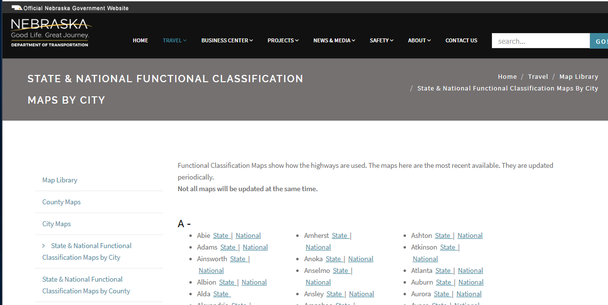
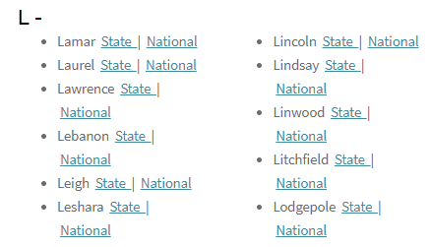
Area –Maps on NDOT Website
Finding Urban Area
https://dot.nebraska.gov/travel/map-library/func-by-city/
Part 1 of 2
Slide 34
Notes:
8/7/2019 Updated NDOR→NDOT on the slide, updated the web link, and updated the screen shot of the website.
You want to Find the map that covers the project area.
The project is in Lancaster County, near the city of Lincoln.
In this example, you would select the City of Lincoln, which is over 5,000 population and is near the project.
What you are trying to determine is if the project is inside or outside the City of Lincoln urban area boundary.

Slide 35
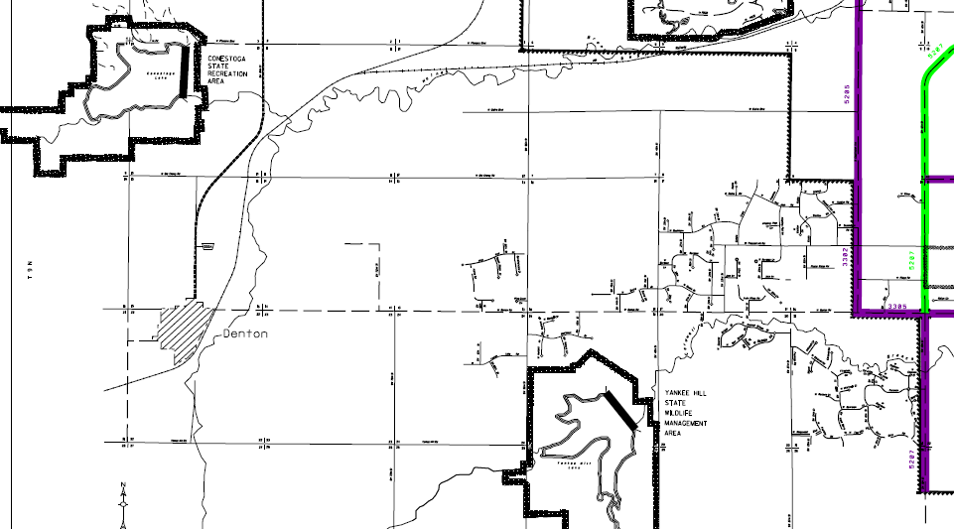
Example – County Bridge, 2-lane
Step 1a – verify area type (rural or urban)
Urban
Area
Rural
Lincoln Urban Area Boundary
Lincoln Urban Area Boundary
Rural
Area
Bridge
Part 1 of 2
NDOT Map
https://dot.nebraska.gov/travel/map-library/
Slide 35
Notes:
8/7/2019 Updated NDOR→NDOT on the slide (lower left), updated the web link and added an audio media
This is the selected map, which shows the City of Lincoln’s urban area boundary.
The bridge is outside of the Urban Area.
Therefore, the project is in a Rural Area.
The road where the project is located will be found on the County map.

Slide 36
Example – Finding the Correct Standards Table
Step 1b – any reason to apply urban area standards instead of rural area standards?
(Notes 2 and 3)
Part 1 of 2
No
428 NAC 2-001.03A2 , Pg 42
428 NAC 2-001.03B, Pg 47
Slide 36
Notes:
You need to check Notes 2 and 3 in order to confirm if Rural Area standards apply or if Urban Area standards apply.
.
Note 2: Rural area design standards shall be used for new and reconstructed roads and streets when the anticipated posted speed limit is greater than or equal to 50 MPH. The county road is 50 MPH in this example.
Note 3: Urban area design standards may be used in lieu of rural area design standards in residential and commercial areas lying outside urban area boundaries. Where speeds are 45 MPH or less. The area in this example appears to be rural in character.
In this case, we have confirmed that Rural Area standards apply to this project.

Slide 37
Finding the Correct Table
Finding the Standards Table
In what Area is the road?
  Urban or Rural
What is the Functional Classification of the road?
  Minor Arterial
  Major Collector
  Minor Collector
  Local
State Functional Classification
Scenic-Recreation
State Functional Classification
Local
Minimum Maintenance
Remote Residential
Part 1 of 2
Slide 37
428 NAC 2-001.03A2, Page 42
Notes:
Now that we have determined that Rural Area standards apply, let’s determine the Functional Classification that applies to the project.
Both National and State.
Note that the State Functional Classification needs to be checked, to verify if one of the optional classifications applies: Minimum Maintenance, Remote Residential or Scenic-Recreation.

Slide 38
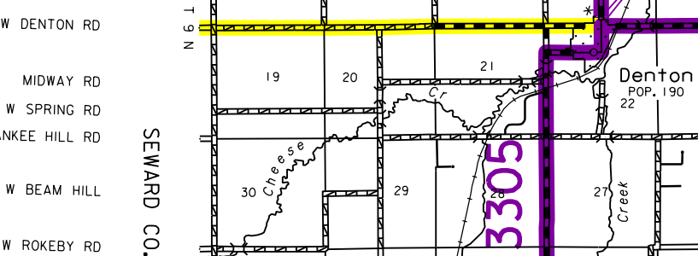
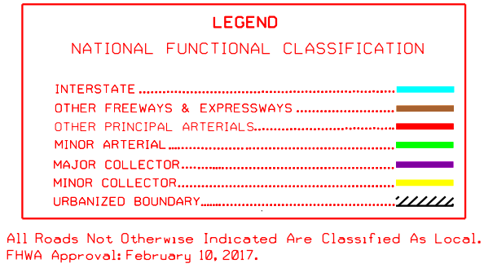
Example – County Bridge, 2-lane
https://dot.nebraska.gov/media/8706/cfunclancasternfc.pdf
Step 2a – verify functional classification
National Functional Classification:
Local
Part 1 of 2
S. 119th St
Slide 38
Notes:
8/7/2019 Updated NDOR→NDOT in the script and one audio media, updated the web link, Legend and map on the slide since the NDOT updated their website and the county map since this video’s previous version.
From the National Functional Classification Map found on NDOR’s NDOT’s website:
S 119th St is not color coded.
Therefore, the National Functional Classification for this segment is LOCAL

Slide 39
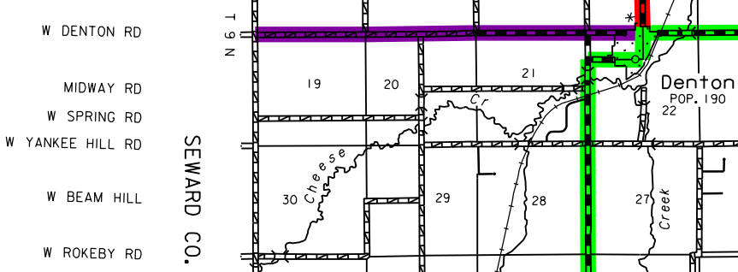
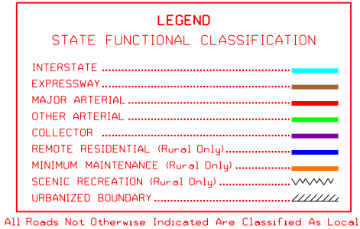
Example – County Bridge, 2-lane
https://dot.nebraska.gov/media/5220/cfunclancastersfc.pdf
Step 2a – verify functional classification
State Functional Classification:
Local
Part 1 of 2
S. 119th St
Slide 39
Notes:
8/7/2019 Updated NDOR→NDOT in the script and one audio media, updated the web link, Legend and map on the slide since the NDOT updated their website and the county map since this video’s previous version.
From the State Functional Classification Map found on NDOR’s NDOT’s website:
S 119th St is not color coded.
Therefore, the State Functional Classification for this segment is LOCAL
The map will indicate if the road is classified as Minimum Maintenance, Remote Residential or Scenic-Recreation.

Slide 40


Functional Classification
Neb. Rev. Stat. 39-2110
http://www.nebraskalegislature.gov/laws/browse-chapters.php?chapter=39
Work with NDOT to verify or establish functional classification. Call 402-479-4750, ask for the
    Highway Materials & Test Manager, or the
    Roadway Asset Management Engineer
Online maps
    https://dot.nebraska.gov/travel/map-library/
Reclassification Guides
    https://dot.nebraska.gov/travel/map-library/
Slide 40
Notes:
8/7/2019 Updated contact information
If there is any question, or a need for help in verifying or establishing functional classification of a public highway, road or street, contact the Nebraska Dept of Transportation as shown on this screen.
Maps and re-classification guidance can be found online, using the weblinks shown on this screen.
NOT FOR AUDIO
The reference to maps is removed; they are not always up-to-date; proposed guidance is to contact NDOT.
Your agency works with NDOT in order to establish functional classification, so you should have records.
NDOT maps may not be up to date. Call Dave Brokaw for confirmation/verification
Design must be done in consistent with the anticipated functional classification.
You can go to the following website and view NDOTs Reclassification Guides http://www.transportation.nebraska.gov/maps/#class once there you can open up one of the following:
Local - Remote Residential Roads
Counties Eligible for Remote Road Classification
Local - Minimum Maintenance Roads
Change to Add Roads to State Highway System
Change to Only County or City System

Slide 41
Finding the Correct Table
Finding the Standards Table
Example – County Bridge, 2-lane
Verify the Area type standards
  Urban or Rural
What is the National Functional Classification of the road?
  Other Principal Arterial
  Minor Arterial
  Major Collector
  Minor Collector
  Local
Part 1 of 2
Slide 41
428 NAC 2-001 Part Two
Notes:
Knowing the Area standards that apply – Rural
And the Functional Classification – Local
We can now find the standards table that applies to this project.

Slide 42
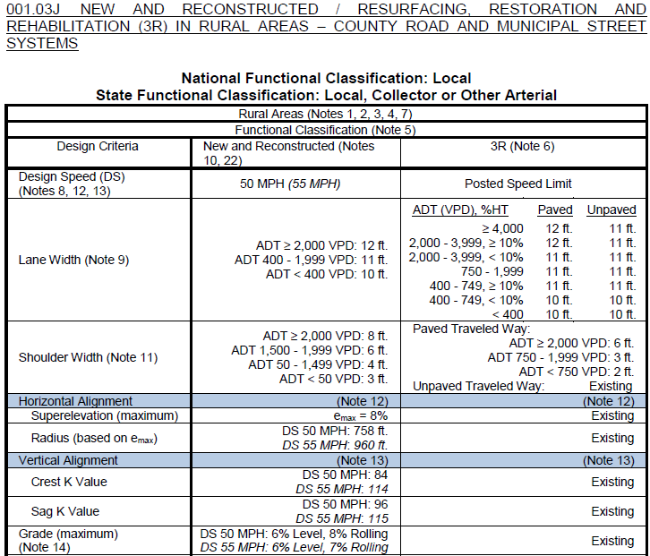
Finding the Standards Table
Example – County Bridge, 2-lane
Step 3 Find the Table – Rural, Local table, 001.03J, Pgs 69-70
Slide 42
Notes:
Select Table J on pages 69-70.
The table header indicates that it applies to
Rural Areas, and
Functional Classification of Local, both National And State

Slide 43
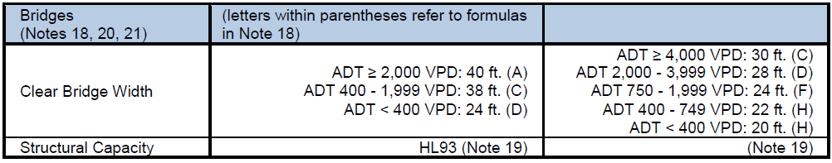
Finding the Standards Table
Example – County Bridge, 2-lane
Step 3 Find the Table – Rural, Local table, 001.03J
Bridges and Structures Criteria on Page 70
Design Criteria New & Reconstructed 3R
Part 1 of 2
Slide 43
Notes:
This slide shows the bottom part of Table J, on page 70 of the standards.
Knowing the traffic is less than 400 VPD, and the scope of work is Reconstruction, at this point you can conclude that the clear bridge width minimum is at least 24 ft and the structural capacity must be a minimum of HL93.
In the next video, Part II of Bridges and Structures, we will check the appropriate clear bridge width formula to see if the minimum is actually greater than 24 ft.
Note that there is an error in this particular Standards table.
For the N&R ADT 400-1,999 VPD group, the value for CBW shown in the table is 38 ft – it should be 28 ft.
This will need to be corrected in a future rulemaking effort.
If you notice any errors throughout the standards, please contact Liaison Services Section.

Slide 44
Review Questions
2016 Minimum Design Standards
Structures- Bridges, Non-Buried Structures, Culverts
Part 1 of 2
Part 1 of 2
Slide 44
Notes:
Now for some quiz questions over Part I of Bridges and Structures.
When it comes time to answering a review question, you have the option of pausing the video before the answer is given.

Slide 45
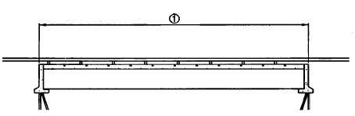

Definitions
Is the length of a structure measured perpendicular or parallel to the road?
Parallel (along center of road)
A bridge as defined in the MDS refers to structures (a) more than 20 ft long or (b) 20 ft and longer?
(a) > 20 ft
The term Non-buried structure in the MDS refers to what length of structures?
Part 1 of 2
4 ft – 20 ft
Slide 45
428 NAC 2-001.03A5, Page 44
Notes:
Answer: Length of a structure is measured along the center of, or parallel to the road, not transverse to the road.
It is a key measurement and important to understand.
Answer: more than 20 ft. Bridge is defined on page 44 of the minimum design standards, as well as in the Code of Federal Regulations, The length of the opening along the center of the roadway for a bridge is defined as more than 20 ft.
Answer: A non-buried structure refers to a structure from 4 ft in length to 20 ft in length and has 2 ft or less of fill or pavement on top. It can be one of several types – bridge, culvert, corrugated metal pipe, multiple pipes – so even if it looks like a bridge-type of structure, it is termed a non-buried structure in the minimum design standards, because of its length and because it has 2 ft or less of fill or pavement on top.
NOT FOR AUDIO
001.03A5a BRIDGE
A structure including supports erected over a depression or an obstruction, such as water, highway, or railway, and having a track or passageway for carrying traffic or other moving loads, and having an opening measured along the center of the roadway of more than 20 feet between undercopings of abutments or spring lines of arches, or extreme ends of openings for multiple boxes; it may also include multiple pipes, where the clear distance between openings is less than half of the smaller contiguous opening.
NOT FOR AUDIO
001.03A5c NON-BURIED STRUCTURE
A non-buried structure is a structure including supports erected over a depression or an obstruction, such as water or a trail, having a track or passageway for carrying traffic or other moving loads, an opening measured along the center of the roadway of 20 feet or less, and has 2 feet or less of fill or pavement material placed on top of the structure. Examples include concrete, steel and timber structures, concrete slab structures, culverts, corrugated metal pipes, etc.

Slide 46
Structures – Note 19 – Quiz
Notes
Structures
Under certain conditions, a structure can be load posted after 3R work is done on it. T or F
For 3R work on a structure, when is HS15 loading required?
If original design loading is unknown
Part 1 of 2
Slide 46
428 NAC 2-001.03B, Notes 19 and 20, Page 54
Notes:
(a) True, Note 19 on page 54 allows a structure to be load posted after 3R work is done if the traffic volume is less than 400 VPD and the national functional classification is Local. Also, a structure may be load posted after maintenance work.
(b) HS15 loading is required if it was the original design loading of the structure, or if the original design loading of the structure is unknown. See Note 19.

Slide 47
Structures-Specific Learning Objectives - Review
Structures
What are the two design criteria for structures?
On what sources are the values (in the tables) for those criteria based?
Is the clear bridge width value a table look-up?
Clear Bridge Width, Structural Capacity
AASHTO Green Book, TRB SR-214
No - it is formula based
Part 1 of 2
428 NAC 2-001.03 Tables Pages 55-78
428 NAC 2-001, Pages 2 and 3
428 NAC 2-001.03B, Note 18, Page 53
Slide 47
Notes:
Clear Bridge Width, and Design Structural Loading Capacity
AASHTO Green Book, 11th Edition, and TRB SR-214
No, a CBW standard value is based on a simple formula, but it cannot be less than the value in the table (with some exceptions allowed for 3R standards)

Slide 48


2016 Minimum Design Standards
Boards - Liaison Services Section
Structures- Bridges, Non-Buried Structures, Culverts
Part 1 of 2
County Roads and Municipal Streets
8/8/2019
Notes:
This concludes Part I of Nebraska’s 2016 Minimum Design Standards for County Roads and Municipal Streets, with respect to bridges, non-buried structures and culverts.

