Slide 1

Name-a-Snowplow
Instructional Materials
Fall 2026

Slide 2
Contest Timing
Monday | Tuesday | Wednesday | Thursday | Friday
August 24 | 25 Submissions Open @ 8:00 AM | 26 | 27 | 28
31 | September 1 | 2 | 3 | 4
7 | 8 | 9 | 10 Submissions Close at 11:59 PM | 11

Slide 3
Contest Limitations
Open to Kindergarten - 6th Grade
Submissions must be completed by teachers
Two ways to submit:
  One name as a whole class
  Individual student submissions (one per student)
Submit through form on our website (link)
https://dot.nebraska.gov/safety/name-a-snowplow-contest/

Slide 4
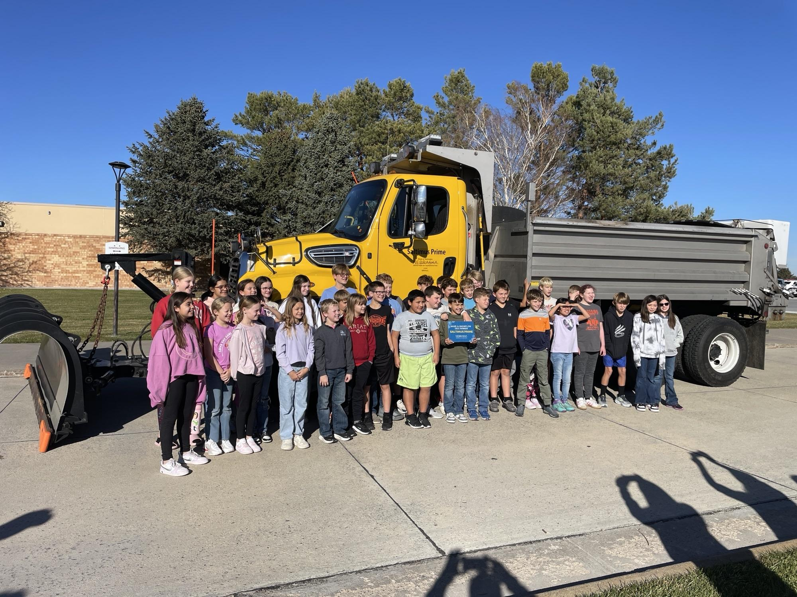
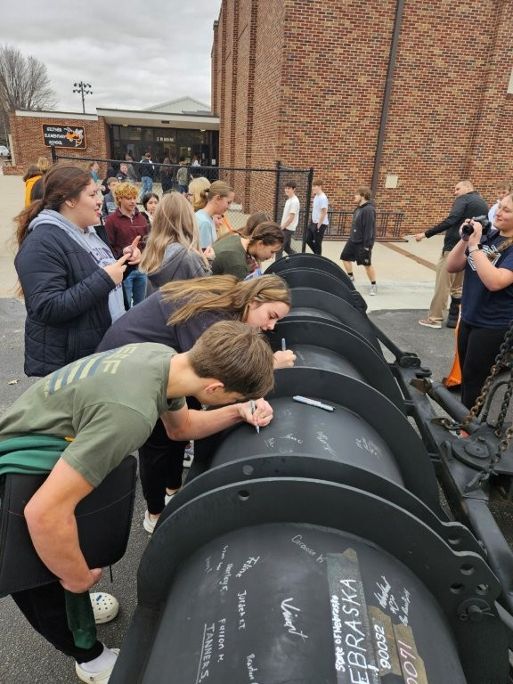
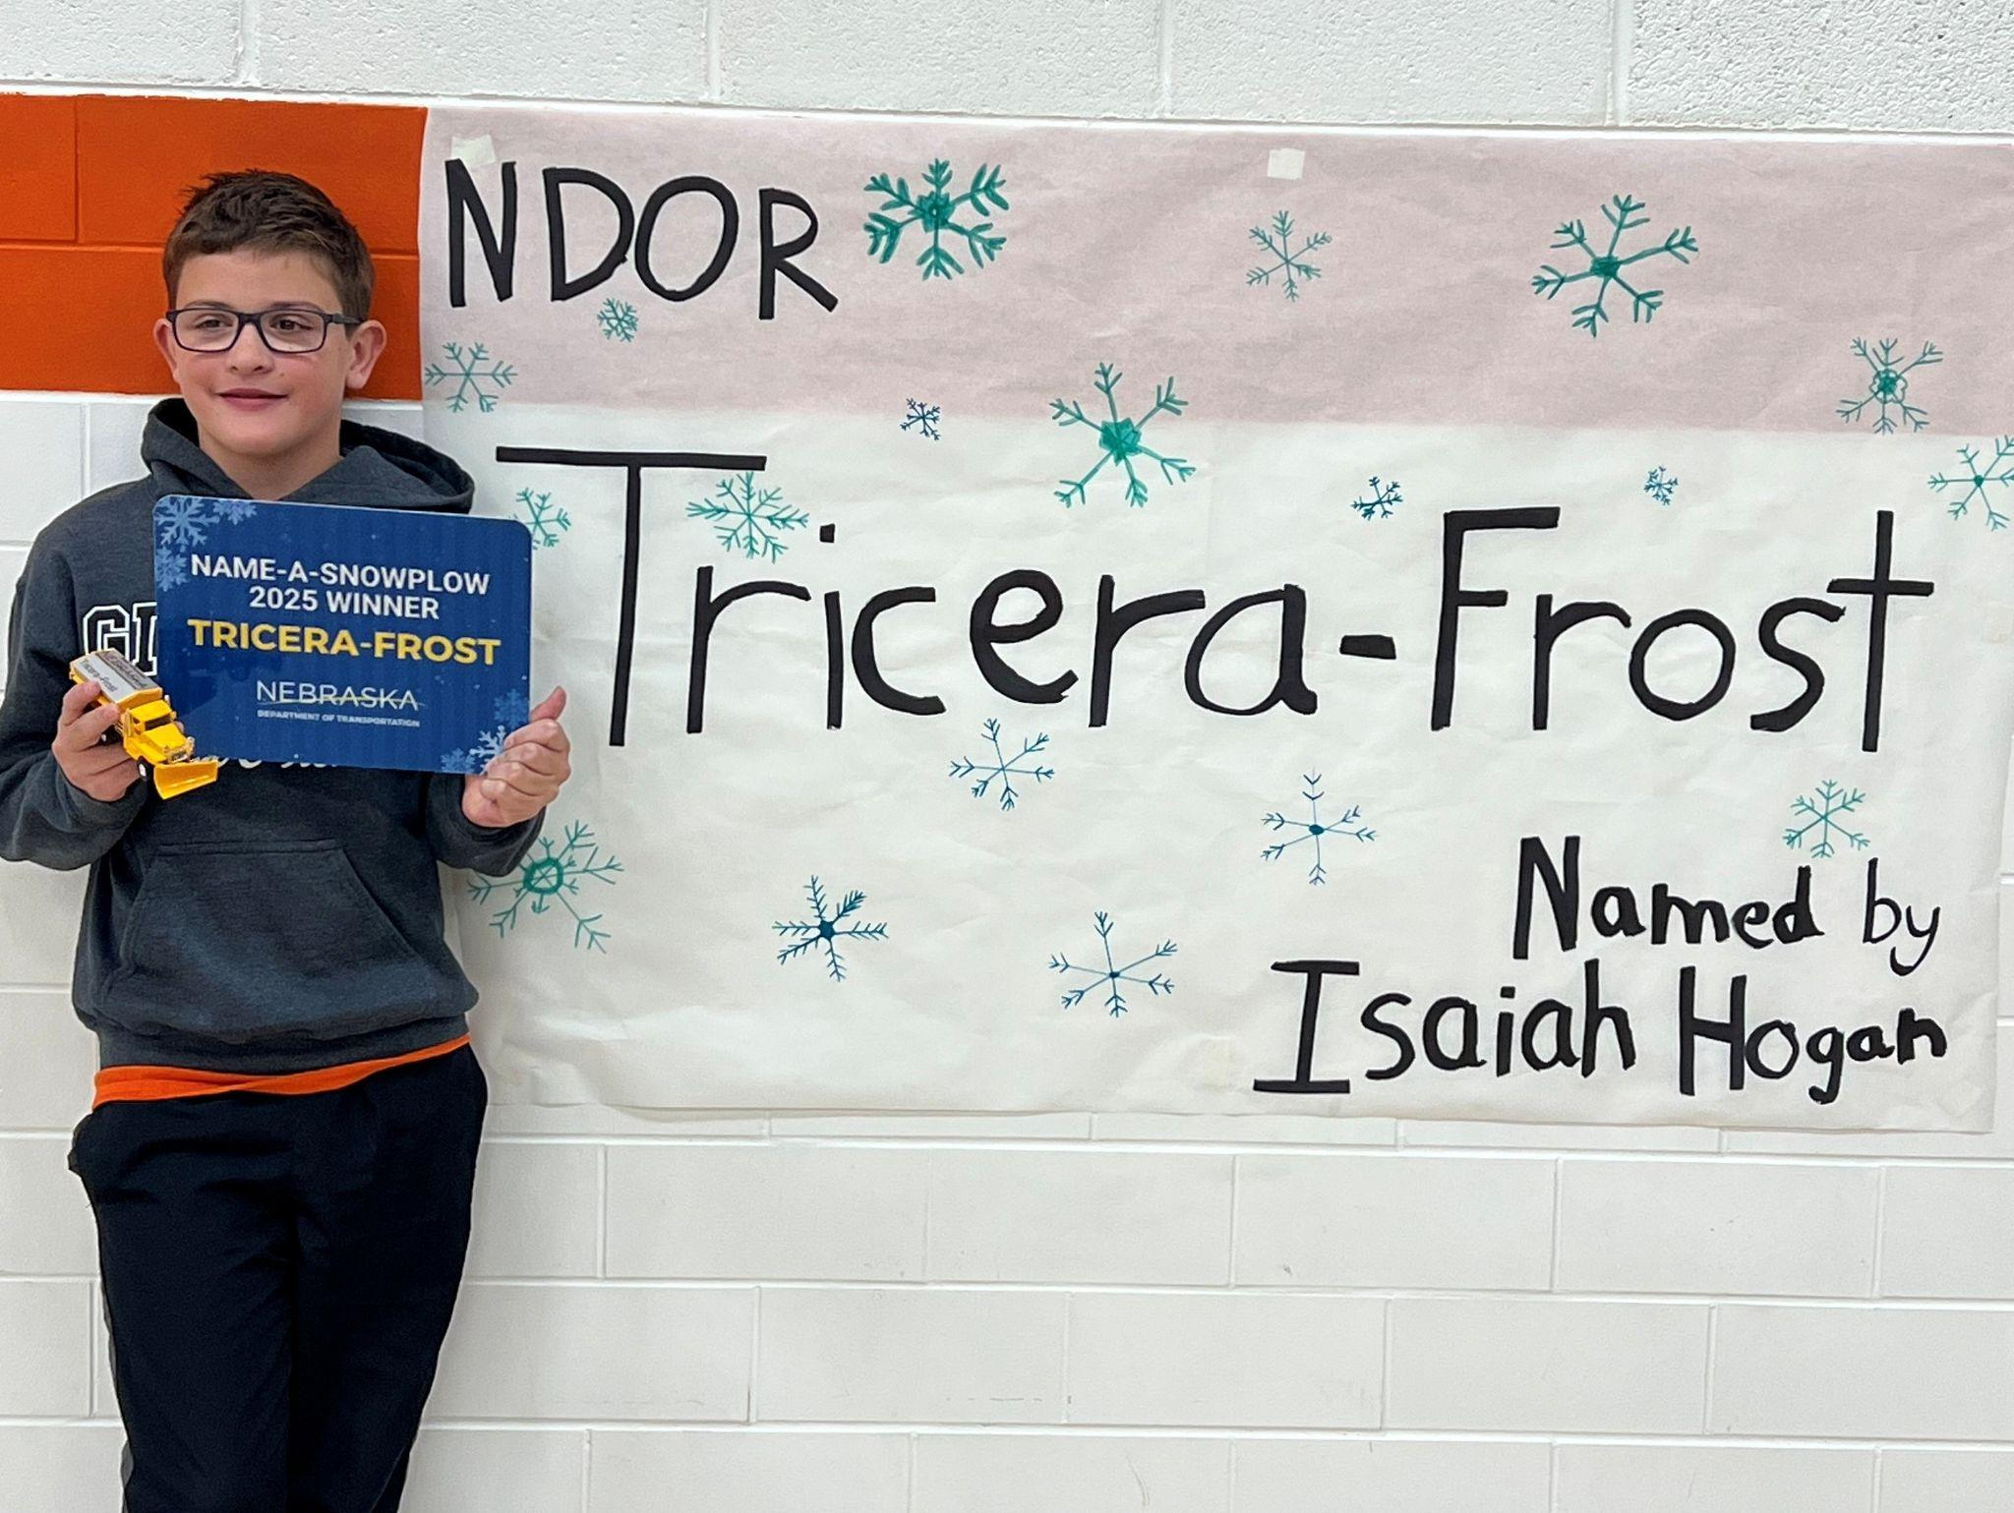
What do we win?
The winning student will receive a snowplow themed prize (book or toy snowplow) and commemorative Name-a-Snowplow sign.
NDOT’s Snow Warriors will make a celebratory visit to your school to do a brief education presentation and present an additional commemorative sign for your classroom/school.

Slide 5
Suggested Curricular Connections
Nebraska’s College and Career Ready Standards for English Language Arts (link)
Speaking & Listening | Presentation of Knowledge and Ideas: Present information, findings, and supporting evidence in which the organization, development, and style are appropriate to the discipline, audience, and/or context.
Vocabulary | Acquisition & Use: Build and use a range of conversational, academic, and discipline-specific grade-level vocabulary and apply to reading, writing, speaking, and listening.

Slide 6
Suggested Curricular Connections
Social Emotional Learning (link).
Social awareness: The ability to take the perspective of and empathize with others from diverse backgrounds and cultures, to understand social and ethical norms for behavior, and to recognize family, school, and community resources and supports.
Responsible decision-making: The ability to make constructive and respectful choices about personal behavior and social interactions based on consideration of ethical standards, safety concerns, social norms, the realistic evaluation of consequences of various actions, and the well-being of self and others.

Slide 8
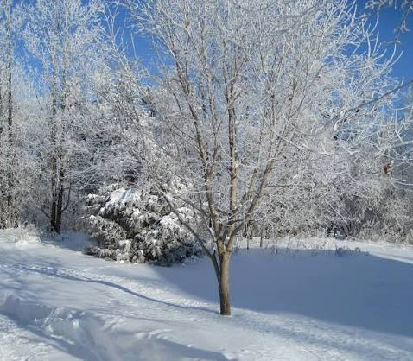

Activating Prior Knowledge
Silently think to yourself about the last time we had a BIG snow…

Slide 9

Activating Prior Knowledge
Turn to a partner and share something you like (or dislike!) about having lots of snow.

Slide 10
By the end of this lesson, I will…
Know | words can have similar sounds that make something funny (pun/wordplay)
Understand | why snowplow drivers are an important part of my community
Be Able To | connect winter to something popular or trendy using wordplay

Slide 11

Imagine…
What happens if someone has someplace important to go on a day when we get a snow storm?

Slide 12




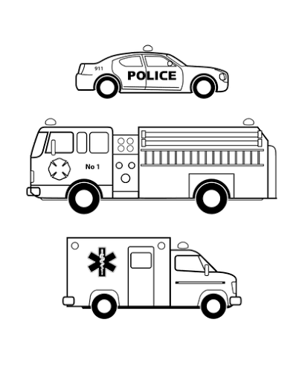
Imagine…

Slide 13
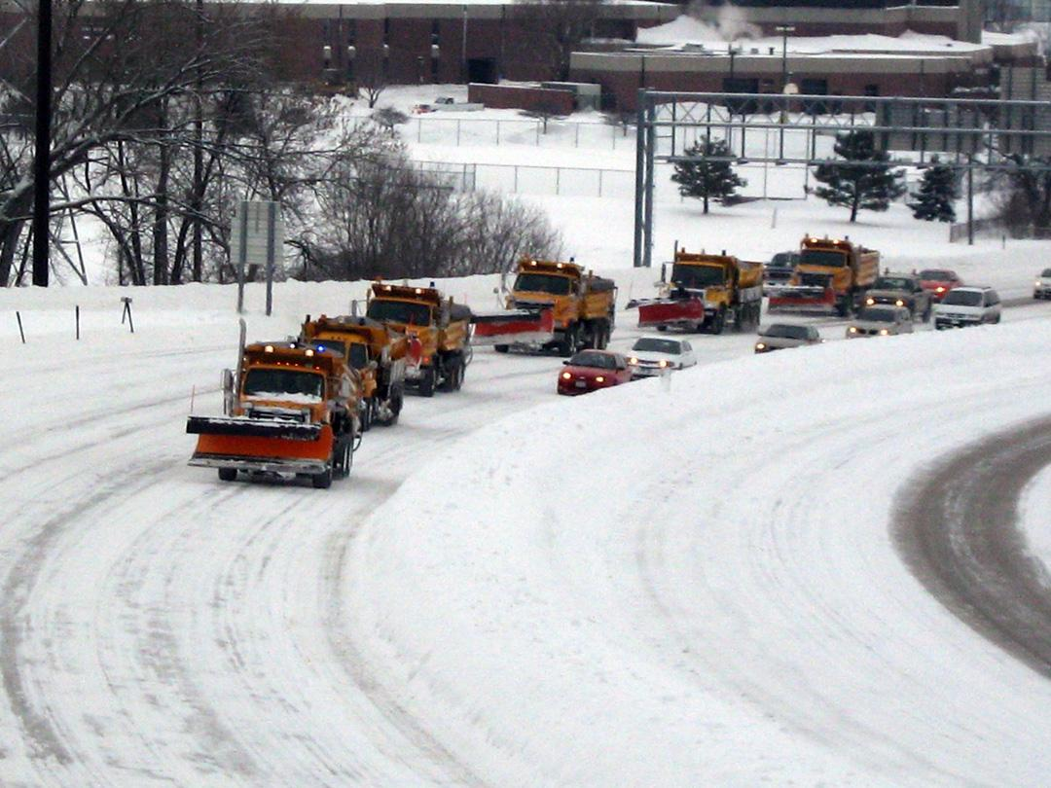
Snowplow drivers help our community keep moving after a snowstorm.
Work
Emergency services
Food
Family

Slide 14
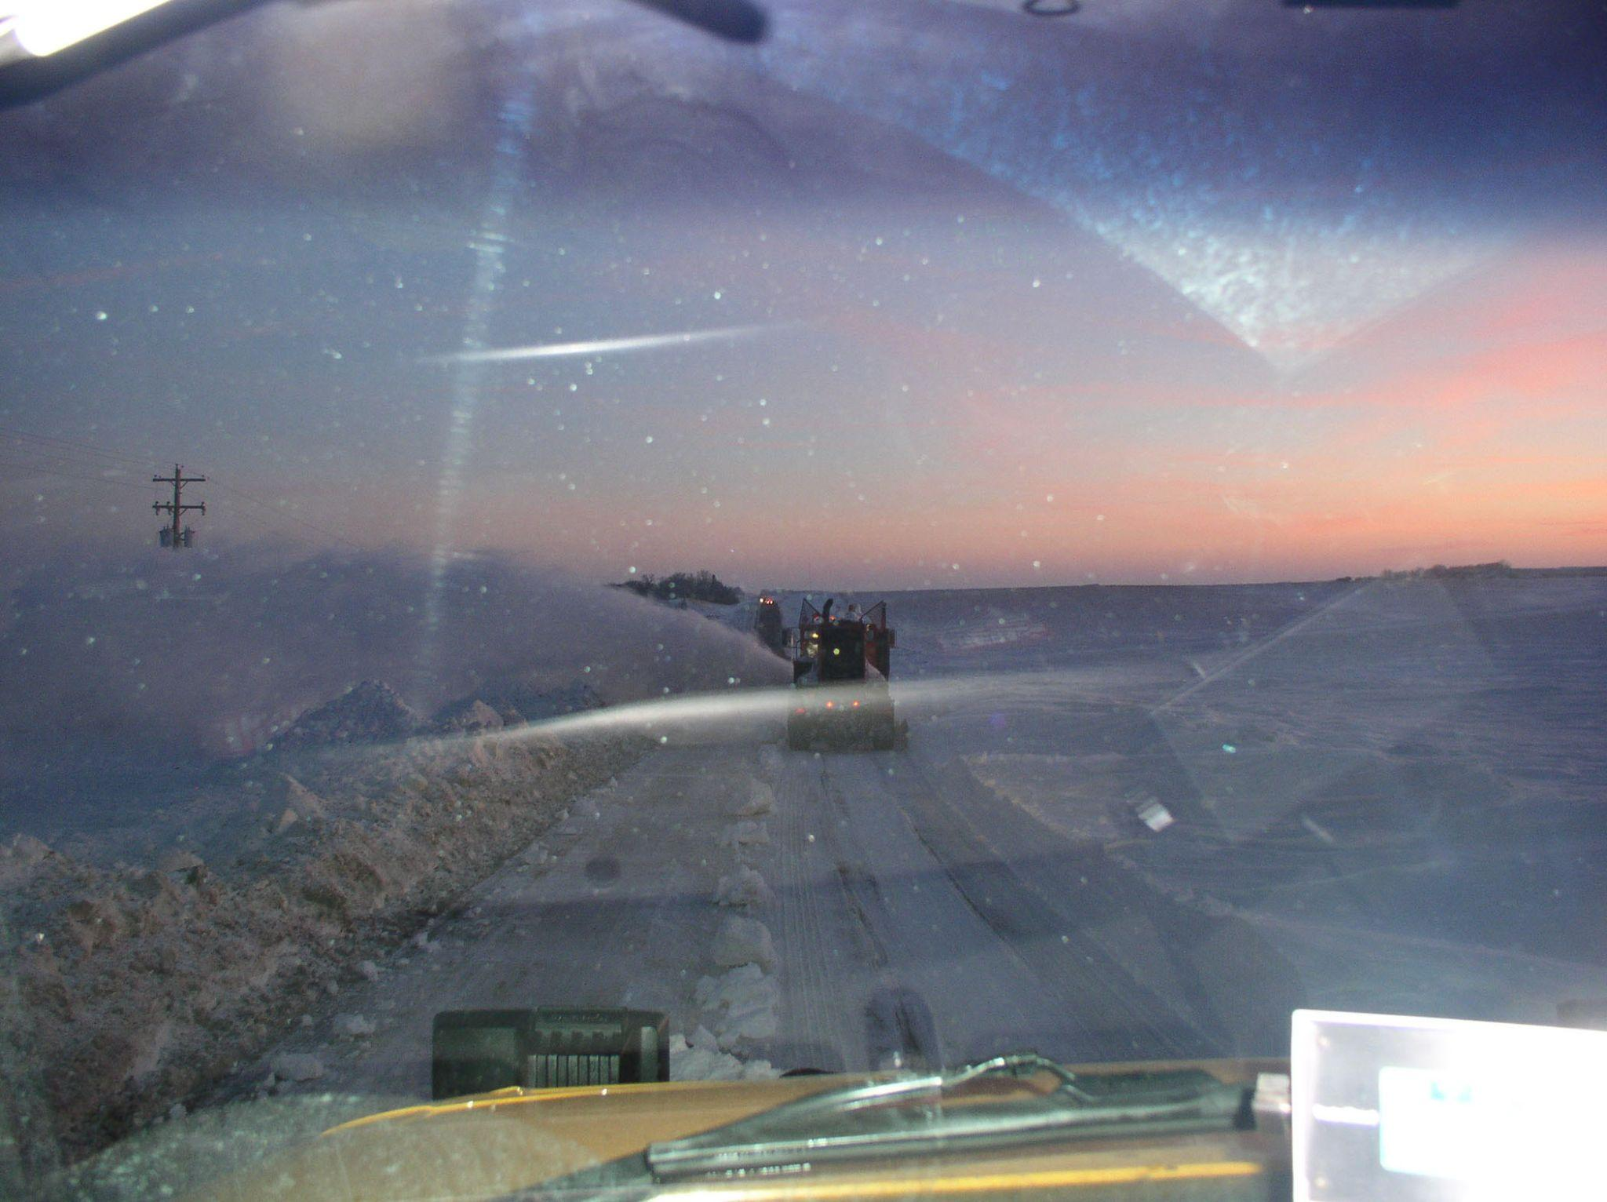
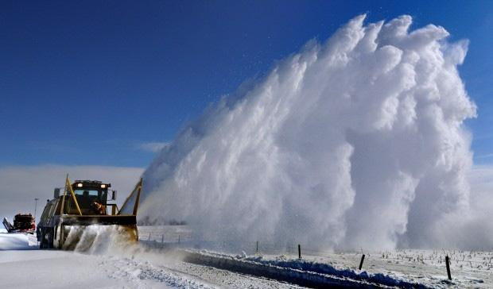
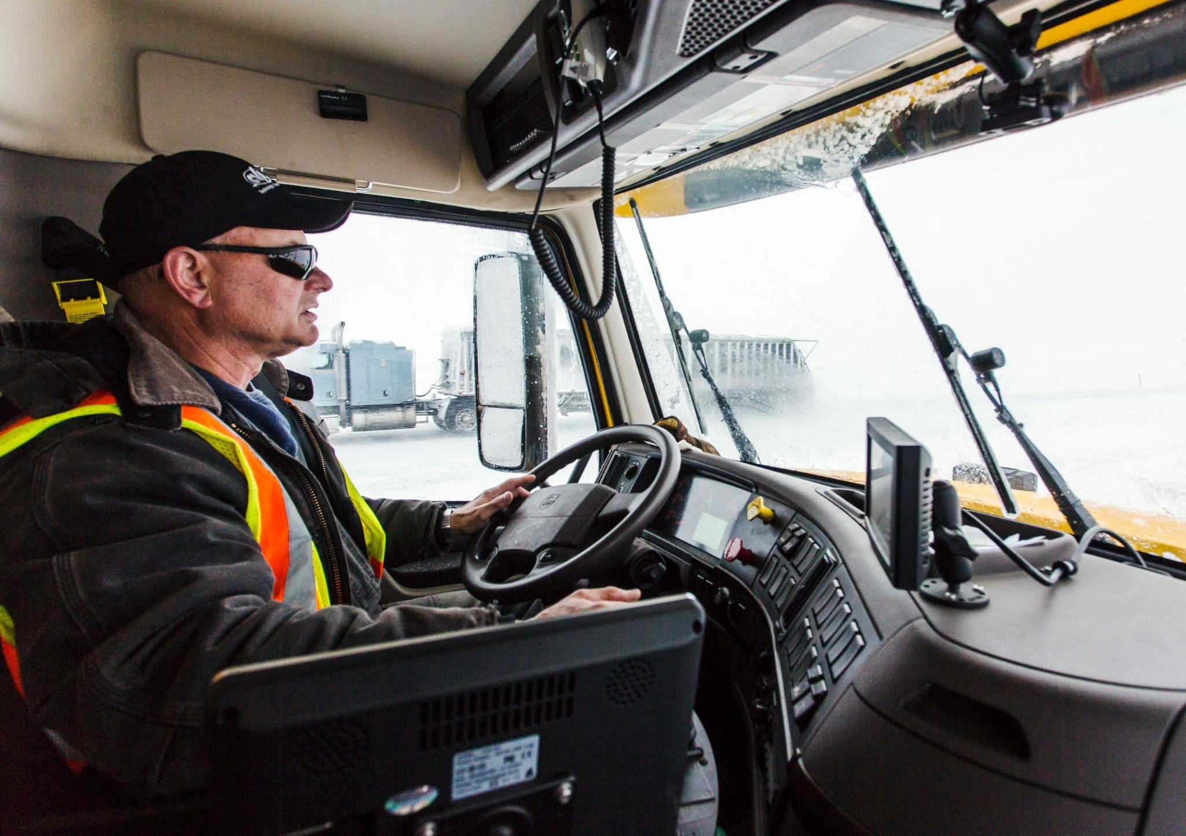
Being a snowplow driver isn’t easy!

Slide 15
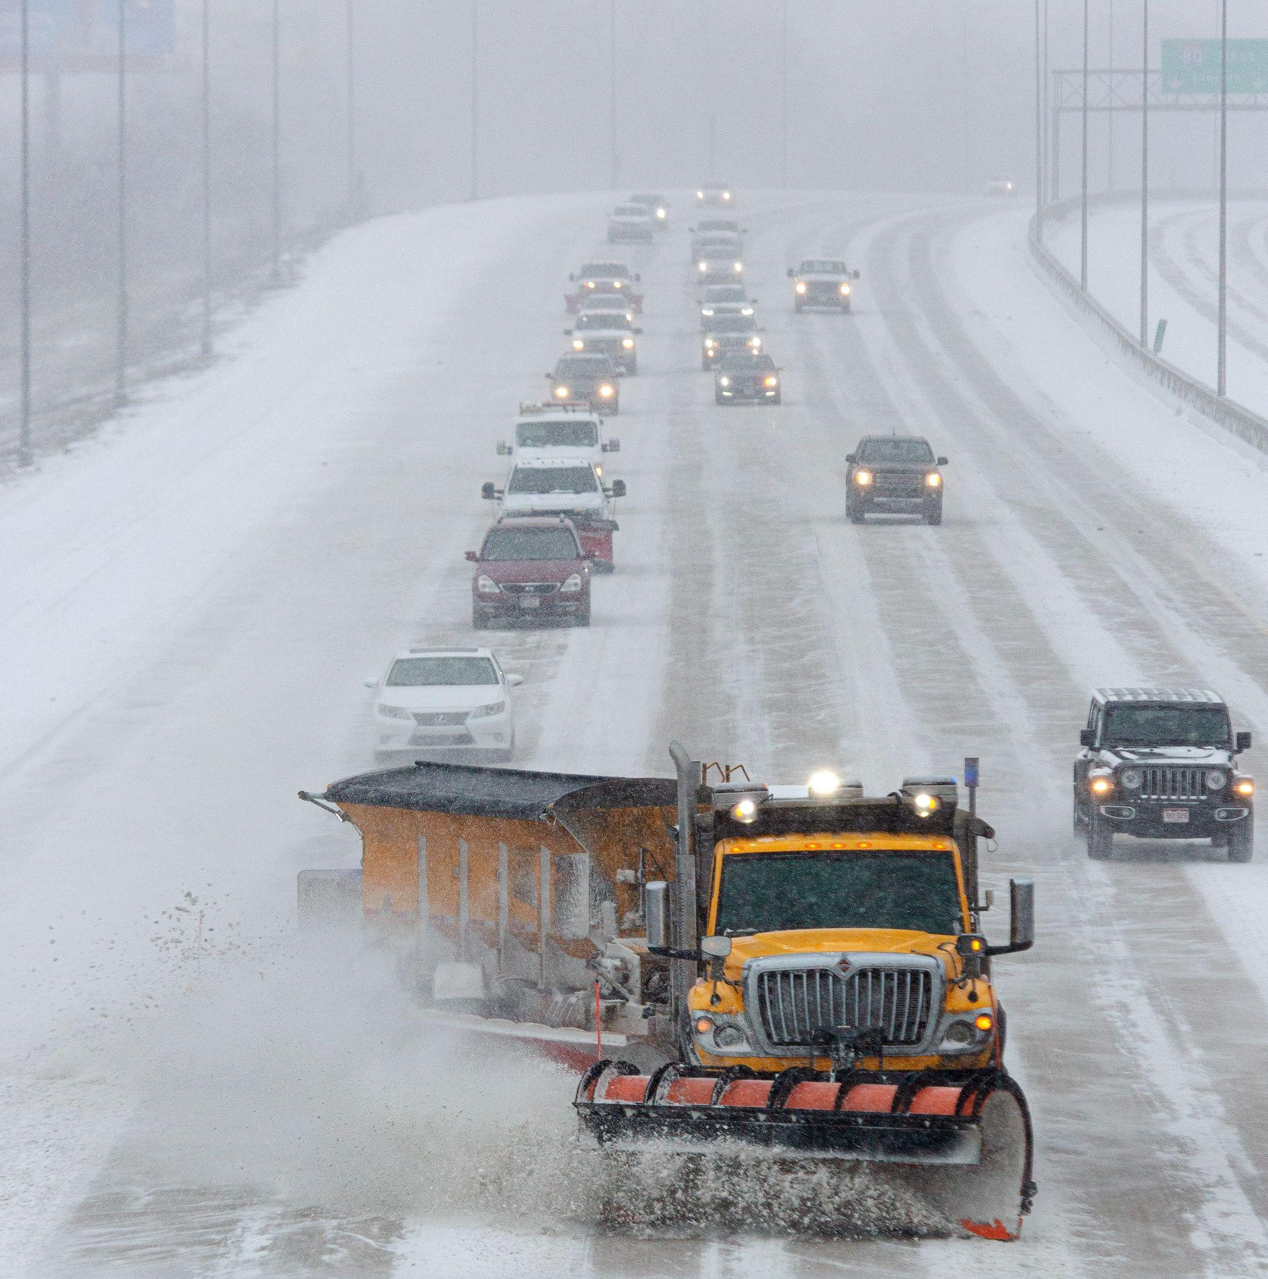
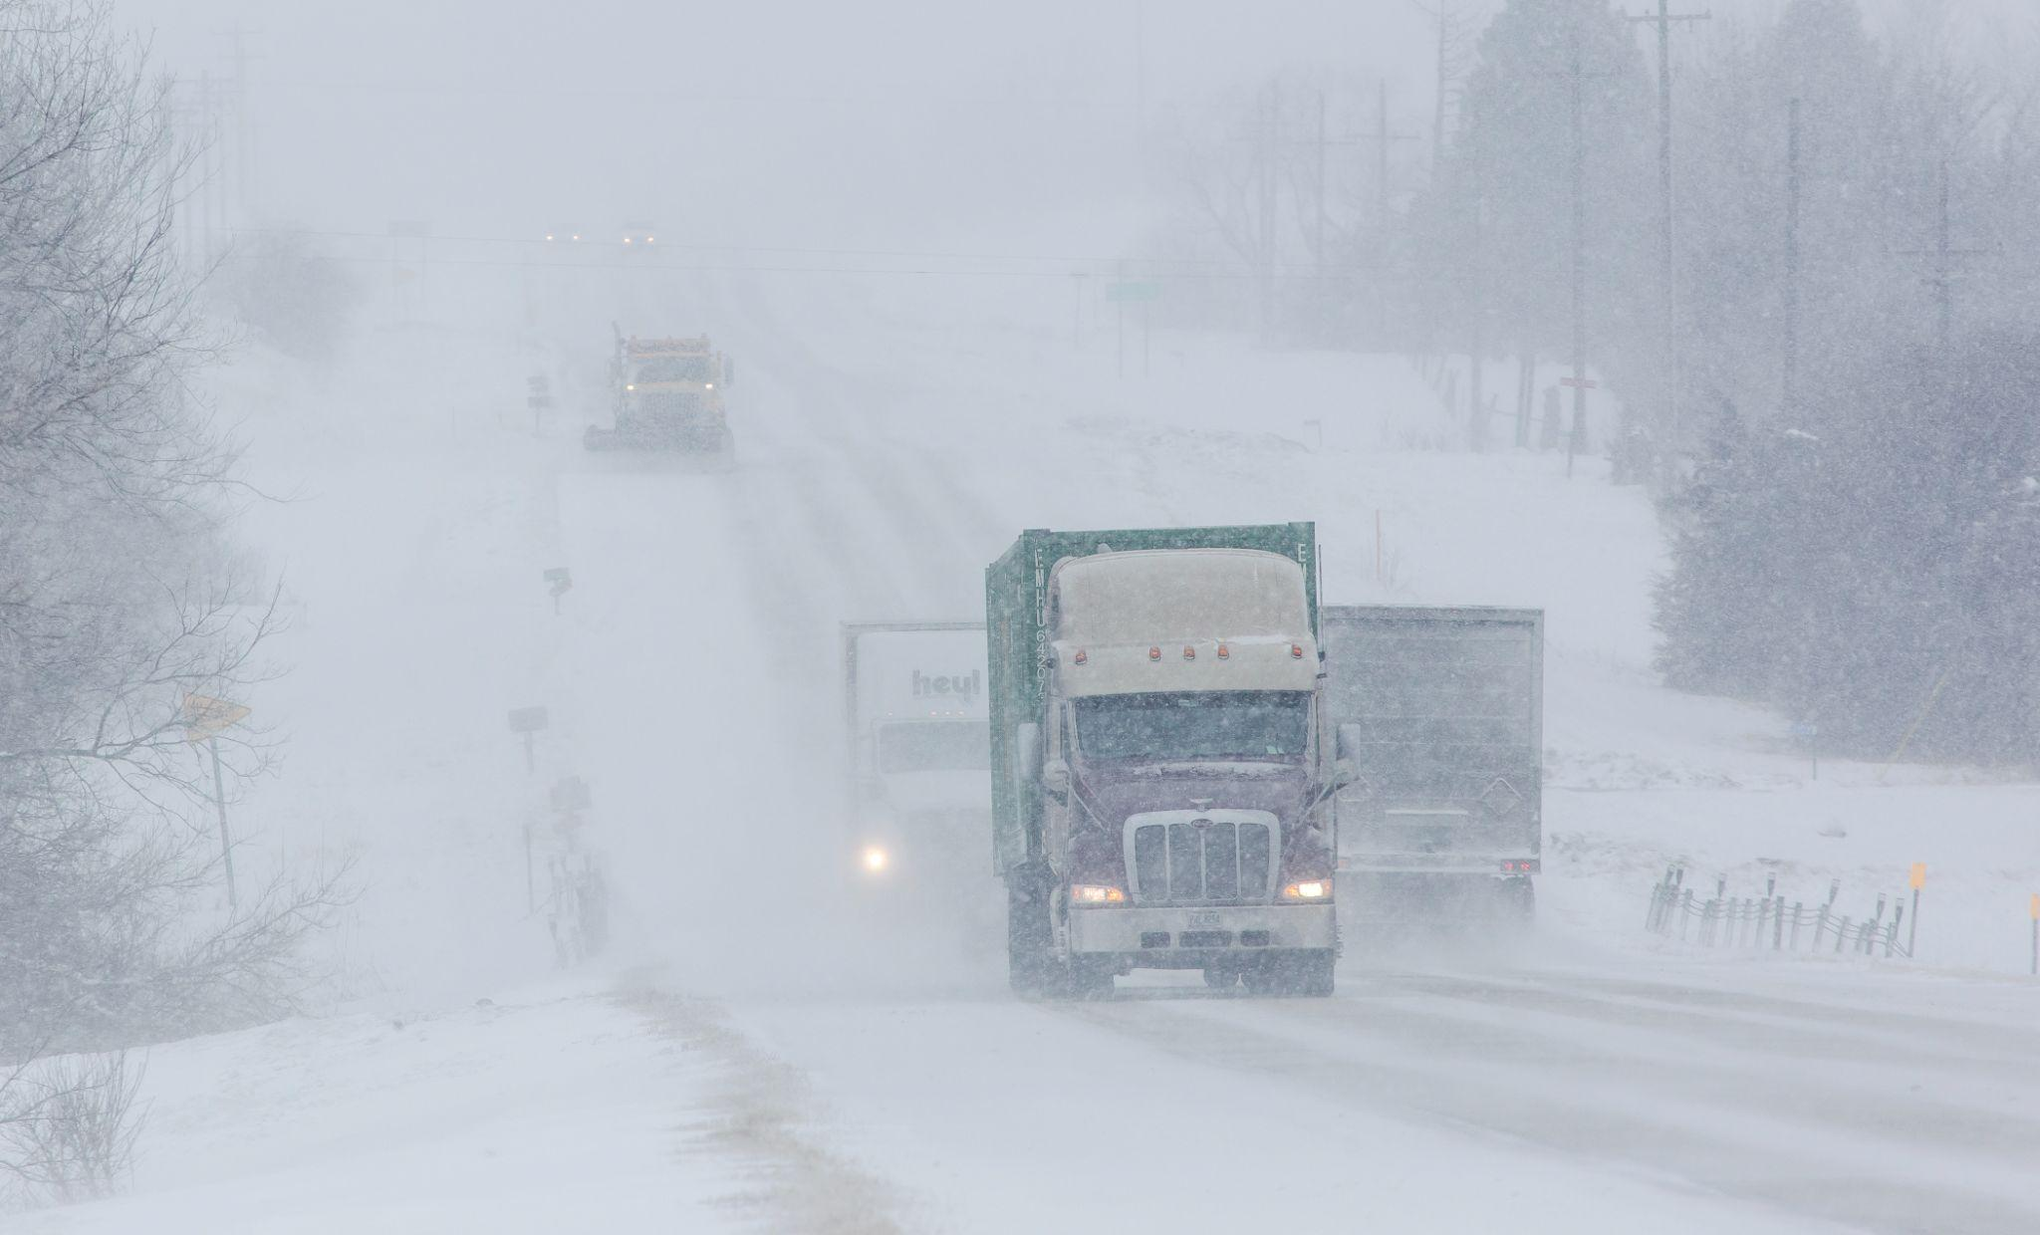
Being a snowplow driver isn’t easy!

Slide 16
How can we celebrate and thank
snowplow drivers?

Slide 17

Name-a-Snowplow
Contest!

Slide 18
NDOT has over 650 snowplows!
… but only 81 of them have names.

Slide 19
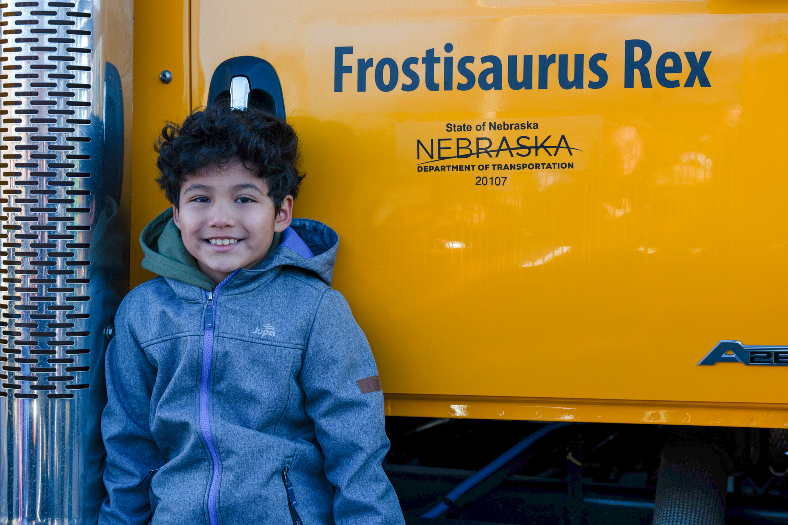
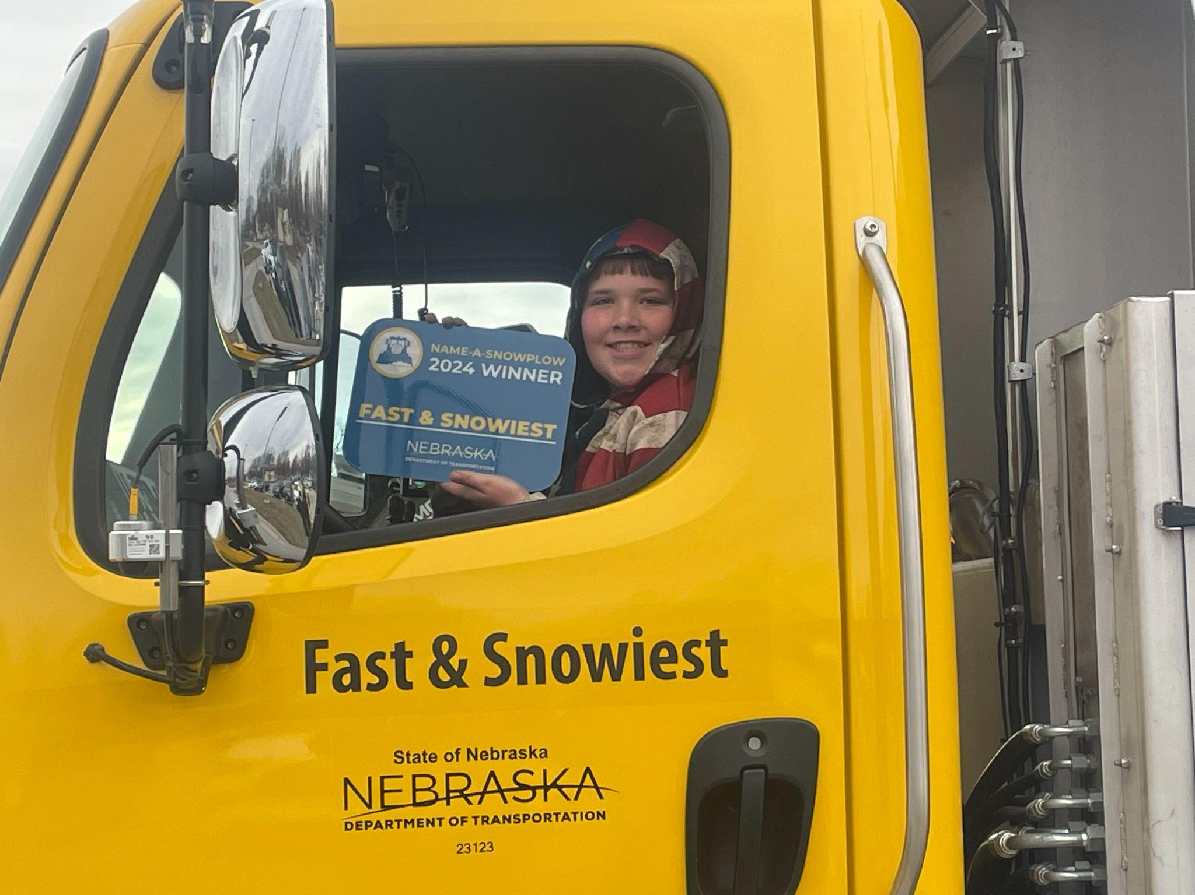
Examples

Slide 20
How do you name a snowplow?
Lots of names that have been chosen are PUNS or WORDPLAY
Wordplay is a clever use of words to make something funny.
A pun is a specific kind of wordplay that focuses on how words that sound the same can be used in a humorous way.

Slide 21
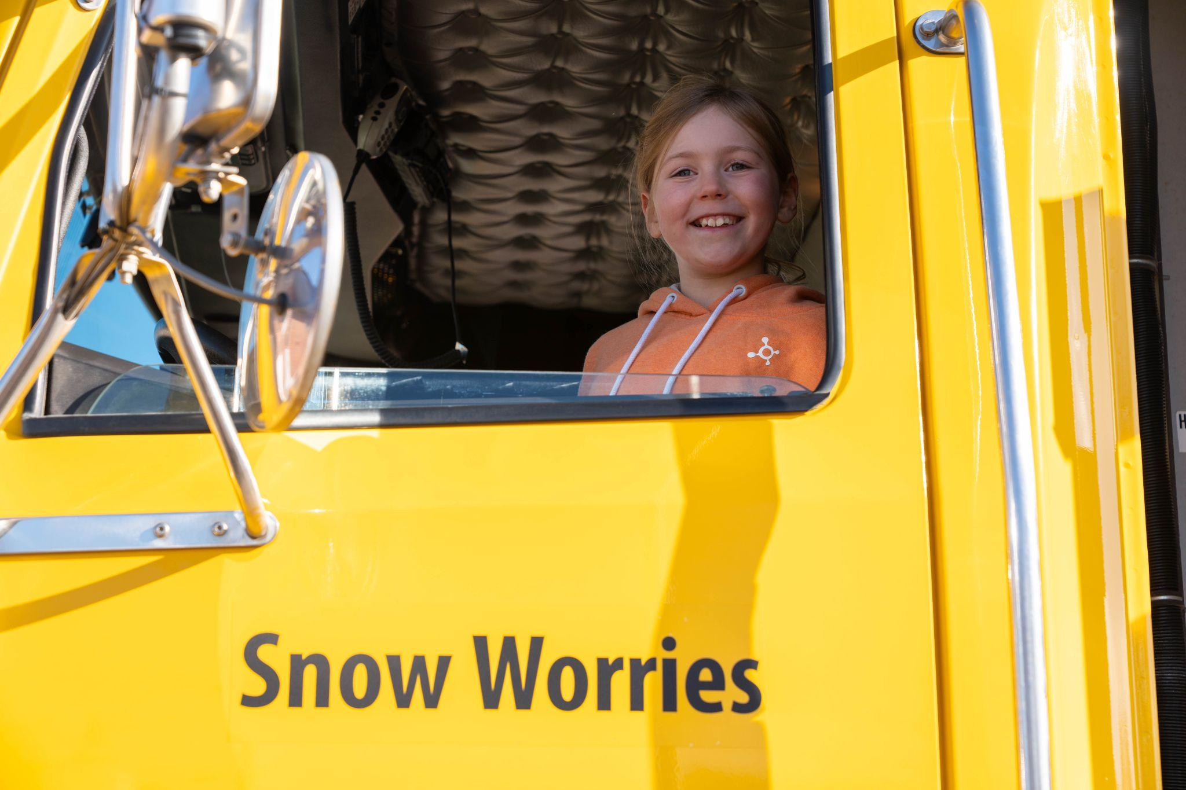
Puns / Wordplay
“No worries!” is a very common phrase.
“No” and “snow” sound very similar.

Slide 22
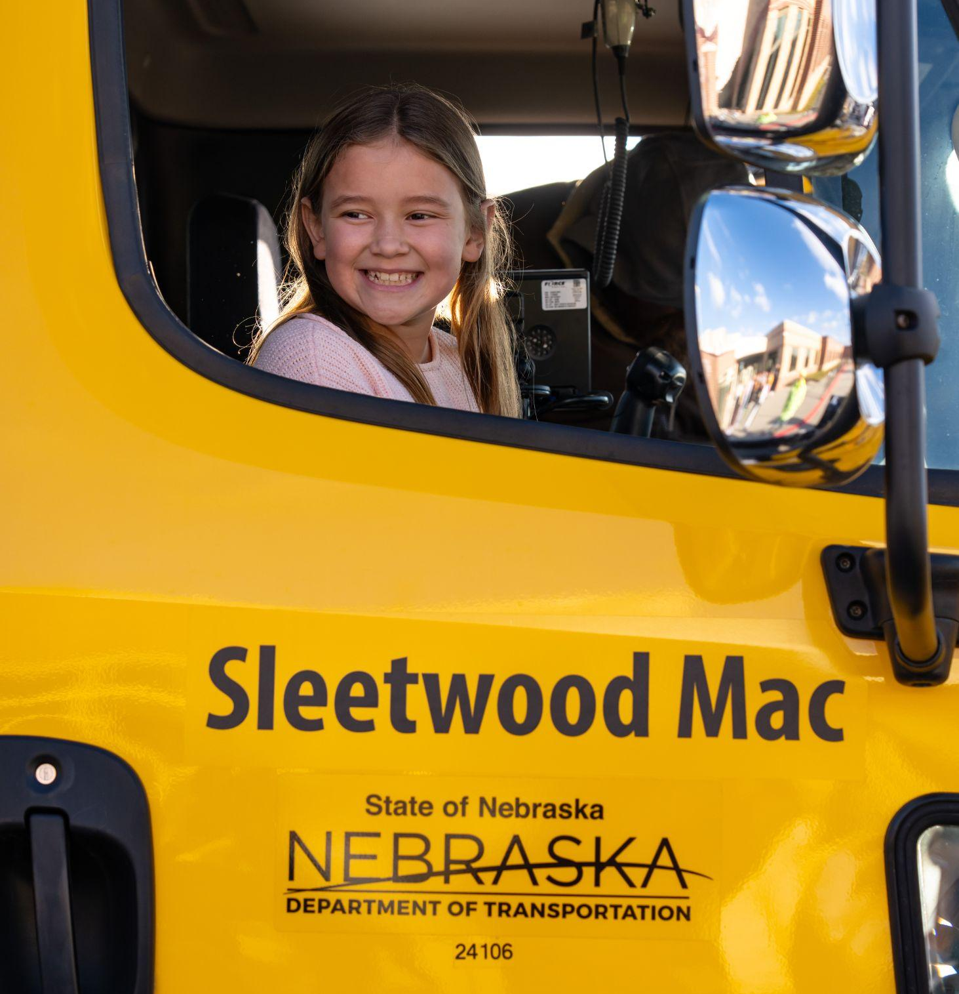
Puns / Wordplay
Fleetwood Mac is a popular band.
Sleet is a kind of winter precipitation.
“Sleet” and “Fleet” rhyme!

Slide 23
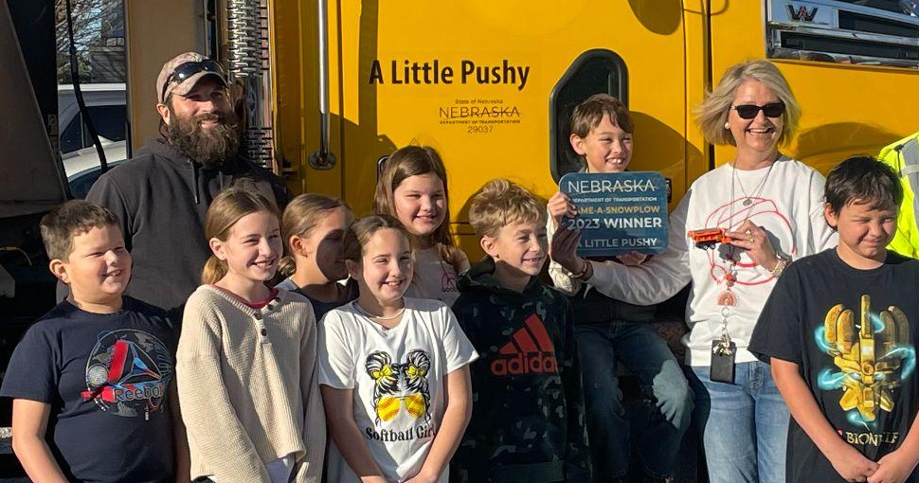
Puns / Wordplay
Someone who is bossy might be called “a little pushy.”
Snowplows push snow.
It’s also funny because snowplows are actually pretty big!

Slide 24
How do you name a snowplow?
Make a list of winter words
Make a list of ways we can move snow
Make a list of popular characters, shows, books, phrases, ideas, etc.
Practice connecting these lists together in fun, punny ways!

Slide 25
Example
Things I know about snow: flakes, flurries, blizzard
Movies I like: Fast and Furious, Zootopia, The Wizard of Oz
What words in the SNOW category could be connected to the MOVIES category?

Slide 26
Example
Things I know about snow: flakes, flurries, blizzard
Movies I like: Fast and Furious, Zootopia, The Wizard of Oz
What words in the SNOW category could be connected to the MOVIES category?
Do any of the words SOUND similar?

Slide 27
Example
Things I know about snow: flakes, flurries, blizzard
Movies I like: Fast and Furious, Zootopia, The Wizard of Oz
Furious …
Wizard…

Slide 28
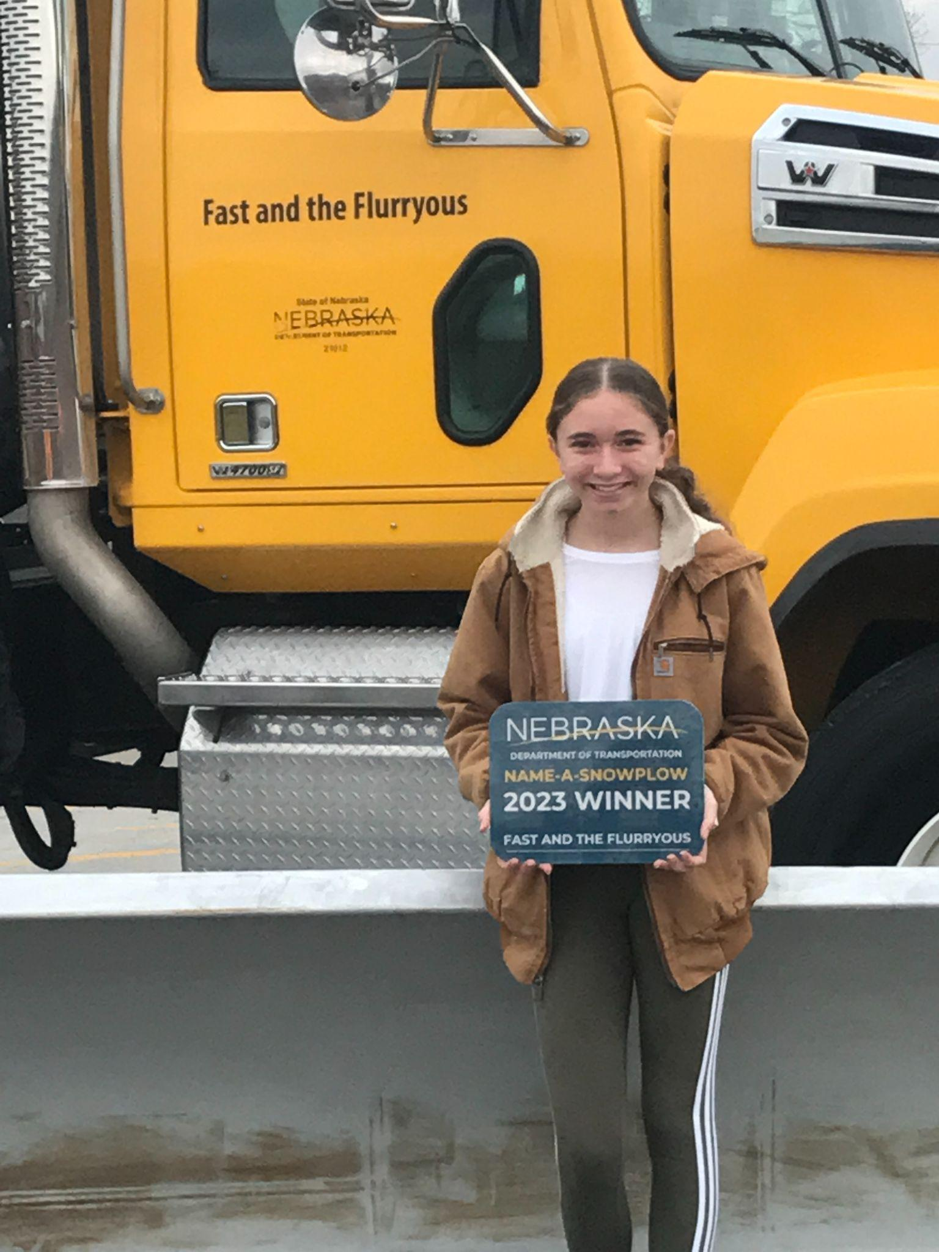
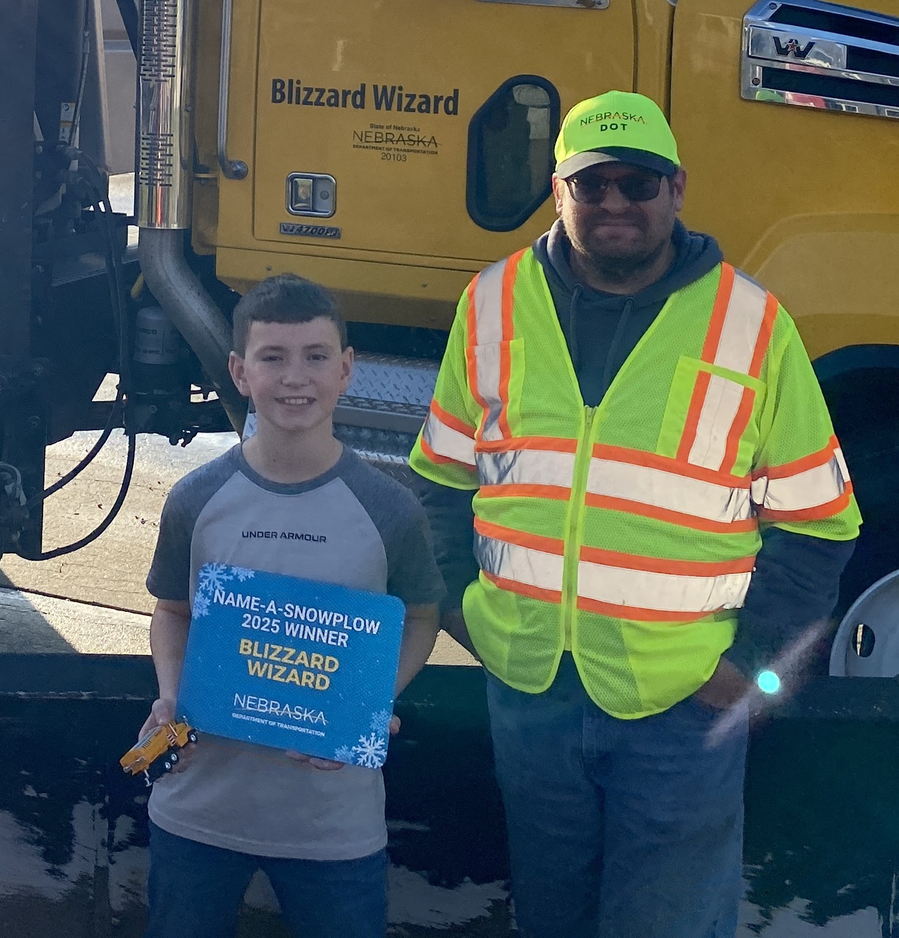
Example
Furious = Flurryous
Wizard = Blizzard

Slide 29
How do you name a snowplow?
Make a list of winter words
Make a list of ways we can move snow
Make a list of popular characters, shows, books, phrases, ideas, etc.
Practice connecting these lists together in fun, punny ways!

