Slide 1
NEBRASKA AIRPORT
LICENSE STANDARDS
Statutes and Sketches
Nebraska Aviation Symposium, Kearney, NE 2020

Slide 2
Title 17
Nebraska Administrative Code, Chapter 1
Full text (PDF) is available at:
https://www.nebraska.gov/rules-and-regs/regsearch/Rules/Transportation_Dept_of/Title-17/Chapter-01.pdf
(or just Google “NE Administrative Code Title 17”)
- Minimum Standards are described under Section 003.02 -

Slide 3
THREE SURFACES:
PRIMARY SURFACE
APPROACH
TRANSITION ZONE

Slide 4
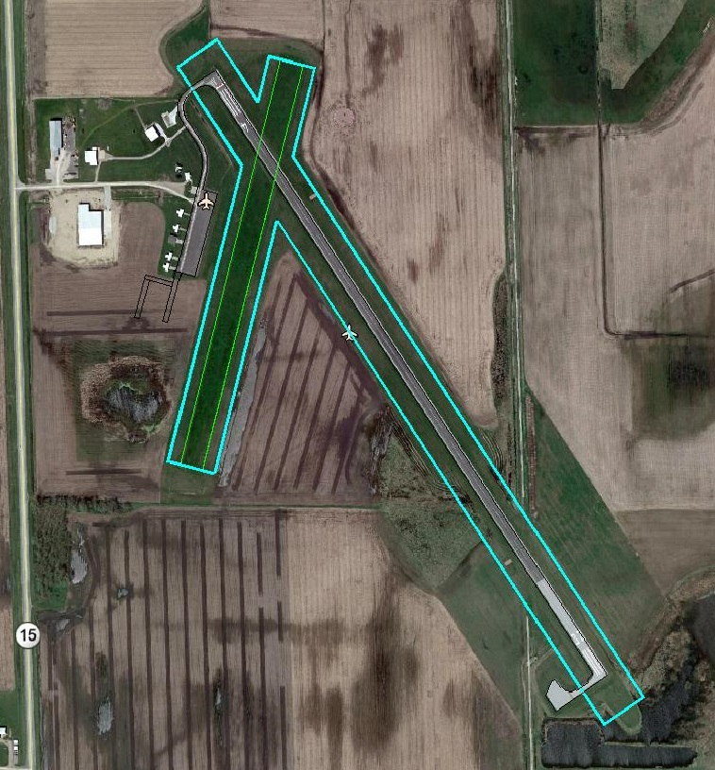
The Primary Surface
A rectangle, 250’ wide and extending 200’ past the runway end.
No 200’ extension if the runway is turf.

Slide 5
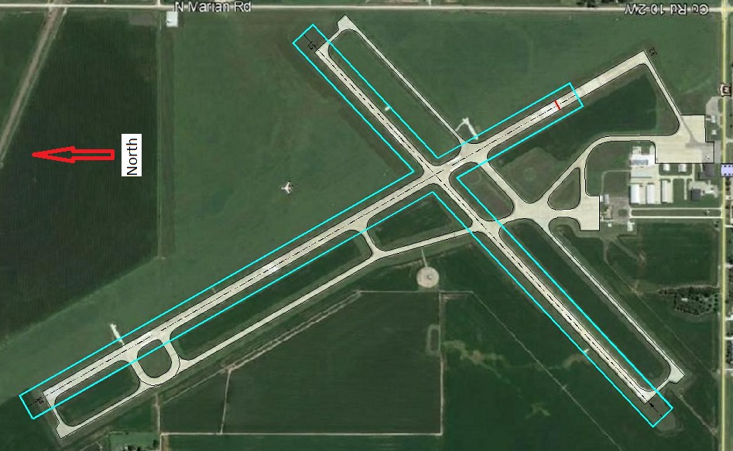
The Primary Surface
A rectangle, 250’ wide and extending 200’ past the runway end, unless
there’s a Displaced Threshold

Slide 6
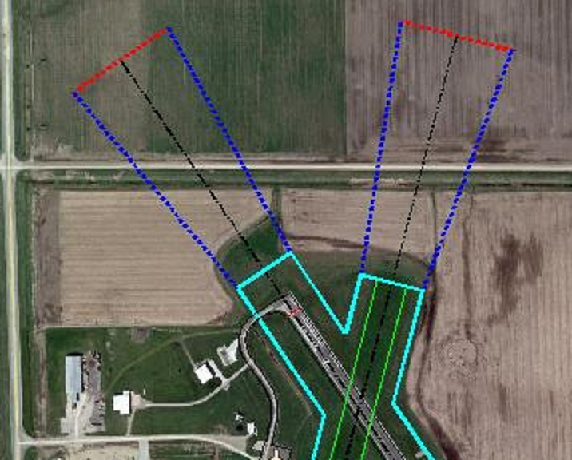
The Approach
A trapezoid, 250’ wide near the runway, 1000’ long, and 450’ wide at its far end. The Approach has a 20:1 slope

Slide 7
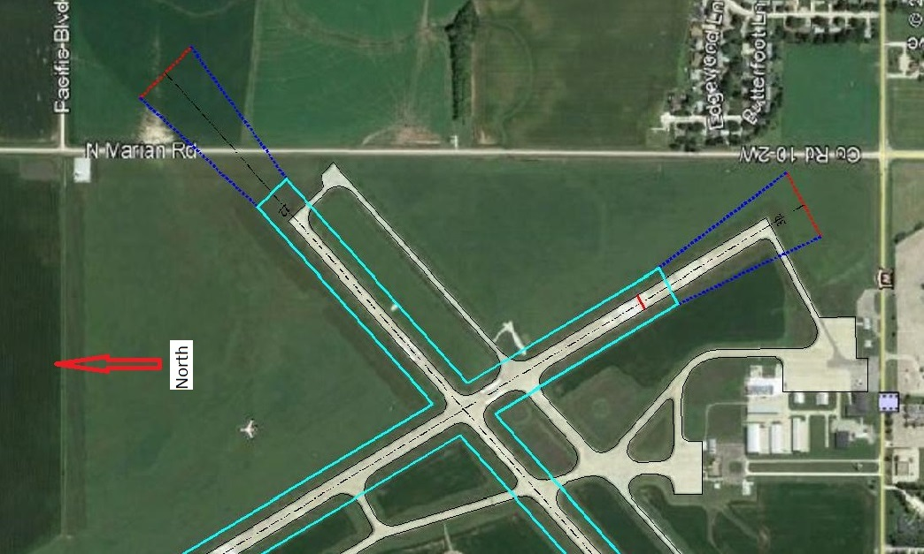
The Approach
A trapezoid, 250’ wide near the runway, 1000’ long, and 450’ wide at its far end. The Approach has a 20:1 slope

Slide 8
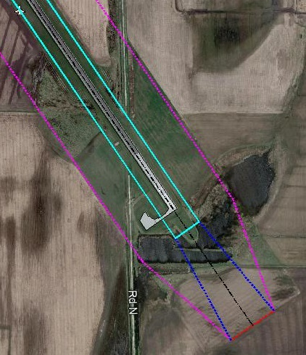
The Transition Zone
“Hard to describe.” It parallels the runway to the end of the Primary Surface, then tapers to the far end of the Approach. It has a 7:1 slope at right angles to the runway, starting from the edge of the Primary Surface.

Slide 9
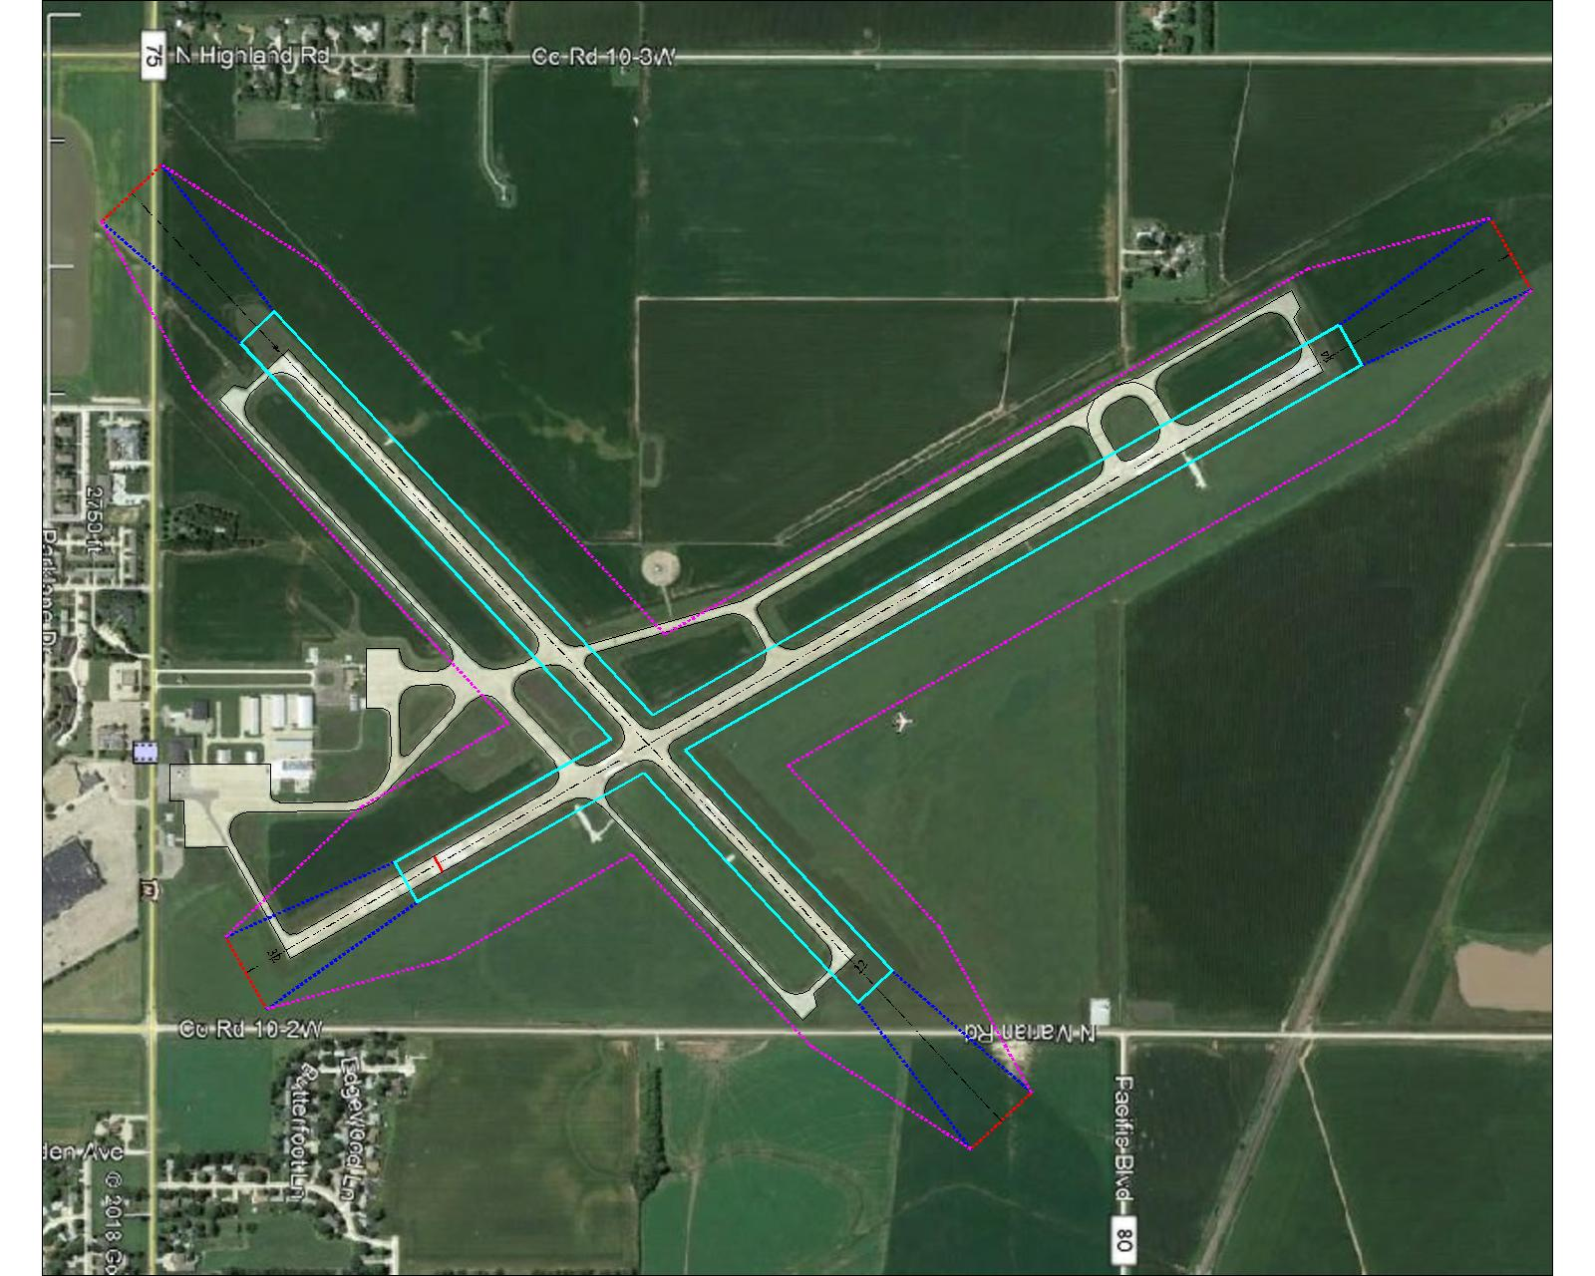
Primary Surface, Approaches, and Transition Zone
All three License surfaces at Hastings

Slide 10
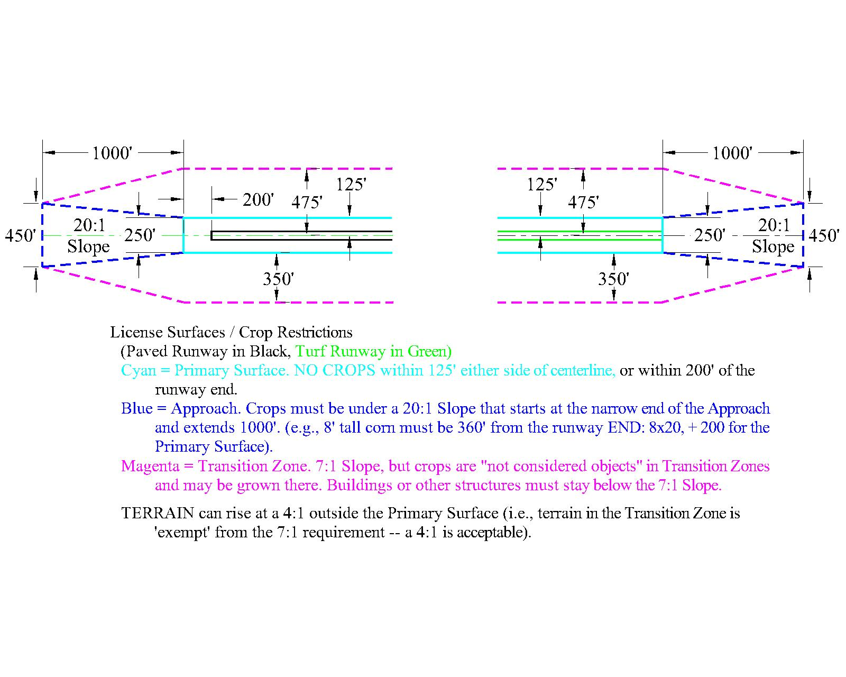
License Surfaces Plan View

Slide 11
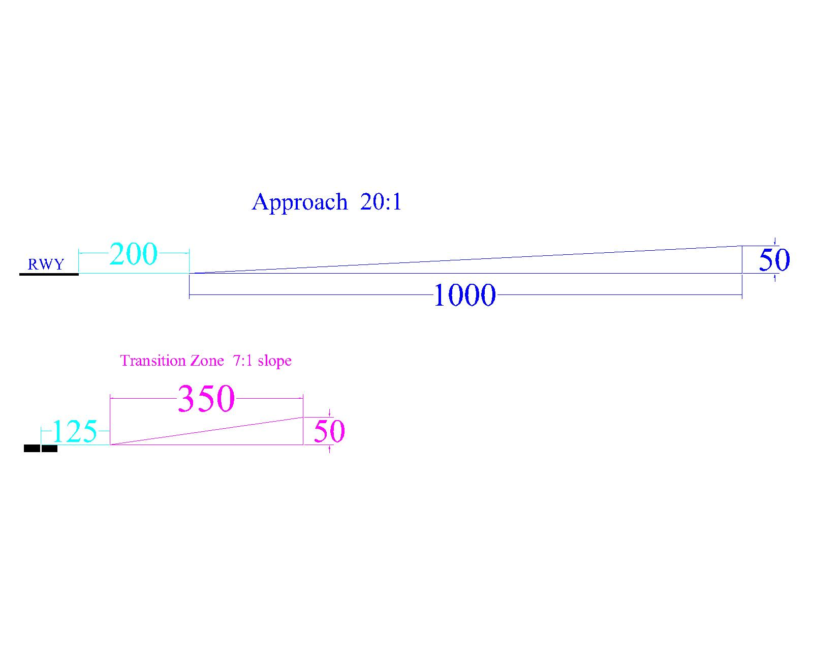
Approach and Transition Zone Profile Views

Slide 12
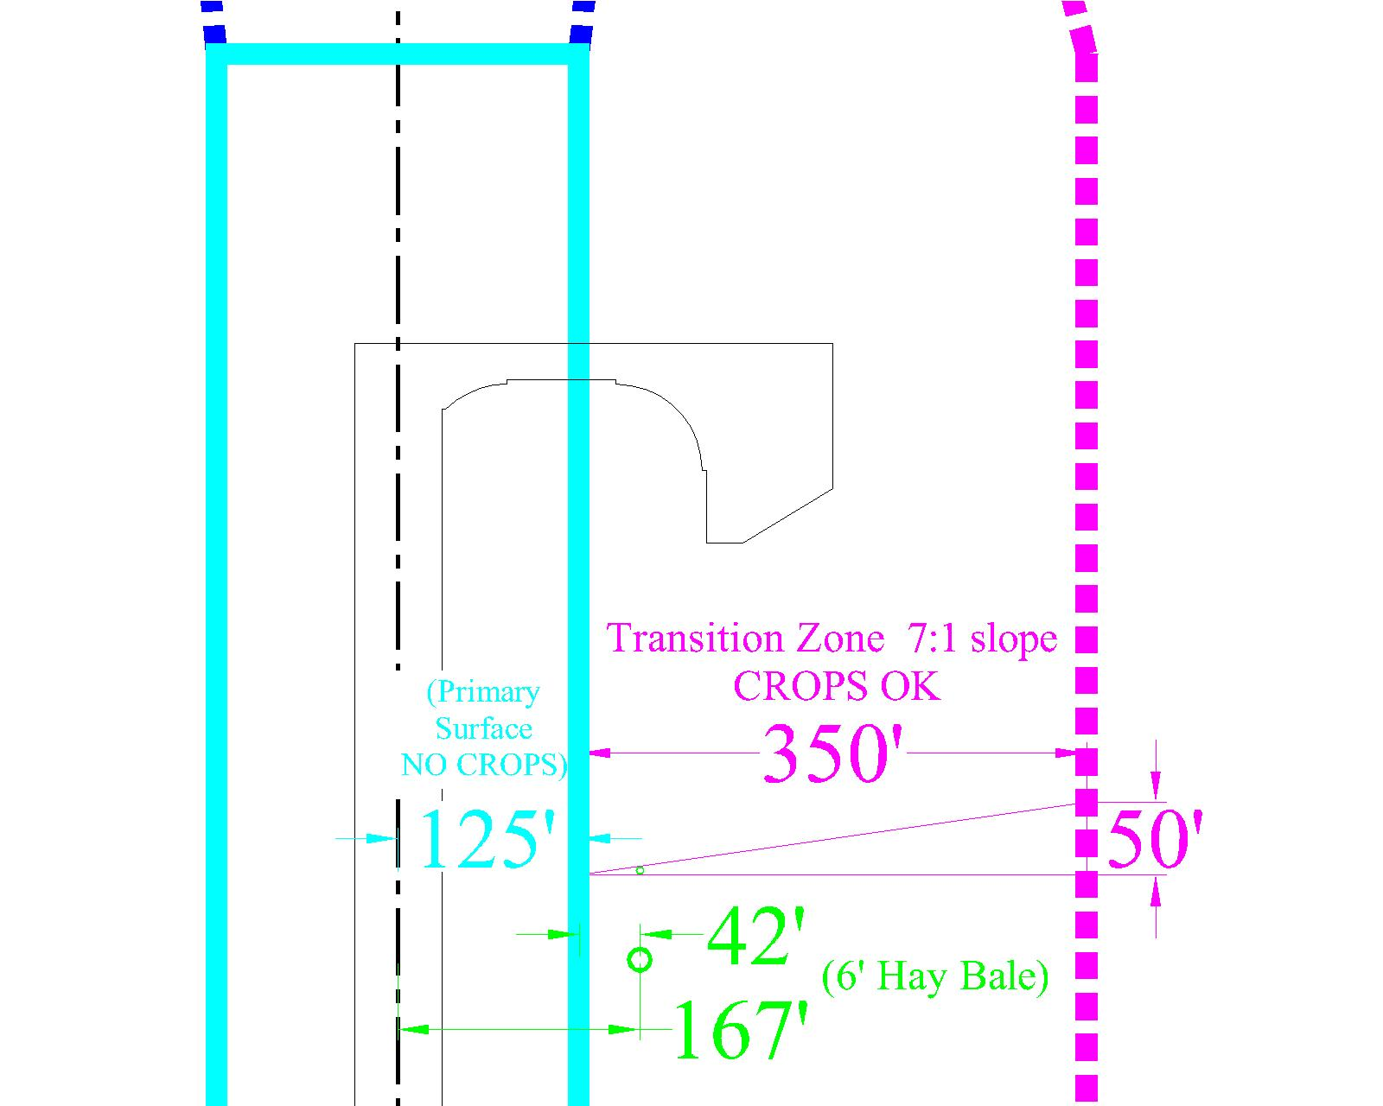
Transition Zone Plan & Profile (Crops)
Please note that HAY BALES ARE NOT ‘CROPS’

Slide 13
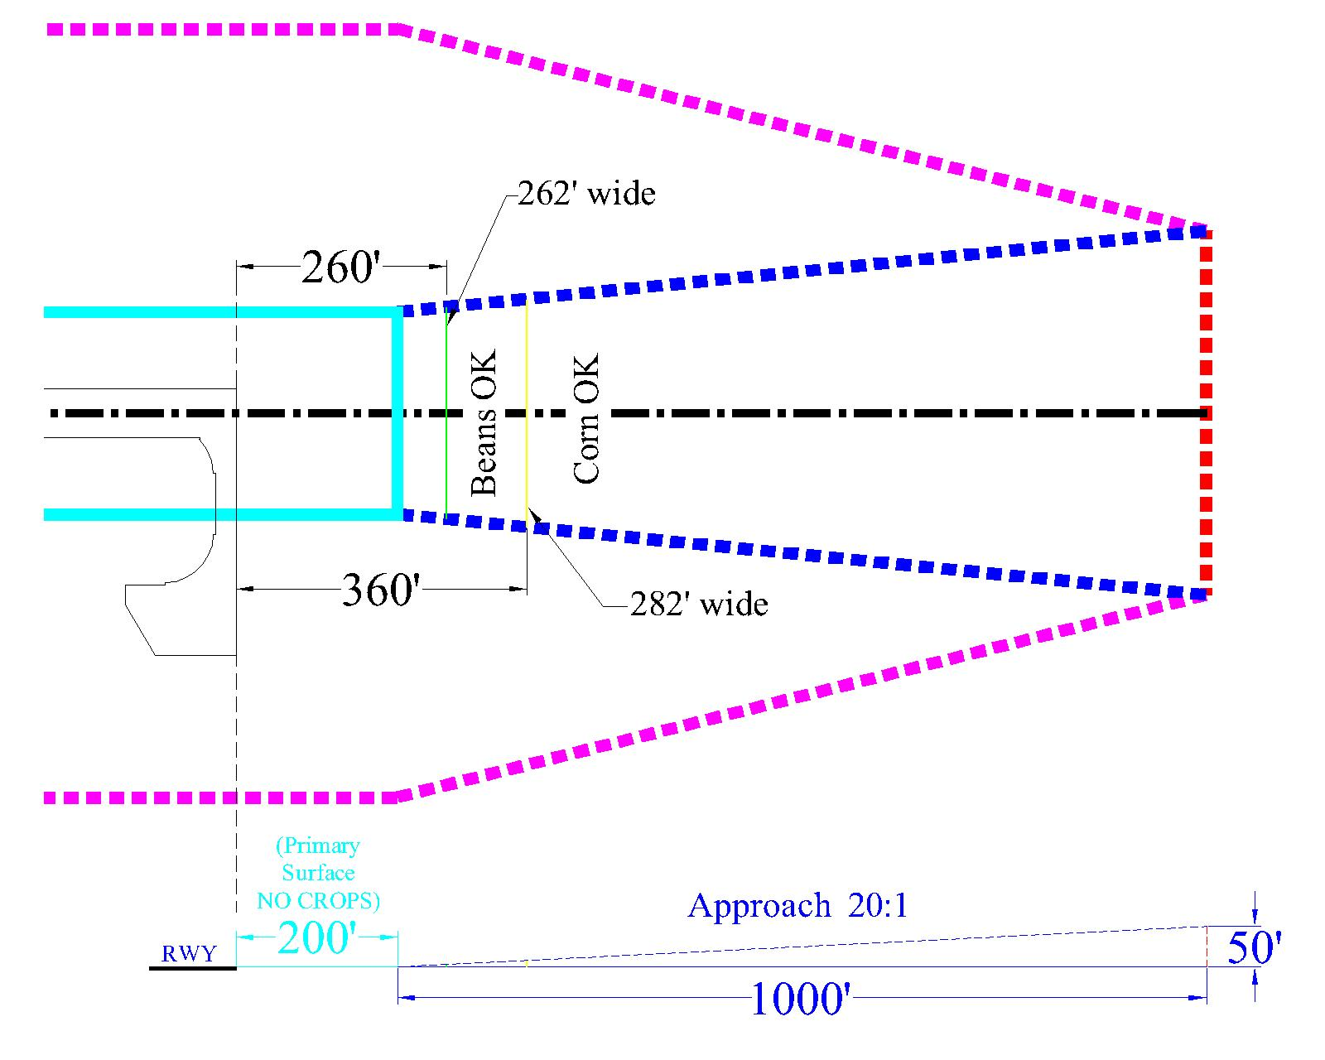
Approach Plan & Profile
(Distances from runway end assume 3’ beans and 8’ corn)

Slide 14
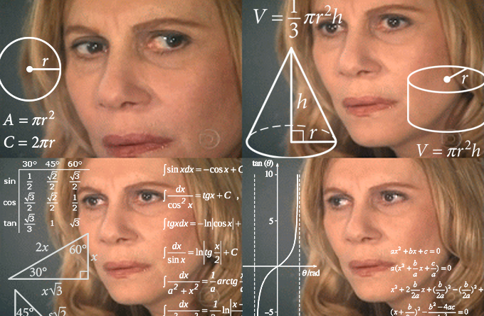
Doing the Math
OR,
How do we figure out if something’s a violation or not?

Slide 15
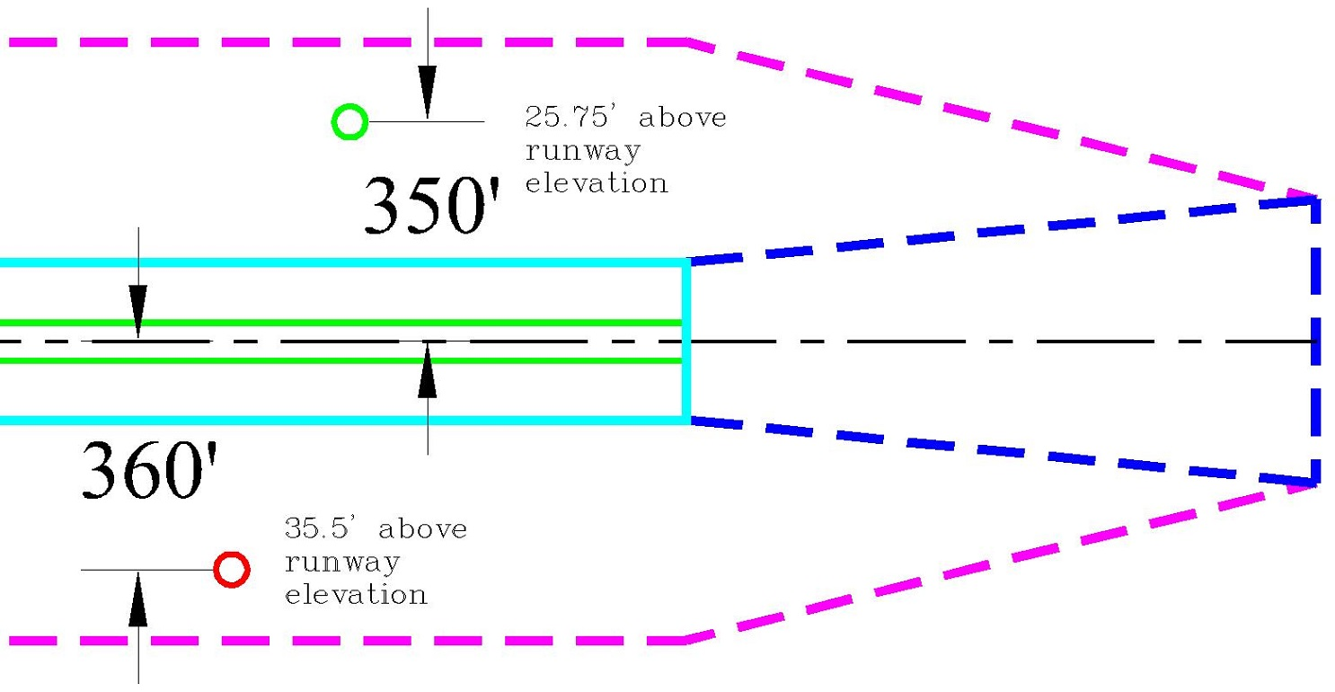
Transition Zone (parallel to runway) formula:
(Horizontal distance – 125) / 7 = “Do Not Exceed” (DNE) height above runway
Observed height + inspector eye height = Object’s height above runway
If Object’s height < DNE, no violation. If Object’s height > DNE, Object violates.
350 – 125 = 225
225 / 7 = 32.1
Shot @ 20’ above rwy
+ eye height = ?
360 – 125 = 235
235 / 7 = 33.57 DNE
Shot @ 30’ above rwy
+ eye height = ?

Slide 16
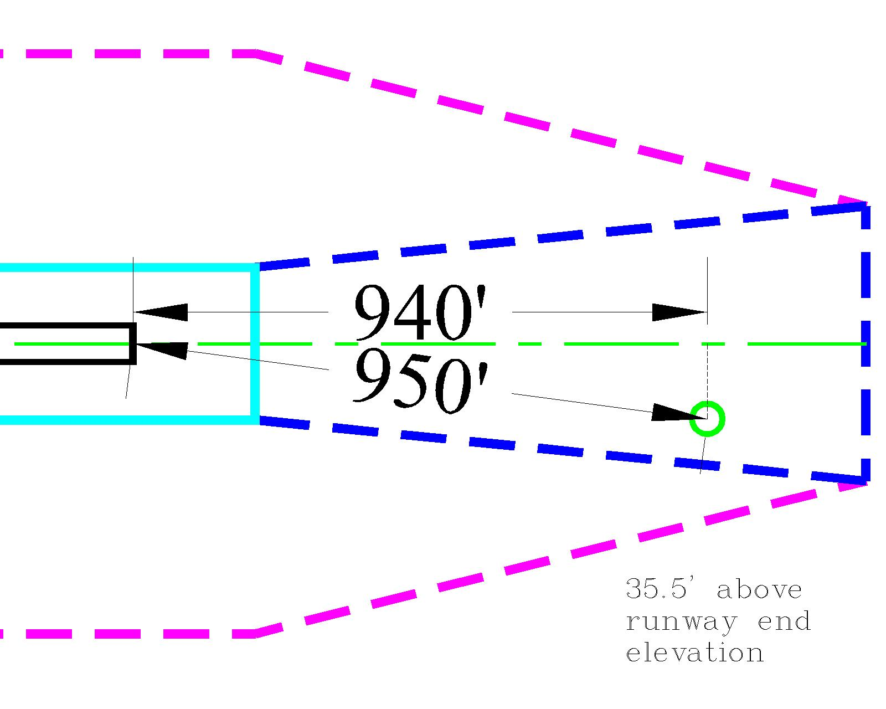
Approach Zone formula: Observed Horizontal Distance as measured perpendicular to centerline – 200, then / object’s height = Clearance Slope
(object’s height is Observed Height + eye height)
(To calculate DNE height, divide by 20 instead of object’s height)
940 – 200 = 740
Obs. Ht. 30 + 5.5 = 35.5
740 / 35.5 = 20.8 ROUND DOWN: Clearance Slope = 20:1

Slide 17
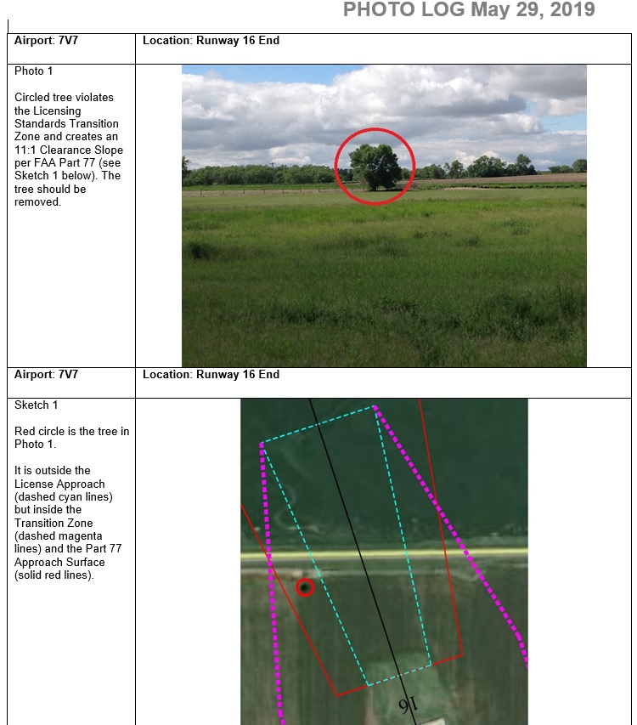
Red Cloud 2019

Slide 18
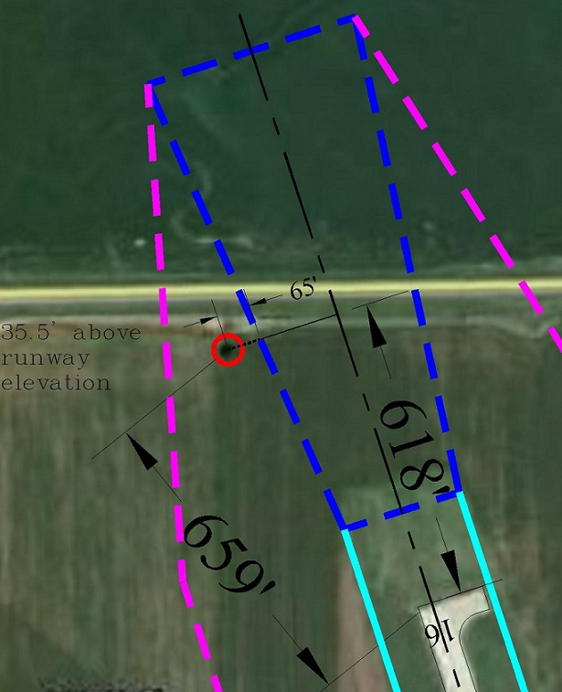
Transition Zone, next to Approach
Approach DNE:
418/20 = 20.9
TZ DNE:
65/7 = 9.29
“Total DNE” is
20.9+9.29 = 30.19
Observed height + inspector’s eye height was 35.5, so the tree violated the TZ by 5.31’.

Slide 19
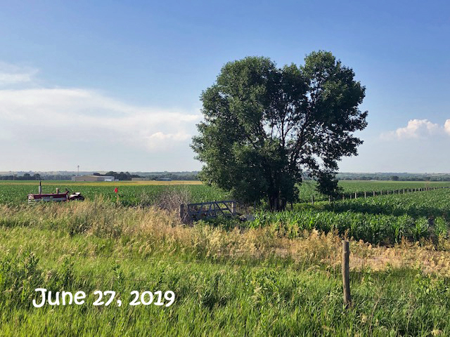
Red Cloud “Before”

Slide 20
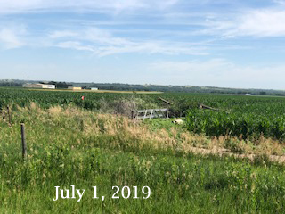
Red Cloud “After”

Slide 21

But what if I can’t fix it in time??

Slide 22
Waivers will no longer be granted ‘automatically.’ If you cannot correct a violation within the allotted time (by end-of-year), you MUST REQUEST A WAIVER using this Request Form.
The form will be available to download from our website (including an instruction sheet), or you can request a paper or electronic copy from Aeronautics.

Slide 23
Thank You
For protecting your airspace and keeping your airports safe!
QUESTIONS??
Dave Lehnert 402-471-7928 dave.lehnert@nebraska.gov
Thomas Jacobson 402-471-7925 thomas.jacobson@nebraska.gov
Ann Richart 402-471-7922 ann.richart@nebraska.gov

