Slide 1


Records Management for Nebraska Public Entities
Tab 12
Boards - Liaison Services Section
Notes:
9/11/2022 Updated Slide 1 by adding 3-ring binder Tab number.
9/9/2021 Updated Slide 4
8/14/2019 Updated four slides – 4 and 11 thru 13. Minor changes such as updating web links. Previous version dated 2/1/2019.
Goal: approximately 5 minute presentation
As an appointed licensed superintendent, you may be responsible for managing the many written records generated by the road or street department.
So what? Why is that important? What should be done with all of that paperwork?
RECORDS MANAGEMENT IS NOT OPTIONAL!

Slide 2
Public Records
What is a “Record?”
Why keep records?
What records must be kept, and for how long?
Notes:
Three main points to get across in a very short presentation

Slide 3
Public Records
What is a “Record?”
Why keep records?
What records must be kept, and for how long?
Notes:
First main point: What is a Record?

Slide 4
What is a “Record”?
Any material that documents a transaction, decision or activity of public business
Design plans
Right-of-way acquisition docs
Contract
Interlocal agreement
One- and Six-Year plan
Email
Budget Report
Plat Map
Photograph
Memo
Vehicle Operator Report
Letter
Meeting minutes
Field notebook
Contractor invoice
Grading computations
Weigh ticket
Equipment repair receipt
Maintenance activity
Bridge inspection
Policy
Disciplinary action
Gravel and rock report
Inventory
Gas Truck Tank deliver sheet
Notes:
9/9/2021 shortened the word “documents” to “docs”
8/14/2019 Updated “Annual Report (SSAR)” to “Email”
What do we mean by a “record?”
RECORD: Any material that documents a transaction, decision or activity of public business. (Reference: SOS Tutorial Video, Slide 41)
It could be a set of design plans, right-of-way acquisition documents, a contract, an interlocal agreement, a One- and Six-Year plan, a budget, a map, a photograph, a memo, a letter, meeting minutes, and so forth.
ESSENTIAL RECORDS: records that are critically important to the continued functioning of, or re-building of and agency in the event of a disaster.

Slide 5
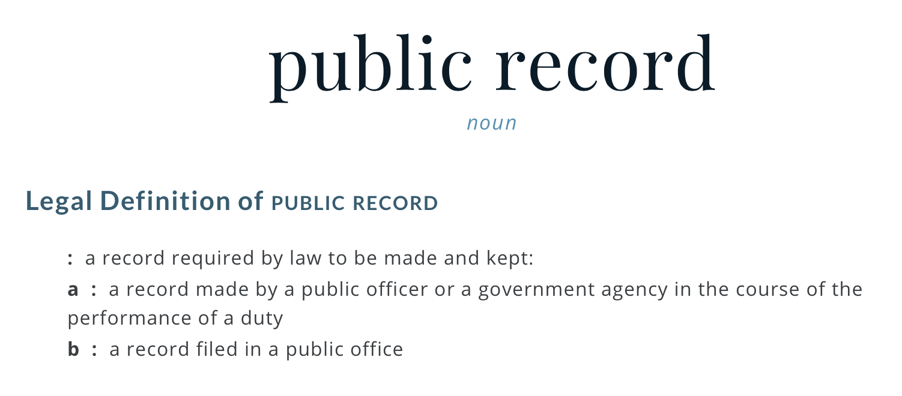
What is a “Public Record”?
Notes:
What do we mean by a “public record?”
A record required by law to be made and kept.
A record that is made by a public officer (such as a County Highway or City Street Superintendent), or that is filed in a public office.
Example: deeds and easements filed in the county courthouse.

Slide 6

Records are information … not format
Public records encompass all aspects of a public agency’s work and can be on paper or electronic.
Notes:
Paper, e-mail, on a computer, or in the cloud. The form or material don’t matter.
Image Source: http://www.tripwire.com/state-of-security/wp-content/uploads/cache//shutterstock_355975007/3259250916.jpg

Slide 7
Public Records
What is a “Record?”
Why keep records?
What records must be kept, and for how long?
Notes:
Second main point: Why keep Records?

Slide 8
Why Must Agencies Keep Records?
To effectively carry out an agency’s mission
Accountability & Transparency (It’s public money!)
Conduct daily business
  Documentation of Decisions, Protect Citizen Rights
Ease succession transitions
Recover from disaster – preserve records of permanent value
Neb. Rev. Stat. §§84-1201 to 84-1228
Notes:
1 – Records are critical to the functioning of all government agencies.
5 – you won’t be in your position forever! When you become Superintendent, you likely want to inherit a good set of records! Do the same for the next person!!

Slide 9
Public Records
What is a “Record?”
Why keep records?
What records must be kept, and for how long?
Notes:
Second main point: Why keep Records?

Slide 10
What Records Must be Kept, and for How Long?
Statewide policies
Your Agency’s policies
  Consistent with, or stricter than, statewide policies
Neb. Rev. Stat. §§84-1201 to 84-1228
Notes:
Set up a procedure for dealing with documents day-to-day so it doesn’t end up being an overwhelming chore at some point.

Slide 11
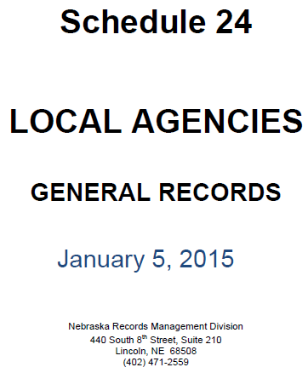
https://sos.nebraska.gov/records-management/retention_schedules.html
Schedule 24
Notes:
8/14/2019 Updated web link

Slide 12
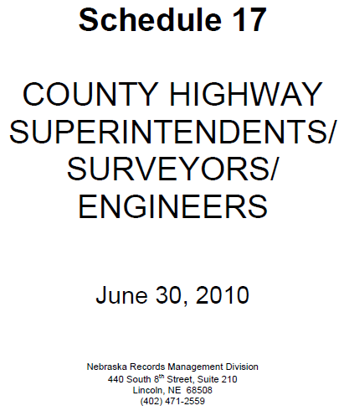
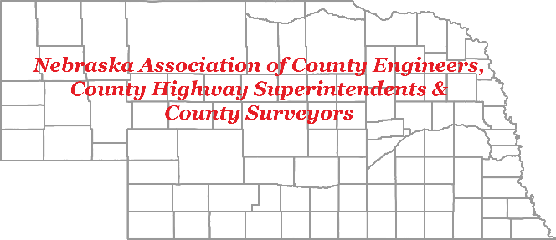
Counties
https://sos.nebraska.gov/records-management/retention_schedules.html
Need to review several different schedules to know all requirements
Thank you to:
Notes:
8/14/2019 Updated web link
How long do the Vehicle Operator Reports need to be kept before disposing of them? Dispose of after 2 Years.

Slide 13
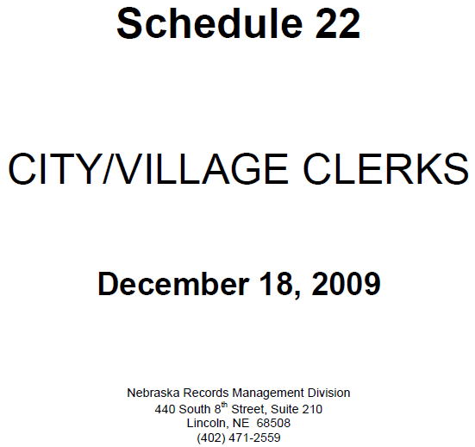
Municipalities
https://sos.nebraska.gov/records-management/retention_schedules.html
Need to review several different schedules to know all requirements
Notes:
8/14/2019 Updated web link

Slide 14
Many Statutes Address Record Keeping
Examples
§39-1411 Road and bridge records
§39-1510 Plat records of public roads
Notes:
39-1411.
Road and bridge records, who must keep; carrying capacity posted on bridges.
The county highway superintendent or some other qualified person designated by the county board shall keep in his or her office a road record which shall include a record of the proceedings in regard to the laying out, establishing, changing, or discontinuing of all roads in the county hereafter established, changed, or discontinued, and a record of the cost and maintenance of all such roads. Such person shall record in the bridge record a record of all county bridges and culverts showing number, location, and description of each, and a record of the cost of construction and maintenance of all such bridges and culverts. If the carrying capacity or weight limit of any bridge is less than the limits set forth in subsections (2), (3), and (4) of section 60-6,294, the county shall cause to be firmly posted or attached upon such bridge in a conspicuous place at each end thereof a board or metal sign showing the carrying capacity or weight which the bridge will safely carry or bear.
39-1510.
Highway superintendent; office; plat records of public roads.
The county highway superintendent shall be provided by the county with a suitable office which may be in the office or room occupied by the county board or elsewhere, as the board may choose, and he shall keep in his office plat records showing accurately all public roads and highways established in the county.

Slide 15
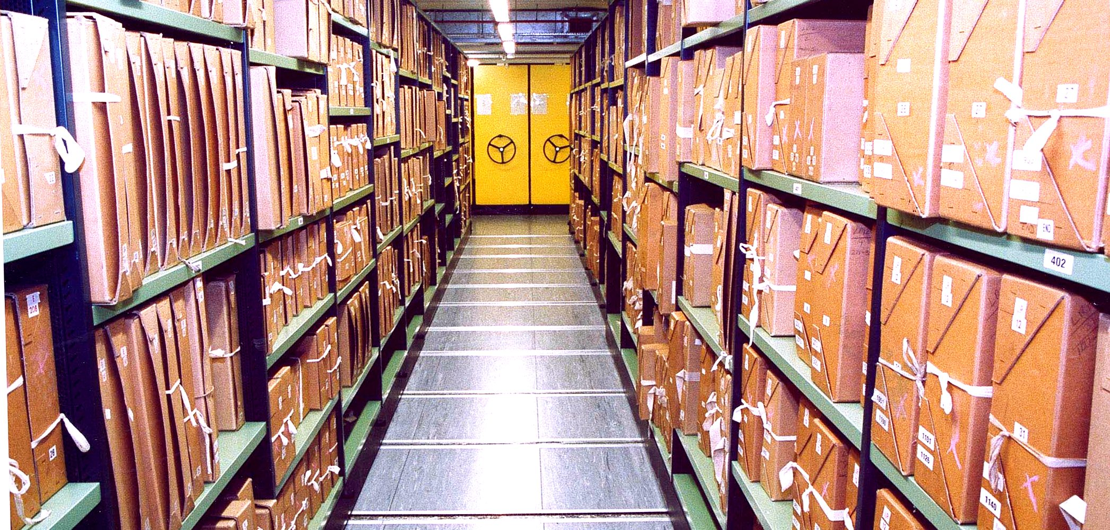
Questions?

