Slide 1
District Utility Program Meeting
District 4
October 19, 2023
Notes:
HDR (Kristen, Amanda or Alyssa)

Slide 2
This meeting is being recorded
Notes:
HDR (Kristen, Amanda or Alyssa)

Slide 3
Welcome
Before we begin, let’s have a brief safety moment.
In-Person Attendees
Emergency Exits
Tornado Shelter
911 Caller
AED Location
Restrooms
Virtual Attendees
Unmute yourself or use your chat box if you are in an emergency situation.
Notes:
NDOT Utility Coordinator (In-person safety briefing)
HDR (Kristen, Amanda or Alyssa) (Virtual safety briefing)

Slide 4
Agenda
Introductions
Utility Program Updates
Construction Activities vs. Utility Conflicts
Construction Projects Review
Outstanding 2023 Construction Projects
2024 Construction Projects
2025 Construction Projects
Questions & Wrap Up
Notes:
HDR (Kristen, Amanda or Alyssa)

Slide 5
Introductions
Notes:
HDR (Kristen, Amanda or Alyssa)

Slide 6
Introduce Yourself
Introduce yourself and share:
Name
Organization
Role
Favorite Pizza Topping
In-Person Attendees
Please go around the room and introduce yourself.
Virtual Attendees
Please type the information in the chat box.
Notes:
HDR (Kristen, Amanda or Alyssa)

Slide 7
Utility Program Updates
Notes:
Jamie Mikkleson

Slide 8
Key Outcome
To improve utility coordination from Design through Construction.
Notes:
Jamie Mikkleson

Slide 9
Improvement Emphasis
Communication during planning and construction
Improved utility data collection and plan presentation
Construction schedule coordination
Notes:
Jamie Mikkleson

Slide 10
Ndot utility section
Notes:
Jamie Mikkleson

Slide 11
Utilities Organization Structure
Kyle Keller
Katie Acevedo
Katharine Fischer
Don Horton
Rhett Robinson
Dave Hansen
Curt Yager
Districts 1 & 8
Districts 2 & 3
District 4
Districts 5, 6, & 7
Notes:
Jamie Mikkleson

Slide 12
Program level updates
Notes:
Jamie Mikkleson

Slide 13
Accommodation Policy
Sets forth guidelines & requirements for accommodating utility facilities within State Highway Property
In process of completely revamping the policy
Notes:
Jamie Mikkleson

Slide 14
Accommodation Policy
Current Step
Review & comment phase
Next Step
Implementation phase
Internal & FHWA concurrent review
Internal implementation & Stakeholder outreach
Notes:
Jamie Mikkleson

Slide 15
Policy – key changes
Depth of bury by facility type
Update casing requirements for steel pipelines
Outlines NDOT utility coordination process
Expand construction and maintenance requirements
Identifies construction plan and ‘As-Installed’ plan requirements
Addresses change in ownership and abandoned or out of service facilities
Broadband chapter
Notes:
Jamie Mikkleson

Slide 16
Project level updates
Notes:
Jamie Mikkleson

Slide 17
Conflict analysis process
Utility Company will perform Conflict Analysis​
​Review for conflicts with:
Final construction – limits of construction, ROW, ditch grading
Temporary construction – drives, access crossings, phasing
NDOT will review analysis and work with Utility Company
If relocations are required, Utility Company will provide relocation information: ​
Scope of work​
Detailed cost estimate​
Schedule of relocation work​
Notes:
Jamie Mikkleson

Slide 18
Utility questionnaire
Receive via email from NDOT Utility Coordinator
Action by Utility Company required: ​
Review and provide information for existing facility locations​
Review existing locations for construction conflicts, both temporary and permanent conflicts​
Transmit responses and supporting documentation back to NDOT​
NDOT will track unresponsive utility companies & continue to follow up
Notes:
Jamie Mikkleson

Slide 19
Relocation process
NDOT will review and provide comments on relocation plans and detailed cost estimate​
Will be incorporated into the agreement
Master (Blanket) Agreement or Utility Project Agreement​
Only if relocation is reimbursable
Letter of Authorization
Every relocation
Notes:
Jamie Mikkleson

Slide 20
2024 Goals
Implement Utility Accommodation Policy
Identify utility conflicts early
Coordinate utility relocations to be complete by construction start
Professional development of coordinator staff
2024 District Utility Program Meetings – October
Notes:
Jamie Mikkleson

Slide 21
Activities vs. conflicts
When we say… | Think about…
Access Crossings – Contractor ~Pipes or Temp. Bridge | Cranes and large equipment Impacts or proximity to overhead power Piling for temporary bridge
Shoo-flys – Traffic | In addition to access crossings Additional fill Impacts to pedestals, pull boxes, overhead power, etc.
Grade beam on pile | Cranes Impacts or proximity to overhead power
Over-excavation | Possibility on any project Most likely at culverts and locations of known muck
Notes:
Jamie Mikkleson

Slide 22
Activities vs. conflicts
When we say… | Think about…
Concrete Box Culverts | Sheet pile driven at wingwalls Impacts to buried lines Impacts or proximity to overhead power Temporary shoring on phased construction
Culvert Replacements – Phased construction | Potential for temporary shoring Need room (H & V) to construct end treatments
Culvert Replacements – Jacking | Large jacking pits - ~50’x100’, not shown in plans Temporary excavation down to flowline to construct Need room (H & V) to construct end treatments
Notes:
Jamie Mikkleson

Slide 23
Activities vs. conflicts
When we say… | Think about…
Temporary Roads & Drives | Can require grading and ditch work Similar impacts to permanent construction
Guardrail | Posts can impact underground facilities
Sidewalk & ADA work | Pavement removal Shallow service lines
Curb Inlets | 3 ft – 6 ft deep, in most cases Cast in place inlets require extra room for form work
Notes:
Jamie Mikkleson

Slide 24
Construction Projects Review
District 4

Slide 25
Construction Year 2024
The following projects are anticipated to be let during 2024
Notes:
Kathy Fischer or Rhett Robinson

Slide 26
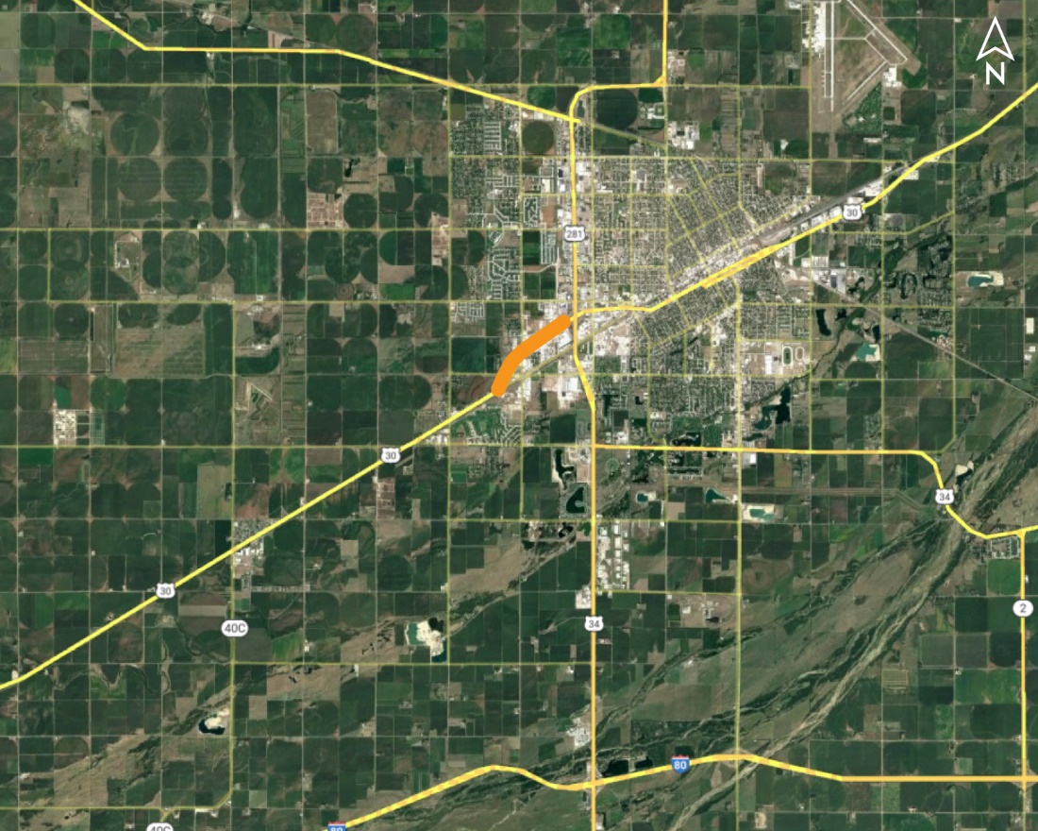
US-281 West, Grand Island Project No.: S-30-4(1046); Control No.: 41704
Project Length: 3.71
Scope of Work:
Full Depth Pavement
Grading
ITS/Lighting

Slide 27
US-281 West, Grand Island Project No.: S-30-4(1046); Control No.: 41704
Status: Preparing for Bid
Right-of-Way: In Progress
Traffic Impacts:
Phase Traffic Control
Letting Date: 9/28/2023
Construction Timing: 4/1/2024 - 11/1/2025

Slide 28
US-281 West, Grand Island Project No.: S-30-4(1046); Control No.: 41704
Anticipated Utilities Impact:
Urban Recon
New ROW
Culvert Extension/Replace
Anticipated Request from Utilities:
Provide Existing Locations
Coordination with NDOT
Additional Information:
K-Sheets Required
Special Provisions Required
Utilities Involved:
Allo Comm., City of Grand Island, Cogent Comm. Inc. (Sprint & T-Mobile), Great Plains Comm., Lumen (CenturyLink), Northwestern Energy, OPTK Networks (NebraskaLink), Southern PPD, Unite Private Net., Verizon / MCI , Windstream Comm.

Slide 29
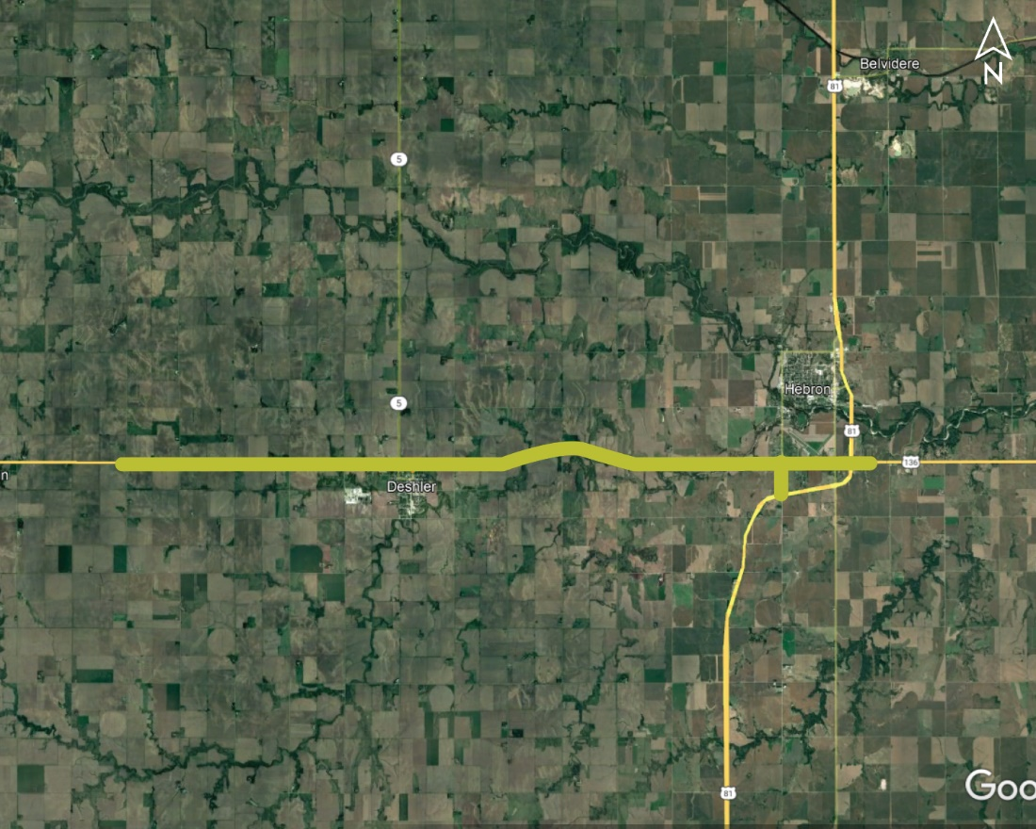
Nuckolls Co Line - L85F Project No.: STP-136-5(113); Control No.: 42543
Project Length: 14.3
Scope of Work:
Resurfacing
Grading
Culvert Extension/Replace

Slide 30
Nuckolls Co Line - L85F Project No.: STP-136-5(113); Control No.: 42543
Status: Design
Right-of-Way: Completed
Traffic Impacts:
Phase Traffic Control
Letting Date: 12/14/2023
Construction Timing: 6/24/2024

Slide 31
Nuckolls Co Line - L85F Project No.: STP-136-5(113); Control No.: 42543
Anticipated Utilities Impact:
Urban Reconstruction
New ROW
New Alignment
Anticipated Request from Utilities:
Provide Existing Locations
Coordination with NDOT
Additional Information:
K-Sheets Required
Special Provisions Required
Utilities Involved:
Black Hills Energy, City of Deshler, City of Hebron, Enbridge, Glenwood Telephone, Great Plains Comm., Norris PPD, NuStar Pipeline, Tallgrass Energy, Unite Private Net., Viaero Fiber Net. (NE-CO Cell.), Windstream Comm.

Slide 32
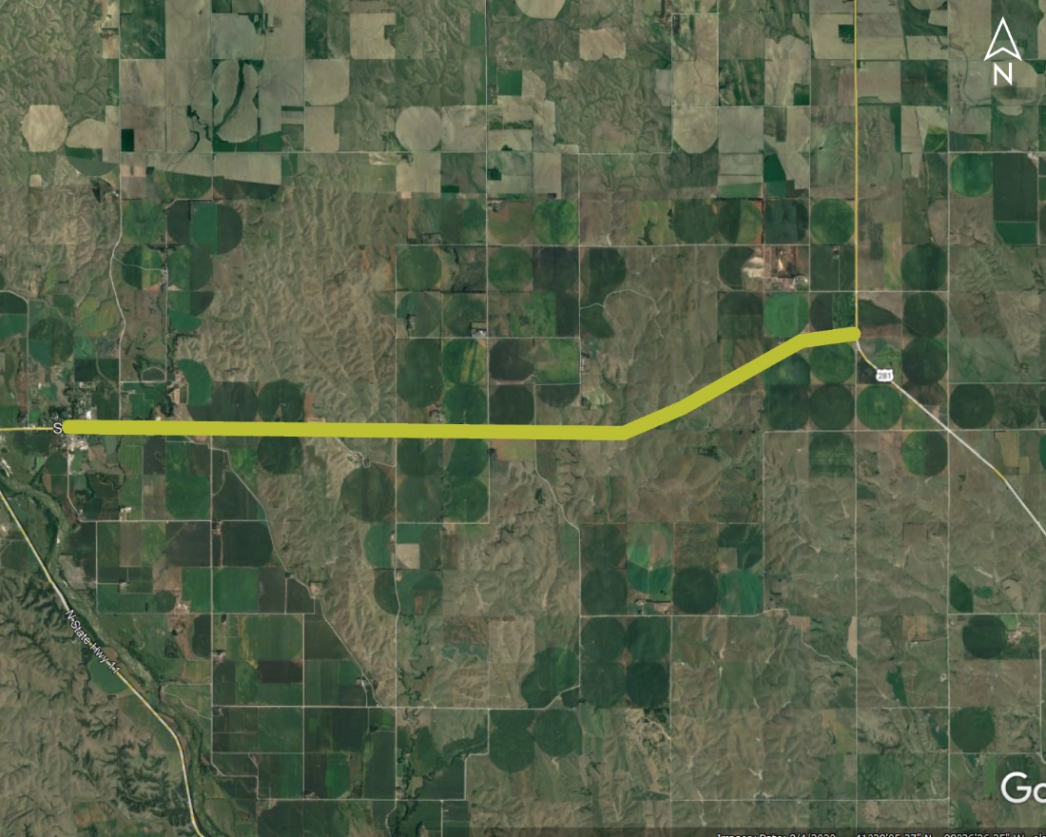
Scotia East Project No.: STP-HSIP-22-4(113); Control No.: 42605
Project Length: 8.41
Scope of Work:
Resurfacing
Culvert Extension/Replace

Slide 33
Scotia East Project No.: STP-HSIP-22-4(113); Control No.: 42605
Status: Preparing for Bid
Right-of-Way: Completed
Traffic Impacts:
None
Letting Date: 9/28/2023
Construction Timing: 5/20/2024

Slide 34
Scotia East Project No.: STP-HSIP-22-4(113); Control No.: 42605
Anticipated Utilities Impact:
Culvert Extension/Replacement
Bridge Repair/Replacement
Anticipated Request from Utilities:
Provide Existing Locations
Coordination with NDOT
Locates
Additional Information:
No K-Sheets Required
No Special Provisions Required
Utilities Involved:
Black Hills Energy, Frontier Comm., Great Plains Comm., Hamilton Telecom. (NCTC), Howard Greeley RPPD, Lumen (CenturyLink), Twin Loups Irr. District, Village of Scotia

Slide 35
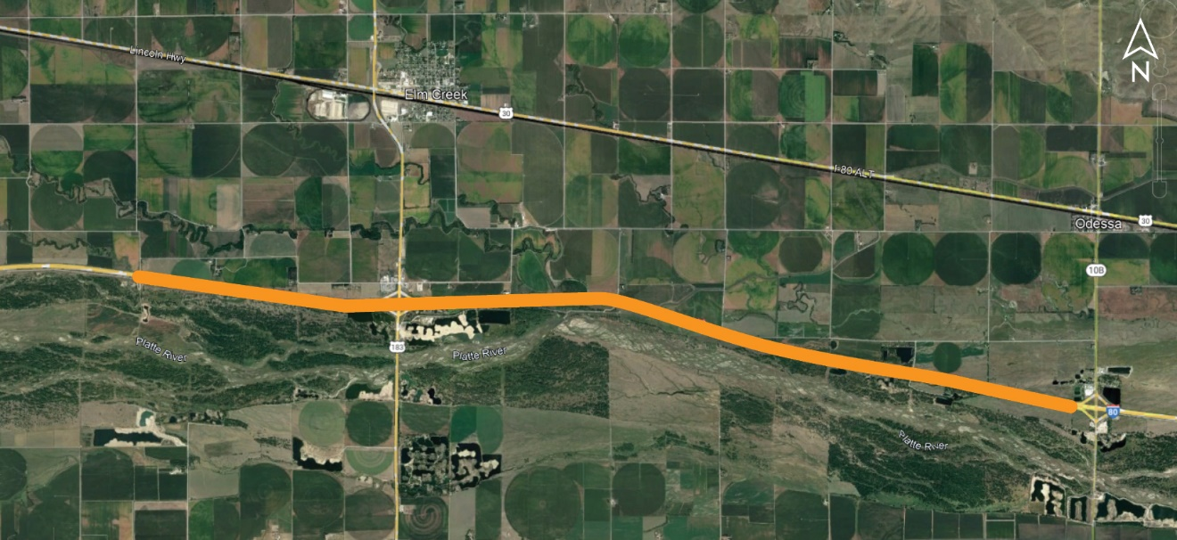
Dawson Co Line - Odessa (TK) Project No.: NH-80-5(76); Control No.: 42756
Project Length: 9.25
Scope of Work:
Bridge Replacement
Full Depth Pavement
Guardrail

Slide 36
Dawson Co Line - Odessa (TK) Project No.: NH-80-5(76); Control No.: 42756
Status: Preparing for Bid
Right-of-Way: Not Required
Traffic Impacts:
Phase Traffic Control
Letting Date: 12/14/2023
Construction Timing: 4/1/2024 - 5/22/2026

Slide 37
Dawson Co Line - Odessa (TK) Project No.: NH-80-5(76); Control No.: 42756
Anticipated Utilities Impact:
Bridge Repair/Replacement
Access Crossings
Full Depth Pavement
Anticipated Request from Utilities:
Provide Existing Locations
Coordination with NDOT
Locates
Additional Information:
No K-Sheets Required
No Special Provisions Required
Utilities Involved:
Black Hills Energy, Charter Comm. (Spectrum), Dawson PPD, Frontier Comm., Glenwood Telephone, Great Plains Comm., Lumen (CenturyLink), Nebraska PPD, Southern PPD, Tallgrass Energy

Slide 38
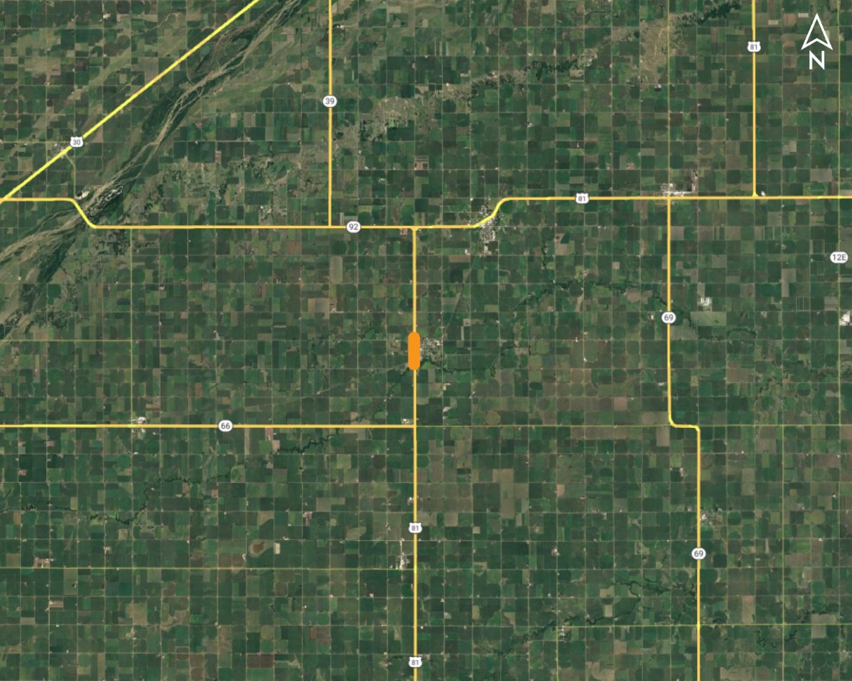
In Stromsburg Project No.: NH-81-2(155); Control No.: 42782B
Project Length: 0.87
Scope of Work:
Urban Reconstruction
Shoulder Work
Culvert Extension/Replace

Slide 39
In Stromsburg Project No.: NH-81-2(155); Control No.: 42782B
Status: Design
Right-of-Way: Completed
Traffic Impacts:
Full Detour
Local Detour
Letting Date: 12/14/2023
Construction Timing: 4/1/2025 - 10/31/2025

Slide 40
In Stromsburg Project No.: NH-81-2(155); Control No.: 42782B
Anticipated Utilities Impact:
Full Depth Pavement
Anticipated Request from Utilities:
Provide Existing Locations
Coordination with NDOT
Additional Information:
K-Sheets Required
Special Provisions Required
Utilities Involved:
City of Stromsburg, Cogent Comm. Inc. (Sprint & T-Mobile), Northern Natural Gas, Polk County RPPD, Vyve Broadband, Windstream Comm.

Slide 41
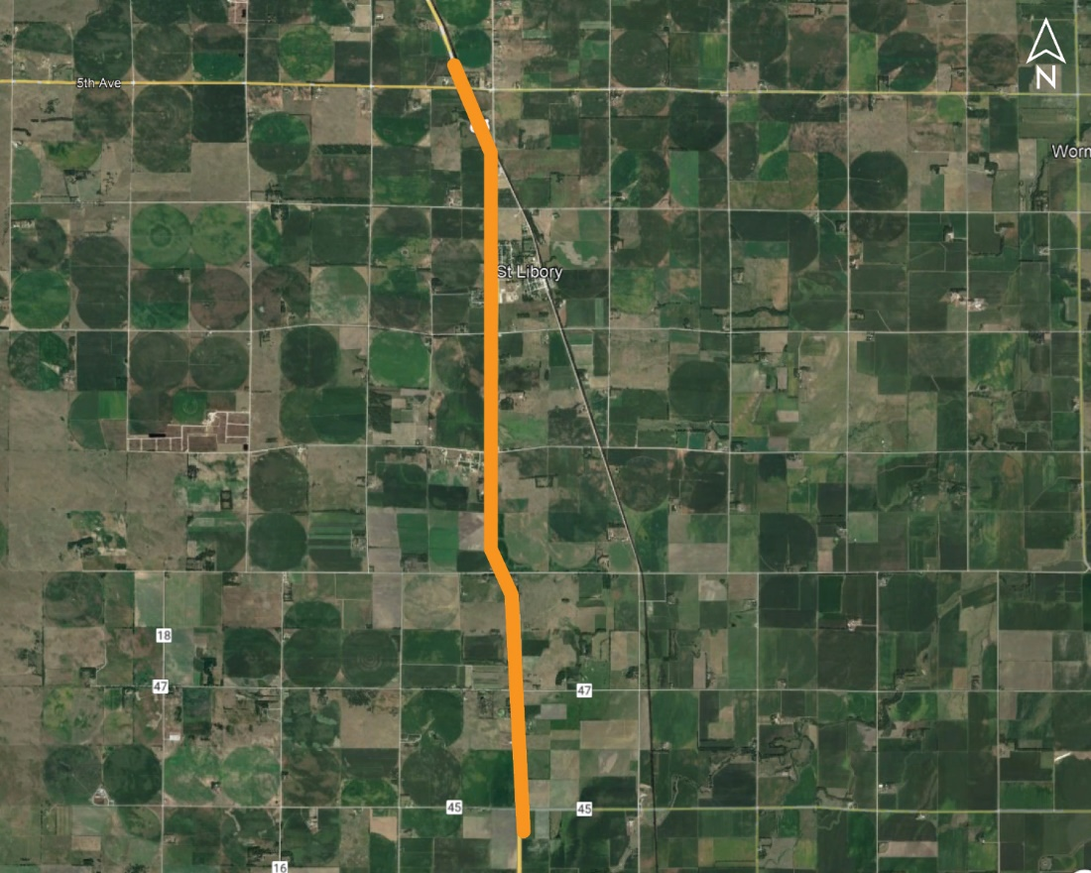
St Libory North & South (MS) Project No.: NH-281-2(129); Control No.: 42826
Project Length: 6.3
Scope of Work:
Resurfacing
Culvert Extension/Replace
Shoulder Work

Slide 42
St Libory North & South (MS) Project No.: NH-281-2(129); Control No.: 42826
Status: Design
Right-of-Way: Not Required
Traffic Impacts:
Phase Traffic Control
Letting Date: 12/14/2023
Construction Timing: 4/1/2024 - 12/7/2024

Slide 43
St Libory North & South (MS) Project No.: NH-281-2(129); Control No.: 42826
Anticipated Utilities Impact:
Culvert Extension/Replacement
Shoulder Work
Anticipated Request from Utilities:
Provide Existing Locations
Coordination with NDOT
Additional Information:
No K-Sheets Required
No Special Provisions Required
Utilities Involved:
Charter Comm. (Spectrum), City of Grand Island, Howard Greeley RPPD, Lumen (CenturyLink), Nebraska PPD, Southern PPD

Slide 44
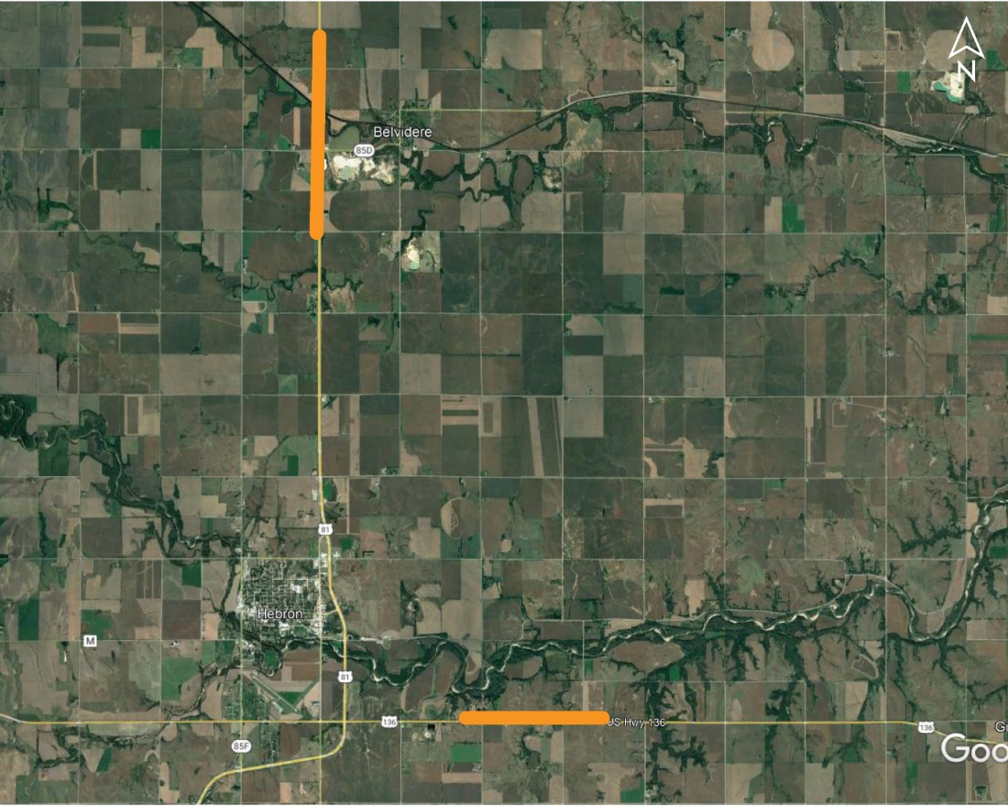
Belvidere North Bridges (MS) Project No.: NH-81-1(123); Control No.: 42851
Project Length: 3 Bridge Locations
Scope of Work:
Bridge Replacement
Grading
ITS/Lighting

Slide 45
Belvidere North Bridges (MS) Project No.: NH-81-1(123); Control No.: 42851
Status: Design
Right-of-Way: In Progress
Traffic Impacts:
Phase Traffic Control
Letting Date: 12/14/2023
Construction Timing: 6/10/2024 - 6/21/2025

Slide 46
Belvidere North Bridges (MS) Project No.: NH-81-1(123); Control No.: 42851
Anticipated Utilities Impact:
Access Crossings
Bridge Repair/Replacement
Temp. Roads/Drives
Anticipated Request from Utilities:
Provide Existing Locations
Coordination with NDOT
Additional Information:
K-Sheets Required
Special Provisions Required
Utilities Involved:
Glenwood Telephone, Great Plains Comm., Norris PPD, Viaero Fiber Net. (NE-CO Cell.), Windstream Comm.

Slide 47
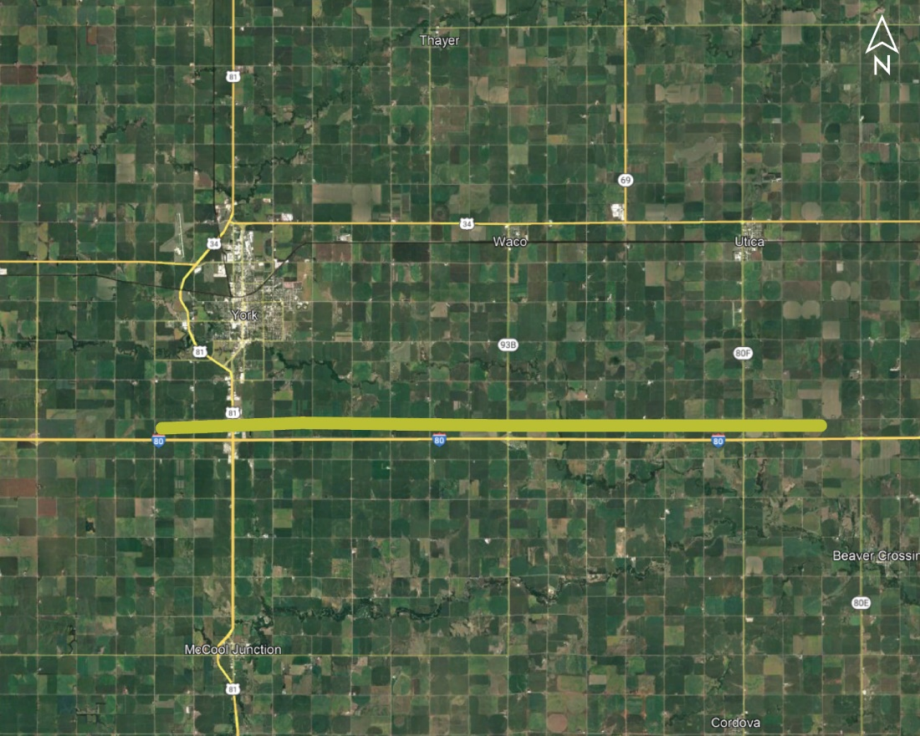
York - Utica Project No.: HSIP-80-8(165); Control No.: 42923
Project Length: 14.68
Scope of Work:
Guardrail

Slide 48
York - Utica Project No.: HSIP-80-8(165); Control No.: 42923
Status: Design
Right-of-Way: Not Required
Traffic Impacts:
None
Letting Date: 12/14/2023
Construction Timing: 5/27/2024

Slide 49
York - Utica Project No.: HSIP-80-8(165); Control No.: 42923
Anticipated Utilities Impact:
Guardrail
Anticipated Request from Utilities:
Provide Existing Locations
Coordination with NDOT
Additional Information:
No K-Sheets Required
No Special Provisions Required
Utilities Involved:
Allo Comm., Black Hills Energy, Charter Comm. (Spectrum), City of York, Nebraska PPD, Norris PPD, NuStar Pipeline, OPTK Networks (NebraskaLink), Perennial PPD, Unite Private Net., Windstream Comm.

Slide 50
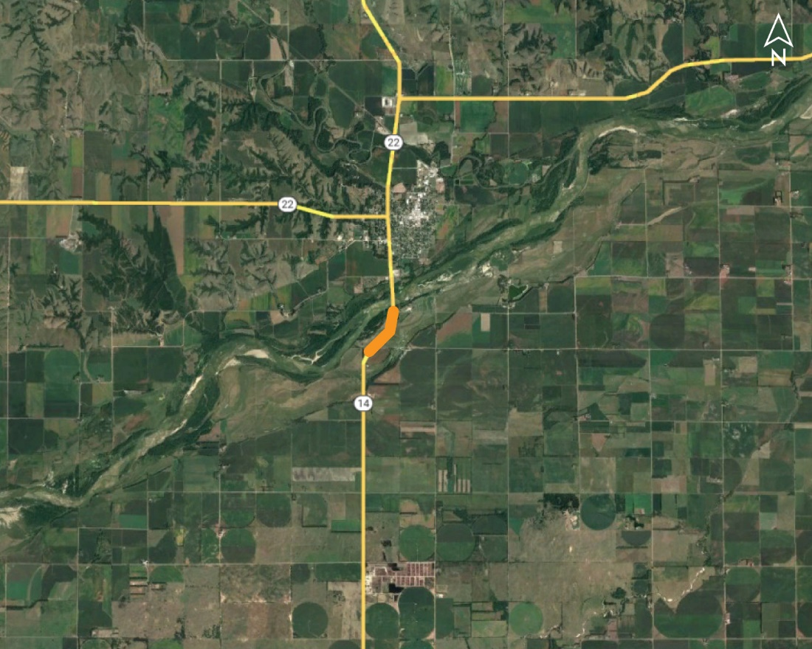
Fullerton Wetland Mitigation Site Project No.: MISC-14-3(1016); Control No.: 42403B
Project Length: 0
Scope of Work:
Grading

Slide 51
Fullerton Wetland Mitigation Site Project No.: MISC-14-3(1016); Control No.: 42403B
Status: Design
Right-of-Way: Not Required
Traffic Impacts:
None
Letting Date: 2/1/2024
Construction Timing: 4/1/2024

Slide 52
Fullerton Wetland Mitigation Site Project No.: MISC-14-3(1016); Control No.: 42403B
Anticipated Utilities Impact:
Grading
No Impacts
Anticipated Request from Utilities:
Provide Existing Locations
Coordination with NDOT
Additional Information:
No K-Sheets Required
No Special Provisions Required
Utilities Involved:
City of Fullerton, Cornhusker PPD, Loup River PPD, Lumen (CenturyLink), Vyve Broadband

Slide 53
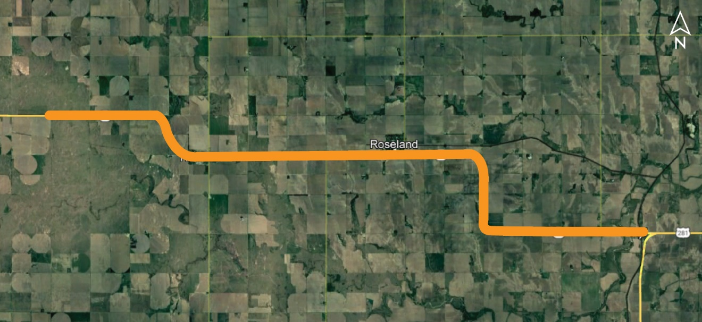
Kearney/Adams Co Line East (MS) Project No.: STP-74-4(111); Control No.: 42831
Project Length: 17.64
Scope of Work:
Resurfacing
Culvert Extension/Replace
Bridge Repair

Slide 54
Kearney/Adams Co Line East (MS) Project No.: STP-74-4(111); Control No.: 42831
Status: Design
Right-of-Way: In Progress
Traffic Impacts:
Phase Traffic Control
Letting Date: 2/1/2024
Construction Timing: 5/1/2024 - 10/31/2024

Slide 55
Kearney/Adams Co Line East (MS) Project No.: STP-74-4(111); Control No.: 42831
Anticipated Utilities Impact:
Bridge Repair/Replacement
Culvert Extension/Replacement
Anticipated Request from Utilities:
Provide Existing Locations
Coordination with NDOT
Additional Information:
No K-Sheets Required
Special Provisions TBD
Utilities Involved:
Black Hills Energy, Glenwood Telephone, Nebr. DNR (USGS), Southern PPD, Tallgrass Energy, Village of Ayr, Village of Holstein, Village of Roseland, Windstream Comm.

Slide 56
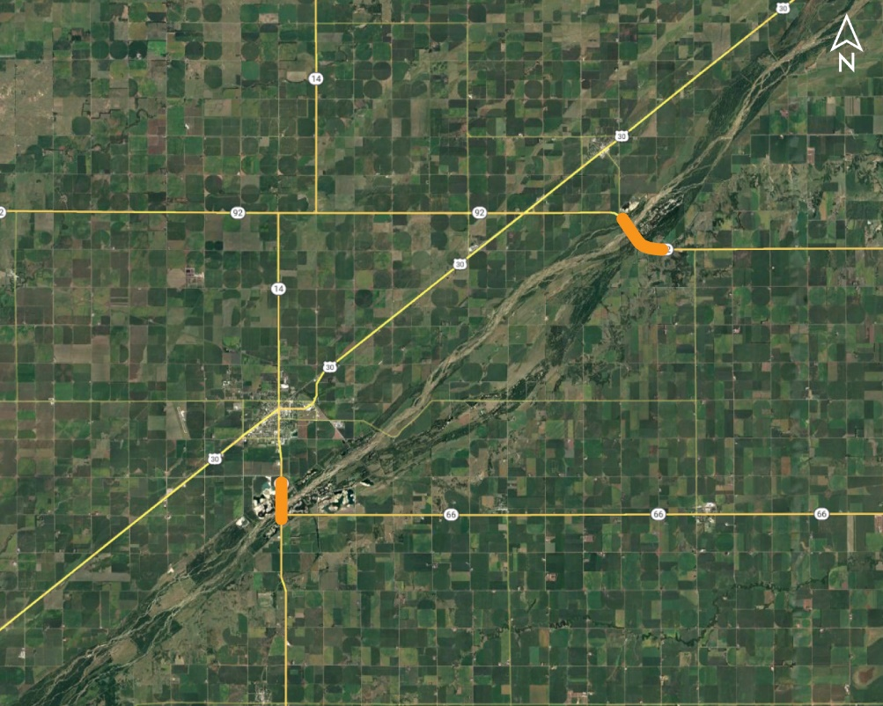
District 4 - Districtwide Bridges (MS) Project No.: STP-NH-92-5(110); Control No.: 42897
Project Length: 8 Bridge Locations
Scope of Work:
Bridge Repair
Guardrail
Grading

Slide 57
District 4 - Districtwide Bridges (MS) Project No.: STP-NH-92-5(110); Control No.: 42897
Status: Design
Right-of-Way: Not Required
Traffic Impacts:
Phase Traffic Control
Letting Date: 2/1/2024
Construction Timing: 5/1/2024 - 10/31/2024

Slide 58
District 4 - Districtwide Bridges (MS) Project No.: STP-NH-92-5(110); Control No.: 42897
Anticipated Utilities Impact:
Bridge Repair/Replacement
Anticipated Request from Utilities:
Provide Existing Locations
Coordination with NDOT
Additional Information:
No K-Sheets Required
Special Provisions TBD
Utilities Involved:
Black Hills Energy, Charter Comm. (Spectrum), City of Ord, Great Plains Comm., Hamilton Telecom. (NCTC), Howard Greeley RPPD, Lumen (CenturyLink), Village of Cairo, Vyve Broadband, Black Hills Energy

Slide 59
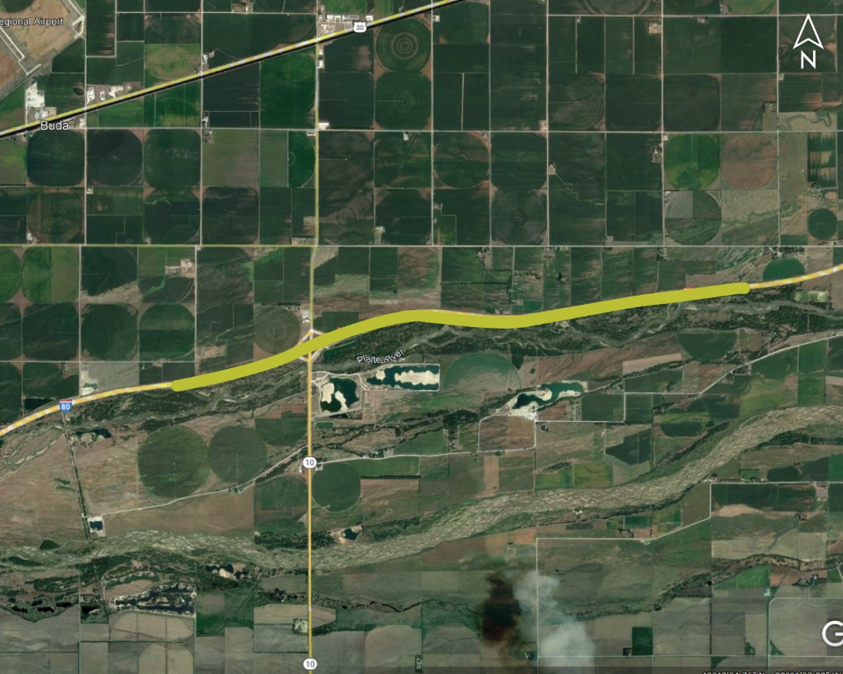
Minden - Gibbon Project No.: NH-80-6(116); Control No.: 42854
Project Length: 4.49
Scope of Work:
Resurfacing
Guardrail

Slide 60
Minden - Gibbon Project No.: NH-80-6(116); Control No.: 42854
Status: Design
Right-of-Way: In Progress
Traffic Impacts:
Full Detour
Letting Date: 2/29/2024
Construction Timing: 5/13/2024

Slide 61
Minden - Gibbon Project No.: NH-80-6(116); Control No.: 42854
Anticipated Utilities Impact:
No Impacts
Anticipated Request from Utilities:
Provide Existing Locations
Coordination with NDOT
Additional Information:
No K-Sheets Required
No Special Provisions Required
Utilities Involved:
Dawson PPD, Frontier Comm., Hamilton Telecom. (NCTC), Lumen (CenturyLink)

Slide 62
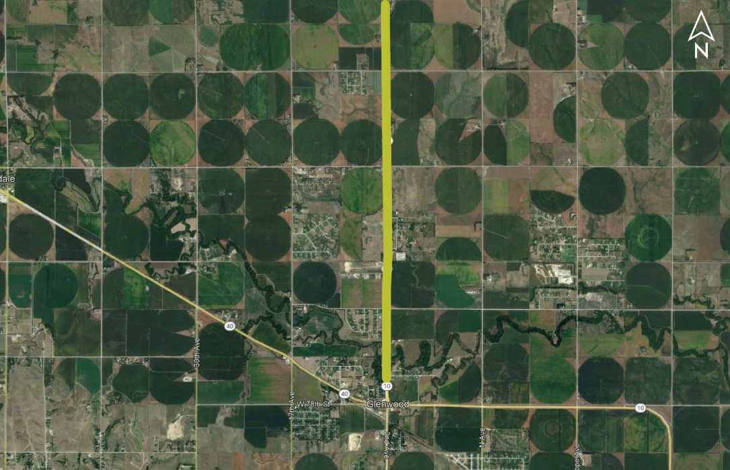
N-40 North Project No.: STP-10-2(123); Control No.: 42873
Project Length: 4.76
Scope of Work:
Resurfacing
Bridge Repair
Guardrail

Slide 63
N-40 North Project No.: STP-10-2(123); Control No.: 42873
Status: Design
Right-of-Way: In Progress
Traffic Impacts:
Phase Traffic Control
Letting Date: 2/29/2024
Construction Timing: 7/15/2024

Slide 64
N-40 North Project No.: STP-10-2(123); Control No.: 42873
Anticipated Utilities Impact:
Bridge Repair/Replacement
Guardrail
Anticipated Request from Utilities:
Provide Existing Locations
Coordination with NDOT
Additional Information:
No K-Sheets Required
No Special Provisions Required
Utilities Involved:
Black Hills Energy, Charter Comm. (Spectrum), City of Kearney, Dawson PPD, Frontier Comm., Great Plains Comm., Northwestern Energy, Unite Private Net., Vyve Broadband

Slide 65
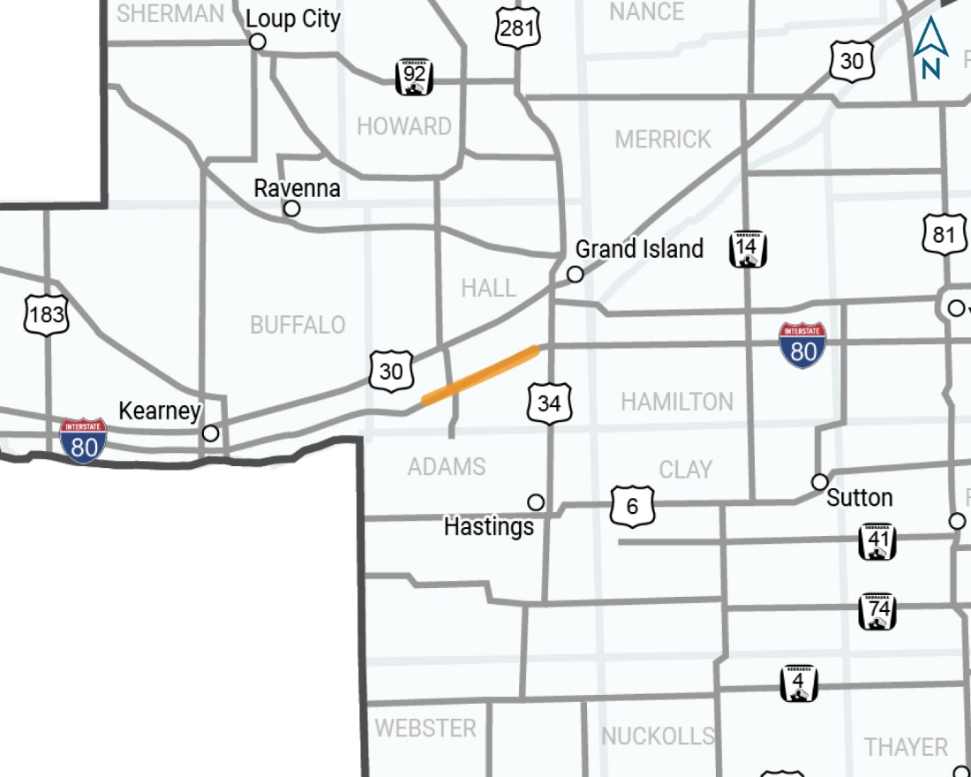
Wood River - Platte River Project No.: NH-80-6(119); Control No.: 42921
Project Length: 11.63
Scope of Work:
Crack Seal

Slide 66
Wood River - Platte River Project No.: NH-80-6(119); Control No.: 42921
Status: Design
Right-of-Way: Not Required
Traffic Impacts:
Phase Traffic Control
Letting Date: 6/20/2024
Construction Timing: 11/1/2024 - 3/31/2025

Slide 67
Wood River - Platte River Project No.: NH-80-6(119); Control No.: 42921
Anticipated Utilities Impact:
No Impacts
Anticipated Request from Utilities:
Provide Existing Locations
Coordination with NDOT
Additional Information:
No K-Sheets Required
No Special Provisions Required
Utilities Involved:
Central Platte NRD, Lumen (CenturyLink), Southern PPD

Slide 68
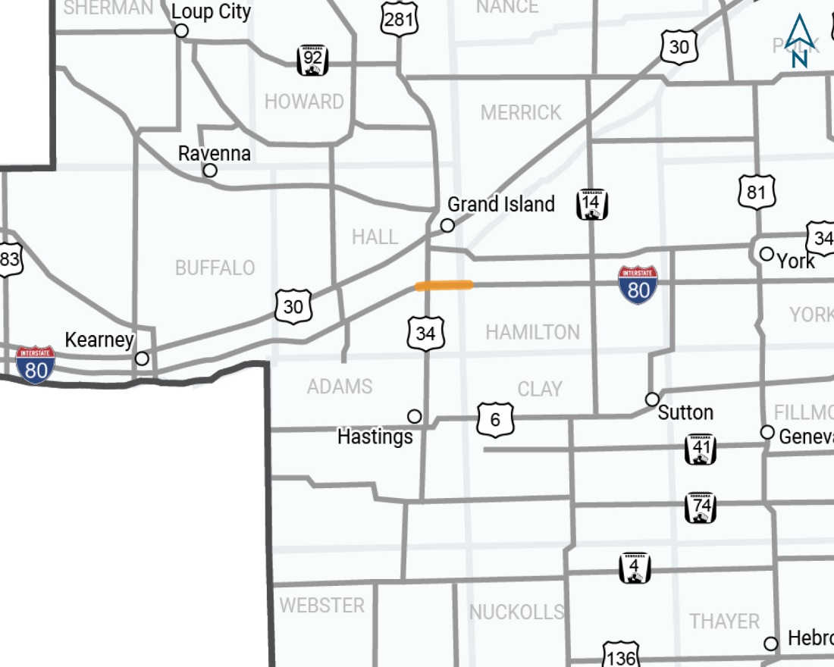
Platte River - Phillips Project No.: NH-80-6(118); Control No.: 42920
Project Length: 7.7
Scope of Work:
Crack Seal

Slide 69
Platte River - Phillips Project No.: NH-80-6(118); Control No.: 42920
Status: Design
Right-of-Way: Not Required
Traffic Impacts:
Phase Traffic Control
Letting Date: 8/24/2023
Construction Timing: 11/1/2023 - 3/31/2024

Slide 70
Platte River - Phillips Project No.: NH-80-6(118); Control No.: 42920
Anticipated Utilities Impact:
No Impacts
Anticipated Request from Utilities:
Provide Existing Locations
Coordination with NDOT
Additional Information:
No K-Sheets Required
No Special Provisions Required
Utilities Involved:
Black Hills Energy, Charter Comm. (Spectrum), City of Grand Island, Great Plains Comm., Hamilton Telecom. (NCTC), Lumen (CenturyLink), Nebraska PPD, Northwestern Energy, Southern PPD, Tallgrass Energy, Viaero Fiber Net. (NE-CO Cell.), Windstream Comm.

Slide 71
Construction YEAR 2025
The following projects are anticipated to be let during 2025
Notes:
Kathy Fischer or Rhett Robinson

Slide 72
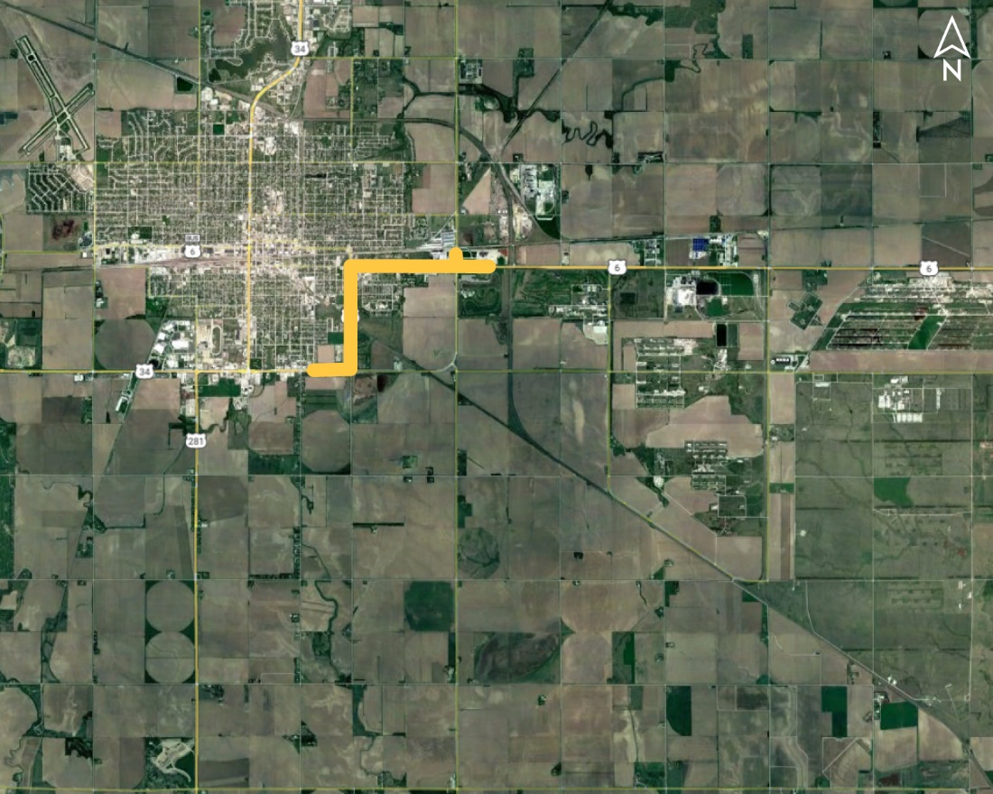
Hastings Southeast Project No.: S-6-4(1022); Control No.: 41086
Project Length: 2.43
Scope of Work:
Urban Reconstruction
Culvert Extension/Replace
ITS/Lighting

Slide 73
Hastings Southeast Project No.: S-6-4(1022); Control No.: 41086
Status: Design
Right-of-Way: In Progress
Traffic Impacts:
Phase Traffic Control
Full Detour
Local Detour
Letting Date: 8/29/2024
Construction Timing: 4/1/2025-11/1/2026

Slide 74
Hastings Southeast Project No.: S-6-4(1022); Control No.: 41086
Anticipated Utilities Impact:
Urban Reconstruction
New ROW
Culvert Extension/Replacement
Anticipated Request from Utilities:
Potholing Required
Provide Existing Locations
Coordination with NDOT
Additional Information:
K-Sheets Required
Special Provisions Required
Utilities Involved:
Allo Comm., Black Hills Energy, Charter Comm. (Spectrum), City of Hastings, Cogent Comm. Inc. (Sprint & T-Mobile), Great Plains Comm., Nebraska PPD, OPTK Networks (NebraskaLink), Southern PPD, Verizon / MCI, Windstream Comm. & Zayo Group.

Slide 75
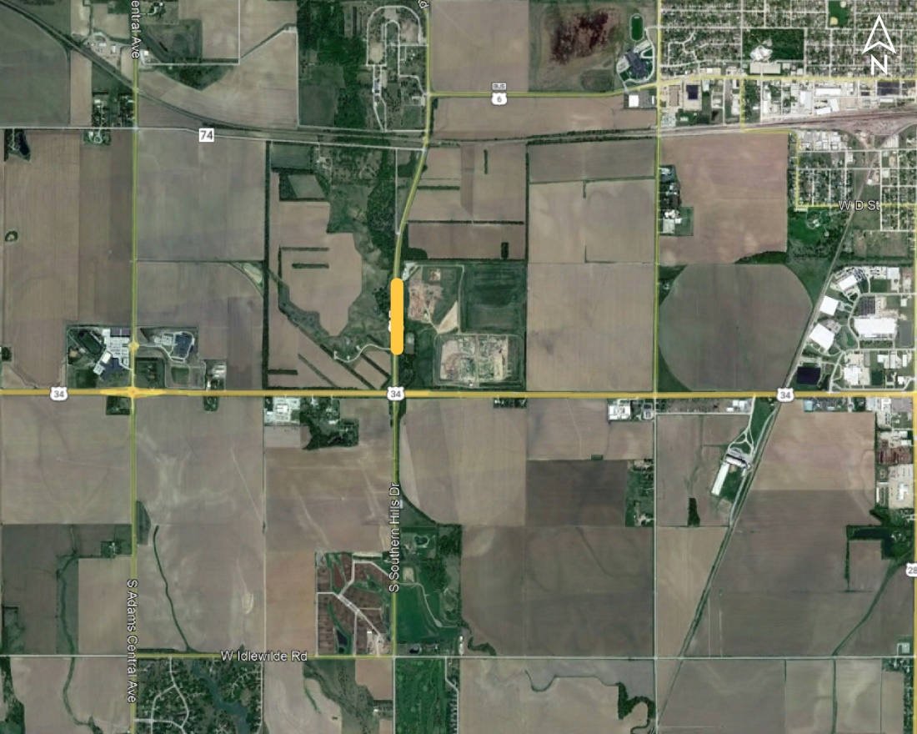
Hastings Regional Center Spur Bridge Project No.: STP-S01C(102); Control No.: 42742
Project Length: 0
Scope of Work:
Bridge Repair
Guardrail
Grading

Slide 76
Hastings Regional Center Spur Bridge Project No.: STP-S01C(102); Control No.: 42742
Status: Design
Right-of-Way: In Progress
Traffic Impacts:
Full Detour
Letting Date: 8/29/2024
Construction Timing: 5/26/2025

Slide 77
Hastings Regional Center Spur Bridge Project No.: STP-S01C(102); Control No.: 42742
Anticipated Utilities Impact:
Bridge Repair/Replacement
Anticipated Request from Utilities:
Provide Existing Locations
Coordination with NDOT
Additional Information:
No K-Sheets Required
No Special Provisions Required
Utilities Involved:
City of Hastings, Verizon / MCI, Viaero Fiber Net. (NE-CO Cell.), Windstream Comm.

Slide 78
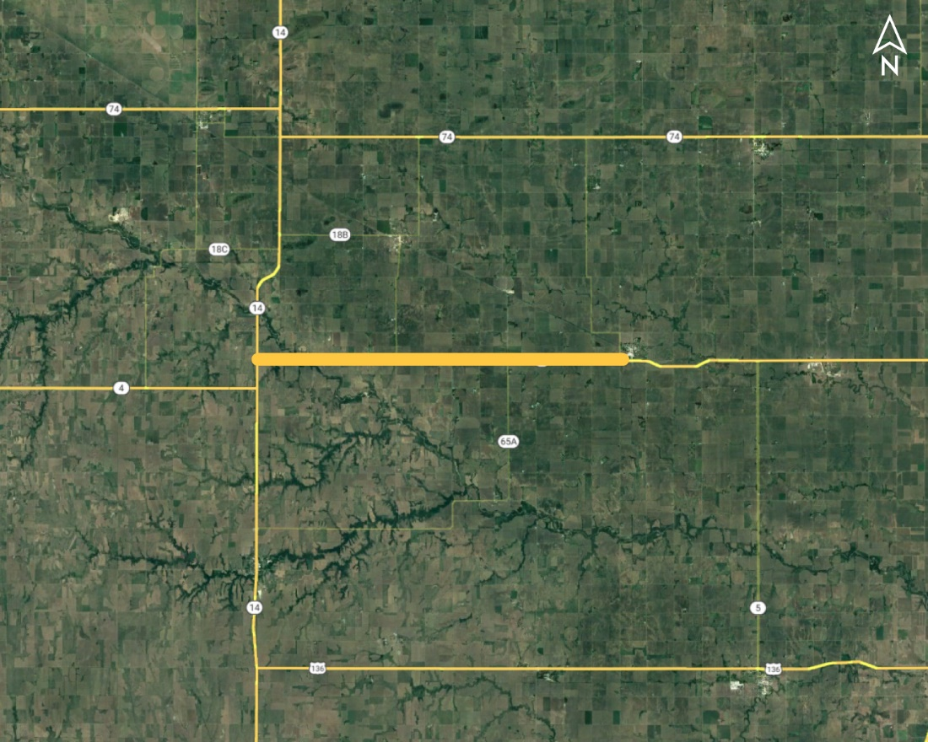
Davenport West (MS) Project No.: STP-4-5(106); Control No.: 42778
Project Length: 12.9
Scope of Work:
Resurfacing
Culvert Extension/Replace

Slide 79
Davenport West (MS) Project No.: STP-4-5(106); Control No.: 42778
Status: Design
Right-of-Way: In Progress
Traffic Impacts:
Phase Traffic Control
Letting Date: 8/29/2024
Construction Timing: 5/1/2025-10/31/2025

Slide 80
Davenport West (MS) Project No.: STP-4-5(106); Control No.: 42778
Anticipated Utilities Impact:
Culvert Extension/Replace
Guardrail
Bridge Repair/Replace
Anticipated Request from Utilities:
Provide Existing Locations
Coordination with NDOT
Additional Information:
No K-Sheets Required
Special Provisions TBD
Utilities Involved:
Black Hills Energy, Nebraska PPD, South Central PPD, Tallgrass Energy, Viaero Fiber Net. (NE-CO Cell.), Windstream Comm.

Slide 81
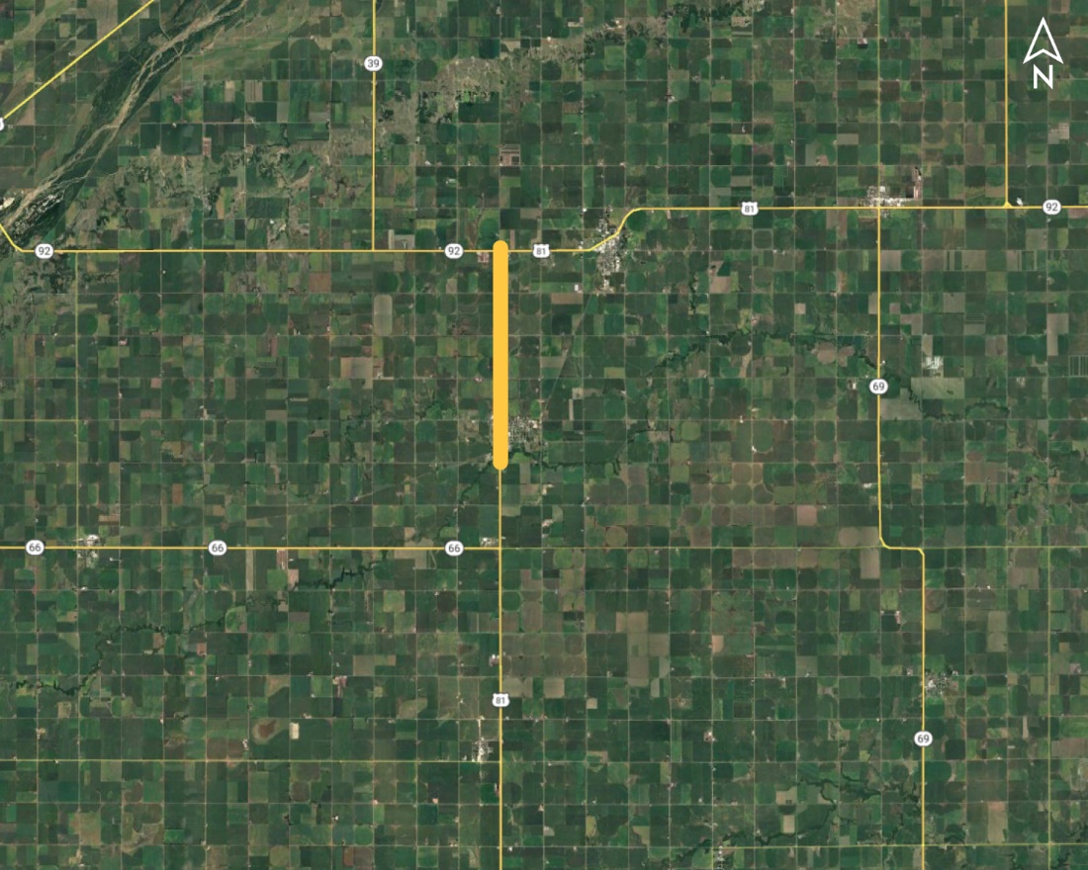
Stromsburg North Project No.: NH-STP-81-2(154); Control No.: 42782A
Project Length: 4.28
Scope of Work:
Resurfacing
Pavement Repairs
Shoulder Work

Slide 82
Stromsburg North Project No.: NH-STP-81-2(154); Control No.: 42782A
Status: Preparing for Bid
Right-of-Way: Not Required
Traffic Impacts:
Phase Traffic Control
Letting Date: 8/29/2024
Construction Timing: 4/1/2024-10/31/2024

Slide 83
Stromsburg North Project No.: NH-STP-81-2(154); Control No.: 42782A
Anticipated Utilities Impact:
No Impacts
Anticipated Request from Utilities:
Provide Existing Locations
Coordination with NDOT
Additional Information:
No K-Sheets Required
No Special Provisions Required
Utilities Involved:
City of Stromsburg, Cogent Comm. Inc. (Sprint & T-Mobile), Northern Natural Gas, Polk County RPPD, Vyve Broadband, Windstream Comm.

Slide 84
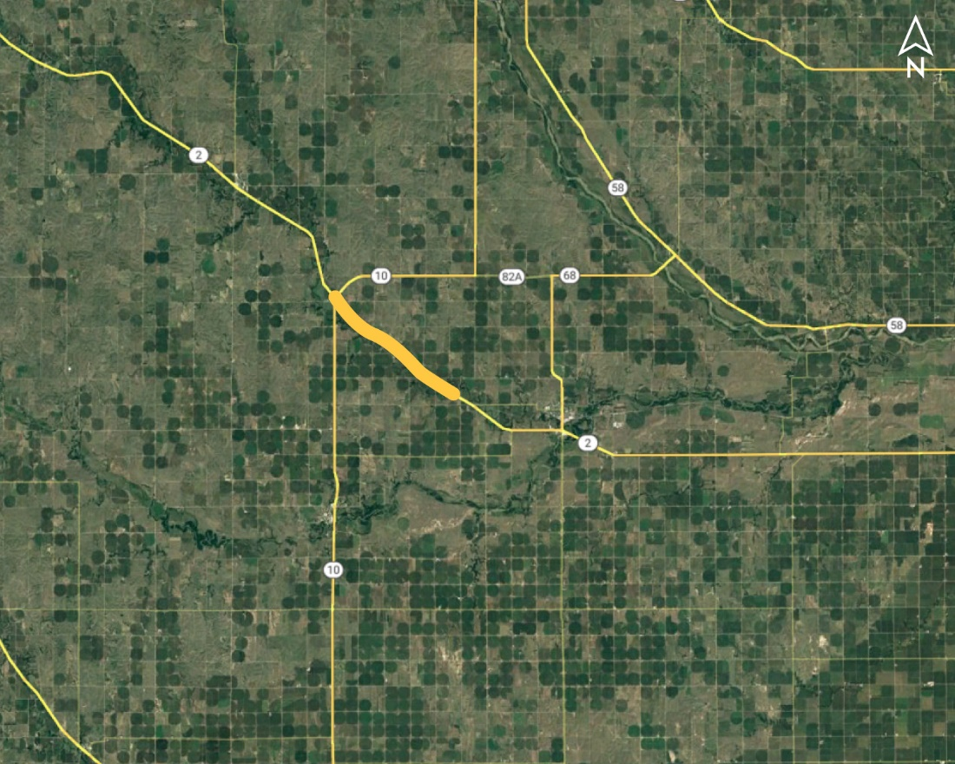
Hazard East (MS) Project No.: NH-2-4(111); Control No.: 42786
Project Length: 6.25
Scope of Work:
Resurfacing
Bridge Repair
Guardrail

Slide 85
Hazard East (MS) Project No.: NH-2-4(111); Control No.: 42786
Status: Design
Right-of-Way: In Progress
Traffic Impacts:
Phase Traffic Control
Letting Date: 8/29/2024
Construction Timing: 5/1/2025-10/31/2025

Slide 86
Hazard East (MS) Project No.: NH-2-4(111); Control No.: 42786
Anticipated Utilities Impact:
No Impacts
Anticipated Request from Utilities:
Provide Existing Locations
Coordination with NDOT
Additional Information:
No K-Sheets Required
Special Provisions TBD
Utilities Involved:
Black Hills Energy, Charter Comm. (Spectrum), City of Loup City, Custer PPD, Hamilton Telecom. (NCTC), Loup Valley RPPD, Lumen (CenturyLink), Nebr. DNR (USGS), Viaero Fiber Net. (NE-CO Cell.), Village of Hazard

Slide 87
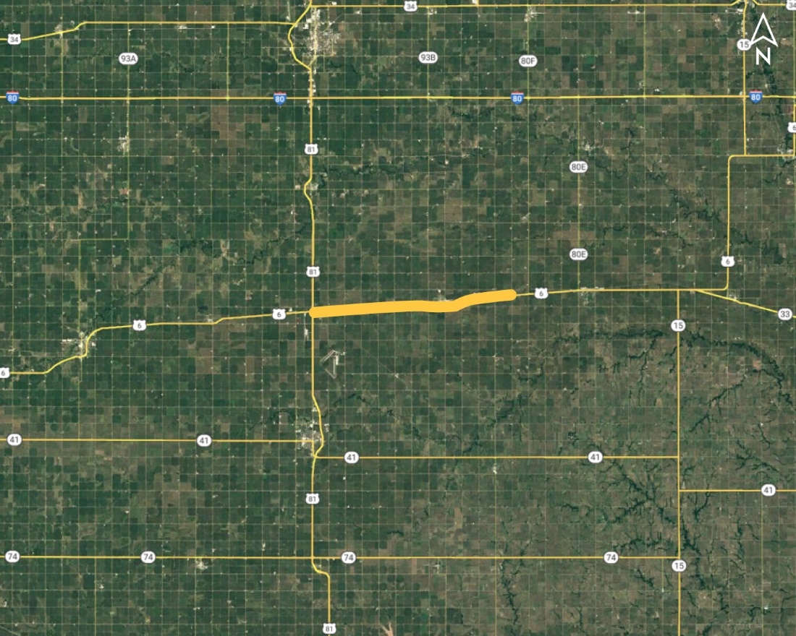
In Fairmont & East (MS) Project No.: STP-6-5(117)4; Control No.: 42813
Project Length: 11.85
Scope of Work:
Resurfacing
Bridge Repair
Guardrail

Slide 88
In Fairmont & East (MS) Project No.: STP-6-5(117)4; Control No.: 42813
Status: Design
Right-of-Way: In Progress
Traffic Impacts:
Phase Traffic Control
Letting Date: 8/29/2024
Construction Timing: 4/15/2025-11/2/2025

Slide 89
In Fairmont & East (MS) Project No.: STP-6-5(117)4; Control No.: 42813
Anticipated Utilities Impact:
Bridge Repair/Replacement
Culvert Extension/Replacement
Guardrail
Anticipated Request from Utilities:
Locates
Provide Existing Locations
Coordination with NDOT
Additional Information:
No K-Sheets Required
Special Provisions TBD
Utilities Involved:
Black Hills Energy, Glenwood Telephone, Lumen (CenturyLink), NuStar Pipeline, Perennial PPD, Unite Private Net., Verizon / MCI, Viaero Fiber Net. (NE-CO Cell.), Village of Exeter, Village of Fairmont, Windstream Comm., Zayo Group

Slide 90
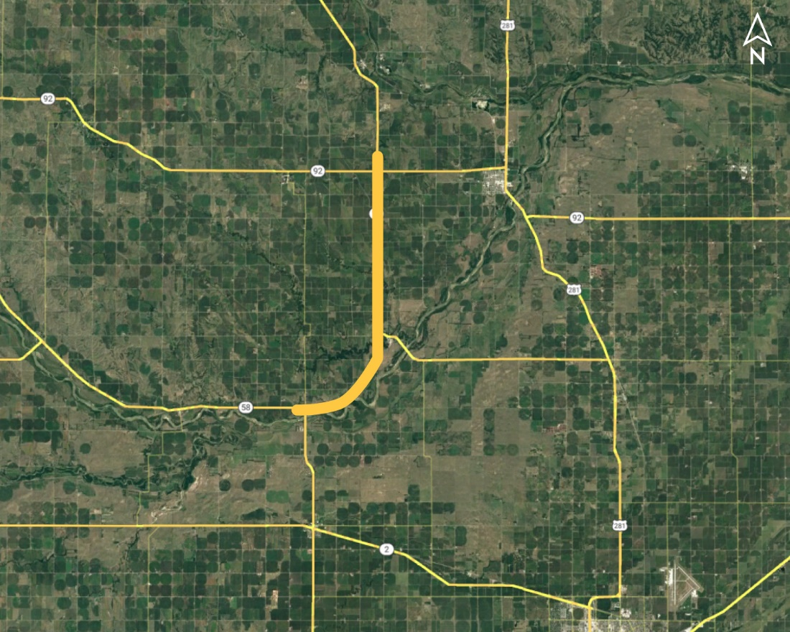
S. Jct. N-58 - N-92 (MS) Project No.: STP-11-2(122); Control No.: 42814
Project Length: 11.98
Scope of Work:
Resurfacing
Bridge Repair
Culvert Extension/Replace

Slide 91
S. Jct. N-58 - N-92 (MS) Project No.: STP-11-2(122); Control No.: 42814
Status: Design
Right-of-Way: Not Required
Traffic Impacts:
Phase Traffic Control
Letting Date: 8/29/2024
Construction Timing: 5/13/2025-11/2/2025

Slide 92
S. Jct. N-58 - N-92 (MS) Project No.: STP-11-2(122); Control No.: 42814
Anticipated Utilities Impact:
Lighting
Bridge Repair/Replacement
Culvert Extension/Replacement
Anticipated Request from Utilities:
Provide Existing Locations
Coordination with NDOT
Additional Information:
No K-Sheets Required
Special Provisions TBD
Utilities Involved:
Black Hills Energy, Hamilton Telecom. (NCTC), Howard Greeley RPPD, Lumen (CenturyLink), Nebr DNR (USGS), Nebraska PPD, Viaero Fiber Net. (NE-CO Cell.), Village of Dannebrog

Slide 93
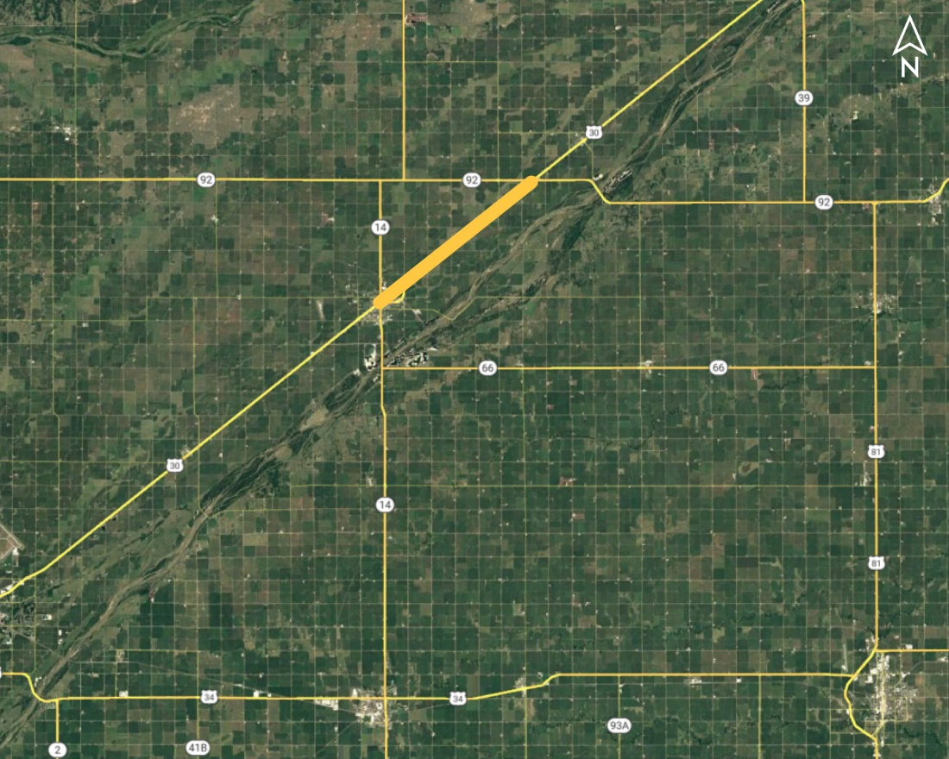
Central City East (MS) Project No.: NH-30-5(136); Control No.: 42818
Project Length: 8.23
Scope of Work:
Resurfacing
Grading
Full Depth Pavement

Slide 94
Central City East (MS) Project No.: NH-30-5(136); Control No.: 42818
Status: Design
Right-of-Way: In Progress
Traffic Impacts:
Local Detour
Letting Date: 10/3/2024
Construction Timing: 6/16/2025-11/22/2025

Slide 95
Central City East (MS) Project No.: NH-30-5(136); Control No.: 42818
Anticipated Utilities Impact:
Culvert Extension/Replacement
New ROW
Lighting
Anticipated Request from Utilities:
Provide Existing Locations
Coordination with NDOT
Additional Information:
No K-Sheets Required
No Special Provisions Required
Utilities Involved:
City of Central City, Clarks Telecom., Cogent Comm. Inc. (Sprint & T-Mobile), Great Plains Comm., Hamilton Telecom. (NCTC), Lumen (CenturyLink), Northeast Nebr. Telephone Co. , Southern PPD, Vyve Broadband

Slide 96
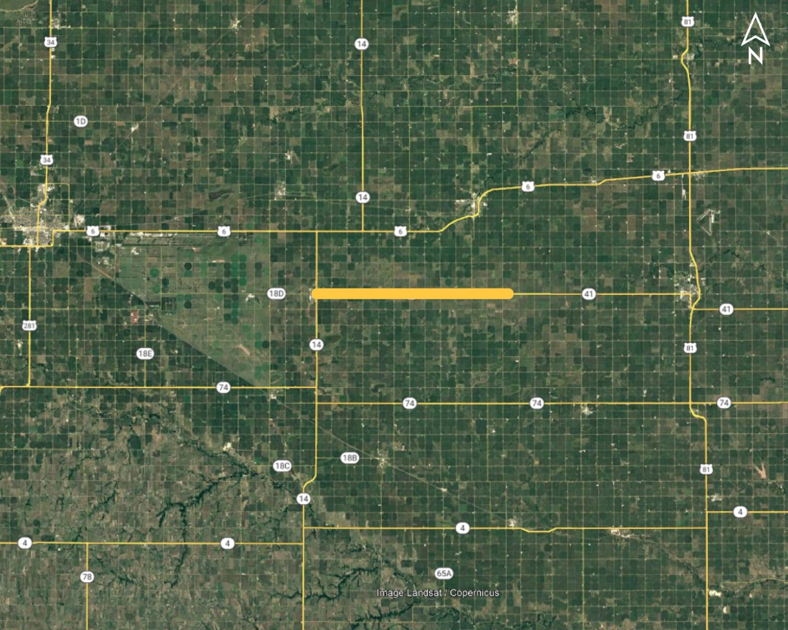
Clay Center East Project No.: STP-41-5(108); Control No.: 42829
Project Length: 11.62
Scope of Work:
Resurfacing
Culvert Extension/Replacement

Slide 97
Clay Center East Project No.: STP-41-5(108); Control No.: 42829
Status: Design
Right-of-Way: Not Required
Traffic Impacts:
Phase Traffic Control
Letting Date: 8/29/2024
Construction Timing: 6/23/2025

Slide 98
Clay Center East Project No.: STP-41-5(108); Control No.: 42829
Anticipated Utilities Impact:
Culvert Extension/Replacement
Grading
Anticipated Request from Utilities:
Provide Existing Locations
Coordination with NDOT
Additional Information:
No K-Sheets Required
Special Provisions TBD
Utilities Involved:
Black Hills Energy, City of Clay Center, Glenwood Telephone, South Central PPD, Tallgrass Energy, Unite Private Net., Windstream Comm.

Slide 99
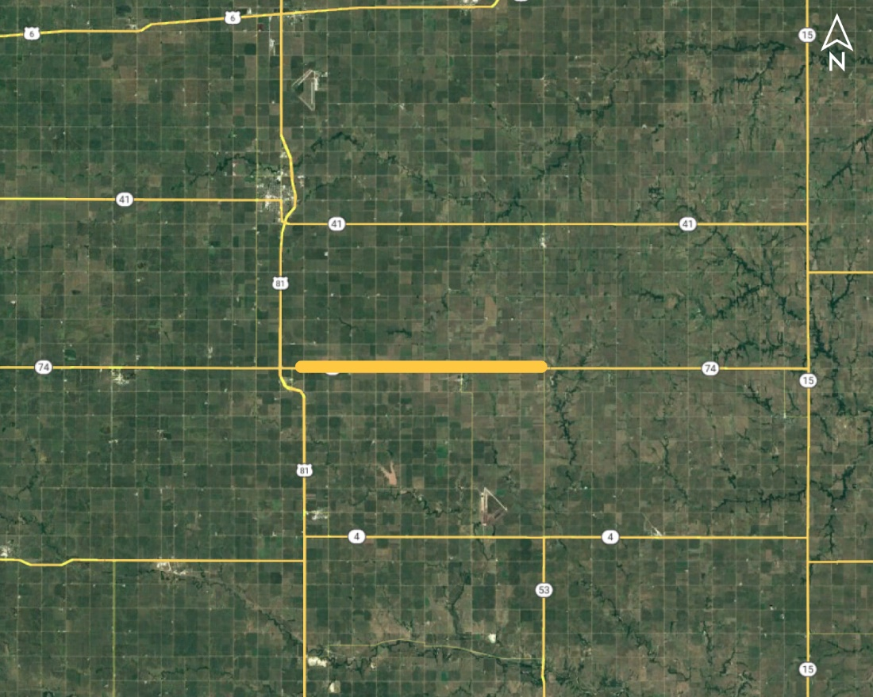
Strang Spur East Project No.: STP-74-5(112); Control No.: 42832
Project Length: 11.74
Scope of Work:
Resurfacing
Culvert Extension/Replacement

Slide 100
Strang Spur East Project No.: STP-74-5(112); Control No.: 42832
Status: Design
Right-of-Way: In Progress
Traffic Impacts:
Phase Traffic Control
Letting Date: 8/29/2024
Construction Timing: 7/22/2025

Slide 101
Strang Spur East Project No.: STP-74-5(112); Control No.: 42832
Anticipated Utilities Impact:
New ROW
Culvert Extension/Replacement
Anticipated Request from Utilities:
Provide Existing Locations
Coordination with NDOT
Additional Information:
No K-Sheets Required
Special Provisions TBD
Utilities Involved:
Black Hills Energy, Glenwood Telephone, Little Blue NRD, Perennial PPD, Tallgrass Energy, Unite Private Net., Village of Ohiowa, Windstream Comm.

Slide 102
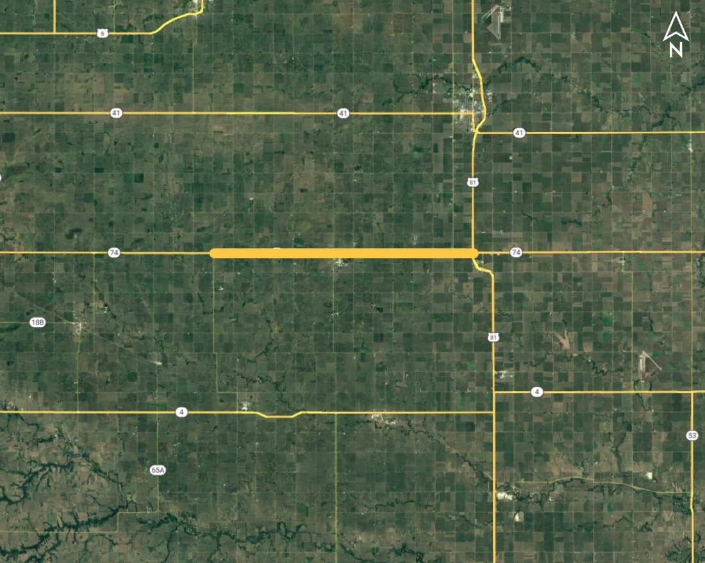
Ong Spur - US-81 (MS) Project No.: STP-74-5(113); Control No.: 42833
Project Length: 13.29
Scope of Work:
Resurfacing
Bridge Repair
Guardrail

Slide 103
Ong Spur - US-81 (MS) Project No.: STP-74-5(113); Control No.: 42833
Status: Design
Right-of-Way: In Progress
Traffic Impacts:
Phase Traffic Control
Letting Date: 8/29/2024
Construction Timing: 5/1/2025-10/31/2025

Slide 104
Ong Spur - US-81 (MS) Project No.: STP-74-5(113); Control No.: 42833
Anticipated Utilities Impact:
Culvert Extension/Replacement
Guardrail
Shoulder Work
Anticipated Request from Utilities:
Provide Existing Locations
Coordination with NDOT
Additional Information:
No K-Sheets Required
No Special Provisions Required
Utilities Involved:
Black Hills Energy, Glenwood Telephone, Great Plains Comm., Perennial PPD, Tallgrass Energy, Unite Private Net., Village of Shickley, Windstream Comm.

Slide 105
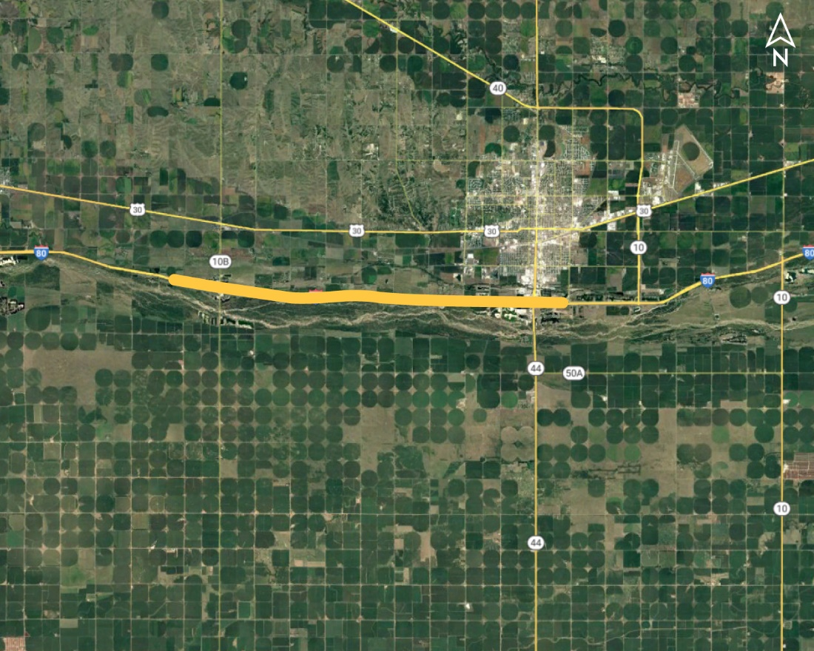
Odessa - Kearney East Crossover (MS) Project No.: NH-80-5(84); Control No.: 42852A
Project Length: 9.29
Scope of Work:
Full Depth Pavement
Grading
ITS/Lighting

Slide 106
Odessa - Kearney East Crossover (MS) Project No.: NH-80-5(84); Control No.: 42852A
Status: Design
Right-of-Way: Not Required
Traffic Impacts:
Phase Traffic Control
Letting Date: 8/28/2025
Construction Timing: 9/1/2026-10/31/2026

Slide 107
Odessa - Kearney East Crossover (MS) Project No.: NH-80-5(84); Control No.: 42852A
Anticipated Utilities Impact:
Lighting
Grading
Temp. Roads/Drives
Anticipated Request from Utilities:
Provide Existing Locations
Coordination with NDOT
Additional Information:
No K-Sheets Required
Special Provisions TBD
Utilities Involved:

Slide 108
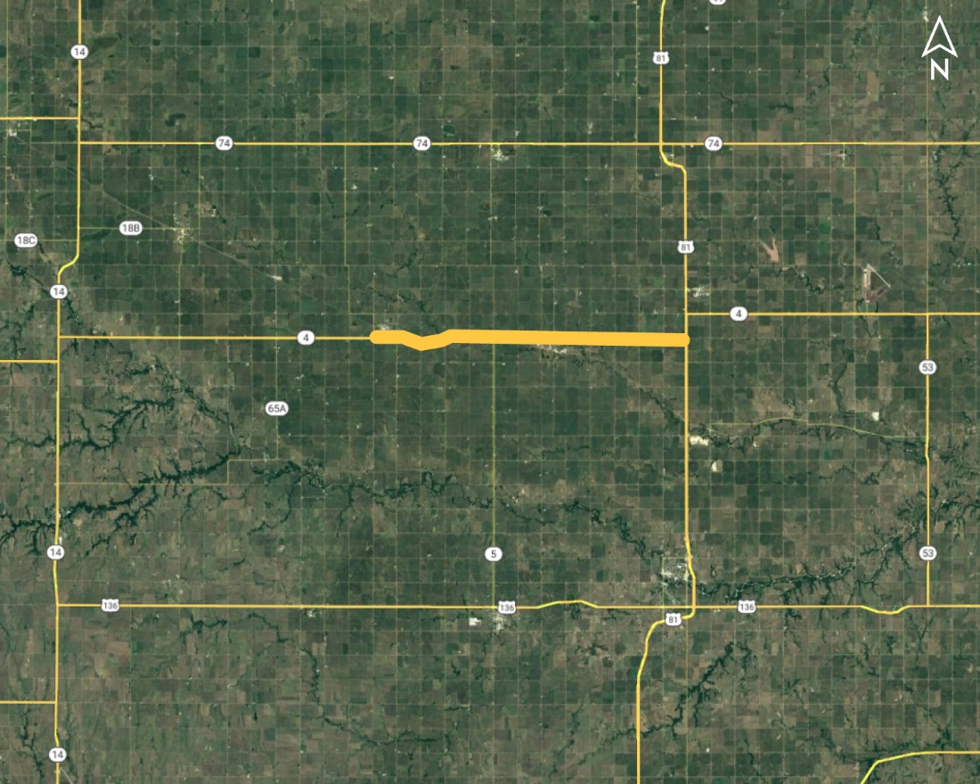
Davenport East (MS) Project No.: STP-4-5(107); Control No.: 42875
Project Length: 12.95
Scope of Work:
Resurfacing
Culvert Extension/Replace
Bridge Repair

Slide 109
Davenport East (MS) Project No.: STP-4-5(107); Control No.: 42875
Status: Design
Right-of-Way: In Progress
Traffic Impacts:
Phase Traffic Control
Letting Date: 8/29/2024
Construction Timing: 5/1/2025-10/31/2025

Slide 110
Davenport East (MS) Project No.: STP-4-5(107); Control No.: 42875
Anticipated Utilities Impact:
Bridge Repair/Replacement
Culvert Extension/Replacement
Guardrail
Anticipated Request from Utilities:
Provide Existing Locations
Coordination with NDOT
Additional Information:
No K-Sheets Required
Special Provisions TBD
Utilities Involved:
Black Hills Energy, Glenwood Telephone, Great Plains Comm., Nebraska PPD, Norris PPD, NuStar Pipeline, Tallgrass Energy, Unite Private Net., Viaero Fiber Net. (Ne-Co Cell.), Village of Davenport, Windstream Comm.

Slide 111
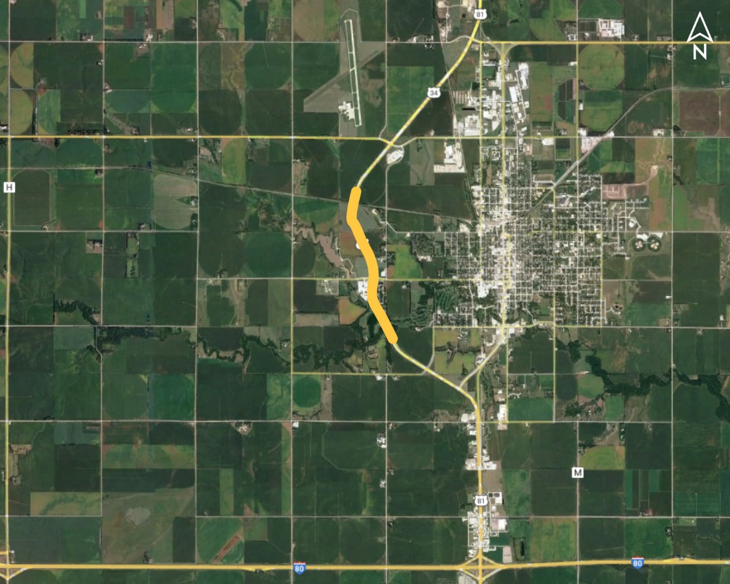
York Bypass Bridges Project No.: NH-81-2(149); Control No.: 42889
Project Length: 0
Scope of Work:
Bridge Repair
Guardrail

Slide 112
York Bypass Bridges Project No.: NH-81-2(149); Control No.: 42889
Status: Design
Right-of-Way: In Progress
Traffic Impacts:
Phase Traffic Control
Letting Date: 8/29/2024
Construction Timing: 5/1/2025

Slide 113
York Bypass Bridges Project No.: NH-81-2(149); Control No.: 42889
Anticipated Utilities Impact:
Bridge Repair/Replacement
Anticipated Request from Utilities:
Provide Existing Locations
Coordination with NDOT
Additional Information:
No K-Sheets Required
No Special Provisions Required
Utilities Involved:
Allo Comm., Charter Comm. (Spectrum), Nebraska PPD, Unite Private Net., Verizon / MCI, Windstream Comm.

Slide 114
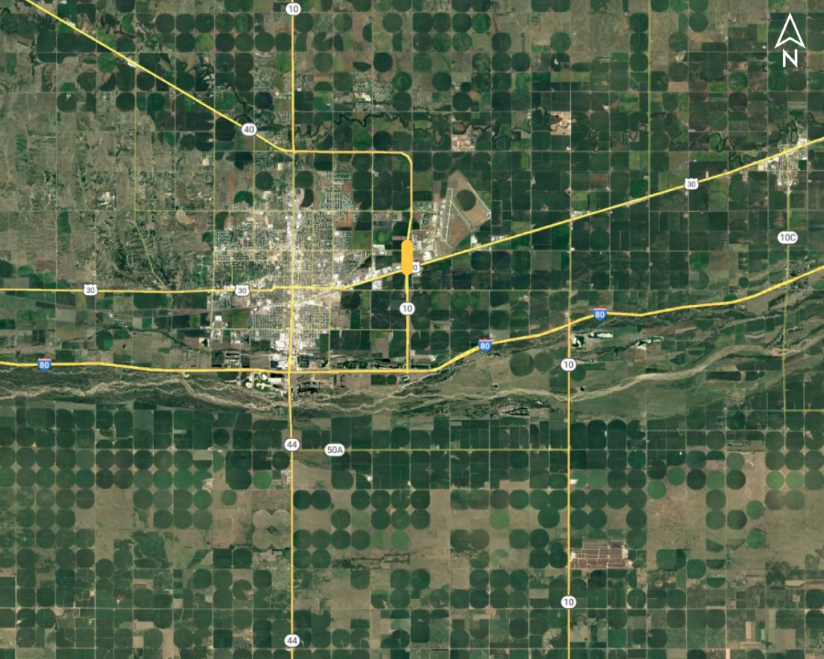
Kearney East Bridges (MS) Project No.: STP-NH-10-2(125); Control No.: 42890
Project Length: 4 locations
Scope of Work:
Bridge Repair
Guardrail
Resurfacing

Slide 115
Kearney East Bridges (MS) Project No.: STP-NH-10-2(125); Control No.: 42890
Status: Design
Right-of-Way: Not Required
Traffic Impacts:
Phase Traffic Control
Letting Date: 8/29/2024
Construction Timing: 6/17/2025-8/31/2025

Slide 116
Kearney East Bridges (MS) Project No.: STP-NH-10-2(125); Control No.: 42890
Anticipated Utilities Impact:
Bridge Repair/Replacement
No Impacts
Anticipated Request from Utilities:
Provide Existing Locations
Coordination with NDOT
Additional Information:
K-Sheets TBD
Special Provisions TBD
Utilities Involved:
Allo Comm., Black Hills Energy, Charter Comm. (Spectrum), City of Kearney, Cogent Comm. Inc. (Sprint & T-Mobile), Dawson PPD, Great Plains Comm., Nebraska PPD, Northwestern Energy, Unite Private Net., Verizon / MCI , Viaero Fiber Net. (NE-CO Cell.), Winds

Slide 117
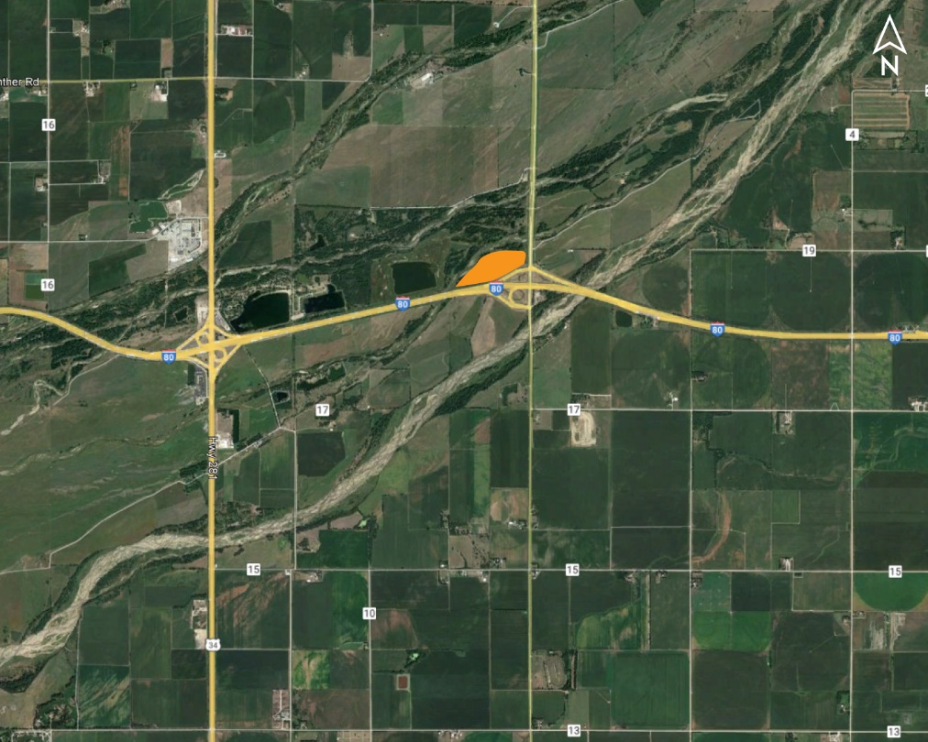
District 4 Wetland Bank Project No.: MISC-40(65); Control No.: 42891
Project Length: 0
Scope of Work:
Grading

Slide 118
District 4 Wetland Bank Project No.: MISC-40(65); Control No.: 42891
Status: Planning
Right-of-Way: In Progress
Traffic Impacts:
None
Letting Date: 8/29/2024
Construction Timing: 5/1/2025-10/31/2025

Slide 119
District 4 Wetland Bank Project No.: MISC-40(65); Control No.: 42891
Anticipated Utilities Impact:
Grading
No Impacts
Anticipated Request from Utilities:
Provide Existing Locations
Coordination with NDOT
Additional Information:
No K-Sheets Required
No Special Provisions Required
Utilities Involved:
Southern PPD, Viaero Fiber Net. (NE-CO Cell.)

Slide 120
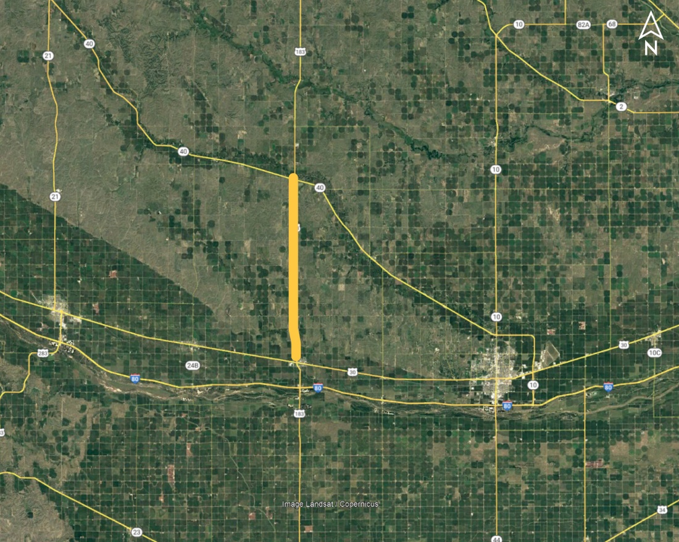
Elm Creek - Miller (MS) Project No.: STP-183-2(111); Control No.: 42898
Project Length: 14.42
Scope of Work:
Resurfacing
Bridge Replacement
Grading

Slide 121
Elm Creek - Miller (MS) Project No.: STP-183-2(111); Control No.: 42898
Status: Design
Right-of-Way: In Progress
Traffic Impacts:
Phase Traffic Control
Letting Date: 8/29/2024
Construction Timing: 5/1/2025-10/31/2025

Slide 122
Elm Creek - Miller (MS) Project No.: STP-183-2(111); Control No.: 42898
Anticipated Utilities Impact:
Bridge Repair/Replacement
Culvert Extension/Replacement
Guardrail
Anticipated Request from Utilities:
Provide Existing Locations
Coordination with NDOT
Additional Information:
K-Sheets TBD
Special Provisions TBD
Utilities Involved:
Black Hills Energy, Charter Comm. (Spectrum), Cogent Comm. Inc. (Sprint & T-Mobile), Dawson PPD, Frontier Comm., Great Plains Comm., Lumen (CenturyLink), Nebraska PPD, OPTK Networks (NebraskaLink), Tallgrass Energy, Verizon / MCI, Village of Elm Creek, Vi

Slide 123
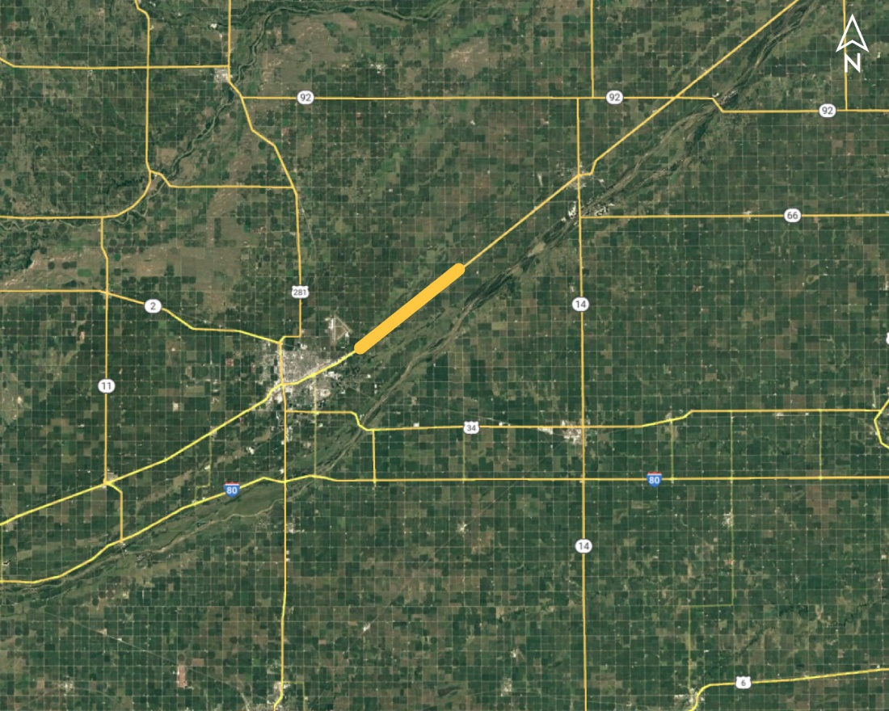
Chapman West (MS) Project No.: NH-30-5(139); Control No.: 42929
Project Length: 8.03
Scope of Work:
Resurfacing
Grading
Full Depth Pavement

Slide 124
Chapman West (MS) Project No.: NH-30-5(139); Control No.: 42929
Status: Design
Right-of-Way: In Progress
Traffic Impacts:
Local Detour
Letting Date: 12/12/2024
Construction Timing: 5/1/2025-10/31/2025

Slide 125
Chapman West (MS) Project No.: NH-30-5(139); Control No.: 42929
Anticipated Utilities Impact:
Turn Lane Add/Adjust
Lighting
Anticipated Request from Utilities:
Provide Existing Locations
Coordination with NDOT
Additional Information:
K-Sheets TBD
Special Provisions TBD
Utilities Involved:
AT&T Comm., Black Hills Energy, Charter Comm. (Spectrum), City of Grand Island, Cogent Comm. Inc. (Sprint & T-Mobile), Great Plains Comm., Lumen (CenturyLink), Southern PPD, Tallgrass Energy, Village of Chapman,
Vyve Broadband

Slide 126
Kearney East Project No.: STP-30-4(167); Control No.: 42969
Project Length: 1.88
Scope of Work:
ITS/Lighting

Slide 127
Kearney East Project No.: STP-30-4(167); Control No.: 42969
Status: Design
Right-of-Way: Not Required
Traffic Impacts:
Phase Traffic Control
Letting Date: 8/29/2024
Construction Timing: 4/1/2025

Slide 128
Kearney East Project No.: STP-30-4(167); Control No.: 42969
Anticipated Utilities Impact:
Lighting
Grading
Anticipated Request from Utilities:
Provide Existing Locations
Coordination with NDOT
Additional Information:
K-Sheets TBD
Special Provisions TBD
Utilities Involved:
Black Hills Energy, Cable USA, Charter Comm. (Spectrum), City of Kearney, Cogent Comm. Inc. (Sprint & T-Mobile), Frontier Comm., Great Plains Comm., Nebraska PPD, Northwestern Energy, OPTK Networks (NebraskaLink), Unite Private Net., Verizon / MCI , Winds

Slide 129
District 4 High Mast Tower Replacement Project No.: STP-80-7(175); Control No.: 43011
Project Length: 0
Scope of Work:
ITS/Lighting

Slide 130
District 4 High Mast Tower Replacement Project No.: STP-80-7(175); Control No.: 43011
Status: Design
Right-of-Way: Not Required
Traffic Impacts:
Phase Traffic Control
Letting Date: 8/29/2024
Construction Timing: 5/1/2025

Slide 131
District 4 High Mast Tower Replacement Project No.: STP-80-7(175); Control No.: 43011
Anticipated Utilities Impact:
Lighting
Grading
Anticipated Request from Utilities:
Potholing TBD
Provide Existing Locations
Coordination with NDOT
Additional Information:
No K-Sheets Required
Special Provisions TBD
Utilities Involved:
I-80, Phillips Intx.: Black Hills Energy, Hamilton Telecom., Southern PPD
US-81 & US-136: Norris PPD, Tallgrass Energy, Viaero Fiber (NE-CO-Cell.), Windstream Comm.

Slide 132
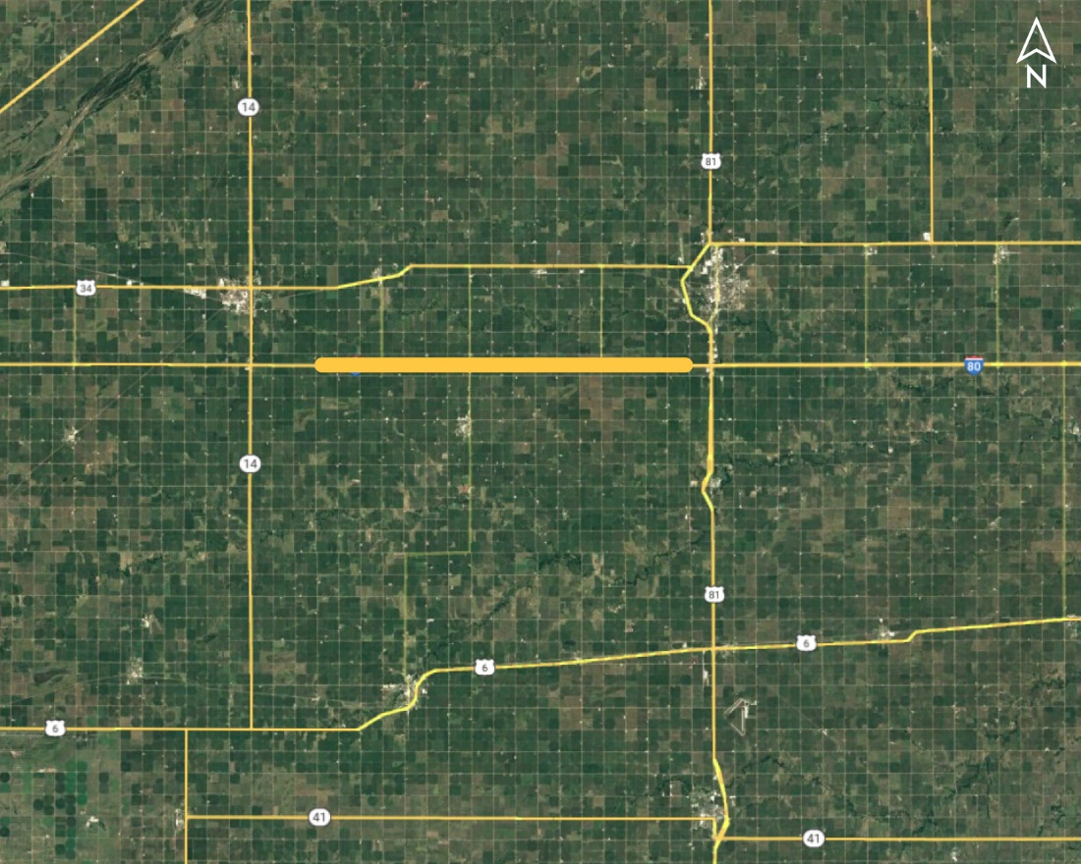
Hampton - York Project No.: HSIP-80-7(174); Control No.: 42990
Project Length: 15
Scope of Work:
Guardrail

Slide 133
Hampton - York Project No.: HSIP-80-7(174); Control No.: 42990
Status: Design
Right-of-Way: Not Required
Traffic Impacts:
None
Letting Date: 10/3/2024
Construction Timing: 4/1/2025

Slide 134
Hampton - York Project No.: HSIP-80-7(174); Control No.: 42990
Anticipated Utilities Impact:
Guardrail
Anticipated Request from Utilities:
Provide Existing Locations
Coordination with NDOT
Additional Information:
K-Sheets TBD
Special Provisions TBD
Utilities Involved:
Black Hills Energy, Hamilton Telecom. (NCTC), Mainstay Comm., Southern PPD

Slide 135
Questions & Wrap Up
Notes:
HDR (Kristen, Amanda or Alyssa)

Slide 136
Any final Questions?
Ask them now!
If you have questions after this meeting, or would like to view more detailed project maps, please reach out to your utility coordinator.
Notes:
HDR (Kristen, Amanda or Alyssa)

Slide 137
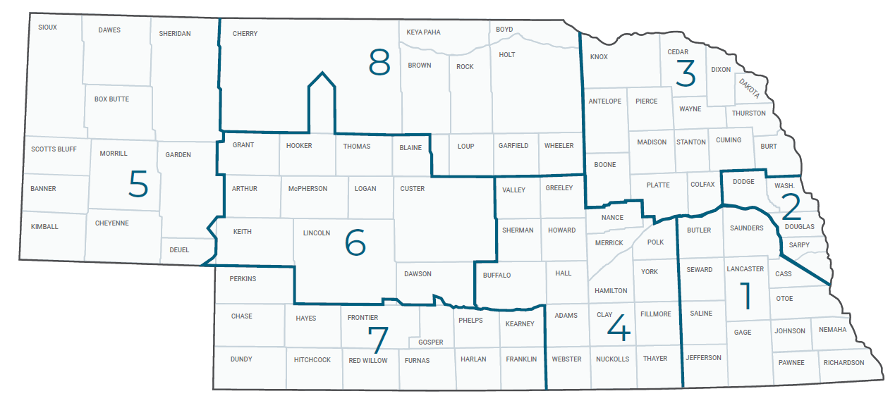
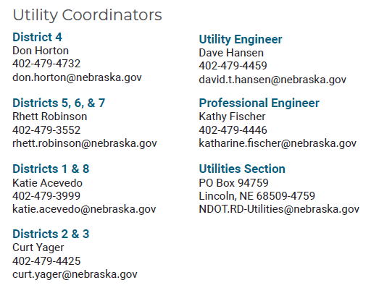
Have a Question about a project your Utility is involved in?
Contact your district’s utility coordinator!
Notes:
HDR (Kristen, Amanda or Alyssa)

Slide 138
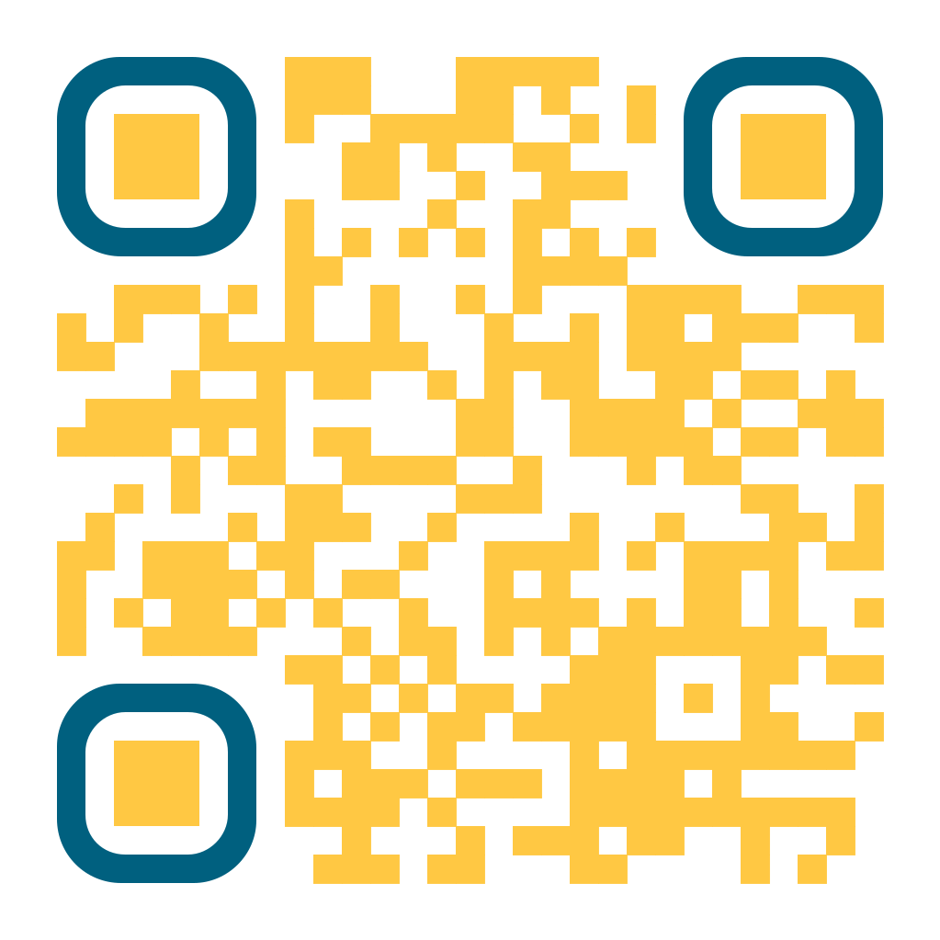
We need your feedback
Your valuable feedback helps these meetings – and NDOT’s utility coordination program – be better.
Use your phone’s camera to scan this QR code or use our paper survey.
Notes:
HDR (Kristen, Amanda or Alyssa)

Slide 139
Visit our Website
Visit NDOT.info/utility for more information on:
Utility accommodation
Permitting
Coordination
Project information
Reimbursements
Additional information
Notes:
HDR (Kristen, Amanda or Alyssa)

Slide 140
Thank You
Notes:
HDR (Kristen, Amanda or Alyssa)

