Slide 1
23rd Street, Columbus & 10th Street Superfund Site NH-30-5(134); C.N. 32234
Pre-Construction
Public Information Open House Meeting
August 11, 2022

Slide 2
Agenda
Introductions
Project Overview
Project Schedule
What to Expect
2022 EPA Construction Phasing
Impact Minimization
10th Street Superfund Site Details
Project Contacts & Updates

Slide 3
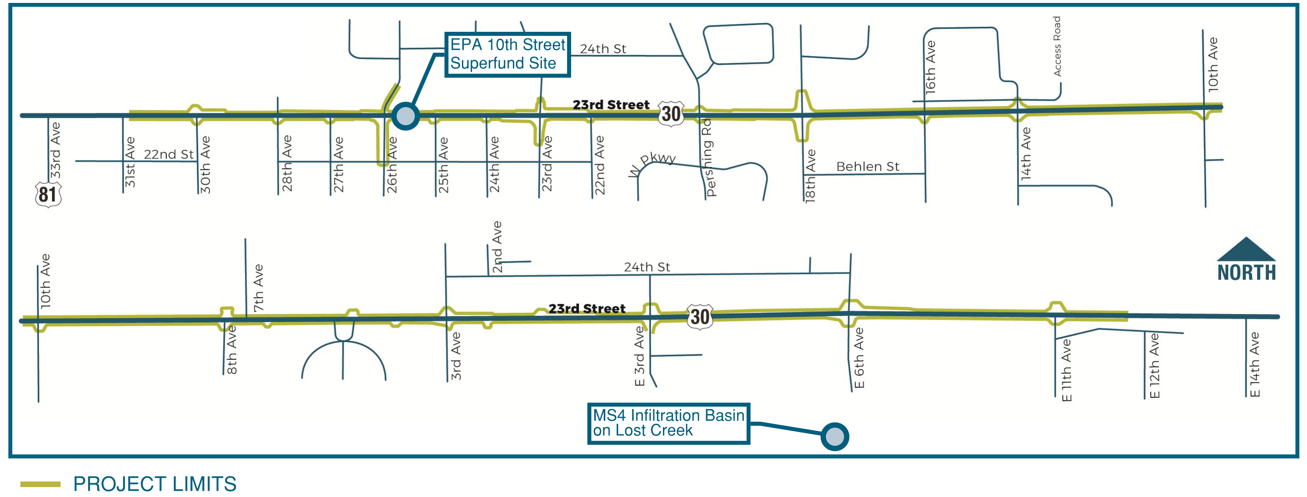
Project Overview

Slide 4
Project Overview
Remove and replace concrete pavement
Curb inlets and storm sewer
Sidewalk and curb ramps
Additional turn lane capacity
Driveway consolidation
Roadway lighting
Traffic signals
Utility improvements

Slide 5
Project Schedule

Slide 6
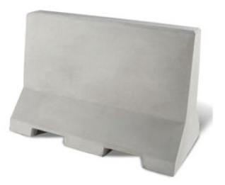
What to Expect
Highway traffic will be maintained through the project.
Lane mergers and shifting traffic.
Phased and sequenced construction to maintain access to adjacent properties.
Concrete barrier to protect against drop off at Superfund Site work zone.
Short-term closures of 27th Ave., 26th Ave., and 25th Ave.
Right in/Right out at drives & intersections.

Slide 7
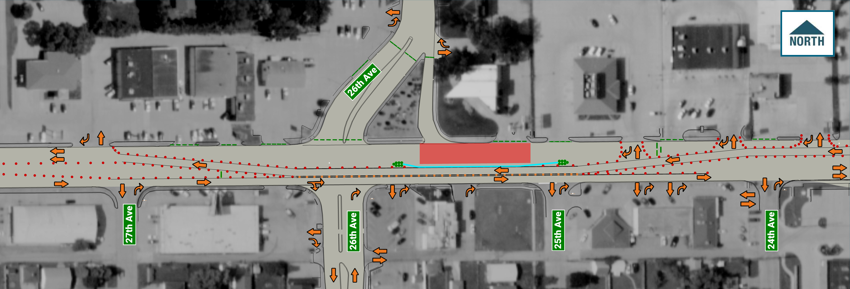
EPA Mitigation Phase 1
WORK ZONE

Slide 8
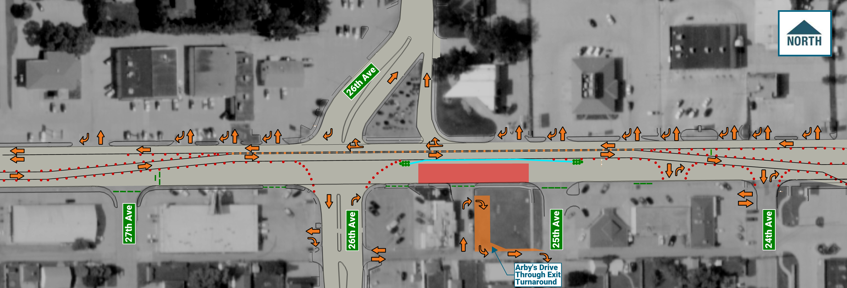
EPA Mitigation Phase 2
WORK ZONE

Slide 9
Impact Minimization
Access maintained to businesses during construction
Temporary pavement to restore 23rd Street traffic conditions in winter months
Main construction of 23rd Street over 3 years
Starting Spring 2023

Slide 10
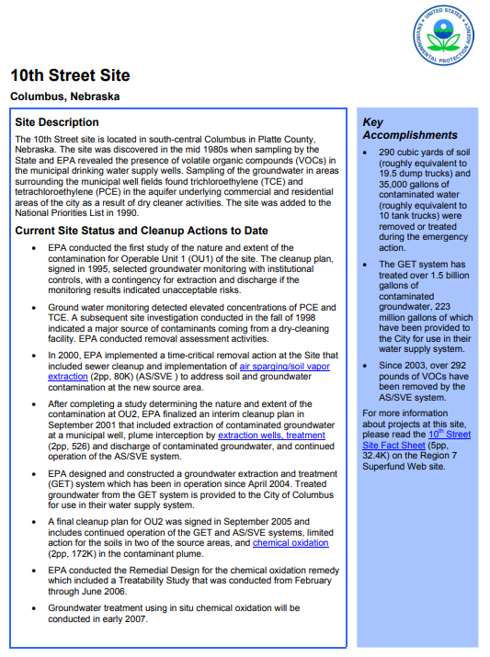
EPA Community Involvement Engage with Communities Affected by Superfund Sites
Conduct early, frequent, and meaningful community involvement.
Keep the public well-informed of ongoing and planned activities.
Encourage and enable the public to get involved.
Listen carefully to what the public is saying.
Consider whether a change to the planned actions is appropriate in response to public comments or concerns.
Explain to community members how EPA considered their comments, what the Agency plans to do, and why this decision was made.

Slide 11
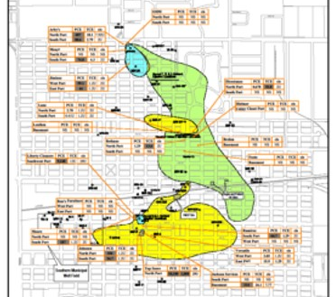
Sub-Slab Vapor Results
33rd Ave
26th Ave
23rd Ave
18th Ave
US-30 / 23rd St

Slide 12
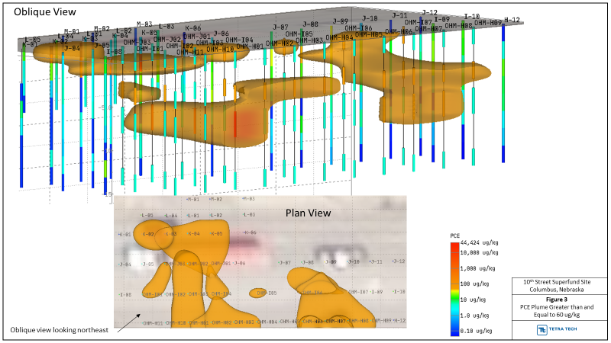

Slide 13
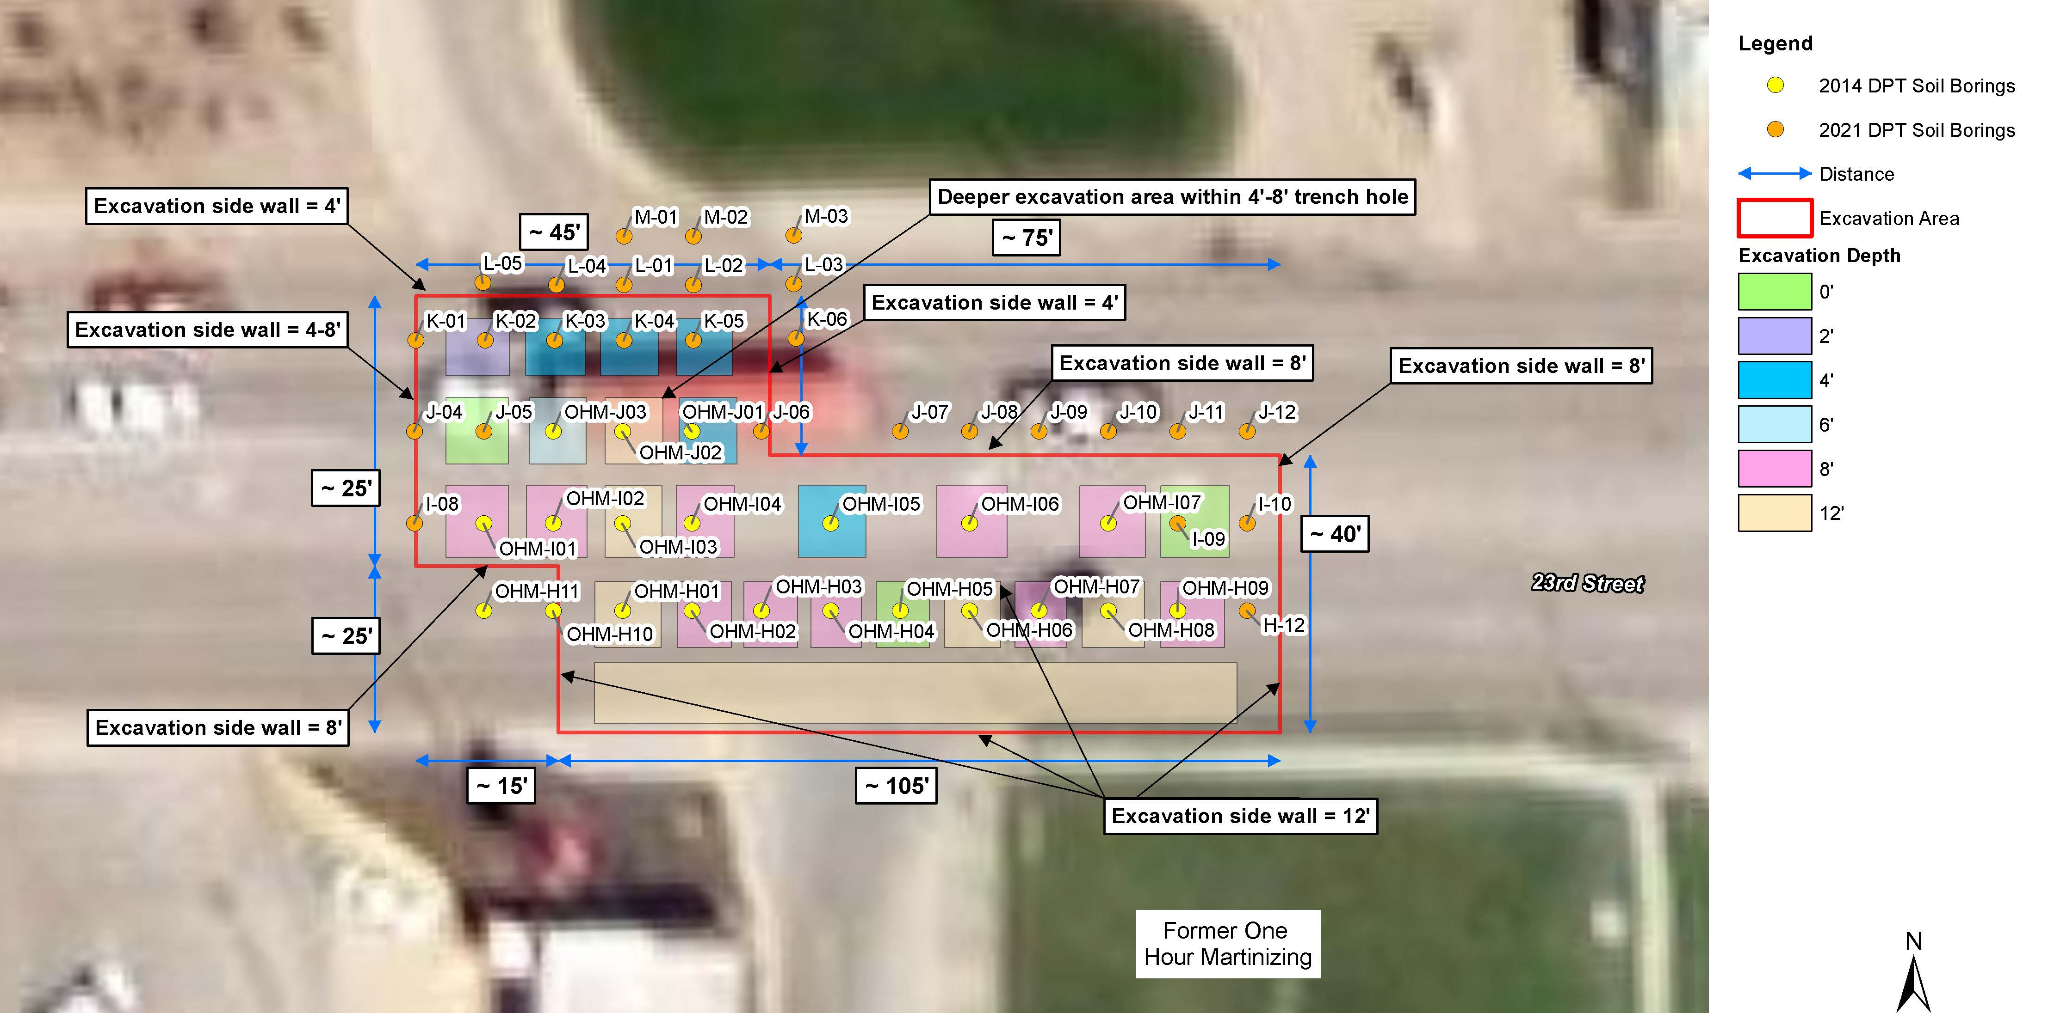
Sample Location Map
26th Ave
US-30 / 23rd St

Slide 14
EPA Contacts:
Eric Nold
On-Scene Coordinator
EPA Region 7 (SEMD/AERR)
11201 Renner Blvd.
Lenexa, KS 66219
1-800-223-0425
nold.eric@epa.gov
Amelia Holcomb
Community Involvement Coordinator
EPA Region 7 (ORA/OPA)
11201 Renner Blvd.
Lenexa, KS 66219
913-551-7952
1-800-223-0425
holcomb.amelia@epa.gov
David Wennerstrom
Remedial Project Manager
EPA Region 7 (SEMD/REMB/FFPC)
11201 Renner Blvd.
Lenexa, KS 66219
1-800-223-0425
wennerstrom.david@epa.gov
Pamela Houston
Community Involvement Coordinator
EPA Region 7 (ORA/OPA)
11201 Renner Blvd.
Lenexa, KS 66219
913-551-7952
1-800-223-0425
houston.pamela@epa.gov

Slide 15
Project Contacts:
Tony Lange
NDOT Project Manager
402-564-5751
anthony.lange@nebraska.gov
Mike Steffensmeier
Paulsen, Inc.
402-802-6605
msteffensmeier@paulseninc.com

Slide 16
Project information available on NDOT website at: ndot.info/32234

Slide 17
Public Information Meeting #2: To be held in early 2023 to discuss details on remaining highway construction.

Slide 18
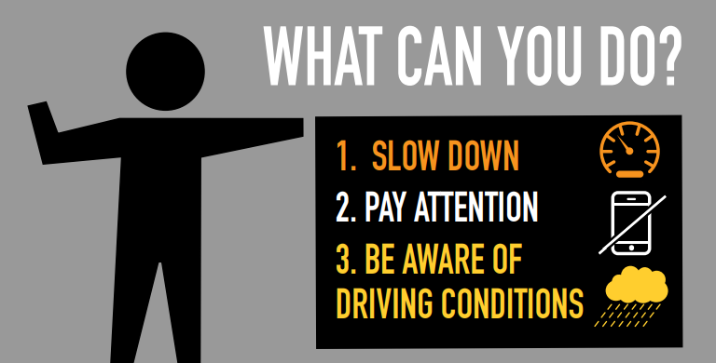
Work Zone Safety
Thank You!

