Slide 1



Managing Nebraska’s Roads and Streets
Classification of Highways, Roads and Streets
Statutes Chapter 39 Article 21
NBCS Regulation 428 NAC 1
Tab 8.1
Notes:
9/11/2022 Updated Slide 1 by adding 3-ring binder Tab number. Deleted slides 22 (Van Dorn St project) and 25 (Petersburg NE project). Added project location maps to the four remaining exercises (slides 21 thru 24). As a fifth exercise, added Slide 25 for the Wayne NW project. Slides 8, 17 and 20 had minor updates. Slides 27 and 28 added to review jurisdictional responsibility. Now 29 total slides.
2/24/2022 Hid slides that were numbered 20-25 in the 10/11/2021 version, numbered 21-26 in the current version; each showed a project to assign for an exercise. Inserted new slide 20 to indicate it is time for exercises.
8/13/2021 updated slide 2 and deleted slides 9 and 10 (Plickers)
2/2/2020 Updated. Slide 16 minor change. Added Slide 16 – national urban map for Nebraska. Added Ayer SE slide (slide 26) for class hands-on exercise. Previous version 8/14/2019.
8/14/2019 Updated. Previous version 2/2/2019. 5 slides affected. Delete Slide 9 (session 400 covered status of 428 NAC). Slides 2, 4, 11 and 12 updated.
26 slides, 1 hidden, makes for 25 slides for the presentation.
Pre-Workshop Course on Nebraska’s Classifications for Highways, Roads and Streets
80 minutes (1 hour, 20 minutes)

Slide 2
General Outline
Short Review of Road/Street Classification
State Functional Classification System
National Functional Classification System
Examples
AGENDA
Notes:
8/13/2021 deleted two bullet points (questions and quiz)
8/14/2019 Updated, deleted first bullet (status of Classification laws and regulation 428 NAC 1 – covered in session 400). Other changes made to reflect the agenda.
2 min
Will sometimes work in teams

Slide 3
What is Classification?
Defines each segment’s role moving traffic through a network
  Travel objectives: long-distance, get to town, go downtown, go to the shopping center, go home
What?
Review 428 NAC 1
Notes:
1 min
The stages of traffic movement (a hypothetical trip) are:
Main movement
Transition
Distribution/Collection
Access
Termination
Source: Green Book 1.2.1
The classification of highways into different operational systems, functional classes, or geometric types is needed for
communication among engineers, administrators, and the general public. Various classification schemes have been applied for
distinct purposes in different rural and urban regions. Classification of highways by design types based on the major geometric
features (e.g., freeways, conventional streets, and highways) is the most helpful approach for highway location and design
procedures. Classification by route numbering (e.g., U.S., State, and County) is the most helpful approach for traffic operations.
Administrative classification (e.g., National Highway System or Non-National Highway System) is used to denote the levels of
government responsible for and the method of financing highway facilities. Functional classification, the grouping of highways by
the character of service they provide, was developed for transportation planning purposes. Comprehensive transportation
planning, which is an integral part of total economic and social development, uses functional classification as an important
planning tool. The emergence of functional classification as the predominant method of grouping highways is consistent with
the policies contained in this publication. Source: Green Book

Slide 4
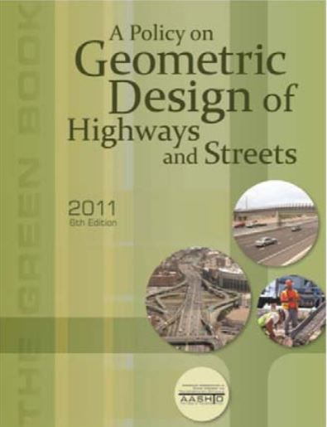
Classification – A Variety of Ways
Type – best for design procedures
  freeway, highway, conventional street
Numbering – best for operations
Administrative (NHS vs. non-NHS) – best for jurisdictional responsibility, funding
Functional – best for planning purposes
  Character of service
  Each segment serves a function in the network of roads and streets
Notes:
8/14/2019 Updated, added sub-bullet under “Functional” bullet.
2 min
The classification of highways into different operational systems, functional classes, or geometric types is needed for
communication among engineers, administrators, and the general public. Various classification schemes have been applied for distinct purposes in different rural and urban regions.
Classification of highways by design types based on the major geometric features (e.g., freeways, conventional streets, and highways) is the most helpful approach for highway location and design procedures.
Classification by route numbering (e.g., U.S., State, and County) is the most helpful approach for traffic operations.
Administrative classification (e.g., National Highway System or Non-National Highway System) is used to denote the levels of government responsible for and the method of financing highway facilities.
Functional classification, the grouping of highways by the character of service they provide, was developed for transportation planning purposes. Comprehensive transportation planning, which is an integral part of total economic and social development, uses functional classification as an important planning tool. The emergence of functional classification as the predominant method of grouping highways is consistent with the policies contained in this publication. Source: Green Book

Slide 5
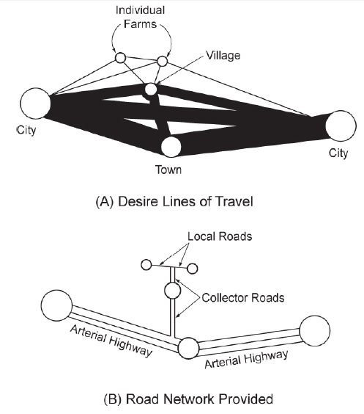
Integrated System of Roads
A Policy on Geometric Design of Highways and Streets, Figure 1-2, AASHTO “Green Book”
Slide 5
Notes:
This concept of an integrated system of roads shown here is taken from
AASHTO’s A Policy on Geometric Design of Highways and Streets, also known as The Green Book, 6th Edition, 2011.
The schematic illustration shows desire lines of travel, with the circles representing trip origins and destinations, and line thickness representing relative amounts of travel desire. The sizes of the circles indicate the relative trip-generating and attracting power of the places shown. The thicker lines represent more desire (or volume), as between cities and towns, and the smaller lines represent less desire, as between farms and villages.
Because it is impractical to provide direct-line connections for every desire line, trips should be channelized on a limited road network in the manner shown in the bottom schematic illustration.
Heavy travel movements are served directly or nearly so, and the smaller movements are channeled into
somewhat indirect paths.
The facilities in the illustration are labeled local access, collector, and arterial, which are terms that describe their functional relationships. In this scheme, the functional hierarchy is also seen to be related to the hierarchy of trip
distances served by the network.

Slide 6
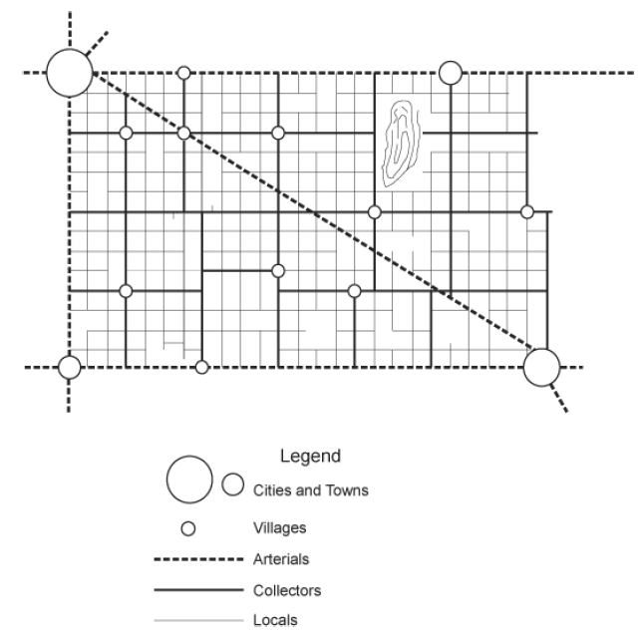
Integrated System of Roads
Rural
A Policy on Geometric Design of Highways and Streets, Figure 1-3, AASHTO “Green Book”
Slide 6
Notes:
A more complete illustration of a functionally classified rural network is shown in this figure,
Which is also taken from The Green Book.
Arterial highways generally provide direct service between cities and larger towns that generate and attract a large proportion of the relatively longer trips.
Roads of the intermediate functional category (collectors) serve small towns directly, connecting them to the arterial network.
Roads of this category collect traffic from the local roads serving individual farms and other rural land uses or distribute traffic to these local roads from the arterials.

Slide 7
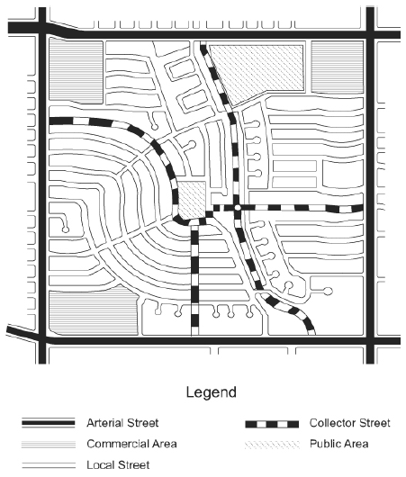
Integrated System of Roads
Slide 7
Urban/Suburban
A Policy on Geometric Design of Highways and Streets, Figure 1-4, AASHTO “Green Book”
Notes:
The previous screen had a rural setting. The same basic concepts apply in urban and suburban areas, and a similar hierarchy of systems can be defined. This screen shows a schematic illustration of a functionally classified suburban street network.
Because of the high intensity of land use and travel in urban and suburban areas, specific travel-generation centers are more difficult to identify. In these areas, additional considerations, such as the spacing of intersections, become more important in defining a logical and efficient network.

Slide 8
Why do you Need to Know the Classification of a Segment?
Planning, Coordinating
  Developing a functioning network
Standards
  Design Expectations – speed, capacity, access
Jurisdictional Responsibility and Funding
Performance
  Benchmarks, targets
Communication
  The public, planners, engineers
Why?
Notes:
9/11/2022 added “Jurisdictional Responsibility in the 3rd bullet
1 min

Slide 9

State Functional Classification
§39-2102 thru §39-2105
§39-2109 thru §39-2112
428 NAC 1
https://sos.nebraska.gov/rules-and-regs/regsearch/Rules/Transportation_Dept_of/Title-428/Chapter-1.pdf
State
Notes:
8/14/2019 Updated web links to 428 NAC 1
1 min
Rural and Municipal - different character of travel, municipality is more densely populated
GET ON INTERNET – FIND STATE STATUTES
LOOK AT YOUR 428 NAC 1 BOOKS – WHERE TO FIND CLASSIFICATION?

Slide 10
Who Does What
Legislature set up State Functional Classification System
NBCS sets specific criteria for State Functional Classification System
NDOT works with Counties and Municipalities to assign FC to each public road and street segment
Counties and Municipalities can appeal NDOT decision to the NBCS
Roles
Notes:
8/14/2019 Updated web link in third bullet
2 min
And you can request a reclassification of a road or street, request goes to NDOT

Slide 11
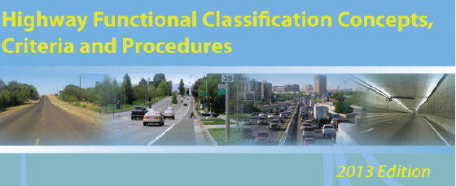

National Functional Classification
National Publication Number FHWA PL-13-026 https://www.fhwa.dot.gov/planning/processes/statewide/related/highway_functional_classifications/fcauab.pdf
Federal
23 CFR 470
Notes:
1 min

Slide 12
Area
Urban
  Dense development
  Determined by census
  Populations 5,000 and more
  Local and State officials decide, US Secretary of Transportation approves
  NOT always the same as corporate limits
Federal, 428 NAC 2
Rural
  Sparse development
  All areas not designated Urban
Notes:
1 min
US Census determines Urbanized area boundaries

Slide 13
Why Rural/Urban?
Population density
Different design considerations
Different design criteria
  Design criteria not applied strictly according to urban vs. rural boundaries
  Low-speed, High-speed
Notes:
1 min
What Federal transportation programs are impacted by adjustments to UZA boundaries?
The following FHWA Programs distinguish between urban and rural areas:
• Highway Functional Classification: The highway functional classification system distinguishes
both by type of roadway facility and whether the facility is located in an urban or rural area. A
specific type of roadway facility may have different design criteria depending on whether it is in
a rural or urban area, but highway design criteria are not applied strictly according to an urban
versus rural boundary designation.
Source: Urbanized Area FAQ (FHWA document)

Slide 14
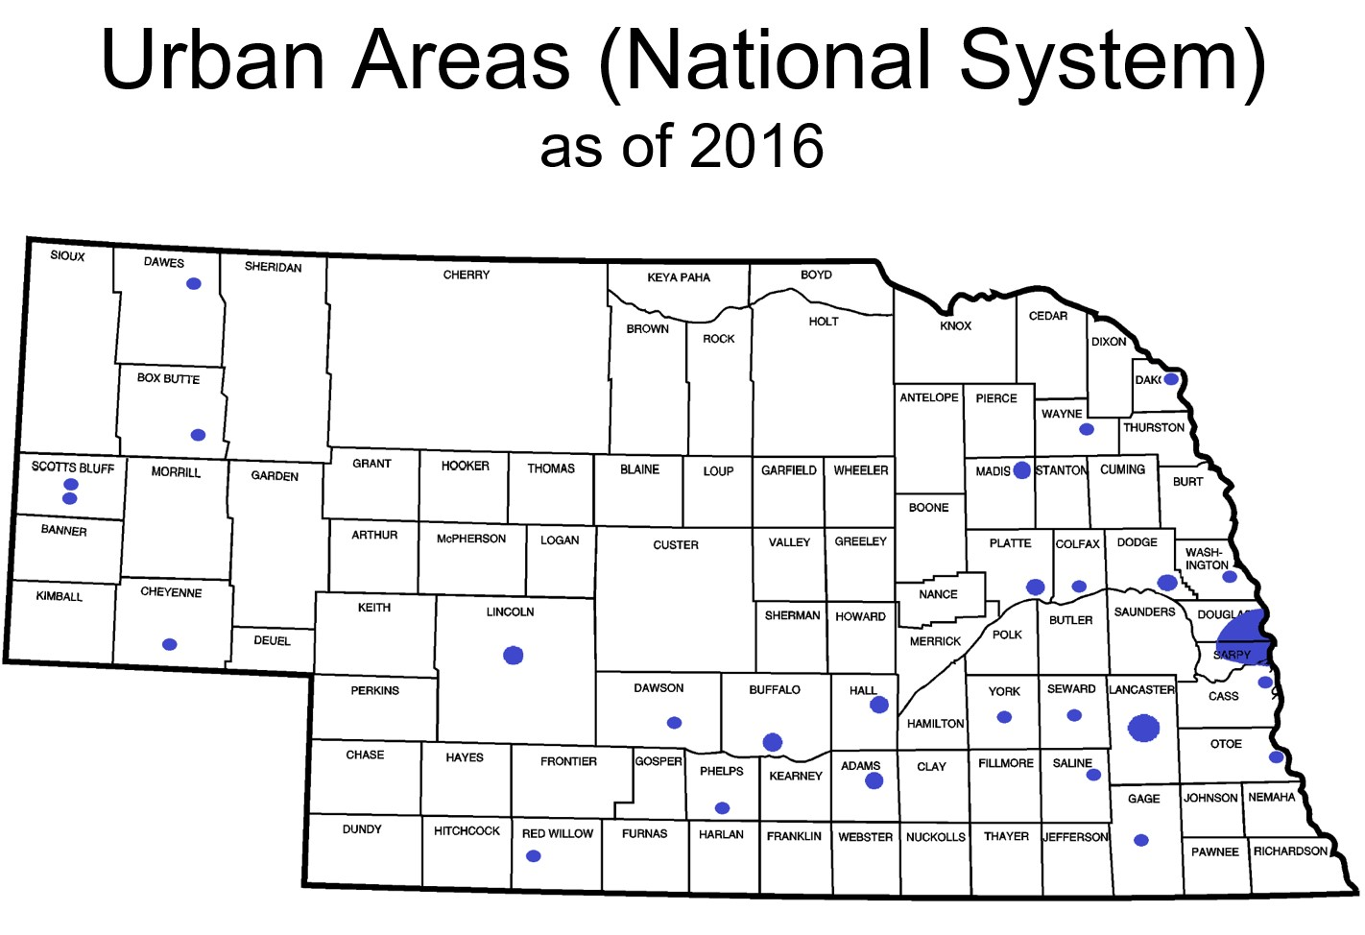
Nebraska’s Urban Areas
Notes:
2/2/2020 Added slide to show with a map what are Nebraska’s urban areas.
The State thinks in terms of municipalities – there would be about 530 dots and splotches on a State map.
For Standards purposes – for all roads and streets except roads with functional classifications of minimum maintenance or remote residential (don’t forget – low-water stream crossings and fords is not a functional classification) – go by Urban area, not municipality.

Slide 15
State Areas vs. National Areas
State System
Various State Statutes
Municipal
Corporate Limits
National System
23 U.S.C. 101(a), 23 CFR 470.105
Federal Aid Policy Guide Chapter 4
Urban
  Dense development
  Determined by census
  Populations 5,000 and more
  Local and State officials decide, US Secretary of Transportation approves
Slide 15
Notes:
Municipal is defined by corporate limits
For the National system, however, the term Urban is used, and it means something slightly different that the State’s Municipal area.
Therefore, Urban applies only in and around Cities of the First Class, and the Lincoln and Omaha areas.
If your highway, road or street of interest is in one of these cities, it is in an Urban area
and if it is near the corporate limits of any one of these then you need to verify if it is in the Urban area.
31 cities in Nebraska have more than 5,000 within their corporate limits.
For Municipal area, refer to State Statutes §14-101, §14-117, §15-101, §16-101, §17-201, §19-2201, etc. - key words territorial boundaries and corporate limits

Slide 16
Nebr Rural Highways
Neb. Rev. Stat. 39-2105 (2)
Interstate
Expressway
Major Arterial
Other Arterial
Collector
Local
Scenic-Recreation
Minimum Maintenance
Remote Residential
National System
23 CFR 470
Interstate
Other Freewys/ Exprss
Other Principal Arterial
Minor Arterial
Major Collector
Minor Collector
Local
State vs National
Notes:
1/31/2020 Updated – Added “Nebr” in title for list on the left.
2 min
The State and National systems do not correlate with one another exactly.
Several classification names are different.
The criteria used to define each classification is not described exactly the same.
The two broad categories differ slightly – the State uses corporate limits, the Federal government uses the Urban boundary.
Nebraska has the three additional rural classifications, listed at the bottom.
A road classified nationally as Local is not necessarily classified as Local on the State FC system; it could be any of the three optional classifications, or even a higher classification such as collector.

Slide 17
Finding Functional Classification of a Segment of a Road or Street
Online: NDOT’s Map Library
Paper Copy: Request from NDOT Boards-Liaison Services Section
Where to Find FC
Notes:
9/11/2022 added “Copy” in 2nd bullet
1 min

Slide 18
Integrated System of Public Roads
Segments are interconnected
  None are independent
Segments serve different functions
Segments work together to move traffic
Notes:
1 min

Slide 19
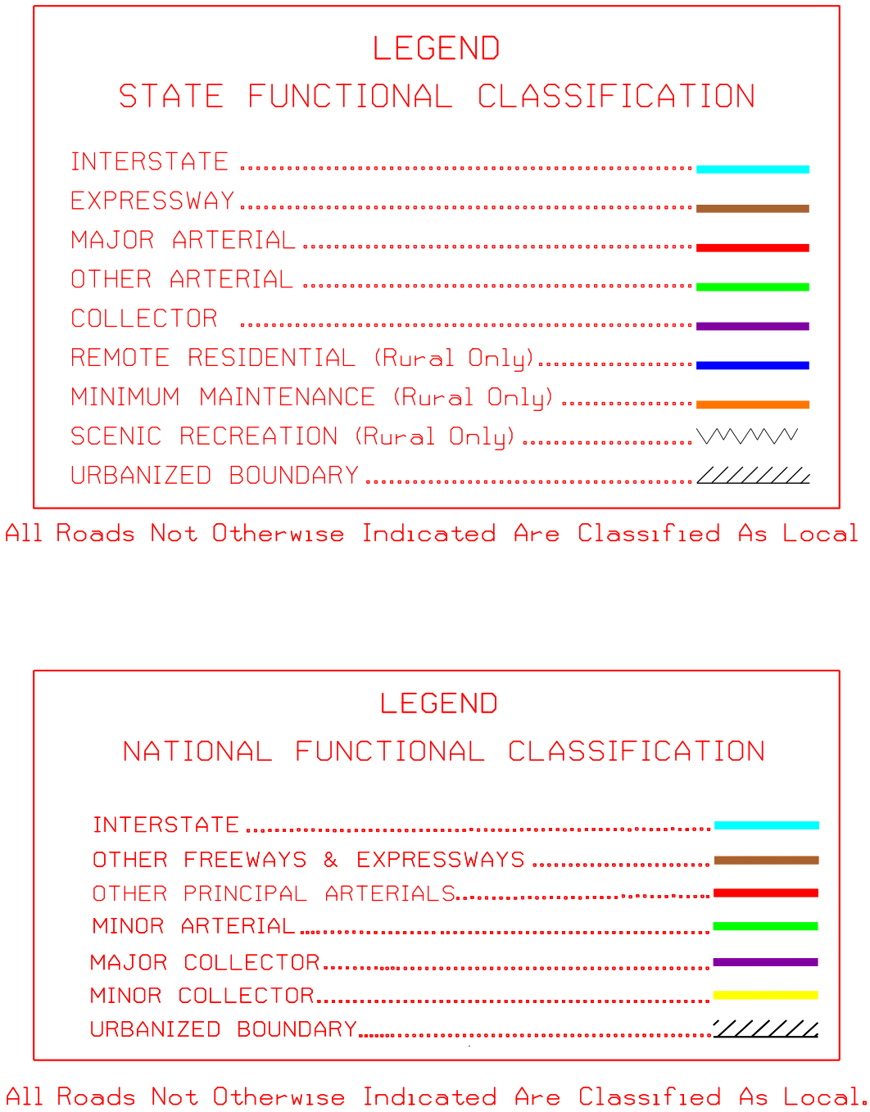
Notes:
1 min
All maps have been converted to the new NATIONAL FC system

Slide 20
Exercises
Find FC
Notes:
9/11/2022 changed “Hands On” to “Find FC”
2/24/2022 New Slide to indicate its time for the class to do some hands-on exercises.
Instructor Demo(s) (5 minutes – usually one county project and one municipality project) followed by hands-on exercises. Hands-on exercises can be assigned to individuals or teams; 5 to 10 minutes each.
Hand out maps as needed
Follow along on your laptop or device if you want

Slide 21
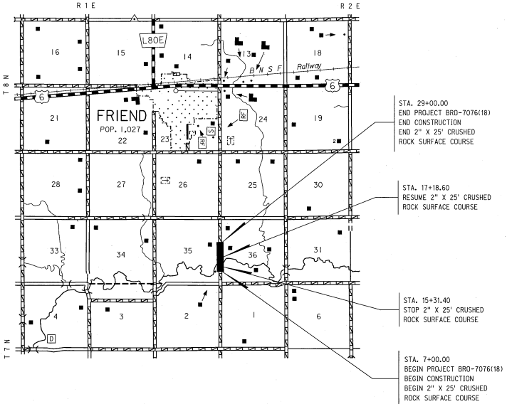
Example
Instructor Demo
Saline County south of Friend
Notes:
9/11/2022 added project location map
5 min
Instructor live demonstration
Follow along on your laptop or device

Slide 22
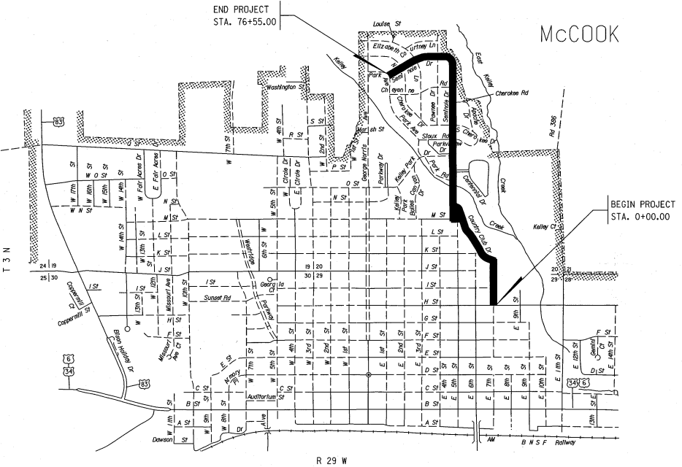
Example
Instructor Demo
City of McCook
Notes:
9/11/2022 added project location map
5 min
Instructor live demonstration
Follow along on your laptop or device

Slide 23
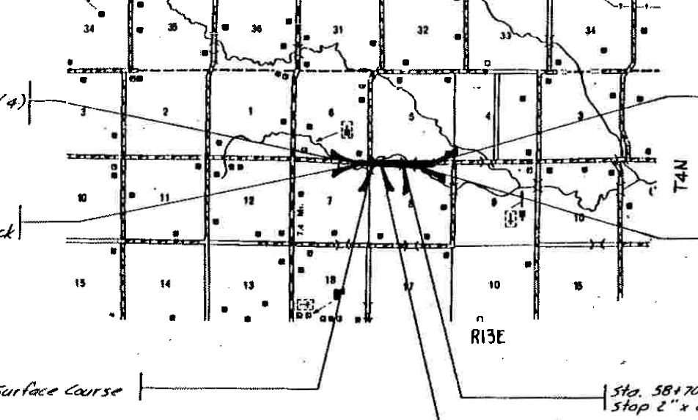
Example
Hands On
Nemaha County 5 mi south of Johnson
Notes:
9/11/2022 added project location map
15 min (5 min for teams, 10 min review)
Teams Exercise

Slide 24
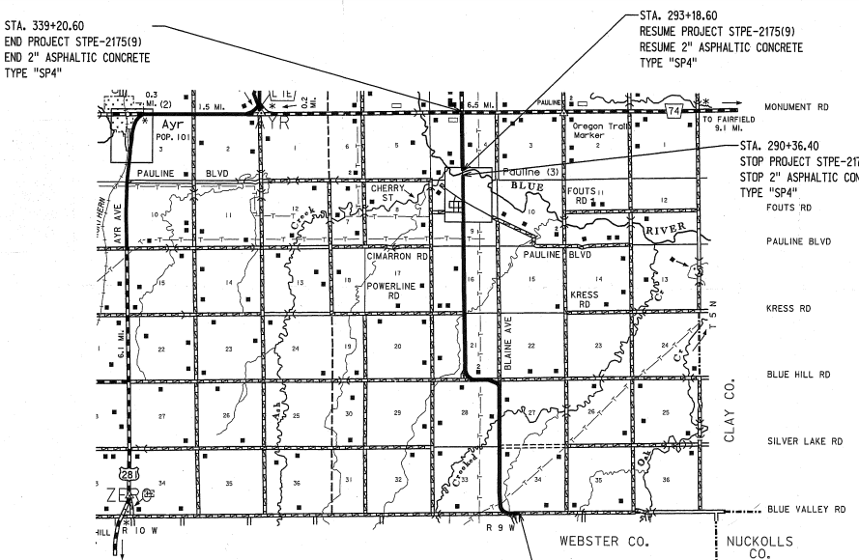
Exercise
Hands On
Adams County south and east of Ayr
Notes:
9/11/2022 added project location map
2/1/2020 added slide.
15 min (5 min for teams, 10 min review)
Teams Exercise

Slide 25
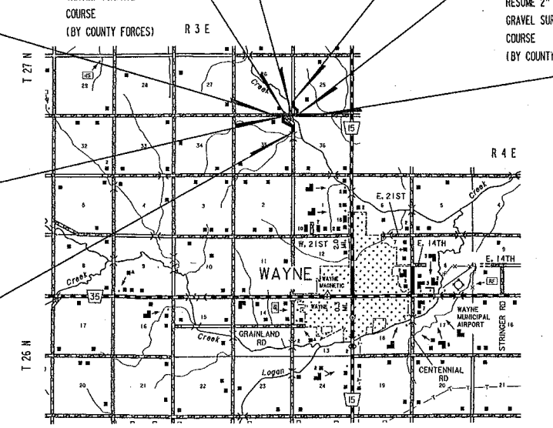
Exercise
Hands On
Wayne County north and west of Wayne
Notes:
9/11/2022 added project location map
2/1/2020 added slide.
15 min (5 min for teams, 10 min review)
Teams Exercise

Slide 26
Your Road or Street?
Suggest a road or street and we will find the functional classification
Hands On
Notes:
5 min

Slide 27

Neb. Rev. Stat. 39-2105
Interstate
Expressway
Major Arterial
Other Arterial
Collector
Local
Scenic-Recreation*
Minimum Maintenance
Remote Residential
INCORPORATED MUNICIPALITIES – STREETS WITHIN CORPORATE LIMITS
Jurisdictional Responsibility
COUNTIES – RURAL HIGHWAY CATEGORY
*Some State Highways could be Scenic-Recreation
Notes:
9/11/2022 - Added slide for Jurisdictional Responsibility

Slide 28
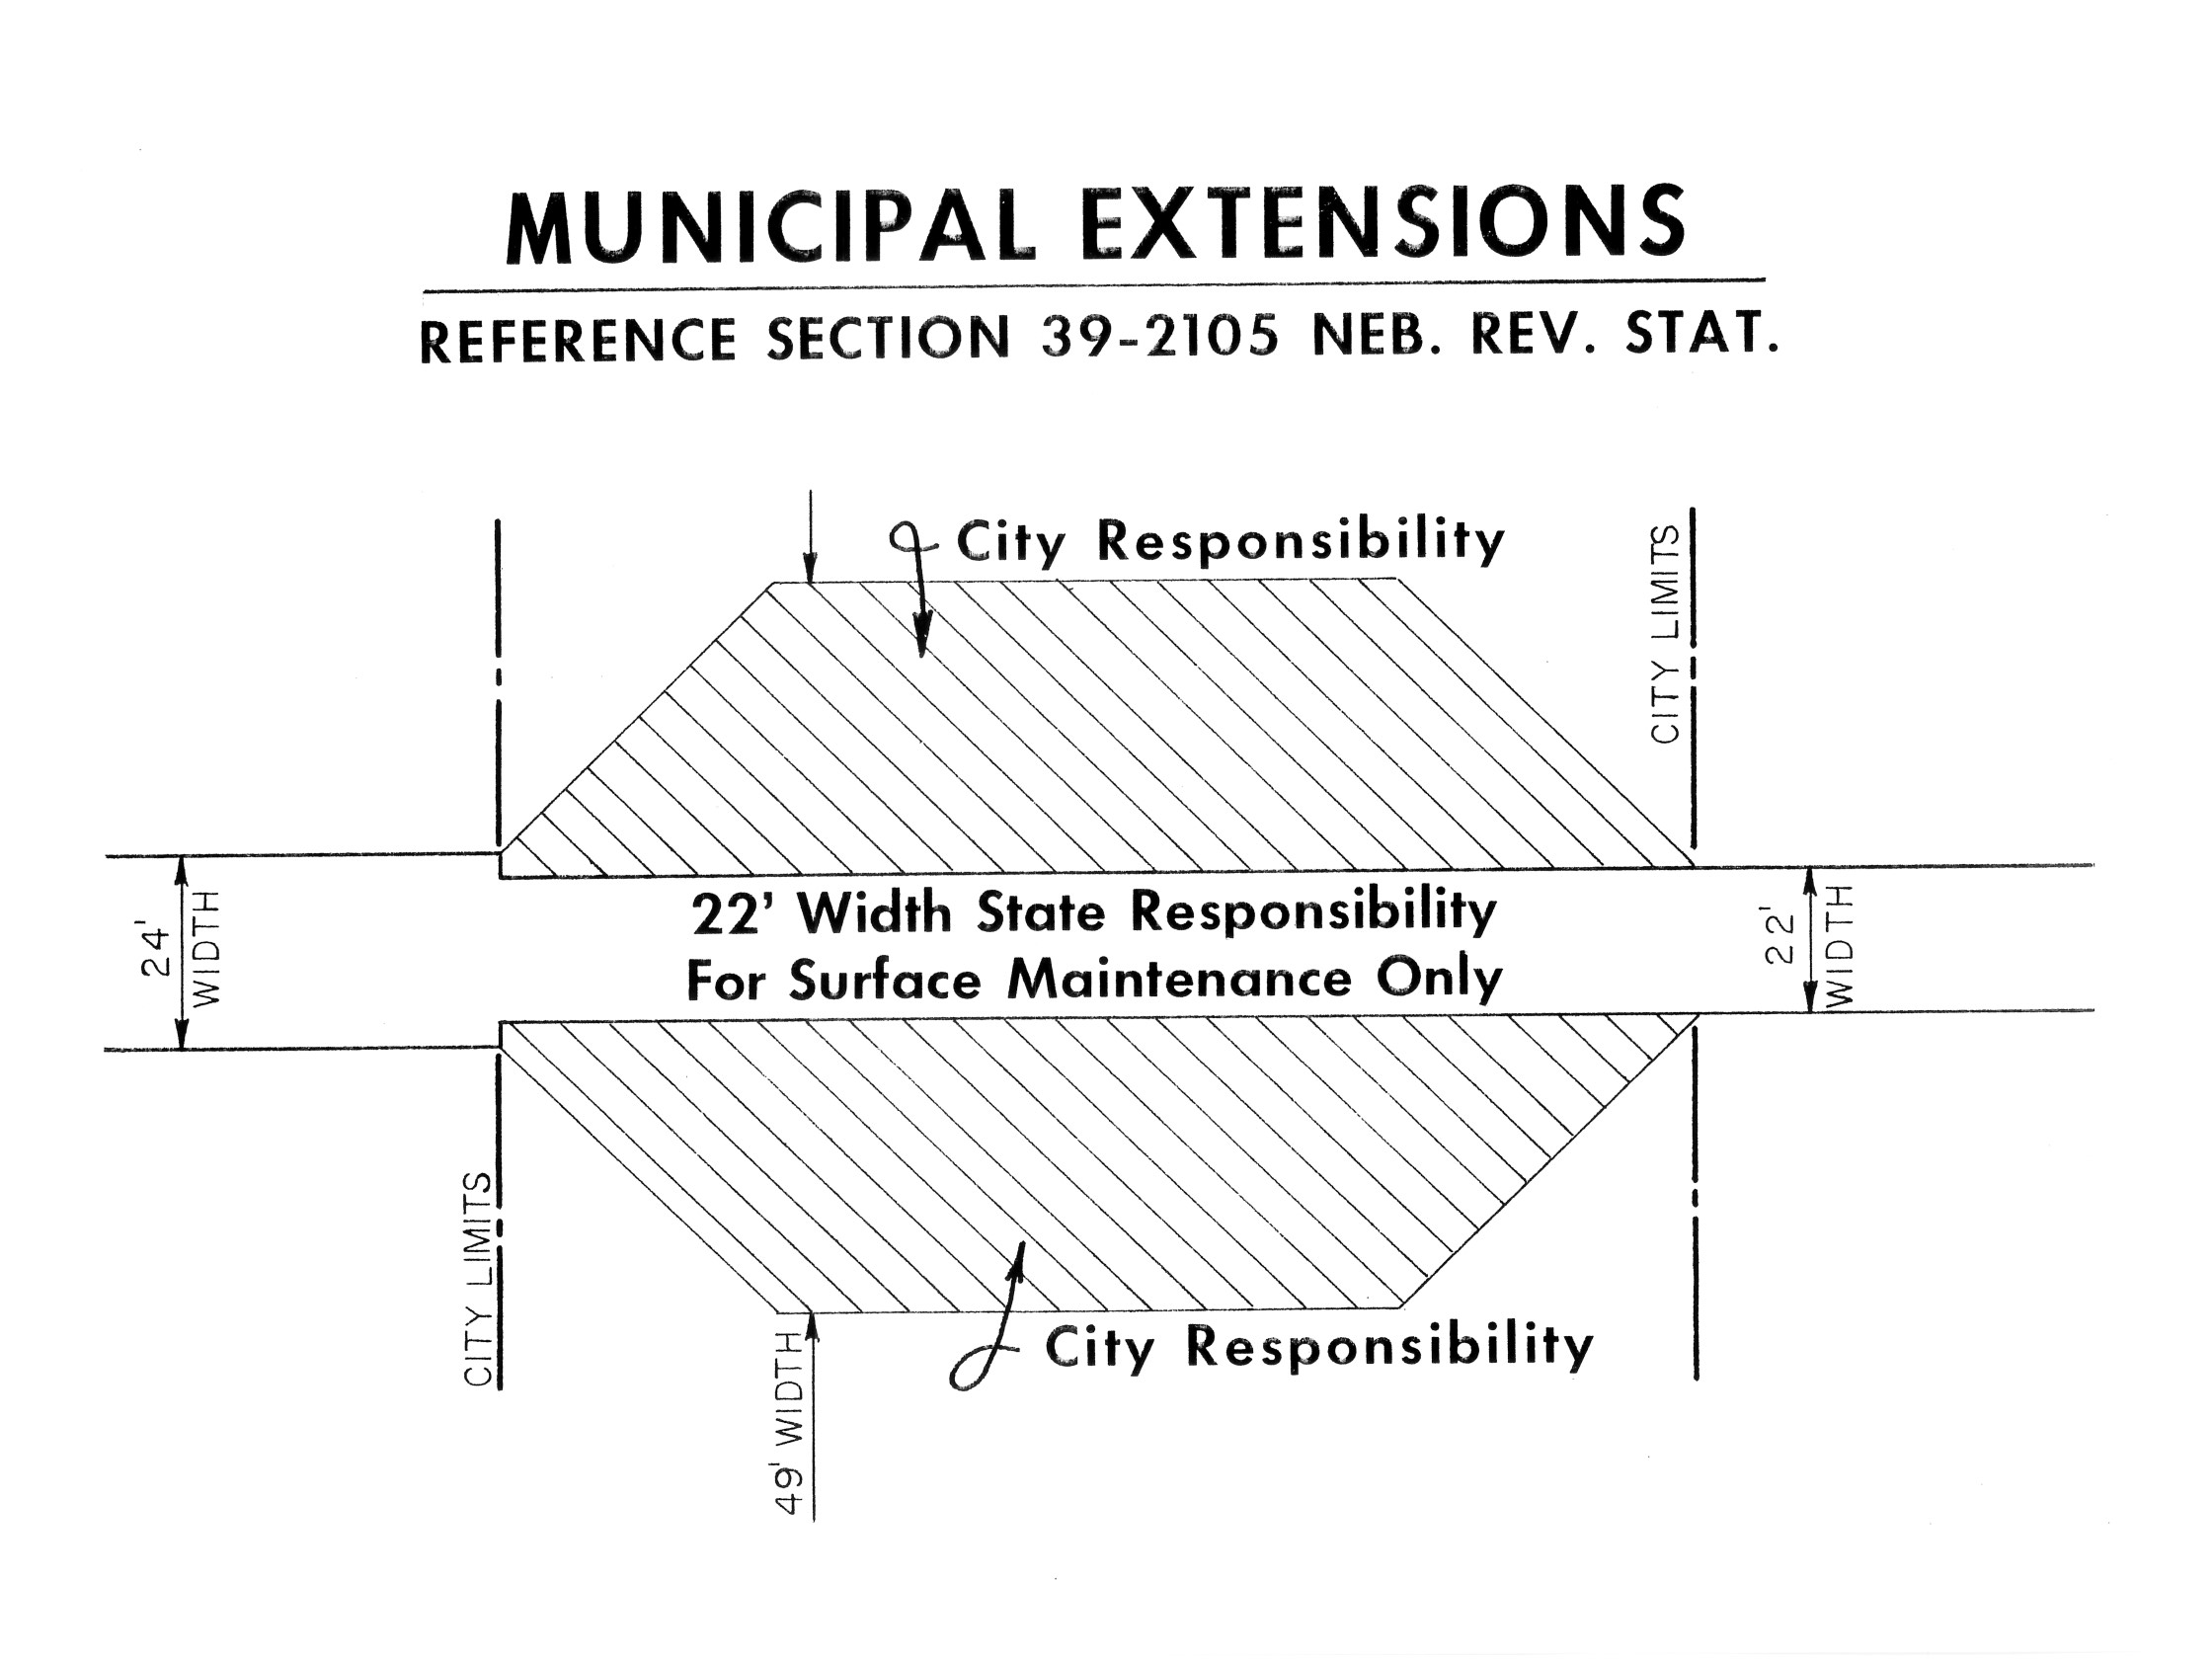


(Blue Sheet in Notebook)
State Law
http://www.nebraskalegislature.gov/laws/browse-chapters.php?chapter=39
Expressway or
Major Arterial
Interlocal agreements with NDOT (for mowing, snow removal, etc.)
Slide 28
Notes:
9/11/2022 Added slide for review of municipal extensions.
PIQ20 Don’t forget about municipal extensions. Except Interstates, the State is NOT responsible for that portion of a municipal extension which exceeds the design of the rural state highway leading into a municipality. Refer to video B02 Functional Classification Basics.
The Municipality is responsible for that portion that exceeds the design of the rural highway that leads into the municipality.
This applies only to municipal extensions of state highways with a State functional classification of Expressway or Major Arterial.
State Statute 39-2105 reads: When the design of a rural highway differs at the different points where it leads into the municipality, the state's responsibility for the municipal extension thereof shall be limited to the lesser of the two designs.
This screen shows an example of what this means. On the right side of the screen the rural State highway entering corporate limits is 22 ft wide. On the left side of the screen the rural highway leaving corporate limits is 24 ft wide. According to State Statute 39-2105, the municipality has jurisdictional responsibility for that portion which exceeds the design of the rural portion. If the two rural portions are different, which they are in the example, the municipality is responsible for that portion which exceeds the lesser of the two designs. So, in this example, the State is responsible for the 22 ft width and the municipality is responsible for that portion which exceeds 22 ft width..
For works or projects on a State highway, there may be some cost sharing required for the Municipality. Usually, this affects only cities with a population of over 5,000 and is a function of the number of thru traffic lanes. For further information, you may request a copy of Department of Transportation Instruction 60-11, Municipal Sharing.
And also note that there are usually interlocal agreements between the municipality and the Nebraska Department of Transportation for mowing, snow removal and other activities.
39-2105. Functional classifications; jurisdictional responsibility.
Jurisdictional responsibility for the various functional classifications of public highways and streets shall be as follows:
(1) The state shall have the responsibility for the design, construction, reconstruction, maintenance, and operation of all roads classified under the category of rural highways as interstate, expressway, and major arterial, and the municipal extensions thereof, except that the state shall not be responsible for that portion of a municipal extension which exceeds the design of the rural highway leading into the municipality. When the design of a rural highway differs at the different points where it leads into the municipality, the state's responsibility for the municipal extension thereof shall be limited to the lesser of the two designs. The state shall be responsible for the entire interstate system under either the rural or municipal category and for connecting links between the interstate and the nearest existing state highway system in rural areas, except that if such a connecting link has not been improved and a sufficient study by the Department of Transportation results in the determination that a link to an alternate state highway would provide better service for the area involved, the department shall have the option of providing the alternate route, subject to satisfactory local participation in the additional cost of the alternate route;
(2) The various counties shall have the responsibility for the design, construction, reconstruction, maintenance, and operation of all roads classified as other arterial, collector, local, minimum maintenance, and remote residential under the rural highway category;
(3) The various incorporated municipalities shall have the responsibility for the design, construction, reconstruction, maintenance, and operation of all streets classified as expressway which are of a purely local nature, that portion of municipal extensions of rural expressways and major arterials which exceeds the design of the rural portions of such systems, and responsibility for those streets classified as other arterial, collector, and local within their corporate limits; and
(4) Jurisdictional responsibility for all scenic-recreation roads and highways shall remain with the governmental subdivision which had jurisdictional responsibility for such road or highway prior to its change in classification to scenic-recreation made pursuant to this section and sections 39-2103, 39-2109, and 39-2113.
Source: Laws 1969, c. 312, § 5, p. 1121; Laws 1971, LB 738, § 1; Laws 1980, LB 873, § 2; Laws 1983, LB 10, § 4; Laws 2008, LB1068, § 5.
DORI 60-11, July 2005, Page F-15, Municipal Cost Sharing (non-Interstate projects), Projects determined by NDOT to be economic development projects are negotiated on a case-by-case basis.
Section 4 – Municipalities with a Population of 5,000 or less. Generally, no financial participation is required. Constructing parking areas at the request of the Municipality is paid 100% by the Municipality. Federal-aid Safety projects off the State Highway System requires 20% matching funds from the Municipality. On 3R projects, if Municipality requests reconstruction of sidewalks, it pays 100% of sidewalks, but the NDOT pays for ADA ramps and blending back to the sidewalk.
Section 5 – Municipalities with a Population over 5,000. May require participation. Depends on the number of thru traffic lanes. No cost if only two thru traffic lanes. 20% if there are four thru traffic lanes. And more if there are more than four thru traffic lanes.

Slide 29
Classification
Wrap Up
Questions?
Notes:
2 min

