Slide 1
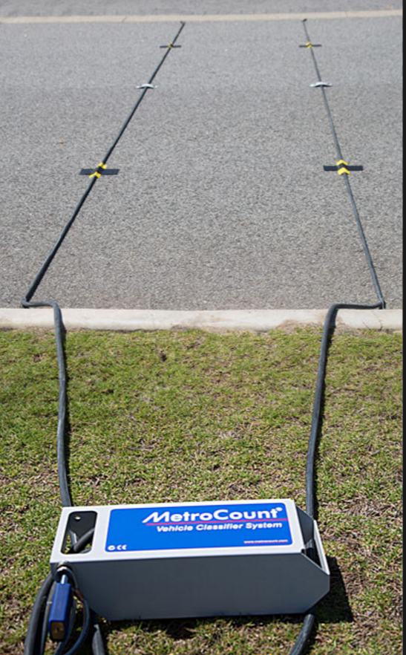
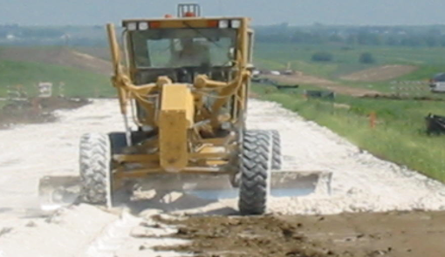
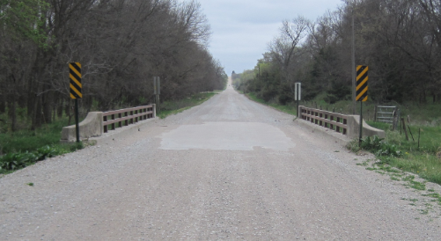
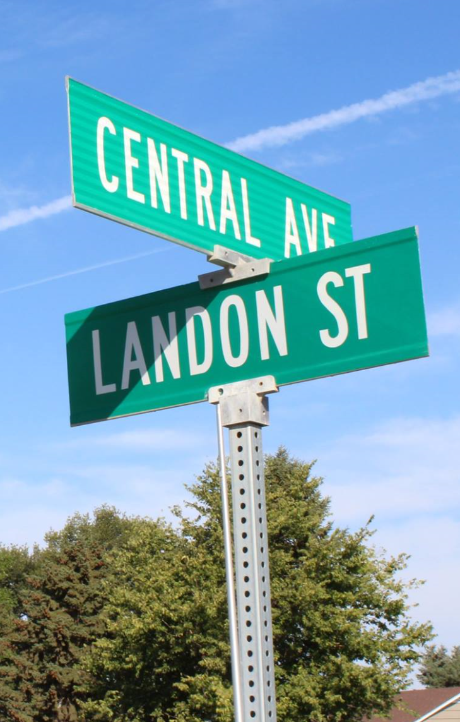
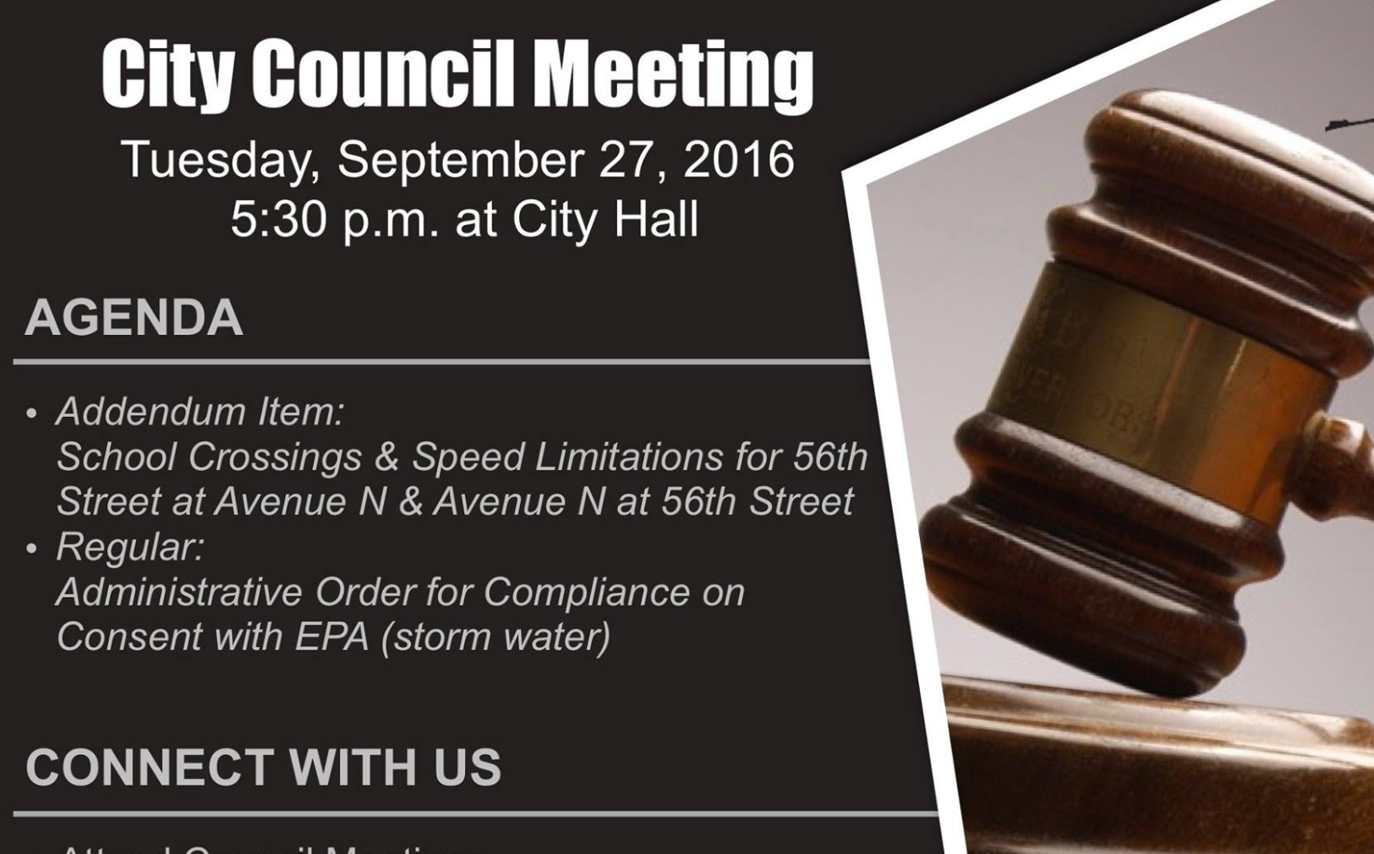


Managing Nebraska’s
Public Roads and Streets
Introduction to
Classification and Standards
428 NAC 1 and 428 NAC 2
Boards - Liaison Services Section
https://dot.nebraska.gov/business-center/lpa/boards-liaison/training/
8/4/2019
Video B01
Notes:
8/4/2019 updated web links. The previous version was dated 12/15/2017; slides 13 and 15 from that version are deleted, with the web link from Slide 15 added to Slide 13 in the updated version (was Slide 14). Other than web links (3 slides – 1, 13 and 14), Slide 13 in this version was updated because of LB82.
Welcome to this first of several videos on Nebraska’s system of
Classifying and applying standards to its highways, roads and streets.
Before watching this series of videos on Classifications and Standards, it is important that you watch two other, introductory, videos:
The Prelude to the Video Series
Managing Nebraska’s Public Roads and Streets – An Introduction – The Big Picture
Those two videos introduce the entire video series and provide information useful in knowing and understanding before going through the Classifications and Standards video series.
They can be found at the web link shown on this slide.

Slide 2

Introduction to
Classification and Standards
About videos on Classification (428 NAC 1) and Standards (428 NAC 2)
Nebraska Law review (Classification and Standards)
Nebraska Administrative Code (NAC) Title 428
Boards - Liaison Services Section
Slide 2
Notes:
This video: describes the scope of this entire series of all of the Classification and Standards videos,
Gives a brief review of Nebraska law as it pertains to classification and standards for Nebraska’s highways, roads and streets,
And Briefly introduces the Nebraska Administrative Code Title 428, in particular, for Classification and standards.

Slide 3
Terminology and Acronyms used in this video
NBCS = “The Board” = “The Board of Public Roads” = Nebraska Board of Public Roads Classifications and Standards
Standards vs. Minimum Design Standards (MDS)
Neb. Rev. Stat.
NAC = Nebraska Administrative Code
Highways = Roads = Streets (§39-101(3), §60-624)
3R = Resurfacing, Restoration and Rehabilitation
FC = Functional Classification
Notes:
First, some terminology and acronyms . . .
NBCS is the Nebraska Board of Public Roads Classifications and Standards; it may also be called the Board of Public Roads, or just The Board.
Standards refers to the NBCS standards, including design, construction, maintenance and relaxation of standards. MDS refers to the Minimum Design Standards, which address only the design aspect of a work or project. Standards are often termed “minimum” but realize there are maximums (for superelevation, grade) and ranges ( for cross slopes). When we say “minimum” – sometimes it refers to all of those.
Neb. Rev. Stat. refers to the Nebraska Revised Statutes
NAC is the Nebraska Administrative Code. These are regulations, that have the force of law.
The word “Highway” in Nebraska law also refers to roads and streets. Highway means the entire width between the boundary limits of any street, road, avenue, boulevard, or way which is publicly maintained when any part is open to the use of the public for purposes of vehicular travel.
3R is short for resurfacing, restoration and rehabilitation. For more details, see the video dedicated to 3R.
FC is Functional Classification.

Slide 4
Introduction to
Classification and Standards
About videos on Classification (428 NAC 1) and Standards (428 NAC 2)
Nebraska Law review (Classification and Standards)
Nebraska Administrative Code (NAC) Title 428
Boards - Liaison Services Section
Slide 4
Notes:
The next screen identifies the topics for covered in each Classification and Standards video in this series.

Slide 5
Classification and Standards Videos
Introduction to Classification and Standards
428 NAC 1 Functional Classification
428 NAC 2 Standards
428 NAC 2-001.03 Minimum Design Standards (MDS) – Main Elements and Criteria
MDS – Finding the Correct Standards Table
MDS – Definitions and Notes
MDS – 3R Requirements
MDS – Values in the Standards Tables
MDS – Bridges and Structures
Americans with Disabilities Act (ADA)
THIS VIDEO
Slide 5
Notes:
This video is an introduction to the videos on Classification and Standards.
Videos that follow Topics covered in other videos in this series include:
Video #2 – the basics of Nebraska’s Functional Classification system
Video #3 - Standards
And, beginning with Video #4, several videos covering
Minimum Design Standards for County Roads and Municipal Streets including
Main Elements and Criteria
Finding the Correct Table for any given segment of road or street – with an example
Definitions and Notes
3R requirements,
Finding the Correct Values in the standards Tables – with an example
And Bridges and Structures, which has two parts.
Finally, there is a video on Americans with Disabilities Act, also known as ADA.
The ADA is a Federal law. It is not a part of Nebraska’s design standards.
It is included for information only, as it may affect the scope of works or projects on roads and streets.
IT IS RECOMMENDED THAT YOU VIEW THESE VIDEOS IN THIS ORDER
BECAUSE EACH ONE BUILDS ON, OR REFERENCES THE PREVIOUS VIDEO OR VIDEOS.
Video #3 gives an overview of the Standards, and covers
Construction Standards 428 NAC 2-002
Minimum Maintenance Standards
Relaxation of Standards, and
Standard Compliance Inspection Procedures
Details on Minimum Design Standards are presented in the videos following Video #3.
This series of videos is oriented toward County Highway Superintendents and City Street Superintendents, or anyone interested in Nebraska’s system of classification and standards for county roads and municipal streets.
The State Highway Standards generally are not addressed in this series of videos.
State Highway Standards apply to relatively few miles of county roads and municipal streets.

Slide 6
Introduction to
Classification and Standards
About videos on Classification (428 NAC 1) and Standards (428 NAC 2)
Nebraska Law review (Classification and Standards)
Nebraska Administrative Code (NAC) Title 428
Boards - Liaison Services Section
Slide 6
Notes:
The following is a brief review of Nebraska law as it pertains to classification and standards for Nebraska’s highways, roads and streets

Slide 7


Chapter 39 Article 21
§39-2101 Provides
“The Big Picture”
State Law
In 1969, Nebraska’s Legislature declared the importance of:
Safe and efficient transportation over public roads
  An integrated system of public roads
  Adequate Public Roads
Slide 7
Notes:
State Statute 39-2101 is a declaration that provides a broad overview, or the Big Picture view of 1969 legislation, which was a significant change in Nebraska’s approach to its system of highways, roads and streets. The Nebraska Legislature recognized, determined and declared that
Safe and efficient transportation over public roads is a matter of major importance to all Nebraskans
An integrated system of public roads is essential to the general welfare of the State
Adequate Public Roads
- Provide for the free flow of traffic
Protect the health and safety of the citizens of the state,
result in lower cost of motor vehicle operation
- Increase property values
- Generally promote the economic and social progress of the state

Slide 8
§39-2101
“The Big Picture”
(continued)
State Law
Establish a system of functional classification
Each segment of public road identified according to the function it serves
Identification by function will permit the establishment of uniform standards for each classification:
  - Design
  - Construction
  - Operation (Local Decision)
  Maintenance
Slide 8
Notes:
Fundamental to the development of an integrated system of public roads is a determination of the function that each road segment serves. This is where the video on Functional Classification basics, fits into the big picture.
Through adoption by law of a functional classification system, it is the intent of the Legislature that each segment of public road shall be identified according to the function it serves according to a few defined functions – overall determined by the road’s mobility (think traffic moving quickly, and possibly over long distances such as an interstate, expressway or arterial) and by the road’s amount at-grade access points (think collector and local roads).
Identifying functional classifications permits the establishment of uniform standards for:
- Design
- Construction
- Maintenance
This is where the videos on the Standards fits in the big picture.

Slide 9
§39-2101
“The Big Picture”
(continued)
State Law
The Legislature created the Board of Public Roads Classifications and Standards, responsible to
Develop reasonable standards
Boards - Liaison Services Section
Slide 9
Notes:
Establishment of a Board of Public Roads Classifications and Standards, which has NDOR NDOT, County, Municipal & General Public Representation provides that:
Each governmental entity & the public will have equal voice in developing reasonable standards for each classification of road
Standards shall be adequate to meet the needs of an increasingly mobile society

Slide 10
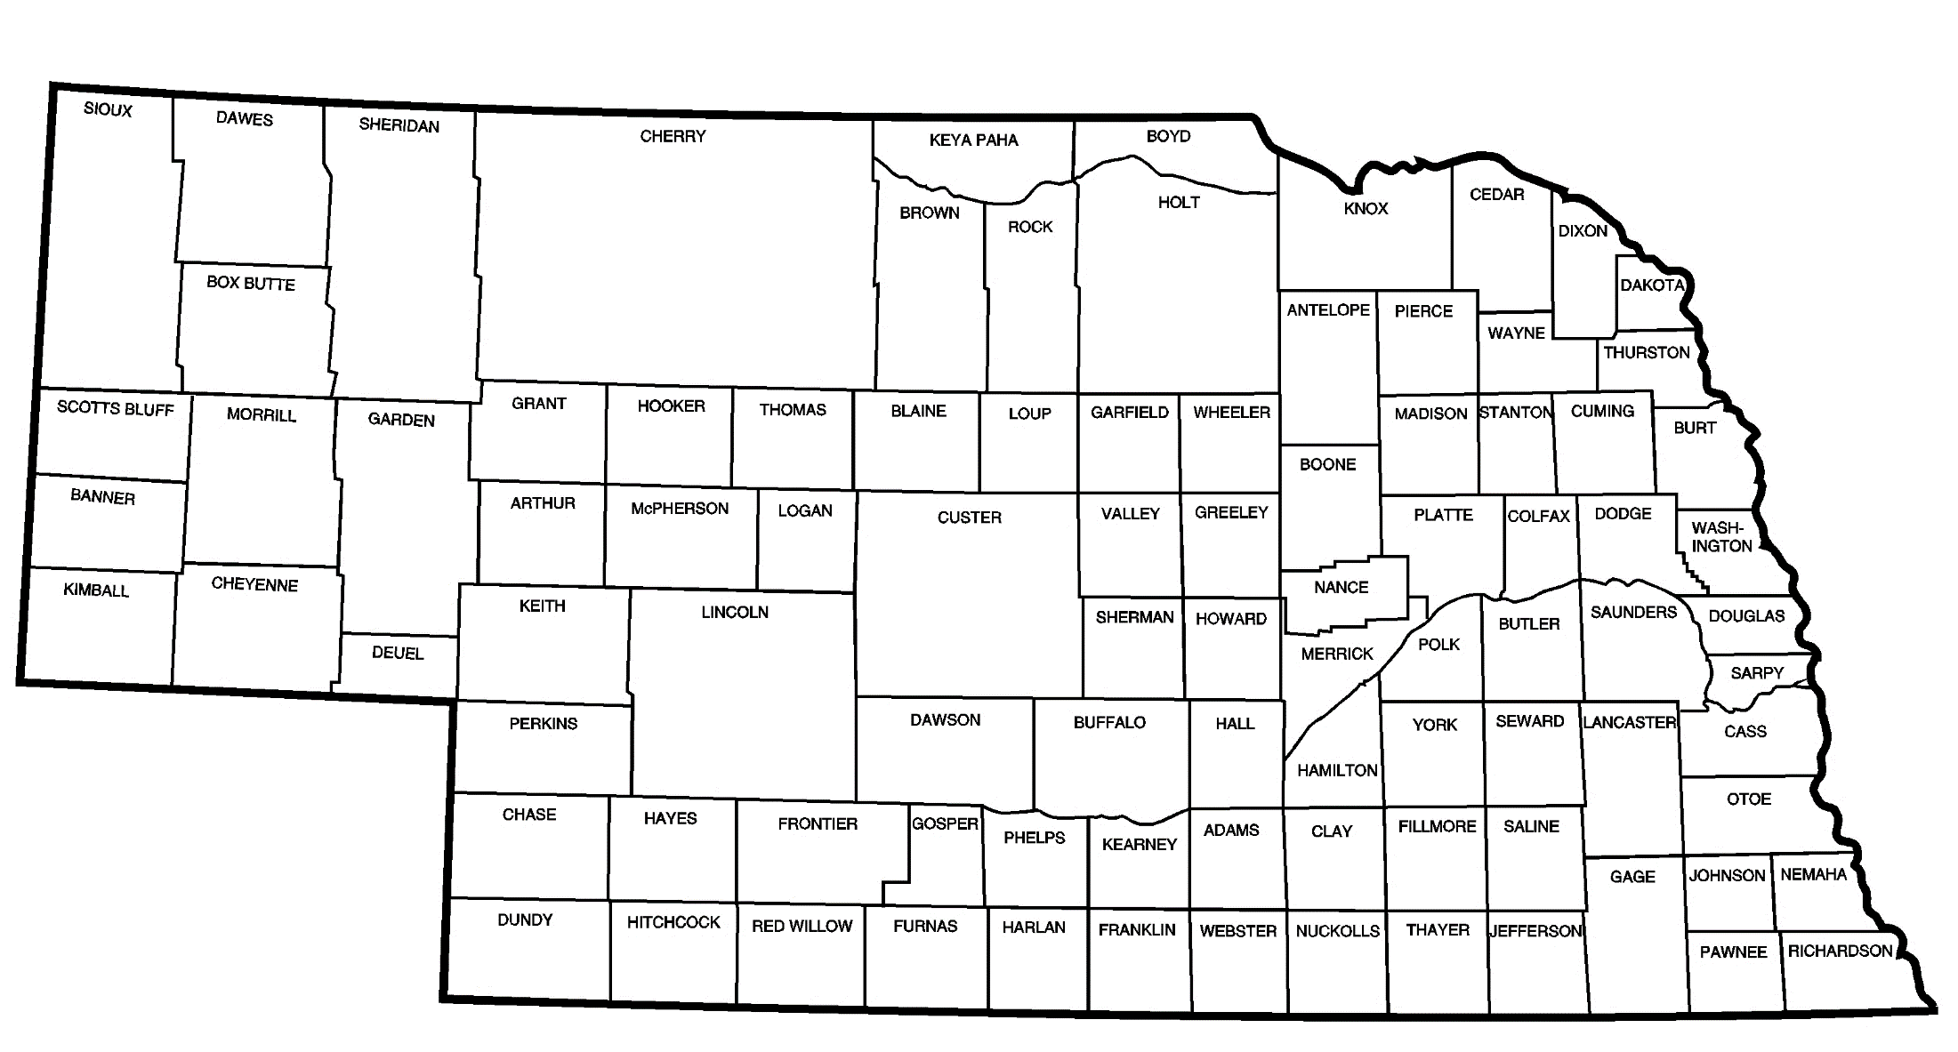

Nebraska’s Public Roads System
Nebraska's public roads system
  is one of the largest in the nation, serves sparsely populated areas as well as large urban centers, all of which have transportation needs
Modern standards must address roads of various functions, classifications and areas
Not enough money to build every road as if it is an arterial
Good program management leads to more efficient use of pubic roads funds
Slide 10
Notes:
Nebraska’s Public Roads System
Is one of the nation’s largest systems
It serves sparsely populated areas as well as large urban centers
All of these areas have transportation needs.
Nebraska’s standards address roads that have a variety of functions
Nebraska legislation recognizes that there is not enough money to build every road and street to arterial type standards
And it emphasizes good program management, and cooperation, at all levels of government.

Slide 11
Introduction to
Classification and Standards
About videos on Classification (428 NAC 1) and Standards (428 NAC 2)
Nebraska Law review (Classification and Standards)
Nebraska Administrative Code (NAC) Title 428
Boards - Liaison Services Section
Slide 11
Notes:
For the final segment of this video, let’s take a brief look at the Nebraska Administrative Code Title 428.

Slide 12
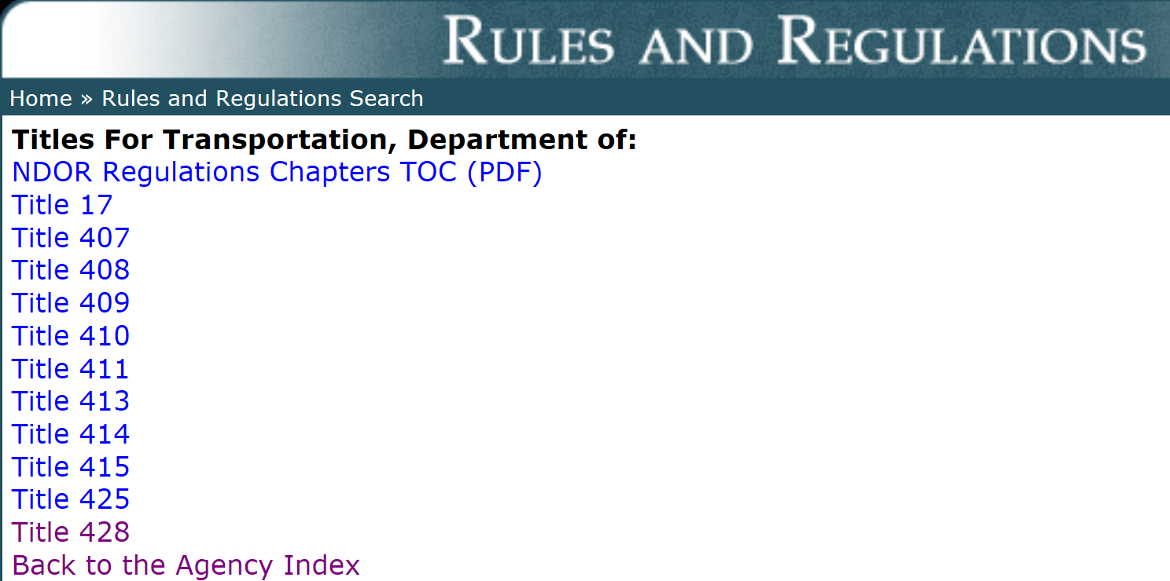
Title 428
NBCS Regulations
NBCS regulations
http://www.sos.ne.gov/rules-and-regs/regsearch/Rules/index.cgi?l=Transportation_Dept_of
Slide 12
Notes:
NBCS rules and regulations in Title 428 can be found on the Secretary of State’s website, listed under the Department of Roads Transportation.
As you can see on the screen, there are nine several other rules associated with the Nebraska Department of Roads Transportation. These range from include rules such as :
Title 407 is NDOT: Hearing Practice and Procedure. (for the Nebraska Dept of Transportation)
[Title 408 is NDOT: Hay Harvesting Permits. ]
[Title 409 is Construction Division: the rule for Bidding State Highway Work. ]
[Title 410 is Utilities Section: Utility Permits.]
Title 411 is Traffic Division: the Manual on Uniform Traffic Control Devices, [release of Blood Alcohol content information, etc.]
[Title 413 is Agreements Section: Consultant Services]
[Title 414 is Scenic Byways]
[Title 415 is Rail & Public Transportation Division: for Public Transportation Assistance Program, Rail Crossings, etc.]
Title 425, regulations for the Board of Examiners for County Highway and City Street Superintendents: Hearing Practice and Procedure for Contest Cases. This is the Board that conducts examinations twice per year. 39-2304.
Title 428, the one we are most concerned with for this video series, has regulations for the Board of Public Roads Classification and Standards.
NOT FOR AUDIO
39-2106:
To assist in developing the functional classification system, there is hereby established the Board of Public Roads Classifications and Standards which shall consist of eleven members to be appointed by the Governor with the approval of the Legislature. Of the members of such board, two shall be representatives of the Department of Roads, three shall be representatives of the counties, one of whom shall be a licensed county highway superintendent in good standing and two of whom shall be county board members, three shall be representatives of the municipalities who shall be either public works directors or licensed city street superintendents in good standing, and three shall be lay citizens who shall represent the three congressional districts of the state.

Slide 13
Title 428
How it is Organized
Title 428 Table of Contents
Chapter 1 Procedures for Classifications (428 NAC 1)
Chapter 2 Procedures for Standards (428 NAC 2)
https://dot.nebraska.gov/business-center/lpa/boards-liaison/nbcs/downloads/
Slide 13
Notes:
8/4/2019 Updated to reflect changes per LB82 (2019). Deleted chapters 3, 4 and 5 because of statute changes, mainly LB82.
There are two chapters in 428 NAC: Chapter 1 has procedures for Classifications, and Chapter 2 has procedures for Standards.
This is how Title 428 is organized.
There are Five Two chapters.
[Note to reader: Read each Chapter title.]

Slide 14
Managing Nebraska’s
Public Roads and Streets
Introduction to
Classification and Standards
428 NAC 1 and 2
Boards - Liaison Services Section
https://dot.nebraska.gov/business-center/lpa/boards-liaison/training/
8/4/2019
Video B01
Notes:
This has been an Introduction to the videos that will address Nebraska’s system of Classification and Standards.

