Slide 1
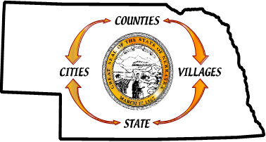
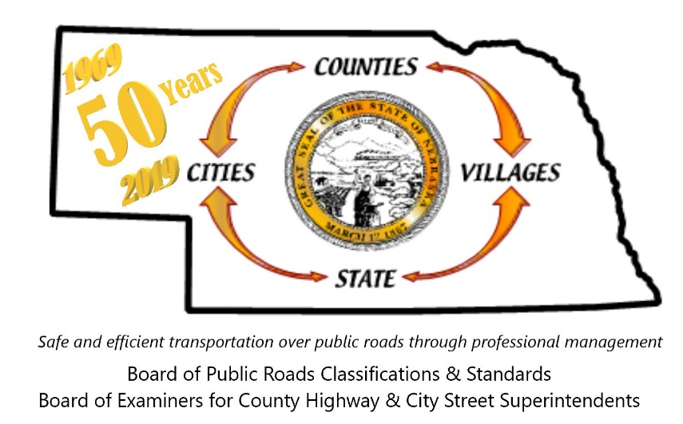

Developing a Multi-Project Program or Strategy
Nebraska Board of Public Roads Classifications & Standards (NBCS)
Process Adopted by NBCS Board originally April 16, 2021,
updated November 18, 2022
Roger Figard, Chairman
Handout: https://dot.nebraska.gov/business-center/lpa/boards-liaison/nbcs/downloads/
402-479-4436
Boards – Liaison Services Section
ndot.blshelp@nebraska.gov
November 27, 2022
Slide 1
Notes:
11/27/2022 added updated adoption and version dates, and updated NBCS logo on slide 1 (no changes to slide 1 Transcript), added slides 4 and 34, and made changes to slides 3, 5 (formerly slide 4), 28 thru 33 (formerly slides 27 thru 32) and 35 (formerly slide 33).
Transcript
Hello, the purpose of this video from the Nebraska Board of Public Roads Classifications & Standards (NBCS) is:
To share the Board’s process and approach for developing, supporting, approving and implementing multi-project programs and strategies that provide additional flexibility in design and maintenance standards for highways, roads and streets.
A handout is available on the Board’s website, the weblink shown in the middle of your screen, and is recommended reading to supplement this video.
It has an introduction to practical design, a process flow chart, and an application form with instructions – all of which were approved by the Board on April 16, 2021, and an update approved on November 18, 2022.
Throughout this video, the word “program” will be used as a short way of saying “multi-project program or strategy.”
Before addressing the process, there is a quick overall review of Board standards and what led up to multi-project programs and strategies.
----------------------------------------------------------------------------------------------------
Video scheduled for release after NBCS Board adopts a process for multi-project programs and strategies process.
Audience: NDOT, Cities, Counties, Consultants - anyone interested in Nebraska's highways, roads and streets
Purpose: Explain the Board's process, request form and background information
Handouts: NBCS documents (Intro/Checklist, process, request form with instructions)
Title: Developing a Program or Strategy
When? April 2021, update November 2022
Video length: 15 minutes target
Major Points for Audience to Understand and Remember:
Legislation LB82(2019) and the resulting statute 39-2113(7) allow NBCS, NDOT, Counties and Cities to work together to develop Multi-Project Programs or Strategies. It's a new option that our state’s public roads administrators haven't had before, in addition to a relaxation of standards (for one project) and changing standards.
Performance based design basics - the basis for multi-project programs and strategies
NBCS Board developed a typical way to process requests, but is flexible enough to change according to circumstances
Explain process and application form, and what the Board will consider when deciding approvals (conditions will be important)
An NBCS Committee will review each request and make a recommendation to the full Board
If the NBCS and applicant move forward with the proposal, a Memorandum of Understanding will be signed

Slide 2
If NBCS Minimum Standards Cannot Be Met
Two Options Have Been Available
Relaxation of Standards, for a specific work or project. The NBCS decides these at public Board meetings. Regulated by Title 428, Chapter 2-004
Change the Standards. Requires rulemaking, a process involving public comments and public hearing(s).
Now there is a third option available
Multi-Project Program or Strategy
Slide 2
Notes:
Transcript
Until recently, if NBCS minimum design or maintenance standards could not be met, there were two options available:
Request a relaxation of standards from the NBCS. OR
Change the standards.
The first option applies to a specific project and is usually requested in the preliminary engineering phase of the project.
The second option requires rulemaking, an extensive effort and therefore occurs only once every few years.
A third option is now available: a multi-project program.
It is NOT a new standard but it DOES allow flexibility with current NBCS standards, and it could be an interim solution potentially leading to changing the standards (option #2) via rulemaking.
It is required that NDOT, counties and municipalities work in cooperation with the NBCS to establish a program, prior to its implementation.
Note that the NBCS does not approve designs, rather, it would be agreeing to allow an entity to not meet certain of its standards.

Slide 3
§39-2113(7) - from LB82 (2019)
Authorizes certain programs to be developed
  Design: practical, flexible and context sensitive
  Asset preservation, preventative maintenance
Individual projects and works conforming to the program will have Board preapproval
Cooperation between the NBCS and NDOT, counties and municipalities
  develop, support, approve and implement
“Practical Design”
Slide 3
Notes:
11/27/2022 added “which applies only to counties and municipalities” in the Transcript at the end of the third paragraph, with no changes to the slide itself.
Transcript
NBCS standards are based on criteria – mainly geometric criteria such as lane width, shoulder width, horizontal curvature, and vertical curvature.
If a standard cannot be met for a particular project, counties and cities are required to request a relaxation of standards for that project from the NBCS. This will remain the same.
However, LB82 (passed in 2019), and formalized in state statute 39-2113(7), allows more flexibility in meeting those standards.
A program – which implies multiple projects or works – can now be established; projects or works conforming to such a program would have Board preapproval, eliminating the need for the Board to review and grant a relaxation of standards for each of those individual works or projects.
Strictly speaking, bringing a program or strategy to the NBCS for approval is NOT a relaxation of standards even though it involves not meeting Board standards. A relaxation of standards applies to only one project and is governed by the regulation 428 NAC 2-004, which applies only to counties and municipalities.
The terminology used in the state statute, and shown on this slide – practical design, flexible design, context sensitive design, asset preservation – reflect a performance-based approach, in recognition that standards are a good starting point but there are many factors, beyond geometrics, that go into decision-making when designing and constructing highways, roads and streets.
The statute allows the NBCS, NDOT, counties and municipalities to cooperate and agree upon programs based on such design practices, typically referred to as PRACTICAL DESIGN.

Slide 4
Performance-Based Flexible Design
Dimensional design criteria
  A good start, but sometimes leads to overdesign, greater (unnecessary) cost, or designs that don’t fit the roadway context
Industry trend: appropriate, project-specific design based on traffic operations and safety performance
  AASHTO “Green Book” 7th Edition, 2018
Slide 4
Notes:
11/27/2022 new slide.
Transcript
Roadway project development is more than geometric design, which is the basis of the current NBCS standards design criteria.
Design standards are a good starting point for design decisions. However, it may not always be beneficial or reasonable to construct all some roadways to meet all standard criteria.
Projects on existing roadways often are limited in scope and available funds. Utilizing performance-based flexible design is intended to help stakeholders make the most of project investments, for the public’s ultimate benefit.
The 7th Edition (2018) of A Policy on Geometric Design of Highways and Streets from AASHTO, commonly known as the “Green Book” lists and explains factors, beyond geometric design, that are considered during project development.
Its policy explains the evolution of design indicating that AASHTO now “encourages flexible design, which emphasizes the role of the planner and designer in determining appropriate design dimensions based on project-specific conditions and existing and future roadway performance rather than meeting specific nominal design criteria.
To summarize, designers have in the past sought to assure good traffic operations and safety performance for the design of specific projects primarily by meeting dimensional design criteria . . . For some projects this may have led to overdesign, additional costs or not fitting into the roadway context.”

Slide 5
Practical Design
Primary problem and need
Extend the life of assets
Overall Benefit to the Public
  Quantitative – Cost vs. Performance
    Benefit/Cost, Best Value, Life Cycle analyses
  Qualitative – if infeasible to estimate benefits in terms of dollars
Slide 5
Notes:
11/27/2022 Changed slide third bullet extensively and made several corresponding changes to the Transcript pointing out that a qualitative analysis demonstrating benefits is allowable for more situations that just context sensitive design situations.
Transcript
PRACTICAL DESIGN IS a nationwide movement or trend to rebalance limited funds toward the need, or the problem, where asset preservation and safety performance are the focus.
Strict adherence to geometric, dimensional criteria could lead to overdesign, resulting in unnecessary costs, or may be inappropriate for the roadway context.
Practical design emphasizes the primary problem and need, extending the life of the asset, and on benefits: cost vs performance.
Focusing the funding on the primary problem or need in constructing projects intends to provide substantial an overall benefit at a reasonable cost to the public. This allows savings to be invested in other roadways, thus improving the overall roadway network.
Practical design tries to get at WHAT IS THE OVERALL BENEFIT TO THE PUBLIC?
Proving Demonstrating the overall benefit typically quantitatively in terms of cost savings may involves involve analyses such as cost benefit analyses, best value analyses and/or lifecycle analyses. A qualitative analysis would be acceptable if it isn’t feasible to demonstrate benefits in terms of cost savings.
An example of demonstrating the overall benefit qualitatively is to It may take into account consider the needs and values of the community; be it county, municipality or whatever local community, to enable a project that balances safety while making improvements in a manner that fits the surroundings of the roadway while providing an identifiable overall benefit to the public.
[Context sensitive – i.e. the road up into the mountains, the city street accommodating pedestrians, bicyclists and transit. ]

Slide 6
Why Develop a Program?
A recurring situation where meeting NBCS standards costs more than it benefits
such as . . .
“If it ain’t broke, don’t fix it.” No significant, relevant crash history.
Safety performance, driver expectancy and uniformity are not
  substantially or materially improved by building to standards, or
  reduced because added features adequately compensate.
Community needs and values (context sensitive design) are a primary need.
Slide 6
Notes:
Transcript
There are different reasons to request a program. Usually these are recurring situations on roadways similar to each other, having similar characteristics, and that applying an NBCS standard costs more than it benefits. Such as
If it ain’t broke, don’t fix it – there is no significant, relevant crash history, and building to the standard just for the sake of satisfying the standard would be overbuilding.
Safety performance, driver expectancy and uniformity are not substantially or materially improved by building to the standard. Mitigation features introduced with the design might offset the change in performance resulting from not meeting the standard. For example, adding rumble strips at the edge line.
If community needs and values are primary considerations, such as context sensitive design. The benefits of context sensitive design are often more qualitative than quantitative.

Slide 7
Programs and Safety
Safety performance is the uppermost concern of the NBCS.
  Programs don’t change that!
Safety conscious design is key – embed safety as part of design process.
Programs focus $ on safety issues alongside problems and needs
Slide 7
Notes:
Transcript
As you may have realized from the previous slide,
Practical Design is not a work around, or a way of avoiding standards.
IT DOESN’T SACRIFICE SAFETY!
A program is NOT a clever way of avoiding standards.
Safety is perhaps the uppermost concern of the NBCS and programs won’t change that.
So continue embedding safety conscious design as part of your design process
And giving due consideration to safety issues

Slide 8
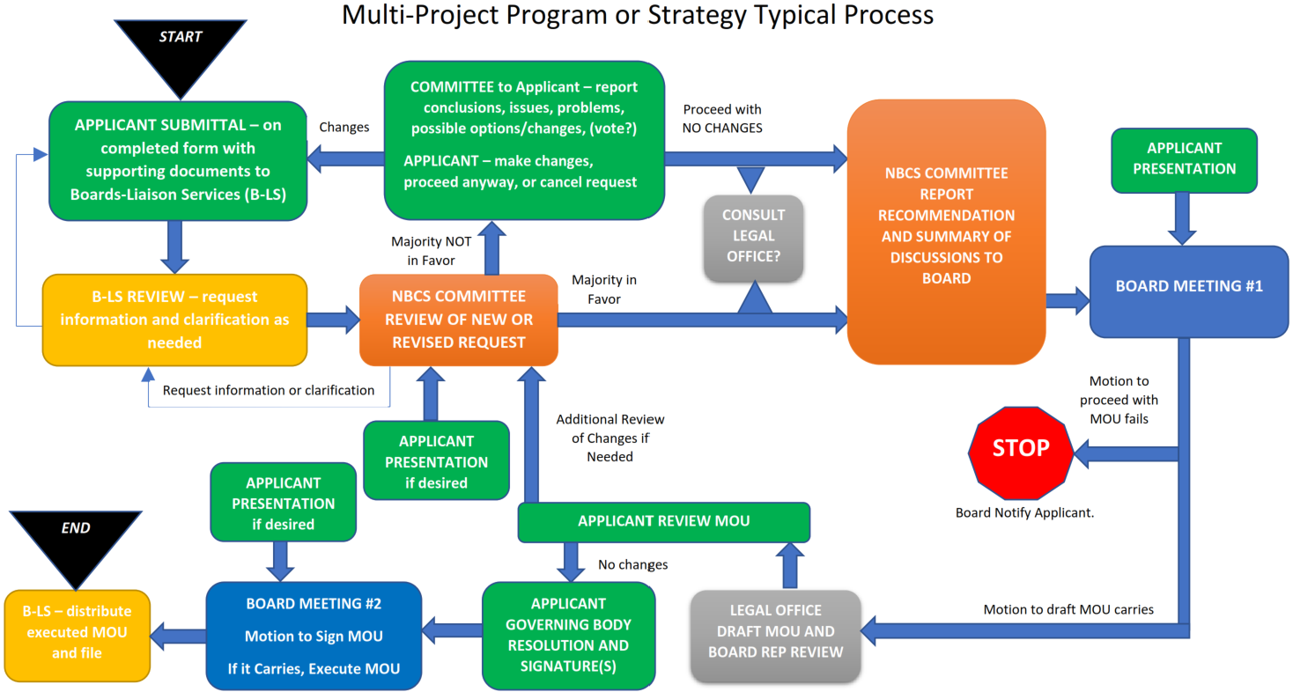
Submitting a Program to the NBCS
Slide 8
Notes:
Transcript
Now for the approval process, as adopted by the Board at its April 16, 2021 meeting. The entire process is shown on one page, shown here on this screen, and in the handout available on the Board’s website shown on the first slide in this presentation. The following discussion will explain that handout. This screen is difficult to read because of size limitations. So, the following screens will look different than the handout, for the sake of clarity.

Slide 9
Multi-Project Program or Strategy
Typical Process
APPLICANT SUBMITTAL – on completed form with supporting documents to Boards-Liaison Services (B-LS)
Slide 9
Notes:
Transcript
The process starts when an entity applies for a program.
The Board views this process as a guide; as stated previously, it doesn’t preclude reasonable adjustments for particular applications.
That’s why this is called a Typical Process.
The application is submitted to NDOT Boards-Liaison Services section, just like any relaxation of standards request would be.
But the process will be different.

Slide 10
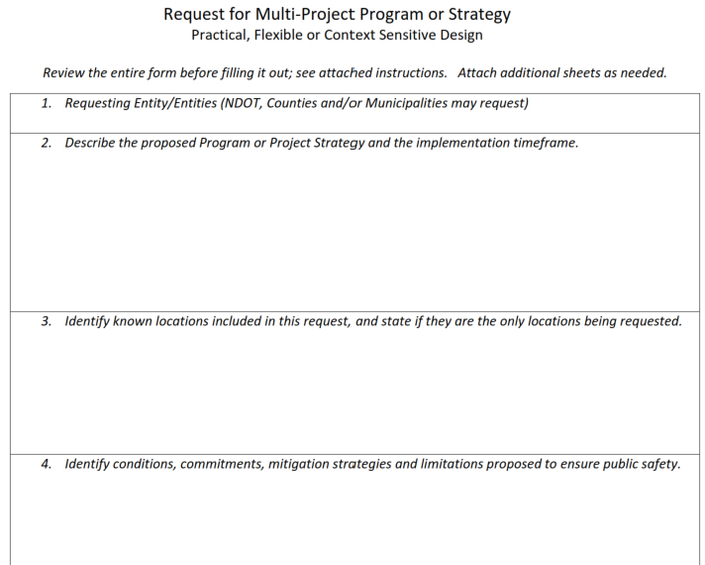
Multi-Project Program or Strategy
Typical Process
APPLICANT SUBMITTAL – on completed form with supporting documents to Boards-Liaison Services (B-LS)
Slide 10
Notes:
Transcript
Much of the same information required for a relaxation of standards request is also required for a multi-project program, but unlike a relaxation of standards request, the Board is proposing an application form. Since Relaxation of Standards requests are regulated by the Nebraska Administrative Code, and these new program requests are not . . .
The purpose of the application form is to communicate what the Board will likely need in order to consider such requests.
A complete submittal will minimize back-and-forth information requests and get through the process quicker. The application form is two pages; there is another page with instructions.
It is very important to demonstrate that there is an overall benefit to the public, and to the network of highways, streets and roads.
Include enough information for the NBCS Board to make an informed decision.
The form is, well, only a form, a means of communicating. Add sheets and reports as needed. Analyses – such as costs and benefits, best value, and life cycle can be attached.
Visuals – photos and even videos can be submitted to help the Board understand.
Requests and presentations need to be thorough and objective, providing facts, supporting data, and justification. There needs to be more justification than simply not being able to afford to build to standards.
When you review the form, note that the applicant will propose conditions and commitments that it believes should be a part of the memorandum of understanding (MOU). An example is building or installing certain features such as signs, delineation, and rumble strips that mitigate the effects of not meeting standards.
The Board may, in approving the program, add conditions and commitments.

Slide 11
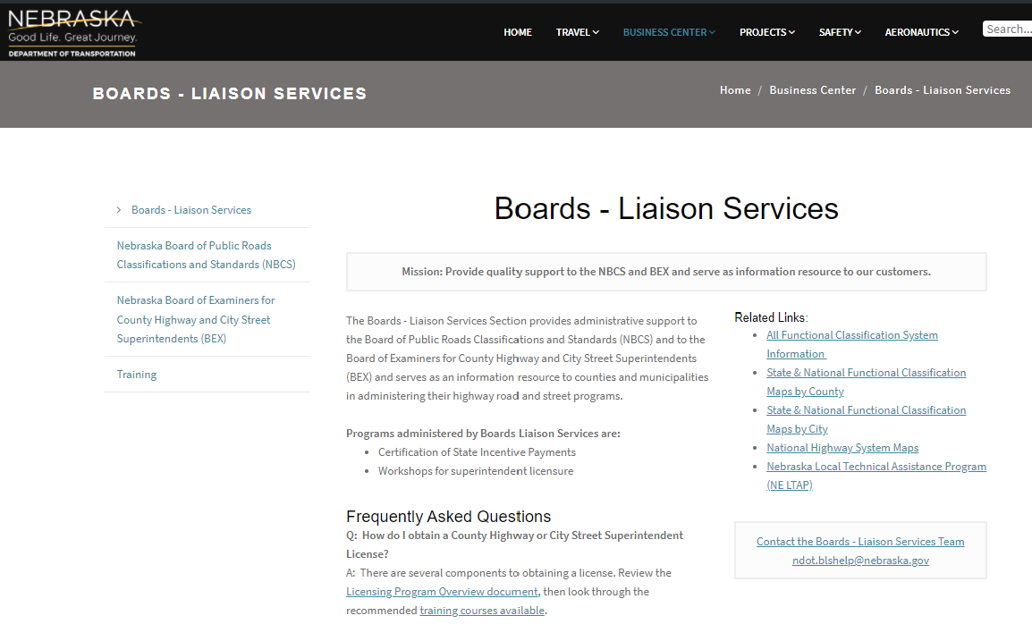
Multi-Project Program or Strategy
Typical Process
APPLICANT SUBMITTAL – on completed form with supporting documents to Boards-Liaison Services (B-LS)
B-LS REVIEW – request information and clarification as needed
https://dot.nebraska.gov/business-center/lpa/boards-liaison/
Slide 11
Notes:
Transcript
NDOT’s Boards-Liaison Services will review the application, and request further information and clarification as needed.
All correspondence, in writing or email, is done via Boards-Liaison Services.

Slide 12
Multi-Project Program or Strategy
Typical Process
APPLICANT SUBMITTAL – on completed form with supporting documents to Boards-Liaison Services (B-LS)
B-LS REVIEW – request information and clarification as needed
NBCS COMMITTEE REVIEW OF NEW OR REVISED REQUEST
Slide 12
Notes:
Transcript
A Board committee, consisting of five members, likely will be assigned to review and make recommendations to the full Board.
Likely, because of the nature of these types of requests, which can potentially cover many roadways on one application.

Slide 13
Multi-Project Program or Strategy
Typical Process
APPLICANT SUBMITTAL – on completed form with supporting documents to Boards-Liaison Services (B-LS)
B-LS REVIEW – request information and clarification as needed
NBCS COMMITTEE REVIEW OF NEW OR REVISED REQUEST
Request information or clarification
APPLICANT PRESENTATION if desired
Slide 13
Notes:
Transcript
The committee can request any information or clarification through Boards-Liaison Services. And, if desired, the applicant may give a presentation to the committee.

Slide 14
Multi-Project Program or Strategy
Typical Process
APPLICANT SUBMITTAL – on completed form with supporting documents to Boards-Liaison Services (B-LS)
Majority NOT in Favor
B-LS REVIEW – request information and clarification as needed
NBCS COMMITTEE REVIEW OF NEW OR REVISED REQUEST
Majority in Favor
Request information or clarification
APPLICANT PRESENTATION if desired
Slide 14
Notes:
Transcript
The committee expresses its non-binding opinion and prepares a report with recommendations to the full Board.

Slide 15
Multi-Project Program or Strategy
Typical Process
APPLICANT SUBMITTAL – on completed form with supporting documents to Boards-Liaison Services (B-LS)
CONSULT LEGAL OFFICE
Majority NOT in Favor
B-LS REVIEW – request information and clarification as needed
NBCS COMMITTEE REVIEW OF NEW OR REVISED REQUEST
Majority in Favor
Request information or clarification
APPLICANT PRESENTATION if desired
Slide 15
Notes:
Transcript
If the Committee favors the proposal, NDOT’s legal office may be consulted for their review of the proposal, since they will likely be involved later in drafting a memorandum of understanding.

Slide 16
Multi-Project Program or Strategy
Typical Process
COMMITTEE to Applicant – report conclusions, issues, problems, possible options/changes
APPLICANT – make changes, proceed anyway, or cancel request
APPLICANT SUBMITTAL – on completed form with supporting documents to Boards-Liaison Services (B-LS)
Changes
Majority NOT in Favor
B-LS REVIEW – request information and clarification as needed
NBCS COMMITTEE REVIEW OF NEW OR REVISED REQUEST
Request information or clarification
APPLICANT PRESENTATION if desired
Slide 16
Notes:
Transcript
If the Committee is not in favor of the proposal, it will communicate the reasons to the applicant and to the Board. The applicant then has three choices.
1) Make changes, which are submitted to Boards-Liaison Services.

Slide 17
Multi-Project Program or Strategy
Typical Process
COMMITTEE to Applicant – report conclusions, issues, problems, possible options/changes
APPLICANT – make changes, proceed anyway, or cancel request
APPLICANT SUBMITTAL – on completed form with supporting documents to Boards-Liaison Services (B-LS)
Proceed with NO CHANGES
Changes
CONSULT LEGAL OFFICE
Majority NOT in Favor
B-LS REVIEW – request information and clarification as needed
NBCS COMMITTEE REVIEW OF NEW OR REVISED REQUEST
Request information or clarification
APPLICANT PRESENTATION if desired
Slide 17
Notes:
Transcript
2) Proceed without changes and take its chances with the full Board. Again, NDOT’s legal office reviews the proposal.

Slide 18
Multi-Project Program or Strategy
Typical Process
COMMITTEE to Applicant – report conclusions, issues, problems, possible options/changes
APPLICANT – make changes, proceed anyway, or cancel request
APPLICANT SUBMITTAL – on completed form with supporting documents to Boards-Liaison Services (B-LS)
Changes
STOP
Majority NOT in Favor
B-LS REVIEW – request information and clarification as needed
NBCS COMMITTEE REVIEW OF NEW OR REVISED REQUEST
Request information or clarification
APPLICANT PRESENTATION if desired
Slide 18
Notes:
Transcript
3) Cancel the request.

Slide 19
Multi-Project Program or Strategy
Typical Process
COMMITTEE to Applicant – report conclusions, issues, problems, possible options/changes
APPLICANT – make changes or proceed anyway
APPLICANT SUBMITTAL – on completed form with supporting documents to Boards-Liaison Services (B-LS)
Proceed with NO CHANGES
CONSULT LEGAL OFFICE
Majority NOT in Favor
B-LS REVIEW – request information and clarification as needed
NBCS COMMITTEE REVIEW OF NEW OR REVISED REQUEST
Majority in Favor
Request information or clarification
APPLICANT PRESENTATION if desired
Slide 19
Notes:
Transcript
The remainder of the process, assuming the applicant hasn’t cancelled the request, picks up on the right side (of the screen) where NDOT’s legal office reviews the proposal.

Slide 20
Multi-Project Program or Strategy
Typical Process
COMMITTEE to Applicant – report conclusions, issues, problems, possible options/changes
APPLICANT – make changes or proceed anyway
APPLICANT SUBMITTAL – on completed form with supporting documents to Boards-Liaison Services (B-LS)
Proceed with NO CHANGES
NBCS COMMITTEE REPORT (RECOMMENDATION AND SUMMARY OF DISCUSSIONS) DISTRIBUTED TO BOARD
CONSULT LEGAL OFFICE
Majority NOT in Favor
B-LS REVIEW – request information and clarification as needed
NBCS COMMITTEE REVIEW OF NEW OR REVISED REQUEST
Majority in Favor
Request information or clarification
APPLICANT PRESENTATION if desired
Slide 20
Notes:
Transcript
The full Board will be in receipt of the Committee’s recommendation.

Slide 21
Multi-Project Program or Strategy
Typical Process
APPLICANT PRESENTATION
DRAFT MOU AND NBCS COMMITTEE REPORT (RECOMMENDATION AND SUMMARY OF DISCUSSIONS) DISTRIBUTED TO BOARD
BOARD MEETING #1
Slide 21
Notes:
Transcript
The Board considers the request at a public meeting. The applicant would usually make a presentation at this meeting. The graphic indicates Board Meeting #1 because a second meeting will be necessary to sign the MOU if all is well.

Slide 22
Multi-Project Program or Strategy
Typical Process
STOP
APPLICANT PRESENTATION
Motion to proceed with MOU fails
DRAFT MOU AND NBCS COMMITTEE REPORT (RECOMMENDATION AND SUMMARY OF DISCUSSIONS) DISTRIBUTED TO BOARD
BOARD MEETING #1
LEGAL OFFICE DRAFT MOU AND BOARD REP REVIEW
Motion to draft MOU carries
Slide 22
Notes:
Transcript
The Board decides to approve, or not approve. If it does not approve, the process stops. If approved, an MOU is drafted, specifically for the proposed program, after the meeting, and reviewed by a Board representative.

Slide 23
Multi-Project Program or Strategy
Typical Process
STOP
APPLICANT PRESENTATION
Motion to proceed with MOU fails
DRAFT MOU AND NBCS COMMITTEE REPORT (RECOMMENDATION AND SUMMARY OF DISCUSSIONS) DISTRIBUTED TO BOARD
BOARD MEETING #1
LEGAL OFFICE DRAFT MOU AND BOARD REP REVIEW
Motion to draft MOU carries
APPLICANT REVIEW MOU
Slide 23
Notes:
Transcript
The MOU will be forwarded to the applicant for review and signature by the governing body.

Slide 24
Multi-Project Program or Strategy
Typical Process
APPLICANT GOVERNING BODY RESOLUTION AND SIGNATURE(S)
APPLICANT REVIEW MOU
No changes to MOU
Slide 24
Notes:
Transcript
This shows the case where governing body acts per its procedures at a public meeting and signs the MOU without changes.

Slide 25
Multi-Project Program or Strategy
Typical Process
REVIEW BY BOARD REP, COMMITTEE , AND/OR BOARD AS APPROPRIATE
B-LS
Governing Body Makes Changes to MOU
APPLICANT GOVERNING BODY RESOLUTION AND SIGNATURE(S)
APPLICANT REVIEW MOU
No changes to MOU
Slide 25
Notes:
Transcript
If the governing body chooses to make changes to the MOU at this point, the Board will need to decide to accept or not accept the changes.
The governing body’s changes to the MOU are returned to Boards-Liaison Services.
Changes will be reviewed by a Board representative or possibly at a public meeting by the full Board, or possibly both, depending on the changes.
On the one-page handout of this process provided on the Board’s website, the arrow points to the NBCS Committee as the receiver of the MOU changes; physically though, the changes are sent to Boards-Liaison Services, but the Committee, or a designated Board member, would likely review the changes anyway, and is so shown that way on the handout. The screen you are looking at is correct; all correspondence, in writing or email, is done via Boards-Liaison Services.

Slide 26

Multi-Project Program or Strategy
Typical Process
Not accepted
REVIEW BY BOARD REP, COMMITTEE , AND/OR BOARD AS APPROPRIATE
STOP
B-LS
Governing Body Makes Changes to MOU
Accepted
APPLICANT GOVERNING BODY RESOLUTION AND SIGNATURE(S)
BOARD MEETING #2
Motion to Sign MOU
If it Carries, Execute MOU
APPLICANT REVIEW MOU
No changes to MOU
Slide 26
Notes:
Transcript
Once the governing body has properly executed the MOU, the NBCS Board will make its motion to accept, and sign the MOU at a public meeting.
Although unlikely, the applicant could make another presentation at this public meeting if that is desired or needed. This is shown on your handout, but not shown here.
If the governing body made changes, as shown in the upper track on the screen, and the changes are not acceptable to the Board, the process stops until agreement can be reached or the applicant either cancels the request or doesn’t respond.

Slide 27
Multi-Project Program or Strategy
Typical Process
Not accepted
REVIEW BY BOARD REP, COMMITTEE , AND/OR BOARD AS APPROPRIATE
STOP
B-LS
Governing Body Makes Changes to MOU
Accepted
APPLICANT GOVERNING BODY RESOLUTION AND SIGNATURE(S)
BOARD MEETING #2
Motion to Sign MOU
If it Carries, Execute MOU
APPLICANT REVIEW MOU
No changes to MOU
B-LS – distribute executed MOU and file
Slide 27
Notes:
Transcript
Boards-Liaison Services will distribute the executed MOU to the parties. That’s the process, which provides some structure for these requests. It is a process that could be adjusted over time as all stakeholders gain experience with these programs and strategies.

Slide 28
Primary Considerations
Achieves an overall benefit or a “net” positive benefit.
Roadway is already reasonably improved.
Focuses funding on the primary problem or need.
Reasonably consistent with driver expectancy and system uniformity.
Results in cost savings that could be applied toward other capital and/or system preservations improvements.
Slide 28
Notes:
11/27/2022 changed “a substantial” to “an” in the first bullet to be more consistent with language in the enabling statute 39-2113(7). Transcript not changed.
Transcript
When considering a request for a program, the Board anticipates focusing on five primary considerations.
The following is a brief discussion of each.

Slide 29
Primary Considerations
Achieves an overall benefit or a “net” positive benefit.
Roadway is already reasonably improved.
Focuses funding on the primary problem or need.
Reasonably consistent with driver expectancy and system uniformity.
Results in cost savings that could be applied toward other capital and/or system preservations improvements.
Slide 29
Notes:
11/27/2022 changed “a substantial” to “an” in the first bullet to be more consistent with language in the enabling statute 39-2113(7). Transcript not changed.
Transcript
A substantial overall benefit or a “net” overall benefit is required by the statute 39-2113(7). In not meeting standards, the applicant must quantify the benefits of the strategy or, in the case of context sensitive design, qualitatively state the benefits. The Board will want some assurance that safety performance, driver expectancy and uniformity with other similar roadways in the network are as good or better than the existing design. Analyses must be well thought out and based on industry recognized research and policy, such as AASHTO, TRB, FHWA and other recognized sources, policies and methods.

Slide 30
Primary Considerations
Achieves an overall benefit or a “net” positive benefit.
Roadway is already reasonably improved.
Focuses funding on the primary problem or need.
Reasonably consistent with driver expectancy and system uniformity.
Results in cost savings that could be applied toward other capital and/or system preservations improvements.
Slide 30
Notes:
11/27/2022 changed “a substantial” to “an” in the first bullet to be more consistent with language in the enabling statute 39-2113(7). Transcript not changed.
Transcript
1969 legislation anticipated, or at least had the stated goal, of upgrading all highways, roads and streets to NBCS standards. For the past fifty years and longer, entities have been working toward this, resulting in today’s system that is in a large part uniform across the state and mostly meeting driver expectancy.
However, some roads may not have been upgraded, often due to lack of funding.
The Board does not anticipate approving a program that accepts such roadways as they are, believing that entities must continue to strive to improve them in terms of safety performance, driver expectancy and uniformity.
There must be reasonable uniformity and satisfaction of driver expectancy existing for roadways included in the request.
One way that may satisfy this consideration is to show that roadways included in the proposed program have been constructed in compliance with historic design standards, whether New, Reconstructed or 3R standards, OR criterium, formal guidelines or the industry’s prevailing standard of care at the time it was constructed or improved.

Slide 31
Primary Considerations
Achieves an overall benefit or a “net” positive benefit.
Roadway is already reasonably improved.
Focuses funding on the primary problem or need.
Reasonably consistent with driver expectancy and system uniformity.
Results in cost savings that could be applied toward other capital and/or system preservations improvements.
Slide 31
Notes:
11/27/2022 changed “a substantial” to “an” in the first bullet to be more consistent with language in the enabling statute 39-2113(7). Transcript not changed.
Transcript
It is important for applicants to accurately describe the primary problem(s) or need(s) for roadways included in a proposed program, how funding will address those, the net overall benefits, and why it makes good sense to not build to Board design or maintenance standards.

Slide 32
Primary Considerations
Achieves an overall benefit or a “net” positive benefit.
Roadway is already reasonably improved.
Focuses funding on the primary problem or need.
Reasonably consistent with driver expectancy and system uniformity.
Results in cost savings that could be applied toward other capital and/or system preservations improvements.
Slide 32
Notes:
11/27/2022 changed “a substantial” to “an” in the first bullet to be more consistent with language in the enabling statute 39-2113(7). Transcript not changed.
Transcript
Any proposed program must demonstrate that driver expectancy and system uniformity will be maintained. In other words, drivers won’t be confronted with something unfamiliar or uncharacteristic and roadways will be reasonably like other roadways similarly classified AFTER THE PROJECT(S) ARE BUILT.

Slide 33
Primary Considerations
Achieves an overall benefit or a “net” positive benefit.
Roadway is already reasonably improved.
Focuses funding on the primary problem or need.
Reasonably consistent with driver expectancy and system uniformity.
Results in cost savings that could be applied toward other capital and/or system preservations improvements.
Slide 33
Notes:
11/27/2022 changed “a substantial” to “an” in the first bullet to be more consistent with language in the enabling statute 39-2113(7). Transcript not changed.
Transcript
One of the cornerstones of practical design is that it allows limited funding to be spread over more improvement or maintenance projects. A proposal therefore should show how the program will improve the overall system or network of roadways. Cost savings alone will not lead to Board approval.
Furthermore, since the program proposes to not meet Board standards, justification must be provided for each non-standard value, based on analysis, industry guidelines, research and/or standards of care; there should be a technical basis for not meeting standards. For example, conformity to guidelines adopted by the American Association of State Highway and Transportation Officials (AASHTO); for NDOT projects and programs, refer to State statute 39-1316.
This screen summarizes primary considerations when the Board decides on proposed programs.
As with the process discussed earlier, the Board may need to adjust over time as experience is gained, but these considerations are a starting point.
A proposal needs to make common sense, and also fit within the context of the entire system or network of roadways.

Slide 34
Summary – Practical Design
A “practical design” program is a group or series of works or projects that have NBCS approval to not meet some of its design and maintenance standards.
With that approval, the individual works or projects do not need a relaxation of standards from the NBCS.
A program consists of projects that address
  the primary problem or need,
  extending the life of assets, or
  context sensitive design.
Slide 34
Notes:
11/27/2022 new slide
Transcript
To summarize, a program consists of two or more projects that have NBCS approval to not meet some of its design and maintenance standards.
That means, once a program is approved by the NBCS, individual works or projects that fit the program do not have to come to the NBCS Board for a relaxation of standards.
Such programs address the primary problem or need for the roadway segments involved, or extend the life of those assets, or fit the roadway into its surroundings using context sensitive design.

Slide 35
NDOT
Boards-Liaison Services
PO Box 94759
Lincoln, NE 68509
Nebraska Board of Public Roads Classifications & Standards (NBCS)
Contact Information
ndot.blshelp@nebraska.gov
402-479-4436
Boards – Liaison Services Section
November 27, 2022
Slide 35
Notes:
11/27/2022 changed the version date and the NBCS logo on the slide, no changes to the Transcript.
Transcript
The purpose of this video was to share the Board’s proposed process for practical design programs and strategies.
The NBCS cooperates with the Nebraska Department of Transportation (NDOT), counties and municipalities to get these programs approved.
All questions and comments are to be directed to Boards-Liaison Services staff. See the contact information on this screen.

