Slide 1
Records Management for Nebraska Public Entities
Nebraska County Highway and City Street Superintendents
Kearney, NE
Notes:
As an appointed licensed superintendent, you may be responsible for managing the many written records generated by the road or street department.
So what? Why is that important? What should be done with all of that paperwork?
RECORDS MANAGEMENT IS NOT OPTIONAL!

Slide 2
What is a “Record”?
Any material that documents a transaction, decision or activity of public business.
Design plans
Right-of-way acquisition Documents
Contract
Interlocal agreement
One- and Six-Year plan
Annual Report (SSAR)
Budget Report
Plat Map
Photograph
Memo
Vehicle Operator Report
Letter
Meeting minutes
Field notebook
Contractor invoice
Grading computations
Weigh ticket
Equipment repair receipt
Maintenance activity
Bridge inspection
Policy
Disciplinary action
Gravel and rock report
Inventory
Gas Truck Tank deliver sheet
Notes:
What do we mean by a “record?”
RECORD: Any material that documents a transaction, decision or activity of public business. (Reference: SOS Tutorial Video, Slide 41)
It could be a set of design plans, right-of-way acquisition documents, a contract, an interlocal agreement, a One- and Six-Year plan, a budget, a map, a photograph, a memo, a letter, meeting minutes, and so forth.
ESSENTIAL RECORDS: records that are critically important to the continued functioning of, or re-building of and agency in the event of a disaster.

Slide 3
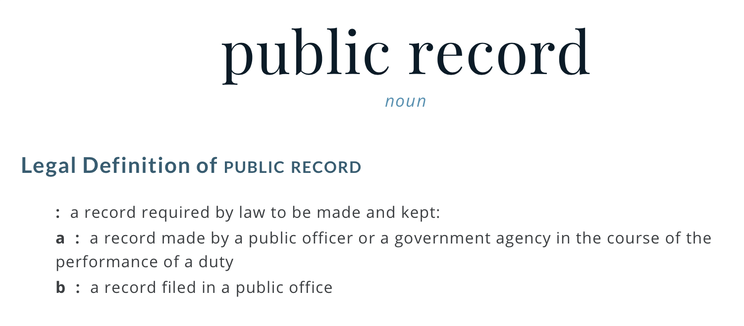
What is a “Public Record”?
Notes:
What do we mean by a “public record?”
A record required by law to be made and kept.
A record that is made by a public officer (such as a County Highway or City Street Superintendent), or that is filed in a public office.
Example: deeds and easements filed in the county courthouse.

Slide 4
Records are information … not format
Public records encompass all aspects of a public agency’s work and can be on paper or electronic.
Notes:
Paper, e-mail, on a computer, or in the cloud. The form or material don’t matter.
Image Source: http://www.tripwire.com/state-of-security/wp-content/uploads/cache//shutterstock_355975007/3259250916.jpg

Slide 5
Why Must Agencies Keep Records?
To effectively carry out an agency’s mission
It’s public money!
Accountability & Transparency
Answering to the People
Conduct daily business
Documentation of Decisions
Ease transitions
Recover from disaster
Notes:
1 – Records are critical to the functioning of all government agencies.
5 – you won’t be in your position forever! When you become Superintendent, you likely want to inherit a good set of records! Do the same for the next person!!

Slide 6
The Life of a Record
Record Management: The administrative and managerial activities related to managing records throughout their life cycle.
Creation/Receipt
Maintenance & Use
Disposition
Destruction
Preservation
Notes:
All records have a life span, or life cycle.
State Archives are at 12th & R St in Lincoln, managed by the State Historical Society. They keep state statutes and local laws, newspapers, geological records, organization records,
Some records do not need to be kept. Not all e-mails, not all notes, etc. need to be kept. Your agency should have a Records Management Schedule.

Slide 7
Record Management Goals
Effectively carry out an agency’s mission
Protect the rights of residents
Accountability through public access
Preserve records of permanent value
Notes:
There are only about 20 copies of the Declaration of Independence, solely because people realized the need to preserve that document.
What needs to be preserved, and for how long?

Slide 8
Elements of a Records Management Program
A strong policy and financial support from the governing or supervising authority
Standard policies and procedures
A filing and indexing system
A regular inventory of records
Records retentions schedules
Identify the period of time records are to be preserved
Notes:
Set up a procedure for dealing with documents day-to-day so it doesn’t end up being an overwhelming chore at some point.

Slide 9
Elements of a Records Management Program, cont’d
Appropriate use of technology to create, store and retrieve records
Secure and cost-effective storage
Identifying and preserving essential (vital) records
Destroying obsolete records

Slide 10
It’s the Law
Managing records is not optional.
Most entities have their own laws.
Local
State
Federal

Slide 11
Benefits of Record Management
Identify and protect essential (vital) records
Locate information
Reduce storage volume
Improve standard operating procedures
Reduce costs
Improve customer relations
Improve public trust and accountability
Reduce liability risks

Slide 12
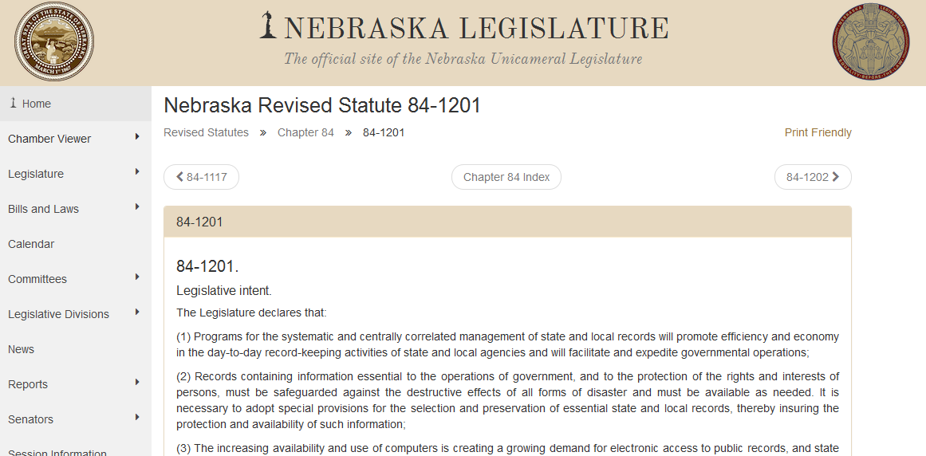
Neb. Rev. Stat. §§84-1201 to 84-1228
Notes:
Secretary of State is the keeper of Records Management Schedules.

Slide 13
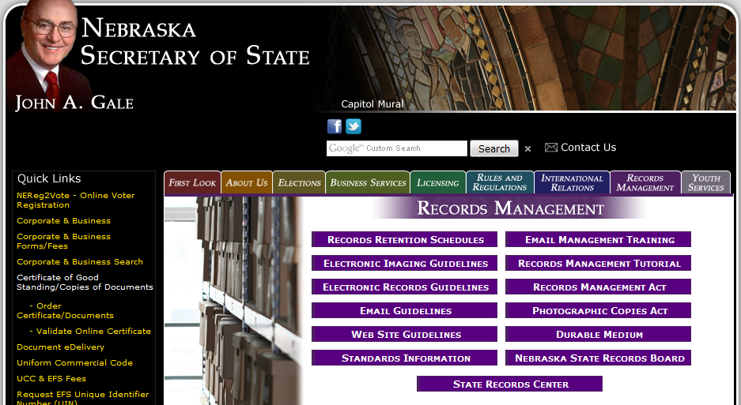
Records Management
http://www.sos.ne.gov/dyindex.html
http://www.sos.ne.gov/records-management/records_mgmt_tutorial.html
Notes:
The Secretary of State is the agency responsible for Records Management.
Their website has a 90-minute tutorial that provides more detail than this presentation. It is oriented more toward disaster preparedness, but does present the basics of records management.

Slide 14
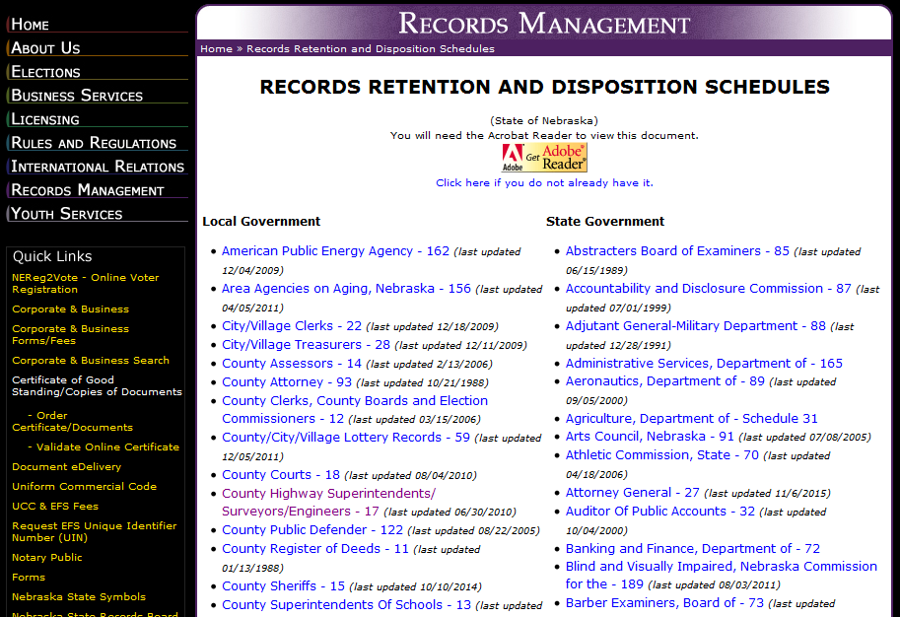
and more Local Govt (60 total)

Slide 15
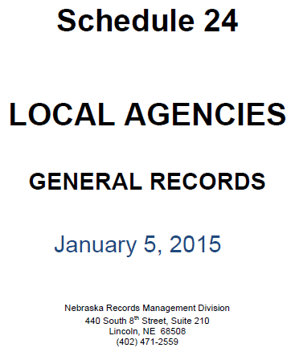

Slide 16
Municipalities
Need to review several different schedules to know all requirements

Slide 17
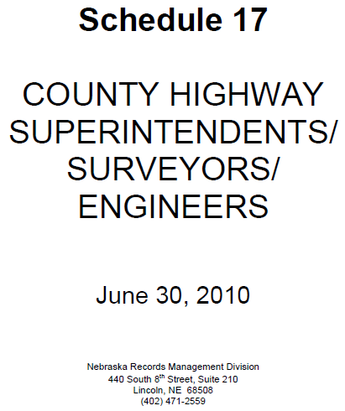
Counties
Need to review several different schedules to know all requirements
Thank you to:
Notes:
How long do the Vehicle Operator Reports need to be kept before disposing of them? Dispose of after 2 Years.

Slide 18
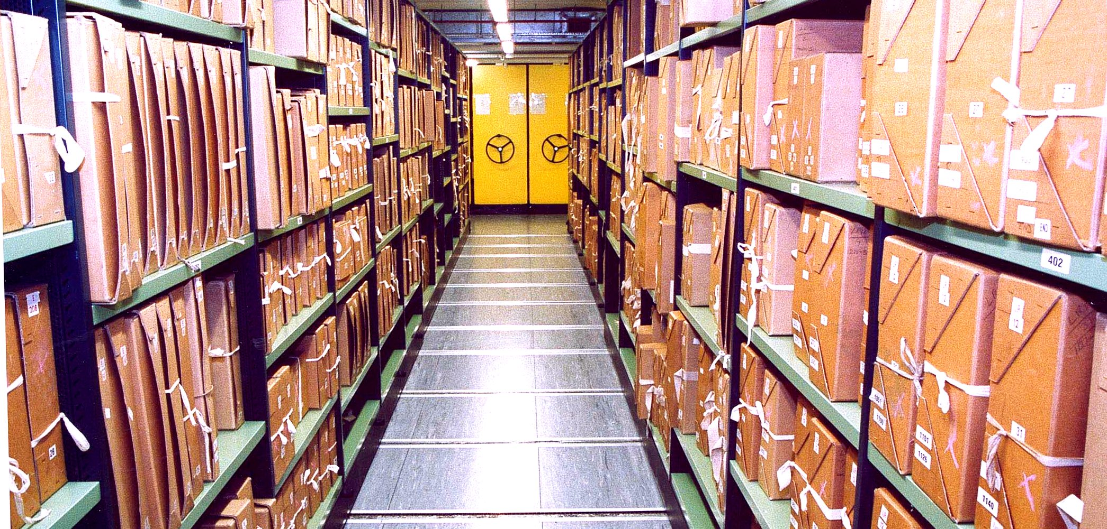
Questions?

