Slide 1
District Utility Program Meeting
District 3
October 10, 2023
Notes:
HDR (Kristen, Amanda or Alyssa)

Slide 2
This meeting is being recorded
Notes:
HDR (Kristen, Amanda or Alyssa)

Slide 3
Welcome
Before we begin, let’s have a brief safety moment.
In-Person Attendees
Emergency Exits
Tornado Shelter
911 Caller
AED Location
Restrooms
Virtual Attendees
Unmute yourself or use your chat box if you are in an emergency situation.
Notes:
NDOT Utility Coordinator (In-person safety briefing)
HDR (Kristen, Amanda or Alyssa) (Virtual safety briefing)

Slide 4
Agenda
Introductions
Utility Program Updates
Construction Activities vs. Utility Conflicts
Construction Projects Review
Outstanding 2023 Construction Projects
2024 Construction Projects
2025 Construction Projects
Questions & Wrap Up
Notes:
HDR (Kristen, Amanda or Alyssa)

Slide 5
Introductions
Notes:
HDR (Kristen, Amanda or Alyssa)

Slide 6
Introduce Yourself
Introduce yourself and share:
Name
Organization
Role
Favorite Pizza Topping
In-Person Attendees
Please go around the room and introduce yourself.
Virtual Attendees
Please type the information in the chat box.
Notes:
HDR (Kristen, Amanda or Alyssa)

Slide 7
Utility Program Updates
Notes:
Jamie Mikkleson

Slide 8
Key Outcome
To improve utility coordination from Design through Construction.
Notes:
Jamie Mikkleson

Slide 9
Improvement Emphasis
Communication during planning and construction
Improved utility data collection and plan presentation
Construction schedule coordination
Notes:
Jamie Mikkleson

Slide 10
Ndot utility section
Notes:
Jamie Mikkleson

Slide 11
Utilities Organization Structure
Kyle Keller
Katie Acevedo
Katharine Fischer
Don Horton
Rhett Robinson
Dave Hansen
Curt Yager
Districts 1 & 8
Districts 2 & 3
District 4
Districts 5, 6, & 7
Notes:
Jamie Mikkleson

Slide 12
Program level updates
Notes:
Jamie Mikkleson

Slide 13
Accommodation Policy
Sets forth guidelines & requirements for accommodating utility facilities within State Highway Property
In process of completely revamping the policy
Notes:
Jamie Mikkleson

Slide 14
Accommodation Policy
Current Step
Review & comment phase
Next Step
Implementation phase
Internal & FHWA concurrent review
Internal implementation & Stakeholder outreach
Notes:
Jamie Mikkleson

Slide 15
Policy – key changes
Depth of bury by facility type
Update casing requirements for steel pipelines
Outlines NDOT utility coordination process
Expand construction and maintenance requirements
Identifies construction plan and ‘As-Installed’ plan requirements
Addresses change in ownership and abandoned or out of service facilities
Broadband chapter
Notes:
Jamie Mikkleson

Slide 16
Project level updates
Notes:
Jamie Mikkleson

Slide 17
Utility questionnaire
Receive via email from NDOT Utility Coordinator
Action by Utility Company required: ​
Review and provide information for existing facility locations​
Review existing locations for construction conflicts, both temporary and permanent conflicts​
Transmit responses and supporting documentation back to NDOT​
NDOT will track unresponsive utility companies & continue to follow up
Notes:
Jamie Mikkleson

Slide 18
Conflict analysis process
Utility Company will perform Conflict Analysis​
​Review for conflicts with:
Final construction – limits of construction, ROW, ditch grading
Temporary construction – drives, access crossings, phasing
NDOT will review analysis and work with Utility Company
If relocations are required, Utility Company will provide relocation information: ​
Scope of work​
Detailed cost estimate​
Schedule of relocation work​
Notes:
Jamie Mikkleson

Slide 19
Relocation process
NDOT will review and provide comments on relocation plans and detailed cost estimate​
Will be incorporated into the agreement
Master (Blanket) Agreement or Utility Project Agreement​
Only if relocation is reimbursable
Letter of Authorization
Every relocation
Notes:
Jamie Mikkleson

Slide 20
2024 Goals
Implement Utility Accommodation Policy
Identify utility conflicts early
Coordinate utility relocations to be complete by construction start
Professional development of coordinator staff
2024 District Utility Program Meetings – October
Notes:
Jamie Mikkleson

Slide 21
Activities vs. conflicts
When we say… | Think about…
Access Crossings – Contractor ~Pipes or Temp. Bridge | Cranes and large equipment Impacts or proximity to overhead power Piling for temporary bridge
Shoo-flys – Traffic | In addition to access crossings Additional fill Impacts to pedestals, pull boxes, overhead power, etc.
Grade beam on pile | Cranes Impacts or proximity to overhead power
Over-excavation | Possibility on any project Most likely at culverts and locations of known muck
Notes:
Jamie Mikkleson

Slide 22
Activities vs. conflicts
When we say… | Think about…
Concrete Box Culverts | Sheet pile driven at wingwalls Impacts to buried lines Impacts or proximity to overhead power Temporary shoring on phased construction
Culvert Replacements – Phased construction | Potential for temporary shoring Need room (H & V) to construct end treatments
Culvert Replacements – Jacking | Large jacking pits - ~50’x100’, not shown in plans Temporary excavation down to flowline to construct Need room (H & V) to construct end treatments
Notes:
Jamie Mikkleson

Slide 23
Activities vs. conflicts
When we say… | Think about…
Temporary Roads & Drives | Can require grading and ditch work Similar impacts to permanent construction
Guardrail | Posts can impact underground facilities
Sidewalk & ADA work | Pavement removal Shallow service lines
Curb Inlets | 3 ft – 6 ft deep, in most cases Cast in place inlets require extra room for form work
Notes:
Jamie Mikkleson

Slide 24
Construction Projects Review
District 3

Slide 25
Outstanding Construction Year 2023
The following projects will likely not be completed in 2023

Slide 26
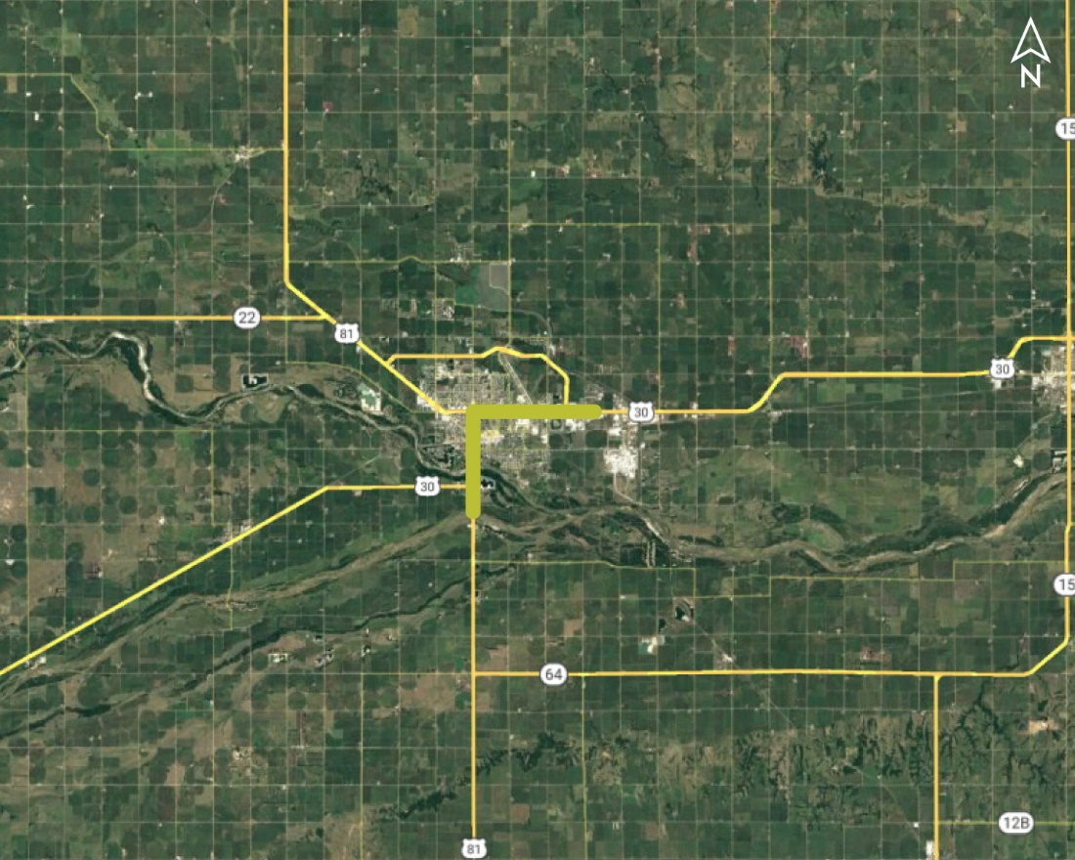
23rd St, Columbus (LET) Project NO.: NH-30-5(134); Control NO.: 32234
Project Length: 2.7
Scope of Work:
Urban Reconstruction

Slide 27
23rd St, Columbus (LET) Project NO.: NH-30-5(134); Control NO.: 32234
Status: Awarded
Right-of-Way: Completed
Traffic Impacts:
Phase Traffic Control
Local Detour
Letting Date: 4/7/2022
Construction Timing: Currently in Construction

Slide 28
23rd St, Columbus (LET) Project NO.: NH-30-5(134); Control NO.: 32234
Anticipated Utilities Impact:
Urban Recon
Anticipated Request from Utilities:
Provide Existing Locations
Coordination with NDOT
Additional Information:
K-Sheets Required
Special Provisions Required
Utilities Involved:
Black Hills Energy, Charter Comm. (Spectrum), City of Columbus, Cornhusker PPD, Eagle Comm., Frontier Comm., Great Plains Comm., Loup River PPD, Lumen (CenturyLink), Midstates Data Transport, Nebraska PPD

Slide 29
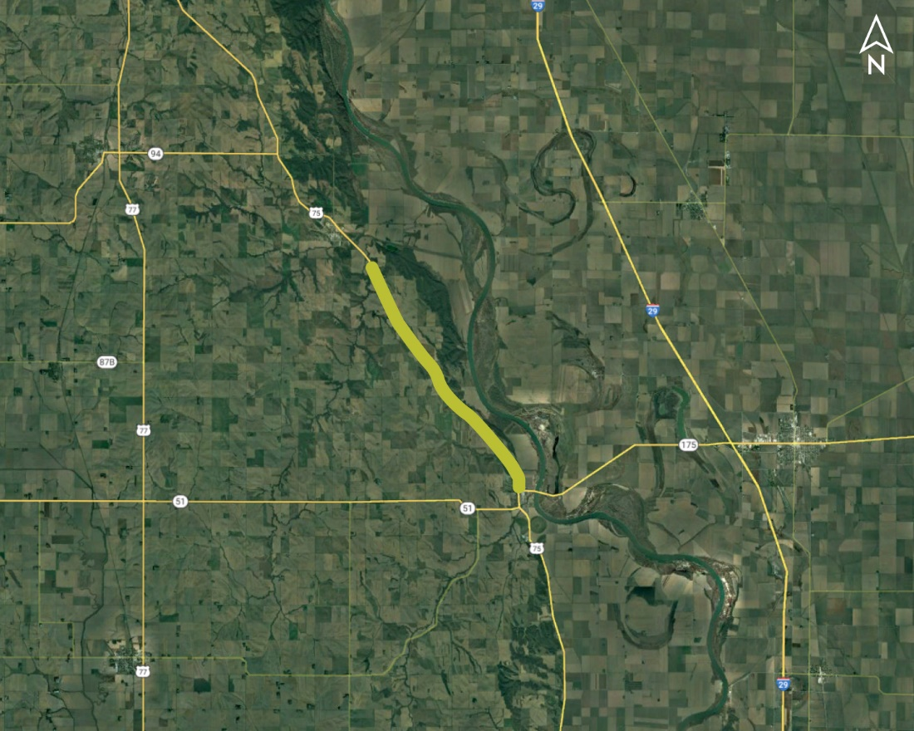
Decatur - Macy (LET) Project NO.: STP-75-3(118); Control NO.: 32139
Project Length: 7.7
Scope of Work:
Resurfacing
Guardrail
Culvert Extension/Replace

Slide 30
Decatur - Macy (LET) Project NO.: STP-75-3(118); Control NO.: 32139
Status: Awarded
Right-of-Way: Not Required
Traffic Impacts:
Phase Traffic Control
Letting Date: 3/2/2023
Construction Timing: Currently in Construction

Slide 31
Decatur - Macy (LET) Project NO.: STP-75-3(118); Control NO.: 32139
Anticipated Utilities Impact:
Culvert Extension/Replacement
Bridge Repair/Replacement
Guardrail
Anticipated Request from Utilities:
Provide Existing Locations
Coordination with NDOT
Additional Information:
No K-Sheets Required
No Special Provisions Required
Utilities Involved:
Burt County PPD, Fastwyre Broadband (ABB), Lumen (CenturyLink), Northeast Nebr. Telephone Co., Village of Decatur

Slide 32
Construction Year 2024
The following projects are anticipated to be let during 2024

Slide 33
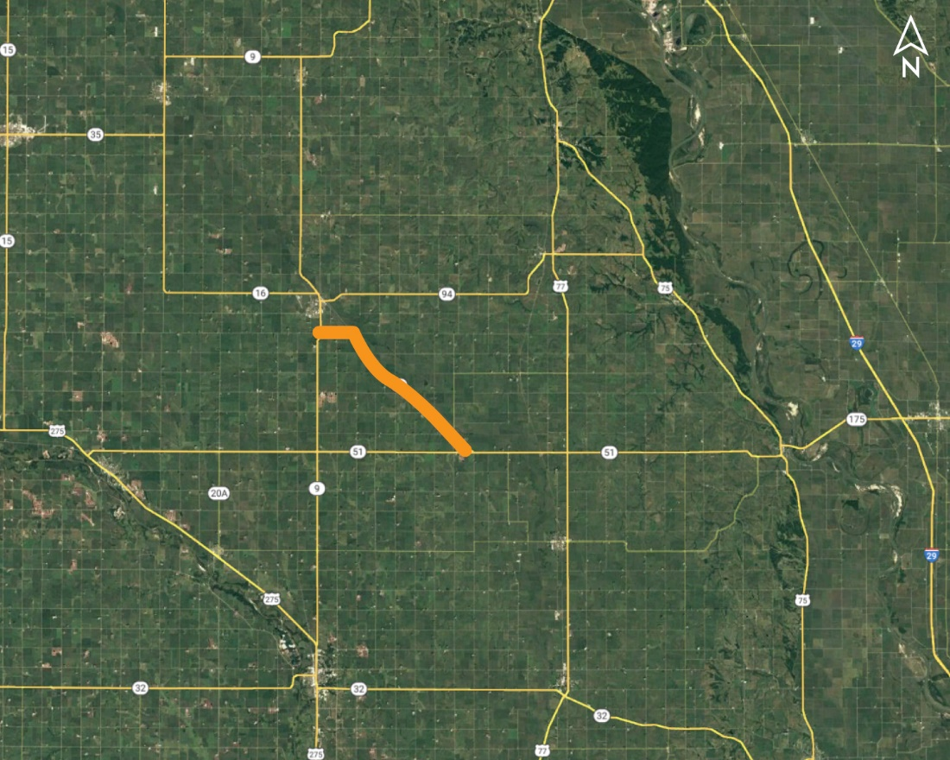
N. Jct. N-51 - S. Jct. N-9 (MS) Project NO.: STP-16-3(110); Control NO.: 32289
Project Length: 10.3
Scope of Work:
Resurfacing
Bridge Replacement
Guardrail

Slide 34
N. Jct. N-51 - S. Jct. N-9 (MS) Project NO.: STP-16-3(110); Control NO.: 32289
Status: Preparing for Bid
Right-of-Way: Completed
Traffic Impacts:
Full Detour
Phase Traffic Control
Letting Date: 10/19/2023
Construction Timing: 6/17/2024

Slide 35
N. Jct. N-51 - S. Jct. N-9 (MS) Project NO.: STP-16-3(110); Control NO.: 32289
Anticipated Utilities Impact:
Culvert Extension/Replacement
Bridge Repair/Replacement
Anticipated Request from Utilities:
Provide Existing Locations
Additional Information:
No K-Sheets Required
Special Provisions Required
Utilities Involved:
Black Hills Energy, Cuming County PPD, Cuming County RWD 1, Great Plains Comm., Nebraska PPD, Village of Bancroft

Slide 36
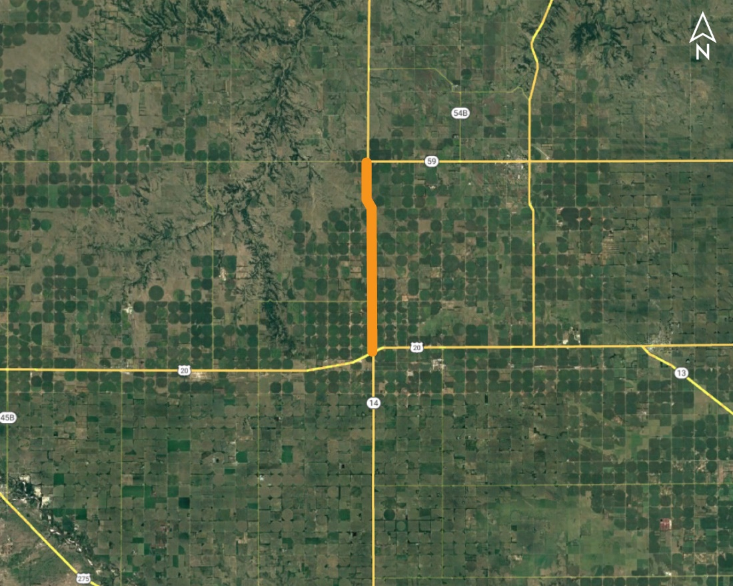
US-20 - N-59 Project NO.: STP-14-4(117); Control NO.: 32284
Project Length: 8.3
Scope of Work:
Resurfacing
Shoulder Work
Guardrail

Slide 37
US-20 - N-59 Project NO.: STP-14-4(117); Control NO.: 32284
Status: Preparing for Bid
Right-of-Way: Completed
Traffic Impacts:
Phase Traffic Control
Letting Date: 12/14/2023
Construction Timing: 7/8/2024

Slide 38
US-20 - N-59 Project NO.: STP-14-4(117); Control NO.: 32284
Anticipated Utilities Impact:
Shoulder Work
Guardrail
Lighting
Anticipated Request from Utilities:
Provide Existing Locations
Additional Information:
No K-Sheets Required
No Special Provisions Required
Utilities Involved:
AT&T Comm., Great Plains Comm., North Central PPD, Northeast Nebr. Telephone Co.

Slide 39
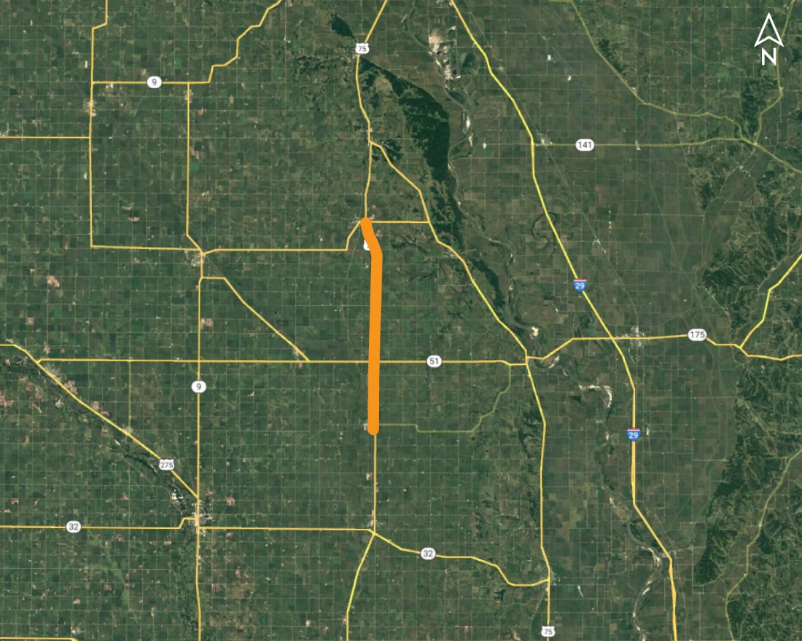
Lyons - Walthill (MS) Project NO.: NH-77-3(126); Control NO.: 31922
Project Length: 17.7
Scope of Work:
Resurfacing
Culvert Extension/Replace
Guardrail

Slide 40
Lyons - Walthill (MS) Project NO.: NH-77-3(126); Control NO.: 31922
Status: Design
Right-of-Way: Completed
Traffic Impacts:
Phase Traffic Control
Letting Date: 5/16/2024
Construction Timing: 8/1/2024

Slide 41
Lyons - Walthill (MS) Project NO.: NH-77-3(126); Control NO.: 31922
Anticipated Utilities Impact:
Shoulder Work
Culvert Extension/Replacement
Guardrail
Anticipated Request from Utilities:
Provide Existing Locations
Additional Information:
No K-Sheets Required
Special Provisions Required
Utilities Involved:
AT&T Comm., Burt County PPD, , City of Lyons, Lower Elkhorn NRD, Lumen (CenturyLink), Nebraska PPD, Zayo Group

Slide 42
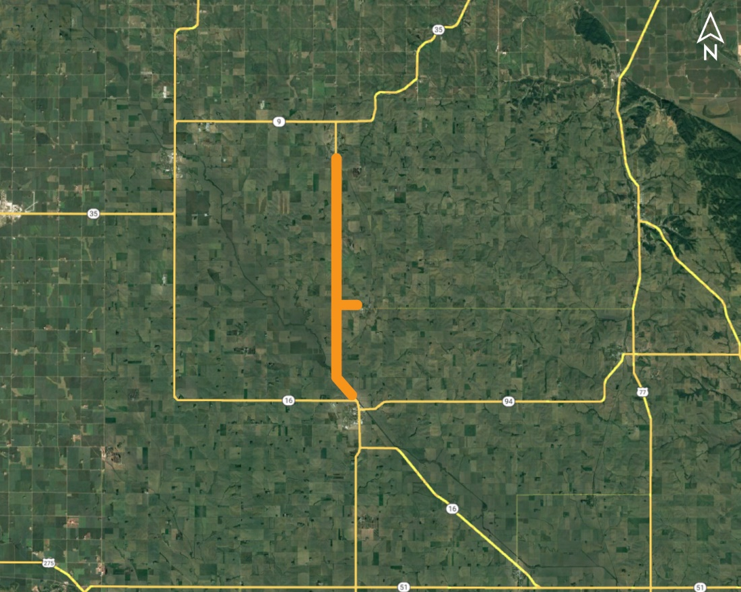
Pender - Emerson (MS) Project NO.: STP-9-4(116); Control NO.: 32136
Project Length: 12.1
Scope of Work:
Resurfacing
Culvert Extension/Replace
Guardrail

Slide 43
Pender - Emerson (MS) Project NO.: STP-9-4(116); Control NO.: 32136
Status: Design
Right-of-Way: Completed
Traffic Impacts:
Phase Traffic Control
Letting Date: 2/1/2024
Construction Timing: 3/11/2024

Slide 44
Pender - Emerson (MS) Project NO.: STP-9-4(116); Control NO.: 32136
Anticipated Utilities Impact:
Bridge Repair/Replacement
Culvert Extension/Replacement
Guardrail
Anticipated Request from Utilities:
Provide Existing Locations
Additional Information:
No K-Sheets Required
No Special Provisions Required
Utilities Involved:
Black Hills Energy, City of Pender, Fastwyre Broadband (ABB), Great Plains Comm., Lumen (CenturyLink), Middle Missouri Tribes NRD, Northeast Power, Northern Natural Gas, Papio-Missouri, Skywave Wireless, Thurston County Rural Water, Village of Emerson, Village of Pender, Village of Thurston

Slide 45
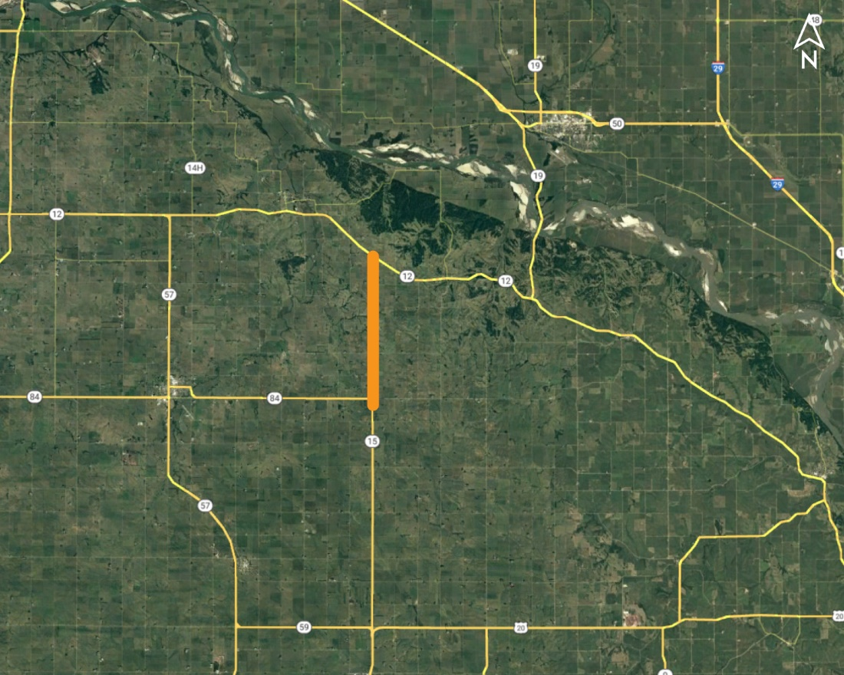
N-12 North & South Project NO.: STP-NH-15-4(122); Control NO.: 32288
Project Length: 9.3
Scope of Work:
Resurfacing
Shoulder Work
Guardrail

Slide 46
N-12 North & South Project NO.: STP-NH-15-4(122); Control NO.: 32288
Status: Design
Right-of-Way: Not Required
Traffic Impacts:
Phase Traffic Control
Letting Date: 2/1/2024
Construction Timing: 7/15/2024

Slide 47
N-12 North & South Project NO.: STP-NH-15-4(122); Control NO.: 32288
Anticipated Utilities Impact:
Culvert Extension/Replacement
New ROW
Guardrail
Anticipated Request from Utilities:
Provide Existing Locations
Additional Information:
No K-Sheets Required
No Special Provisions Required
Utilities Involved:
Black Hills Energy, Cedar Vision Inc, Cedar-Knox PPD, City of Hartington, Great Plains Comm., Hartelco, Lumen (CenturyLink), Northeast Nebr. Telephone Co., Northeast Power

Slide 48
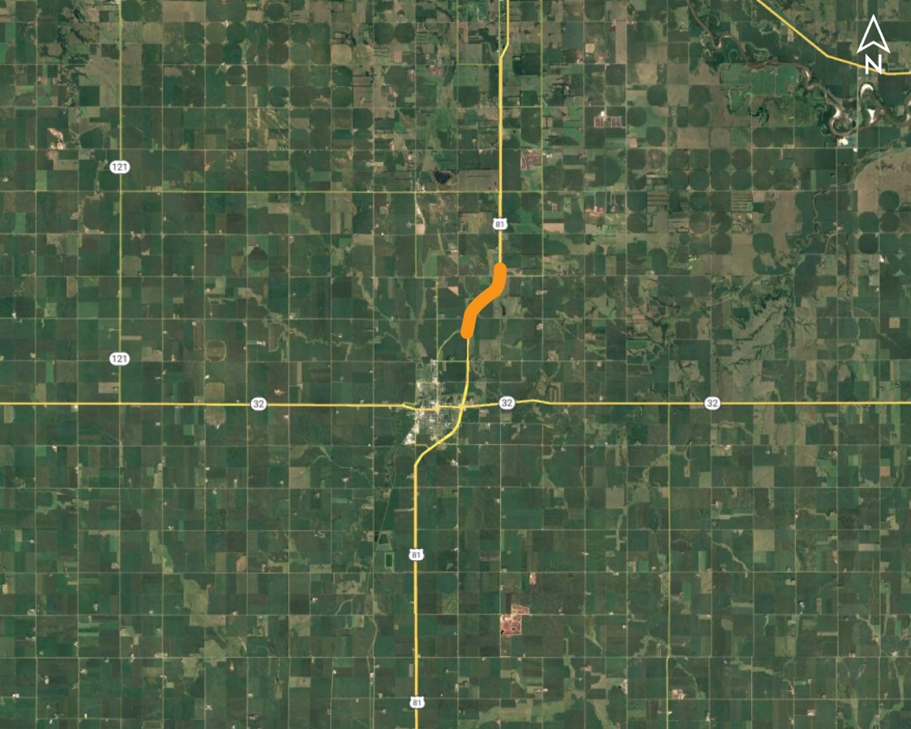
US-81/N Main St Near Madison Project NO.: HSIP-81-3(147); Control NO.: 32350
Project Length: 0
Scope of Work:
Full Depth Pavement
Grading

Slide 49
US-81/N Main St Near Madison Project NO.: HSIP-81-3(147); Control NO.: 32350
Status: Design
Right-of-Way: In Progress
Traffic Impacts:
Phase Traffic Control
Letting Date: 2/1/2024
Construction Timing: 7/29/2024

Slide 50
US-81/N Main St Near Madison Project NO.: HSIP-81-3(147); Control NO.: 32350
Anticipated Utilities Impact:
Full Depth Pavement
Anticipated Request from Utilities:
Provide Existing Locations
Additional Information:
No K-Sheets Required
Special Provisions Required
Utilities Involved:
Black Hills Energy, City of Madison, Frontier Comm., Great Plains Comm., Sparklight Fiber (Cable One)

Slide 51
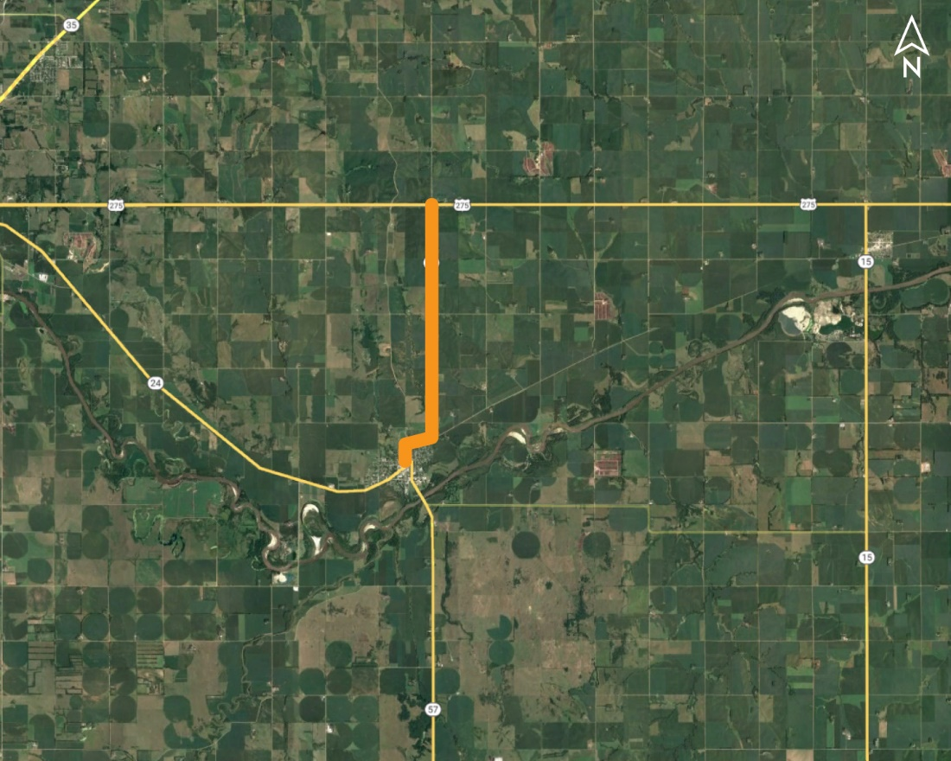
In Stanton & North Project NO.: STP-57-3(111); Control NO.: 32359
Project Length: 5
Scope of Work:
Resurfacing
Grading
Urban Reconstruction

Slide 52
In Stanton & North Project NO.: STP-57-3(111); Control NO.: 32359
Status: Design
Right-of-Way: In Progress
Traffic Impacts:
Phase Traffic Control
Letting Date: 2/29/2024
Construction Timing: 6/10/2024

Slide 53
In Stanton & North Project NO.: STP-57-3(111); Control NO.: 32359
Anticipated Utilities Impact:
Grading
Culvert Extension/Replacement
Anticipated Request from Utilities:
Provide Existing Locations
Additional Information:
K-Sheets Required
Special Provisions Required
Utilities Involved:
Black Hills Energy, City of Stanton, Great Plains Comm., Lumen (Century Link), Sparklight Fiber (Cable One), Stanton County PPD, Stanton Telecom., Tallgrass Energy

Slide 54
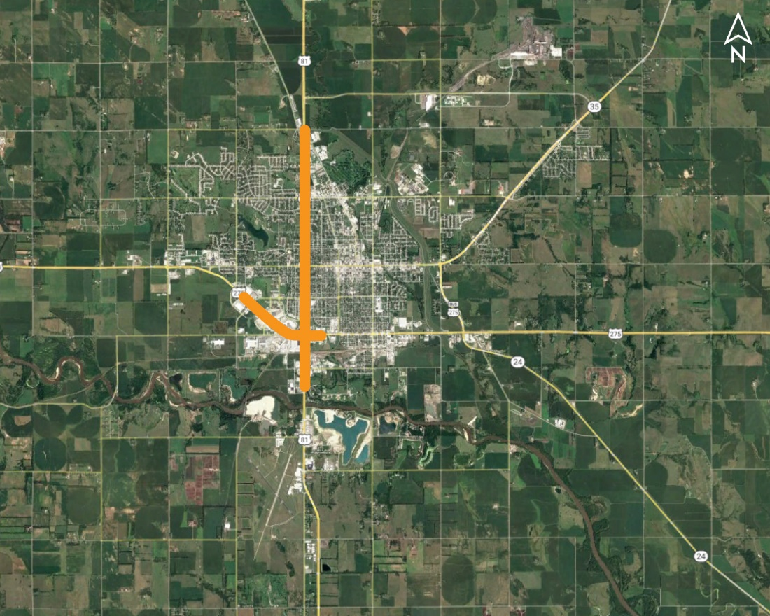
In Norfolk Traffic Signals Project NO.: HSIP-81-3(150); Control NO.: 32363
Project Length: 5.3
Scope of Work:
Misc.

Slide 55
In Norfolk Traffic Signals Project NO.: HSIP-81-3(150); Control NO.: 32363
Status: Design
Right-of-Way: Not Required
Traffic Impacts:
Phase Traffic Control
Letting Date: 2/1/2024
Construction Timing: 4/1/2024

Slide 56
In Norfolk Traffic Signals Project NO.: HSIP-81-3(150); Control NO.: 32363
Anticipated Utilities Impact:
Lighting
Anticipated Request from Utilities:
Provide Existing Locations
Additional Information:
K-Sheets TBD
Special Provisions Required
Utilities Involved:
Allo Comm., Black Hills Energy, City of Norfolk, Lumen (CenturyLink), Midstates Data Trasnport, Nebraska DEQ, Nebraska PPD, NuStar Pipeline, Pierce Telephone Co., Sparklight Internet (CableOne), Unite Private Networks, USCOC N-K

Slide 57
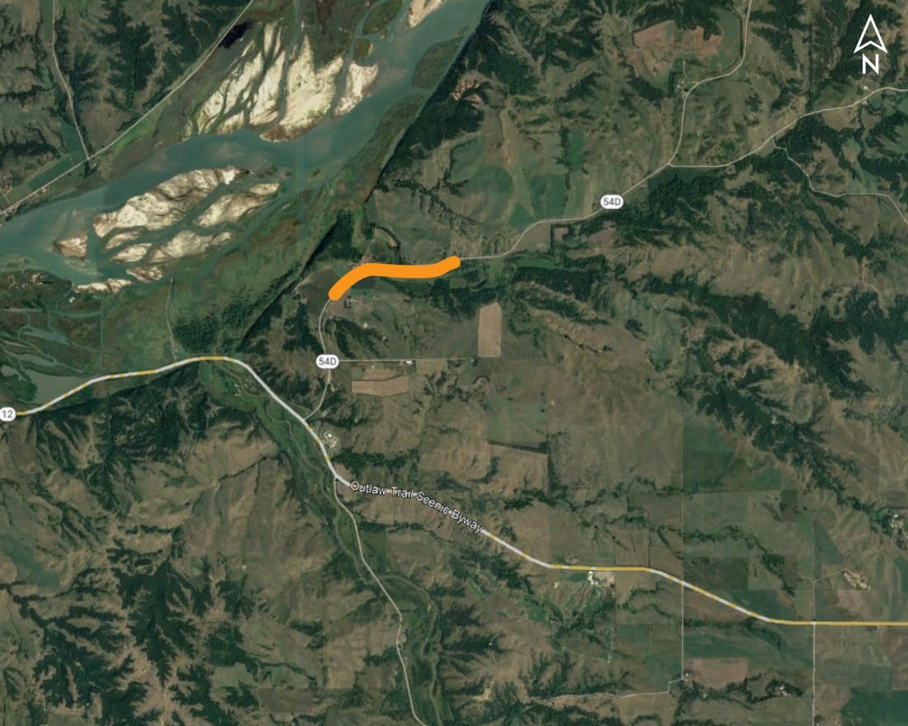
Santee South Bridge (MS) Project NO.: STP-S54D(104); Control NO.: 32278
Project Length: 0
Scope of Work:
Bridge Replacement
Guardrail
Access X-ings & Shoo-Fly

Slide 58
Santee South Bridge (MS) Project NO.: STP-S54D(104); Control NO.: 32278
Status: Design
Right-of-Way: In Progress
Traffic Impacts:
Phase Traffic Control
Letting Date: 2/29/2024
Construction Timing: 6/3/2024

Slide 59
Santee South Bridge (MS) Project NO.: STP-S54D(104); Control NO.: 32278
Anticipated Utilities Impact:
Bridge Repair/Replacement
Anticipated Request from Utilities:
Provide Existing Locations
Additional Information:
K-Sheets: K-Sheets Required
Special Provisions: Special Provisions Required
Utilities Involved:
Bureau of Indian Affairs, Great Plains Comm., North Central PPD

Slide 60
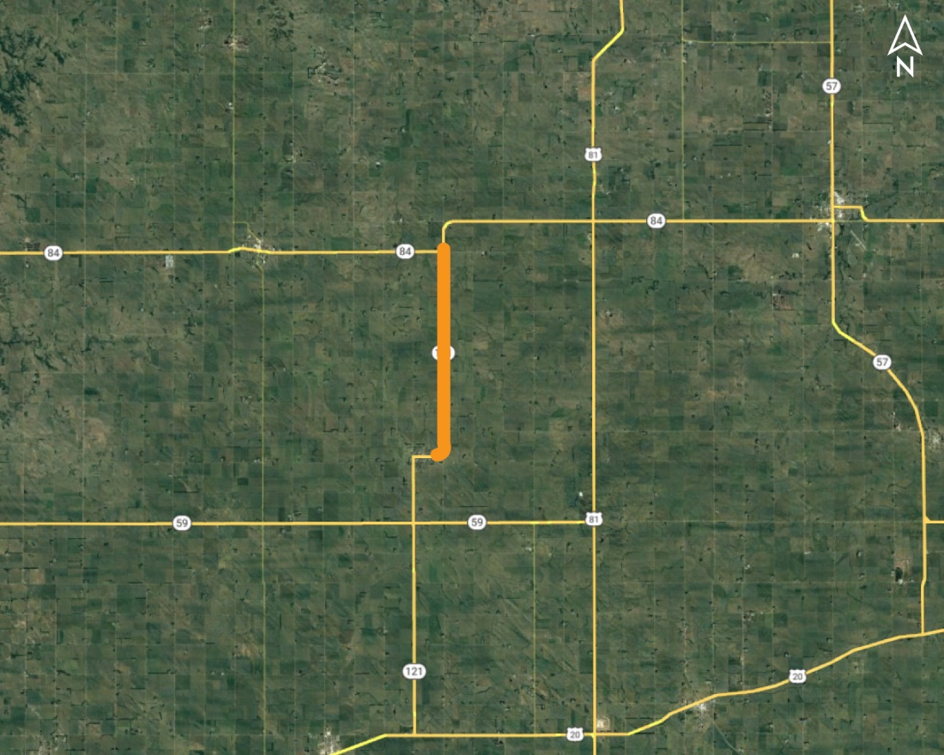
Wausa North Project NO.: STP-121-4(116); Control NO.: 32379
Project Length: 7.1
Scope of Work:
Resurfacing

Slide 61
Wausa North Project NO.: STP-121-4(116); Control NO.: 32379
Status: Design
Right-of-Way: Not Required
Traffic Impacts:
Phase Traffic Control
Letting Date: 5/16/2024
Construction Timing: 8/26/2024

Slide 62
Wausa North Project NO.: STP-121-4(116); Control NO.: 32379
Anticipated Utilities Impact:
Shoulder Work
Anticipated Request from Utilities:
Provide Existing Locations
Additional Information:
No K-Sheets Required
No Special Provisions Required
Utilities Involved:
Black Hills Energy, Cedar-Knox PPD, Great Plains Comm., Village of Wausa, WAPA

Slide 63
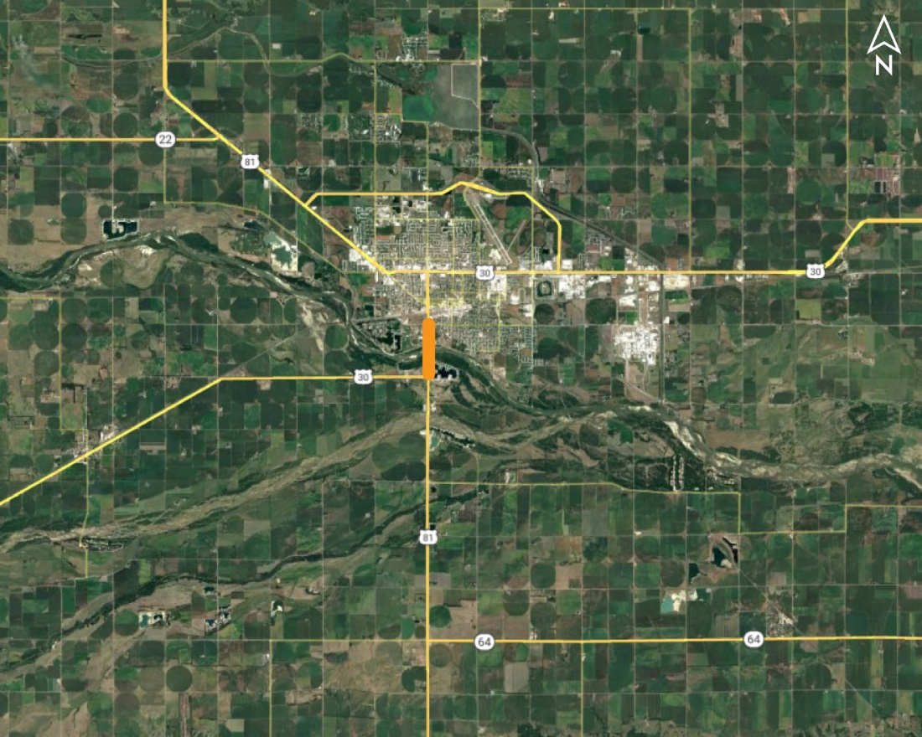
Columbus South Bridges Project NO.: NH-30-5(131); Control NO.: 31983
Project Length: 0
Scope of Work:
Bridge Replacement
Full Depth Pavement
Urban Reconstruction

Slide 64
Columbus South Bridges Project NO.: NH-30-5(131); Control NO.: 31983
Status: Design
Right-of-Way: In Progress
Traffic Impacts:
Phase Traffic Control
Letting Date: 7/25/2024
Construction Timing: 9/23/2024

Slide 65
Columbus South Bridges Project NO.: NH-30-5(131); Control NO.: 31983
Anticipated Utilities Impact:
Bridge Repair/Replacement
Guardrail
Lighting
Anticipated Request from Utilities:
Provide Existing Locations
Additional Information:
K-Sheets TBD
Special Provisions Required
Utilities Involved:
Allo Comm., Black Hills Energy, City of Columbus, Frontier Comm., Great Plains Comm., Loup River PPD, Lumen (CenturyLink)

Slide 66
I-129 over Missouri River, So. Sioux City Project NO.: STR-129-1(1016); Control NO.: 32416
Project Length: 0
Scope of Work:
Bridge Repair

Slide 67
I-129 over Missouri River, So. Sioux City Project NO.: STR-129-1(1016); Control NO.: 32416
Status: Design
Right-of-Way: Not Required
Traffic Impacts:
Other
Letting Date: 12/19/2023
Construction Timing: 3/1/2024

Slide 68
I-129 over Missouri River, So. Sioux City Project NO.: STR-129-1(1016); Control NO.: 32416
Anticipated Utilities Impact:
Bridge Repair/Replacement
Anticipated Request from Utilities:
Coordination with NDOT
Additional Information:
No K-Sheets Required
No Special Provisions Required
Utilities Involved:
City of South Sioux City, Mid American Energy, Sparklight Internet (CableOne)

Slide 69
Construction Year 2025
The following projects are anticipated to be let during 2025

Slide 70
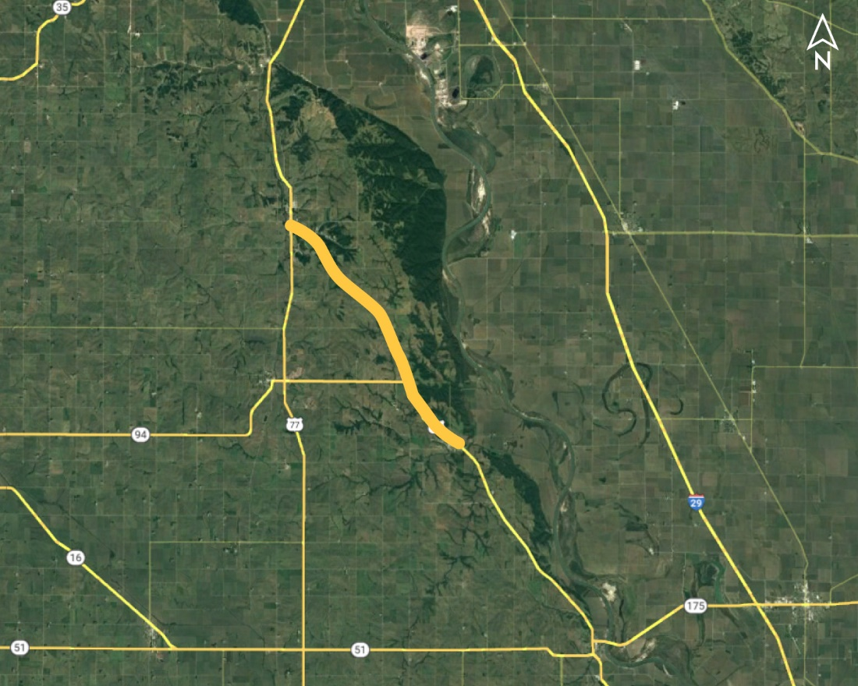
Macy - Winnebago (MS) Project NO.: STP-75-4(115); Control NO.: 31989
Project Length: 10.3
Scope of Work:
Resurfacing
Shoulder Work
Culvert Extension/Replace

Slide 71
Macy - Winnebago (MS) Project NO.: STP-75-4(115); Control NO.: 31989
Status: Design
Right-of-Way: In Progress
Traffic Impacts:
Phase Traffic Control
Letting Date: 8/29/2024
Construction Timing: 5/19/2025

Slide 72
Macy - Winnebago (MS) Project NO.: STP-75-4(115); Control NO.: 31989
Anticipated Utilities Impact:
Culvert Extension/Replacement
Guardrail
Shoulder Work
Anticipated Request from Utilities:
Provide Existing Locations
Coordination with NDOT
Potholing TBD
Additional Information:
No K-Sheets Required
Special Provisions TBD
Utilities Involved:
Black Hills Energy, Burt County PPD, Fastwyre Broadband (ABB), Great Plains Comm., Lumen (CenturyLink), Nebraska PPD, Omaha Tribe of NE, Village of Winnebago, Winnebago Tribe of NE

Slide 73
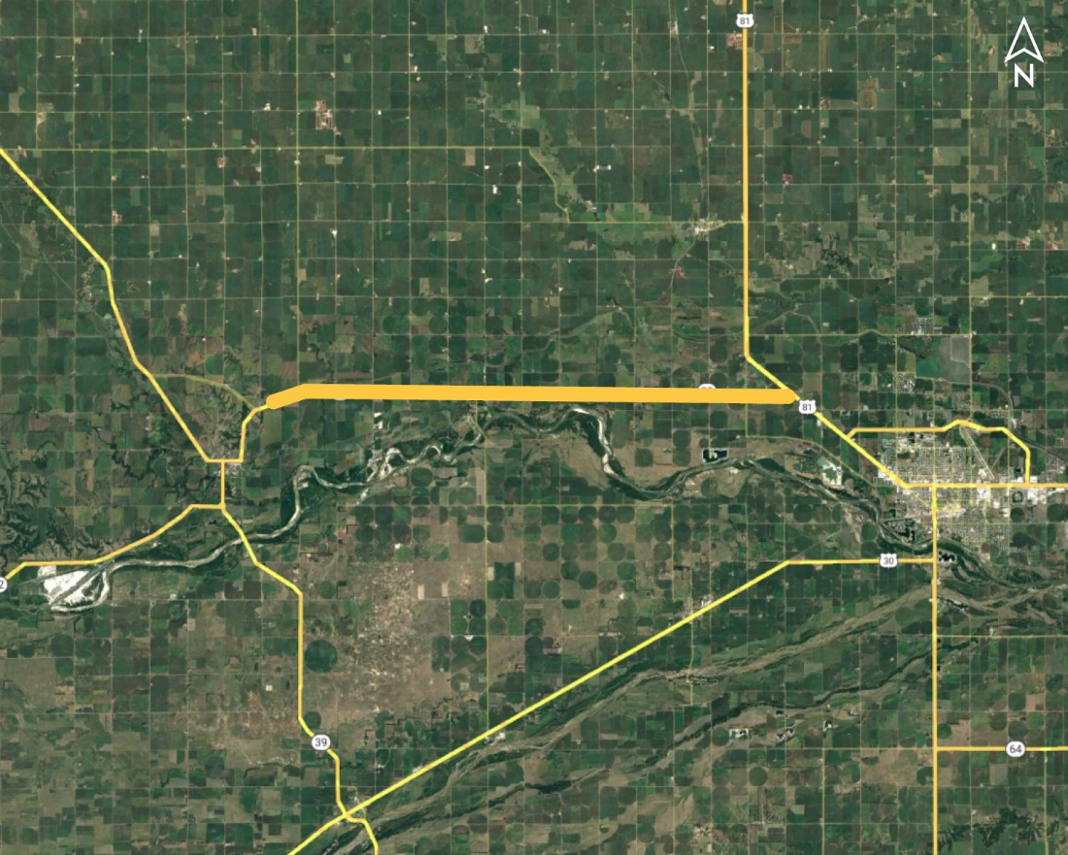
Monroe East & West (MS) Project NO.: STP-22-5(119); Control NO.: 32292
Project Length: 13.2
Scope of Work:
Resurfacing
Bridge Replacement
Urban Reconstruction

Slide 74
Monroe East & West (MS) Project NO.: STP-22-5(119); Control NO.: 32292
Status: Design
Right-of-Way: Completed
Traffic Impacts:
Phase Traffic Control
Local Detour
Letting Date: 8/29/2024
Construction Timing: 3/17/2025

Slide 75
Monroe East & West (MS) Project NO.: STP-22-5(119); Control NO.: 32292
Anticipated Utilities Impact:
Bridge Repair/Replacement
Grading
New ROW
Anticipated Request from Utilities:
Provide Existing Locations
Coordination with NDOT
Locates
Additional Information:
K-Sheets Required
Special Provisions Required
Utilities Involved:
Cornhusker PPD, Frontier Comm., Kinder Morgan, Loup River PPD, Northeast Nebr. Telephone Co., Village of Monroe

Slide 76
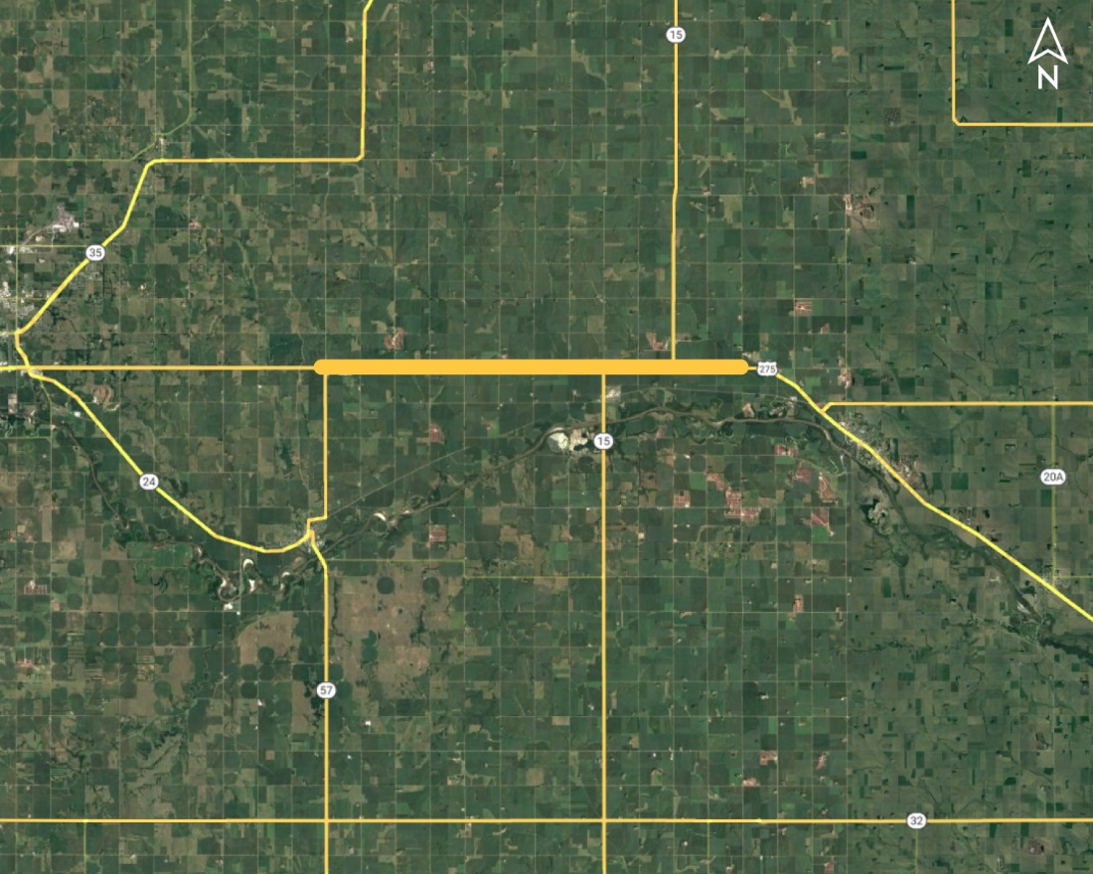
N-57 - East Jct N-15 Project NO.: TIB-275-6(149); Control NO.: 32319A
Project Length: 11.8
Scope of Work:
Full Depth Pavement
Bridge Replacement
Grading

Slide 77
N-57 - East Jct N-15 Project NO.: TIB-275-6(149); Control NO.: 32319A
Status: Design
Right-of-Way: In Progress
Traffic Impacts:
Phase Traffic Control
Letting Date: 8/29/2024
Construction Timing: 4/1/2025

Slide 78
N-57 - East Jct N-15 Project NO.: TIB-275-6(149); Control NO.: 32319A
Anticipated Utilities Impact:
Full Depth Pavement
Grading
Anticipated Request from Utilities:
Provide Existing Locations
Coordination with NDOT
Locates
Additional Information:
K-Sheets Required
Special Provisions Required
Utilities Involved:
Black Hills Energy, Cuming County PPD, Great Plains Comm., Lumen (CenturyLink), Stanton County PPD, Stanton Telecom

Slide 79
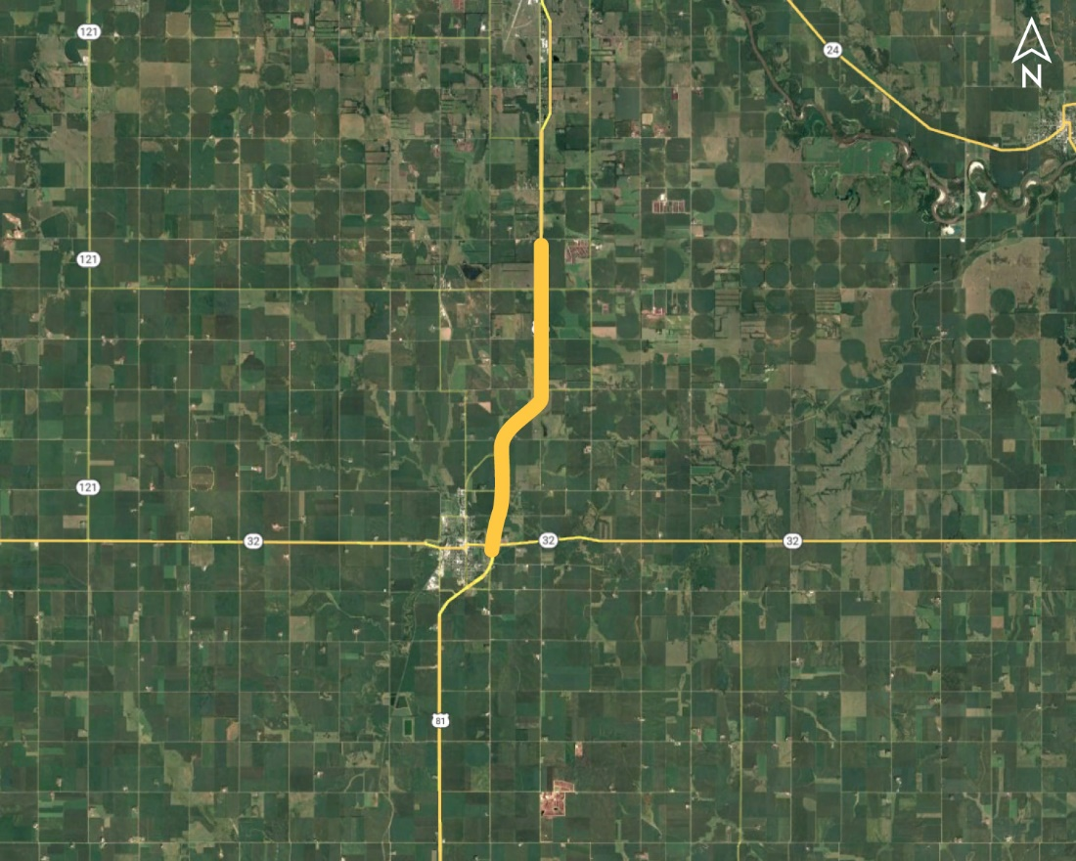
Madison North Project NO.: NH-81-3(149); Control NO.: 32357
Project Length: 6.6
Scope of Work:
Resurfacing
Culvert Extension/Replace
Guardrail

Slide 80
Madison North Project NO.: NH-81-3(149); Control NO.: 32357
Status: Design
Right-of-Way: In Progress
Traffic Impacts:
Phase Traffic Control
Letting Date: 8/29/2024
Construction Timing: 5/12/2025

Slide 81
Madison North Project NO.: NH-81-3(149); Control NO.: 32357
Anticipated Utilities Impact:
Culvert Extension/Replacement
Guardrail
Bridge Repair/Replacement
Anticipated Request from Utilities:
Provide Existing Locations
Potholing TBD
Coordination with NDOT
Additional Information:
No K-Sheets Required
Special Provisions TBD
Utilities Involved:
Black Hills Energy, City of Madison, Elkhorn Rural PPD, Frontier Comm., Great Plains Comm., Lumen (CenturyLink), Midstates Data Trasnport , Nebraska PPD, Sparklight Internet (CableOne)

Slide 82
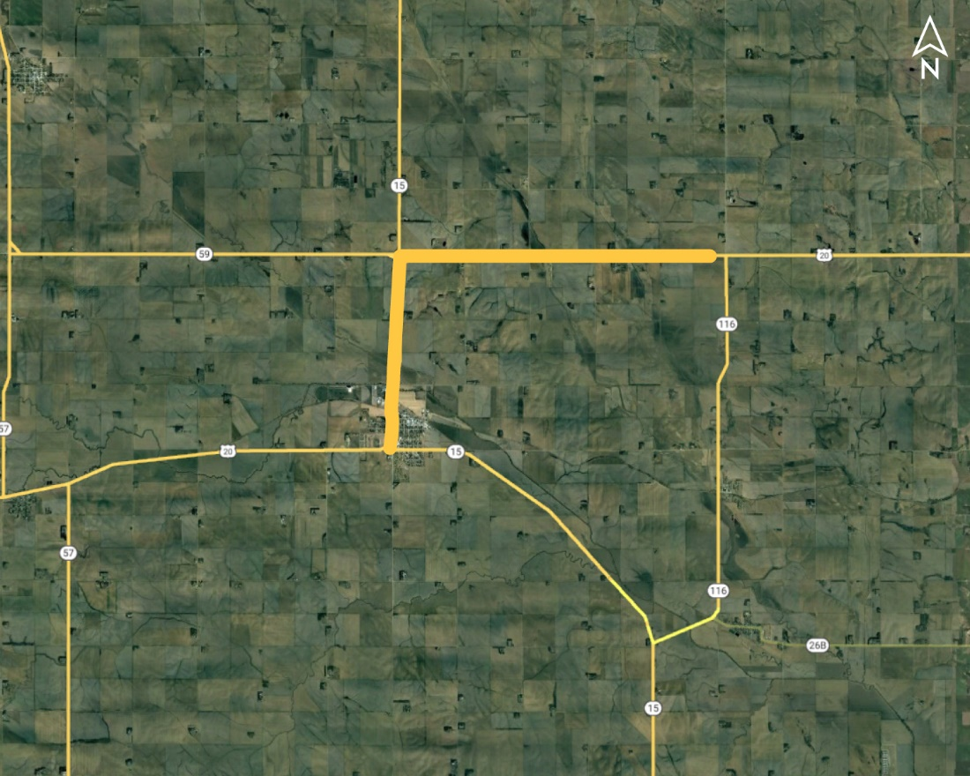
Laurel - N-116 Project NO.: NH-20-6(112); Control NO.: 32358
Project Length: 7.9
Scope of Work:
Resurfacing
Bridge Replacement
Guardrail

Slide 83
Laurel - N-116 Project NO.: NH-20-6(112); Control NO.: 32358
Status: Design
Right-of-Way: In Progress
Traffic Impacts:
Phase Traffic Control
Letting Date: 8/29/2024
Construction Timing: 6/30/2025

Slide 84
Laurel - N-116 Project NO.: NH-20-6(112); Control NO.: 32358
Anticipated Utilities Impact:
Bridge Repair/Replacement
Culvert Extension/Replacement
Temp. Roads/Drives
Anticipated Request from Utilities:
Provide Existing Locations
Coordination with NDOT
Additional Information:
No K-Sheets Required
Special Provisions TBD
Utilities Involved:
Black Hills Energy, Cedar Knox PPD, City of Laurel, Fastwyre Broadband (ABB), Great Plains Comm., Lower Elkhorn NRD, Lumen (Century Link), Northeast Nebr. Telephone Co., Northeast Power

Slide 85
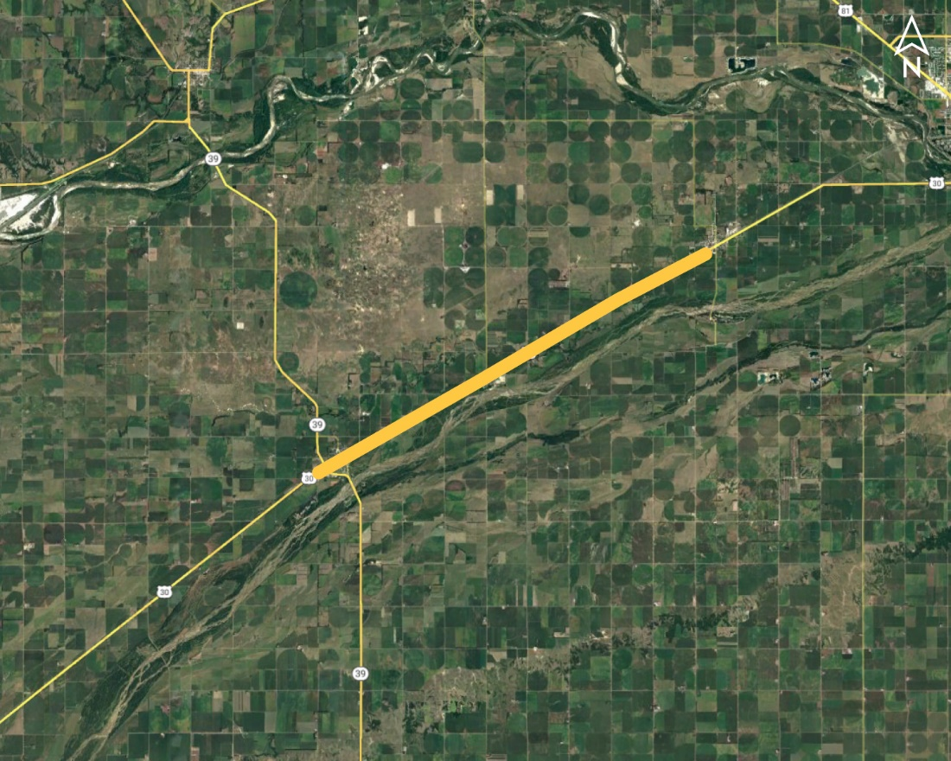
Silver Creek - Duncan Project NO.: NH-30-5(138); Control NO.: 32366
Project Length: 10.1
Scope of Work:
Resurfacing
Urban Reconstruction
Guardrail

Slide 86
Silver Creek - Duncan Project NO.: NH-30-5(138); Control NO.: 32366
Status: Design
Right-of-Way: In Progress
Traffic Impacts:
Phase Traffic Control
Letting Date: 8/29/2024
Construction Timing: 4/1/2025

Slide 87
Silver Creek - Duncan Project NO.: NH-30-5(138); Control NO.: 32366
Anticipated Utilities Impact:
Bridge Repair/Replacement
Guardrail
Shoulder Work
Anticipated Request from Utilities:
Provide Existing Locations
Coordination with NDOT
Additional Information:
No K-Sheets Required
No Special Provisions Required
Utilities Involved:
Arvig Enterprises (Tekstar Comm.), Cornhusker PPD, Frontier Comm., Loup River PPD, Lumen (CenturyLink), Midstates Data Trasnport , Northeast Nebr. Telephone Co., NuStar Pipeline, Polk County Rural PPD, Village of Duncan, Village of Silver Creek, Vyve Broadband

Slide 88
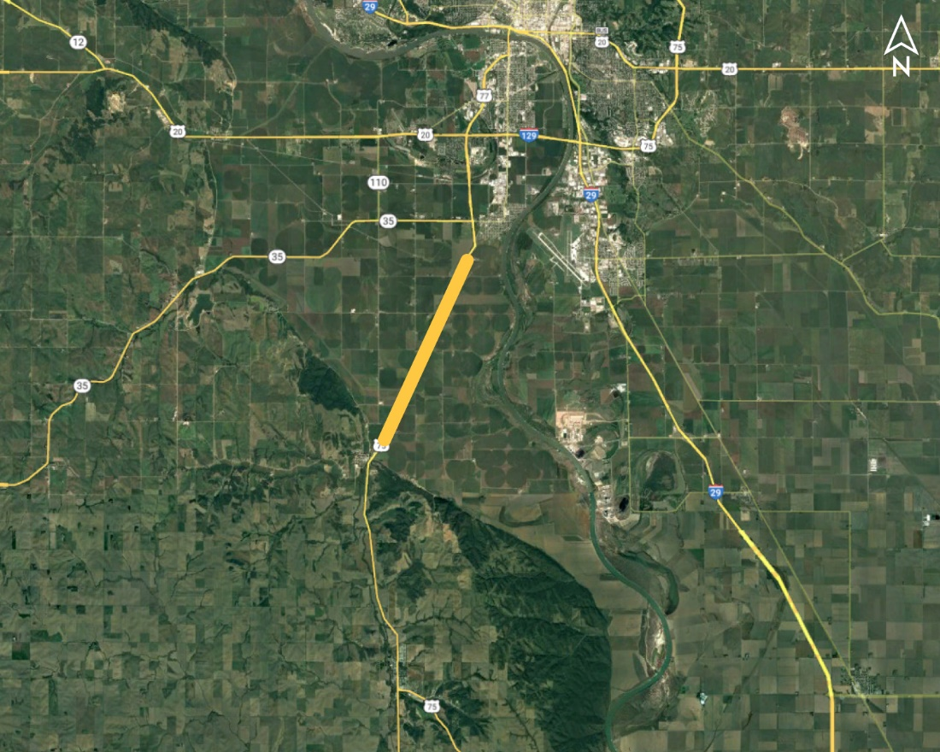
Homer North Project NO.: NH-HSIP-75-4(116); Control NO.: 32377
Project Length: 5.5
Scope of Work:
Shoulder Work

Slide 89
Homer North Project NO.: NH-HSIP-75-4(116); Control NO.: 32377
Status: Design
Right-of-Way: Not Required
Traffic Impacts:
Phase Traffic Control
Letting Date: 8/29/2024
Construction Timing: 7/28/2025

Slide 90
Homer North Project NO.: NH-HSIP-75-4(116); Control NO.: 32377
Anticipated Utilities Impact:
Shoulder Work
Anticipated Request from Utilities:
Provide Existing Locations
Additional Information:
No K-Sheets Required
No Special Provisions Required
Utilities Involved:
Dakota County Rural Water, Fastwyre Broadband (ABB), Great Plains Comm., Lumen (CenturyLink), Nebraska PPD, Northeast Power, Northern Natural Gas, Verizon / MCI

Slide 91
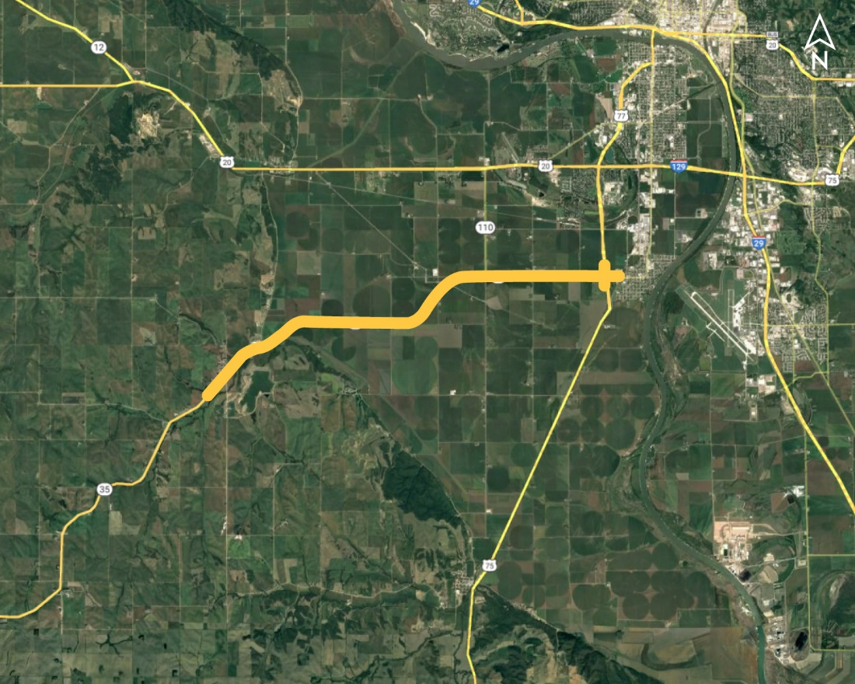
SW of Hubbard - US-75/77 Project NO.: NH-35-4(127); Control NO.: 32150A
Project Length: 9.4
Scope of Work:
Resurfacing
Shoulder Work
Grading

Slide 92
SW of Hubbard - US-75/77 Project NO.: NH-35-4(127); Control NO.: 32150A
Status: Design
Right-of-Way: In Progress
Traffic Impacts:
Phase Traffic Control
Letting Date: 10/3/2024
Construction Timing: 5/1/2025

Slide 93
SW of Hubbard - US-75/77 Project NO.: NH-35-4(127); Control NO.: 32150A
Anticipated Utilities Impact:
Guardrail
Culvert Extension/Replacement
Bridge Repair/Replacement
Anticipated Request from Utilities:
Provide Existing Locations
Coordination with NDOT
Potholing TBD
Additional Information:
K-Sheets Required
Special Provisions Required
Utilities Involved:
City of Dakota City, Great Plains Comm., Lumen (CenturyLink), Mid American Energy, Nebraska PPD, Northeast Nebr. Telephone Co., Northeast Power, Northern Natural Gas, Papio-Missouri, Sparklight Internet (CableOne), Verizon / MCI, Village of Hubbard

Slide 94
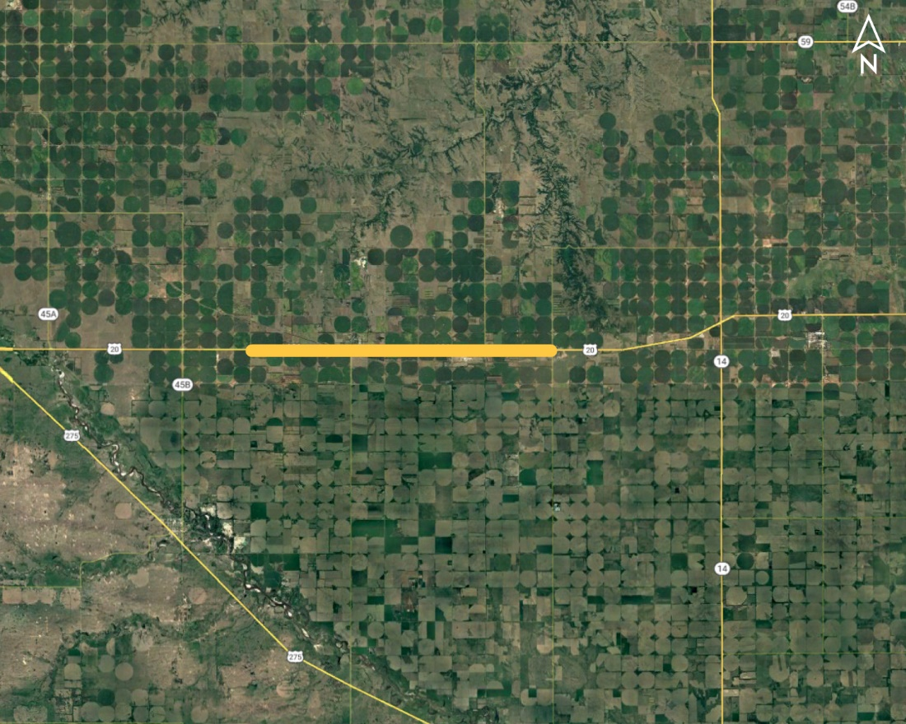
Orchard East & West (MS) Project NO.: NH-20-5(113); Control NO.: 32291
Project Length: 8.8
Scope of Work:
Urban Reconstruction
Resurfacing
Shoulder Work

Slide 95
Orchard East & West (MS) Project NO.: NH-20-5(113); Control NO.: 32291
Status: Design
Right-of-Way: In Progress
Traffic Impacts:
Phase Traffic Control
Letting Date: 11/7/2024
Construction Timing: 7/28/2025

Slide 96
Orchard East & West (MS) Project NO.: NH-20-5(113); Control NO.: 32291
Anticipated Utilities Impact:
Shoulder Work
Anticipated Request from Utilities:
Provide Existing Locations
Coordination with NDOT
Additional Information:
No K-Sheets Required
Special Provisions TBD
Utilities Involved:
Black Hills Energy, Frontier Comm., Great Plains Comm., North Central PPD, Village of Orchard, Village of Royal

Slide 97
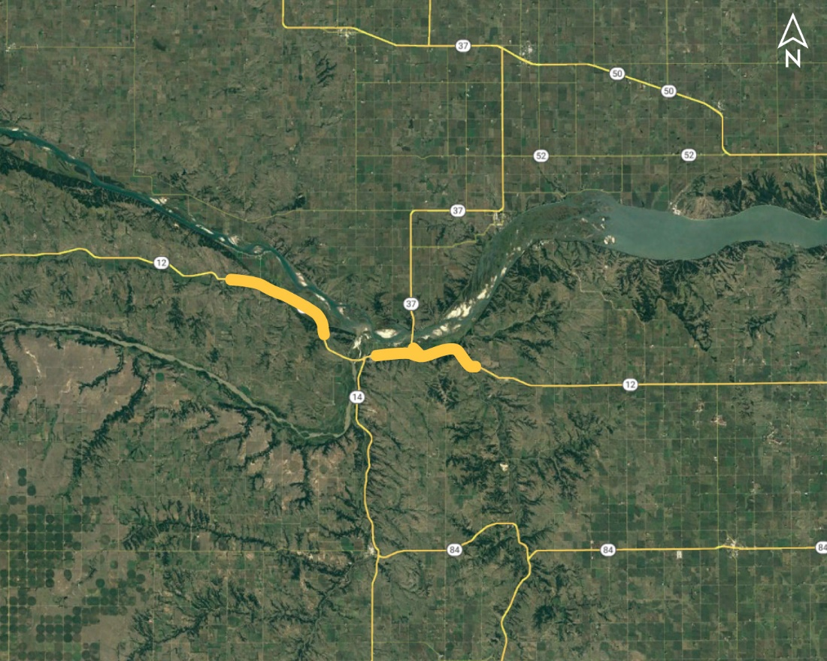
Niobrara East & West Project NO.: S-12-5(1011); Control NO.: 31674
Project Length: 10.6
Scope of Work:
Full Depth Pavement
Guardrail
Bridge Replacement

Slide 98
Niobrara East & West Project NO.: S-12-5(1011); Control NO.: 31674
Status: Design
Right-of-Way: In Progress
Traffic Impacts:
Phase Traffic Control
Letting Date: 12/12/2024
Construction Timing: 5/1/2025

Slide 99
Niobrara East & West Project NO.: S-12-5(1011); Control NO.: 31674
Anticipated Utilities Impact:
Guardrail
Anticipated Request from Utilities:
Provide Existing Locations
Coordination with NDOT
Utilities Workshop
Additional Information:
K-Sheets Required
Special Provisions Required
Utilities Involved:
Great Plains Comm., North Central PPD, Santee Tribe, U.S. Army Corps of Engineers, Village of Niobrara

Slide 100
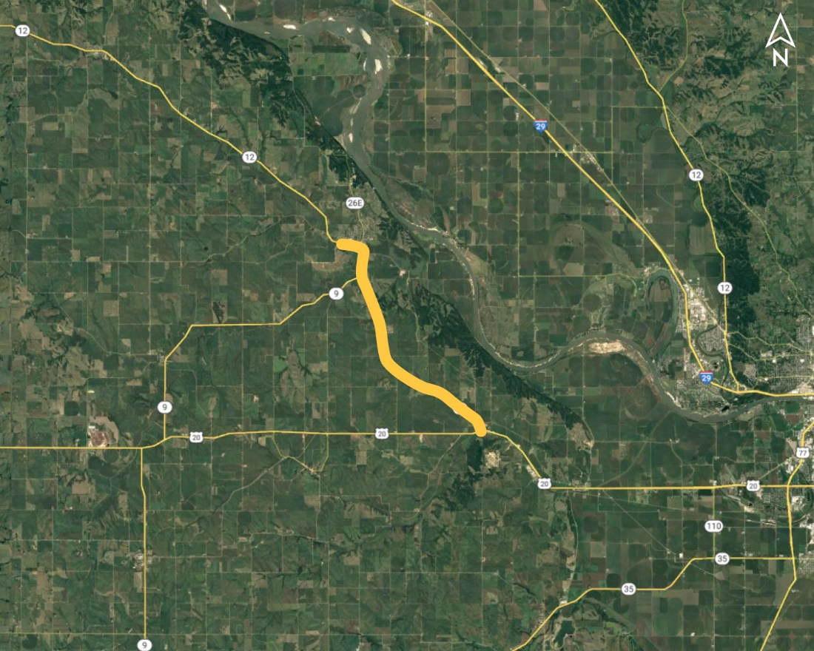
Ponca - US-20 Project NO.: STP-12-6(119); Control NO.: 32352
Project Length: 8.2
Scope of Work:
Resurfacing
Bridge Replacement
Guardrail

Slide 101
Ponca - US-20 Project NO.: STP-12-6(119); Control NO.: 32352
Status: Design
Right-of-Way: In Progress
Traffic Impacts:
Phase Traffic Control
Letting Date: 12/12/2024
Construction Timing: 3/3/2025

Slide 102
Ponca - US-20 Project NO.: STP-12-6(119); Control NO.: 32352
Anticipated Utilities Impact:
Bridge Repair/Replacement
Culvert Extension/Replacement
Guardrail
Anticipated Request from Utilities:
Provide Existing Locations
Coordination with NDOT
Additional Information:
K-Sheets Required
Special Provisions Required
Utilities Involved:
Black Hills Energy, City of Ponca, Great Plains Comm., Northeast Nebr. Telephone Co., Northeast Power, Sparklight Fiber (Cable One)

Slide 103
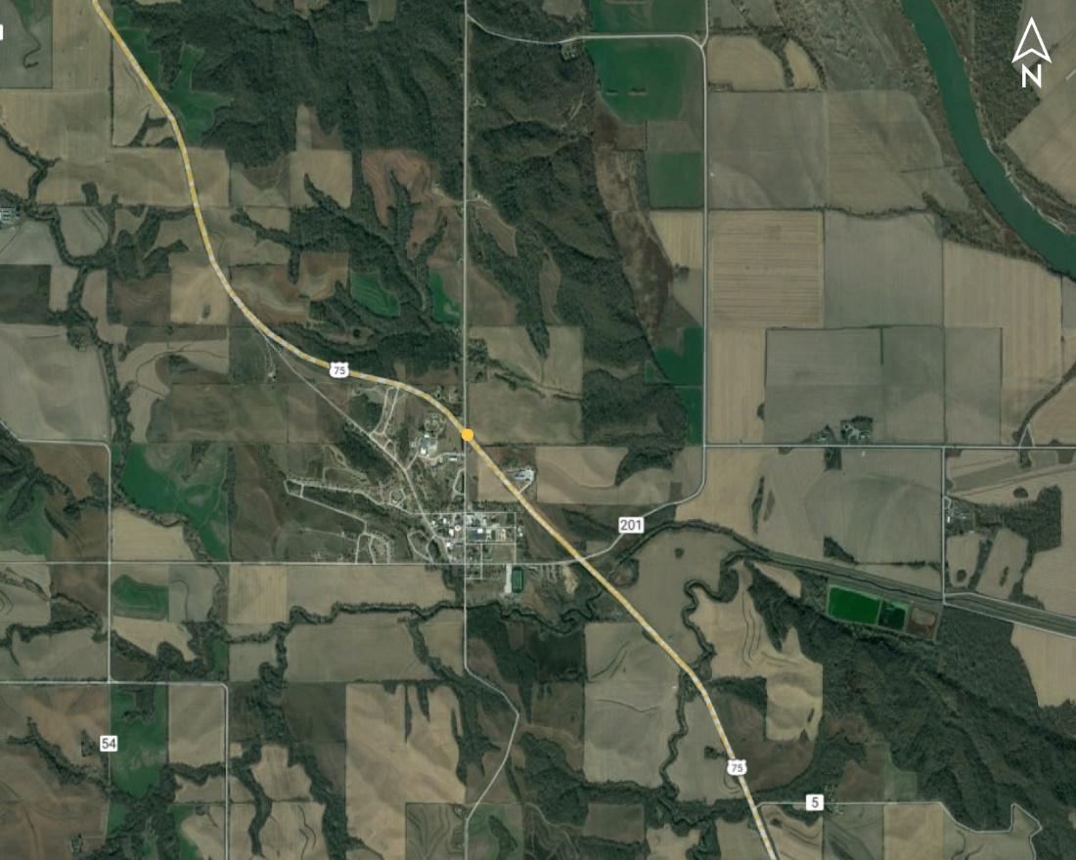
Macy Intersection Project NO.: DPS-75-4(118); Control NO.: 32415
Project Length: 0
Scope of Work:
Urban Reconstruction
Full Depth Pavement
Grading

Slide 104
Macy Intersection Project NO.: DPS-75-4(118); Control NO.: 32415
Status: Design
Right-of-Way: In Progress
Traffic Impacts:
Phase Traffic Control
Letting Date: 3/6/2025
Construction Timing: 5/1/2025

Slide 105
Macy Intersection Project NO.: DPS-75-4(118); Control NO.: 32415
Anticipated Utilities Impact:
New Alignment
Anticipated Request from Utilities:
Utilities Workshop
Provide Existing Locations
Coordination with NDOT
Additional Information:
K-Sheets Required
Special Provisions Required
Utilities Involved:
Burt County PPD, Fastwyre Broadband (ABB), Omaha Tribe of NE

Slide 106
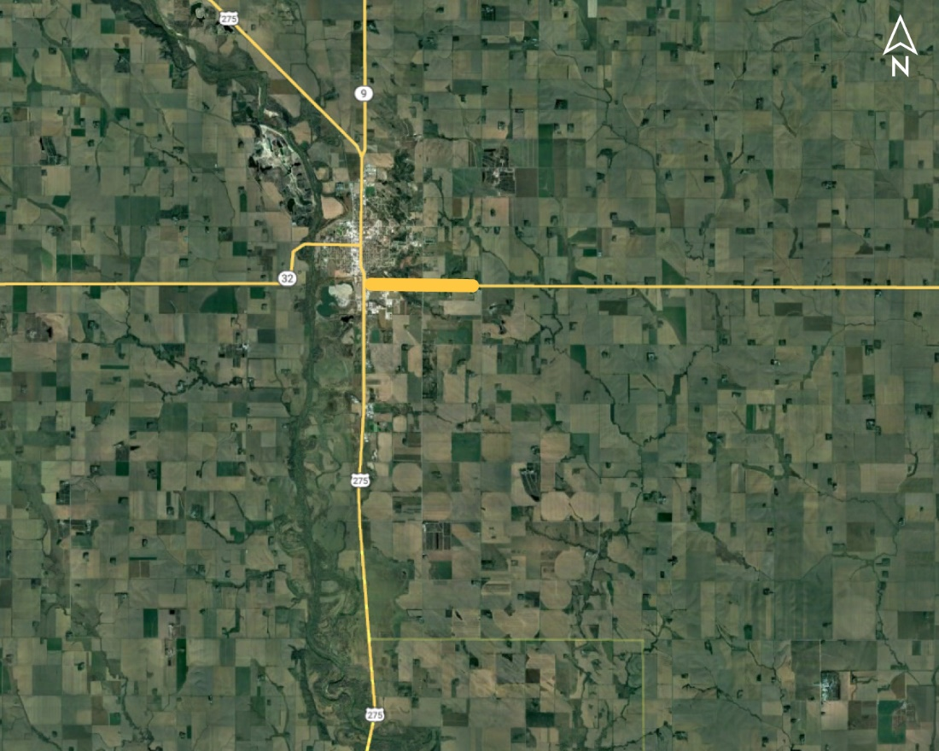
West Point East Project NO.: STP-HSIP-32-6(116); Control NO.: 32404
Project Length: 1.7
Scope of Work:
Resurfacing
Full Depth Pavement
Guardrail

Slide 107
West Point East Project NO.: STP-HSIP-32-6(116); Control NO.: 32404
Status: Design
Right-of-Way: In Progress
Traffic Impacts:
Phase Traffic Control
Letting Date: 5/15/2025
Construction Timing: 6/23/2025

Slide 108
West Point East Project NO.: STP-HSIP-32-6(116); Control NO.: 32404
Anticipated Utilities Impact:
Culvert Extension/Replacement
Guardrail
Anticipated Request from Utilities:
Provide Existing Locations
Coordination with NDOT
Additional Information:
K-Sheets TBD
Special Provisions TBD
Utilities Involved:
Black Hills Energy, City of Westpoint, Cuming County PPD, Cuming County RDW 1, Great Plains Comm., Lumen (CenturyLink), Skywave Wireless

Slide 109
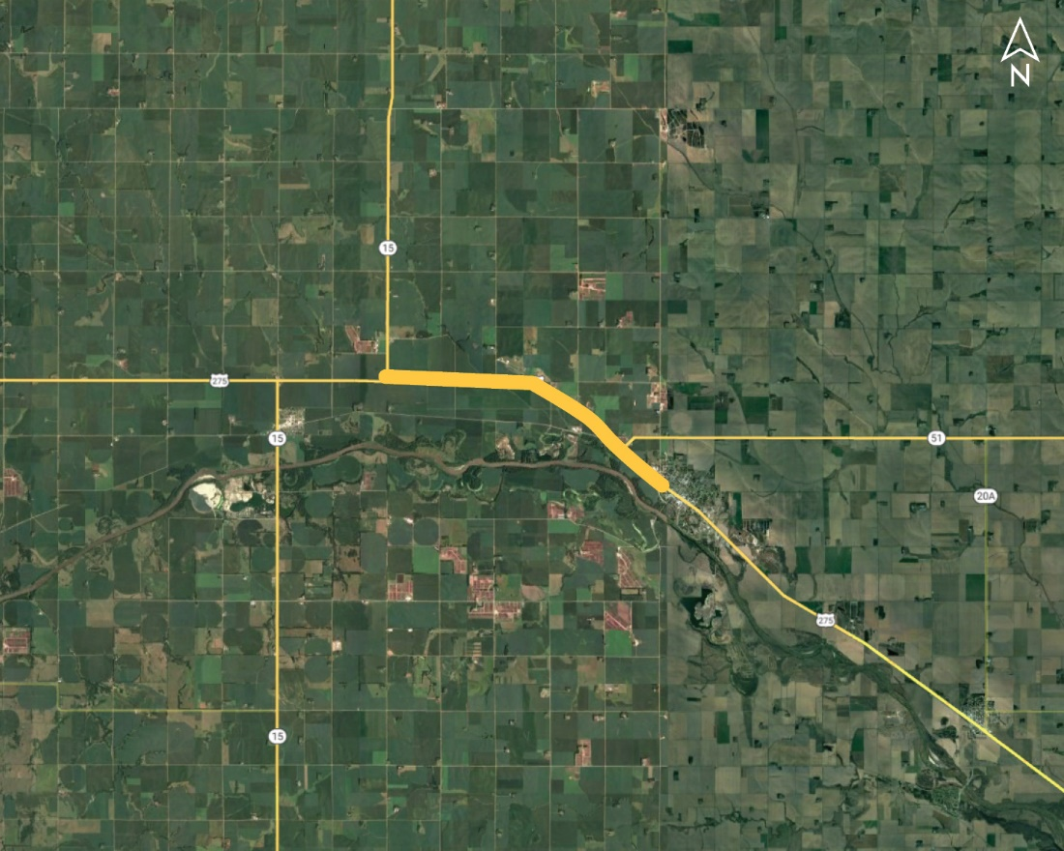
East Jct N-15 - Wisner Project NO.: TIB-275-6(150); Control NO.: 32319B
Project Length: 4.2
Scope of Work:
Full Depth Pavement
Grading

Slide 110
East Jct N-15 - Wisner Project NO.: TIB-275-6(150); Control NO.: 32319B
Status: Design
Right-of-Way: In Progress
Traffic Impacts:
Phase Traffic Control
Letting Date: 8/28/2025
Construction Timing: 10/1/2025

Slide 111
East Jct N-15 - Wisner Project NO.: TIB-275-6(150); Control NO.: 32319B
Anticipated Utilities Impact:
Grading
Temp. Roads/Drives
New ROW
Anticipated Request from Utilities:
Utilities Workshop
Provide Existing Locations
Coordination with NDOT
Additional Information:
K-Sheets Required
Special Provisions Required
Utilities Involved:
City of Wisner, Cuming County PPD, Cuming County RWD 1, Great Plains Comm., Lumen (CenturyLink), Tallgrass Energy

Slide 112
Questions & Wrap Up
Notes:
HDR (Kristen, Amanda or Alyssa)

Slide 113
Any final Questions?
Ask them now!
If you have questions after this meeting, or would like to view more detailed project maps, please reach out to your utility coordinator.
Notes:
HDR (Kristen, Amanda or Alyssa)

Slide 114
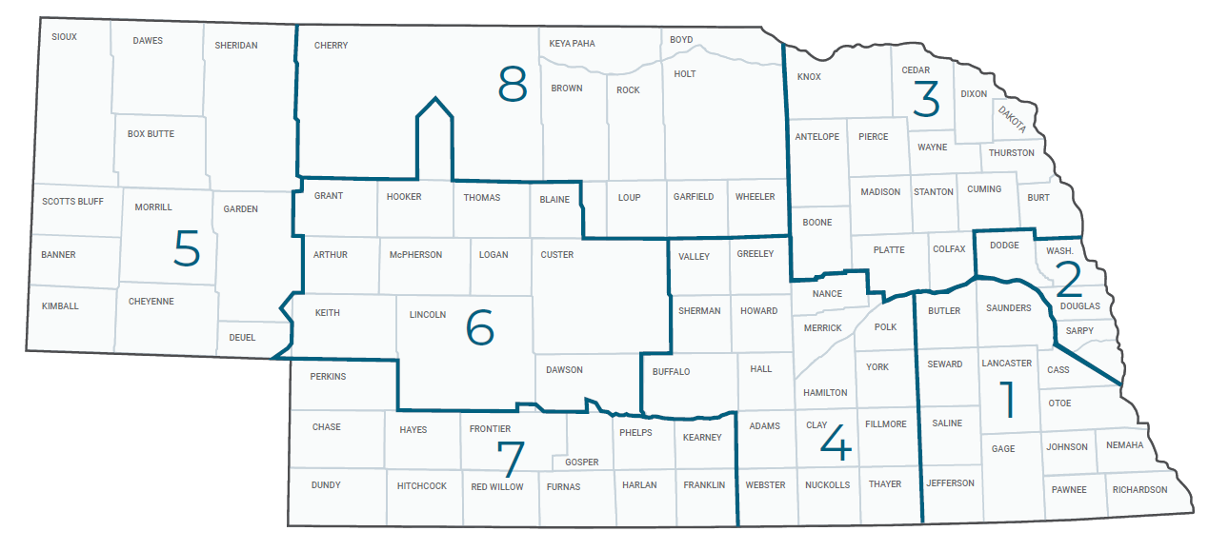
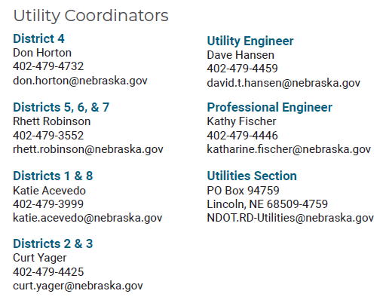
Have a Question about a project your Utility is involved in?
Contact your district’s utility coordinator!
Notes:
HDR (Kristen, Amanda or Alyssa)

Slide 115
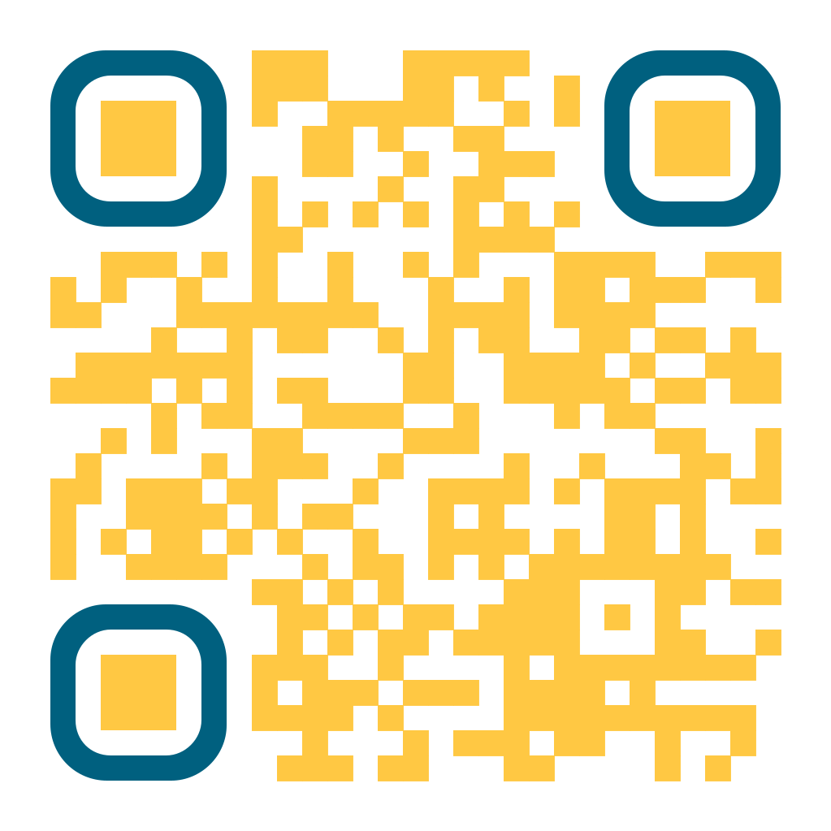
We need your feedback
Your valuable feedback helps these meetings – and NDOT’s utility coordination program – be better.
Use your phone’s camera to scan this QR code or use our paper survey.
Notes:
HDR (Kristen, Amanda or Alyssa)

Slide 116
Visit our Website
Visit NDOT.info/utility for more information on:
Utility accommodation
Permitting
Coordination
Project information
Reimbursements
Additional information
Notes:
HDR (Kristen, Amanda or Alyssa)

Slide 117
Thank You
Notes:
HDR (Kristen, Amanda or Alyssa)

